Slide 1

MA Year One
Mental Health Unit: Session One

Slide 2
Aims
Unit Overview – 4 sessions
Assessment Overview
Way of working

Slide 3
Unit Overview
Within this module we're going to be looking at Mental Health, what it is and the difference between Mental Health, Mental Well-being and Mental Illness.
We're also going to be looking at different models
We'll look at classification and diagnosis
We'll also look at the Welsh Matrix (Matrics Cymru) and explore MH with Children and young people.
Finally, we’ll take a look at how we may see mental health presenting in the therapy room and where these presenting issues may have started.

Slide 4
Learning outcomes
Upon the successful completion of this module, the student should be able to:
  Demonstrate familiarity with a model of assessment compatible with their core theoretical model in order to determine the client's therapeutic needs, while maintaining an awareness of other assessment strategies.
  Critically appraise a range of therapeutic responses, strategies and interventions to inform practice and critically assess potential limitations of their preferred theoretical model or models in work with specific clients.
  Recognise signs and symptoms associated with mental distress and regularly update knowledge about mental health and well-being and be aware of psychopharmacological interventions commonly used in the treatment of mental health problems and be sensitive to the impact that prescribed medication may have on the therapeutic relationship and process of counselling/psychotherapy.
  Critically evaluate ways in which government policies and recommendations such as those in the National Institute for Health and Clinical Excellence (N.I.C.E.) guidelines may impact on mental health service provision and client well-being.
  Critically appraise the range of psychological services and interventions available to clients and recognise and respect inter-professional and multi-agency approaches to mental health.
  Apply consistently a comprehensive, in-depth and research-informed body of knowledge in their practice.
  Critically appraise the effect of their own values, beliefs, attitudes and behaviours when working as a psychotherapist.
  Ensure a consistent commitment to continuing professional and personal development, including self-awareness and fitness to practice.

Slide 5
Module Assessments
There are two assessments for this module:
AC1: 30 minute presentation. Due 2nd March 2022 – to present on the 3rd March.
AC2: 4,000 word essay. Due 27th April 2022.

Slide 6

Questions?

Slide 7

Mental Health
What does the term 'Mental Health' Mean to you.
Spending 10 minutes, discuss this idea with your small group.

Slide 8

Mental Health
The World Health Organisation (WHO) defines this concept of mental health as, ‘a state of well-being in which an individual can realise his or her own, potential, cope with the normal stress of life, work productively and make a contribution to his or her community’ (WHO, 2013, p.6).
What are your thoughts about this statement?

Slide 9
Mental Wellbeing
This is a phrase that is being used a lot in recent months. What does it mean to you?
Working independently, see if you can come up with a short phrase that identifies Mental Wellbeing for you.

Slide 10

Mental Wellbeing
Mental Wellbeing: There are many different definitions of mental wellbeing, but they generally include areas such as: life satisfaction, optimism, self-esteem, mastery and feeling in control, having a purpose in life and a sense of belonging and support.

Slide 11
MEntal Illness
Finally, what do you think Mental Illness means? What does it refer to?
Consider your own emotional experience when you think about mental illness. What happens when you 'roll' that phrase around in your mind? What comes up for you?

Slide 12
Mental Illness
Mental illness erfers to suffering, disability or morbidity due to mental, neurological and substance use disoders, which can arise due to the genetic, biological and psychological make-up of individuals as well as adverse social conditions and environmental factors.
"Investing in mental health" relates both to the promotion and protectoin of mental health and to the prevention and treatment of mental illness or disorders (WHO, 2013).

Slide 13
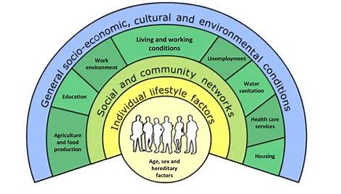
Social determinants of health
“The social determinants of health are the circumstances which people are born, grow up, live, work, age, and the systems put in place to deal with illness. These circumstances are in turn shaped by a wider set of forces: economics, social policies and politics.”
Patel, V., Minas, H., Cohen, A., and Prince, M. eds .2014 Global Mental Health. Oxford: Oxford Press (Chapter 7)

Slide 14
Activity
In your groups, take one aspect of the Wheel and consider how this area might have an impact on an individual's mental health.
You might like to apply this to the current health crisis and consider the impact that this also might have to mental health and the implications for future illness.

Slide 15
The medical model
A term coined by psychiatrist R.D. Laing, in The Politics of the Family and Other Essays (1971), a medical model is a "set of procedures in which all doctors are trained.“
The medical model's school of thought is that mental disorders are believed to be the product of physiological factors. Simply stated, the medical model treats mental disorders as physical diseases whereby medication is often used in treatment.
When it comes to mental illness, the medical model, which is more widely used by psychiatrist than psychologist will treat these disorders in the same way as a broken leg.

Slide 16
Thoughts?
Any thoughts about the medical model at this point?

Slide 17
Models of mental illness
Spiritual Model
Moral Character Model
The Statistical
The Disease/ Medical/ Biological Model
  Genetics
  Neuroimaging
  Neurobiology

Slide 18
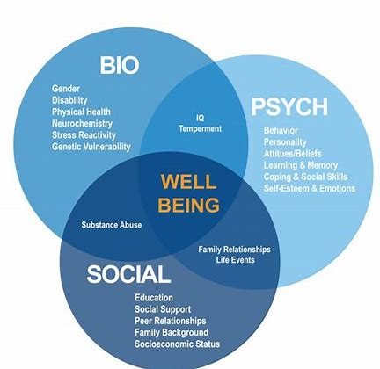
Other Models
Psychological Models Psychodynamic Model
  The Behavioural Model
  The Cognitive-behavioural Model
  Existential / Humanistic Model
The Social Model
Psychosocial Model —
  The Social Learning Model
Family Therapy Model
Biopsychosocial Model
Recovery Model

Slide 19
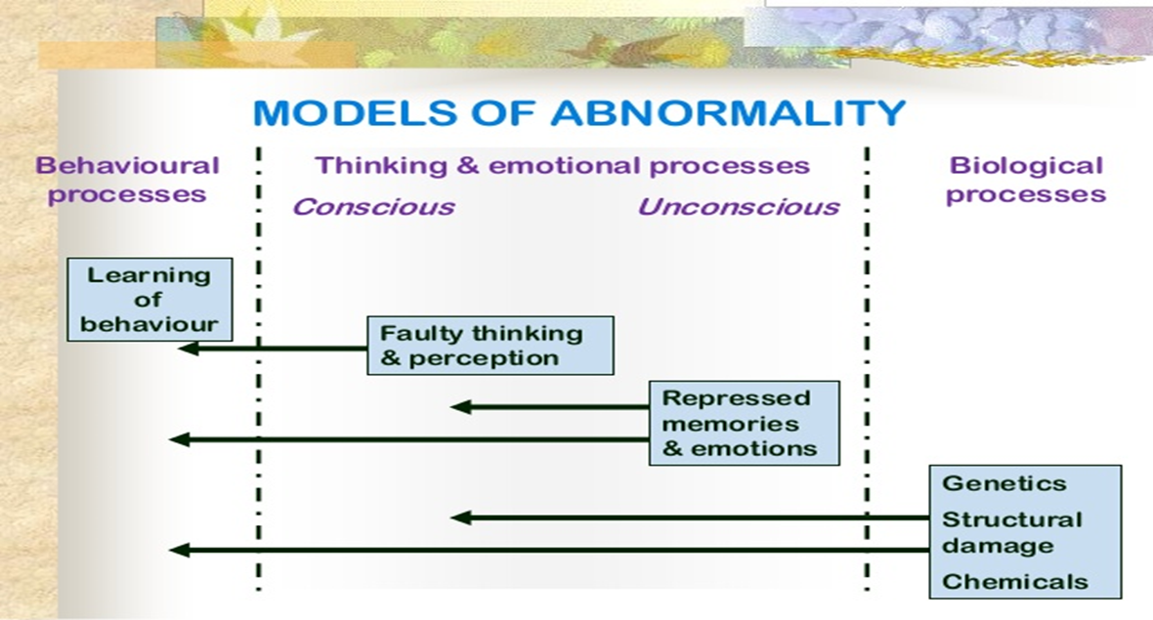
Models of abnormality

Slide 20
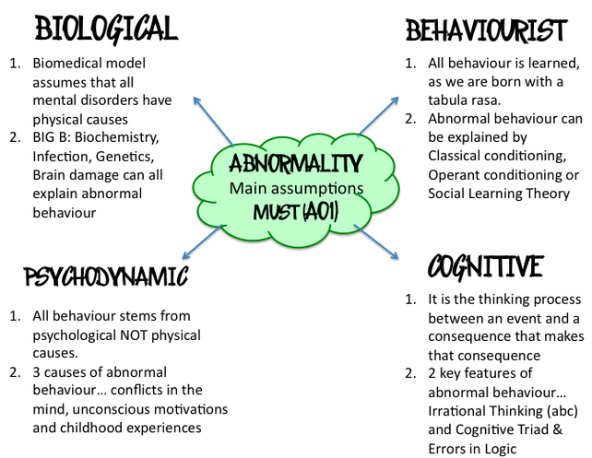
Models of abnormality

Slide 21
Group Work
In your groups discuss these different theories and also any others that you may have come across. What do you think might be the strengths and weaknesses/limitations of these models. Where do you think you might be challenged by some of these ideas?
How would you feel if a client came with one of these ideas about their mental health and had strong views about one of these models?

Slide 22

Thoughts so far?

Slide 23
REsources
Claringbull, N., (2011). Mental health in Counselling and Psychotherapy(Counselling and Psychotherapy practice series). Exeter, UK: Learning Matters. Chapter 1
Pilgrim, D. (2017) Key Concepts in Mental Health 4th Ed. Sage: London.
WHO (2013) Investing In Mental Health: Evidence For Action: World Health Organization. https://apps.who.int/iris/bitstream/handle/10665/87232/9789241564618_eng.pdf;jsessionid=3FD90930322A6A4DC4B9E3ACBB059137?sequence=1
Mental Health Foundation (2016) Fundamental facts about Mental Health 2016: Mental Health Foundation. https://www.mentalhealth.org.uk/publications/fundamental-facts-about-mental-health-2016

Slide 24
Additional REsources
Paris, J., (2013) The intelligent Clinician’s Guide to the DSM-5. Oxford: Oxford University Press
American Psychiatric Association. (2013). Diagnostic and Statistical Manual of Mental Disorders
Frances, A., (2013). Saving normal: an insider's revolt against out-of-control psychiatric diagnosis, DSM-5, big pharma, and the medicalization of ordinary life. New York: William Morrow
MIND
Rethink

