Slide 1
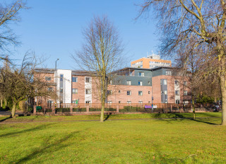
STRATEGIES FOR EFFECTIVE COMMUNICATION IN A BUSINESS SETTING.
Joliana Dede – 2121171
Carolina Griza - 2115255
Olga Jarmusevica – 2115871
EFFECTIVE TEAM WORKING AND COMMUNICATION
BMSW4002
ABDI RAHMAN

Slide 2

Contents Page:
Introduction……………….....................................3
Effective Communication………………………….4
Effective Communication Used to………………..5
Models of Communication………………………...6
The Shannon Weaver Model……………………..7
The Types of Barriers……………………………...8
Eliminate the Barriers……………………………...9
Communication Channels………………………..10
Channels of Communication……………………..11
Communication Improvement Channels………..12
Conclusion………………………………………….13
Reference List……………………………………...14
Teamwork Evaluation Table………………………15

Slide 3

Introduction:
Edgbaston Manor Care Home:
Provides dedicated residential, nursing and dementia care.
Luxury interiors with all bedrooms en-suit.
Fabulous views to the park.
Access to balconies and the stunning roof terrace.
Access to their own patio areas and there are pleasant sensory gardens.

Slide 4
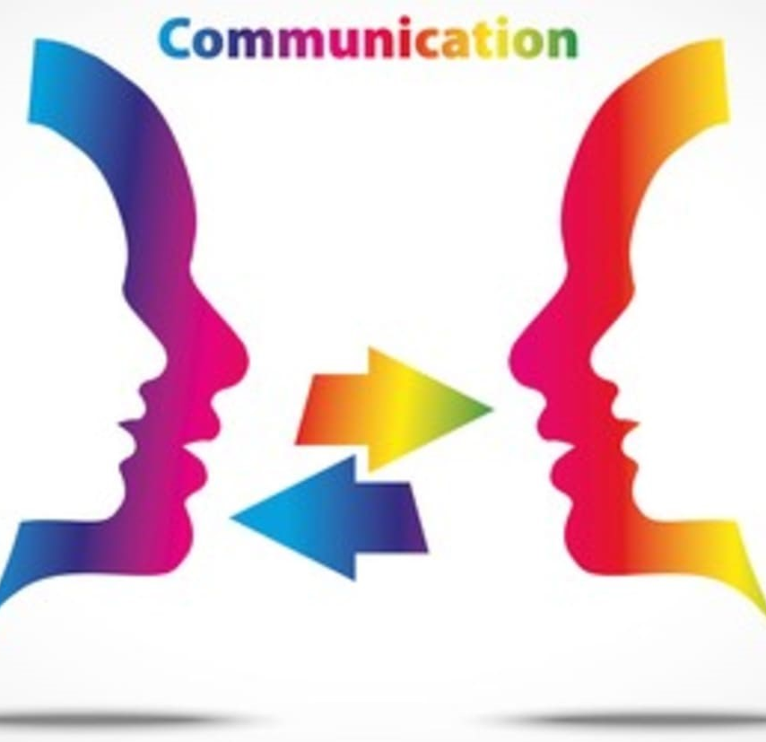
Effective Communication:
Communication is the process used to exchange information.
Effective communication is more than just exchanging information. It’s understanding the emotions of that person. As well as being able to listen and makes the receiver understand much clearly.

Slide 5
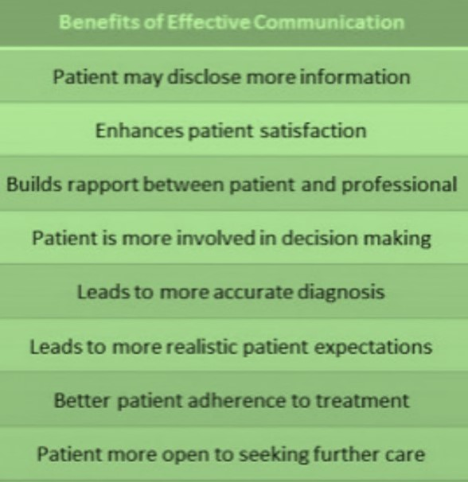
Effective communication is used to:
Improve care service
Building trust on health and social care system
Preventing or resolving problems
Improves productivity
Promotes team building
Create more transparency
Create better working environment for carers

Slide 6
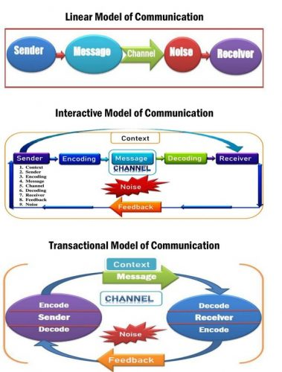
Models of communication:
Models help to identify and understand the process of communication. The role of them is to simplify communication and identify where and with whom it’s take place.
The Shannon – Weaver Mathematical Model, 1949
Berlo’s Model of Communication, 1960
Schramm’s Interactive Model, 1954

Slide 7
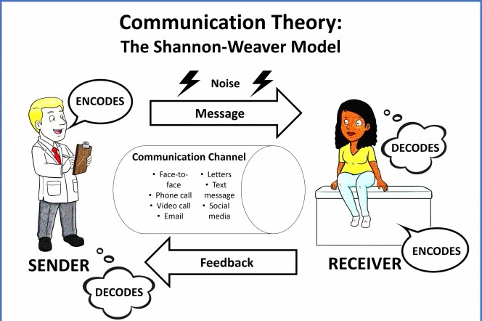
The Snannon – Weaver Model:
This model takes communication as a two way process. It makes the model applicable in general communication.
Distraction noise helps with effective communication between sender and receiver.
Notes:
The sender calling and because of the noise receiver didn’t get all info. He send a feedback with question.

Slide 8
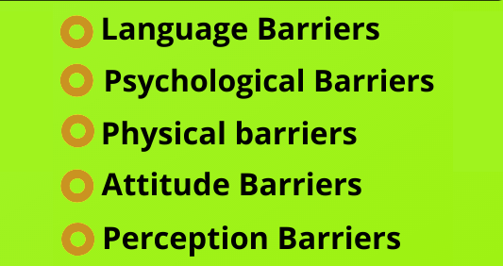
The types of barriers:
Misunderstanding can cause because of the language, accents and dialect of the sender and receiver.
Caused by individual mindsets or mental health concerns.( disagreements can cause serious problems.)
Lateness because of no motivation and discomfort because of the noise. Problems with concentration.
May result from personality conflicts, poor management, resistance to change or a lack of motivation.
Can lead to several distortions, which are biases or judgments of others.

Slide 9
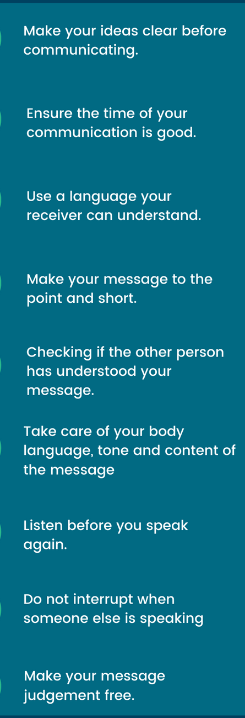
Eliminate the barriers:
Encourage team members to use clear speech and avoid figurative language, jargon, and slang.
Encourage open, honest communication by offering multiple channels for employee feedback, such as open office hours, anonymous surveys, and team meetings.
Add private, closed spaces for employees to collaborate or work without interruptions.

Slide 10
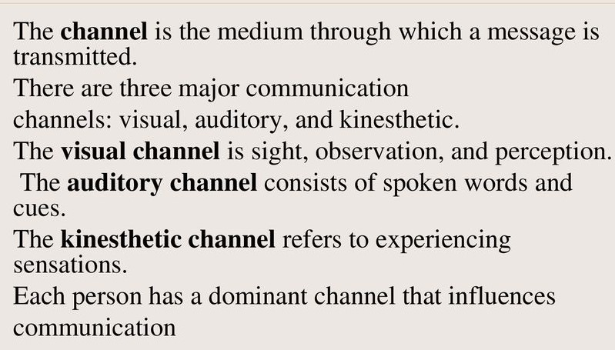
Communication channels:
Communication channels is information flows forward, backwards and sideways. It’s refer to the way this information is sent or received between two or more people.

Slide 11
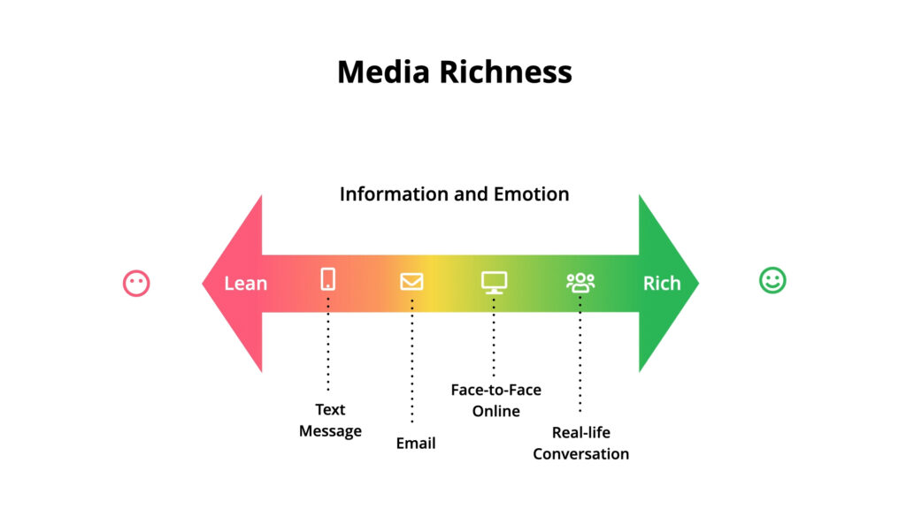
Channels of communication:
Verbal communication: face to face, telephone, meetings, reports, mails.
Nonverbal communication: eye movement, gestures, facial expression.

Slide 12
Communication improvement channels:
Be attentive: listen completely and attentively.
Ask open questions: patient can relax and be respective to others.
Be curious: maintain a sense about your patient.
Involve friends and family because they can help patient investigate new options
Talk clearly and in a simple way.
Take care of your patient life.

Slide 13

Conclusion:
In conclusion, we has discussed about effective communication, models and barriers of communication and channels of communication and how to improve it.
It’s important to communicate effective. The more we communicate the better we understand each other.

Slide 14

Reference List:
Dr. K. Usha Rani, (2016), Communication Barriers, Joell Veda’s Publication
Faulkner, A, (1984), Communication, Churchill Livingstone
Payne, M, (1982), Working in Teams, Macmillan
Mounter, P, and Smith, L, (2008), Effective Internal Communication, 2nd ed. Kogan Page
Adair, J, (1987), Effective teambuilding: how to make a winning team, London: Pan
Drew, C, (2022), Shannon Weaver Model Of Communication – 7 Key Concepts, Helpful Professor
Thomas, C, (2022), The 10 Most Essential Digital Communication Channels for Business, Talkative
Bales, F. R, (1951), Channels of communication in small groups, 16(4), p.461-468, American Sociological Review

Slide 15
Teamwork Evaluation | Team responses.
Who was in your team? | Joliana Carolina Olga
What were the key strengths of your team? | Good Communication Focus on results
What were the challenges that you overcame as a team? | Not enough time Can’t get all at the same time
What would you do differently if you worked as a team again? | Spending more time to prepare.
How would you rate your team working? Out of 10? | 8

