Slide 1


LCHS 4002
Digital Skills and Research Methods
2219523/2225289/ digital skills and research
Assignment Title: Are digital skills important for study and work?
Lecturer's Name: Dr Olu Adegbite

Slide 2
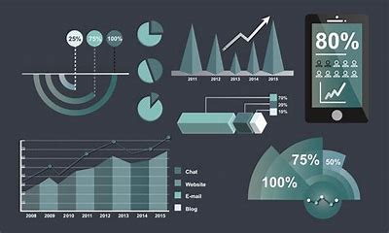
How? What? Why? Where?
The purpose for this proposal is to understand why digital skills are valued in the place of work and study. Digital skills and their allegiance to the work place indicate that technology has numerous purposes and relied on by individuals to solve problems
Examples:
Email
Word Processing
Social Media
Web-based research and problem solving
Data Entry and Handling
Employers are struggling to find talent to fulfil their technological needs. Returned surveys indicate that nearly 40% of the UK's working population lack digital skills(Gori Yahaya,2021) ,this experiment illustrates that the vast majority of working individuals struggle with the technological side of working.
.

Slide 3


introduction
Which digital tool is most used by students at UWTSD?
My partners and I have chosen to explore this question is because we want to highlight the importance of digital skills and how they impact our lives today. Digital skills are technological ways of handling data, socialising inside and outside of work, applying for jobs and accessing emails. According to past research (Adams, 2022), digital skills are now considered a critical component for employability meaning that digital skills are required in the place of work. In this presentation we will traverse the question by sharing some information we have gathered independently.

Slide 4


Proposed method
While conducting this research, we plan to evaluate which digital tool is most used by students at UWTSD.
The participants that we would like to include in this proposal are our classmates.
Numerous studies have used what we call a quantitative approach, this is a study that gathers numeric data for example, personal income levels or might include more numeric data gathered through surveys of people, which is an example of how we are going to gather your data today.
We will be asking a series of Closed questions , Ranked questions and Likert scale questions:
Do you think MS Teams are important?-
Do you think Moodle is the most important digital skill?
Rank these applications according to how often you have used them as a student or worker
I feel that using social media tools successfully is the most important skill to have?
Rank these words in order according to how you feel about your level of digital skill

Slide 5
Ethical consideration
WHAT IS ETHICAL CONSIDERATION?
Ethical consideration is a collection of principles to do with having integrity ,fairness and open-mindedness , meaning that all confidentiality of data and analysis will be conducted fairly. An example of when Ethical consideration needs to be applied is when individuals are applying for jobs.
WHY IS ETHICAL CONSIDERTION IMPORTANT?
Ethics are important because they improve public reputation by reflecting high value morals as well as maintaining confidentiality.
Me and my group will ensure to apply these principles during our proposal.

Slide 6

hypothesis
This presentation seeks to prove or disprove through our research that more university students find Moodle a more helpful and educational tool to use over MS Teams and other social media platforms.
An advantage of using Moodle is the home page, the home page gives you easier access to all modules which is better suited to students .

