Slide 1
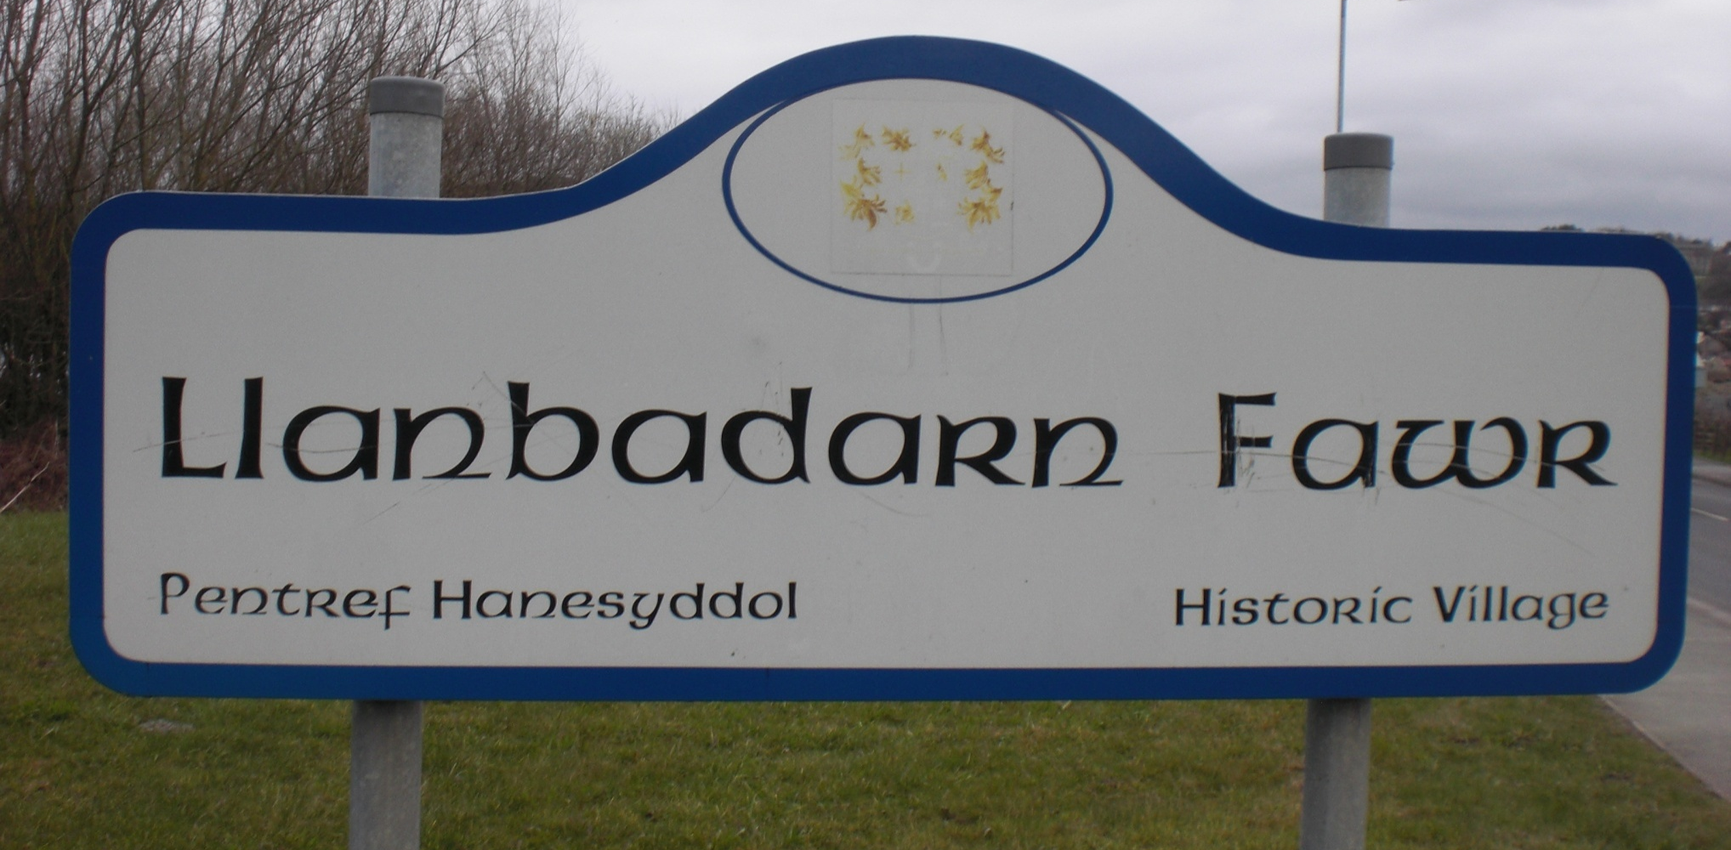
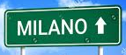
Celtic Place-Names on the Continent
Welsh and Celtic
Place-Names

Slide 2
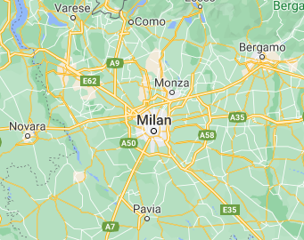
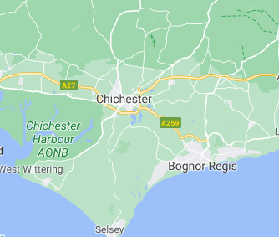
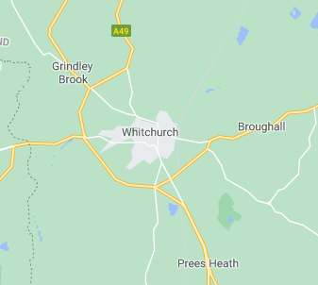
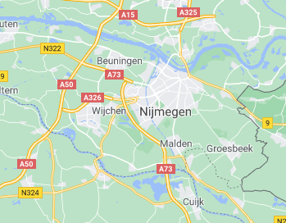
Mediolanum
Noviomagus

Slide 3
Latin | Germanic | Celtic
duo | two | dau
novus | new | newydd
frater | brother | brawd
ferveo ‘to boil’ | brew | berwi
portus | ford | rhyd
plenus | full | llawn

Slide 4
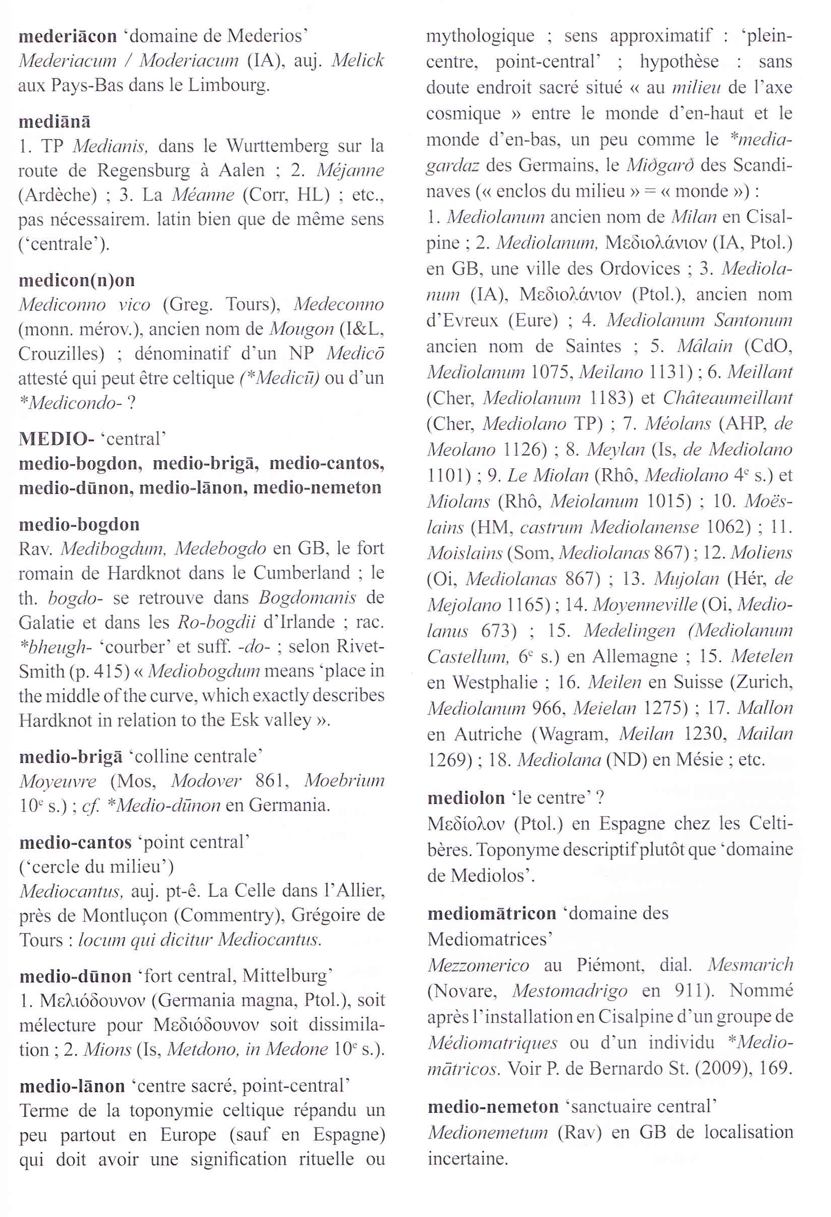
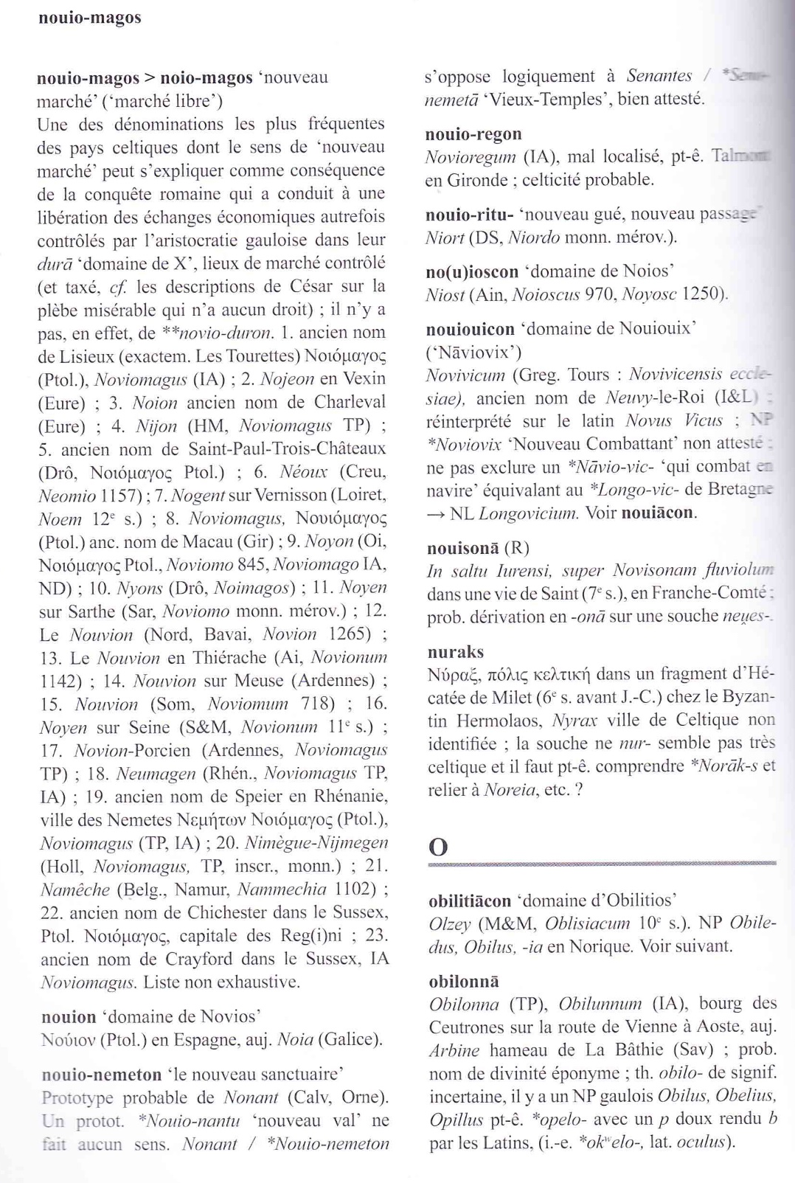

Slide 5
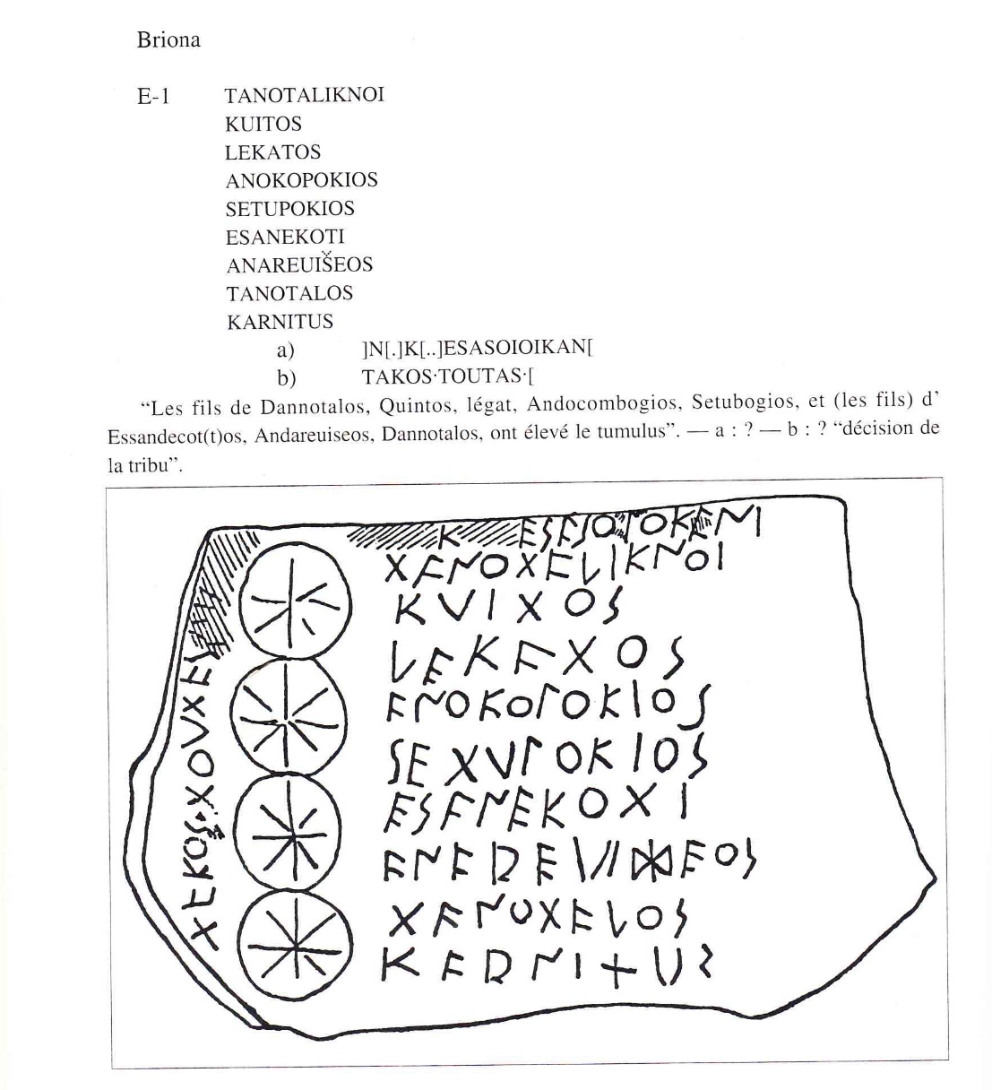
Continental Celtic Inscriptions
Map of inscriptions
Add Briona p. 72

Slide 6
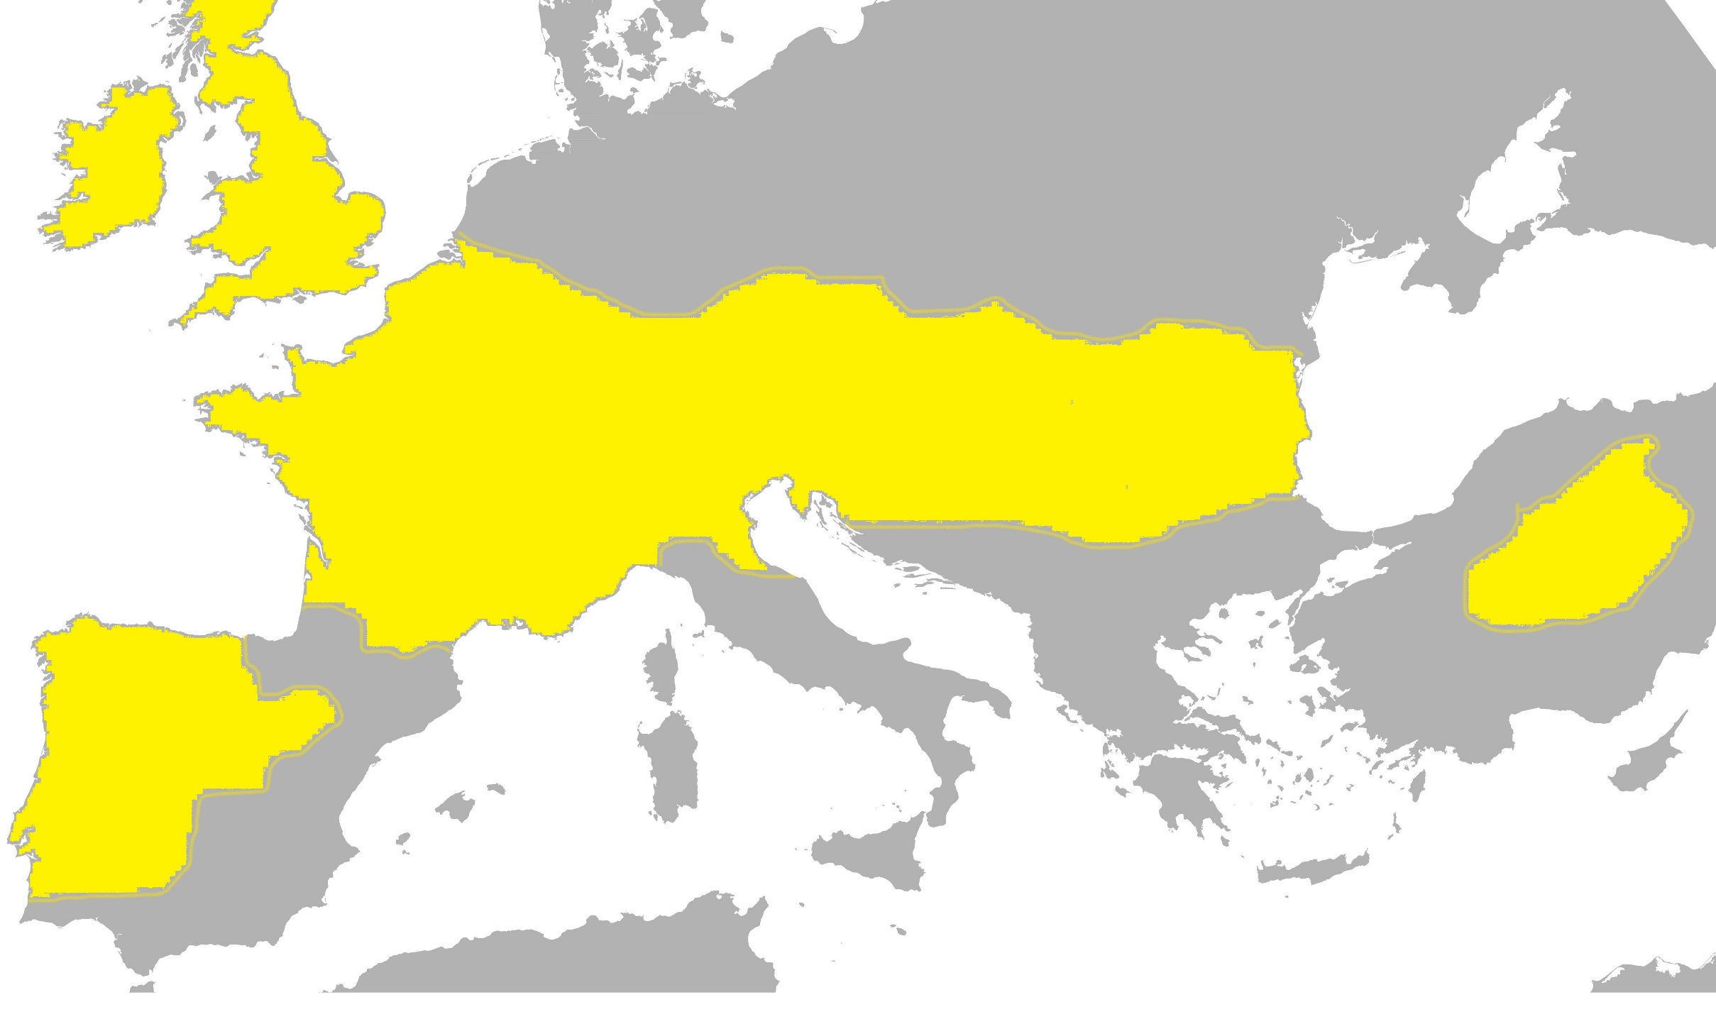
Distribution of Celtic Place-Names
Then the place-name map

Slide 7
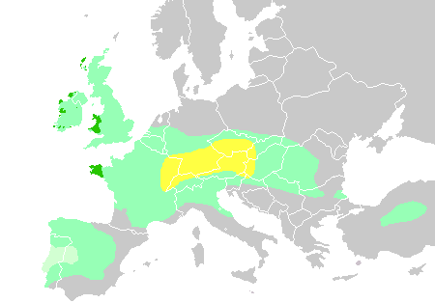
Celtic Expansion (Wikipedia)
Theories of origins

Slide 8
Segobriga
Celt *sego- ‘strong, strength’ + *briga ‘hillfort’. Found in central Spain (near Cerro de Cabeza del Griego), where it is attested as Segobriga in the writings of Strabo and Pliny. Another example is Seprio in Lombardy: the earliest form there, Sibrium in the medieval Ravenna Cosmography, already shows reduction.
Maroialum
Celt *maro- ‘large’ + *ialon ‘unfruitful land’. Numerous places in France surviving as Mareuil, Mareil, Méreau, etc. Earliest form Maroialensim aeclesiam c.580 AD Gregory of Tours.
Uxelodunum
Celt *uxelo- ‘high, noble’ + *dunum ‘fortified place’. Found several times in France and once in Cumberland in northern England. The earliest Continental instance is Uxellodunum in the writings of Julius Caesar. Uxelus is also recorded as the name of a deity, and that is an alternative in this name.
Vindobona
Celt *uindo- ‘white, bright’ + *bona ‘?place, settlement’. The well-recorded ancient name of Vienna/Wien in Austria.

Slide 9
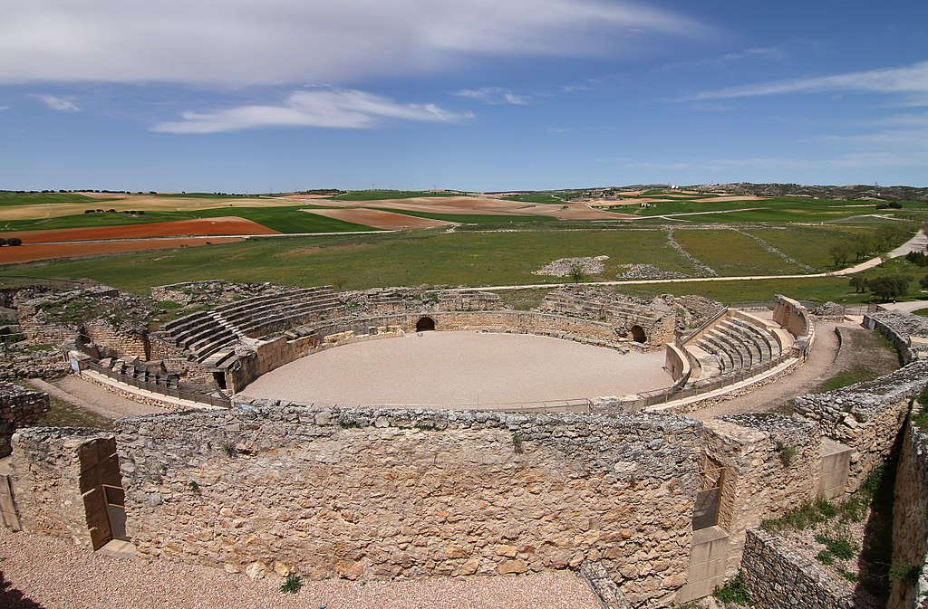
Segobriga

Slide 10
Nemetodurum
Celt *nemeto- ‘sacred site, grove’ + *duro- ‘walled town’. Nanterre in France, first recorded as Nemptudoro in the work of Gregory of Tours (as above).
Lugudunum
Celt Lugus + *dunum ‘fortified place’. Lugus was the name of a deity (Middle Welsh Lleu) whose name seems to mean ‘light’. The compound is a recurrent one, with examples from France, the Netherlands and northern England. The most famous, which derives directly from the early Celtic name, is the French city of Lyon.
Samarobriva
Celt *samara- ‘summer, summery’ + *briua ‘bridge’. The first element here actually represents the river Somme, apparently called ‘summery’ because of a calm, gentle flow. The compound is the ancient name of Amiens, a name which is itself derived from a Celtic folk-name Ambiani, possibly meaning ‘people living on both sides [of the Somme]’.
Vernodubrum
Celt *uerno- ‘alder-trees, marsh’ + *dubro ‘water’. The river Verdouble in southern France, recorded by Pliny as Vernodubrum.

Slide 11
Condate
Celt *condate ‘confluence’. Frequent across France (surviving as Condat, Condes, etc.), and also found at Northwich in Cheshire.
Genua
Celt *genua- ‘mouth (of a river, valley, etc.). Survives in the name of Genoa in northern Italy. Welsh genau is similarly used topographically.
Dubis
Celt *dub- ‘black’. The river Doubs in south-eastern France, recorded as flumen Dubis by Caesar. Compare the common later Welsh name dulais, where the cognate du is combined with glais ‘stream’.
Parisii
An example of the many ethnonyms, or folk names, in use among Celtic-speaking peoples. These people evidently gave their name to Paris; another group sharing the same name, and possibly coming originally from the same region, were to be found in eastern Yorkshire in the Roman period. Unfortunately, though all agree it is Celtic, scholars do not agree on the linguistic interpretation of the name: ‘the cauldron makers’, ‘the spear people’ or ‘the rulers’ are current proposals.

Slide 12
Camboritum
Celt *cambo- ‘bent, crooked’ + *ritu- ‘ford’. France.
Adjective + noun.
Caetobriga
Celt *kaeto- ‘wood’ + *briga ‘hillfort’. Portugal.
Noun + noun.
Deoua
Celt *deuo- ‘god’. River Deva, Spain. (Cf. River Dee.)
Simplex.
Acitorigiacum
Pers.n. Acitorix + suffix *-ako-. Spain.

Slide 13
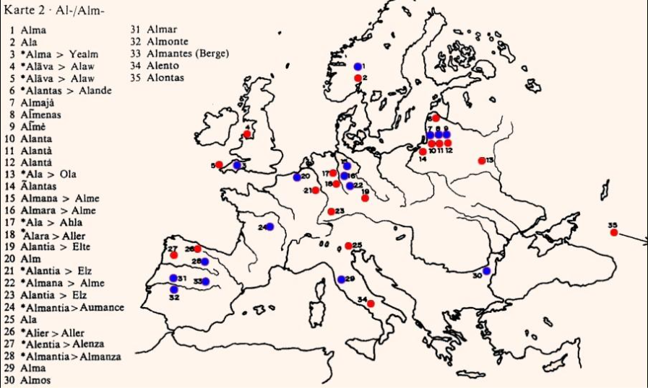

Slide 14
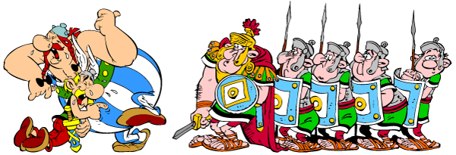
Caesarobriga
Caesaromagus
Augustodurum
Augustonemetum
Aquae Helveticae
Victoriacum
Paternacum

Slide 15
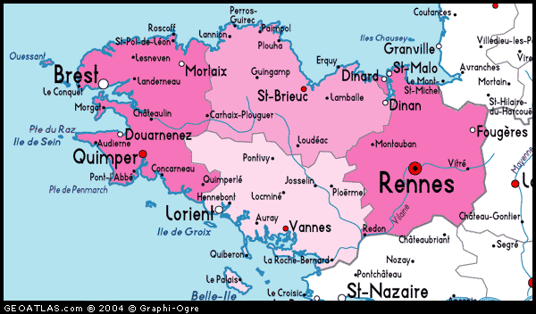

Slide 16
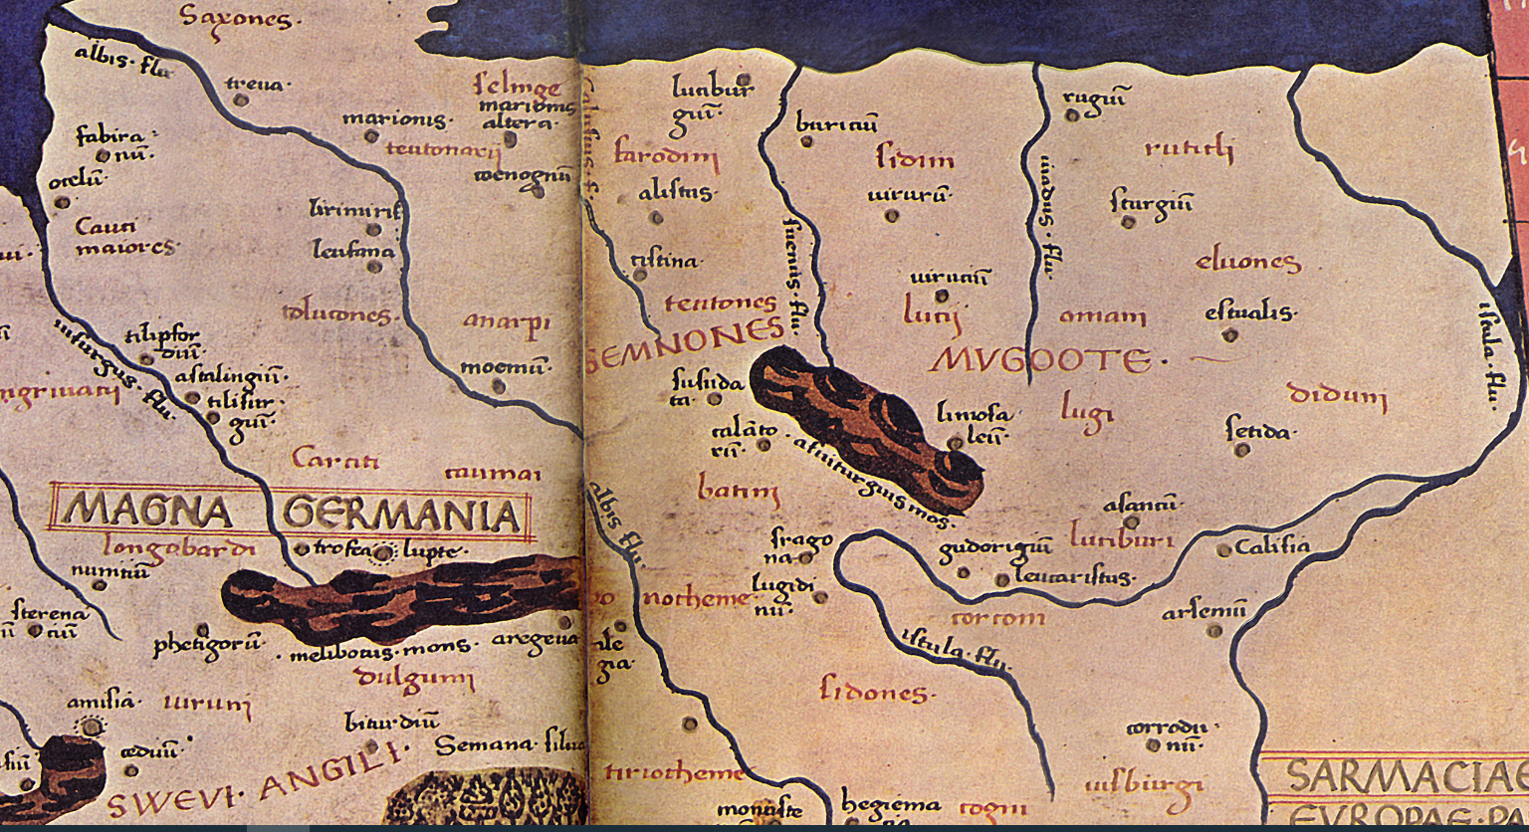

Slide 17
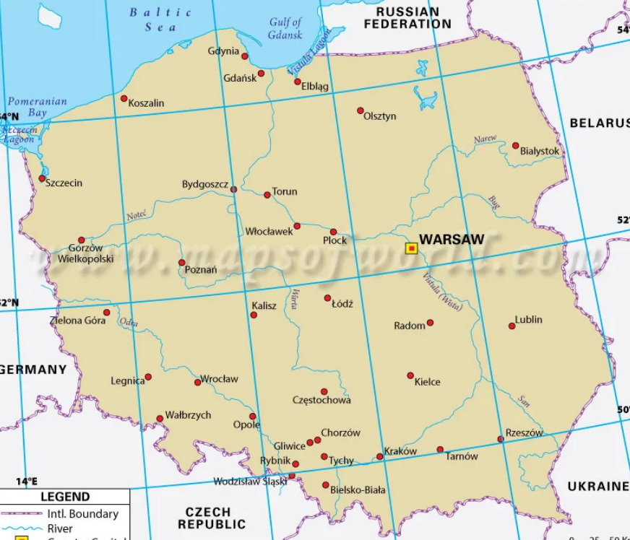

Slide 18
Lugii (western Poland, around ?Poznan)
Lugidunum (modern Legnice).
A connection with the god Lugus, whom we met at Lyon, is probable. The tribe would be his devotees. The dunum ‘fortified place’, may contain the tribe’s name, or a related personal name Lugis.
Karrodunum (modern Krapkowice).
‘Karro-’ is ‘cart, chariot’, and the name is a recurrent one in Europe.
Boudorigion (unlocated, but near previous)
A personal name Boudorix [literally ‘victory-king’] + suffix, to give ‘place of Boudorix’.

Slide 19
Dounoi?
Cotini?

