Slide 1
Public Health: Hepatitis B Outbreak
(Case Study E)
Module: Introduction to Public Health
Module Code: LCHS4008
Lecturer: Christopher Mafuva
Assignment Title: Group discussion
Presented by: Group 2
Sasha Mohammed (2429698), Svetlana Chebac (2429341), Mihaela Sprincean (2429956),
Sima Pervin (2428548), Jordan (? )

Slide 2

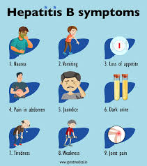
Introduction to Hepatitis B
Hepatitis B is a viral disease (HBV) that mainly targets the liver and can cause both temporary and chronic health problems.
It is typically spread through contact with contaminated blood or bodily fluids, such as semen (NHS, 2023).
In this situation, Tom, a 15-year-old adolescent, was found to have the infection after showing signs like severe fatigue, decreased hunger, and a yellow tint to his skin and eyes.
Notes:
Good morning everyone. Today I’ll be discussing Hepatitis B and how public health professionals measure and monitor this infectious disease. Hepatitis B is a viral infection that mainly targets the liver and can cause both acute and chronic illness (NHS, 2023). It spreads through contact with infected blood or body fluids, for example during sexual contact or from mother to baby at birth. In our case study, Tom, a 15-year-old, developed fatigue, loss of appetite and jaundice before being diagnosed with Hepatitis B. This shows how important early detection is to prevent further spread in the community.

Slide 3
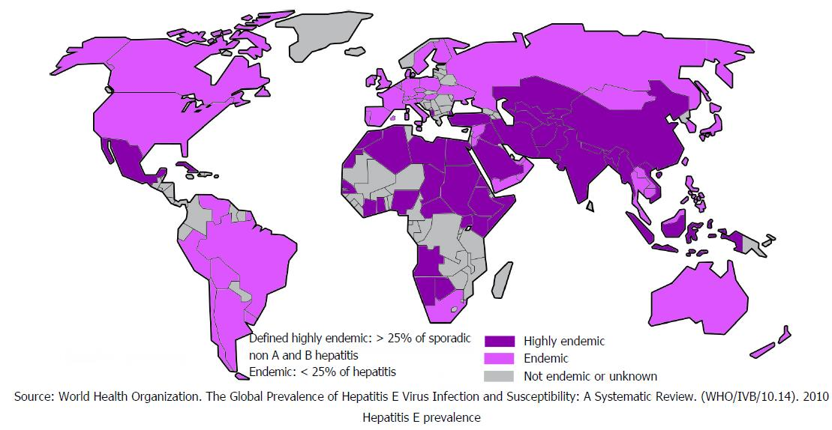
Why Measure an Outbreak?
Understand the scale and how it’s spreading
Identify vulnerable or high-risk groups
Support planning for prevention and treatment
Maintain and protect public health
Observing the transmission of Hepatitis B is crucial for determining the number of affected individuals and understanding how the virus is spreading.
It assists in recognising vulnerable groups, guides the development of prevention and care plans, and significantly contributes to safeguarding community health" (WHO, 2022; UKHSA, 2023).
Notes:
Measuring an outbreak is essential to understand its scale and how the virus is spreading. Accurate data help identify who is most at risk and guide public health teams in prevention and treatment planning (WHO, 2022; UKHSA, 2023). When Hepatitis B cases are measured systematically, health authorities can decide where to send resources such as vaccination programmes, screening services, and health education. Measurement also helps maintain and protect overall public health by tracking progress and preventing future outbreaks.

Slide 4
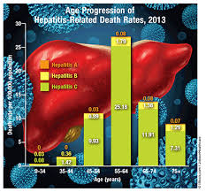
Incidence and Prevalence Rates
Incidence refers to the count of newly diagnosed cases during a defined period, whereas prevalence indicates the overall number of individuals affected by the condition.
These figures assist healthcare authorities in evaluating the long-term effects of Hepatitis B and in shaping their intervention strategies" (WHO, 2022; PHE, 2020).
According to WHO, nearly 820,000 deaths globally were attributed to complications of Hepatitis B in 2019 (WHO, 2022).
During an outbreak, increased mortality might be seen if diagnosis or treatment is delayed, especially among vulnerable populations.
Notes:
Incidence means the number of new cases identified over a set time period, while prevalence is the total number of people living with the condition. These rates are used to monitor trends and assess how effective control measures are (PHE, 2020). Globally, around 820 thousand deaths in 2019 were linked to Hepatitis B (WHO, 2022). In the UK, there are about 180 thousand people living with chronic infection. Understanding these figures allows health planners to evaluate the impact on services and to target screening in high-risk groups.

Slide 5

Contact Tracing
Contact tracing is carried out to identify individuals who have had close interaction with a person confirmed to have Hepatitis B, including relatives, peers, or sports teammates.
These contacts are then provided with testing, information, and immunisation to help prevent additional spread of the virus.(NICE, 2022).
Notes:
Once a Hepatitis B case is identified, contact tracing is vital to limit the spread. Public health teams work with the infected person to list anyone who may have been exposed — family members, sexual partners or sports teammates. Those contacts are then offered testing and vaccination to prevent further transmission (NICE, 2022). This strategy also provides education on safe practices such as not sharing razors or toothbrushes. Effective contact tracing helps break the chain of infection and protect the wider community.
In summary, accurately measuring and monitoring Hepatitis B outbreaks allows public health teams to identify risks early, protect communities, and guide effective prevention. I’ll now hand over to the next speaker who will discuss the strategies used to control the outbreak

Slide 6
References
National Institute for Health and Care Excellence (NICE) (2022) Hepatitis B: Contact Tracing and Immunisation. Available at: https://www.nice.org.uk/guidance
NHS (2023) Hepatitis B. Available at: https://www.nhs.uk/conditions/hepatitis-b/
Public Health England (PHE) (2020) Hepatitis B Epidemiology in England: 2020 Report. Available at: https://www.gov.uk/government/publications/hepatitis-b-epidemiology-in-england
UK Health Security Agency (UKHSA) (2023) Hepatitis B: Guidance, Data and Analysis. Available at: https://www.gov.uk/government/collections/hepatitis-b-guidance-data-and-analysis
World Health Organization (WHO) (2022) Hepatitis B Fact Sheet. Available at: https://www.who.int/news-room/fact-sheets/detail/hepatitis-b

