Slide 1
MODULE NAME – problem solving and decision making
MODULE CODE lclm4004
STUDENT NAME –Hamdh Ahsan
STUDENT ID 2532836
LECTURER
Assignment 1: Presentation

Slide 2
Introduction
Basil’s Bakery is a small independent bakery located in a shopping retail park in Coventry, UK. The presentation analyses the challenges affecting the business using the PESTLE framework and a Fishbone (Cause-and-Effect) diagram. The aim is to identify why sales have declined and recommend areas for improvement

Slide 3
Company Backgroun
Company: Basil’s Bakery
Founded: 2015 Owner: Basil Location: Shopping retail park, Coventry, UK Products: Artisan cakes, pastries and breads made from high-quality organic ingredients. Customers: Local shoppers, retail employees, office workers and warehouse staff. Business model: Independent bakery focusing on fresh, premium-quality baked goods.

Slide 4
Problem – Nature and Scope (5W2H)
What?
Sales and customer footfall have remained around 25% below 2019 levels.
Who? Basil, his employees and customers.
Where? Basil’s Bakery, Coventry retail park.
When? Decline started in 2020 during COVID-19 lockdowns and has continued between 2023–2025.
Why? Fewer visitors to the retail park.
Shop closures reducing customer numbers.
More people working from home.
No delivery service.
Limited ability to take pre-orders.
Rising business costs.
How? Reduced customer demand and increasing operating costs have lowered profitability.
How much? Sales have stagnated at approximately 25% below 2019 figures.

Slide 5
PESTLE Analysis (Political, Economic, Social)
Political
COVID-19 lockdown restrictions reduced customer footfall.
Business rates and government policies affect operating costs.
Economic Rising inflation has increased utility bills, rent and insurance.
Organic ingredients have become more expensive and unpredictable.
Social More people work from home and visit the retail park less often.
Customers increasingly expect delivery and convenient ordering.

Slide 6
PESTLE Analysis (Technological, Legal, Environmental)
Technological
No online ordering or delivery system.
Limited ability to manage customer pre-orders.
Legal Must comply with UK food hygiene and health & safety regulations.
Employment laws and minimum wage increases increase labour costs.
Environmental Organic produce is vulnerable to crop failures and weather conditions.
Sustainable sourcing increases supply costs but supports the bakery’s brand.

Slide 7
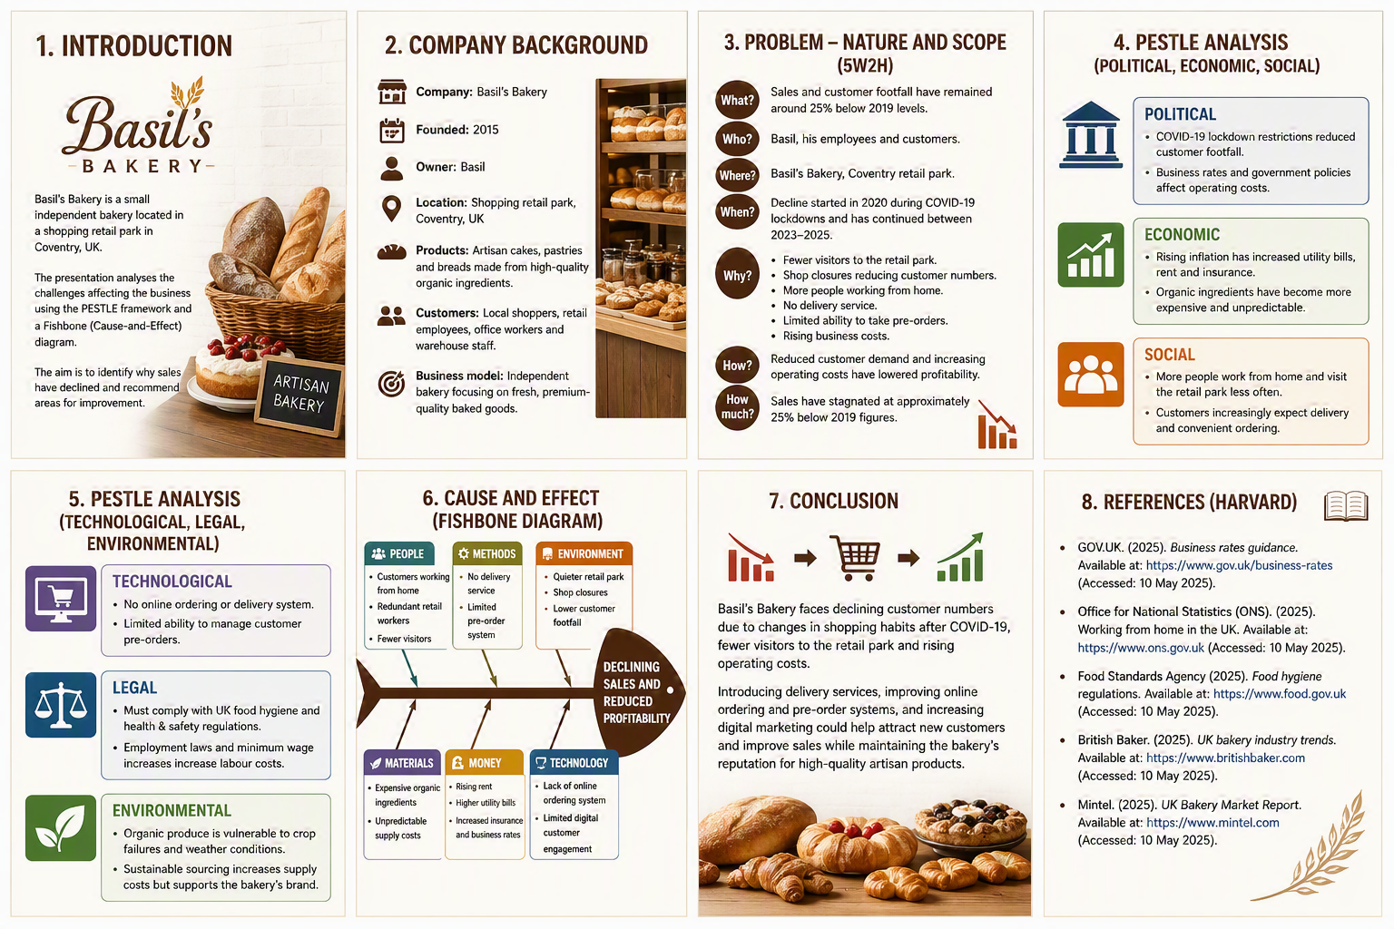
Cause and Effect (Fishbone Diagram)
Problem:
Declining sales and reduced profitability
People Customers working from home
Redundant retail workers
Fewer visitors
Methods No delivery service
Limited pre-order system
Environment Quieter retail park
Shop closures
Lower customer footfall
Materials Expensive organic ingredients
Unpredictable supply costs
Money Rising rent
Higher utility bills
Increased insurance and business rates
Technology Lack of online ordering system
Limited digital customer engagement

Slide 8
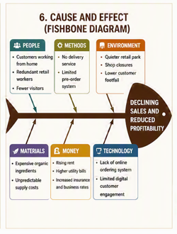

Slide 9
Conclusion
Basil’s Bakery faces declining customer numbers due to changes in shopping habits after COVID-19, fewer visitors to the retail park and rising operating costs. Introducing delivery services, improving online ordering and pre-order systems, and increasing digital marketing could help attract new customers and improve sales while maintaining the bakery’s reputation for high-quality artisan products.

Slide 10
References (Harvard)
GOV.UK. (2025). Business rates guidance. Office for National Statistics (ONS). (2025). Working from home in the UK. Food Standards Agency (2025). Food hygiene regulations. British Baker. (2025). UK bakery industry trends. Mintel. (2025). UK Bakery Market Report.

Slide 11

Questions

