Slide 1
BMSK6010
Inspiring Leadership
Session 5

Slide 2


Review of pre-session activities
Difference and leadership
Leadership and power
Some other leadership models
Q & A
Pre-session activity

Slide 3

Recap/Review
Leadership & Management
Situational Leadership
The Leadership Continuum
David Marquet
Martin Luther King
Paul Hersey
Experiences/Case Studies

Slide 4
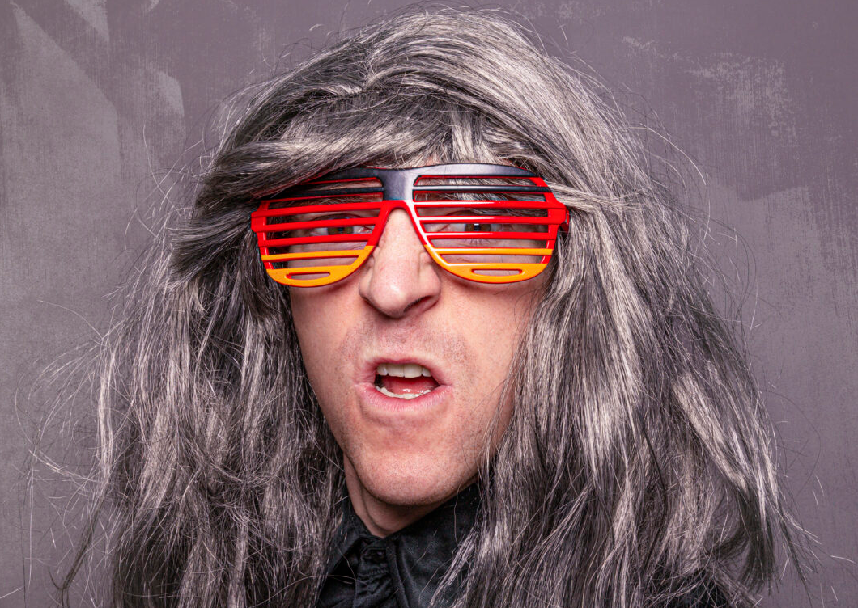
Activity
After reading and researching Chapter 7, ‘Difference & Leadership’ in Carroll et al, (2015)…………….
Critically analyse whether ‘difference and diversity are significant for leadership style?
You may find it useful to read Chapter 21, ‘Women and Leadership: Selection, Development, Leadership Style, and Performance’ by Gipson, et al, in Maund, A. (ed). (2018) BA in Leadership and Management, Skills for the workplace, Student yearbook, final year’
Summarise your findings for discussion
Fully reference the evidence you provide

Slide 5
Module Task Assessment
5th July 2026
TASK
Common Assessment Criteria
Critically assess a recognised leadership model or theory in relation to its ability to impact on individual’s workplace performance
Evaluate own ability to use a range of leadership styles, in different situations and with different types of people, to fulfil the leadership role
Assess your own ability to set direction, motivate, delegate and empower others to bring about a workplace change
Engagement with Literature Skills. (30)
Knowledge and Understanding Skills (25)
Cognitive and Intellectual Skills (25)
Practical Application Skills (10)
Transferable Skills for Life and Professional Practice (10)

Slide 6

Difference and Leadership –Some reflective thoughts
Under what circumstances have you felt ‘different’ and what was your experience?
What kinds of pressures (if any) did you come under to ‘fit in’, to modify what you said or to conform to norms?
Has it been important to you to speak up or stand out on a particular issue against the views of the majority and, if so, what happened?
Have you had experience of seeking to introduce new and different perspectives into group discussions and, if so, what unfolded? Were you heard? Did what you say change things?

Slide 7

Difference and Leadership
Have you come across individual leaders or acts of leadership that seemed open and inviting of difference? What occurred and what were the consequences?
How would you characterise or describe leadership that is open and sensitive to exploring issues of difference?
What are the institutional, political or social supports that enable that kind of leadership, and what kinds of obstacles are likely to block or undermine it?

Slide 8
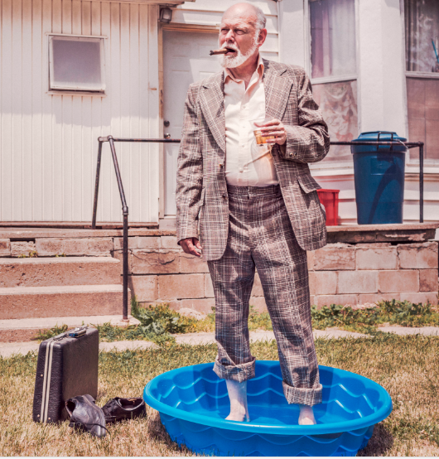
Difference and Leadership
Can you identify examples – from your own context or the public arena – of leadership practices with significant positive impacts on appreciation of difference.

Slide 9

Leadership and Difference
Difference is tightly interwoven with dynamics of power
Leadership has a long history of being constructed in ways which privilege and empower some people over others
Critical perspectives on leadership and diversity seek to engage more reflexively with power and leadership.

Slide 10
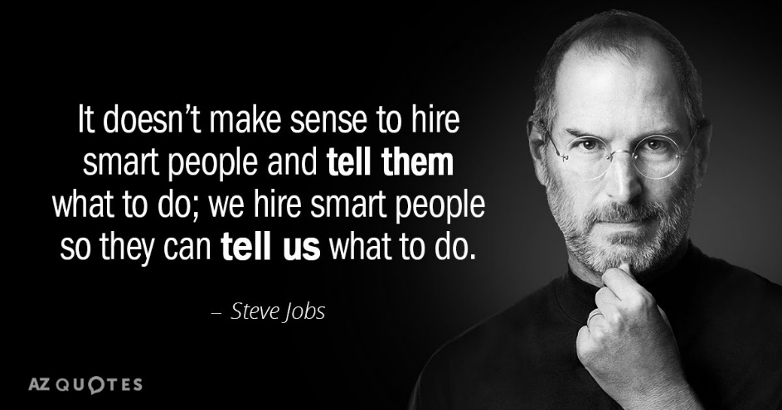
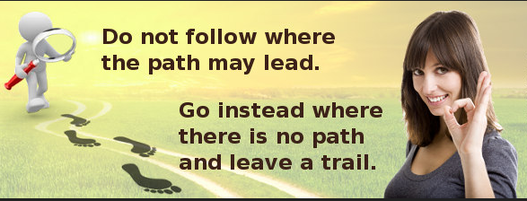
Leadership and power
What is the source of a leader’s power?
Discussion

Slide 11
Leadership & Power (French and Raven 1959)
Reward power: ability and resources to obtain rewards for those who comply, e.g. pay, promotion, recognition, privileges.
Coercive power: ability to punish or to bring about undesirable outcomes, e.g. withholding pay rises & promotion, withdrawing friendship, formal reprimands
Legitimate power: the right to exercise power because of leader's position in the organisation
Referent power: subordinate's identification with the leader because of attractiveness, reputation, or charisma. Etzioni (1961) refers to this a “personal power”
Expert power: competence, special knowledge or expertise in a given area. Expert power is normally limited to narrow, well-defined areas or specialisms
Notes:
French and Raven (1959) developed a typology that identifies five sources of power: (a) reward power, (b) coercive power, (c) legitimate power, (d) expert power, and (e) referent power.
Social influence is defined as 'change in the belief, attitude, or behaviour of a person (the target of influence), which results from the action of another person (an influencing agent)', and social power as the potential for such influence.
Coercive power
This is the power to force someone to do something against their will. It is often physical although other threats may be used. It is the power of dictators, despots and bullies. Coercion can result in physical harm, although its principal goal is compliance. Demonstrations of harm are often used to illustrate what will happen if compliance is not gained.
Coercion is also the ultimate power of all governments. Although it is often seen as negative, it is also used to keep the peace. Parents coerce young children who know no better. A person holds back their friend who is about to step out in front of a car.
Other forms of power can also be used in coercive ways, such as when a reward or expertise is withheld or referent power is used to threaten social exclusion.
Reward power
One of the main reasons we work is for the money we need to conduct our lives. There are many more forms of reward -- in fact anything we find desirable can be a reward, from a million dollar yacht to a pat on the back.
Reward power is thus the ability to give other people what they want, and hence ask them to do things for you in exchange.
Rewards can also be used to punish, such as when they are withheld. The promise is essentially the same: do this and you will get that.
Legitimate power
Legitimate power is that which is invested in a role. Kings, policemen and managers all have legitimate power. The legitimacy may come from a higher power, often one with coercive power. Legitimate power can often thus be the acceptable face of raw power.
A common trap that people in such roles can fall into is to forget that people are obeying the position, not them. When they either fall from power or move onto other things, it can be a puzzling surprise that people who used to fawn at your feet no long do so.
More broadly, legitimate power is that based on social rules and can be have several different forms and not just be based on position:
Legitimate position power: The social norm of obeying people in a superior position.
Legitimate power of reciprocity: The norm that we should repay those who help us.
Legitimate power of equity: The norm of fair play and due compensation.
Legitimate power of responsibility: The norm of social responsibility in helping others (the 'power of the powerless').
Referent power
This is the power from another person liking you or wanting to be like you. It is the power of charisma and fame and is wielded by all celebrities (by definition) as well as more local social leaders. In wanting to be like these people, we stand near them, hoping some of the charisma will rub off onto us.
Those with referent power can also use it for coercion. One of the things we fear most is social exclusion, and all it takes is a word from a social leader for us to be shunned by others in the group.
Expert power
When I have knowledge and skill that someone else requires, then I have Expert power. This is a very common form of power and is the basis for a very large proportion of human collaboration, including most companies where the principle of specialization allows large and complex enterprises to be undertaken.
Expert power is that which is used by Trades Unions when they encourage their members to strike for better pay or working conditions. It is also the power of the specialist R&D Engineer when they threaten to leave unless they get an exorbitant pay rise or a seat by the window.
And Informational power
Raven (1965) added a sixth source: informational power. This is providing information to a person that results in them thinking/acting in a different way.
Information by itself may not be enough for this and may hence be supported by an argument as to why the information should be believed. If the information is accepted then 'socially independent change' occurs as the person continues to believe this information to be true and acts accordingly.

Slide 12
Geeks or Geezers (Bennis &Thomas 2002)
Core Leadership Competencies
  Adaptive capacity – an ability to "transcend adversity, with all its attendant stresses
  Engaging others through Shared Meaning - an ability to build culture and community in an organization.
  Voice - a distinctive and compelling sense of conviction, or voice driven from a strong set of values.
  Purpose - that purpose includes vision.
The Commonality of Crucibles
  Crucibles are "intense, transformational experiences" from which a leader changes dramatically and emerges much wiser.
Notes:
“A geek" — a leader age 21 to 35
“A geezer" — a leader age 70 to 93
Great Depression versus Dot-Com Collapse
Stephen Covey’s 8th Habit – Developing your Voice

Slide 13

Geeks and Geezers
Geeks often:-
Geezers often:-
Are committed to making a life, not just a living;
View team-building, engagement, and partnerships as essential to leadership;
Recognize that with diversity come new perspectives, ideas, and insights;
Desire and believe that they can better the world;
Are experimental and entrepreneurial, less loyal to employers;
Learn through both traditional and experiential means;
Are more secure with insecurity and change;
Have multiple careers, thanks in part to longer life expectancy.
Have had only one to three jobs in their careers;
Consider their work a vital part of their "social identity;"
Have not generally recognized the value of diversity until late in their careers;
Consider "paying your dues" essential;
Learn in traditional ways such as reading and classrooms;
Are unfamiliar with the pressures of two-career families
Notes:
Geeks, matured in the "Era of Options" (1991-2000), which included MTV, AIDS, terrorism, globalization, the end of the Cold War, weapons of mass destruction, high public distrust of government, and influential special interest groups.

Slide 14

Trait Theory
Vision
Judgement
Commitment
Knowledge
Will-power
Energy & Drive
Sensitivity to others
Communications skills
Strongly help personal beliefs
Ambition

Slide 15
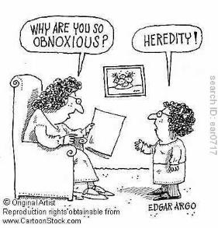
Trait Theory
(The belief that leaders develop
from their own personal qualities)
Mother Teresa Mahatma Gandhi
Moses Margaret Thatcher
Bill Gates

Slide 16

Factors Affecting Leadership Styles
Preference of leader in terms of personal characteristics
History of business
The job/task which needs to be performed
The attitude of the work force
Markets in which the business operates

Slide 17
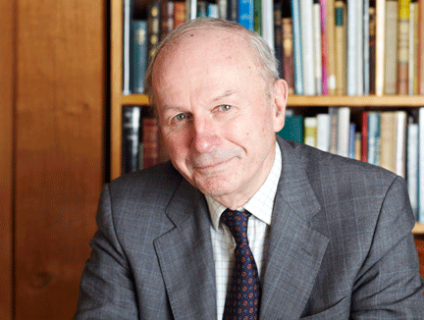

Adair – Action Centred Leadership
Task
Team
Individual

Slide 18
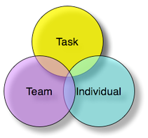
Adair – Action Centred Leadership
The need to accomplish the task
The need to be seen and maintained as a cohesive unit
The need to satisfy an individual’s needs within that team

Slide 19

Task Function
Appreciating/re-appreciating the situation
Controlling quality/tempo of work and performance
Enquiring, communication
Setting standards
Making/adjusting plans
Allocating work/resource

Slide 20
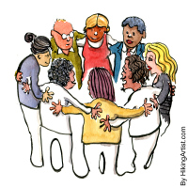
Team Maintenance Function
Setting Standards
Giving Examples
Discipline
Motivating
Praising
Giving Status
Giving a Sense of Purpose
Developing communication within a group
Training the group
Instilling/Maintaining/
Building a team spirit

Slide 21

Individual Function
Attending to Personal Problems
Praising Individuals
Giving Status
Recognising and Using Individual Status
Training the Individual

Slide 22
Some other models to research…
Warren Bennis – Four key abilities
Rensis Likert – Participation management
MacGregor’s Theory X and Theory Y
Kurt Lewin – Directive, Democratic and Laissez-Faire
As you look at these, and other models, put your critical thinking hat on and ask questions about the various theories and models…Do they make sense? Have I seen examples of this in practice? What evidence is being provided? How does this model compare to other models and theories? Strengths? Weaknesses? Who else has looked at these models – what did they have to say about them?
Notes:
Warren Bennis’ 4 Abilities: -
Leaders are able to engage others by creating shared meaning
All authentic leaders have a distinctive voice
All true leaders have integrity
The most important competency is adaptive capacity — this is what allows leaders to respond quickly and intelligently to relentless change
Warren Bennis – 13 Characteristics
1. Administration vs. innovation
2. Carbon copy vs. original
3. Maintenance vs. development
4. System or structure focus vs. people focus (an important differentiation in Bennis leadership theory)
5. Control vs. inspiration
6. Acceptance vs. investigation
7. Short-range vs. long-range perspective
8. Interest in "how" and "when" vs. interest in "what" and "why"
9. View toward bottom line vs. view toward horizon
10. Imitation vs. origination
11. Acceptance vs. challenge of/to status quo
12. Conformity (i.e., "good soldier" mentality) vs. individuality
13. Desire to do things right vs. ability to do the right things

Slide 23

Recap
Difference and leadership
Leadership and power
Geeks and geezers
Trait theory
Factors affecting leadership
Adair,
Bennis, Likert, Lewin, et al

Slide 24
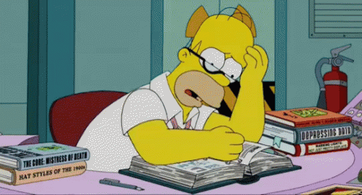
For the next session
Complete the ‘two’ Leadership Self-assessment questionnaires available in Moodle:
Leadership Style Questionnaire
Conceptualising Leadership Questionnaire
When you have completed the two questionnaires, please critically reflect upon and analyse the results – supporting your arguments and conclusions with appropriate evidence.
Write approximately 500 words on your findings
Fully reference the evidence you provide
You should allow 3 hours for this activity
Please note: There are additional questionnaires in the Resources section of the Module in Moodle. There are also many self-assessment questionnaires available on-line.

Slide 25

Summary
Take 5 minutes to reflect upon the session – what have you learnt?
Any key areas you want to research further?
What can help you with your assignment?
What can help you in your career?

