Slide 1


Jeffrey Dahmer
Cassy, Cerys and Saffron

Slide 2

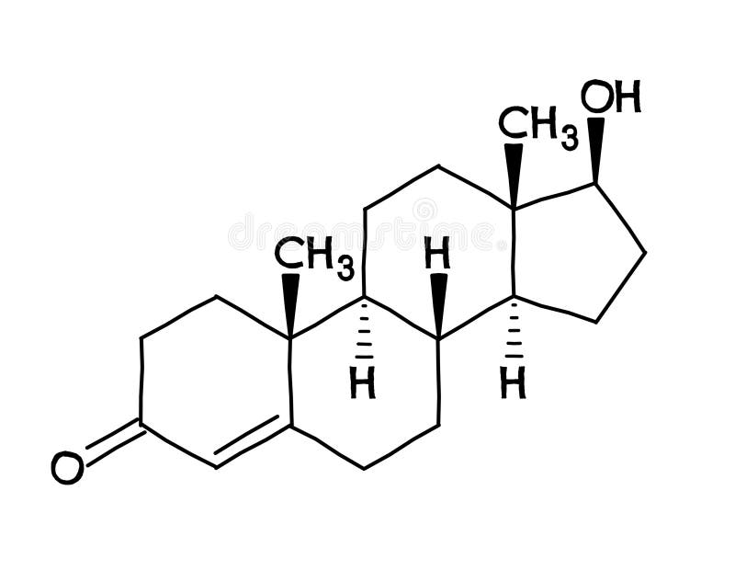
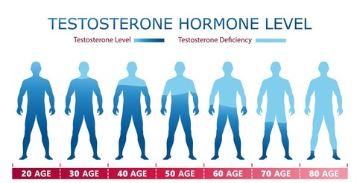
BORN – testosterone
In comparison to women, men have more/higher testosterone. - Cleveland clinic (2022)
Age | Male (in ng/dl) | Female (in ng/dl)
0 to 5 months | 75-400 | 20-80
6 months to 9 years | Less than 7-20 | Less than 7-20
10 to 11 years | Less than 7-130 | Less than 7-44
Balance by hormones, Author: Mike Kocsis (2023)
Notes:
-A hormone called testosterone is present in both humans and other animals. The primary source of testosterone in men is the testicles. While in far smaller quantities, the ovaries of women also produce testosterone
-According to Cleveland clinic (2022) the primary hormone produced by your gonads, or testicles or ovaries, is testosterone. Those assigned male at birth have naturally higher testosterone levels than those assigned female at birth.
It is clear to see from the table above that from birth males produce almost four times the amount of nanograms than female.
-'Relate Dahmer to table eg. Similarities'

Slide 3
BORN – testosterone
The testosterone levels of prisoners who had committed violent and sexual offences against themselves were higher than those of prisoners who had committed theft, drug use, and burglary. - NIH (2013)
Jeffrey Dahmer was a male from birth.
Dahmer committed these types of sexual crimes such as rape, sexual assault (second degree assault) and luring a child with immoral. This occurred when Dahmer was at the age of 18.
Notes:
Continuing onto born testosterone........
-In relation to Jeffrey Dahmer, from birth he was male and therefore has had more testosterone than female, which always meant that its thought to control the production of sperm and red blood cells, as well as bone mass, fat distribution, muscle mass, and libido as stated from National institutes of health (2013).
-Hormones and behavior; Donna Maney (2020)

Slide 4

Made – Social strain theory
Social strain theory in sociology, postulates that people commit
crimes as a result of pressure from social factors like poverty or
lack of quality education.
According to strain theories, certain pressures or strains make criminal activity more likely. Negative feelings like annoyance and rage are brought on by these strains. The pressure these feelings put on people to take corrective action can lead to criminal activity. Agnew. R., Oxford Bibliographies (2015)
Due to Dahmer's lack of social ties, he was able to dehumanise
his victims which in turn contributed to the depravity of his crimes.
Dahmer was a social isolated person and his shyness was a barrier for socialising and making bonds with individual's.
Stronger bonds to society might have made Dahmer more likely to abide by social norms and suppress his dark impulses.
Notes:
This could potentially act on that Dahmer had anger after being bullied by his classmates and therefore made him act in anger.
'Here state the types of ways how he was socially effected'
-Borderline personality disorder
-Neglected by his parents
-Bullied in school
-Manifested an interest in dead animals growing up

Slide 5
References:
Bibliography
Agnew, R., 2015. Strain theories. Oxford: s.n.
Cleveland Clinic , 2022. Testosterone. [Online]
Available at: https://my.clevelandclinic.org/health/articles/24101-testosterone
[Accessed 3 March 2024].
Harrison Wein, P., 2013. National institutes of health. [Online]
Available at: https://www.nih.gov/news-events/nih-research-matters/understanding-how-testosterone-affects-men#:~:text=Testosterone%20is%20a%20sex%20hormone,estradiol%2C%20a%20form%20of%20estrogen.
[Accessed 3 March 2024].
Jr., J. M. D., 1995. Testosterone, crime and misbehaviour. Personality and individual differences , 18(5), p. 692.
Kocsis, M., 2023. Balance by hormones. [Online]
Available at: https://balancemyhormones.co.uk/what-are-normal-testosterone-levels/
[Accessed 3 March 2024].
Ressler, R., & Shechtman, T. (1997, p. 19). A revised strain theory of delinquency. St. Martin's Press
Ocampo, D. A. J., 2019. Health gains. [Online]
Available at: https://healthgains.com/blog/normal-average-testosterone-levels-age-chart/#:~:text=Between%20the%20ages%20of%2017,75%20ng%2FdL%20of%20testosterone.
[Accessed 3 March 2024].

Slide 6
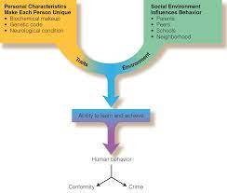
Asperger’s Syndrome- biological trait theory.
Connection between Asperger’s syndrome and the likelihood of criminal behaviour.
Asperger’s syndrome is associated with characteristics such as impairments in social communication, social imagination and reciprocal interaction that is proven more common in males (Payne, 2014).
Study discovered that the men displayed behavioural issues such as physical aggression or sexually inappropriate behaviour (Allen, et al., 2008).
Findings of the most common offences that individuals with Asperger’s Syndrome was violent and threatening behaviour with 81% portraying these characteristics.
Notes:
-Payne (2014) Asperger’s syndrome is associated with characteristics such as impairments in social communication, social imagination and reciprocal interaction that is proven more common in males. The research regarding Asperger’s Syndrome suggests that the way individual’s such as Dahmer perceive their social communication may relate to committing crime due to factors such as deficiencies in empathy.
-Allen et al. (2008) studied male offenders that were diagnosed with Asperger’s Syndrome. His study discovered that the men displayed behavioural issues such as physical aggression or sexually inappropriate behaviour.
-This corresponds with Dahmer’s behaviour of sexual assault and aggressive behaviour towards his victims.
-Findings of the most common offences that individuals with Asperger’s Syndrome was violent and threatening behaviour with 81% portraying these characteristics.

Slide 7

Hold characteristics that enable them to hold different beliefs to other individual's that explains the offending deviant behaviour
the biological trait theory -biological and genetic conditions affect the perception of social communication.
Socially excluded and had inadequate socialisation due to Asperger’s Syndrome- anti-social, aggressive and unempathetic personality traits (Dein & Woodbury-Smith, 2010).
The link heightens the individual's risk for engaging in criminal behaviour because of deficient social awareness and social constraints on the individual's behaviour (Ellens, 2011).
Perception of social norms and behaviours being different from the average individual.
Notes:
-Dein & Woodbury-Smith (2010) - individual’s diagnosed with Asperger’s Syndrome are more likely to offend as they hold characteristics that enable them to hold different beliefs to other individual's that explains the offending deviant behaviour.
-No definite evidence for the link between Asperger’s and criminal offending.
-But the biological trait theory highlights that biological and genetic conditions affect the perception of social communication.
-Dahmer was socially excluded and had inadequate socialisation due to Asperger’s Syndrome- link between Dahmer’s genetics and certain characteristics that determined his anti-social, aggressive and unempathetic personality traits because of this theory.
-Ellens (2011) -connection between sexual serial killing and Asperger’s Syndrome. The link heightens the individual's risk for engaging in criminal behaviour because of deficient social awareness and social constraints on the individual's behaviour.
-Dahmer’s Asperger’s Syndrome is associated with his biological deficits such as no empathy or understanding other individuals' emotions and difficulty dealing with his own emotions causing him to lash out.

Slide 8
The psycho-dynImic theory.
(Martens, 2011) -Jeffrey Dahmer’s behaviour and actions are rooted from underlying issues related to his childhood issues and experiences.
Dahmer was faced with issues with being neglected as a child as his mother suffered with illnesses such as psychosomatic illnesses, depression, and hysteria.
This left Dahmer not able to deal with the emotional stress that caused the impulses of his id that led to aggressive and criminal behaviour.
(Ryan, 2019)-Criminal acts happen due to individual’s emotional states resulting in aggressive actions.
In Dahmer's case the psychodynamic theory says that aggressive and criminal behaviour is because of a dominant id resulting in uncontrollable or impulsive decisions. The theory explains that if an individual has unbalances between the three elements id, ego, and super-ego this is what leads to criminal behaviour.
Notes:
-Martens (2011)-Jeffrey Dahmer’s behaviour and actions are rooted from underlying issues related to his childhood issues and experiences.
-Faced with issues with being neglected as a child as his mother suffered with illnesses such as psychosomatic illnesses, depression, and hysteria. His parents had a troubled marriage that led to a divorce with little attention from his family at home or any individuals in school due to lack of socialisation.
-Rejection, neglect, socialisation, and lack of healthy attachment from his childhood caused Dahmer’s actions to result from his emotional issues as a child.
-Unable to deal with the emotional stress that caused the impulses of his id that led to aggressive and criminal behaviour.
-Ryan (2019)- the psychodynamic theory suggest that criminal acts happen due to individuals emotional states resulting in aggressive actions.
-In Dahmer's case the psychodynamic theory says that aggressive and criminal behaviour is because of a dominant id resulting in uncontrollable or impulsive decisions. The theory explains that if an individual has unbalances between the three elements id, ego, and super-ego this is what leads to criminal behaviour.
-Dahmer had an overwhelmed id, his ego either did not exist or was too low and the superego being non-existent or too weak was what allowed him to conduct criminal behaviour as he did not have a conscious part of the brain to act on his morals such as feeling guilty.

Slide 9
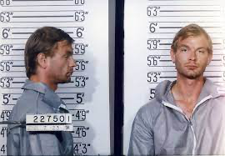
(Yakeley, 2018)-Freud explains that criminals were made based on their childhood experiences meaning that social factors that are out of the child's control shape them to act this way.
Dahmer would project his anger from his childhood onto the victims he killed and sexually assaulted.
(Nichols, 2006) states that when it comes to serial killers motivated factors to committing criminal activities it is driven by their instincts such as the id. These instincts are shaped from the individuals cultural and social environment such as Dahmer’s hard upbringing that affected him.
(Mayes, et al., 2019) reinforces that Dahmer was made a criminal due to the interpersonal and intrapersonal factors the psychodynamic theory highlights.
Notes:
-Yakeley (2018) -Freud-criminals were made based on their childhood experiences meaning that social factors that are out of the child's control shape them to act this way.
-Dahmer’s behaviour was influenced by Freud’s psychodynamic theory as he was under the influence of the id-project his anger from his childhood onto the victims he killed and sexually assaulted.
-Nichols (2006)-serial killers motivated factors to committing criminal activities it is driven by their instincts such as the id- instincts are shaped from the individuals cultural and social environment such as Dahmer’s hard upbringing that affected him.
-Mayes, et al. (2019) - made a criminal due to the interpersonal and intrapersonal factors the psychodynamic theory highlights.
-Emphasis the theory has on interactions and unconscious motivations that an individual experiences as soon as they are born.
-Interaction such as neglecting their child during the development of that individual is the reason for why individual’s carry out criminal activities.
-As a result of Dahmer’s childhood the ego within his personality is more likely to be undeveloped meaning that he is unable to control his impulses.
-Dahmer’s vulnerability because of the unhealthy environment of his upbringing effected the development of the superego that effects the ego not having the ability to develop defences such as discipline. As a result, the ego is limited when it comes to defensive strategies such as identifying criminal activity is wrong.

Slide 10
References:
Allen , D. et al., 2008. Offending Behaviour in Adults with Aspergers Syndrome. Journal of autism and development disorders, 38(4), pp. 748-758.
Dein, K. & Woodbury-Smith, M., 2010. Asperger syndrome and criminal behaviour. the Royal College of Psychiattrists' journal of continuing professional development, 16(1), pp. 37-43.
Ellens, H. J., 2011. Explaining evil. 1st Edition ed. London: Praeger.
Martens, W. H., 2011. Sadism Linked to Loneliness: Pyschodynamic Dimensions of the Sadistic Serial Killer Jeffrey Dahmer. National Psychological Association for Psychoanalysis: The Psychoanalytic review, 98(4), pp. 493-514.
Mayes, L., Potenza, M., Rutherford, H. & Alvarez-Monjaras, M., 2019. A developmental model of addictions: integrating neurological and psychodynamic theories through the lens of attachment. Attachment & human development, 21(6), pp. 616-637.
Nichols, D. S., 2006. Tell Me a Story: MMPI Responses and Personal Biography in the Case of a Serial Killer. Journal of personality assessment, 86(3), pp. 242-262.
Payne, K.-L., 2014. Alexithymia, Asperger's syndrome and criminal behaviour: a review. Journal of criminal psychology, 4(2), pp. 155-162.
Ryan, J., 2019. Class in psychodynamic theory, research and practice. Psychodynamic practice, 25(1), pp. 44-59.
Yakeley, J., 2018. Psychodynamic approaches to violence. Cambridge University Press; BJPsych advances, 24(2), pp. 83-92.

Slide 11
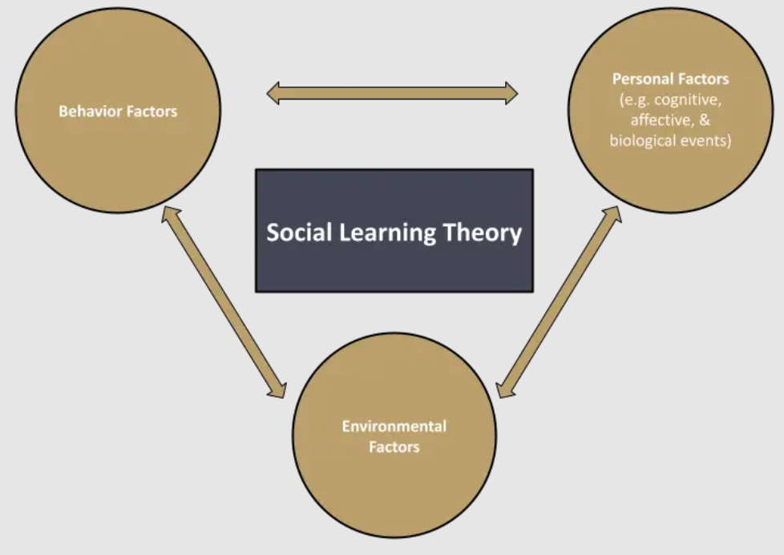
– cognitive social LEARNING theory
MADE
Albert Bandura's Cognitive Social Learning Theory:
  Emphasizes learning through observation and the influence of cognitive processes on behavior.
  Offers insights into how criminal actions, like Jeffrey Dahmer's, may be influenced by observational learning and cognitive factors.
Influence of Family Environment on Dahmer's Cognitive Processes:
  Dahmer's cognitive processes likely influenced by violence and dysfunction in his early family life.
  Cognitive Social Learning Theory suggests that individuals learn new behaviors by observing the outcomes of others' actions.
  Observing family discord and potentially unhealthy coping strategies at home may have contributed to the formation of negative thought patterns in Dahmer.
.
Notes:
Albert Bandura is widely recognised as the creator of social learning theory. During the 1960s, he carried out a well-known experiment known as the Bobo doll experiment, which eventually resulted in his published works on the social learning theory in 1977.
This theory suggests that our learning is influenced by our interactions with others within a social setting. Through observation, individuals tend to adopt behaviours exhibited by those around them. By watching how others act, individuals tend to adopt and mimic that behaviour, especially when their observations are positive or involve rewards linked to the behaviour they observed.
Another way of learning involves an internal reward, like feeling proud, satisfied, and accomplished.

Slide 12
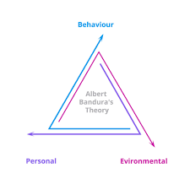
COGNITIVE SOCIAL LEARNING THEORY
MADE
Transition from Animal Cruelty to Severe Acts:
  Dahmer's progression from animal cruelty to more severe criminal activities analyzed using the theory.
  Bandura's theory states that reinforcement (positive or negative) impacts the likelihood of behavior repetition.
  Dahmer's initial acts of violence towards animals may have reinforced his thought processes, potentially leading to the escalation of criminal activities.
Significance of Cognitive Mediators:
  Cognitive Social Learning Theory highlights cognitive mediators like self-efficacy and outcome expectations.
  Dahmer's increasing disconnection from societal norms and the perceived lack of repercussions may have impacted his self-efficacy beliefs, reinforcing deviant behavior.
Notes:
Albert Bandura's Cognitive Social Learning Theory highlights the importance of individuals learning through observation of others and the cognitive processes that impact behaviour. Considering this theory in the context of Jeffrey Dahmer's case provides valuable insights into how his criminal actions might have been impacted by observational learning and cognitive factors.
Dahmer's thought processes might have been shaped by the violence and dysfunction he encountered in his family during his developing years. According to the Cognitive Social Learning Theory, individuals acquire new behaviours and attitudes by observing the consequences of others' actions. Watching family disagreements and potentially unhealthy ways of dealing with problems at home might have impacted the development of negative thinking patterns in Dahmer.
Furthermore, the shift from animal cruelty to more severe acts in Dahmer's behaviour could be analysed using the theory. According to Bandura, reinforcement, whether positive or negative, influences the likelihood of behaviour being repeated. Dahmer's early acts of violence against animals may have strengthened his thought patterns, possibly pushing him towards more severe criminal behaviours.
This theory emphasises the importance of cognitive mediators such as self-efficacy and outcome expectations. Dahmer's growing detachment from societal norms and the lack of consequences for his actions likely influenced his self-efficacy beliefs, reinforcing his deviant behaviour.
The Cognitive Social Learning Theory offers a valuable framework for understanding the development of Jeffrey Dahmer's criminal behaviour. Observational learning, reinforcement mechanisms, and cognitive processes all play a role in shaping an individuals actions, offering a glimpse into how Dahmer's experiences might have influenced his journey towards criminal behaviour.

Slide 13
cannibalism
Psychopathy and Mental Health Issues:
  Dahmer was diagnosed with various mental health disorders, including borderline personality disorder and psychotic disorder. His psychopathic tendencies, coupled with a troubled childhood and adolescence, might have contributed to his criminal behavior.
Sexual Deviance:
  Many of Dahmer's crimes were sexually motivated. His acts of violence and necrophilia were intertwined with a fascination for retaining control over his victims in a state of death. Cannibalism could have been an extension of his desire for dominance and possession.
Isolation:
  Dahmer was known for a lack of social connections and a sense of extreme loneliness. His isolation might have contributed to a warped sense of reality and the dehumanization of his victims, making it easier for him to commit gruesome acts.
Escalation of Violence:
  Serial killers often exhibit an escalation in the severity of their crimes. Dahmer's descent into cannibalism may have been a result of an escalating need for more extreme acts to satisfy his disturbed desires.
Substance Abuse:
  Dahmer struggled with alcohol and substance abuse, which could have impaired his judgment and contributed to his violent tendencies.
Control and Domination:
  Cannibalism may have been a way for Dahmer to exert further control over his victims, again marking the ultimate form of possession and dominance.
Notes:
Psychopathy and Mental Health Issues:
He was diagnosed with various mental health disorders, including borderline personality disorder and psychotic disorder. His troubled childhood and adolescence, along with psychopathic tendencies, might have contributed to his criminal behavior.
Sexual Deviance:
Many of Dahmer's crimes were sexually motivated. His acts of violence and necrophilia were intertwined with a fascination for retaining control over his victims in a state of death. Cannibalism could have been an extension of his desire for dominance and possession.
Isolation:
Dahmer was known for a lack of social connections and a sense of extreme loneliness. His isolation might have contributed to a warped sense of reality and the dehumanization of his victims, making it easier for him to commit gruesome acts.
Escalation of Violence:
Serial killers often exhibit an escalation in the severity of their crimes. Dahmer's descent into cannibalism may have been a result of an escalating need for more extreme acts to satisfy his disturbed desires.
Substance Abuse:
Dahmer struggled with alcohol and substance abuse, which could have impaired his judgment and contributed to his violent tendencies.
Control and Domination:
Cannibalism may have been a way for Dahmer to exert further control over his victims, marking the ultimate form of possession and dominance.

Slide 14
REFERENCES:
Bandura, A., Davidson, H.F., & Davidson, John. (2003). Bandura’s social cognitive theory: an introduction. San Luis Obispo, CA: Davidson Films, Inc.
James, L.R., Hater, J.J., Gent, M.J., & Bruni, J.R. (1978). Psychological climate: Implications from cognitive social learning theory and interactional psychology. Personnel Psychology, 31(4), pp.783-813.
Jentzen, J., Palermo, G., Johnson, L.T., o Khang-Cheng, H., Stormo, K.A., & Teggatz, J. (1994). Destructive hostility: The Jeffrey Dahmer case: A psychiatric and forensic study of a serial killer. The American Journal of Forensic Medicine and Pathology, 15(4), pp.283-294.
Krusemark, S.F. (2003). The influence of learning theories on serial murderer development: Empirical support for a learning hypothesis. The University of Texas at Arlington.
Martens, W.H., & Palermo, G.B. (2005). Loneliness and associated violent antisocial behavior: Analysis of the case reports of Jeffrey Dahmer and Dennis Nilsen. International Journal of Offender Therapy and Comparative Criminology, 49(3), pp.298-307.
Nabavi, R.T., 2012. Bandura’s social learning theory & social cognitive learning theory. Theory of Developmental Psychology, 1(1), pp.1-24.
Romo, E. (2022). An Appetite for Crime: Case Studies of Cannibalism and the Criminological Theories that Explain It.
Sandefur, B. (2021). Applying Criminological Theory to Gacy.

