Slide 1

Week 8
Evidence based and preventative policing
(bmpl4016)
Collaborations& intelligence
Michelle Hill
Bluelightacademy@uwtsd.ac.uk

Slide 2
Recap from last week
Analysing evidence
Research as an investigation
Bias and unconscious bias
RCT's
Research task- partnership working

Slide 3

Last weeks Research task- RECAP
Research into a partnership between the police and another agency. Identify the following:-
What is the partnership?
How/ why was the partnership established?
How is the success of the partnership measured?
What is the evidence saying?
How does the partnership improve public trust?
Using PP, present your findings back to the group

Slide 4

Aims for this week
What is intelligence?
NIM and it's key features
Partnership working & the benefits

Slide 5
What is intelligence?
Criminal intelligence refers to the information and data gathered, analysed, and used by law enforcement agencies and other related organisations to understand, prevent, and respond to criminal activities and threats.
It is a fundamental component of law enforcement and national security efforts and plays a significant role in maintaining public safety.

Slide 6
Key aspects of criminal intelligence
Data Collection: The police collect a wide range of data and information from various sources including:-
Informants
Surveillance
Public records
Social media and more.
This data can relate to individuals, groups, organisations, and criminal activities.

Slide 7
Data analysis
The collected data is analysed to identify patterns, trends, and connections between individuals and criminal activities.
Analysts use various techniques to extract actionable intelligence from raw information.

Slide 8
Crime Prediction and Prevention
Criminal intelligence is used to predict and prevent criminal activities. By identifying potential threats and vulnerabilities.
The police can allocate resources more effectively to deter criminal actions.
Investigations
Intelligence gathered can be used to support ongoing criminal investigations.
It provides leads, evidence, and insights into criminal networks, enabling the police to build cases against suspects.

Slide 9
Counterterrorism
In addition to traditional criminal investigations, criminal intelligence is vital in counterterrorism efforts. It helps identify and track potential threats and extremist groups, both domestically and internationally.
Information Sharing
The police often share intelligence with other agencies at the local, national, and international levels. This collaboration enhances the ability to combat transnational crime and terrorism.

Slide 10
Risk Assessment
Criminal intelligence is used for risk assessment and management, particularly in situations where there is a potential for violence or public harm. It helps authorities make informed decisions to protect public safety.
Law Enforcement Strategy
Agencies use intelligence to formulate law enforcement strategies. This can include resource allocation, surveillance, and tactical operations.

Slide 11
NIM:-
National Intelligence model
Concerned with using intelligence to determine key priorities for policing.
The Home Office describes NIM as "a validated model of policing.... representing best practice in the use of intelligence".

Slide 12
what is nim?
The National Intelligence Model is a business process. Its intention is to provide focus to operational policing and to achieve a disproportionately greater impact from the resources applied to any problem.
It is dependent on a clear framework of analysis of information and intelligence allowing a problem- solving approach to law enforcement and crime prevention techniques.
The expected outcomes are improved community safety, reduced crime and the control of criminality and disorder leading to greater public reassurance and confidence.

Slide 13
What is the purpose?
A model for policing that ensures information is fully researched, developed and analysed to provides intelligence to enable senior managers to make tactical decisions, provide strategies to officers.
NIM can be applied to crime at all levels.
NIM includes working with partners (collaboration) to employ working strategies to tackle crime. NIM also improves integration with partner agencies.
Improves police consistency

Slide 14
Strategic and tactical tasking and co-ordination group meetings
At the heart of the business process is the Strategic and Tactical Tasking and Co-ordination Group Meetings. The process is conducted at three levels to correspond with the specified levels of incidents:
Level 1 represents local crime capable of being managed by local resources
Level 2 represents cross border, inter-force and regional criminal activity usually requiring additional resources;
Level 3 represents the most serious and organised crime.

Slide 15
Task
Provide an example of a crime for each of the following:-
Level 1 represents local crime capable of being managed by local resources
Level 2 represents cross border, inter-force and regional criminal activity usually requiring additional resources;
Level 3 represents the most serious and organised crime.

Slide 16
What is the purpose?
The purpose of the Strategic Tasking and Co-ordination Group Meetings is to agree a control strategy which establishes the intelligence requirement and sets the agenda for intelligence, prevention and enforcement priorities.
The purpose of the Tactical Tasking and Co-ordination Group Meetings is to apply a planned response to the control strategy.
The National Intelligence Model is not confined to or restricted for specialist usage. It is relevant to all areas of law enforcement: crime and its investigation, disorder and community safety. Overall, it is a model for operational policing.

Slide 17
WHAT IS THE PURPOSE?
As such, effective application of the National Intelligence Model should enable police forces to trace the continuum between anti-social behaviour and the most serious crime and then to identify those local issues in most urgent need of attention.
The model is compatible with other operational policing methodologies, in particular those which focus on problem solving by using analytical techniques.
The National Intelligence Model is a tool that Crime and Disorder Reduction Partnerships should use to develop and deliver the strategic priorities in their three year crime and disorder and misuse of drugs strategies. The National Intelligence Model should also be used to inform the strategic priorities of Drug Action Teams

Slide 18
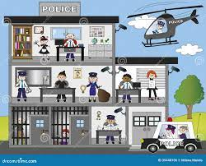
LEVEL 1- LOCAL ISSUES
Crimes will range from low value thefts to murder
This will focus on crimes and criminals impacting the local force and local command unit.

Slide 19
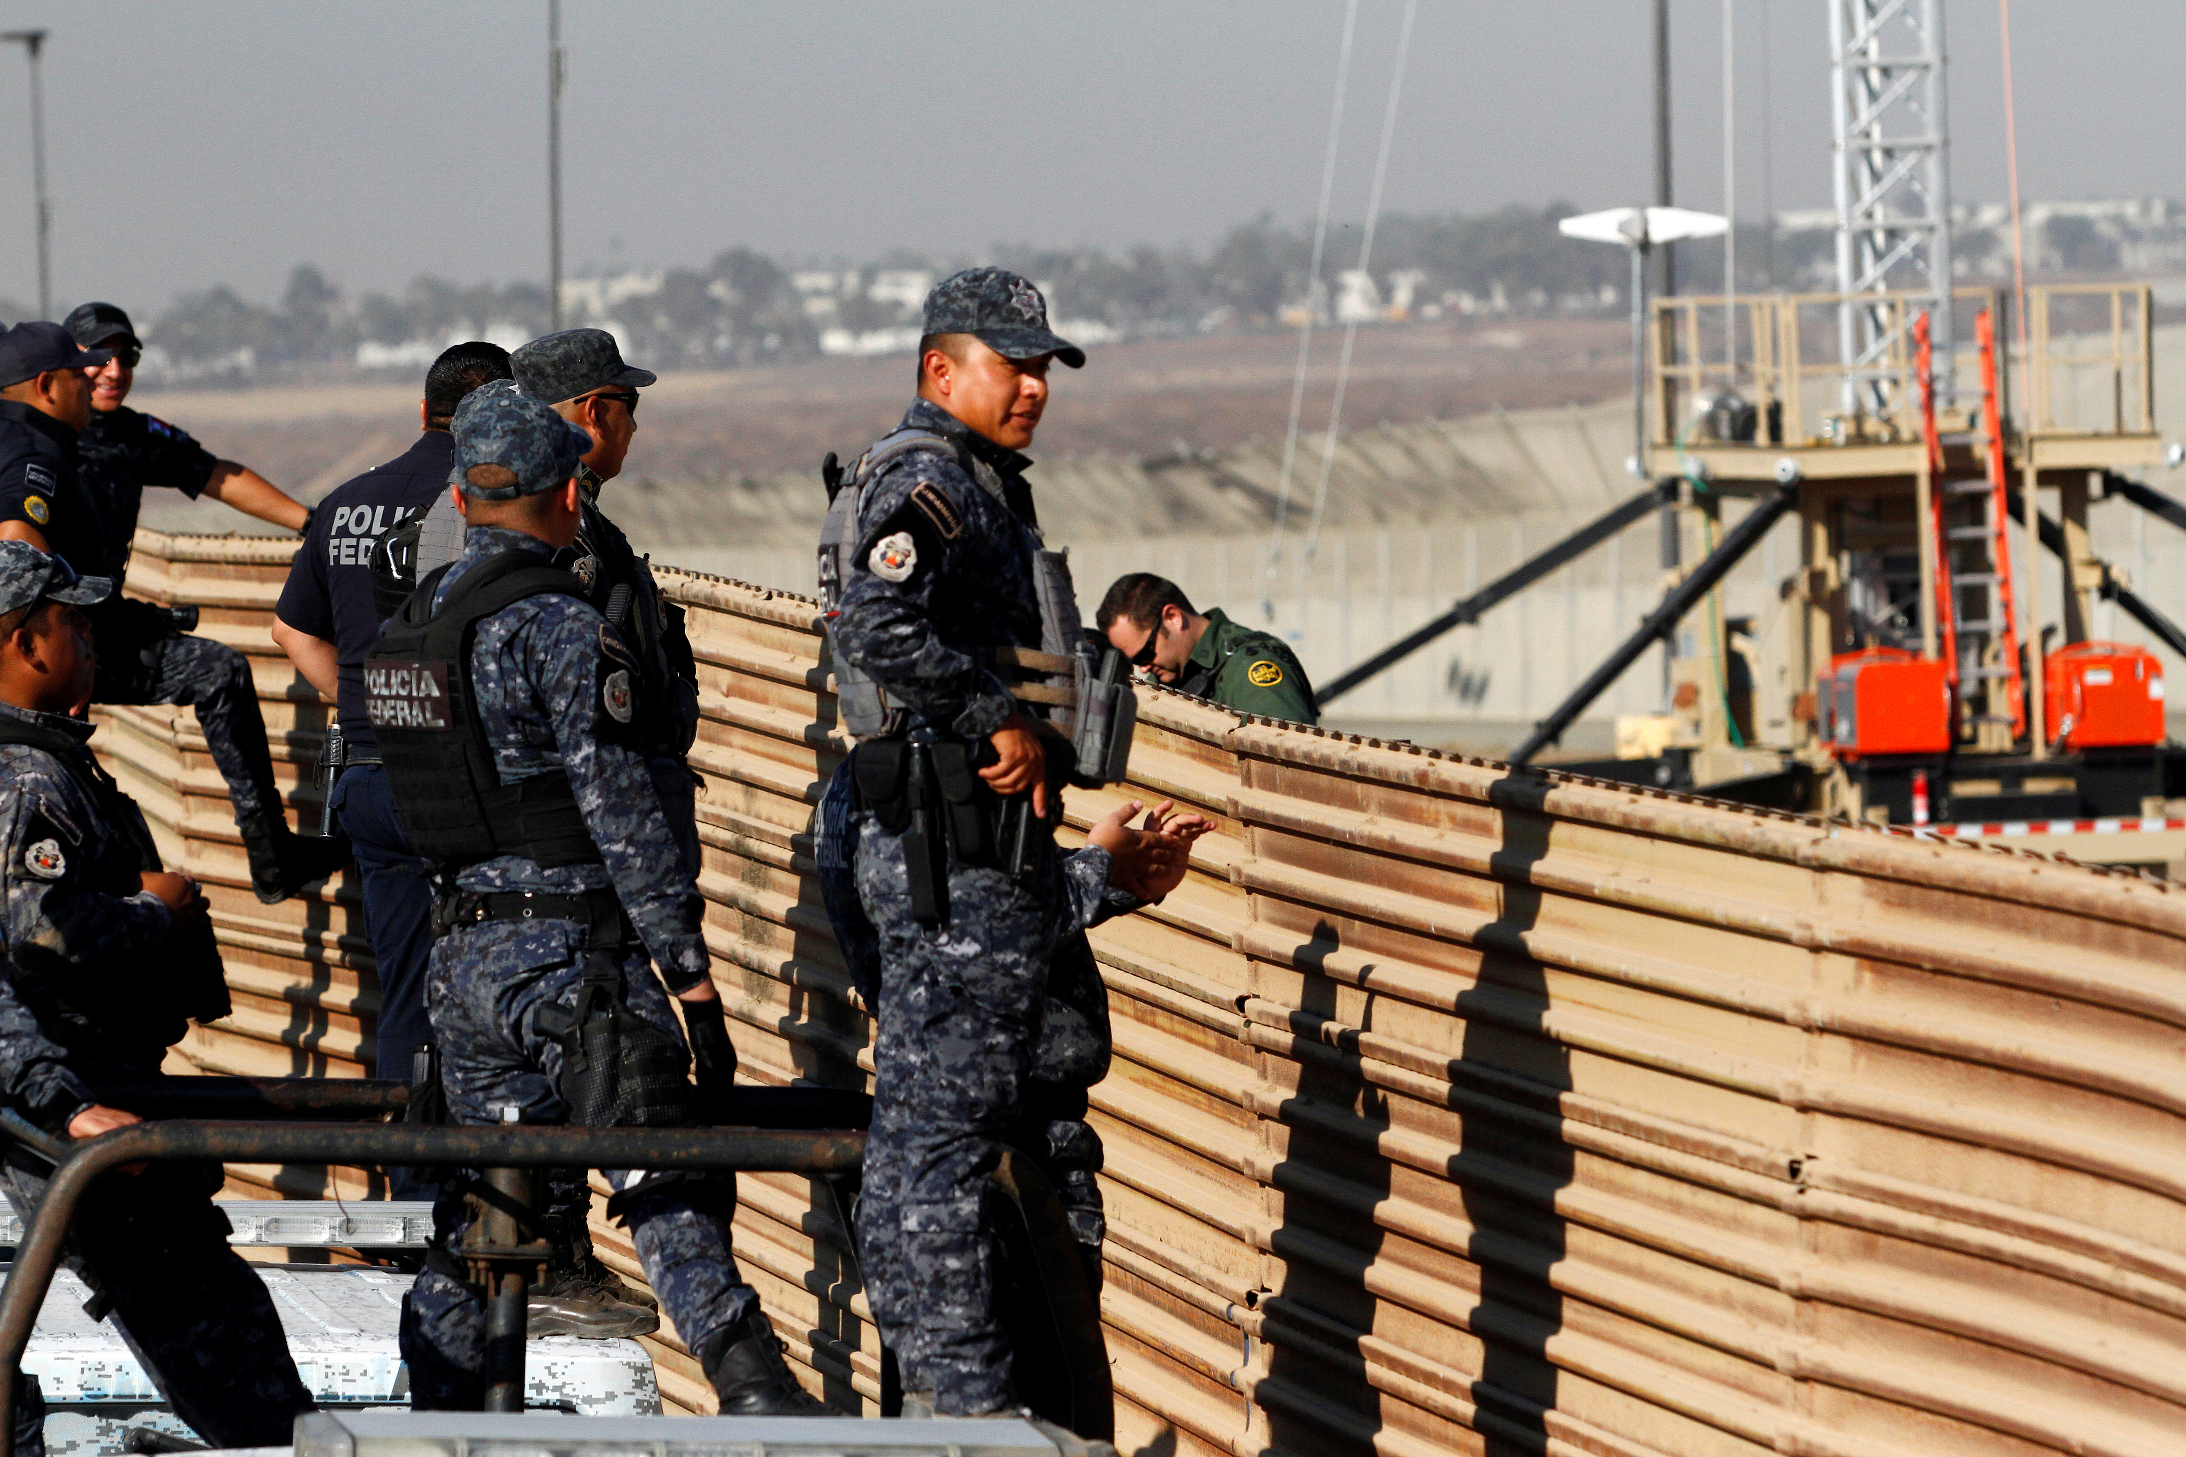
Level 2- cross border
Crime and criminals that impact more than one local command unit, bordering forces.
Can be tackled by resources within the area.
May require the assistance of national experts.

Slide 20
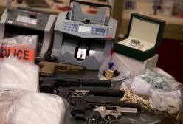
LEVEL 3- SERIOUS AND ORGANISED CRIME
Crime and criminals operating and national/ international scale which require:-
Proactive action
Preventable interventions
Require targeting
Require large resources

Slide 21
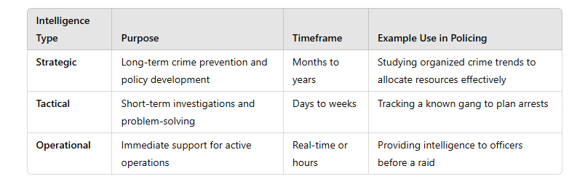
STRATEGIC, TACTICAL AND OPERATIONAL
Studying organised crime trends to allocate resources effectively.

Slide 22
Strategic and Tactical Tasking and Co-ordination Group Meetings
Tasking and co-ordinating process:-
The purpose of this stage is to achieve maximum impact.
Intelligence needs to be available- what is happening when and where?
The team need to be aware of the resources available to them.
The decisions made from this meeting will be the drivers of activity going forward.

Slide 23
What is the purpose to the tasking and co-ordination meeting?
To put in place a strategy, setting out the agenda, prevention and enforcement priorities.
To overcome any obstacles in place of the strategy.
To overcome any issues within the command unit area.
Meetings take place twice a year or quarterly at each level (1,2 &3)

Slide 24
The importance of Intelligence sharing
Improved Response and Coordination: When multiple agencies are working together, intelligence sharing ensures that they are on the same page and can coordinate their efforts more efficiently. This can lead to faster response times and more effective operations.
Better Resource Allocation: Sharing intelligence helps agencies allocate their resources more effectively. For example, if one agency has valuable information about a suspect's location or criminal activity, sharing that information can prevent duplication of efforts and save resources.

Slide 25
Identification of Patterns and Networks: Sharing intelligence across agencies can reveal patterns and connections that may not be apparent when looking at data in isolation. This can lead to the identification of criminal networks and the disruption of larger criminal operations.
Crime Prevention: Early detection of criminal activity through intelligence sharing can enable law enforcement to take proactive measures to prevent crimes and protect the public.

Slide 26
Improved Risk Assessment: Collaborative intelligence sharing allows agencies to assess risks and threats more comprehensively, which can help in developing effective strategies to mitigate those risks.
Public Safety: By working together and sharing intelligence, law enforcement agencies can better protect the public and address public safety concerns, such as terrorist threats or organised crime.

Slide 27
Information Validation: Sharing intelligence enables different agencies to cross-verify information and assess its credibility, leading to more accurate and reliable data for decision-making.
Legal and Ethical Considerations: Effective intelligence sharing also ensures that information is shared in a manner that is consistent with legal and ethical standards, safeguarding individuals' rights and privacy.

Slide 28
Cost-Effective Solutions: Collaboration and intelligence sharing can lead to cost savings as agencies pool their resources, share technology, and benefit from each other's expertise.
International Cooperation: In cases involving transnational crime or terrorism, international intelligence sharing is crucial for addressing threats that extend across borders. Police agencies from different countries must collaborate to combat these challenges effectively.

Slide 29
WHERE WOULD YOU GET YOUR INTELLIGENCE FROM?
Police reports and crime data- Analyse past incidents to identify trends and hotspots.
CCTV and ANPR (Automatic Number Plate Recognition) – Identify stolen vehicles and potential offenders.
Covert surveillance-Monitor suspected individuals or locations.
Community intelligence -Gather information from the public, local businesses, and informants.
Social media and online monitoring -Track suspicious online activity related to selling stolen vehicles.
Collaboration with partner agencies - Share intelligence with other law enforcement agencies, insurance companies, and vehicle registration authorities.

Slide 30

Session 2
Collaboration

Slide 31
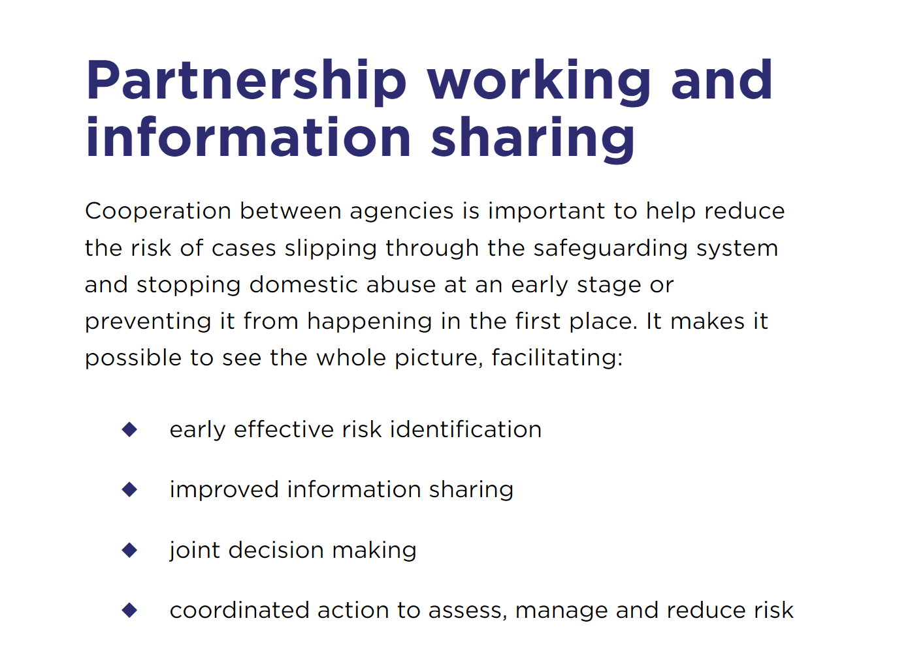
What does The College of policing say?

Slide 32

Task....Research into INTERPOL and answer the following:-
What is INTERPOL?
How does it facilitate partnership working?
What are the advantages?
What area's in particular does INTERPOL assist in?
What areas of crime are considered a significant problem for the UK?

Slide 33
ADVANCED Information SHARING
INTERPOL uses I-24/7 to allow service and database access in each member state, keeping member countries in constant communication with each other.
Police networks contribute to this which includes experts in specific areas, such as human trafficking, who conduct conferences and working groups to share and devise best practice.
Databases hold information on locating absconding offenders and fugitives and forensics.
INTERPOL also provide training to ensure police can work effectively. They also support in networking and assist with operations.

Slide 34

EUROPOL
EUROPOL is comprised of member states within the European Union (EU)
Supports operations within the states but does not initiate these.
Priorities are to stop human trafficking, cybercrime, drugs, illegal immigration, counterfeiting of euros, money laundering, gangs, VAT fraud, terrorisms, organised crime, asset tracing, intellectual property offences and smuggling cigarettes.
Produces reports on patterns of crime in the EU, with a particular focus on terrorism.

Slide 35
europol
Accountable to the EU Council of Ministers for Justice and Home Affairs.
Brexit- prior to Brexit the UK was a member but no longer. In 2021 it was agreed that the UK will have a working and administrative relationship with EUROPOL.
The new relationship includes providing liaison officers to facilitate work between EUROPLO and the National Crime Agency (NCA).
The UK also has access to EUROPOL'S secure messaging system as well as a presence at meetings. The UK also contributes to projects which include analysis and can make use of analytical capabilities of EUROPOL.

Slide 36
Public protection and safeguarding of vulnerable people
Multi- agency working involves co-operation with other organisations responsible for public protection (probation, prison service).
These working relationships are called Multi-agency Public Protection Arrangements (MAPPA) and relate to serious and violent offenders and protecting the public from these as well as sexual and domestic abuse and other violent crimes.

Slide 37
They monitor them and share intelligence and data with other relevant agencies, including risk assessments.
Information may be shared with civil courts and other organisations which include Service Level Agreements which include taking joint action beyond simply sharing data.
This may also include a Multi- Agency Risk Assessment Conference (MARAC) which involves agencies such as Social Services, probation, police, schools.

Slide 38
Community safety partnerships
Focus on local population, particularly vulnerable people and include the police as well as local authorities, fire and rescue, healthcare professionals and probations.
These have statutory (legally required) obligations to protect the public.
Safeguarding adults and children's boards also consider people with specific vulnerabilities who may be victimised due to specific types of crime such as child abuse.
Specialist domestic violence courts may also communicate with the police and officers may find Domestic/ sexual violence Advocates (IDVAs and ISVA's) to support victims.

Slide 39

Working with the third sector
The police will work with third sector organisations in wider to reach victims and wider communities in a way that the police cannot.
Working with women's aid allows the police to signpost victims of abuse to the charity for further support.
Training on domestic violence is also provided by the charity to the police to give them a better sense of understanding

Slide 40
TASK
Why do you think the police need support in tackling domestic violence and abuse?
What advantages do third sector organisations like Women's Aid have over the police regarding communicating effectively with victims?

Slide 41
Advantages of third sector over the police- domestic abuse
The police do not necessarily understand how domestic violence and abuse impacts victims.
The Police may need more training to empathise more and better deal with any barriers.
Third sector organisations aren't ran by the state and don't have the uniform so victims feel more comfortable to confide in them.
Women's Aid have survivors working with them who can relate to victims, providing effective support.
The police will be steering a victim towards a Criminal Justice System solution whereas Women's Aid will be more victim led.

Slide 42
Information partnerships: schools, mental health and the wider community
The police work with organisations such as schools on a ess structured basis. The collaboration is to improve student safety and behaviour.
This is not uncontroversial as it can be said that the pupils could feel intimidated by the police.
This has also been viewed as a success (Birmingham Police and Schools panel)

Slide 43
Mental health
Years of reputational damage concerning the treatment of mentally ill people.
Police are now seen as more understanding and compassionate which had led to fears that other organisations may be overtly reliant upon them and use the police to simply stall for time.

Slide 44
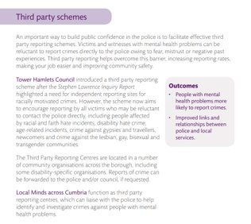
Third party Schemes
(Mind, 2013)
Notes:
Mind have introduced a third party scheme in which victims can report crimes such as racism, hatred, faith hate crime and other hate crimes who are reluctant to report to the police. This was brought in following the Stephen Lawrence enquiry which found the police to be institutionally racist meaning people of black and other ethnic minorities may be less likely to report crime to the police.

Slide 45

Example of NIM in partnership
The Children's Society have launched a National Child Sexual Exploitation (CSE) Action Plan in partnership with National Police Chief Council, Victim Support and the Police to stop incidents of CSE and prosecute perpetrators:-
Pursue | CSE Police and Prevention
Notes:
Play video

Slide 46
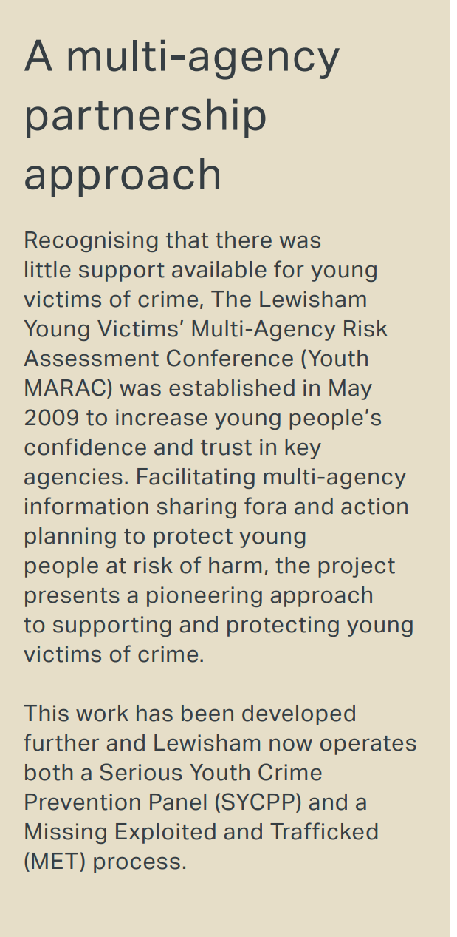
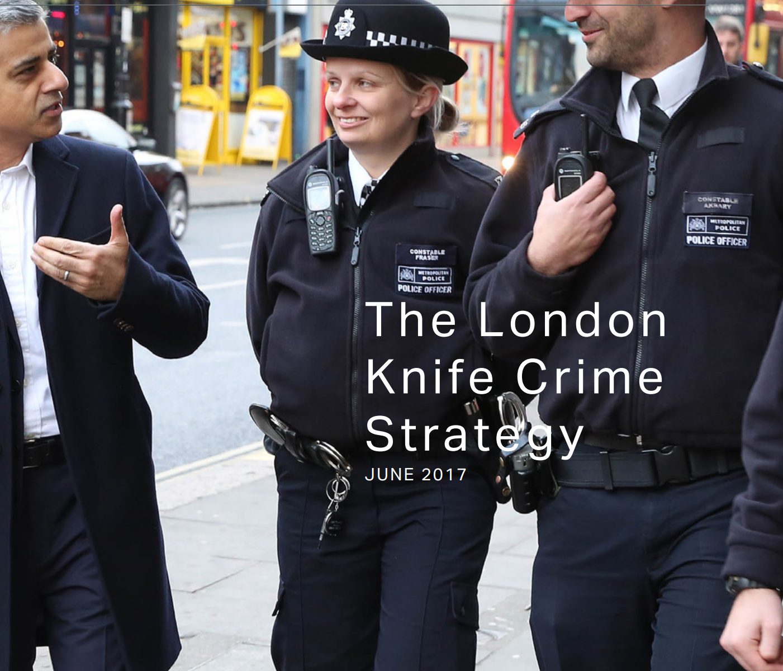
KNIFE CRIME

Slide 47
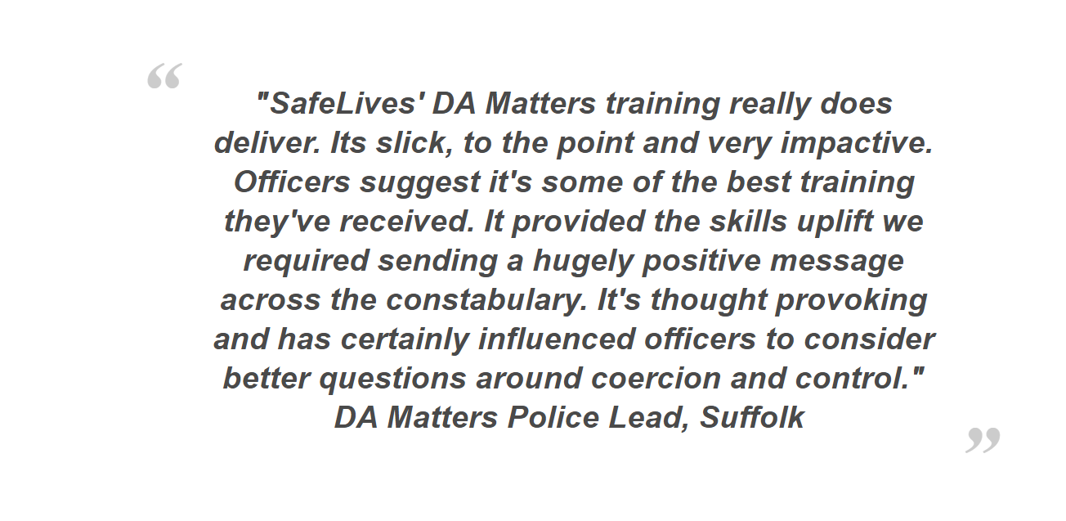
DOMESTIC Abuse
Charity Saves Lives has formed a partnership with the police to develop a bespoke cultural change amongst police officers and staff across the UK.
The charity will train staff to ensure officers are aware of how to deal with Domestic abuse.
SafeLives Workshop 2018 - YouTube
Notes:
Play video

Slide 48

NEXT WEEK
Monday 31st- meet at SA1 (NO TAUGHT SESSION)
Tuesday 1st April- Draft sessions only (PLEASE BOOK IN NOW)
Tuesday 1st April @2pm- Presentation Group 1 (only)

