Slide 1
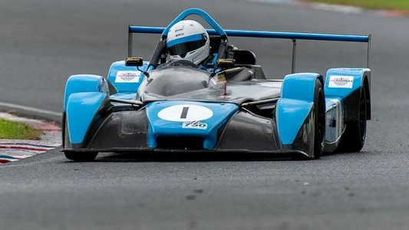
Electric Powered Formula 750
Owen Roberts, Luke Dyas, Peter Grima, Daniel Hannis, Ross Burnside, Rhys Tremelling
https://750formulachampionship.com/

Slide 2
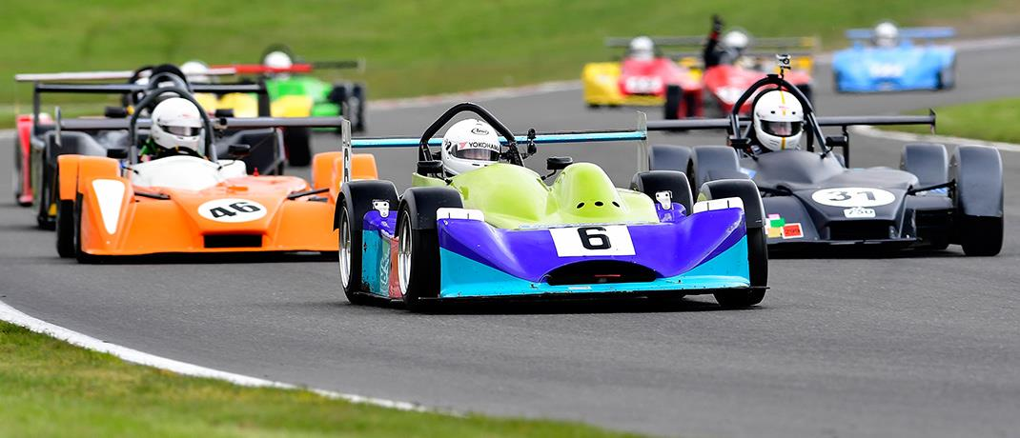
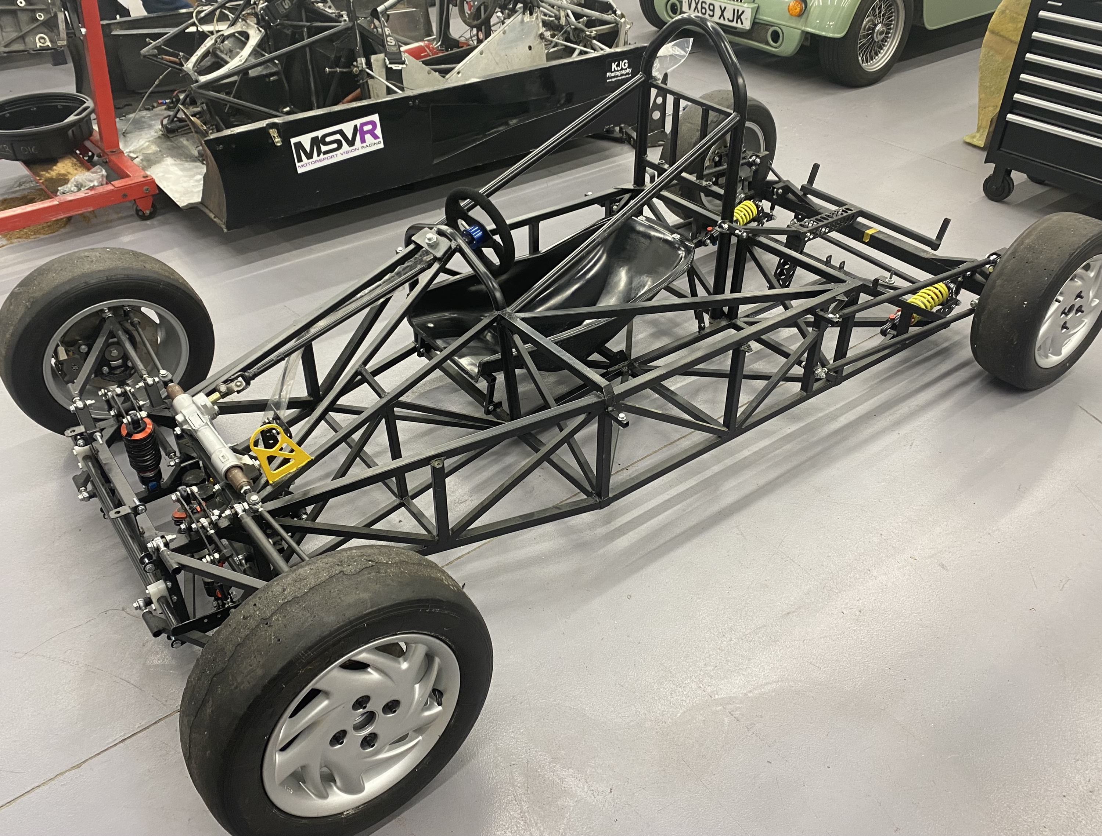
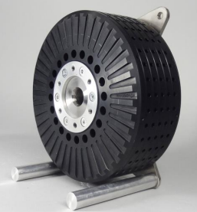
Overview - Driveline/EV
This powertrain is going to be placed into a Falcon rolling chassis.
https://snetterton.msv.com/SN-18-750MC2
The goal is for this EV powered chassis to be able to compete against Internal Combustion Engine (ICE) Formula 750’s​
https://emrax.com/wp-content/uploads/2017/10/user_manual_for_emrax_motors.pdf

Slide 3
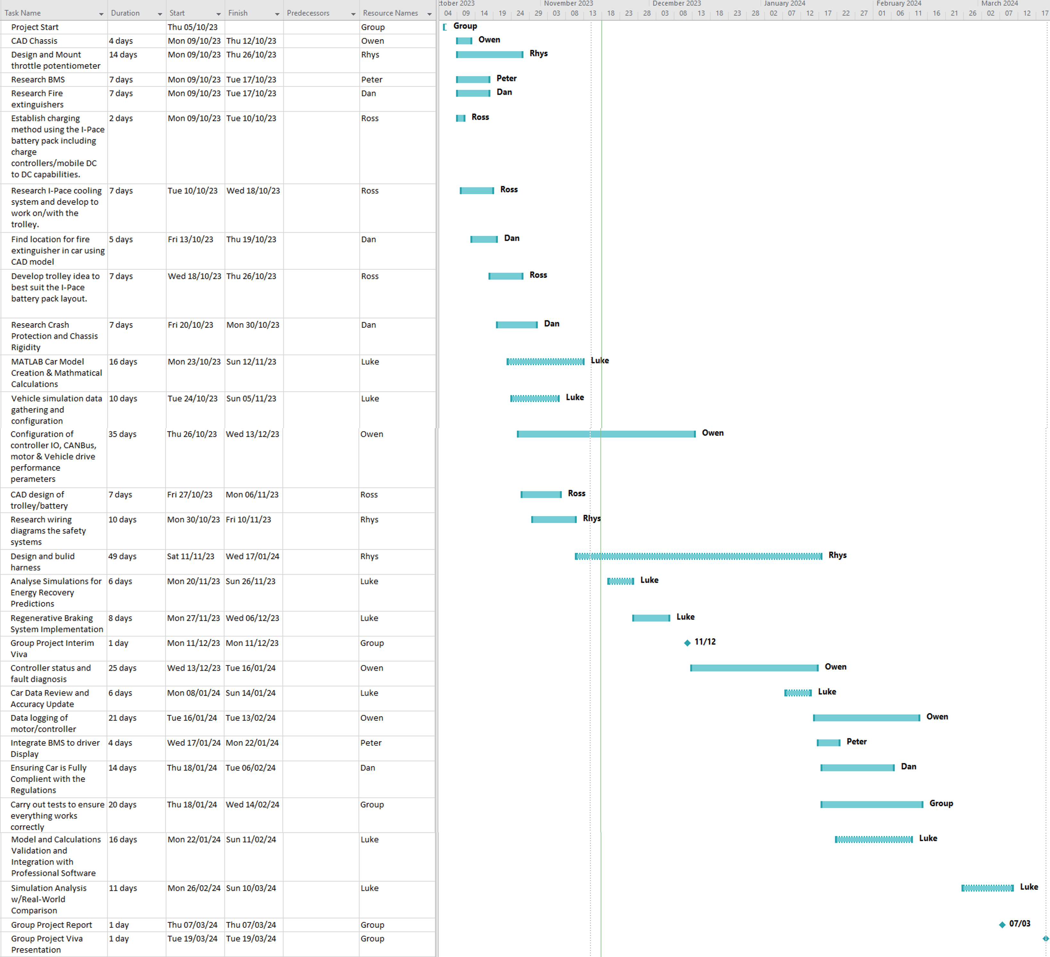
Gantt Chart
✔
✔
✔
✔
✔
✔
✔
✔
✔
✔
✔
✔
✔
✔
X
✔
X
✔
X
X
X
X
X
X
X
X

Slide 4
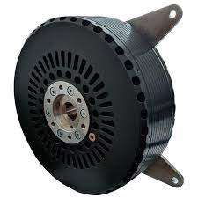
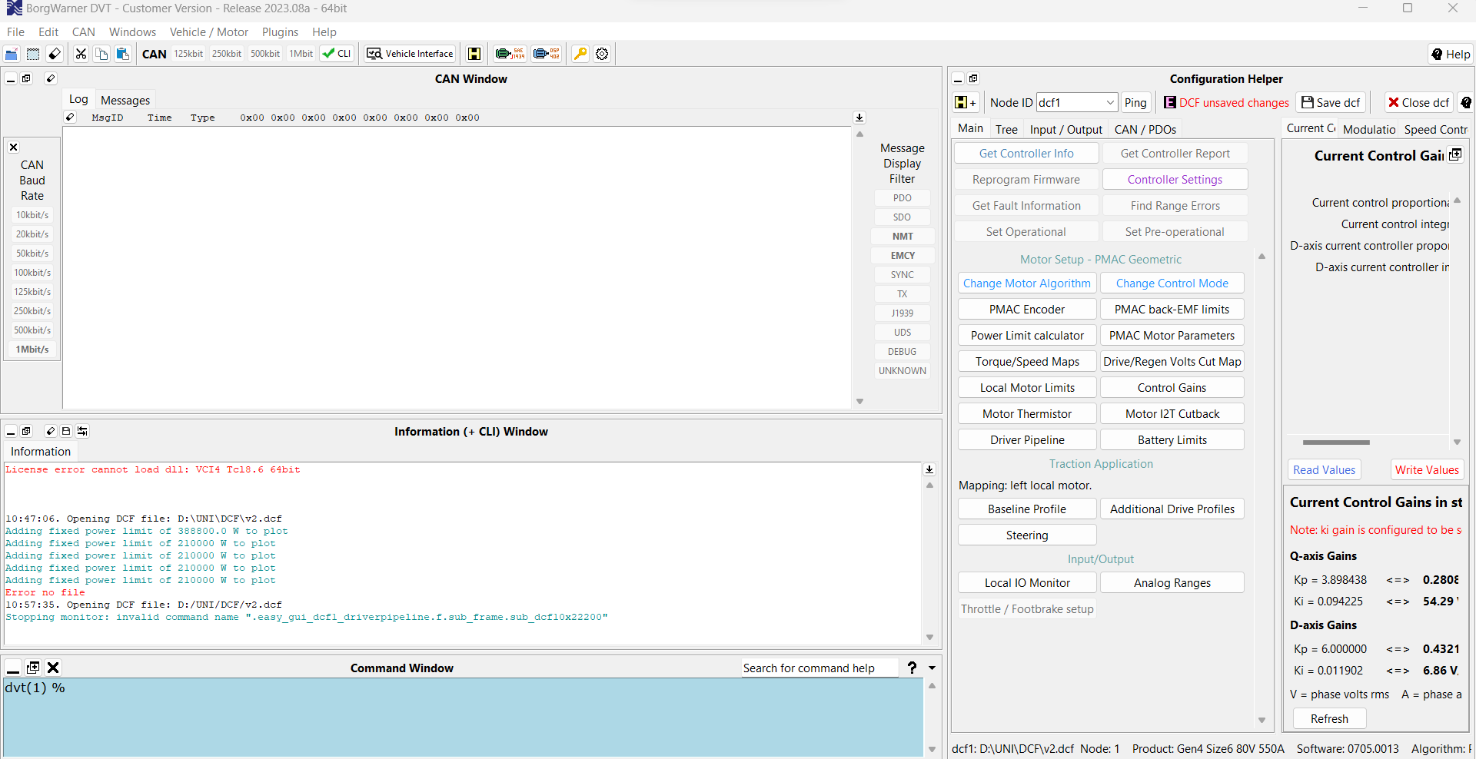
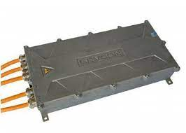
Owen Roberts – Leader & DVT Software
Configuration of controller IO, CANBus, motor parameters & vehicle drive performance parameters ​
Controller status and fault diagnosis ​
Data logging of controller/motor performance on test bench or vehicle​
Lead the team
https://emrax.com/wp-content/uploads/2017/10/user_manual_for_emrax_motors.pdf
https://electricdriveengineering.com.au/product/sevcon-gen4-size-10-sincos/

Slide 5
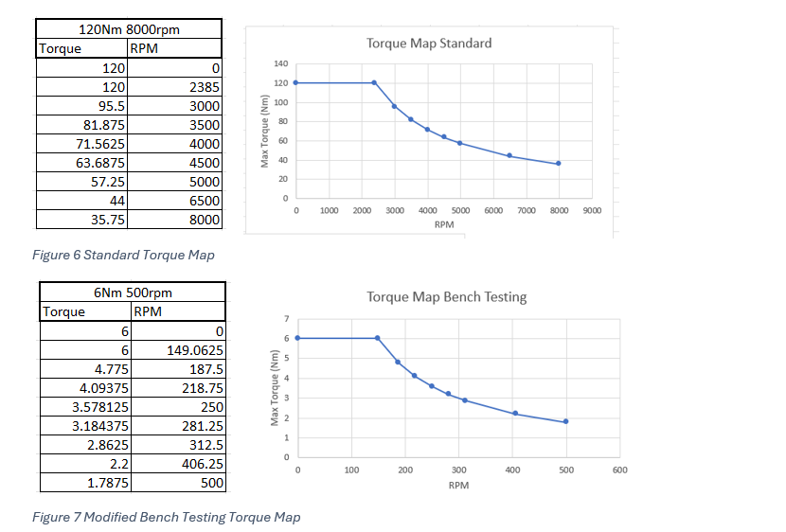
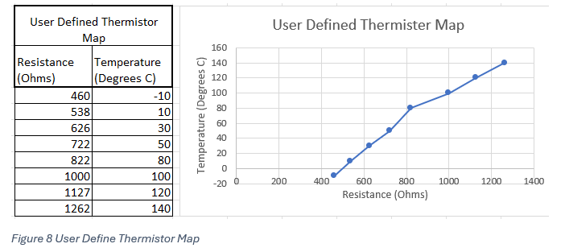
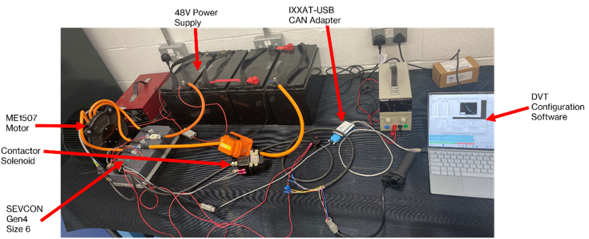
Owen Roberts – Bench Testing DCF Configuration

Slide 6
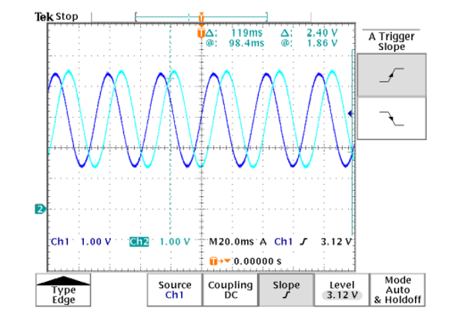
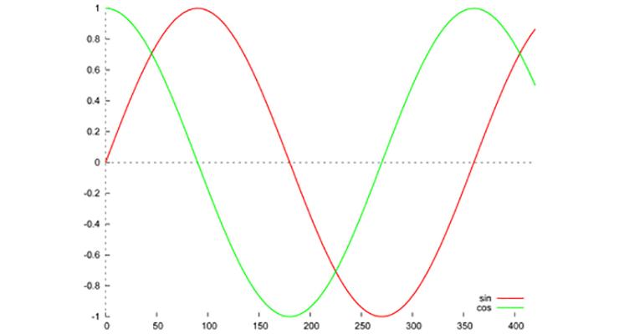
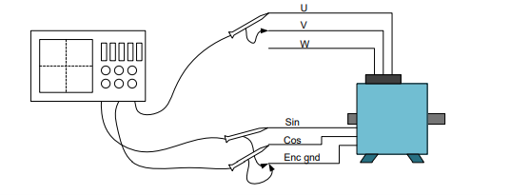
Owen Roberts – Sine/Cosine Encoder
https://www.motioncontroltips.com/what-is-a-sine-encoder-aka-sine-cosine-encoder/
BorgWarner (2015)
Oscilloscope depicting Cosine and Sine Signals from the Encoder
e-kart.fr/images/stories/technique/SEVCON/sevcon-app-note-pmac.pdf

Slide 7
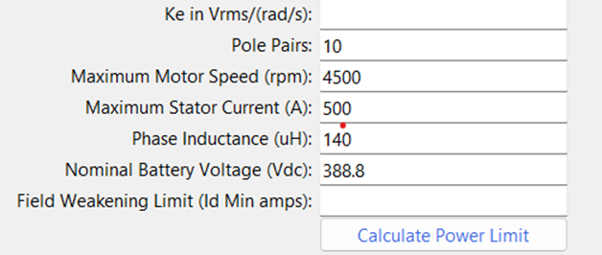

Owen Roberts – DCF Configuration for EMRAX 268 & Sevcon Gen4 Size 10
Power Limit Calculator in DVT

Slide 8
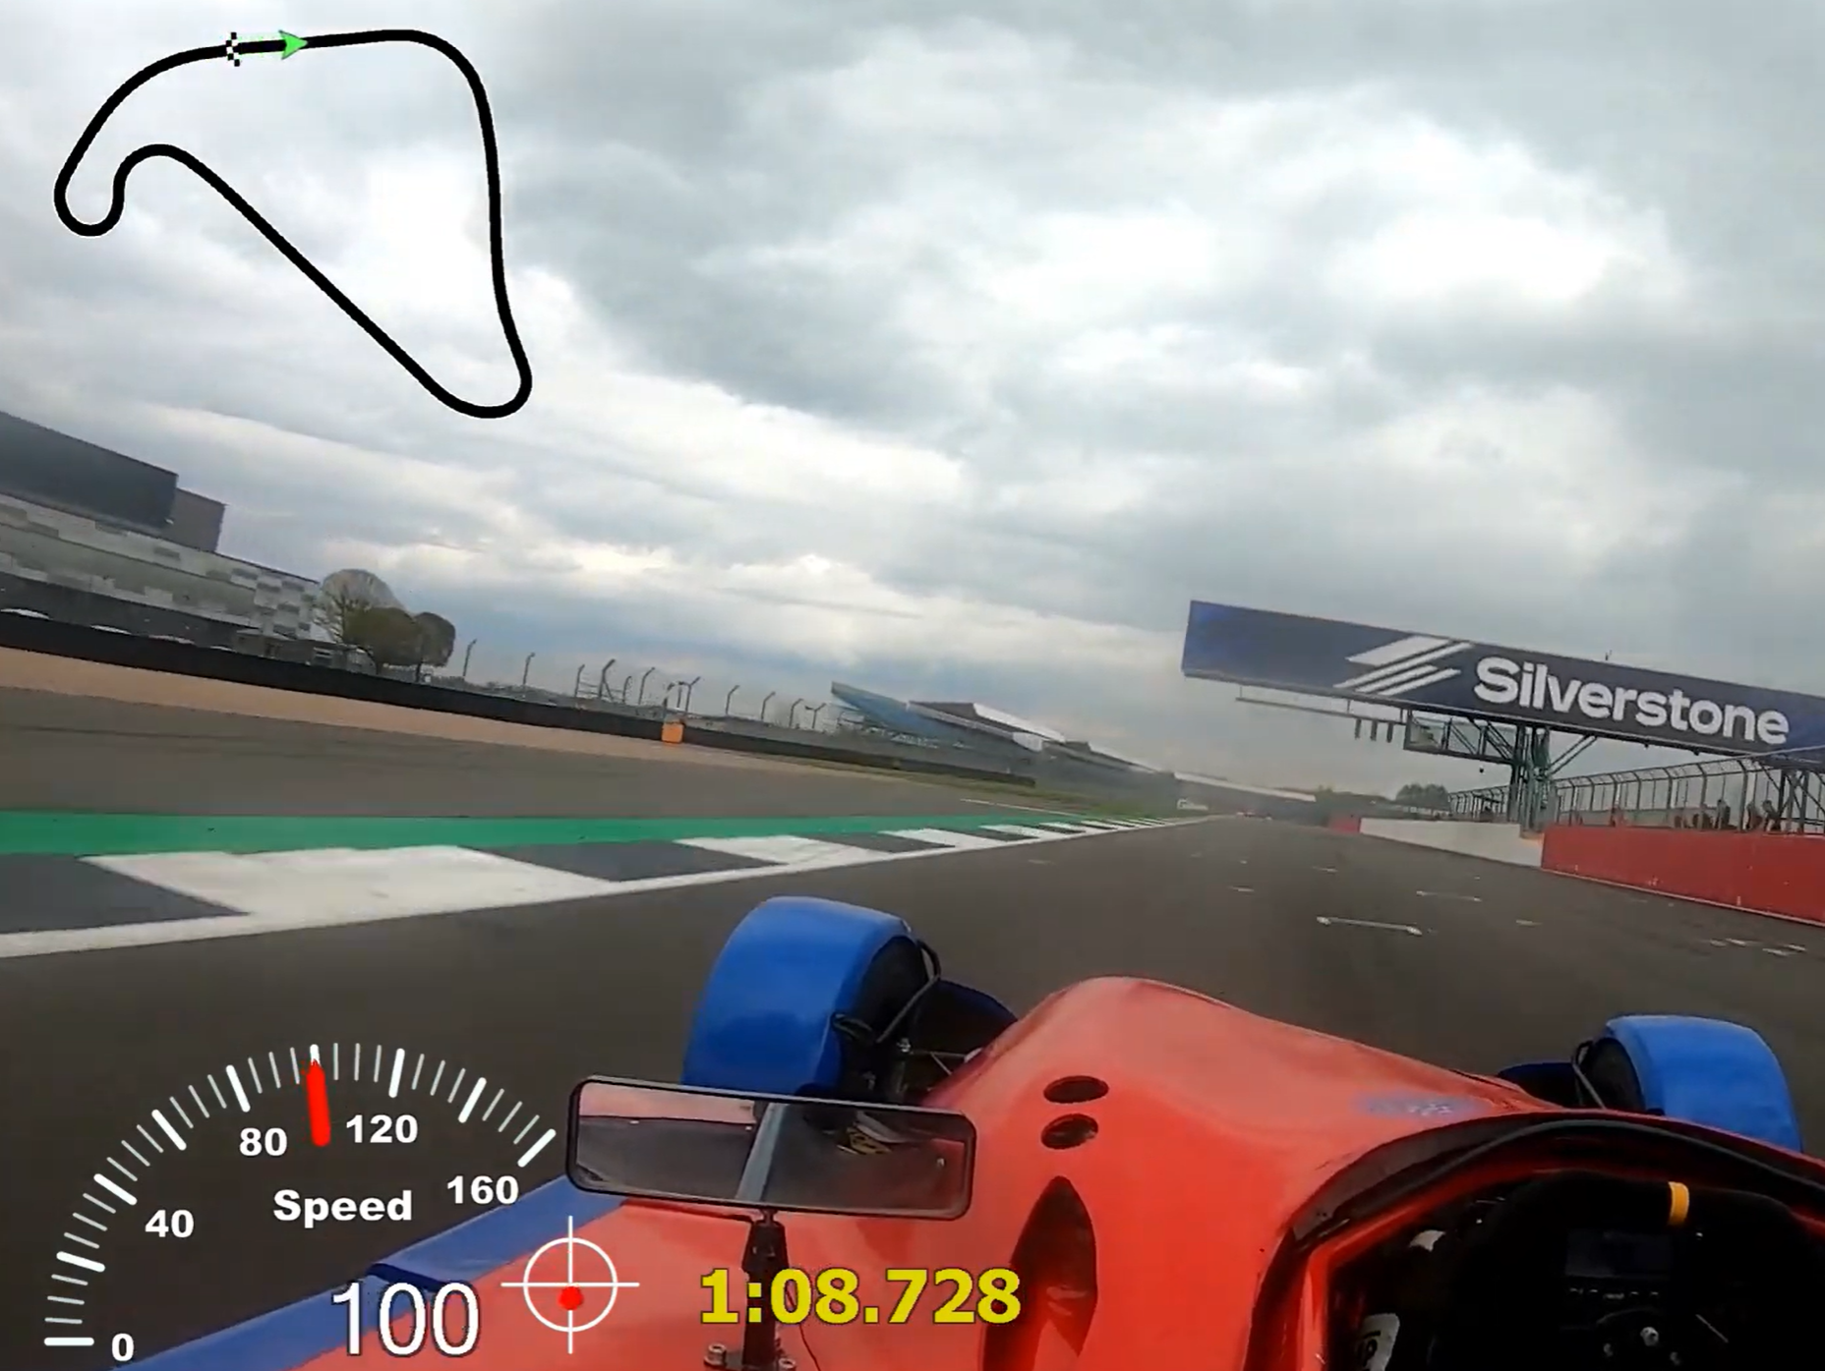
Luke Dyas - Simulation/Predictions and Vehicle Data
- Initial Data Gathering
2024 Racetracks
Donnington Park
Thruxton
Snetterton 3000
Cadwell Park
Silverstone National
Mallory Park
Measured Specifications
Front and Rear Track
Wheelbase
Wheel and Tyre Rolling Radius
Vehicle Frontal Area
Unsprung Mass
Estimated Specifications
Mass Distribution
Total Weight including Driver
Centre of Gravity Height
Roll Centre Height
Coefficient of Aerodynamic Resistance
Coefficient of Rolling Resistance
(Boother, 2023)
Track Data Gathering Techniques
2021 Donnington Qualifying Data
On-board Formula 750 Session Videos

Slide 9
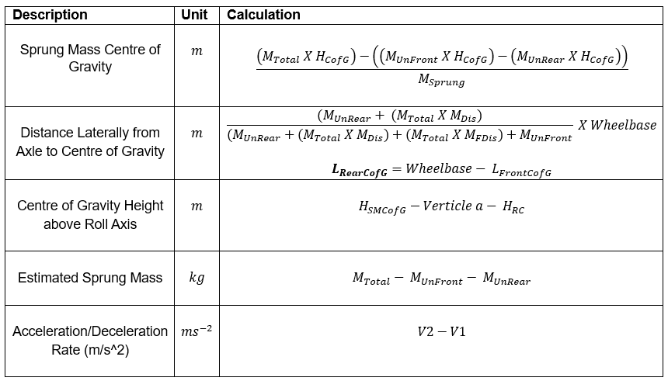
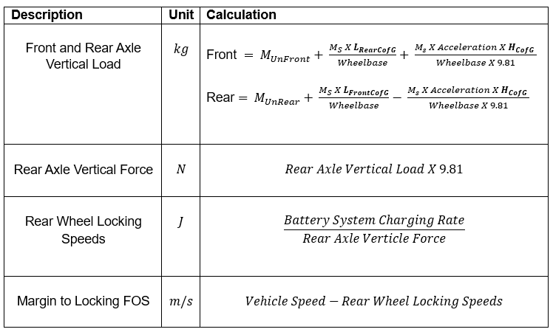
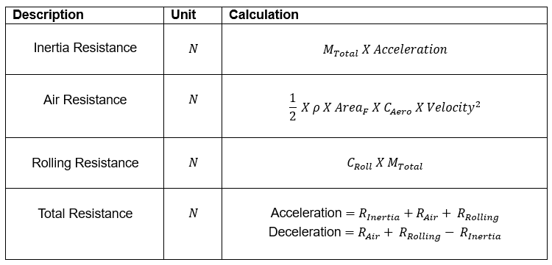
Luke Dyas -Simulation/Predictions and Vehicle Data
- Predictions Calculator Equations
Rear Wheel Locking Speed Calculations
Resistance Calculations

Slide 10
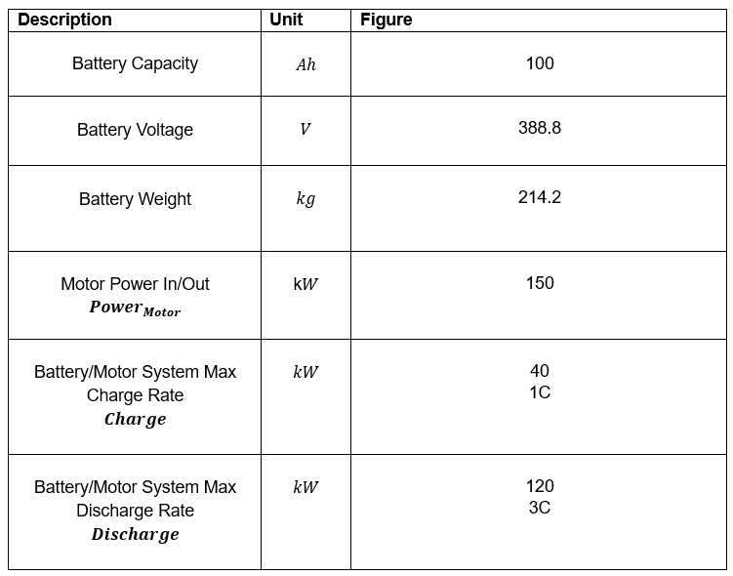
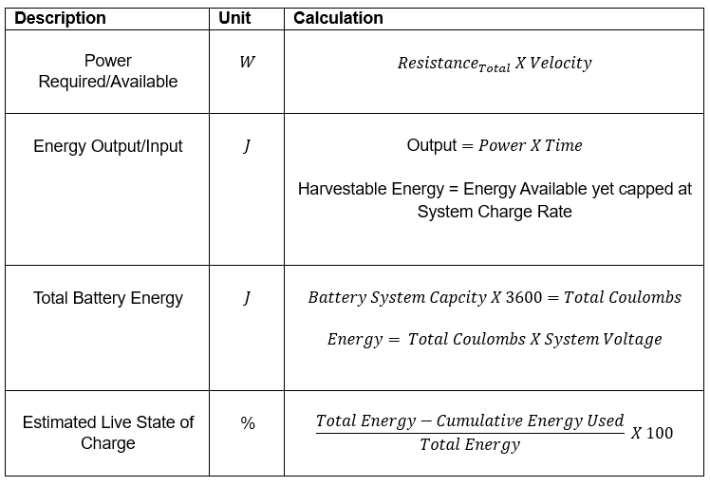
Luke Dyas -Simulation/Predictions and Vehicle Data
- Battery Energy and Power
Battery and Motor Specifications
Battery Energy and Power Calculations

Slide 11
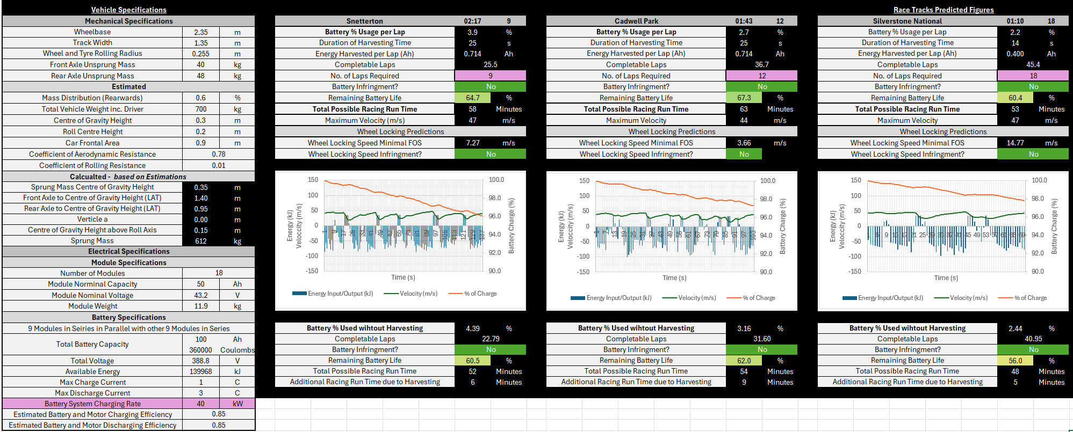
Luke Dyas -Simulation/Predictions and Vehicle Data
- Predictions Calculator Overview

Slide 12
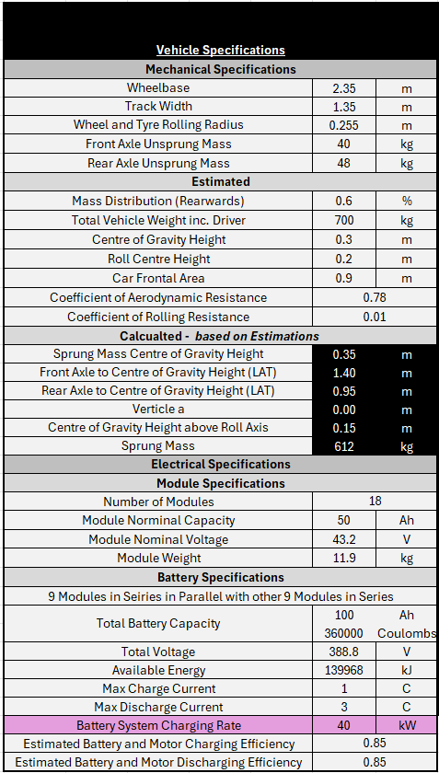
Luke Dyas -Simulation/Predictions and Vehicle Data
Measured Specifications
Estimated Specifications
Calculated Figures
Module Specifications
Battery Specifications
Battery System Charge Rate and Efficiencies

Slide 13
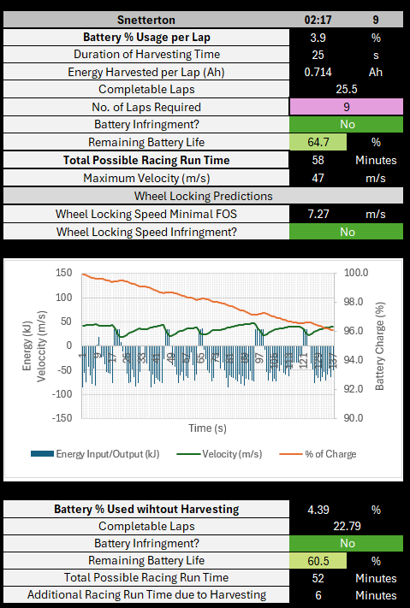
Luke Dyas -Simulation/Predictions and Vehicle Data
Source Lap Time
Estimated Number of Laps
Energy Harvested per Lap
Remaining Battery Life
Total Racing Run Time
Wheel Locking Speeds
Visual Representation of Power Usage, Velocity & Live Energy Amounts
Additional Energy due to Harvesting

Slide 14
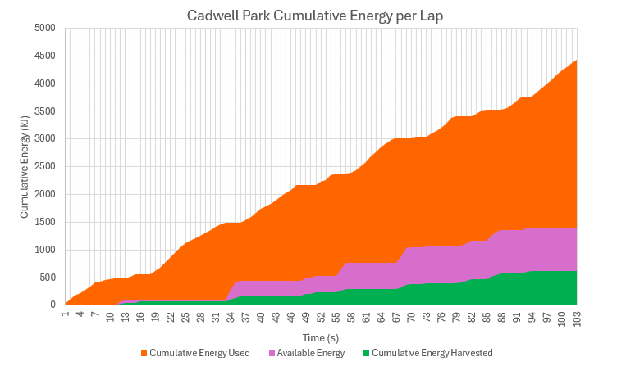
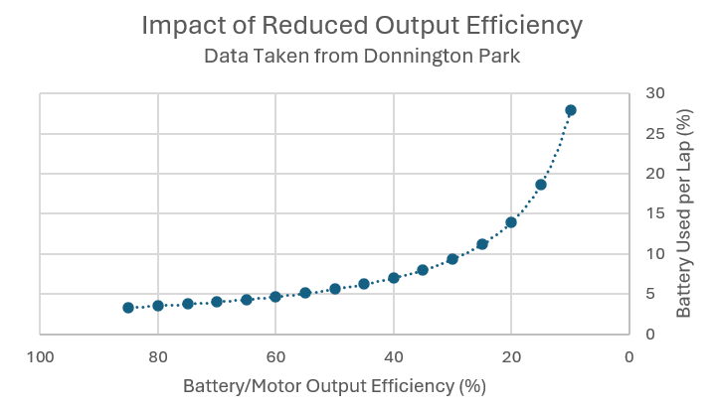
Luke Dyas -Simulation/Predictions and Vehicle Data
- Harvested Energy Summary
- Over 10% of energy
- Other Factors to be considered

Slide 15
Rhys Tremelling
Further design of potentiometer mount – generative design/topology optimisation
Still looking to source the components needed for the safety harness

Slide 16
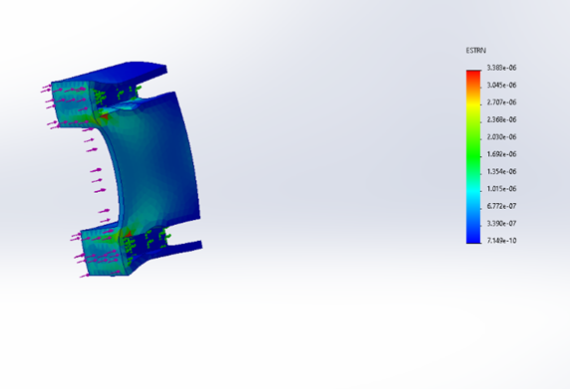
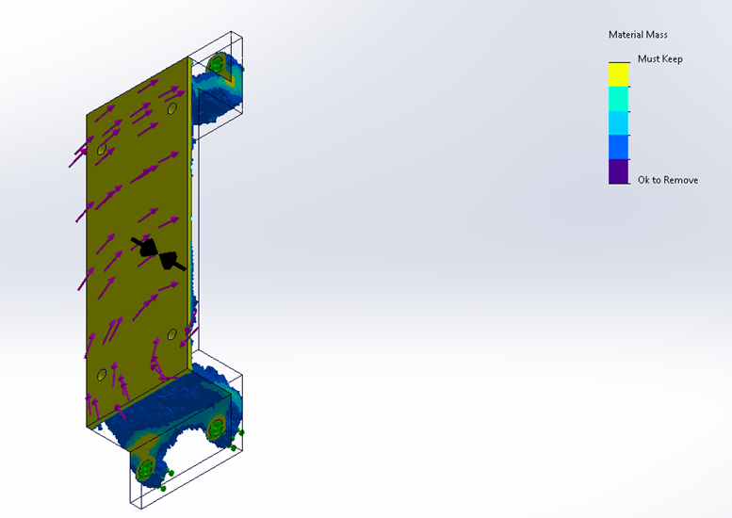
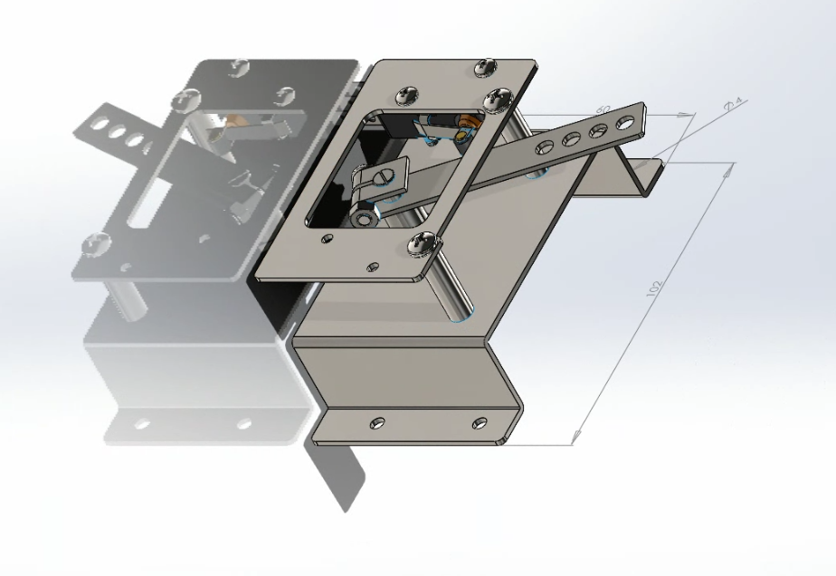
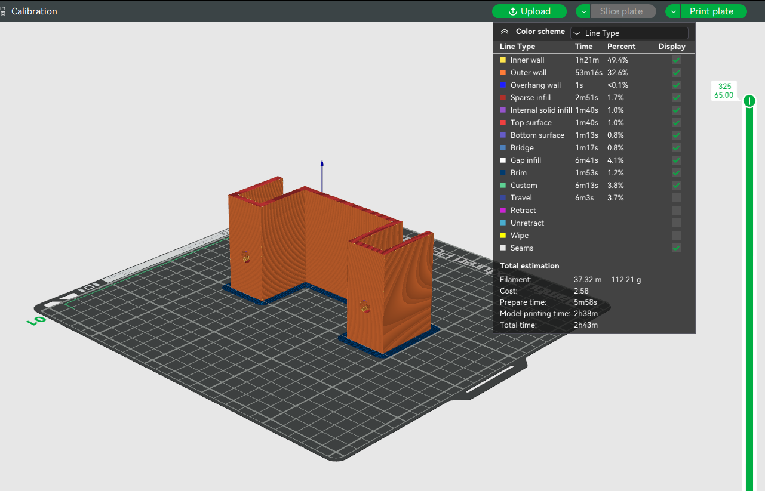
Throttle Mount
Rhys Tremelling - Throttle potentiometer mount
DFMEA study of an early version potentiometer mount
Grabcad file of PB-6 potentiometer (Grabcad. 2021)
Topology optimization study of the potentiometer mount
Developed further while waiting for parts suppliers of safety equipment to get back
Used Solidworks topology optimisation to reduce mass
Looked at different manufacturing methods that can be used. FPB, CNC
Ran simulation of expected forces to check for deformation or failure
Early version potentiometer mount in 3d printer slicer software

Slide 17
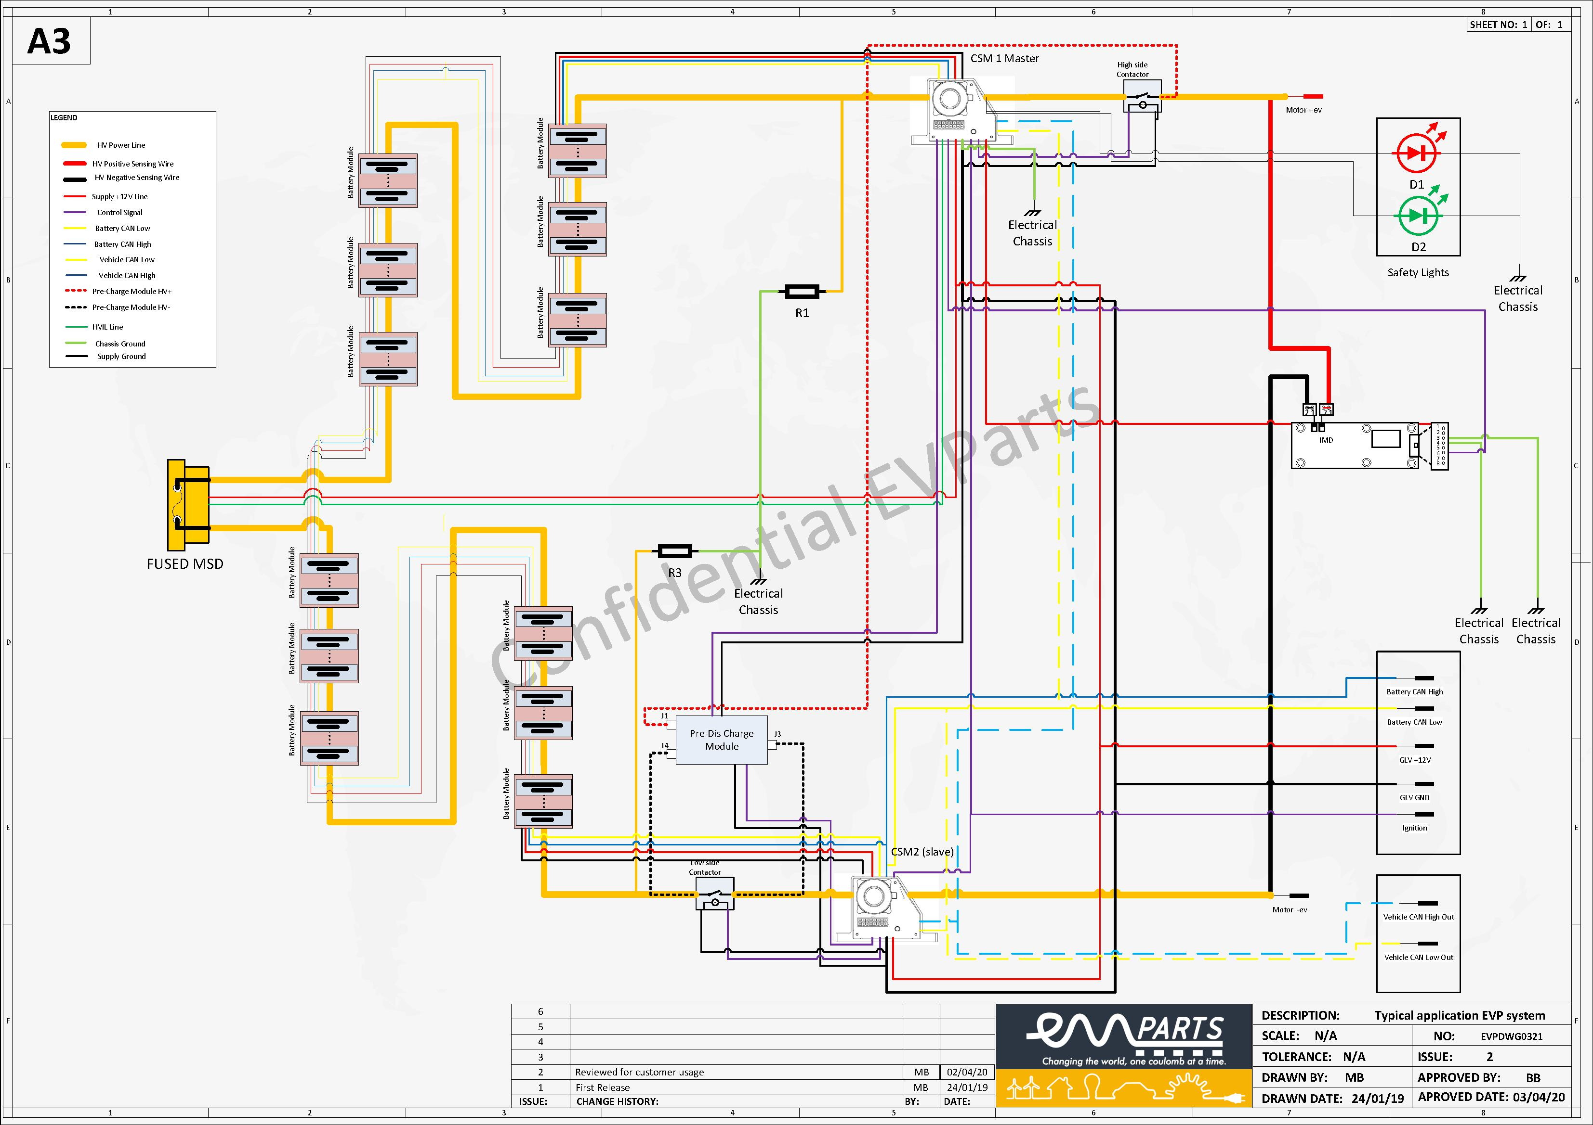
Rhys Tremelling - Safety wiring harness
After further research none of the components were designed for EVs so would most likely not meet MSUK regulations
Found a company that provides electric components for motorsport – evparts.co.uk
They helped current racing to produce EV VW beetle drag car
Discovered that the safety harness system is much more reliant on the BMS
It is also reliant on the Vehicle Control Unit
In contact with Orion UK supplier, Fellten, to try and source parts however they do not have them as they produce road going vehicles not designed for motorsport applications
Circuit diagram of a HV system in typical EV motorsport application (evparts LTD. 2024)

Slide 18
Rhys Tremelling -
With More Time...
Manufacture and install
Manufacture and install throttle potentiometer mount
Locate
Locate the components for the safety harness that are compatible
Purchase
Purchase all of the components
Wire
Wire them all together and fit them to the vehicle

Slide 19
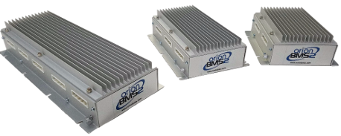
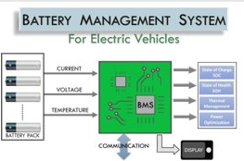
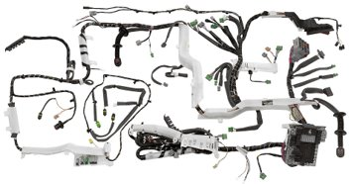
Peter Grima
Role of the BMS
Types of BMS
Ideal BMS
Moving Forward
Orion BMS 2 | Orion Li-Ion Battery Management System)
https://www.linkedin.com/pulse/future-battery-management-systems-bms-emerging-datta-vhanmane/
https://www.researchgate.net/figure/Figure-e-A-complete-network-of-electrical-cables-of-a-typical-modern-car_fig2_367963831

Slide 20
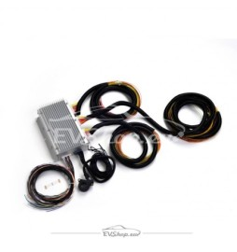
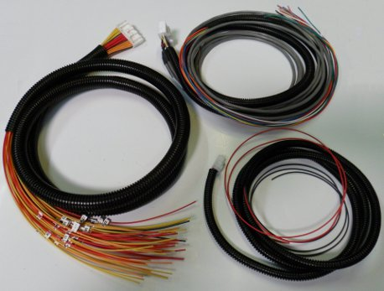
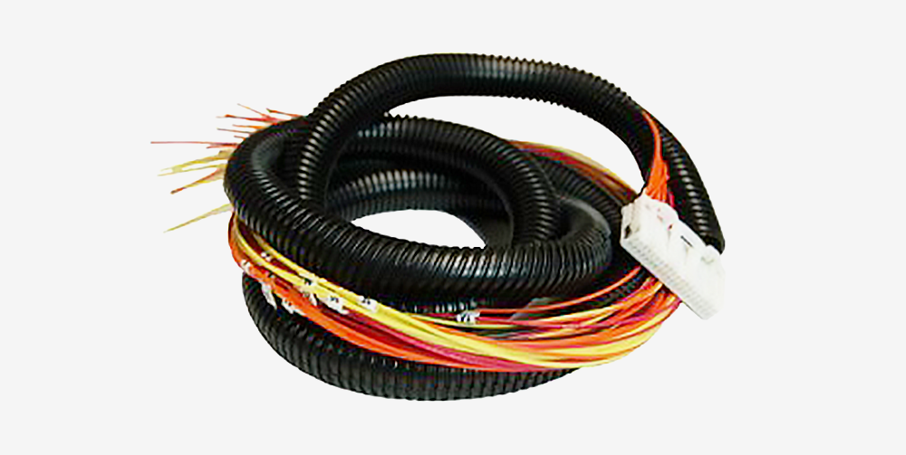
Peter Grima - Wiring Harness
Main - Remote Kit Orion 2 (evshop.eu)
Cell voltage Tap
Total Pack Voltage
Main I/O
Current / Thermistor
(Pre-wired Harnesses | Orion Li-Ion Battery Management System (orionbms.com))
https://shop.fellten.com/shop/orion-2-bms-cell-tap-wiring-harness-13907

Slide 21
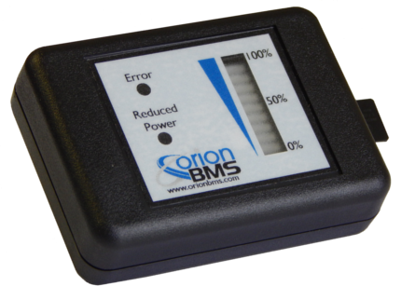
Peter Grima - Display
Data Logging Display
State of Charge
Limited Power Indicator
Malfunction Indicator
Data Logging
Data Logging Display | Orion Li-Ion Battery Management System (orionbms.com)

Slide 22
Peter Grima - Moving Forward
Further investigation into new BMS idea.
Install Wiring
Learn how to use CANBUS
Programme BMS

Slide 23
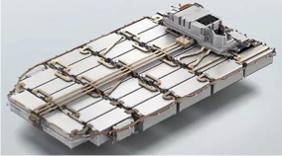
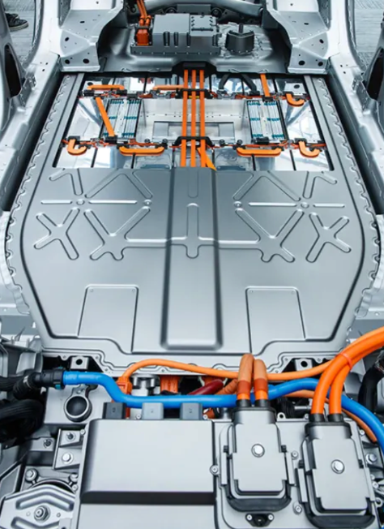
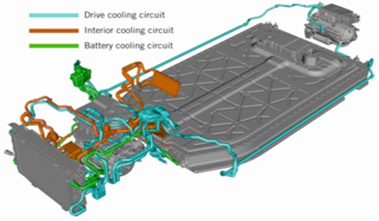
Ross Burnside - 2110614
Mobile Charging
The availability of a Jaguar I-Pace vehicle battery and integral operating systems enabled a foundation for trolley development and a basis for unit dimensions, consisting of:
Wiring, Cooling, and Charging systems present in the vehicle.
“432 […] Lithium-Ion pouch cells, arranged in 36 modules of 12” (media.jaguar.com – 2018).
Jaguar’s pledge to “prolong the life of I-Pace batteries [using] new recycling partnerships and second-life energy storage trials” (media.jaguar.com – 2018) “for one of the largest energy-storage systems in the UK to harness solar and wind power”. (Krivevski, B. – 2023).
Pack Recharge Times:
86.592kWh / 7kW charger = 12.37 hours.
86.592kWh / 22kW charger = 3.936 hours.
(80% = 69.274) / 104kW charger = 0.67
0.67 hours = 40 minutes + 12 seconds
Jaguar I-Pace Battery Pack Dynamics:
Energy Consumption = 90.2kWh (96%=86.592kWh)
Usable Soc Range = 96 – 2 %
Nominal Voltage = 388V
Average Capacity = 232Ah
Instantaneous Power = 321kW (@ 96% SoC) 287kW (@ 50% SoC)
--------------------------------------------------------------------------------------------------------------
Continuous Power = 110kW
Mass = 606kg
Unit Dimensions = (2280*1474*300)mm ( l × w × h )
Configuration = 108S 4P
------------------------------------------------------------------------------------------
Coolant Type = Ethylene Glycol (C2H6O2)
Coolant Temperature. = 11˚C
Coolant Pump = Electric, 12V system operated.
Charge Type = Type 2 (7kW and 22kW chargers)
= Type 3 (104kW fast chargers)
4633540146474160
An image to highlight the specific battery cooling circuit featured in the I-Pace's cooling system. (Fuchss, S. - 2018).
"The 388-V battery pack enables a flat floor while housing 432 NMC cells". (Carney, D. - 2018).

Slide 24
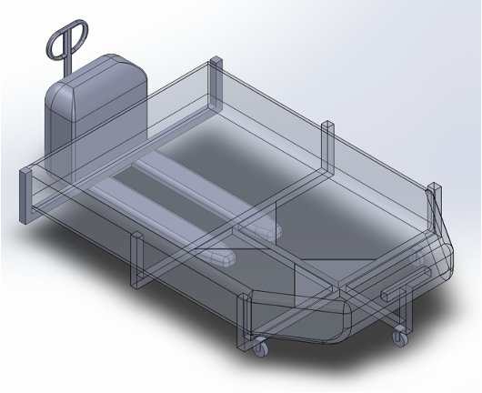
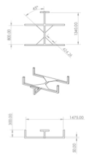
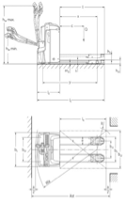
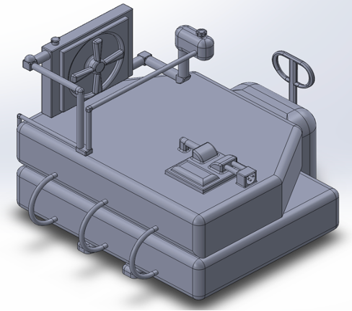
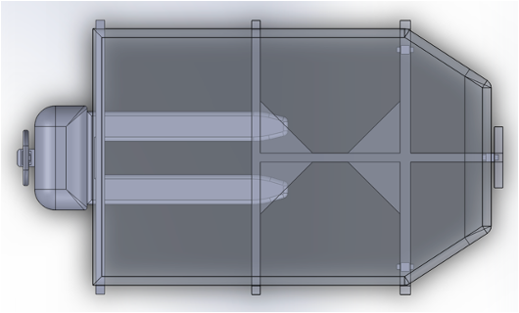
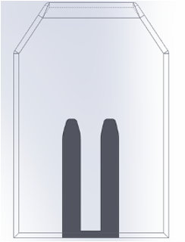
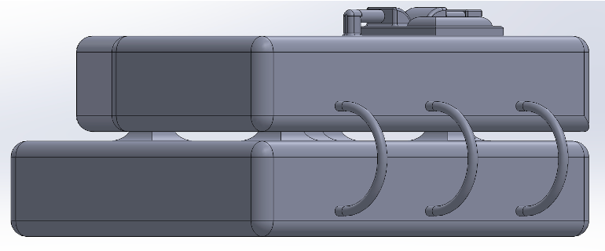
Ross Burnside - Initial Design Concepts:
Two initial design concepts were introduced to the project, with the final third model considered best suited to the unit size and battery pack configuration requirements, manoeuvrability, and handling characteristics:
EJE222, (Jungheinrich – 2023).

Slide 25
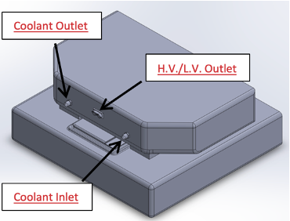
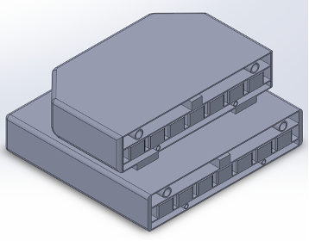





Mk.3 Design Concept – Mobile Charging Trailer:
Cooling/Water-Pump System Concept.
12v Battery System.
Fascia Plate Concept.
Single-Axle Trailer/Framework Concept.
Battery Pack Dimensions (40:60):
Upper Battery Pack (UPB) = (912*1474*300)mm
Lower Battery Pack (LPB) = (1368*1474*300)mm
Charge Prediction Calculations:
Number of charges available = 232/100 = 2.32 charges
Max. Trolley Output Limit = 144,000kJ/h
Vehicle Battery Max. Energy = 139,968kJ
139.968 × 0.8 = 111,974kJ
111,974,000/40,000 = 2799.35 seconds
2799.35/60 = 45.65 minutes
46.65 minutes = 80% charge
The proposed set-up, including the EM203 detachable motorised-caravan-mover (Halfords.com - 2024);
for mobility and incline assistance during unit relocation and charging station set-up.

Slide 26






Ross Burnside -
12v and Cooling System / Fascia-Plate Concept:
Predicted Pumping Power Requirements:
Power = 0.48 × 1095 × 9.81 × 100
515.614kWh of pumping power required for an 8 l/min flow rate
12v system wiring diagram concept – 2110614:
Predicted Battery Pack Heat Generation:
Qgen = (232)^2 × 1.672 × 3600 = 323.977MJ/h
Predicted Battery Pack Heat Generation/sec = 89.994kJ/s
Twin-fan/heat exchanger cooling system concept – 2110614:

Slide 27
Daniel Hannis – Safety Systems
Objectives
  Investigation into fire suppression system – Done
  Purchase of fire suppression system – Order sent
  Putting everyone's CAD models together to finalise our design thus far - Done
  Route fire extinguisher plumbing in CAD - Done
  Ensuring everyone In both groups has followed regulations set by Motorsport UK & Formula Student 2024 so we may pass any inspections/scrutineering - Ongoing
  Investigation into seat harness - Done
  Purchase of seat harness – Order sent
  Design seat harness mounts in CAD - Done
  Investigation into head restraints - Done
  Purchase of head restraints – Order sent
  Investigation of crash worthiness/impact protection - Future
  Install fire suppression system - Future
  Install seat harness and mounting - Future
  Install head restraint foam/padding - Future

Slide 28


Daniel Hannis - Fire Suppression System – Choice, Plumbing & Purchase
- Fire System Plumbing (f-e-v, 2024)
- FEV System (f-e-v, 2024)
Cheapest compliant system that can be easily altered to suit our electric car
Easy to plumb in, kit comes with all needed & 3 buttons
Sent for approval to purchase
- Control box is required due to it allowing all high-voltage electrics being disabled by the BMS
- £868.97 (£1,042.76 inc. VAT)

Slide 29





Daniel Hannis - Fire Suppression System - Design
Fire Suppression System Dimensions
- CAD Model of Fire Suppression System
- Technical Drawing of Fire Suppression System
Design is small enough to fit easily in the Formula 750
Control Box needs to be mounted so it is in visual line of sight of driver
Spoke to FEV and everything here is fully compliant, they are happy to help with any issues in installation
All this work is easily able to given to next year's students
- CAD Model of Current Formula 750 Progress

Slide 30







Daniel Hannis - Seat Harness – Investigation & Design
Corbeau Ultima Pro 6 Point FIA Racing Harness H3026
£230.00 (exc. VAT)
Sent for approval to purchase
- CAD Model of Seat Harness Mount
6 - Point Seat Harness
Two-piece lap belt
Two shoulder straps
Two leg straps
Meets FIA specification 8853/2016
Proven reliability anti-submarine mounting
Elastic straps can be used to snap back all six straps for ease of use on the driver
Sent for approval to purchase
- TRS 6 Point Single Seater FIA Harness Belt (GSM, 2024)
- Mounting Points of Harness (FSUK Rules, 2024, p.54, T5.6.1)
- Seat Harness Position (FSUK Rules, 2024, p.54, T5.5.5)

Slide 31


Daniel Hannis - Head Restraint & Roll Bar Padding - Investigation
- SFI 45.2 FIA Approved Head Restraint Foam (Pegasus Auto Racing Supplies, 2024)
SFI Approved High Density Foam, 8.8 x 16.3" Sheet, 1" thick
$25.59 (Inc. VAT) (American company)
Meets regulations in Formula Student 2024 that requires SFI Spec 45.2
Have a minimum thickness of 38mm/1.5"
Have a minimum width of 15cm and minimum height of 15cm,
Cheapest way of being compliant with the FIA
Multiple sheets can be attached together with adhesive, has been confirmed after rules clarification.
Sent for approval to purchase
- OMP FIA Approved Roll Bar Padding (Demon Tweeks, 2024)
Additional padding required for driver helmets hitting roll bar/chassis
Minimum 12mm/0.5" thickness
Complies with FIA 8857-2001 type A as required in FSUK 2024 rules
3M "Super 77" spray adhesive
£21.74 (£26.09 Inc. VAT)

Slide 32
Daniel Hannis - With More Time...
Investigation Into Crash Worthiness/Impact Protection
Install Fire Suppression System
Install Seat Harness and Mounting
Install Head Restraint foam & Padding

Slide 33
Conclusion
Overall Objective - Produce an EV-powered Formula 750 race car that would be able to compete with the ICE-powered counterparts.
Thank you for listening.
Any questions welcome.

Slide 34
References
BorgWarner. (2015). DVT Reference Manual. [Online]. Available at: https://electricdriveengineering.com.au/wp-content/uploads/2021/10/DVT-Manual-V1.4.pdf. [Accessed: 09/12/2023]
BorgWarner. (2018). Gen4 size 10 Applications Reference Manual. [Online]. Available at: https://electricdriveengineering.com.au/wp-content/uploads/2023/04/Gen4-Size-8-10-Product-Manual.pdf. [Accessed 07/12/2023].
EMRAX. (2020). Manual for EMRAX Motors. [Online]. Last Updated: 5/03/2020. Available at: user_manual_for_emrax_motors.pdfuser_manual_for_emrax_motors.pdf. [Accessed 07/12/2023]
Ehsani, M. et al. (2019) Modern electric, hybrid electric, and fuel cell vehicles. Third edition, International student edition. Boca Raton: CRC Press, an imprint of Taylor & Francis Group.
EMRAX (2020) Manual for EMRAX Motors / Generators. Available at: https://uowtsd.sharepoint.com/teams/Formula750GroupProject146_GRP/Shared%20Documents/General/EV%20Powertrain/Motor%20&%20Controller/manual_for_emrax_motors_version_5.4.pdf?CT=1709233557031&OR=ItemsView [accessed 12/12/23]
Husain, I. (2021) Electric and hybrid vehicles : design fundamentals. Third edition. Boca Raton: CRC Press.
Kaiser, M.J. (1995) Control systems engineering: by Norman S. NISE; Second Edition; Control Engineering Practice. Elsevier Ltd,
Mehrdad Ehsani, Yimin Gao, Stefano Longo and Kambiz Ebrahimi (2019) Modern electric, hybrid electric, and fuel cell vehicles. Boca Raton ; London ; New York: Crc Press, Taylor & Francis Group.
Xiaoshuai Xin, Haichao Shan and Yang Yang (2016) Control strategy for motor drive system of electric vehicle: CONTROL FOR MOTOR DRIVE OF ELECTRIC VEHICLE, IEEJ transactions on electrical and electronic engineering, Available at: https://doi.org/10.1002/tee.22227.
Zhang, H., Cao, D. and Du, H. (eds) (2018) Modeling, dynamics, and control of electrified vehicles. Duxhurst, England: Woodhead Publishing.
Melman, T. et al. (2021) Creating the Illusion of Sportiness: Evaluating Modified Throttle Mapping and Artificial Engine Sound for Electric Vehicles, Journal of advanced transportation. Available at: https://doi.org/10.1155/2021/4396401.

Slide 35
References
Colekmes.com. (2020, May). Controlling the Fire Extinguisher and Formula E Car Battery. [Online]. Available at: https://colekmes.com/2020/05/mengendalikan-fire-extinguisher-dan-baterai-mobil-formula-e/. [Accessed: 09/12/2023]
E-Rallycross. (2023). Sporting Regulations of the FIA World Rallycross Championship. [Online]. Last Updated: 04/03/2023. Available at: file:///C:/Users/2204624/Downloads/2023_fia_world_rallycross_championship_sporting_regulations_march. [Accessed 4/12/23].
EMRAX. (2020). Manual for EMRAX Motors. [Online]. Last Updated: 5/03/2020. Available at: user_manual_for_emrax_motors.pdfuser_manual_for_emrax_motors.pdf. [Accessed 07/12/2023]
Electric Vehicle Database, (2020). - Jaguar I-Pace EV400. [Online] Available at: https://ev-database.org/uk/car/1287/Jaguar-I-Pace-EV400#efficiency [Accessed 02/12/23].
FEV (2024) - Motorsport Fire Extinguishers. [Online] Available at: https://www.f-e-v.co.uk/product/novec-electric-plumbed-in-fia-gas-race-car-fire-suppression-kit-n-tec2250ek/ (Accessed 18/03/2024)
FlexFab, (2023). - High Temp. Coolant Hose, 5780 Series. [Online]. Available at: https://flexfab.com/standard-product/silicone-coolant-hose/high-temp-coolant-hose# [Accessed 09/12/23].
Formula E. (2023). 2023 - 2024 FIA Formula E World Championship Sporting Regulations. [Online]. Published: 09/10/2023. Available at: file:///C:/Users/2204624/Downloads/2023-2024_fia_formula_e_world_championship_-_sporting_regulations. [Accessed 4/12/23].
Formula Student Rules (2024) - Available at: https://www.imeche.org/docs/default-source/1-oscar/formula-student/2024/rules/fsuk-2024-rules---v1-1.pdf?sfvrsn=2
GrabCAD. (n.d.). Electric Vehicle Parts - Curtis Pot Box PB-6. [Online]. Available at: https://grabcad.com/library/electric-vehicle-parts-curtis-pot-box-pb-6. [Accessed: 23/10/2023]
Jungheinrich, (2023). - Pedestrian Pallet Truck 2.2 - 3.5, EJE 222/225/230/235 [Online]. Available at: https://www.jungheinrich.co.uk/products/new-forklifts/pallet-trucks/electric-pallet-trucks/eje-222-225-230-235-108230 [Accessed 10/12/23].

Slide 36
References
Motorsport UK. (2024). The Motorsport UK Yearbook 2023. [Online]. Last Updated: 21/08/23. Available at: https://motorsportuk.s3.eu-west-2.amazonaws.com/wp-content/uploads/2023/12/Motorsport-UK-Yearbook-2024.pdf [Accessed 18/03/24].
TECHOPS SEVCON. (2011). Using DVT with Gen4 Systems. [Online]. Available at: https://www.thunderstruck-ev.com/images/DVT%20Tutorial.pdf. [Accessed 09/12/2023]
750 Motor Club. (2023). Sporting & Technical Regulations 2023. [Online]. Issue Date: 07/02/2023. Available at: https://750mc.co.uk/ugc-1/1/1/0/2023_final_regs_-_750_formula.pdf. [Accessed 4/12/23].​
https://www.linkedin.com/pulse/future-battery-management-systems-bms-emerging-datta-vhanmane/
Pre-wired Harnesses | Orion Li-Ion Battery Management System (orionbms.com)
https://shop.fellten.com/shop/orion-2-bms-cell-tap-wiring-harness-13907
Orion BMS 2 | Orion Li-Ion Battery Management System
Main - Remote Kit Orion 2 (evshop.eu)
Data Logging Display | Orion Li-Ion Battery Management System (orionbms.com)
https://www.researchgate.net/figure/Figure-e-A-complete-network-of-electrical-cables-of-a-typical-modern-car_fig2_367963831
Boother, S. (2023) Stevotube2007 - YouTube, www.youtube.com. Available at: https://www.youtube.com/@Stevotube2007 (Accessed: 15 March 2024).
GrabCAD. (2021). Electric Vehicle Parts - Curtis Pot Box PB-6. [Online]. Available at: https://grabcad.com/library/electric-vehicle-parts-curtis-pot-box-pb-6. [Accessed 27 September 2023].
Brad (EvParts). (2024). Personal communication. Email correspondence. Received by Rhys, 15 February 2024.
Ewert Energy Systems, Inc. (2024). Personal communication. Email correspondence. Received by Rhys, 19 February 2024
Fellten. (2024). Personal communication. Email correspondence. Received by Rhys, 23 February 2024
- FEV (2024) - Motorsport Fire Extinguishers Data Sheet & Instructions [Online] Available at: https://www.f-e-v.co.uk/product/novec-electric-plumbed-in-fia-gas-race-car-fire-suppression-kit-n-tec2250ek/ [Accessed 18/03/2024]
- GSM Performance Sports Seats (2024) – TRS Pro 6 Point Single Seater FIA Harness Belt [Online]. Available at: https://www.sportseats4u.co.uk/product/trs-pro-6-point-single-seater-fia-harness-belt/ [Accessed 18/03/2024]
- Demon Tweeks (2024) – OMP FIA Approved Roll Bar Padding [Online]. Available at: https://www.demon-tweeks.com/omp-fia-approved-roll-bar-padding-2005597/?sku=OMPAA0-0115&istCompanyId=a2904180-3a7d-4e56-b876-cf81c9512180&istFeedId=6fbc4b04-fd28-4ce1-8513-835c8f118690&istItemId=rptlawqxl&istBid=t&gad_source=1&gclid=CjwKCAjw48-vBhBbEiwAzqrZVIOCfj-hjNVo-P-FmOXxadPgiznTfBwNn7WmzGU17SyOT8yxet91_xoC4cMQAvD_BwE&gclsrc=aw.ds

