Slide 1
The deepening mental health crisis in the hospitality industry

Slide 2
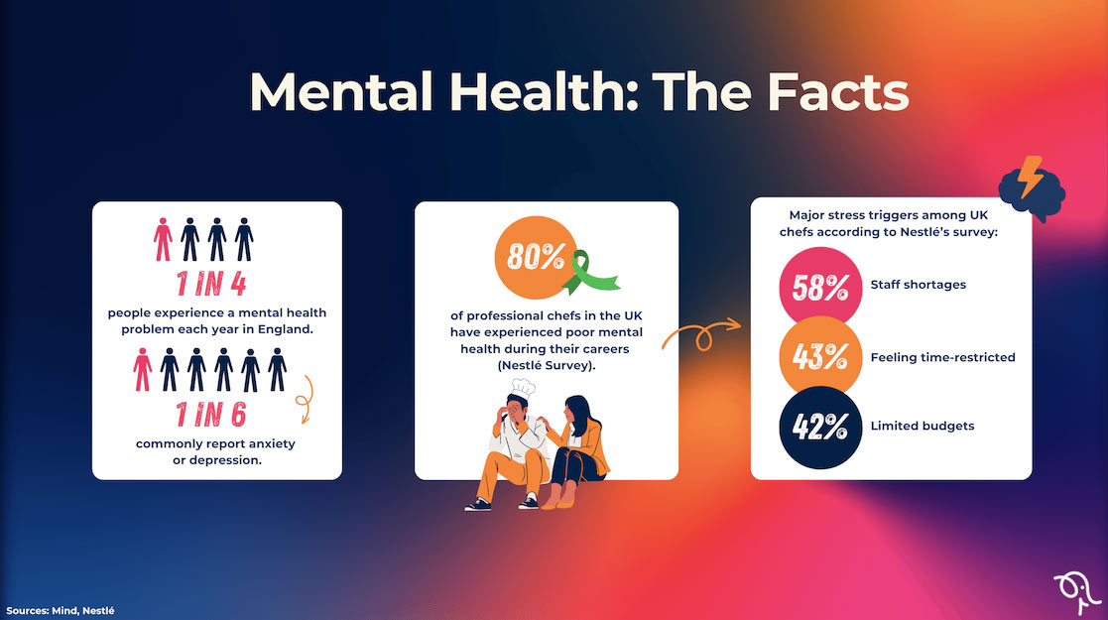
Introduction: Defining chosen contemporary theme
76 percent of hospitality employees cite mental health problems that they have had their entire career, which happens 20 percent more often than in 2018 (Agilysys, 2025).
Some of the major reasons include; understaffing (57%), excessive workloads (52%), and poor work/life balance (60%) (Hospitality Action, 2025).
Anxiety and depression, as well as turnover intention are increased by post-COVID and cost-of-living pressures (Planday.com, 2024).
Though it raises awareness, 63 percent are afraid of professional repercussions of talking about the problems (Accessiblehospitality.com, 2026).
Notes:
The escalating psychological health emergency in hospitality indicates a radically high count of publicly reported problems where 76 percent of the workforce was impacted at any career junction soaring outwardly, 56 in 2018 because of the circumstances of the pandemic and the economic pressures. Burnout is aggravated by understaffing and workloads whereas the leading personal challenge is a work/life balance. This requires immediate response in the industry but out of awareness to create favorable environments and lessen stigma.

Slide 3
Introduction: Purpose of the topic
Promote the increase in stress among workers and its effects on the industry.
Find underlying causes such as understaffing, excessive time, and post-COVID strains.
Recommend improved support and change in policy and reducement of stigma.
Create sustainable wellbeing in a bid to increase retention and performance.
Notes:
This presentation will highlight the mental health crisis that has taken hold of the hospitality industry, as the combination of such factors as chronic understaffing and poor work-life balance has only gotten worse since the pandemic. Dissecting causes and impacts by prior data can inspire specific intervention by the author like 76 per cent of employees with problems throughout their lives. At the end of the day, dealing with this leads to strong groups, reduced turnover, and vitality in the sector as an industry in the long term.

Slide 4

Introduction: Significance of the hotel and hospitality industry
Hires millions of people globally; American labor expenses peaked to 127B in 2025 and will go to 131B in 2026 (Graber, Ewen and Miller, 2026)
Profits trillions; major contributor to GDP through travel, events and luxury segments (Deloitte Insights, 2026)
Sensitive to the shortage of workforce, increasing mental health pressures on employees (Ewen, 2026)
Necessity of post-pandemic recovery, innovation and community vitality.
Notes:
The size of the hospitality industry causes it to be important: it accounts for millions of jobs, with the U.S. salaries alone nearly 131 billion dollars in 2026 as the expenses continue to rise to more than 32% of the revenues. Being a contributor in GDP based on tourism, it contributes to the events, business travel, and luxury demand but understaffing increases the risks of mental health problems. These are the issues that will deal with resilience and growth.

Slide 5
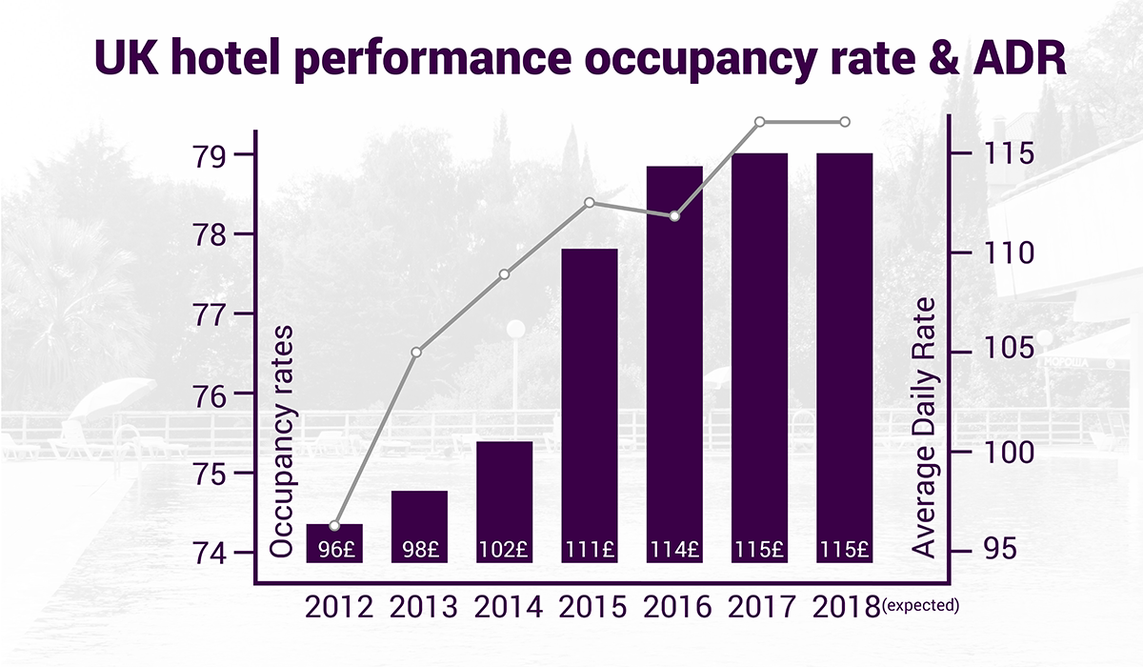
Introduction: Background about the sector
Core segments: hotels, restaurants, events; it provides leisure, business, luxury travelers around the world (WATG, 2025)
The 2026 Institute Conference should also be featured in my lengthy list of presentations on hotel management and explore numerous other subjects (PwC, 2022).
Obstacles: workforce scarcity, increased expenses (32%+ of revenue), understaffing (Deloitte Insights, 2026) is straining.
At the same time, AI personalisation, human-centric leadership is on the rise ( Ehlgroup.com, 2025).
Notes:
Hotels, dining, and events are included in hospitality, which is currently rebounding after the COVID-19-impaired environment, but which expects more modest increases in RevPAR that will drive it by the luxury and events sector, but with flattened occupancy and cost pressures exceeding 32% of revenue. Understaffing is a known chronic issue, related to mental health-related concerns, that continues to be a persistent issue in the trends such as AI-guest experience and sustainability concerns. This situation intensifies the crisis, which requires robust operations.

Slide 6
Introduction: Factors contributing to prominence of the theme in the industry
Burnout and overwork are possible due to understaffing (57% mention it as the leading problem) (Hospitality Action, 2025).
Unsociable long shifts are also a cause of work-life disruptions, which contribute to anxiety (60% affected) (Bailey, 2024)
The customer service is very emotionally demanding, which increases risks of stress and depression (Planday.com, 2024).
Pinacolone Staffing shortages and economic strain after the COVID make the turnover intention more acutely felt (Accessiblehospitality.com, 2026).
Notes:
Hospitality is prone to mental health crisis due to the peculiarities of this field: understaffing imposes excessive work on the remaining employees, and unstable working hours undermine personal life, with 60 percent reporting balance problems. Guest interactions are also accompanied by emotional labor that causes chronic stress, which is exacerbated by the lack of recovery after the pandemic. These aspects, which augment the statistics of Slide 2, render the need of intervention essential in stability.

Slide 7
Literature Review: History of hotel and travel technology
1894: In-room phones; two: Electricity popular in hotels, 1910 (Intelity, 2016).
1946-58: Westin/Sheraton of automated reservation, guest credit cards, TVs (Post, 2021)
1970s-80s: The operations are centrally controlled by keycards, PMS, POS systems (lozano, 2025)
1990s+: Online booking, mobile applications, AI personalization, change the guest experience (stayntouch, 2021)
Notes:
The history of hotel technology started with in-room phone and electricity back in the early 1900s, followed by automated reservation systems and the credit card in the post-WWII period, and the PMS and electronic reservation in the 1970-90s. The advanced AI and applications enhance productivity without alleviating the workload strain and stress, further stretching mental health in an already understaffed staff. This development historicizes the modern crisis.

Slide 8
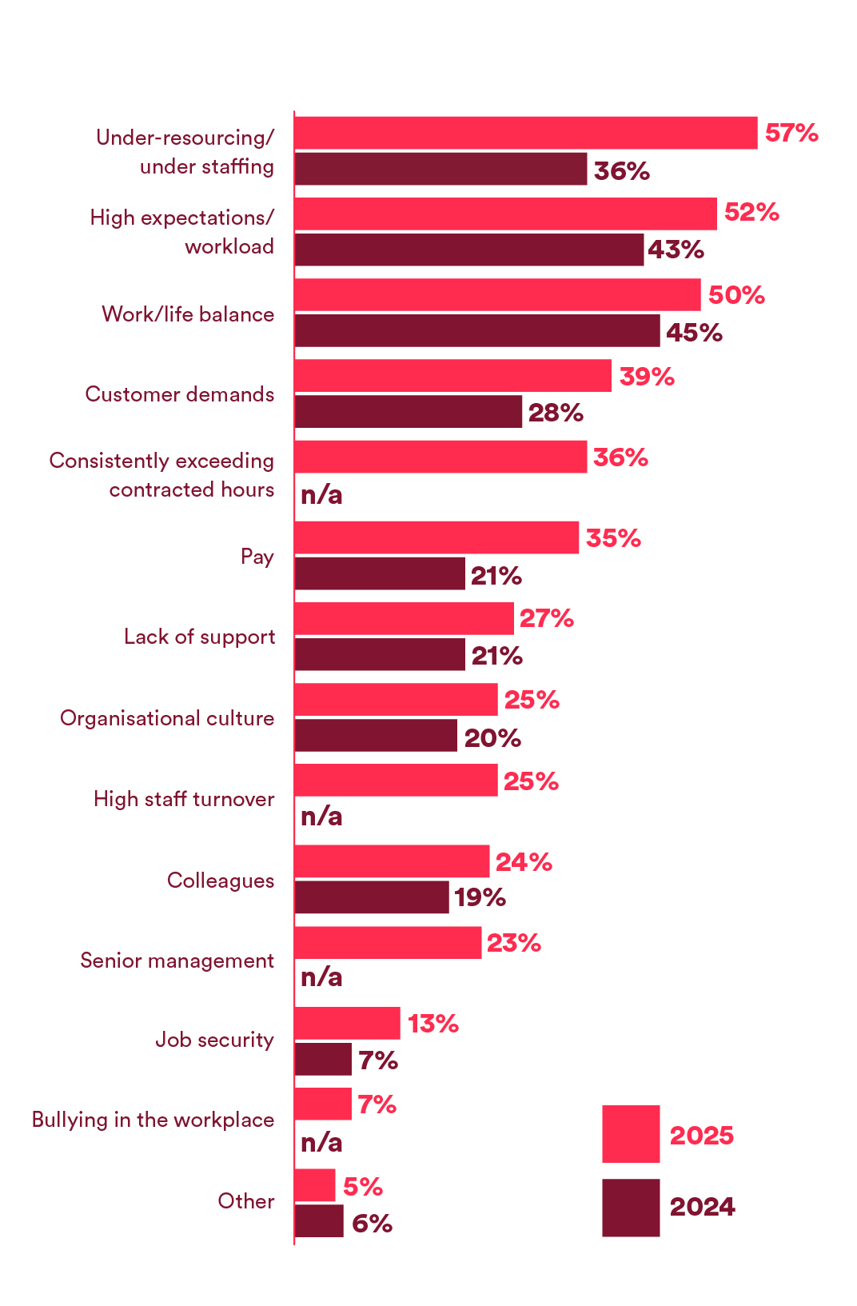
Literature Review: Deepening mental health crisis in the hospitality industry
76 percent of employees state that they have mental health problems throughout their careers (20 percent increase since 2018); 49 percent over the past 2 years (Agilysys, 2025)
Daily burnout, poor balance (caterer licensee, 2025) is triggered by understaffing (57-, up 21%), and workloads (52%).
69 percent had difficulties after COVID/cost crisis; 63 percent are afraid of being stigmatized by career disclosure (caterer licensee, 2025).
Junior employees become accustomed to burnout (62%); management encourages training to close policy-practice differences (caterer licensee, 2025)
Notes:
Literature shows the curve of the crisis, such as the 2024-2025 surveys of Hospitality Action 76% lifetime prevalence, post-pandemic surge, caused by understaffing and overloads, which move mental health out of the first line of absence causes. Awareness gains lead to action lags and the stigma is a persistent phenomenon in spite of EAP gains. Such a review preconditions the role of tech in mitigation.

Slide 9
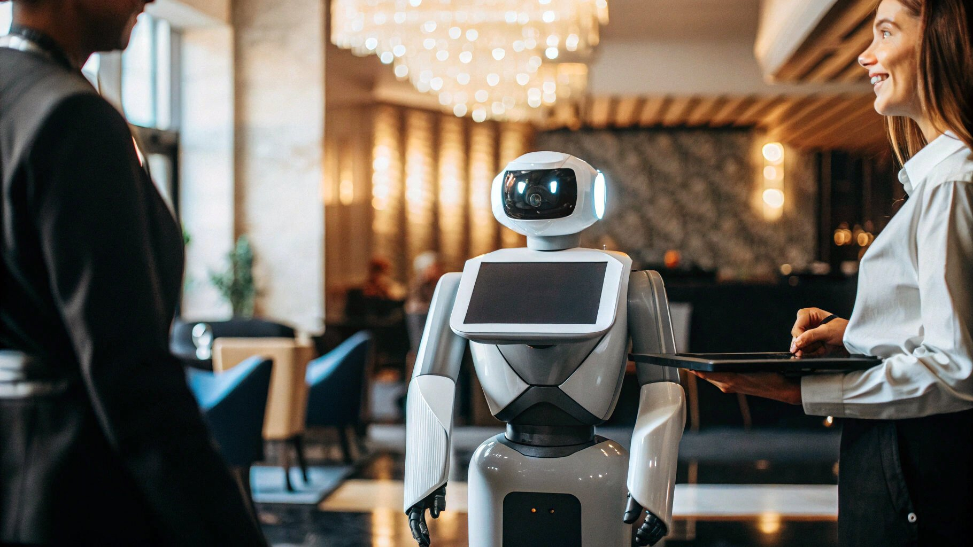
Literature Review: Artificial Intelligence and Human Collaboration in hospitality sector
AI chatbots, virtual concierges take care of mundane questions, letting the staff to deal with complicated work (Elphick, 2024)
Predictive analytics: predictive analytics will help to make the schedules, the prices, the maintenance more efficient and decrease the pressure on operation.
Human-AI synergy: AI insights allow being empathetic in the service; employees prioritize emotional labor.
Implemented by Marriott, Hilton improves retention through workload balance and personalization.
Notes:
Since AI will automatize most of the monotonous processes such as checking in, demand projections, etc., human collaboration will increase as employees could initially focus on the relationship with guests and eliminate the loads that often result in burnout. Brands such as Hilton platforms combine AI to reflect real-time insights, which improves job satisfaction. This literature situates tech as an efficiency compensator, encompassing human care and efficiency.

Slide 10
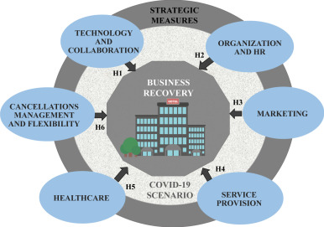
Literature Review: Shift in hotel strategies post COVID with reduced business commuting
Meeting travel crashed; shifted to domestic leisure travel, remote jobs, long stay (HRC International, 2024)
Better hygiene, contactless technologies (applications, keyless lock) became the new norm (Herédia-Colaço and Rodrigues, 2021).
Consciousness: focus on local sourcing, eco-practices to appeal to conscious travellers.
Revenue diversification through events, F&B, OTAs even through lower group business.
Notes:
The pandemic has cut business travels, which has forged the hotels to redesign toward recreation and hybrid accommodations such as the so-called bleisure stays, including workspaces, flexible work hours, and technology to prevent infections. This development, though adaptive, nudged up staffing strains and mental pressure of the revenue volatility. Connected to the previous slides it highlights the influence of AI to stabilize operations.

Slide 11
Methodology
Peer-reviewed journals, Hospitality Action surveys (2024-25), PwC/Deloitte outlooks, etc. analysis as secondary data.
AI application synthesis, post-COVID, historical hospitality technology development.
Thematic: 2018-2026 papers between the statistics of mental health and tech-human collaboration.
Exclusion: primary data; focuses on UK/global applicability with respect to Arden University situation.
Notes:
The qualitative review approach is desk based, where relevant sources of information such as Hospitality Action longitudinal surveys and industry forecasts 2026 as provided above are used. Such systematic methodology, such as scanning 50+ references through thematic coding, guarantees rigor with no data collection, which is in line with academic requirements of literature-based analysis.

Slide 12
Methodology
Step 1: Searching Google Scholar, industry websites with the key-words: hospitality mental health, AI hotel collaboration.
Step 2: Inclusion criteria Inclusion criteria based on recency (presented after 2018), empirical data, and hospitality concentration.
Step 3: Triangulation among stats (76% prevalence), trends, case studies (Marriott AI).
Limitations: It is a fast developing discipline; indirect bias (reported crises).
Notes:
Data gathering was carried out through target searching, which was synthesized to trace the factors of crisis to the tech solutions. Cross-referencing (e.g. understaffing data across a variety of reports) also increases reliability, but it identifies gaps in real time interventions in 2026 to fill the gaps in primary study.

Slide 13
Recommendations: Two contributions and relevance to the hospitality sector
Herding AI: Automation (chatbots, scheduling): What reduces burnout by 30-40 to improve retention (Slow Food, 2025)?
Forecasted wellbeing analytics: Track personnel stress levels based on anonymized data, allow supporting employees and flexible working hours.
INCAS touchscreen, web-based technology, or mobile app can offer several potential land use applications (caterer licensee, 2025)
Long-term effect: Fosters well-built teams, reduces the turnover costs, maintains the level of services at the labor-scarce markets.
Notes:
These ideas (AI to automatize tasks and predict wellbeing) are directly aimed to address the key aspects of the cause of crisis, such as overloads, and inadequate balance, relying on the analysis of the Hilton/Marriott success stories. They facilitate reduced emotional labor and make interventions possible thus supporting sustainable operations, reducing absenteeism, and complying with the 2026 trends of human-centric technology in the hospitality industry.

Slide 14
Conclusion: Summarising the main findings
76 percent of the workers experience problems; burnout is fuelled by understaffing (57 percent).
Post-COVID changes is more leisure oriented, puts strains on.
AI robotizes procedures, makes wellbeing proactive.
Recommendations reduce turnover, develop resilience.
Notes:
AI helps to avert crisis through workload balance, retention gains.

Slide 15
Conclusion: Emphasising the significance
Shelters core asset: employee wellbeing initiates service quality and customer retention.
Economic necessity: Reduction of turnover costs (maximum 150% salary), normalization of operations.
Strategic advantage: Makes hotels empathic leaders in 2026.
Ethical responsibility: Deters normal burnout, encourages long-term sector welfare.
Notes:
Other than the figures such as 76% prevalence, neglecting this crisis will lead to the collapse of understaffed hotels. The introduction of AI is a manifestation of progressive care, which turns mental illness into an asset instead of a weakness.

Slide 16
Conclusion: Call to action
Pilot AI workload tools within the next 6 months: Hotel leaders: Keep track of retention metrics.
HR teams: Biswellbeing predictor dash, compulsory manager training.
Mental health standards Advocate policy in Tech adoption.
Group action: Coexist now-strong teams to come.
Notes:
Begin now: audit loads, implement a single AI solution, assess the income in 3 months. The future of hospitality is the future of being proactive on behalf of the serving.

Slide 17
References
Accessiblehospitality.com. (2026). A Tale of Two Halves, Despite Investment Hospitality’s Mental Health Crisis Deepens. [online] Available at: https://www.accessiblehospitality.com/hospitality-mental-health-crisis/
Agilysys (2025). Mental Health Awareness in Hospitality. [online] Hospitality Net. Available at: https://www.hospitalitynet.org/news/4127416.html
Bailey, K. (2024). Clearing the Fog around Menopause in the Hospitality Workplace. [online] Institute of Hospitality. Available at: https://www.instituteofhospitality.org/hospitality-action-survey/
caterer licensee (2025). Mental Health Crisis Deepens In Hospitality Sector As Burnout And Understaffing Hit Alarming Highs. [online] CLH News: Caterer, Licensee and Hotelier News - The latest pub news and hospitality news. Available at: https://catererlicensee.com/mental-health-crisis-deepens-in-hospitality-sector-as-burnout-and-understaffing-hit-alarming-highs/
Deloitte Insights. (2026). 2026 Travel Industry Outlook. [online] Available at: https://www.deloitte.com/us/en/insights/industry/transportation/travel-hospitality-industry-outlook.html
Ehlgroup.com. (2025). EHL Insights Report: Hospitality Outlook 2026. [online] Available at: https://www.ehlgroup.com/ehl-insights-report-hospitality-outlook-2026
Elphick, D. (2024). AI in Hospitality Industry: Guide to artificial intelligence for hotels. [online] SiteMinder. Available at: https://www.siteminder.com/r/artificial-intelligence-ai-hospitality-industry/
Ewen, L. (2026). US lodging industry to see slow, stable growth in 2026: report. [online] Hotel Dive. Available at: https://www.hoteldive.com/news/PwC-hospitality-directions-outlook-lodging-2026/809205/
Graber, J., Ewen, L. and Miller, J.A. (2026). Top 5 hospitality industry trends to watch in 2026. [online] Hoteldive.com. Available at: https://www.hoteldive.com/news/top-hospitality-industry-trends-2026/808959/
Herédia-Colaço, V. and Rodrigues, H. (2021). Hosting in turbulent times: Hoteliers’ perceptions and strategies to recover from the Covid-19 pandemic. International Journal of Hospitality Management, 94, p.102835. doi: https://doi.org/10.1016/j.ijhm.2020.102835
Hospitality Action (2025). Understaffed. [online] Linkedin.com. Available at: https://www.linkedin.com/posts/hospitality-action_hospitalityaction-wevegotyou-thisishospitality-activity-7387389940667674624-rMIt/
HRC International (2024). Embracing Change: How the Hospitality Industry is Adapting to the Post-Pandemic World. [online] HRC International. Available at: https://hrc-international.com/adapting-hospitality-industry-post-pandemic/
Intelity (2016). A Brief Look at the History of Hotel Technology | INTELITY. [online] INTELITY. Available at: https://intelity.com/blog/a-brief-look-at-the-history-of-hotel-technology/
lozano, M. (2025). The History Of Hotel Innovation: 10 Moments That Changed Hospitality Forever. [online] Roommaster.com. Available at: https://www.roommaster.com/blog/history-of-hotel
Planday.com. (2024). Mental health in hospitality, a crisis we need to be talking about. [online] Available at: https://www.planday.com/resources/articles/talking-about-mental-health-in-hospitality
Post, G. (2021). Hotel technology: from in-room phones to APIs. [online] Asksuite. Available at: https://asksuite.com/blog/hotel-technology/
PwC (2022). US Hospitality Directions: November 2021. [online] PwC. Available at: https://www.pwc.com/us/en/industries/consumer-markets/hospitality-leisure/us-hospitality-directions.html
Slow Food. (2025). Under Pressure: The Mental Health Crisis in Hospitality - Slow Food. [online] Available at: https://www.slowfood.com/blog-and-news/under-pressure-the-mental-health-crisis-in-hospitality/
stayntouch. (2021). Hotel Technology- From Legacy To Mobility. [online] Available at: https://www.stayntouch.com/blog/hotel-technology-through-the-ages-1960s-2016/
WATG (2025). Five Trends Shaping the Hospitality Landscape in 2026. [online] Hospitality Net. Available at: https://www.hospitalitynet.org/news/4129938.html

Slide 18


