Slide 1
Name : Dhvani Rajeshbhai Gohil
Student ID : 2315279
Module Title/Code : Practice-Based Research LCHS7001
Date : 20 March 2024
Lecturer : Dr. Diola Bijlhout

Slide 2



Impact of housing insecurity on chronic health condition in the older population (50-70 years) who are suffering from mental health in the UK

Slide 3
Content
Introduction
Rational of the Study
Aim of the Study
Research Question
Methodology
Recruitment, Sampling & Study Participants
Data Collection Method / Material
Data Analysis Technique
Participants
Methods of Asking
Implication of the Research
Ethical Consideration
Gantt Chart
References

Slide 4

Introduction
Housing insecurity is the core significant issue across the globe, which eventually affects individuals through certain demographic groups. Among the most susceptible are the older adults having the age group (50-70 years) who have experienced mental health issues (Carnemolla et al., 2021).
The research proposal is designed to targets for the study properly with the typical connection among housing insecurity and several challenges, chronic health conditions among older adults having the age group of 50-70 in the UK (Carnemolla et al., 2021).
The mechanisms through which housing instability affects the health results, the study targets to contribute in the development of evidence-based interventions that encourage the health along well-being of older adults (Leung et al., 2020).

Slide 5

Rational of the Study
This research explores the intersection of housing insecurity, mental health challenges among older adults (aged 50-70) in the United Kingdom. Housing insecurity poses significant challenges for this demographic, impacting their mental and physical well-being (Mahmood et al., 2022).
This research is important because of the issue arising for the housing insecurity in older adults which very much imperative because this issue is effecting the lives of the adults which needs to be maintained accordingly (Mason et al., 2019)

Slide 6

Aim of the Study
Investigating the impact of housing insecurity on chronic health conditions between older adults having age range of (aged 50-70) with mental health challenges in the United Kingdom.

Slide 7

Research Question
How does housing insecurity in the UK affect the mental health of the aged population and what measures can reduce such mental issues?

Slide 8

Objectives of the Study
Investigating the relationship between housing insecurity and the older population’s mental health conditions. The key objectives to accomplish are,
To explore the housing insecurity of the older population in the UK
To assess the relationship between housing insecurity and the mental health of the older population in the UK (Mosley-Johnson et al., 2022)
To examine existing policies and support systems for addressing housing issues of the aged population in the UK (Wilder et al., 2021)
To recommend best strategies for mental health issues of the aged population related to housing insecurity (Pirrie et al., 2020).

Slide 9
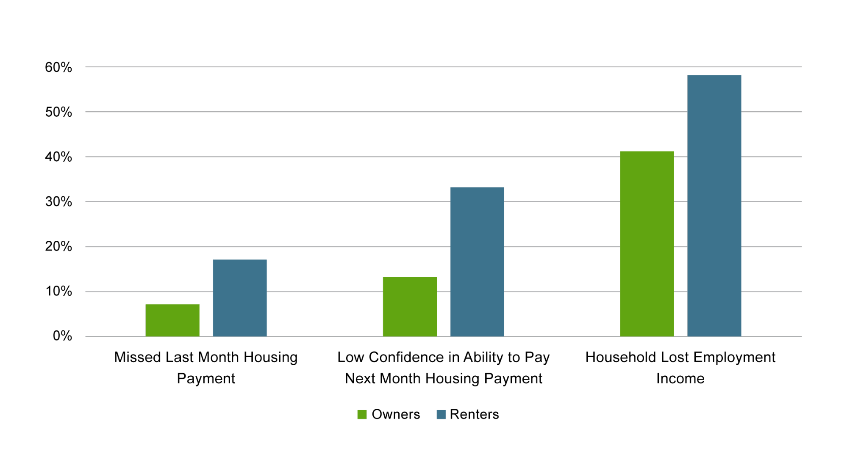
Literature Review
Housing Insecurity Among Older Adults in the UK
Prevalence and Trends
Housing instability is rousingly prevalent between the older adults in the UK because of the certain socioeconomic factors along with the demographic shifts (Mahmood et al., 2022). .
Impact on Well-being
Housing insecurity directly affects the quality of life, independence as well as the social integration of older adults which rise certain vulnerabilities in this population (Berkowitz et al., 2021). .
Mental Health Disorders in Older Adults
Common Conditions
Depression and the substance abuse are much prevalent in the mental health disorders between the older adults which sometimes exacerbated by aging-related stressors (Vicerra et al., 2022).
.

Slide 10

Literature Review
Housing Insecurity and Mental Health
Impairing Factors
Housing uncertainty which amplifies mental health issues through increased stress and the limited access to support networks (Paul et al., 2020) .
Managing Mechanisms
The Older adults owns certain coping strategies to move through the stressors of housing insecurity as well as the mental health issues, which includes seeking social support as well as engaging in self-care practices (Paul et al., 2020) .
Impact of Housing Insecurity on Chronic Health Conditions
Physiological Effects
The stressors interconnected with housing insecurity also participate to physiological issues which increase the risk of developing chronic health conditions such as cardiovascular diseases and respiratory ailments .

Slide 11
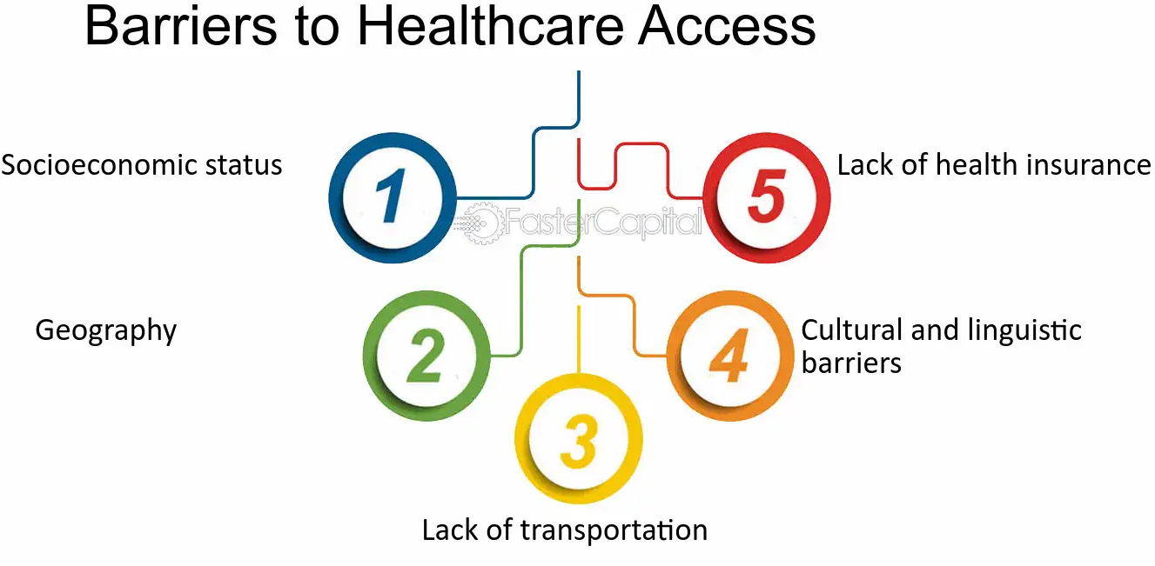
Literature Review
Barriers to Healthcare Access
Housing instability develops the certain barriers to accessing the healthcare services as well as also adhering to treatment regimens, which further creates chronic health conditions between the older adults (Mahmood et al., 2022). .

Slide 12

Research Methodology
Research Methodology
This research will be going to focus on the qualitative research method which will employ a core significant approach to explore the lived experiences of older adults (aged 50-70) having mental health challenges and they are facing housing insecurity in the UK (Porto Valente et al., 2022) .
Research Design
The study will be employing a qualitative research design having a core significant phenomenological approach, to explore the experiences of the older adults (aged 50-70) having mental health challenges which they are facing with housing insecurity in the UK (Rosenthal et al., 2021) .
Through the usage of semi-structured interviews, the design provides the exploration of how the housing insecurity effects overall mental and physical health results in this population (Berkowitz et al., 2021).
The qualitative design is selected to hold the complexity as well as the nuances of participants' experiences which also provides valuable insights for policy and intervention development (Vicerra et al., 2022).

Slide 13
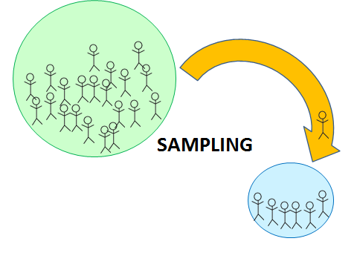
Recruitment, Sampling & Study Participants
Sampling
Purposive sampling chosen to hire participants meeting the inclusion criteria. Participants will be chosen from certain regions across the United Kingdom which mainly includes urban, suburban, and rural areas (Paul et al., 2020)
Efforts made to access the community centers, mental health support groups, and certain social service agencies that cover up older adults who are facing housing insecurity (Mahmood et al., 2022). This approach make sure a diverse representation of experiences and perspectives.

Slide 14

Recruitment, Sampling & Study Participants
Participants
The study involves older adults aged having 50-70 who have been encountered with mental health challenges and are experiencing housing insecurity in the UK (Mosley-Johnson et al., 2022).
They will be hired from accessible locations like certain community centers and social service agencies which serve this demographic through different geographic locations in the UK (Mason et al., 2019).

Slide 15

Data Collection Method / Material
Data Collection
In-depth Interviews: Semi-structured interviews will be performed which also allow participants to share their certain narratives about housing insecurity as well as its effect on their mental health along with chronic health conditions (Carnemolla et al., 2021).
Questions to Ask
How would you define your ongoing housing situation?
Can you please let me know for the challenges or difficulties you have gone through related to housing?
How do you think the housing situation affects the overall mental health?
Have you observed any fluctuations in your physical health since experiencing housing insecurity?
How do you deal with the stressors related to housing instability?
Can you share certain experiences in which the housing situation has effected your access to healthcare services?
How do you visualize an ideal housing situation that might positively affect your mental and physical well-being?

Slide 16

Data Analysis Technique
Thematic analysis will be used to analyse the interview data which is gathered from participants. This approach includes identifying recurring patterns, and themes along with the categories within the qualitative data (Lee et al., 2020).
Following the transcription, the data will be systematically coded to hold the core key concepts as well as the ideas that are related to housing insecurity, mental health along chronic health conditions (Mosley-Johnson et al., 2022).
Through an iterative process, codes will be grouped into broader themes that hold the participants' experiences (Wilder et al., 2021).
The themes will be refined and also interpreted to create meaningful insights into the effect of housing insecurity on the mental as well as the physical health of older adults with mental health issues in the UK.

Slide 17

Method of Asking
Semi-structured interviews will be performed to facilitates participants to share their experiences in-depth (Rosenthal et al., 2021).
Follow-up probes will also be utilized to deal more deeper into specific aspects of their experiences. Interviews will be performed either face-to-face or virtually which are based on participant preferences along with their feasibility (Pirrie et al., 2020).
Employing a proper qualitative approach, this research aims to facilitate a proper rich understanding of the typical interplay among housing insecurity, mental health challenges as well and chronic health conditions among older adults in the UK (Vicerra et al., 2022).

Slide 18
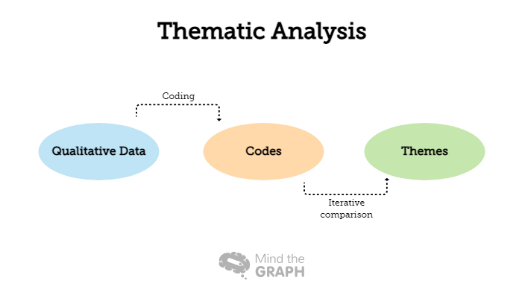
Implication of the Research
The usage of thematic analysis will be used which allows to show specific patterns for the impact of housing insecurity in older people in getting to know and the themes within data that provides the valuable insights which can inform theory development, policy-making and certain the practical applications in several fields (Paul et al., 2020).

Slide 19
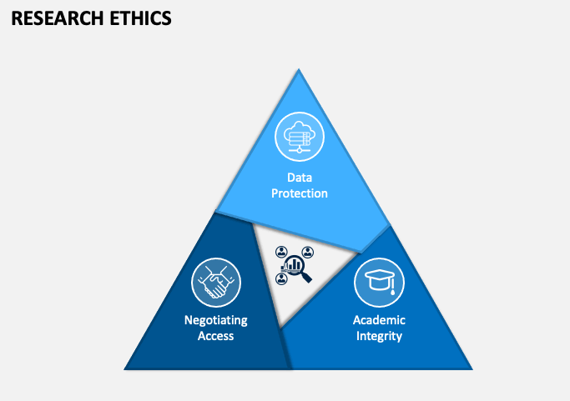
Ethical Consideration
Potential Ethical approval will be collected from the relevant institutional review board. Informed consent will be acquired from all the participants along certain measures will be taken to ensure confidentiality (Porto Valente et al., 2022).
Confidentiality: Participant will be given a study code to individually anonymize data.
Voluntary Participation: Participants might withdraw from the study at any time without any issue (Pirrie et al., 2020).
Secure Data Storage: Data will be stored utilizing encrypted files either university cloud storage then will be wasted upon completion of the research (Leung et al., 2020).
Informed Consent: Participants will be properly informed for the study aims, procedures, and potential risks before facilitating consent (Mosley-Johnson et al., 2022).

Slide 20
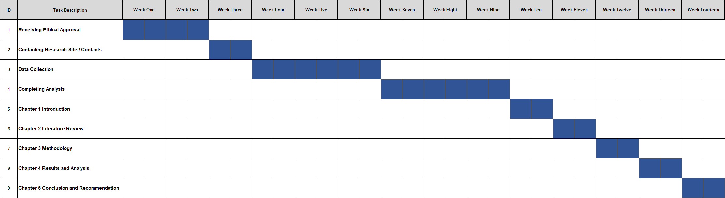
Plan of work and Time Schedule (Gantt Chart)

Slide 21
References
Alidoust, S. and Huang, W., (2023). A decade of research on housing and health: a systematic literature review. Reviews on Environmental health, 38(1), pp.45-64.
Ayón, C., Ramos Santiago, J. and López Torres, A.S., (2020). Latinx undocumented older adults, health needs and access to healthcare. Journal of Immigrant and Minority Health, 22, pp.996-1009.
Baker, E., Lester, L., Mason, K. and Bentley, R., (2020). Mental health and prolonged exposure to unaffordable housing: a longitudinal analysis. Social psychiatry and psychiatric epidemiology, 55, pp.715-721.
Berkowitz, S.A., Palakshappa, D., Rigdon, J., Seligman, H.K. and Basu, S., (2021). Supplemental Nutrition Assistance Program participation and health care use in older adults: a cohort study. Annals of internal medicine, 174(12), pp.1674-1682.
Carnemolla, P. and Skinner, V., (2021). Outcomes associated with providing secure, stable, and permanent housing for people who have been homeless: An international scoping review. Journal of Planning Literature, 36(4), pp.508-525.
Chen, K.L., Miake-Lye, I.M., Begashaw, M.M., Zimmerman, F.J., Larkin, J., McGrath, E.L. and Shekelle, P.G., (2022). Association of promoting housing affordability and stability with improved health outcomes: A systematic review. JAMA Network Open, 5(11), pp.e2239860-e2239860.
DeLuca, S. and Rosen, E., (2022). Housing insecurity among the poor today. Annual Review of Sociology, 48, pp.343-371.

Slide 22
References
Fan, Q., Keene, D.E., Banegas, M.P., Gehlert, S., Gottlieb, L.M., Yabroff, K.R. and Pollack, C.E., (2022). Housing insecurity among patients with cancer. JNCI: Journal of the National Cancer Institute, 114(12), pp.1584-1592.
Gyasi, R.M., Obeng, B. and Yeboah, J.Y., (2020). Impact of food insecurity with hunger on mental distress among community-dwelling older adults. PLoS One, 15(3), p.e0229840.
Hatem, C., Lee, C.Y., Zhao, X., Reesor-Oyer, L., Lopez, T. and Hernandez, D.C., (2020). Food insecurity and housing instability during early childhood as predictors of adolescent mental health. Journal of Family Psychology, 34(6), p.721.
Hoke, M.K. and Boen, C.E., (2021). The health impacts of eviction: Evidence from the national longitudinal study of adolescent to adult health. Social Science & Medicine, 273, p.113742.
Howden-Chapman, P., Bennett, J., Edwards, R., Jacobs, D., Nathan, K. and Ormandy, D., (2023). Review of the impact of housing quality on inequalities in health and well-being. Annual review of public health, 44, pp.233-254.
Howden-Chapman, P.L., Chandola, T., Stafford, M. and Marmot, M., (2011). The effect of housing on the mental health of older people: the impact of lifetime housing history in Whitehall II. BMC public health, 11, pp.1-8.
Lee, B.A. and Evans, M., (2020). Forced to move: Patterns and predictors of residential displacement during an era of housing insecurity. Social Science Research, 87, p.102415.
Leung, C.W., Kullgren, J.T., Malani, P.N., Singer, D.C., Kirch, M., Solway, E. and Wolfson, J.A., (2020). Food insecurity is associated with multiple chronic conditions and physical health status among older US adults. Preventive medicine reports, 20, p.101211.

Slide 23
References
Mahmood, A., Patille, R., Lam, E., Mora, D.J., Gurung, S., Bookmyer, G., Weldrick, R., Chaudhury, H. and Canham, S.L., (2022). Aging in the right place for older adults experiencing housing insecurity: An environmental assessment of temporary housing program. International Journal of Environmental Research and Public Health, 19(22), p.14857.
Mason, K.E., Alexioub, A., Lia, A., and Taylor-Robinson, D., (2019). The impact of housing insecurity on mental health, sleep and hypertension: a longitudinal analysis using linked UK household data, 2009-2019. Melbourne School of Population and Global Health, The University of Melbourne, Australia. [Accessed 29 Feb. 2024].
Mosley-Johnson, E., Walker, R.J., Thakkar, M., Campbell, J.A., Hawks, L., Pyzyk, S. and Egede, L.E., (2022). Relationship between housing insecurity, diabetes processes of care, and self-care behaviors. BMC Health Services Research, 22, pp.1-8.
National Housing Federation., (2023). Two in five older private renters struggle to afford food, heating or clothes. [online] Available at: https://www.housing.org.uk/news-and-blogs/news/two-in-five-older-private-renters-struggle-to-afford-food-heating-or-clothes/#:~:text=More%20than%20two%2Dfifths%20(42,National%20Housing%20Federation%20(NHF). [Accessed 29 Feb. 2024].
NHS., (2017). NHS England» Half of adults aged 55 and over have experienced common mental health problems, say Age UK. [online] England.nhs.uk. Available at: https://www.england.nhs.uk/2017/10/half-of-adults-aged-55-and-over-have-experienced-common-mental-health-problems-say-age uk/#:~:text=Nearly%20half%20of%20adults%20(7.7,people%20in%20the%20UK%20today. [Accessed 29 Feb. 2024].
Olfert, M.D., Hagedorn-Hatfield, R.L., Houghtaling, B., Esquivel, M.K., Hood, L.B., MacNell, L., Soldavini, J., Berner, M., Savoie Roskos, M.R., Hingle, M.D. and Mann, G.R., (2023). Struggling with the basics: food and housing insecurity among college students across twenty-two colleges and universities. Journal of American College Health, 71(8), pp.2518-2529.

Slide 24
References
Paul Jr, D.W., Knight, K.R., Olsen, P., Weeks, J., Yen, I.H. and Kushel, M.B., (2020). Racial discrimination in the life course of older adults experiencing homelessness: results from the HOPE HOME study. Journal of Social Distress and Homelessness, 29(2), pp.184-193.
Pirrie, M., Harrison, L., Angeles, R., Marzanek, F., Ziesmann, A. and Agarwal, G., (2020). Poverty and food insecurity of older adults living in social housing in Ontario: a cross-sectional study. BMC Public Health, 20, pp.1-10.
Porto Valente, C., Morris, A. and Wilkinson, S.J., (2022). Energy poverty, housing and health: the lived experience of older low-income Australians. Building Research & Information, 50(1-2), pp.6-18.
Rosenthal, A., Stover, E. and Haar, R.J., (2021). Health and social impacts of California wildfires and the deficiencies in current recovery resources: An exploratory qualitative study of systems-level issues. PloS one, 16(3), p.e0248617.
Vicerra, P.M.M., (2022). Mental stress and well-being among low-income older adults during COVID-19 pandemic. Asian Journal of Social Health and Behavior, 5(3), pp.101-107.
Wilder, M.E., Kulie, P., Jensen, C., Levett, P., Blanchard, J., Dominguez, L.W., Portela, M., Srivastava, A., Li, Y. and McCarthy, M.L., (2021). The impact of social determinants of health on medication adherence: a systematic review and meta-analysis. Journal of general internal medicine, 36, pp.1359-1370.
Wilder, M.E., Kulie, P., Jensen, C., Levett, P., Blanchard, J., Dominguez, L.W., Portela, M., Srivastava, A., Li, Y. and McCarthy, M.L., (2021). The impact of social determinants of health on medication adherence: a systematic review and meta-analysis. Journal of general internal medicine, 36, pp.1359-1370.

Slide 25
References
Paul Jr, D.W., Knight, K.R., Olsen, P., Weeks, J., Yen, I.H. and Kushel, M.B., (2020). Racial discrimination in the life course of older adults experiencing homelessness: results from the HOPE HOME study. Journal of Social Distress and Homelessness, 29(2), pp.184-193.
Pirrie, M., Harrison, L., Angeles, R., Marzanek, F., Ziesmann, A. and Agarwal, G., (2020). Poverty and food insecurity of older adults living in social housing in Ontario: a cross-sectional study. BMC Public Health, 20, pp.1-10.

Slide 26
Thank you

