Slide 1
Gestalt
Part 2

Slide 2
Awareness
We have paid attention to this in recent weeks, but it’s always useful to remind ourselves about knowing ourselves and living our lives.
Today we use Mindfulness techniques to help us to engage with being in the moment.
Perls believed that to really know ourselves and to really experience life we needed to be here in the present.

Slide 3
Three zones of Awareness
The Inner Zone
The Outer Zone
The Middle Zone

Slide 4
Inner Zone Awareness
Activity One

Slide 5
Middle Zone Awareness
Activity Two

Slide 6
Outer Zone Awareness
Activity 3

Slide 7
Embodiment
The Gestalt approach pays particular attention to bodily presence.
The experience that is happening physically within the body (somatic experiencing).
Sometimes we pay attention to these experiences, but other time we ignore them as they may be related to unacceptable feelings or memories.
When working with clients we often notice the movement in the body, sometimes words are not necessary.

Slide 8
Wholeness: Exploring the Gestalts.
The whole precedes the parts.
The whole is more than the parts, but additionally it is also different from those individual parts.
DOG

Slide 9
Wholeness in Therapy
We don’t see people as labels, instead we see them holistically.
Figure and Ground

Slide 10

Figure and Ground

Slide 11
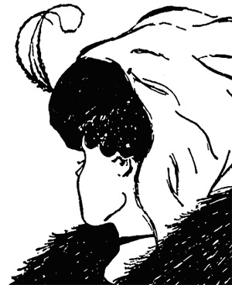
Figure and Ground

Slide 12
Figure and Ground in Gestalt Therapy
We cannot see ourselves and our environment at the same time. Some things become figure, whilst others remain ground. What becomes figure depends on our needs at the time.
When an individual is experiencing a healthy time in their lives they can form clear figures and use available and appropriate resources to fit the need that they have.

Slide 13
Wholeness and Completion of Gestalts
As humans we have a need for completion.

Slide 14
sensation
mobilization
action
contact
withdrawal
Fertile void
awareness
satisfaction
Model of Healthy Functioning

Slide 15
Disturbances or interruptions in the cycle
Some cycles do not get completed.
There are times when we interrupt or change the gestalt cycle without being aware of it. This can limit our experiencing of a need in a here and now.
This can be as a result of a past experience and there was a need to interrupt the cycle. It was needed at the time. However it can then become an unhealthy habit which may not be helpful or useful now.

Slide 16
desensitisation
deflection
introjection
projection
futile void
retroflection
egotism
confluence
Modifications

