Slide 1
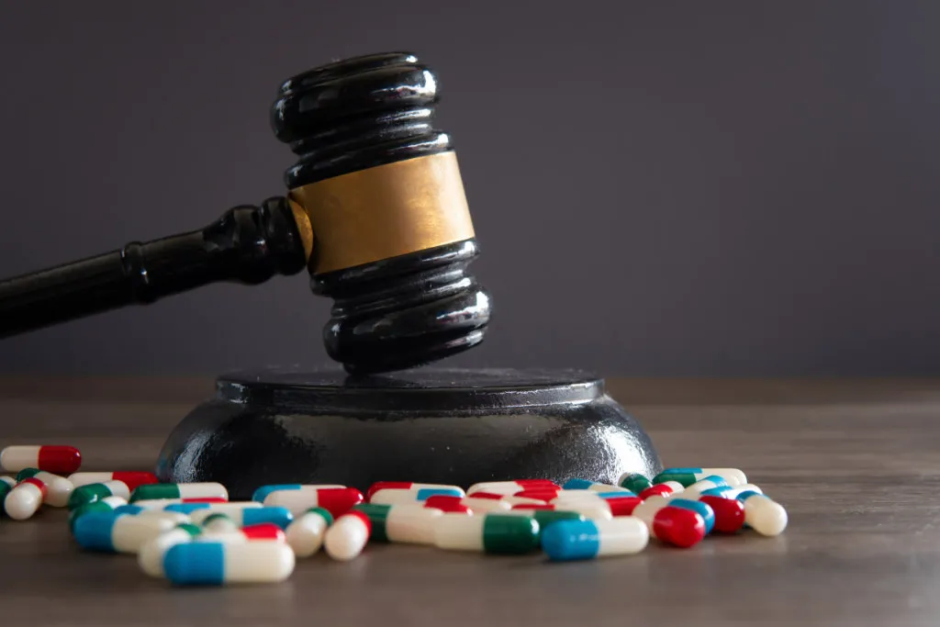
What can the U.K's drug policy do to be more effective?
By Brychan Gilson

Slide 2

What will be covered through this pressentation?
A brief summary of the video "Putting U.K Drug policy into focus"
identify some of the key challenges facing UK drug policy at that time and consider whether these challenges are still present today.
recommendations that were proposed in the film and whether current UK Drug policy has implemented these.
summarise key areas that future drug policy within the UK should prioritise and why?

Slide 3
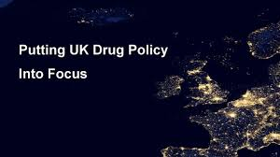
A brief summary of the video "Putting U.K Drug policy into focus"
- the main points being made are that the 1979 drugs policy needs to be updated as it seen as outdated and policies back then were according to Horsley "lots of our policies are based of ideology not evidence" , now in 2025 we have more evidence of the key issues , for instance “There have been 1,232 administrations of naloxone in the UK by the police between June 2019 and 30 December 2024.”- GOV.UK

Slide 4
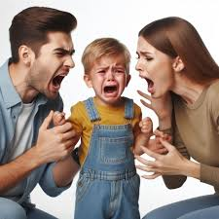
Continuation.
The policy in 1979 is also considered outdated as it has no efforts to reaserch the effect of trauma and how that can lead them to drugs – Douse "many people I see at our legal surgeries every week have experienced ACE's or Adult trauma" , and use "drugs as an effort to escape"
Although the new labour government has parctially addressed this , with from harm to hope, policy introduced in 2021.

Slide 5

What is from harm to hope?
Integrated support: Connects treatment with mental-health care, housing, employment, and family support.
Crime reduction: Focuses on disrupting drug supply and reducing drug-related offending, especially through better support for people leaving prison.
Workforce improvements: Invests in training and increasing the number of skilled staff across treatment services.
Overall, it aims to improve recovery outcomes, save lives, and reduce the wider social harms linked to drugs.

Slide 6

Identify some of the key challenges facing UK drug policy at that time and consider whether these challenges are still present today.
Children in drugs field– Horsleys stated that " now at the point where front line drug dealers in the U.K for heroin + crack cocain are children" - supporting evidence by ‘GOV.Uk website’ estimates 14,500 children were identified as at risk or involved in exploitation in 2023/2024.(next slide image)
B. lack of structural/ visable.(drug consumption rooms.)
- scottland has one yet in England and Wales there are no legitemate drug consumption rooms.
C. why do people take drugs? And how does truama affect this?
Efthimion strain on her family drove her to take drugs at younge age to escape / caused great comfort.

Slide 7
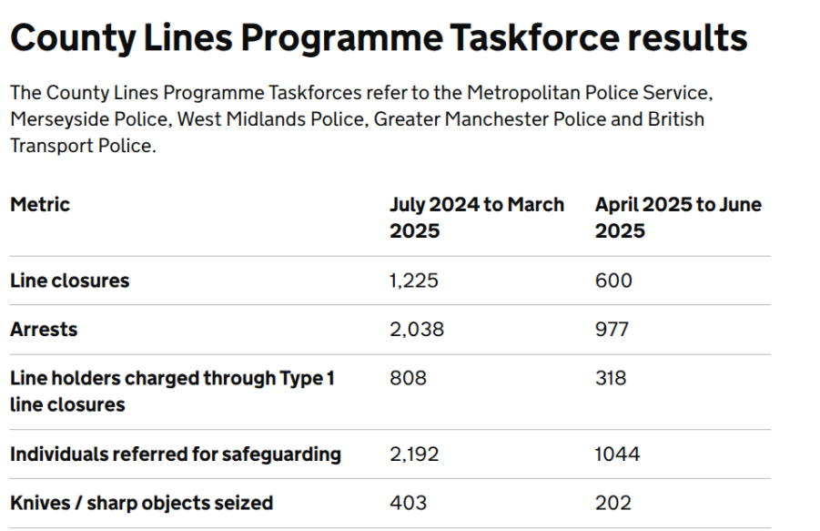
Image for previous slide.
What does this tell us ?

Slide 8
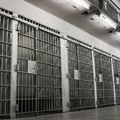
Have the recommendations that were proposed in the film and whether current UK Drug policy has implemented these recommendations.
1.Being harsher punishment on people with drugs/selling, (result in overpopulation in prisons)
2. Try find a solution for the drugs in prisons
-Stephenson "throwing people into prison is not necessarily the best way of solving the problem particularly with high use of drugs in prison as well.
3. The amount of young people in the drugs market and the rise of county lines in the U.K creating a more organised drugs market/operation
Woods statement that “ there is evidence of police activity but that does not necessarily mean there's evidence of reduced crime”. Although there is evidence of the police activity it doesn’t highlight the dark figure of crime with children that sell drugs and go under the radar.

Slide 9

Publics view of the current drugs policy U.K and other partys.
In the video Stphenson points out that "only 1 in 4 members of the public think that the current drug policy is actually working.
Continuation by Stephenson - " HOC , Royal College of Physicians and the times newspaper now support a review of our current drugs policy (2020)

Slide 10
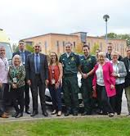
What is project A.D.D.E.R
Project ADDER focuses on reducing drug-related deaths, reducing drug-related offending, reducing the prevalence of drug use, and sustaining a major disruption of high-harm criminal and networks involved in middle market drug and firearms supply.
- https://www.london.gov.uk/who-we-are/what-london-assembly-does/questions-mayor/find-an-answer/project-adder

Slide 11
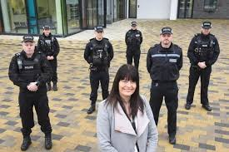
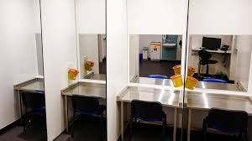
summarise key areas that future drug policy within the UK should prioritise and why?
1.The future drugs policy in the U.K should regard change to the 1971 misuse of drugs act
Harm to hope,project A.D.D.E.R , police carrying meloxone,
2. Drugs in prison should also be a key area that an updated drugs policy should cover.
More research into prisoners and why they take drugs , and find methods to reduce the ammount of drugs in prison.
3. legalisation of The drug consumption rooms.

Slide 12
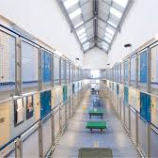
Point 2 on prisons last slide
A growing prison population, an ageing population, staff shortages, and inmates’ drug misuse are some of the acute challenges for doctors trying to deliver high quality care in prisons.

Slide 13
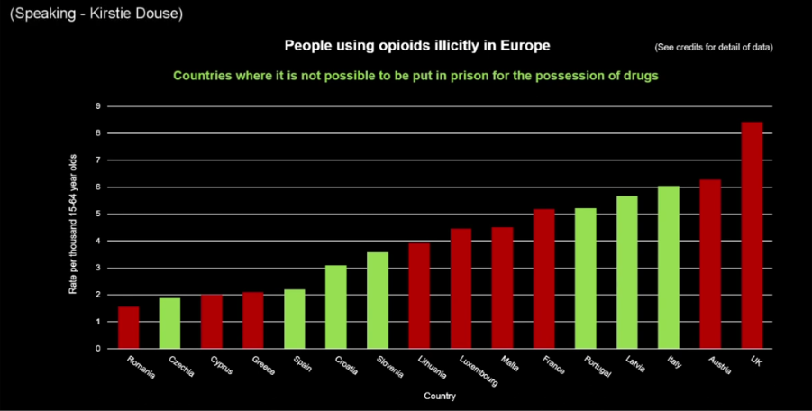
What does this show?

Slide 14
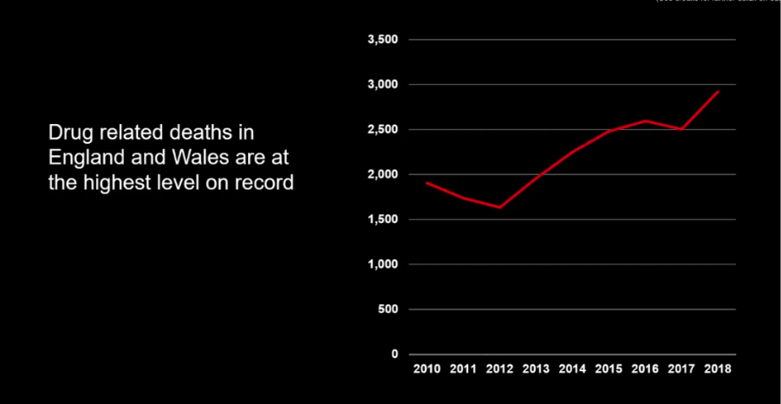
What does the graph show

Slide 15
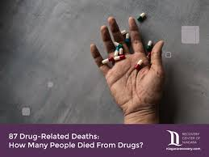
What is it like in the U.K now?
In England and Wales, 5,565 deaths related to drug poisoning were registered in 2024

Slide 16
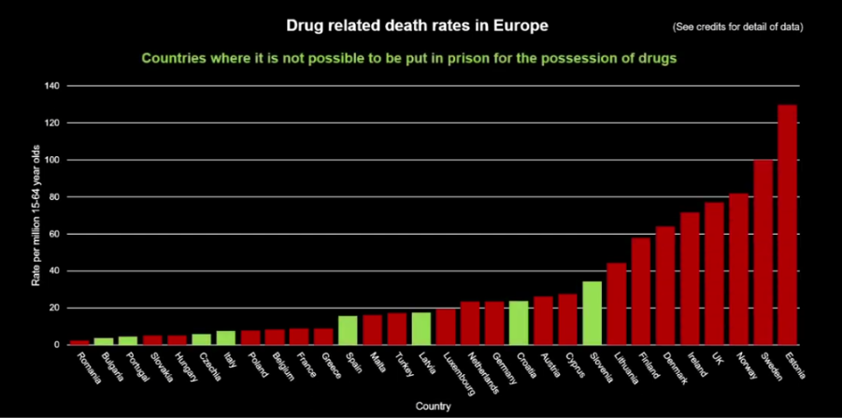

Slide 17


Any quiestions?

Slide 18

refrences
Project ADDER focuses on reducing drug-related deaths, reducing drug-related offending, reducing the prevalence of drug use, and sustaining a major disruption of high-harm criminal and networks involved in middle market drug and firearms supply - Thursday 28 December 2023 (https://www.london.gov.uk/who-we-are/what-london-assembly-does/questions-mayor/find-an-answer/project-adder)
Putting u.k drug policy into focus - (https://youtu.be/dj_5JkgxmRU?si=IxSV0kGhkRofCSdg)

Slide 19
Both from the putting U.K drug policy into focus - (https://youtu.be/dj_5JkgxmRU?si=IxSV0kGhkRofCSdg)

Slide 20
refrences
Illegal drug markets are not restricted to one local authority, nor are the movements of some people who use drugs, or those of many stakeholders, including police forces. - (P.3 , Written evidence submitted by Transform (DRU0106) , https://committees.parliament.uk/writtenevidence/108945/pdf/ )
A growing prison population, an ageing population, staff shortages, and inmates’ drug misuse are some of the acute challenges for doctors trying to deliver high quality care in prisons. - https://www.proquest.com/docview/3081582810/fulltextPDF?accountid=130472&parentSessionId=e6%2Bh%2BorL18toy3Yn0bZfNZAGT3951zZSb0TqdUgWMEA%3D&pq-origsite=primo_ra&sourcetype=Scholarly%20Journals - Howard, Sally. BMJ : British Medical Journal (Online); London Vol. 386, (Jul 16, 2024) (page 1.)

Slide 21
refrences
https://www.gov.uk/government/publications/home-offices-county-lines-programme-data/county-lines-programme-data

Slide 22
refrences
https://www.gov.uk/government/news/child-criminal-exploitation-and-cuckooing-to-be-criminal-offences - Current estimates show that approximately 14,500 children were identified as at risk or involved in child criminal exploitation (CCE) in 2023 to 2024.
GOV.UK “There have been 1,232 administrations of naloxone in the UK by the police between June 2019 and 30 December 2024” - https://www.gov.uk/government/publications/police-carriage-of-naloxone-process-evaluation/police-carriage-of-naloxone-process-evaluation
https://www.gov.uk/government/publications/police-carriage-of-naloxone-process-evaluation/police-carriage-of-naloxone-process-evaluation - author Ipsos UK authors Hattie Moyes, Dr Ammeline Wang, Isobel Martin, Nazifa Uddin, updated 24 september 2025
--- “There have been 1,232 administrations of naloxone in the UK by the police between June 2019 and 30 December 2024.”
In England and Wales, 5,565 deaths related to drug poisoning were registered in 2024 - https://www.ons.gov.uk/peoplepopulationandcommunity/birthsdeathsandmarriages/deaths/bulletins/deathsrelatedtodrugpoisoninginenglandandwales/2024registrations
(10pm 7December I asked chatgpt “give me a brief summary of from harm to hope) - “Integrated support: Connects treatment with mental-health care, housing, employment, and family support.
Crime reduction: Focuses on disrupting drug supply and reducing drug-related offending, especially through better support for people leaving prison.
Workforce improvements: Invests in training and increasing the number of skilled staff across treatment services.
Overall, it aims to improve recovery outcomes, save lives, and reduce the wider social harms linked to drugs.

Slide 23
refrences
Putting U.K drug policy into focus - (https://youtu.be/dj_5JkgxmRU?si=IxSV0kGhkRofCSdg) - All refrences below:
Horsley – lots of our policies are based of ideology not evidence.
Horsley - now at the point where frontline drug dealers in the U.K for heroin and crack cocain are children.
Douse – without support network you can understand why people would start using drugs.
Stephenson – throwing people into prison is not neccissaraly the best way of solving the problem particularly with high use of drugs in prisons as well.

Slide 24
refrences
Efthimion – strain on her family drove her to take drugs at young ageto escape / great comfort.
Stephenson – we don’t want to criminalise young people and ruin their life chances.
Douse - many people at our legal surgeries every week have experienced ACE's or adult trauma. + - drugs as an effort to escape.
Stephenson – only 1 in 4 members of the public think that the current drug policy is actually working. + - HOC, Royal college of Physicians and the Times newspaper now support a review of the current drugs police (2020 for all the refrences by putting u.k drugs policy into focus)

Slide 25
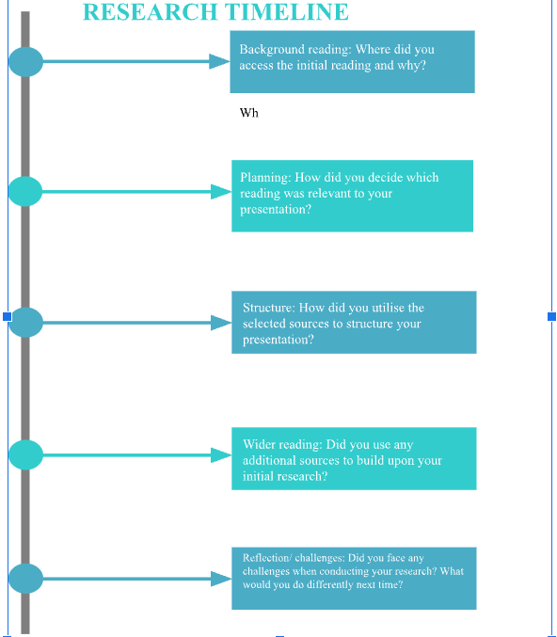
Next slide :)

Slide 26
I found the back ground readig from my search engine and the assistance of the university library helped guied me to cerain websites.
I decideed which reading was relivant my making them match the quiestion being asked and which suited the topic best.
I selected information from government websites, swansea library and graphs to help structure my presentation.
Other than the video we used for many sources on the topic I used other websites like gov.uk to support some statements with statistics.
next time I would be less dependant on my search engine and use the university library more and get a in hand copy of a book.

