Slide 1

IMK
Development

Slide 2
Team
Our team has 3 members, each of the members had a selection of tasks.
The 3 members of our team are….
(Keys for slides)
Matthew Kewin Izaac

Slide 3
Team
Matthew was in control of the main programming and was in charge of keeping the team on track
Kewin was in control of the program design, the marketing and promotion
Izaac was in charge of the financial and legal sections

Slide 4

Idea
The idea we created was an application for pet care companies and individuals. It is aimed to improve the efficiency by keeping the staff and the clients for the company in constant contact so if any issues arise then they can contact the owner.
The idea is a sort of animal social media where there is a main feed displays all of the newest updates about your pets and there is a instant messaging system to allow staff to contact their clients in real time

Slide 5
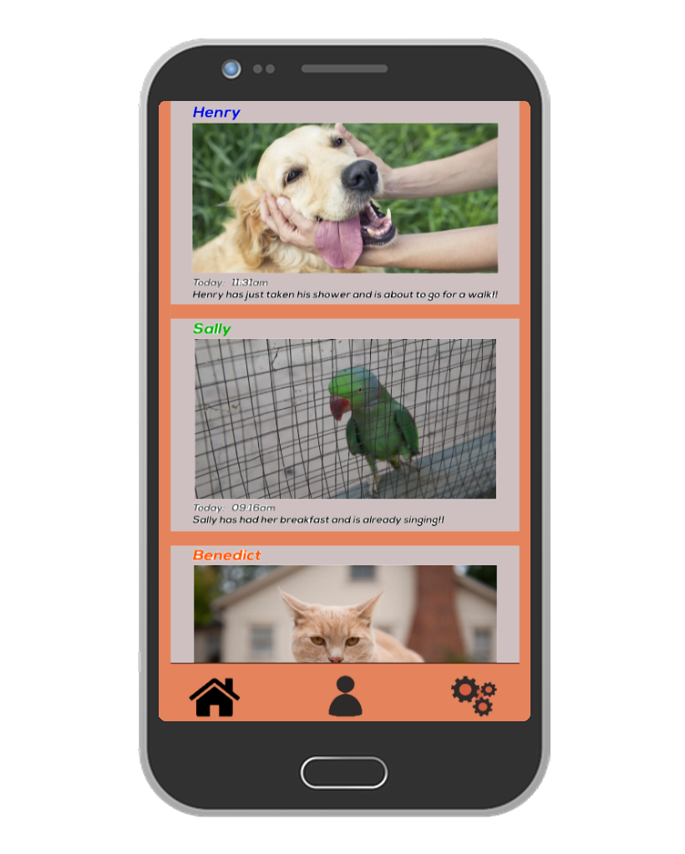

Idea
This is our App Home page. ------------------>
●Able to personalize the colours for each pets names
●Updates sent daily with photos attached
●Date underneath the update showing exactly when it was sent
●Text underneath the date that's under the update to let the owner know any extra details
Homepage button
Profile page button
Settings page button

Slide 6
USP
The thing that sets our idea apart from the competition is that our application aims at excelling the freedom and personalisation of the application. These areas were chosen to improve because other applications of this type don't have many customisation options.

Slide 7
Market
Is there A Market For Your product?
- Pets and pet owners across the globe are increasing - the need, demand and interest for day-care business’ and such are also rising.
- People who are often away from home/busy for work or other reasons will be interested in a software that lets them stay connected with their pets.

Slide 8




Market
How is product different from competitors.
We offer more personalisation options than any other apps;
Separate colour picker for each pet
Colour picker for chat messages
Dark mode
Switch Accounts

Slide 9
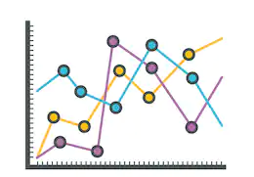
Market
Primary Research + Feedback
Around 40 pet owners surveyed - Around 5 businesses surveyed (no specific age range or gender)
Over 95% liked the idea
Over 90% liked dark mode - one suggested for different levels of darkness
Over 80% liked “switch account” function
100% were happy with chat feature - one suggested colour options

Slide 10

Demo
The following slides contain images of the prototype that we created over the course of around 1 week

Slide 11
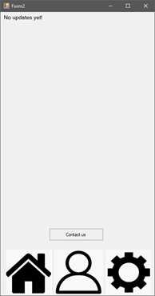
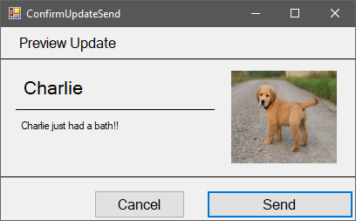
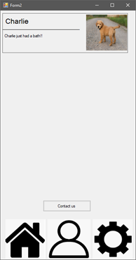
Demo

Slide 12
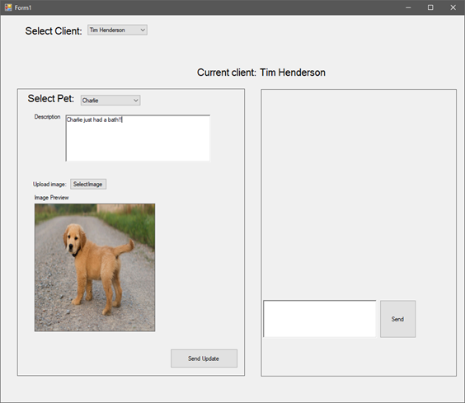
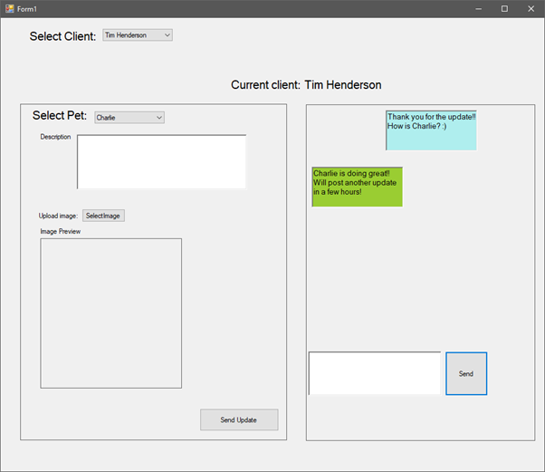
Demo

Slide 13
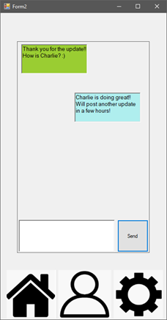
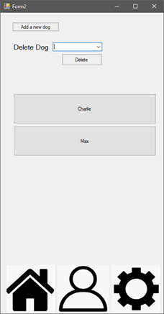
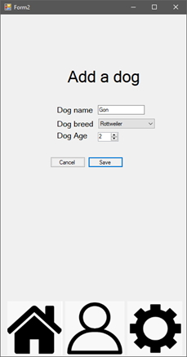
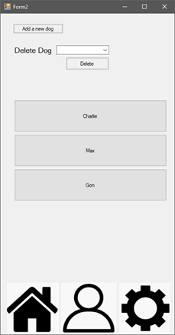
Demo

Slide 14
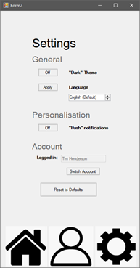
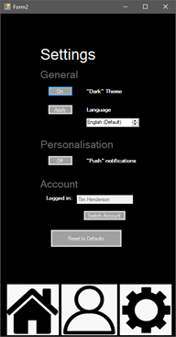
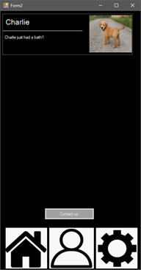
Demo

Slide 15
Creativity Marketing and Promotion
Target Market + Sales & Marketing Strategy
Target Market - Any business or individual that is taking part in a job that looks after others’ pets.
Software will be promoted online as well as out in the public;
Posters/Flyers will be put up in stores and in busy areas of town to promote company.
7-day Free Trial to get public interested
£7.99 monthly (Subscription) - (£4.99 for individuals)
Firstly distributed by contacting various businesses

Slide 16
Creativity Marketing and Promotion
Branding
Logo

Slide 17

Creativity Marketing and Promotion
Branding
Banner used online

Slide 18

Creativity Marketing and Promotion
Branding
Poster/Flyer
to hang up or handout

Slide 19
Creativity Marketing and Promotion
Sales/Revenue Streams
Either we will reach out to companies to see if they are interested in our software,
or businesses will approach is they hear about it first from on of our promotional strategies or somewhere else.
Once purchased we will send them out through an email to the business.

Slide 20
Business
This is the logo we created for our company:
It stands for our companies name which is IMK Development, or full name which is Inside Modern Knowledge.
With slogan which is “Developing Programs, Developing Lives.”

Slide 21
Legal
For protection of data we will follow the correct act, which is the Data Protection Act 2018, which is the latest data protection act. With acts such as:
●All Data is used fairly, lawfully and transparently
●Kept for no longer than is necessary
●Kept securely, with appropriate security, with protection from unauthorised access
●Inform users about how the data is used
●Allow users to be able to edit and delete personal data
For the company we will follow the, Unlimited Company, Corporate Law of United Kingdom, since we are based in the UK. This just includes the basic needs for all staff as well as basic rights that the company will have by others and for us to others.

Slide 22
Financial Overview
Overview of Sales/Cost projections
We will have multiple costs that we will need to factor in, such as the LLC cost which is a one of payment of £12, an office space so that we can all work together, which we found to be on average around £552 rent a month. We would need to work on a computer each, and since we do not need an powerful computer each, we have found ones that we can use for average around £300 each. We will need to advertise our company and what we can do, and for that we will put £100 a month into advertisement such as GoogleAds. We would also need testing for our app on both Android and IOS devices which is crucial so we have set aside £1000 testing for that over a period of time. Any money profit that we make will be split 3 ways between the 3 members of staff that work for the company.

Slide 23
Financial Overview
Required Start-Up Funding + How to acquire it
We will apply to get a small business grant from the government grant to help fund our business venture to help fund us during the initial development of the project. We will also contact local companies to see if they are interested in helping to fund the product creation, and they will receive the final product at a reduced rate.
We will also start a GoFundMe page to allow others to donate to help us with the start of our company, telling them what we do, and what we want to achieve.

