Slide 1

Blood
By the end of the lesson you should be able to:
State the composition of Blood
State the function of red blood cells and plasma
Explain the function of haemoglobin in the transport of oxygen
State the function of macrophages and lymphocytes

Slide 2
The average human has 5 litres of blood
It is a transporting fluid
It carries vital substances to all parts of the body
Blood

Slide 3

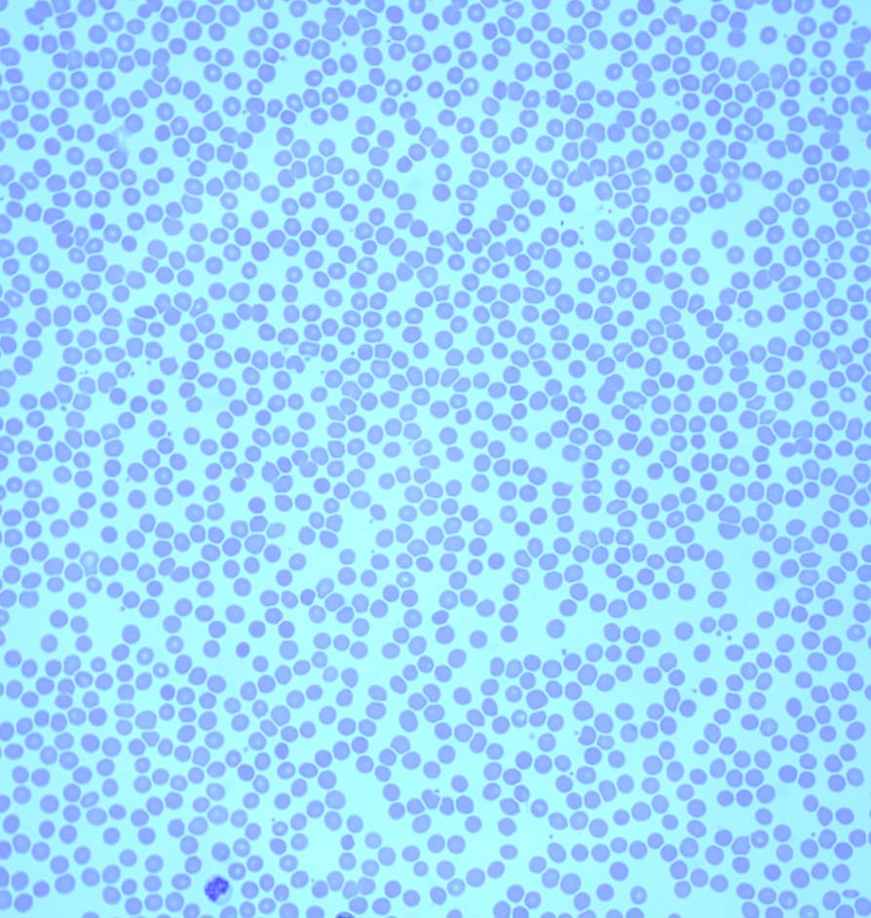
Human blood smear
X 500

Slide 4
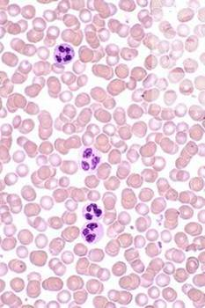
skool blood plasma
plasma (55%)
red blood cells
(5-6-million /ml)
white blood cells
(5000/ml)
platelets

Slide 5
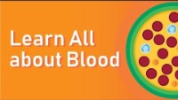
So what is blood made of ?

Slide 6
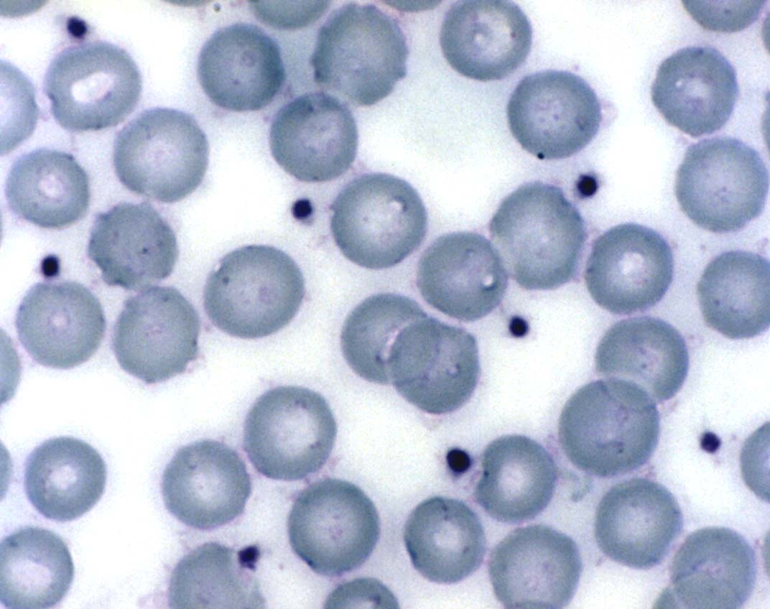
x 1000
Plasma is the liquid portion of the blood 55 % of total volume.
Straw coloured liquid portion of the blood consisting of 90-92 % water and a range of dissolves substances such as enzymes, hormones, gases, plasma proteins, waste products. All of which have a vital part to pay in maintaining the internal environment or homeostasis.

Slide 7
Plasma proteins are formed in the liver.
Three types
Function
Albumin
Fibrinogen and prothrombin
Globulins
Increasing osmatic pressure drawing fluid back into the capillaries.
Involved in blood clotting.
Formed in liver or lymph tissue responsible for immunity and fighting infection.
Notes:
Fibrinogen ( factor 1) - is a glycoprotein made in the liver. During tissue injury such as a cut it is converted by thrombin to fibrin and then to a fibrin based blood clot. This is what stops you from bleeding after cutting yourself.

Slide 8
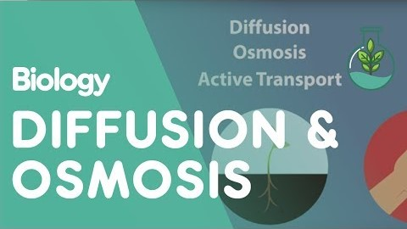
What is osmatic pressure
osmotic pressure, is a form of osmotic pressure induced by proteins, notably albumin, in a blood vessel's plasma (blood/liquid) that displaces water molecules, thus creating a relative water molecule deficit with water molecules moving back into the circulatory system within the lower ..

Slide 9
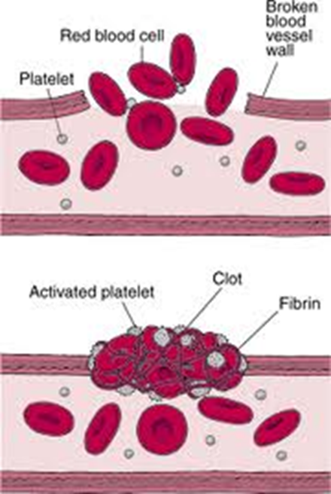
Clotting- (Fibrinogen →Fibrin)
Blood vessel damaged
Platelets release enzymes causing a reaction
Final reaction is soluble protein changed to insoluble protein
Fibres produced trap blood cells and form clot

Slide 10
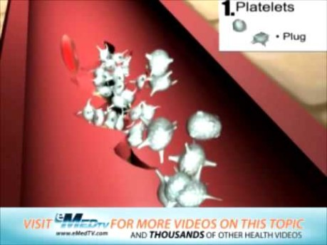
Want to know more about blood clotting?
We will be leaning about this in more depth in later sessions.

Slide 11
Three types of blood cells suspended in plasma
Erythrocytes –red blood cells
Leucocytes – white blood cells
Thrombocytes platelets
Notes:
Platelets help our blood to clot made in the bone marrow.

Slide 12
Red blood cells (RBCs)
transport oxygen
specialised to do this
Also carry some CO₂

Slide 13
White blood cells
the bodies “defence”
part of the immune system
much larger than RBCs
far fewer
have a nucleus
4000-13000 per mm³
2 types
phagocytes and lymphocytes

Slide 14
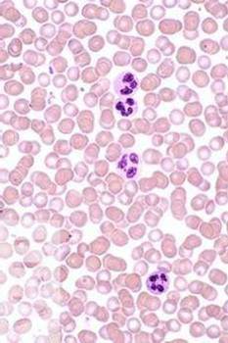
Platelets
if you get cut:-
platelets produce
tiny fibrin threads
these form a web-like
mesh that traps blood
cells.
these harden forming a clot, or "scab."
150,000 to 400,000 per mm³

Slide 15
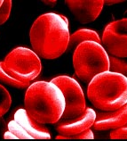
Erythrocytes (Red blood cells)
1) biconcave shape
2) no nucleus
→ extra space inside made in red bone marrow
3) contain haemoglobin
→ the oxygen carrying molecule
→ 250million molecules / cell most abundant
increases the surface area so more oxygen can be carried
Notes:
Erythrocytes are the most abundant blood cells. They are formed in the red bone marrow in the Centre of bones. The biconcave shape increase the surface area, thus allowing for greater absorption of gases such as oxygen and carbon dioxide ( CO2) . Red blood cells contain the pigment haemoglobin this transports oxygen and Carbon dioxide to all the cells of the body. Haemoglobin consists of globlin a protein and complex called haem oxygen attaches itself to the haem portion of the red blood cell. Red blood cells have a limited life of about 120 days after which they are broken down and recycled. If oxygen levels become low due to anaemia, blood loss the body needs to respond to this loss and makes new blood cells Erthropoiesis formation of red blood cells is stimulated. Low oxygen stimulates the production of erythropoietin (EPO) from the kidneys this stimulates the red bone marrow to produce more erythrocytes or red blood cells thus increasing the amount of oxygen in the blood. It is essential that the body has sufficient iron, B12 and folic acid in order to produce red blood cells,

Slide 16
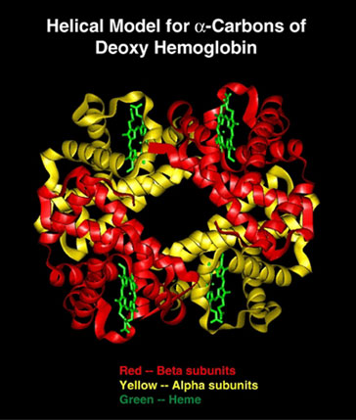
Haemoglobin
gives red blood cells their colour
can carry up to 4 molecules of O₂
associates and dissociates with O₂
contains iron

Slide 17
Erythropoiesis
Kidneys detect hypoxia
Erythropoietin released by kidneys into the blood.
Bone marrow increase erythropoiesis
Increases amount of erythrocytes in blood with capacity to carry O2
Reduction in tissue hypoxia due to increased
Notes:
Hypoxia is when your are suffering from low levels of oxygen

Slide 18
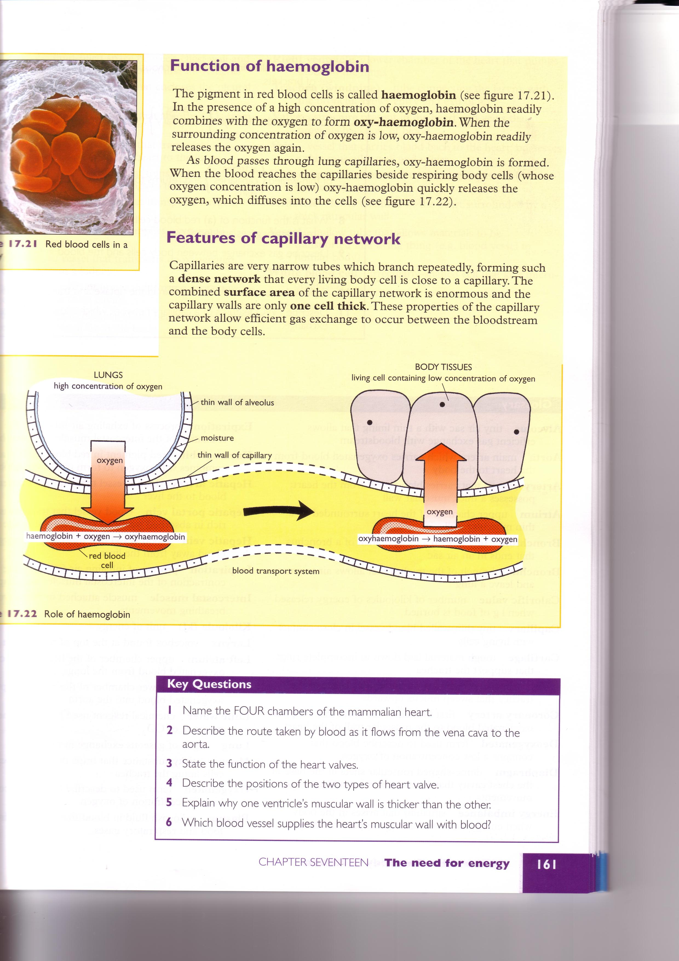
Function of Haemoglobin
When there is a high concentration of oxygen e.g in the alveoli haemoglobin combines with oxygen to form oxyhaemoglobin. When the blood reaches the tissue which have a low concentration of oxygen the haemoglobin dissociates with the oxygen and the oxygen is released into body tissues

Slide 19
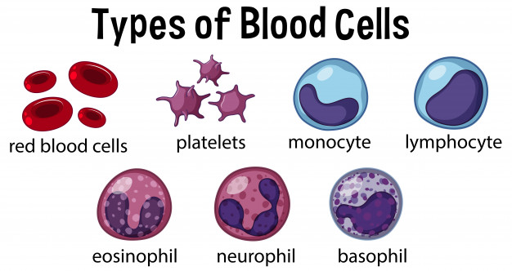

Slide 20
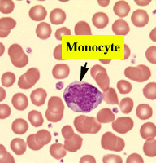
Monocytes
monocytes are important in the immune system’s ability to destroy invaders, but also in facilitating healing and repair. Monocytes are formed in the bone marrow and are released into peripheral blood, where they circulate for several days.

Slide 21
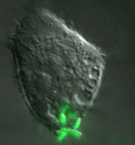

Phagocytes
Monocytes and macrophages
Provide a non-specific response to infection
.
http://www.microbelibrary.org/images/tterry/anim/phago053.html
Notes:
A phagocyte is a type of white blood cell that helps the human body fight off infection and disposes of dead or dying somatic cells. Phagocytes rid the body of bacteria and other pathogens via an ingestion process called phagocytosis

Slide 22
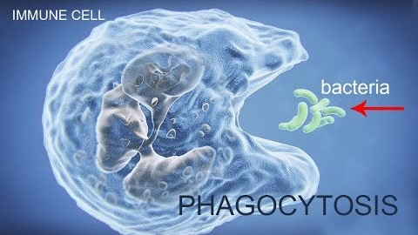
Phagocytosis

Slide 23

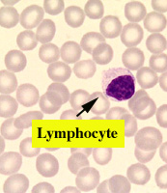
Lymphocyte

Slide 24
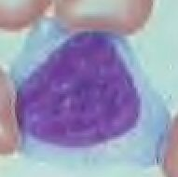
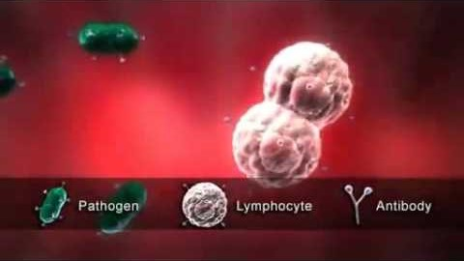
Lymphocytes
Provide a specific immune response to
infectious diseases.
Two Types T –cells and B- cells
They produce antibodies.
Notes:
Lymphocytes are the white blood cells involved in the specific immune response. They produce antibodies that respond to specific antigens on the surface of pathogens. Memory cells remain in the blood stream and lead to a quicker and stronger defense against a secondary infection by the same pathogen..
Communicable diseases
Pathogens are disease-causing viruses, bacteria, fungi or protists, which can infect animals and plants. The immune system, defends the body from pathogens.
Some pathogens produce toxins which make you feel ill. Lymphocytes can also produce antitoxins to neutralise these toxins. Both the antibodies and antitoxins are highly specific to the antigen on the pathogen, thus the lymphocytes that produce them are called 'specific'.

Slide 25
Neutrophil
Neutrophil, type of white blood cell (leukocyte) that is characterized histologically by its ability to be stained by neutral dyes and functionally by its role in mediating immune responses against infectious microorganisms. Neutrophils, along with eosinophils and basophils, constitute a group of white blood cells known as granulocytes.
Eosinophils: These help cells combat parasite infections. Like basophils and mast cells, they play a role in allergic reactions, asthma, and fighting parasite pathogens.
Notes:
What are basophils?
Your body naturally produces several different types of white blood cells. White blood cells work to keep you healthy by fighting off viruses, bacteria, parasites, and fungi.
Basophils are a type of white blood cell. Although they’re produced in the bone marrow, they’re found in many tissues throughout your body.
They’re part of your immune system and play a role in its proper function.
If your basophil level is low, it may be due to a severe allergic reaction. If you develop an infection, it may take longer to heal. In some cases, having too many basophils can result from certain blood cancers.

Slide 26
What do basophils do?
Whether you scrape yourself during a fall or develop an infection from a wound, you can count on your basophils help to get you healthy again.
In addition to fighting parasitic infections, basophils play a role in:
Preventing blood clotting: Basophils contain heparin. This is a naturally occurring blood-thinning substance.
Mediating allergic reactions: In allergic reactions, the immune system is exposed to an allergen. Basophils release histamine during allergic reactions. Basophils are also thought to play a role in causing the body to produce the antibody called immunoglobulin E (IgE).
This antibody then binds to basophils and a similar type of cell called mast cells. These cells release substances such as histamines and serotonin. They mediate the inflammatory response in the area of your body that was exposed to the allergen.
Notes:
Neutrophils, along with eosinophils and basophils, constitute a group of white blood cells known as granulocytes.

Slide 27
At a glance functions of white blood cells
White blood cell | Function
Neutrophils | Bacterial or fungal infection the most common first responders in microbial infections
Eosinophils | Parasitic infections and allergic response ( inflammatory)
Basophils | Allergic and antigen response release histamine.
Monocytes | Phagocytosis of pathogens
Lymphocytes | Includes B cells and T cells produce antibodies

Slide 28
How to remember?
Never – Neutrophils most prevalent so bacterial infections first responders!
Let – Lymphocytes B and T cells produce antibodies
Monkeys – Monocytes- remember munch ) phagocytosis eat the bacteria
Eat – Eosinophils- parasites and allergic responses inflammatory.
Bananas – Basophils Allergic and antigen response release histamine.

Slide 29


Blood
Can you?
State the composition of Blood
State the function of red blood cells and plasma
Explain the function of haemoglobin in the transport of oxygen
State the function of white blood cells.

Slide 30
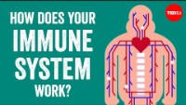
Let’s talk about immunity

