Slide 1

Software Applications for Business
5. Digital Dashboard and Data Analysis

Slide 2
Online Etiquette reminder
Please mute your mic during the Lecture tutorial sessions, to avoid background noise disrupting the session.
You will be prompted to unmute your mic to share activity answers sduring the Q&A session.
Please remember to mute your mic when you have finished speaking to avoid background noise disrupting the session.
Notes:
Chat is disabled to avoid distractions for all during the Lecture-tutorial. Time for Q&A after the Lecture-tutorial. Sessions run smoother as a result.
Avoid typing in the chat unnecessarily during the Lecture tutorial sessions to avoid distracting all participants.
Note: When sharing a PowerPoint deck I do not see chat comments. I check the chat during Activities and during the Q&A at the end.

Slide 3
announcement
No lecture-tutorial next week (7th March) due to reading week (time for students to work on Assessments).
Classes will continue as normal the week after. Week commencing Monday 13th March.
Tutor do: Remove from Teams calendar.

Slide 4
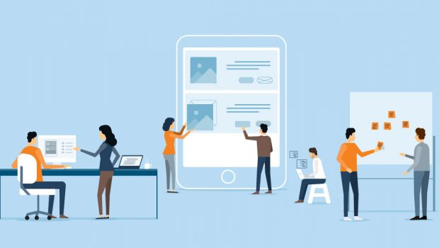
Overview
Slides & Activities
Answer example
Download register & stop recording
Q&A.
This Photo by Unknown Author is licensed under CC BY-SA-NC

Slide 5
Table of contents
Assignment 1: Task 4
Balanced scorecard (BSC)
Data Analysis software
Digital Dashboards
How to create Digital Dashboards
Activity.
This Photo by Unknown Author is licensed under CC BY-SA-NC

Slide 6
Assignment 1: TASK 4
Task 4. Poster of Digital Dashboard and Data Analytics software. (Approx. 200-250 words).
Complete either a(i) or a(ii) below:
a(i): Analyse key features of contemporary Digital Dashboard/Data Analytics software solutions and create a fictitious A3 Digital Dashboard poster for an organisation/project of your choice to show some key features of digital dashboards. Pre-existing images and graphs can be used. PowerPoint or equivalent can be used. Or:
a(ii): Test some features of a freely available Digital Dashboard/Data Analytics software application of your choice and document several screenshots with brief accompanying description to provide evidence of practical use.
Note: There is flexibility in this task. If you prefer ‘Design’ work and would like a career in Marketing, design or content creation select a(i). Or if you prefer working with numbers and would like a career in Business Administration/Management/Data Analysis choose a(ii).

Slide 7
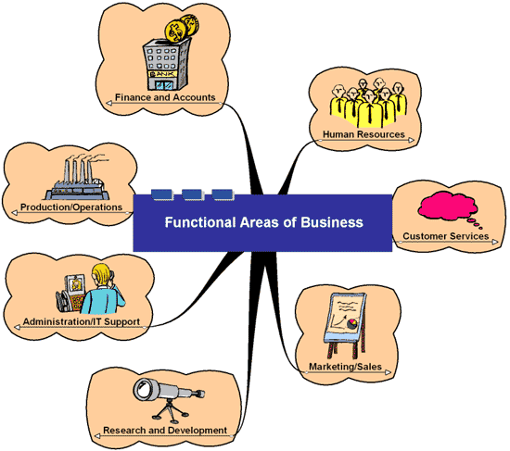
Business functions
In a previous tutorial we identified that businesses and Organisations consist of a number of departments, each of which has a specific job or task to do e.g. Marketing, finance, production - these are also called ‘business functions.
A typical business has many functional areas.
Bg. For more information please click-here.

Slide 8
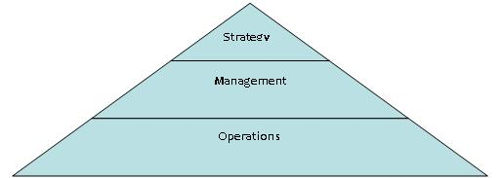
The Organisation Pyramid
We also looked at how key activities of an Organisation can also be classified into 3 main areas, namely Operations, Management & Strategy using the ‘Organisation Pyramid’ diagram, as outlined below.
Diagram ref: http://drmanning.files.wordpress.com/2008/08/pyramid.jpg
Notes:
For a more information and a clear and concise description please click here.

Slide 9
The Organisation Pyramid
And that these activities usually include:
Strategy: Directing the ship;
Management: Planning/Organising the ship; and
Operations: Running the ship.
Diagram ref: http://drmanning.files.wordpress.com/2008/08/pyramid.jpg
Notes:
For a more information and a clear and concise description please click here.

Slide 10

Example software applications for business
We also looked at example Software Applications for each Business function and level, such as
Finance software
Marketing software
HR software
Office Applications
Communication & collaboration tools
Project Management tools
Networking monitoring and Security software
Data Analysis & ERP software.
This Photo by Unknown Author is licensed under CC BY-SA-NC

Slide 11
Example software applications for business
Today we are going to focus on software applications that are commonly used by Management and Directors at a strategic level to support decision making. These software applications include:
Data Analytics/Data Analysis software
ERP software
Digital Dashboards.
This Photo by Unknown Author is licensed under CC BY-SA-NC

Slide 12
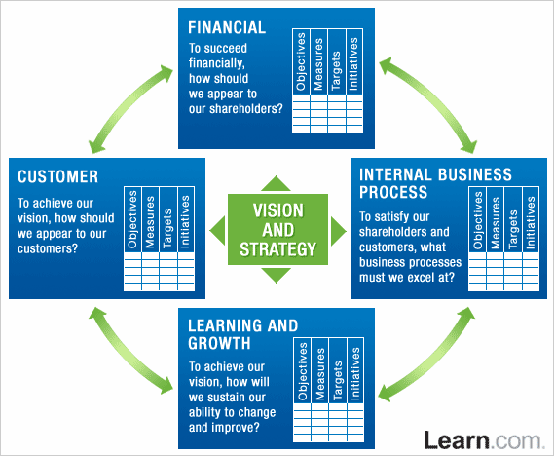
Balanced Scorecard (BSC), Objectives & ERP software
It’s worth mentioning that when Senior management set objectives for an organisation, they often do so ‘Holisitclly’ i.e. to cover all key areas of a Business.
One tool that is used to do this is called a ‘A Balanced Scorecard (BSC)’.
A Balanced scorecard (BSC) is a simple model used by Directors/Managers to create objectives and to evaluate the progress towards objectives, in all areas of the business.
Middle and Senior management often work together to crate these objectives. And Middle/Lower management and operational staff work tougher to achieve them.
ERP/Data Analytics software is used to monitor and evaluate the progress towards achieving those objectives.
Ref:vectorstudy.com - managementtheories.

Slide 13
Activity: Data Analysis software
Q. What is Data Analysis software? What do they do and what are some example data analysis software tools?
Research and document an answer.
Share your answer if asked. *
* Note: 2/3 students will be selected at random to share.

Slide 14
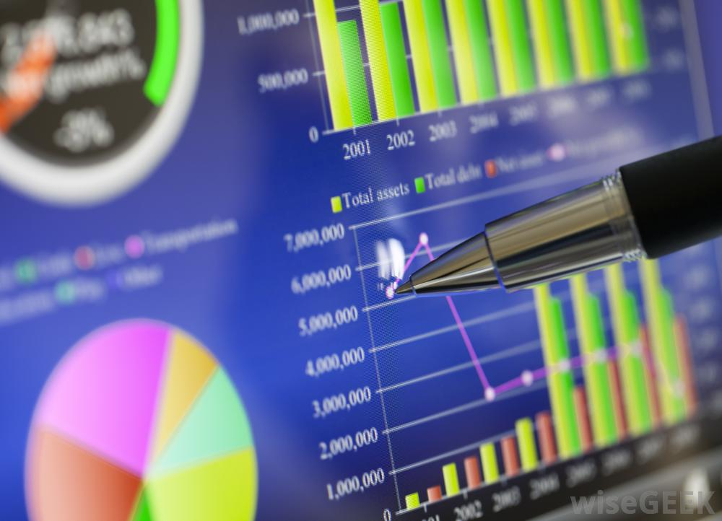
Data Analysis, ERP & digital dashboard software
Data Analysis, ERP and Digital Dashboard software all provide similar functions: they allow data to be stored, analysed and output in a visual format to aid decision making.
You can purchase Data Analysis, ERP and Digital Dashboard software separately.
Today, however, business/Organisations can purchase software that have all three integrated, if needed. It depends on what a business needs.
For example, a small business may onl need an excel spreadsheet for it’s data analysis purposes. However, a larger Organisation may required an ERP solution with a Digital Dashboard too.
It is worth mentioning that ERP software today has Data analysis and Digital Dashboard capabilities, and encompasses all 3 software capabilities.
This Photo by Unknown Author is licensed under CC BY

Slide 15

Bg. Term: data analysis &
Data analytics
Data Analytics and Data Analysis are often used interchangeably to mean the same thing.
Some people view ‘Data analysis’ as being a broader term, the umbrella term used to refer to the process of collecting, compiling and analysing data to present findings to help business decision making.
And Data analytics an aspect / element / component of data analysis that includes the use of more specialist tools and analysis techniques.
Some people actually define it as beng the other way around.
For the purposes of this module and assignment, the terms are used interchangeably. The key focus in this module and assignment is that they are both used to analyse data to aid business decision making.
This Photo by Unknown Author is licensed under CC BY

Slide 16

EXAMPLE Data analysis software
MS Excel
Tableau.com
MS Power BI
ZohoAnalytics
DashBuilder
Seal Report
FreeBoard
Grafana

Slide 17


Bg. Tableau & MS Power BI
Tableau
What is Tableau: click-here.
Where is Tableau: click-here.
How can I use Tableau: click-here.
MS Power BI:
What is MS Power BI: click-here.
Where is MS Power BI: click-here.
How can I use MS Power BI: click-here
This Photo by Unknown Author is licensed under CC BY-SA
This Photo by Unknown Author is licensed under CC BY-SA

Slide 18


Bg. Video: Data Analytics –
9 Essential Tools! (2023)

Slide 19
Activity: ERP software
Q. What is ERP software?
Q. What does ERP software look like?, find an image?
Research and document an answer.
Share your answer if asked. *
* Note: 2/3 students will be selected at random to share.

Slide 20
ERP software
An ERP system, is Business Management software.
Usually a suite of integrated applications. ERP systems provide interfaces for all functional areas at operations level and a high-level dashboard to aid decision making at Management levels.
Companies use it for planning purposes, to analyse business performance, set objectives and to manage all business operations.
It’s an all-in-one solution that provide a GUI interface for all departments and all levels of a Business/Organisation. Some examples include: Sage 300, Odoo, Infor., Workday., Oracle NetSuite, Microsoft Dynamics.
ERP software tools are a form of Data Analysis software. ‘Enterprise-class’ Data analysis software, as ERP software provide interfaces for employees throughout an organisation to enter and edit data in the software and provide Digital Dashboards for Management to view.
For more information please click-here and here.

Slide 21



Bg. Data Analysis & ERP software
Data Analysis Software (or Data analytics tools) provide tools to allow the user to perform quantitative and qualitative data analysis, to provide a visual overview and insights to aid decision making.
Data Analysis Software make it easier for users to view, analyse and edit data/information, to show relationships and correlations between datasets e.g. Sales and Marketing reports, to show the effectiveness of a promotional strategy and the sales of a product.
There are several different types of Data Analysis/Analytics software, some are for general use, some are for academic use, and some are for business use.
ERP software tools are a form of Data Analysis software. Enterprise Data software, as they also provide interfaces for employees throughout an organisation to enter and edit data in the software and provide Digital Dashboards for Management to view.
For more information on Data Analysis tools please click-here.

Slide 22
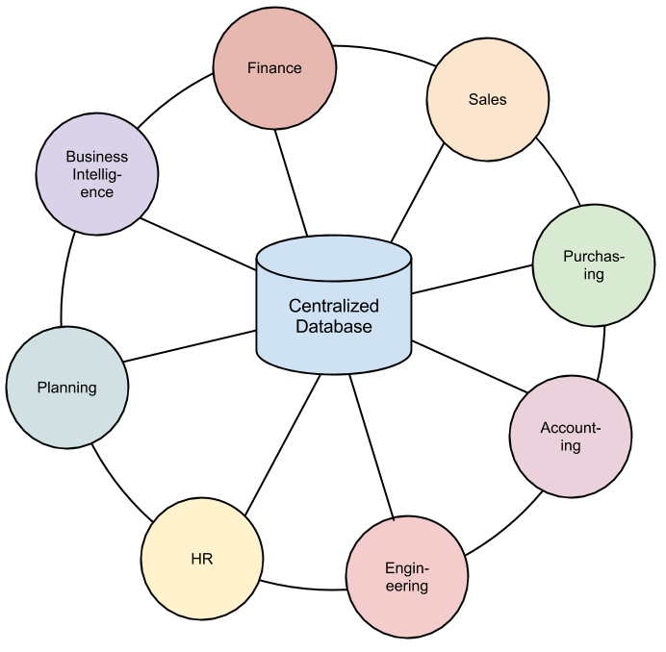
Visual: ERP SOFTWARE
This Photo by Unknown Author is licensed under CC BY

Slide 23
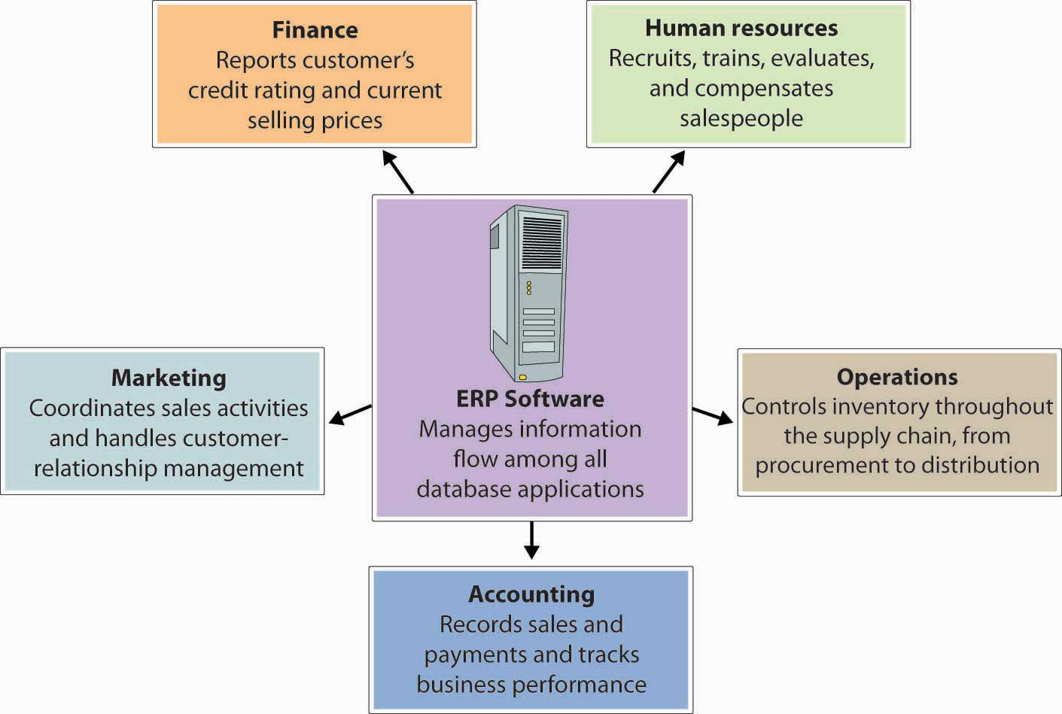
Visual: erp
This Photo by Unknown Author is licensed under CC BY-SA-NC

Slide 24
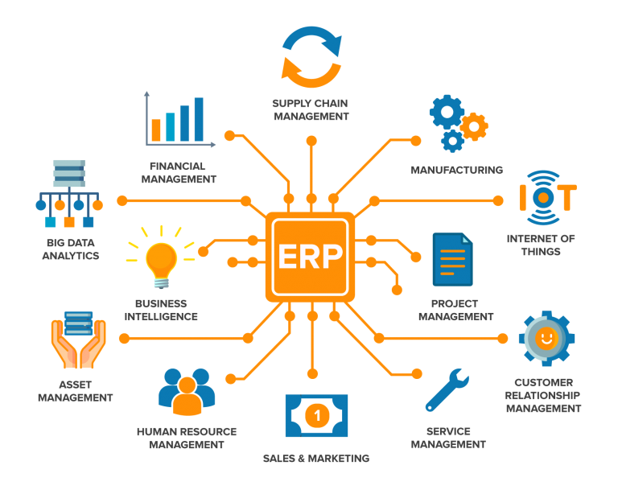
visual: ERP software
(r)

Slide 25
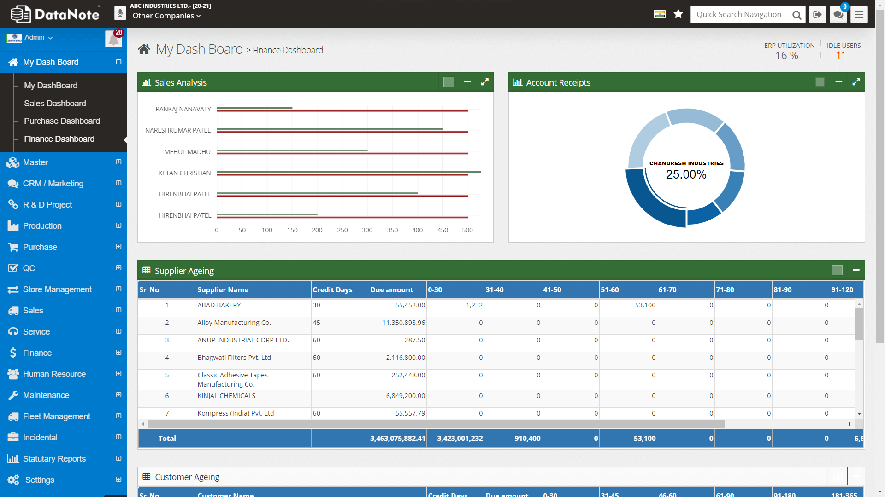
visual: ERP software – DataNote.in ERP (r)

Slide 26
Bg. Enterprise resource planning (ERP) software
ERP provides an integrated real-time view of a business using a central database for all ERP modules/applications.
Each Department in the Organisation will have it’s own Module/application linked to the central database.
The applications that make up the system share data across the various departments/functions (manufacturing, purchasing, sales, accounting, etc.) that entered the data.
ERP system will give a consistent look and feel across modules.
ERP facilitates information flow between all business functions and outside stakeholders (e.g. Suppliers and customers).
Though early ERP systems focused on large enterprises, smaller enterprises increasingly use ERP systems.
An ERP system can integrate various existing organisation systems. It can integrate a variety of software platforms and computer hardware and use a central database to link all systems.

Slide 27
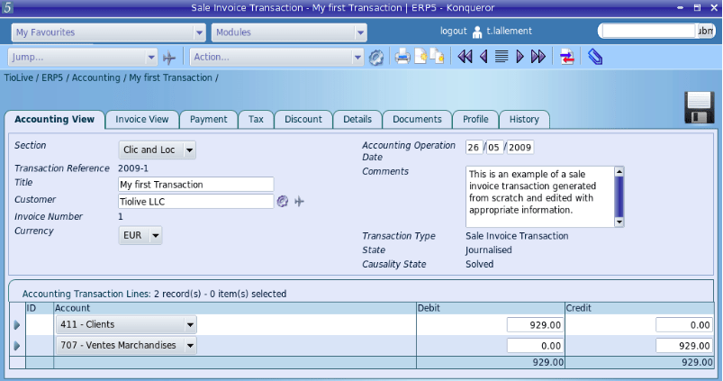
ERP: Accounting view
This Photo by Unknown Author is licensed under CC BY-SA-NC

Slide 28
Activity: Digital Dashboards
Q. What is a Digital Dashboard?
Q. What does a Digital Dashboard look like?, find an image of a Digital Dashboard?.
Research and document an answer.
Share your answer if asked. *
* Note: 2/3 students will be selected at random to share.

Slide 29
Digital Dashboard
A Digital Dashboard is usually* a Management / Strategic high-level information system that provides Management with a snapshot overview of data from all functional areas, usually in a visual format, to aid decision making.
Underneath the high-level visual graphs and charts of a dashboard is typical data analysis formulas and functions such as the use of pivot tables to summarise data. Dashboard graphs are created from underlying data that we are used to seeing in excel spreadsheets.
  * A Digital dashboard today are used by employees at all levels of an organisation, usually analytical/operation dashboards are configured to show more shorter-term data analysis while more Management and Strategic dashboards show higher-level views with longer term results and forecasts.
  For more information click-here and here. Tip: If you have a Google/Gmail a/c and want to see your personal Google dashboard, goto: https://myaccount.google.com/dashboard.

Slide 30
Digital Dashboards cont…
Dashboard software is used to gather, store, track, and display business data in interactive and customisable visualisations that enable users to monitor the business, to analyse data and provide data visualisations that will aid decision making.
A digital dashboard is also known as ‘Business intelligence (BI)’ software.
Examples include, ERP, CRM and SCM software that monitor important parts of the business (aka business metrics) and the overall performance of a company/Organisation.
Business metrics aka performance metrics, measure different aspects of an Organisation, business or project. E.g. financial metrics include product sales revenue/turnover, profits, expenditures, assets, liabilities, and capital etc…
The business user or Manager can then oversee a number of key areas of the business/Organisation by displaying metric data visualisations, metric trends in graphical format, and real-time information in a more easy to understand presentable format.

Slide 31
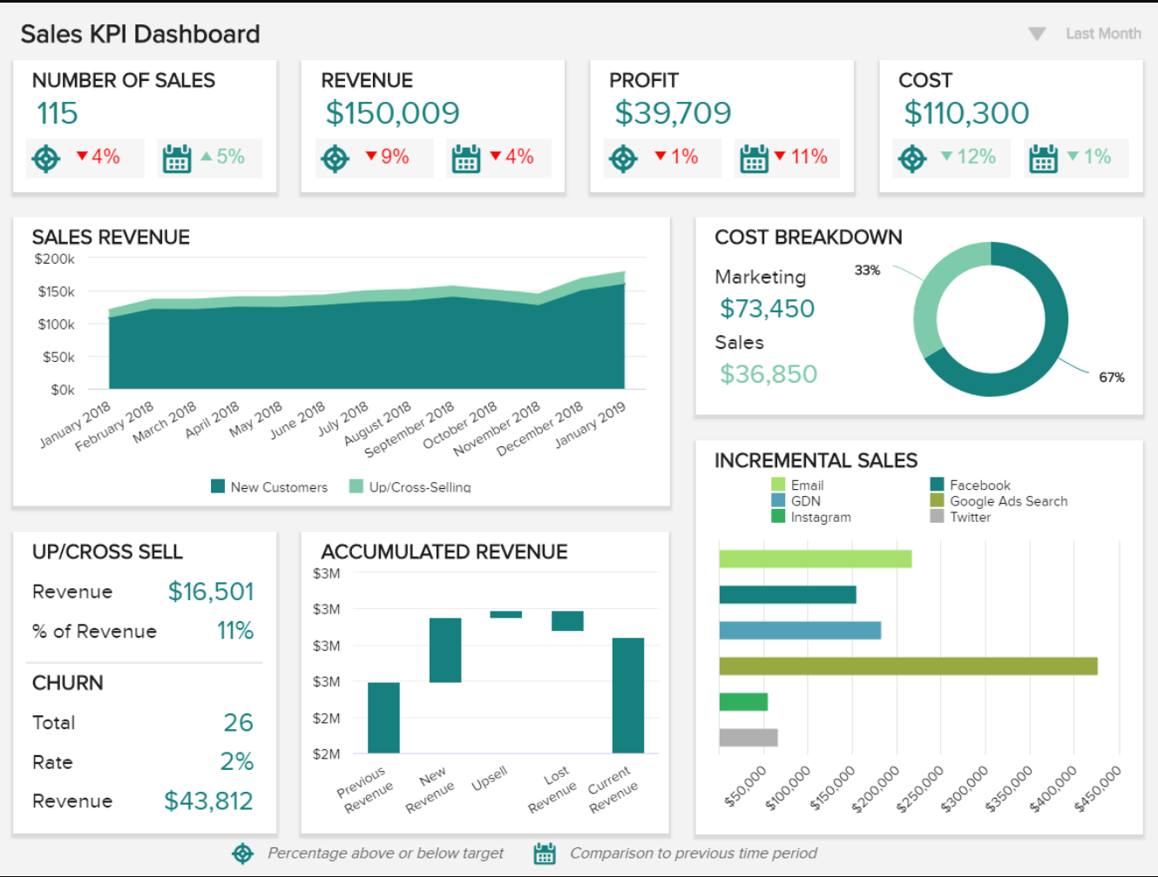
Visual EXAMPLE: Digital Dashboard
Ref: monthly-sales-report-template.png (1168×880) (datapine.com)

Slide 32
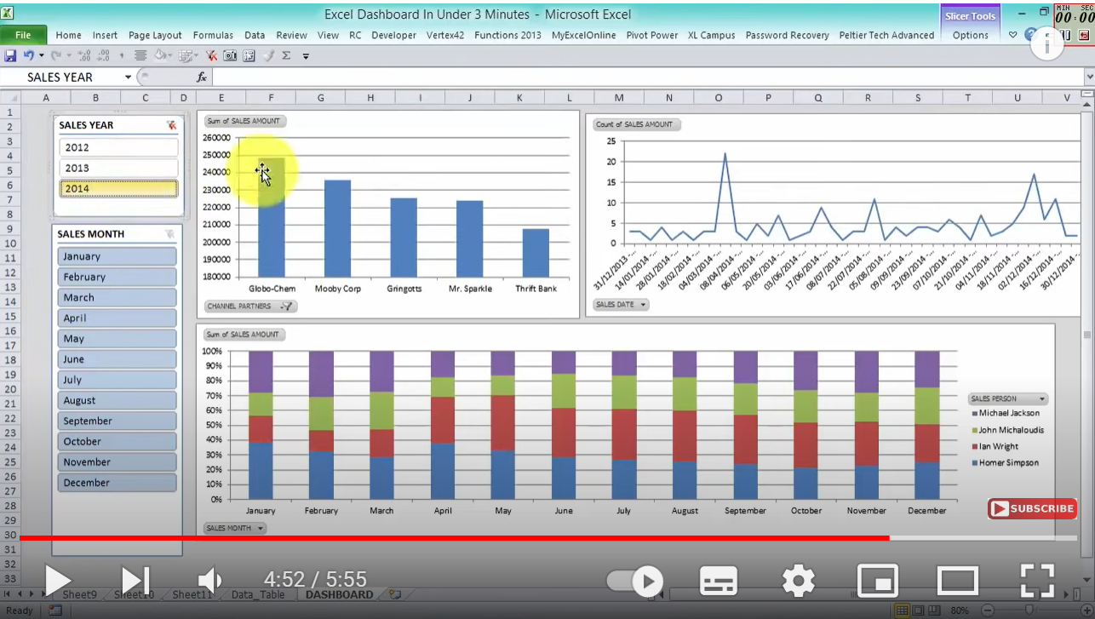
Video example: digital Dashboard in 3minutes using excel

Slide 33
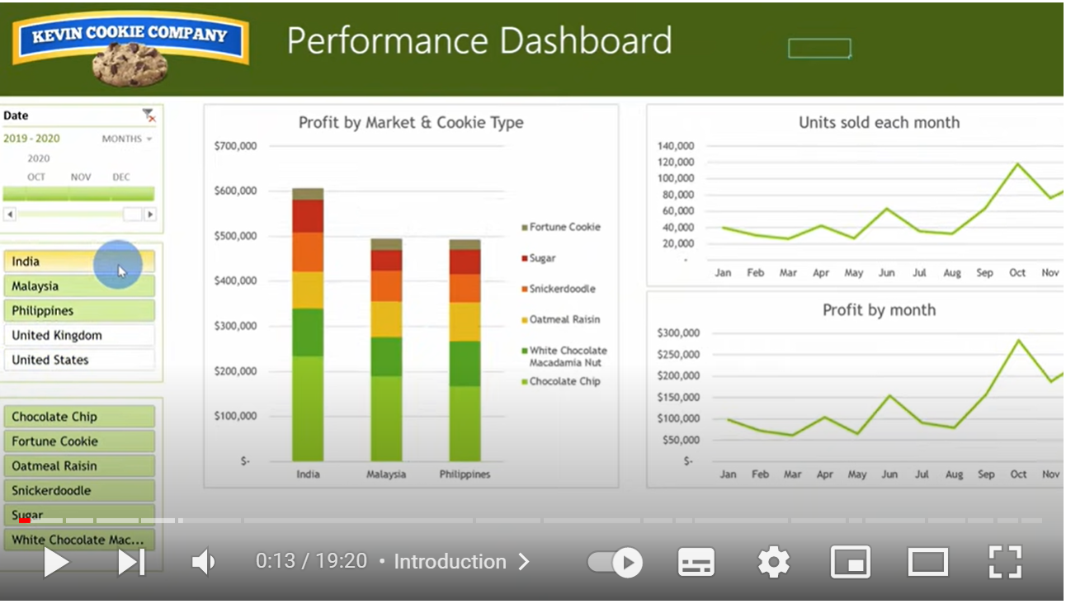
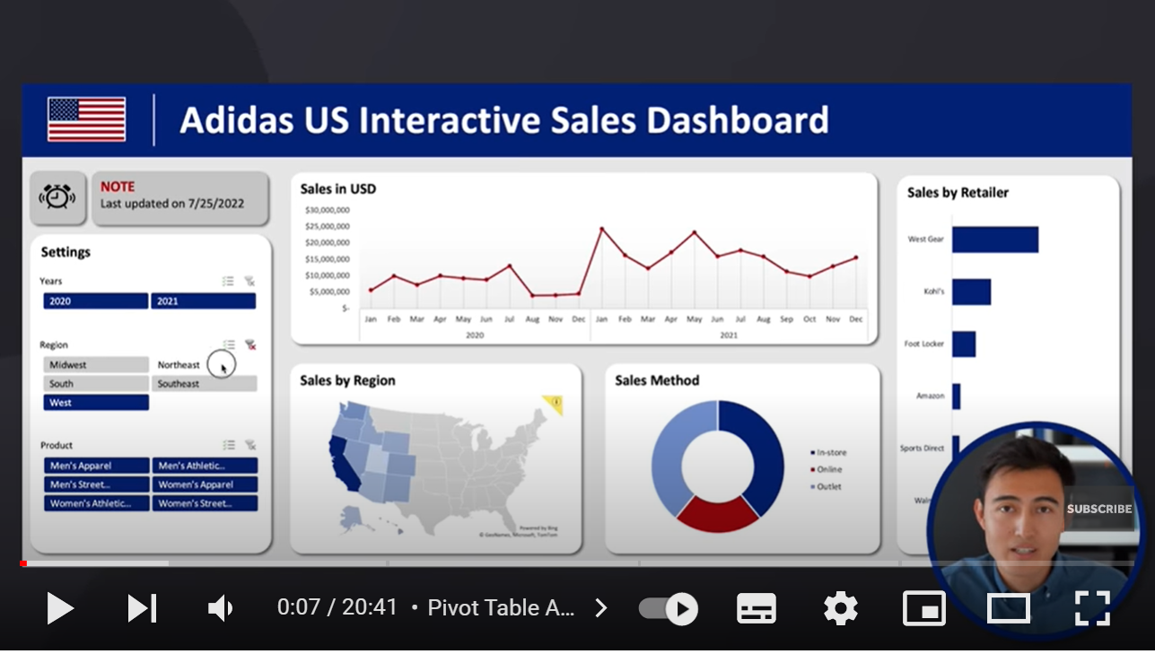
Video Example: how to Create a digital Dashboard in Excel
Example:
Watch 35secs: How to Build Excel Interactive Dashboards (19mins)
Watch 35secs: Build the ULTIMATE Excel Dashboard from Scratch (20mins)
  Other: How to make an Awesome Excel Dashboard in Just 15 Minutes

Slide 34
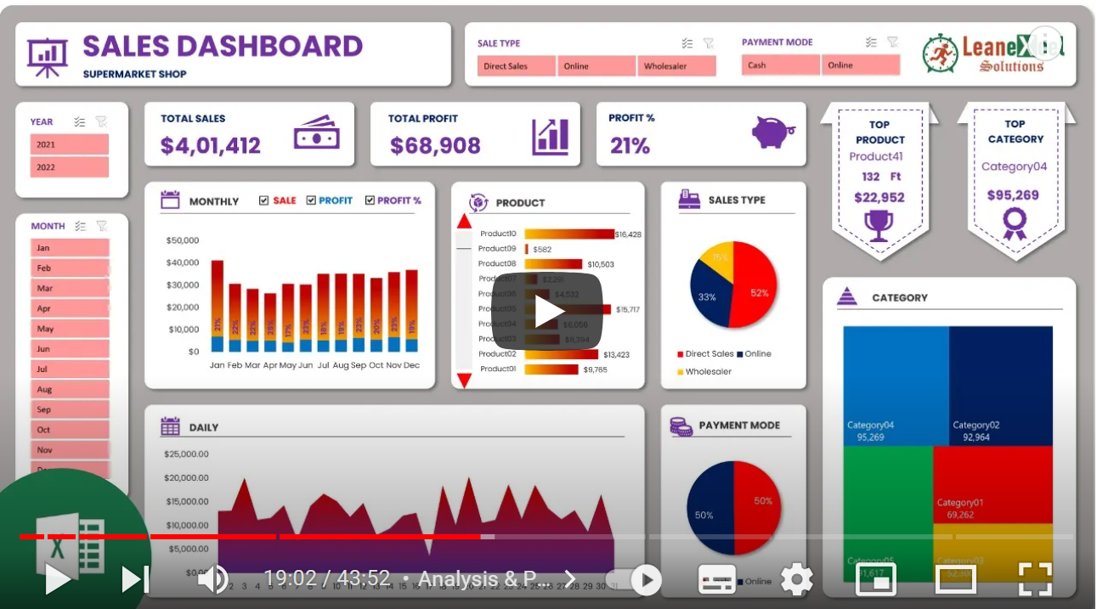
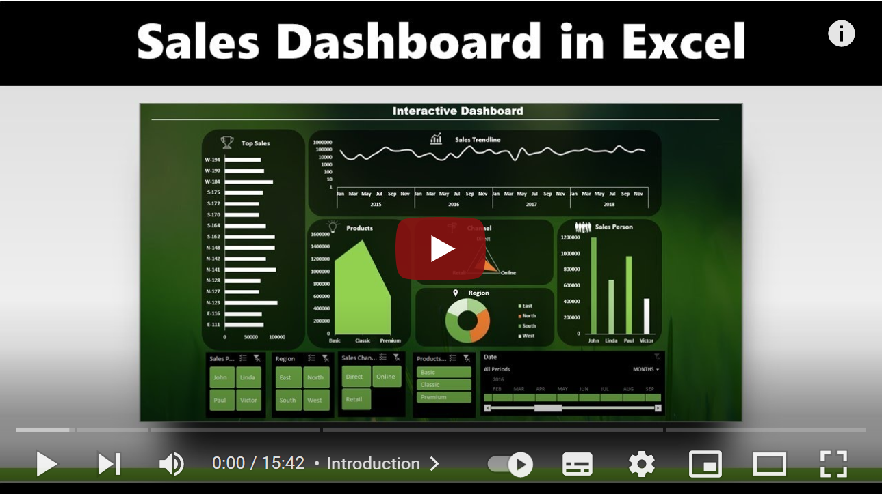
Example tutorials: Create a digital
Dashboard in Excel / Google sheets
The following example video tutorials show you how to create a Digital Dashboard in Excel and Google Sheets. Noted here in case you wanted to learn how to create a Digital Dashboard for Task 4 a.ii.
How to Build Excel Interactive Dashboards (19mins)
How to Create a basic Dashboard in Excel (14mins)
How to Create Dashboards in Excel (14mins)
How to create a basic Sales Dashboard in Excel (15mins)
Create a Dynamic Dashboard in Excel & PowrPoint (43mins)
How to build Interactive Excel Dashboards (52mins)
Microsoft Excel Financial Statistics Dashboards System
How to Create a Dashboard in Google Sheets (10 steps) (56mins)

Slide 35
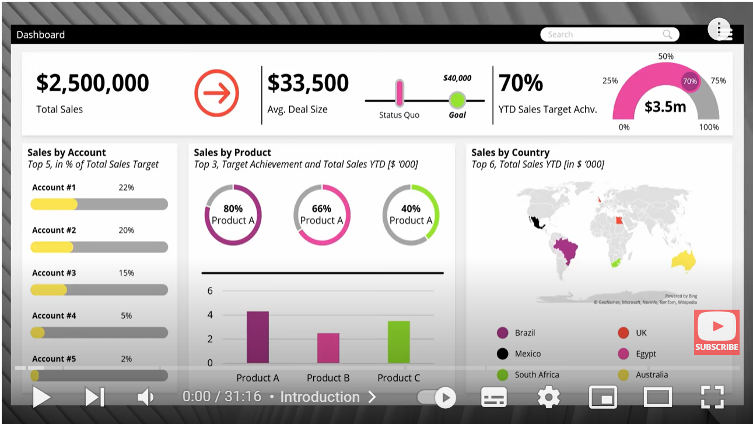
Create an Infographic digital Dashboard in PowerPoint
Examples:
WATCH 30secs (+ 20m50secs for 30secs): PowerPoint DASHBOARD DESIGN | Step-by-Step TUTORIAL (31mins)
WATCH 1min: Create a PowerPoint Infographic Digital Dashboard (9mins) with Zoom effect.
Others:
Tips on how to Create an Infographic in PowerPoint

Slide 36

Create an infographic poster with ‘google drawings’
‘Google Drawings is a free web-based diagramming & drawing software application available as part of Google’s web-based G-suite office applications.
The app allows us to create diagrams, flowcharts, Organisation charts, website wireframes diagrams, mind maps, concept maps, basic image editing and allows collaboration with other users in real-time.
The Diagrams can then be inserted into other Google Apps or downloaded in standard formats such as JPEG, SVG, PNG, or PDF to use in other Apps.
That can be used to create an ‘Infographic’ / Digital Dashboard poster for Task 4 a.(i).
  Design an Infographic in Google Drawings- Applied Digital Skills
  WATCH: Introduction to Design an Infographic in Google Drawings- Applied Digital Skills
In addition to this tutorial, you can view this one to learn how to asily add Graphs/diagrams to your infographic:
WATCH: Add Charts and Diagrams to Google Drawings

Slide 37
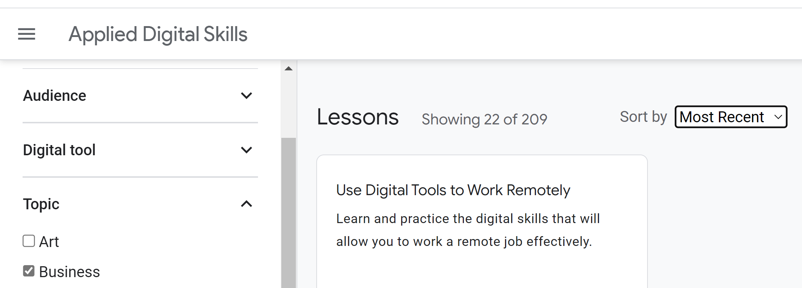
Bg. Awareness Activity: Google digital skills courses
Google has an ‘Applied Digital skills’ website with a wide range of free Digital skill courses that help you to develop your digital skills.
Goto: Applied Digital Skills: Digital Lessons & Curriculum webpage.
Use the ‘Topic’ filter on the left, and select ‘Business’
Next use the ‘Sort by’ option on the right and select ‘Most recent’
Browse through the courses to see some examples. There are may more.
Next select ‘Clear filters’ on the left, and choose a ‘Digital tool’ to find a course of interest to you.

Slide 38
Poster design options
You could choose a poster design tool to answer task a4 (i). There are many poster design tools, here are some examples:
  MS PowerPoint: Please click-here to learn how to create a poster using PowerPoint.
  Other poster design software include:
  MS Publisher
  Adobe Illustrator
  Google Slides
  Adobe Spark
  Canva.com
  Crello.com

Slide 39
A3 Poster dimensions
A3 landscape is 29.7cm high and 42cm wide.
A3 portrait is 42 high and 29.7cm wide.
  Bg. To set an A3 size in PowerPoint: Go to the ‘Design’ tab, click on Page setup/Customise slide size (in newer versions) and set the dimensions as above to create an A3 Poster.
Although the assignment specification mentions A3. There is flexibility here, your Digital Dashboard / Infographic poster can be a different size if needed. That’s ok.

Slide 40
Example software to test
To answer Task 4, you could design a Dashboard in PowerPoint or Google Drawings or you could test and use a Data Analysis/ERP/ Dashboard software. Some are listed below. The choice is yours.
Data Analysis & Analytics software: | Digital Dashboard software: | ERP Software:
MS Excel Tableau. MS Power BI Apache SuperSet. Zoho Analytics. Mode. Google analytics. | SmartSheet.com Dashboards. Grafana.com. Domo.com Dashboards | DoliBar. ERPNext. Odoo. WebERP.

Slide 41

ASSESSMENT Example
Tutor note: Show 1/2 Task 4 answer examples from previous assessment. Link in Moodle (for Tutor only).

Slide 42
Activity: Assignment 1 – Task 4.
Task 4. Poster of Digital Dashboard and Data Analytics software. (Approx. 200-250 words).
Complete either a(i) or a(ii) below:
i. Analyse key features of contemporary Digital Dashboard or Data Analytics software solutions and create a fictitious A3 digital dashboard poster for an organisation/project of your choice to show some key features of digital dashboards. Pre-existing images and graphs can be used. PowerPoint or equivalent can be used. Or:
ii. Test some features of a freely available Digital Dashboard/Data Analytics software application of your choice and document several screenshots with brief accompanying description to provide evidence of practical use.
When complete, include your answer to this task on a page in your e-portfolio.
Next:

Slide 43


The Key to Success
THE KEY TO SUCCESS FOR THIS MODULE IS TO MAKE WEEKLY PROGRESS.
Don’t leave it until the end.

Slide 44
Reminder:
STUDY Time allocation
The study time for Cert.HE modules is divided as follows:
Activity type | Percentage
Scheduled learning | 24%
Independent learning | 76%
Placement learning | 0%
TOTAL | 100%
There will be some time in the tutorials for you to work on an Activity related to the Assignment. But you will need to schedule additional time in your diary to work independently to research learn and complete the activity.

Slide 45


PAL: PEER ASSISTED LEARNING
Student support PAL sessions take place on campus on Thursdays, at 4-5pm in IQ004.
To join online, please email Joey (2003730@student.uwtsd.ac.uk) and she will add you on Teams.

Slide 46


Download
Register
& stop recording

Slide 47
Study Support
Additional study resources and support are available from the University. Support is offered with researching, referencing, avoiding plagiarism. academic writing, critical thinking, presentation skills, planning and organisation, and exam revision. For more information click below:
Online Academic study & Digital skill support resources: Student Essentials | University of Wales Trinity Saint David (uwtsd.ac.uk)
Library, learning and research sources and resources for Computing students: Applied Computing | University of Wales Trinity Saint David (uwtsd.ac.uk)
1-2-1 Study skill support:
1-2-1 Study skill support: https://www.uwtsd.ac.uk/study-skills/.
1-2-1 Library research & referencing support: Book an Appointment | UWTSD.

Slide 48

Q&A Etiquette
To ensure fairness for all and to ensure everyone equally benefits from answers, if you have a general/module/assessment question, ask during the weekly tutorial session.
Not via email or via Teams group.
If you have a personal question that needs to be addressed in private, you can either ask me privately after the class. Or you can email me and I will get back to you asap, but due to the current number of modules and students I teach at the moment, apologies in advance, it may take a little while. Sometimes, it is not possible to answer emails in-between lecture/tutorials sessions. If this is the case, please ask after the next Lecture-tutorial.
I only use MS Teams for delivering Lecture-tutorials and for the Q&A session during each Lecture-tutorial. For general questions, please ask during the Lecture-tutorial Q&A time.

Slide 49

Questions.
Q&A:
Please raise a hand if you have a question.

Slide 50




Reminder: stop recording
Stop video recording.
Add to Moodle.

Slide 51
The end.

Slide 52
Archive slides.

Slide 53


visual: Data Analytics / analysis & software
This Photo by Unknown Author is licensed under CC BY-SA
This Photo by Unknown Author is licensed under CC BY

Slide 54
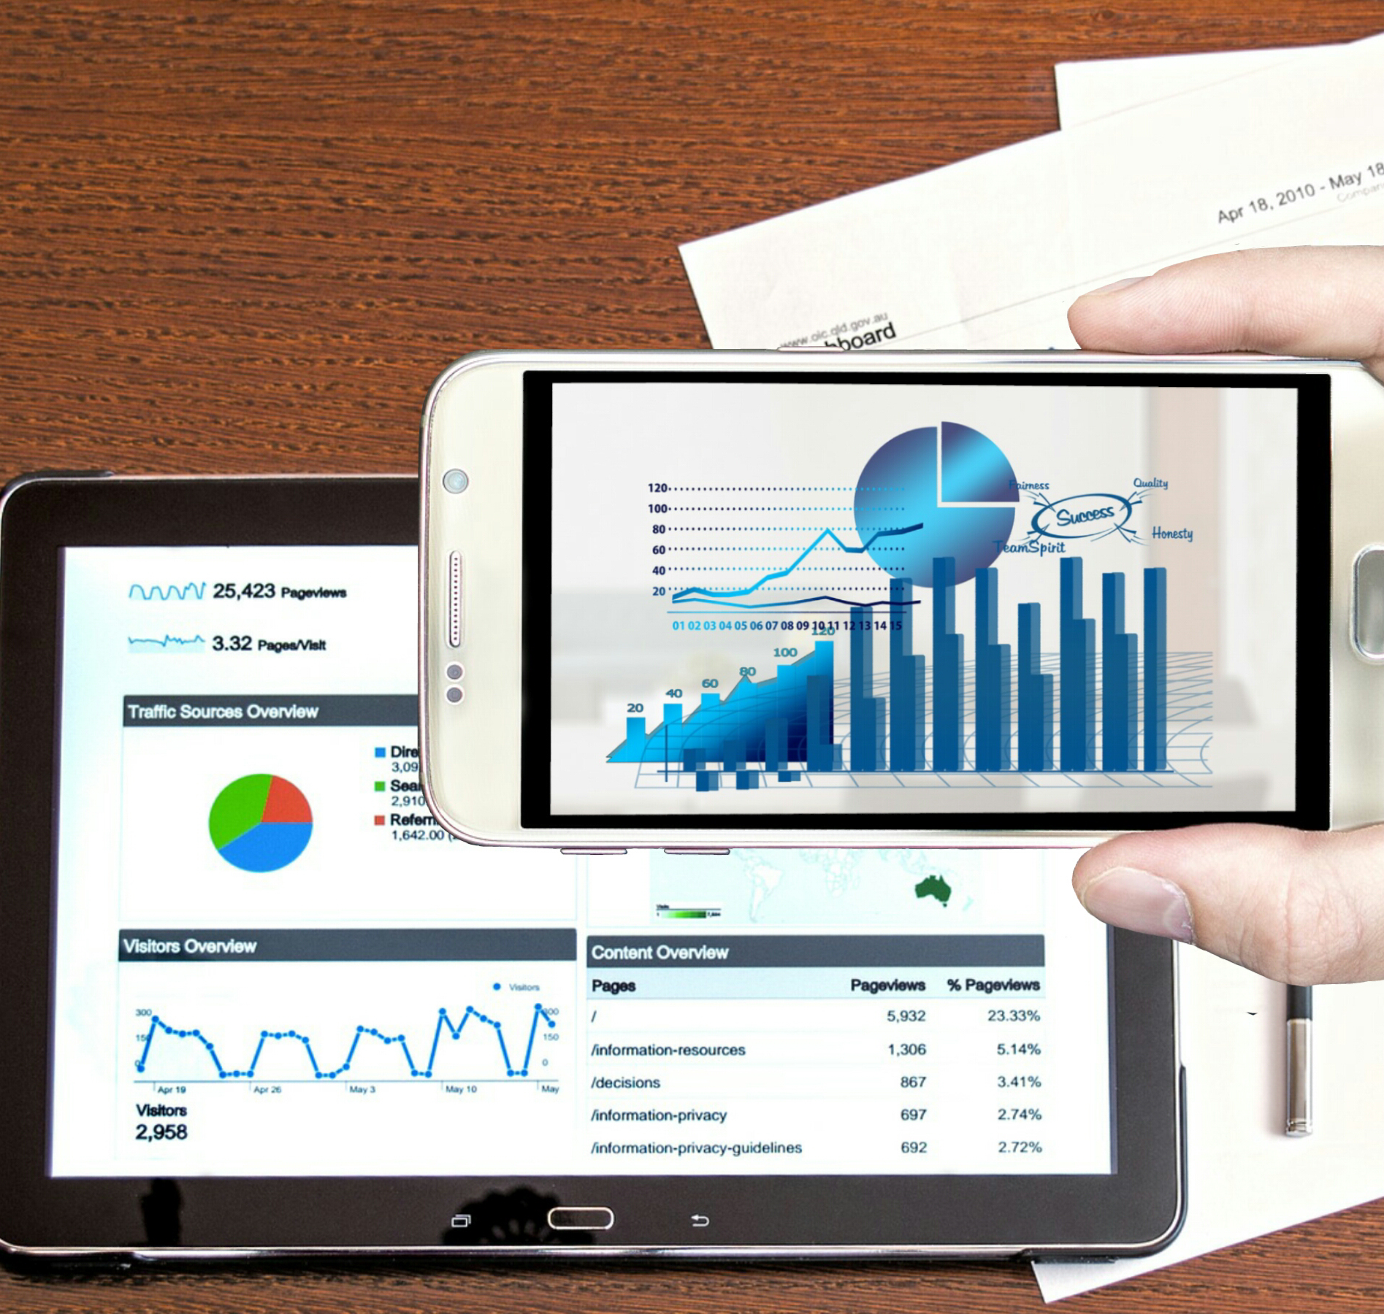
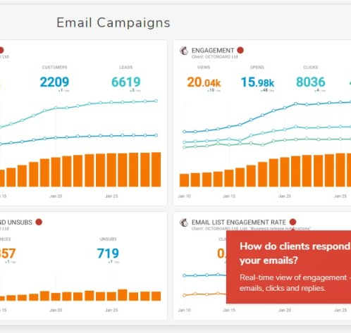
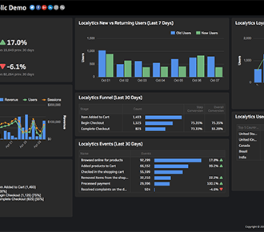
Visual: Digital dashboard
This Photo by Unknown Author is licensed under CC BY
This Photo by Unknown Author is licensed under CC BY-SA-NC

Slide 55
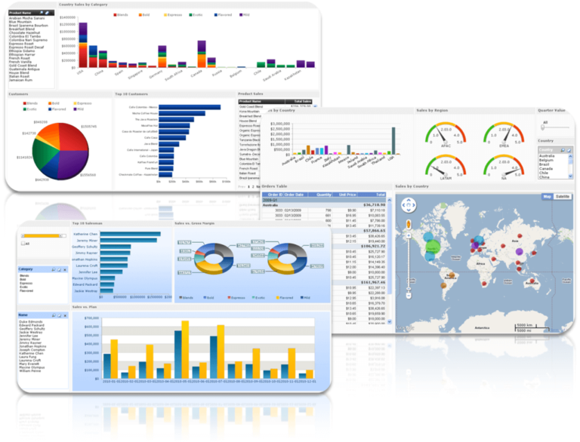
Visual: Digital Dashboard
This Photo by Unknown Author is licensed under CC BY-SA

Slide 56
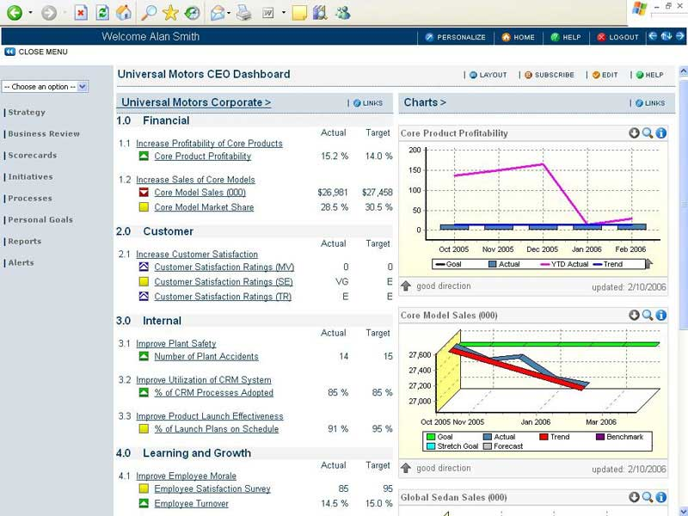
BSC Kpi Dashboard Example:
Ref

Slide 57
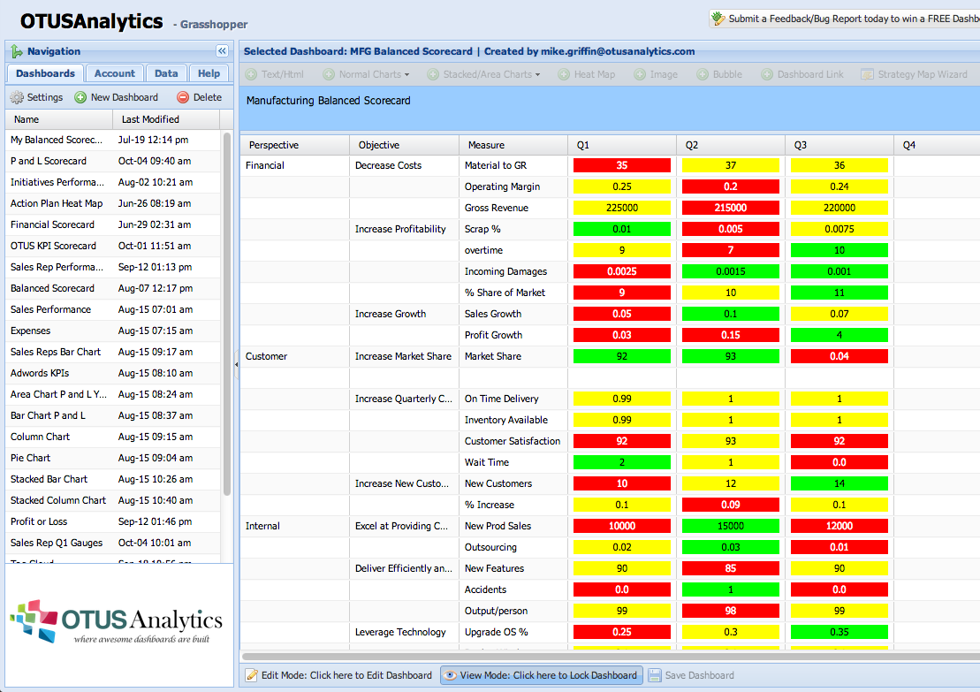
BSC Dashboard by Otus analytics.com

Slide 58
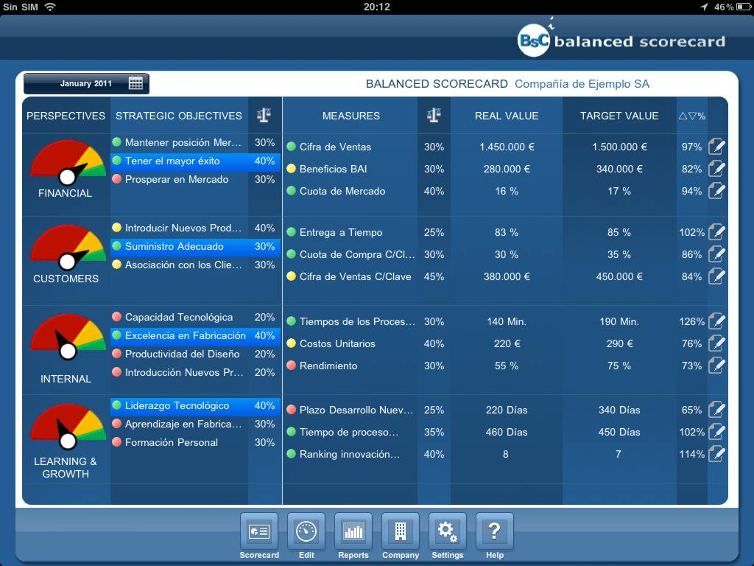
BSC Dashboard for iPad:
For more information please click-here.

Slide 59
BSC Stakeholders & Information Systems
e-ERP System
Strategy
Operations
Customers
Employees
Suppliers
e-SCM
System
e-CRM
System
e-HRM System

Slide 60
Tutor Show:
Assignment 1: Task 4.
Assignment location.
Assignment is available to download from the Assessment tile on Moodle. *
* Currently subject to minor changes through the internal & external verification process.

