Slide 1

MSc Public Health and Social Care in Practice
Quality Assurance and Service Improvements
LCHS7006
Case study: Mid Staffordshire NHS Foundation Trust
Student Name: Smitkumar Bharatbhai Kachhadiya
Student ID:2520164

Slide 2

Introduction
Mid Staffordshire became one of the NHS's most serious healthcare quality failures (Francis, 2013).
Serious leadership, governance and staffing failures caused avoidable patient harm between 2005–2009 (Francis, 2013).
This presentation examines organisational root causes behind the quality and safety failures.
Policy issues influencing healthcare performance and patient outcomes are critically explored throughout.
Leadership and change frameworks are evaluated to improve quality, efficiency and equity.
Mid Staffordshire NHS Foundation Trust
(Francis, 2013)
Notes:
Mid Staffordshire NHS Foundation Trust is one of the biggest health service quality scandals in the UK National Health Service (NHS) history. The Francis Report (2013) was published following serious shortcomings in patient care, governance, staffing and leadership between 2005 and 2009, causing avoidable harm and putting patient lives at risk. Drawing on the findings of the study, this presentation explores the principles behind the failures and the policy challenges in terms of poor service delivery. It also discusses leadership strategies and frameworks for managing change to enhance the quality of health and social care services, and assesses the impact of these on the quality, efficiency and equity of health and social care services.

Slide 3
Case Study Background
Serious care failures affected Mid Staffordshire NHS Foundation Trust between 2005 and 2009 (Francis, 2013).
Patients experienced neglect, poor hygiene, delayed treatment and inadequate nutrition during hospital admission.
Financial priorities frequently outweighed patient safety and compassionate care across the organisation.
Mortality concerns, complaints and staff warnings received inadequate organisational attention (Francis, 2013).
The Francis Inquiry proposed 290 recommendations to strengthen NHS accountability and patient safety.
Notes:
Mid Staffordshire NHS Foundation Trust had long-standing and significant shortcomings in their care between 2005 and 2009. Patients suffered from poor nursing care, hygiene and sanitation, delayed service, lack of nutrition and water, and lack of dignity and compassion. Poor staffing and inadequate clinical governance led to a drop in the quality of care provided, with leadership driven by financial goals and becoming Foundation Trust. Mortality rates and complaints/staff warnings were not handled effectively. The Francis Public Inquiry subsequently revealed significant organisational and regulatory shortcomings and issued 290 recommendations to enhance accountability, transparency, safety and quality of care to patients (Francis, 2013).

Slide 4

Outline the problem
Patients experienced neglect, unmanaged pain and undignified treatment across multiple hospital wards (Francis, 2013).
Patient and staff complaints were repeatedly overlooked, allowing unsafe practices to continue.
Financial targets became organisational priorities instead of patient-centred healthcare delivery (Francis, 2013).
Weak governance created an unsafe environment with declining quality standards throughout the Trust.
Public confidence in NHS services significantly declined following the healthcare scandal (NHS England, 2024).
(NHS England, 2024)
Notes:
The Mid Staffordshire NHS Foundation Trust scandal uncovered many failures in the provision of safe, effective and compassionate patient care. Many patients suffered from neglect, poor hygiene, delayed care, inadequate nutrition and hydration, poorly managed pain and loss of dignity during the period from 2005 to 2009 in the care they received. The complaints from patients, families and healthcare professionals were consistently ignored (Francis, 2013), which allowed unsafe practices to persist. The financial performance and targets of the Foundation Trust came before looking after patients and providing good quality care, a clear failure of governance and organisational culture. All of this negatively affected the health outcomes and the trust of the public in the quality of NHS services.

Slide 5

Root Causes of the Problem
Financial objectives consistently received greater attention than patient safety and compassionate healthcare delivery.
Unsafe staffing and excessive workloads reduced staff capacity to deliver quality care.
Weak governance prevented effective responses to mortality indicators and patient complaints (Powell, 2013).
Staff hesitated to report concerns because accountability and psychological safety remained limited (Hibbert et al., 2023).
Strong leadership and transparent governance improve organisational learning and patient safety (Rafferty and Leary, 2023).
Root cause Symptoms
(Gonzalez, 2019).
Notes:
The failures in Mid Staffordshire were caused by systemic and organisational factors. Senior leaders placed more emphasis on financial targets and Foundation Trust status than on patient safety, leading to the formation of a target-driven culture in which poor care became normal. Poor staffing levels, heavy workloads and insufficient supervision hindered staff from being able to provide compassionate care. There was a lack of clinical governance, which meant that deaths had been missed, incident reports and patient complaints were not acted upon. Also, employees were reluctant to report issues due to a lack of psychological safety and accountability (Powell, 2013). Recent evidence has verified that safety governance must be supported by leadership, clear procedures, transparency in reporting and in the learning and understanding within organisations, rather than blaming individuals (Hibbert et al., 2023; Rafferty and Leary, 2023).

Slide 6

Quality Assurance Breakdown
Warning signs remained disconnected because governance systems failed to integrate critical safety information.
Patient complaints and staff concerns were treated separately instead of identifying wider risks.
Board members prioritised organisational performance over continuous quality improvement and patient safety (Hibbert et al., 2023).
Weak audits failed to identify relationships between staffing shortages and patient outcomes.
Effective governance requires transparent reporting, learning cultures and patient involvement(Jalilvand et al., 2024).
Quality assurance
(NHS England, 2024)
Notes:
Quality assurance at Mid Staffordshire was not effective due to the lack of effective integration and action on warning information. Incidents reported by patients and staff were seen as individual, rather than systemic risks. Mortality indicators were inadequately used, and ineffective audits did not show the link between staffing levels, unsafe practices and poor outcomes. There was less focus on financial performance at board level than care quality, reducing accountability for and oversight of performance. There has been a shift in research focus over the last few years, which has examined how effective governance for patient safety can be reported, with the involvement of patients, staff support, and the ability to turn incidents into organisational learning and improvement procedures (Hibbert et al., 2023; Jalilvand et al., 2024).

Slide 7
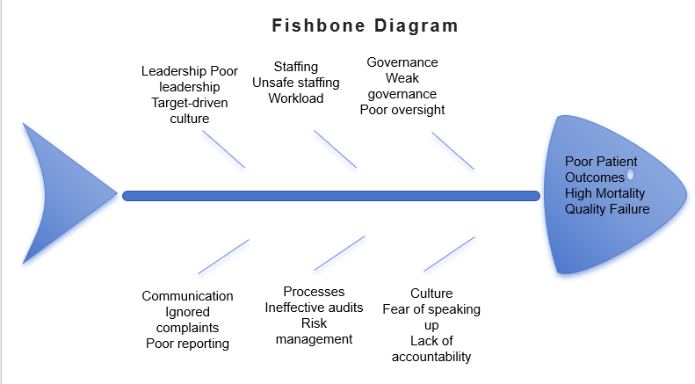
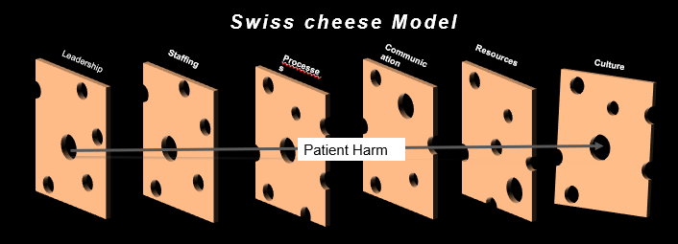
Root Cause Analysis Models – Fishbone Diagram and Swiss Cheese Model
Fishbone analysis identifies leadership, staffing and governance as interconnected organisational failure causes.
Swiss Cheese Model explains patient harm through multiple simultaneous failures in safety barriers.
Weak communication and insufficient resources created opportunities for preventable patient harm (AHRQ, 2024).
Both models demonstrate system-wide failures rather than blaming individual healthcare professionals.
Continuous governance improvement strengthens organisational resilience and patient safety (NHS England, 2022).
(AHRQ, 2024)
Notes:
The Fishbone (Ishikawa) Diagram and the Swiss Cheese Model are complementary tools to consider when analysing the Mid Staffordshire NHS Foundation Trust failures. The Fishbone diagram is used to systematically identify root causes as a result of poor care, as shown below, revealing that several organisational weaknesses in place contributed to poor patient care. The Swiss Cheese Model further describes how several layers of organisational defence failed at the same time, which led to patient harm. All these factors – weak leadership, inadequate staffing, ineffective governance, poor communication and insufficient resources – had "gaps" that combined to allow unsafe practices to reach patients. These models show how the crisis stemmed from interdependent system failures, not individual failings, and the importance of good governance, positive safety culture and ongoing quality enhancement (Agency for Healthcare Research and Quality, 2024; NHS England, 2022).

Slide 8

Policy Issues Contributing to Failure
Performance targets frequently received greater organisational attention than patient safety and care quality.
Foundation Trust ambitions influenced leadership decisions more than patient experience (Francis, 2013).
Regulatory oversight failed to recognise accumulating evidence of systemic healthcare failures.
Patients and families had limited influence over healthcare governance and service improvement.
Francis prioritised openness, safety and compassionate care above organisational reputation (NHS England, 2022).
(NHS England, 2022)
Notes:
The Mid Staffordshire crisis was exacerbated by policy and regulatory pressures, which led to leaders focusing more on financial balance, performance targets and becoming a Foundation Trust than on patient experience. There was a heavy focus on measurable evidence in performance management, and little consideration was given to qualitative evidence from complaints, staff concerns and ward observations (Francis, 2013). Fragmented oversight arrangements and a lack of integration of warning signs meant that systemic failure was not clearly 'seen'. There was also a lack of effective influence over board decisions and service improvement from patients and families. Patient safety, openness and compassionate care were therefore prioritised above institutional reputation or target achievement as a result of the Francis Inquiry (NHS England, 2022).

Slide 9

Impact on Service Provision
Poor staffing significantly reduced healthcare quality through delayed treatment and missed patient care.
Preventable harm increased because overloaded staff struggled meeting essential clinical responsibilities.
Older and vulnerable patients experienced disproportionately poorer healthcare outcomes and greater neglect.
Nurse shortages continue influencing patient safety and treatment effectiveness (Drennan et al., 2024).
Healthcare quality should consider safety, equity and patient experience equally (NHS England, 2024).
(NHS England, 2024)
Notes:
The root causes had a significant impact on service delivery quality, efficiency and equity. Poor quality was identified by lack of care, poor hygiene, inadequate pain management and preventable patient harm. Inadequate staffing also lowered efficiency, as overworked staff had difficulty completing observations, treatments and documentation promptly, causing increased delays and risk for complications. There is ongoing evidence that relates reduced staffing of nurses to delayed treatment and inferior outcomes (Drennan et al., 2024). Equity was weakened because older, dependent, cognitively impaired and less vocal patients were particularly vulnerable to neglect. So, apparently equal services have led to different experiences and outcomes, and there will be a need to evaluate safety in addition to access, experience and clinical outcomes (NHS England, 2024).

Slide 10

Leadership Strategies for Change
Transformational leadership inspires shared commitment towards patient-centred safety and organisational improvement (Ystaas et al., 2023).
Servant leadership prioritises compassion, employee wellbeing and patients before organisational performance.
Clinical leadership strengthens accountability through evidence-based decision-making and multidisciplinary collaboration.
Transactional leadership ensures compliance with healthcare standards through monitoring and accountability.
Combining leadership approaches creates sustainable organisational quality improvement (Demeke, van Engen and Markos, 2024).
Transformational leadership
(Sengupta, 2020)
Notes:
Leadership is needed to restore the safety culture at Mid Staffordshire – a mix of styles is necessary. The transformational leader should set a common vision for the patient, open up to staff, and this has been linked to higher engagement with safety and workforce engagement (Ystaas et al., 2023). Patients and frontline workers are to be valued above a company's reputation, thus serving as a vehicle for compassion, listening and psychological safety (Demeke, van Engen and Markos, 2024). Doctors, nurses and allied professionals should have more responsibility for the quality indicators, staffing decisions, and incident learning, under clinical leadership. But the need for transactional leadership is still there to ensure compliance with mandatory standards through audit, accountability, responsibility and corrective action. Styles should complement and not compete with each other, therefore.

Slide 11
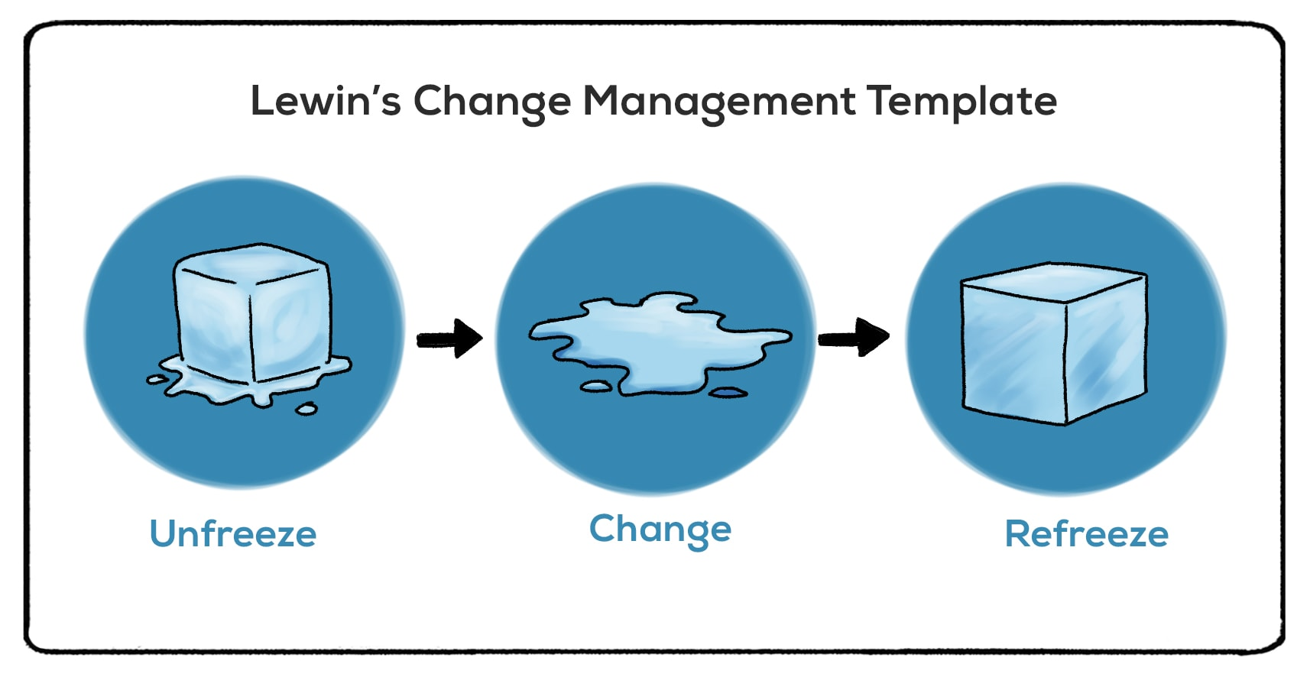
Workforce Change Framework—Lewin’s Model
Unfreeze existing unsafe practices by communicating evidence supporting immediate organisational change.
Engage staff through education, collaboration and patient-centred safety improvement initiatives (Barrow et al., 2022).
Implement multidisciplinary teamwork, reporting systems and compassionate care during organisational change.
Refreeze improvements using governance audits, staff feedback and continuous professional development.
Lewin's framework supports sustainable workforce transformation and safer healthcare delivery (Harrison et al., 2021).
(Barrow et al., 2022)
Notes:
Lewin's three-stage model offers a structured approach to workforce preparation. Leaders need to convey, as part of the unfreezing process, that evidence of harm exists, that care in the past has been inadequate (and that this is not the norm), and that they should speak with staff and patients about the need for change. During change, the Trust should implement safe escalation processes, compassionate care practices, multi-disciplinary safety huddles, better staffing audits and protected incident reporting (Barrow et al., 2022). Staff involvement is key as imposed change could generate resistance rather than commitment. New practices need to be integrated into the routines of a ward during the process of refreezing stage. This can be achieved with induction, policy, ward audit, supervision, appraisal and feedback from the patient and staff. The model acknowledges the complexities of organisational change but also enables the stages for the stabilisation of safer working practices (Harrison et al., 2021).

Slide 12
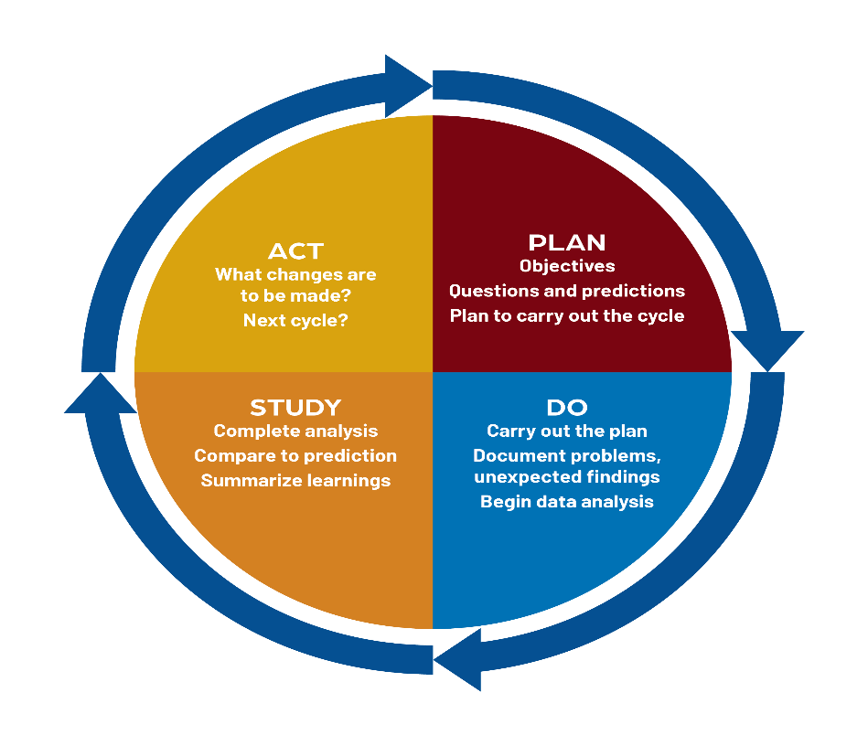
Improvement Framework—PDSA Cycle
Plan improvements using measurable quality indicators, staffing data and patient safety objectives.
Test proposed improvements within one ward before wider organisational implementation.
Study outcomes using incident reports, patient feedback and staff performance information (Barr and Brannan, 2024).
Act by refining successful interventions before expanding improvements across additional departments.
PDSA supports evidence-based improvement through continuous organisational learning (NHS England, 2026).
PDSA cycle
(Barr and Brannan, 2024)
Notes:
Improvements should be first tested in one ward in the Plan–Do–Study–Act cycle. The team would determine what measurable issues were present in the Plan stage, including delayed observations, unsafe staffing or unaddressed complaints, and baseline data and targets. Revised staffing escalation and daily safety huddles would be piloted with a small number of staff in Do. During Study, leaders would compare incident rates, response times, and missed-care information with baseline information, patient feedback, and staff experiences. In the ACT phase, the effective changes would be improved and expanded, and the ineffective would be changed before another cycle. This ‘trial and test' approach minimises the risk of implementing changes and allows for evidence-based learning to inform change rather than adopting untried organisation-wide changes (Barr and Brannan, 2024; NHS England, 2026).

Slide 13
Strengths, Weaknesses and Barriers
Poor leadership commitment may reduce implementation speed and long-term organisational sustainability.
PDSA enables practical, affordable and continuous improvement through structured small-scale testing.
Resistance, workforce shortages and blame culture remain significant barriers to successful change (Endalamaw et al., 2024).
Governance, training and accountability help sustain quality improvements over time (NHS England, 2024).
Kotter recommends urgency, leadership coalitions and shared vision for effective transformation.
Notes:
PDSA is real, relatively low cost and allows for continuous learning through small, measurable tests. The flexibility provides the frontline staff with the ability to tailor interventions so that they fit the ward situation before roll-out. But cycles can get superficial if goals, indicators and evidence are not precise, and cycles can be slow if there is no leadership and consistent data over time. Challenges are likely to be resistance to change from staff, change fatigue, staff shortages, fear of blame and limited skills to improve. Kotter's larger principles can help to overcome these obstacles by establishing a sense of urgency to address patient harm, establish a multidisciplinary guiding coalition, and communicate a credible patient safety vision. It is important to acknowledge short-term gains, but establish governance structures, training and accountability to ensure that change is maintained (Endalamaw et al., 2024; NHS England, 2024).

Slide 14
Report Structure
The report will include an introduction of the Mid Staffordshire case and the primary care failures.
It will then critically examine the root causes of the organisation, such as leadership, staffing, governance, communication and safety culture.
The Fishbone Diagram and Swiss Cheese Model will be used to assist in the systems-based analysis, followed by policy and regulatory issues will be evaluated.
Next, the impact of these on service quality, efficiency and equity will be explored, and then leadership strategies, Lewin's model of change in the workforce and the PDSA development model of improvement will be used.
The report will end with barriers, recommendations.
Notes:
The report will include an introduction of the Mid Staffordshire case and the primary care failures. It will then critically examine the root causes of the organisation, such as leadership, staffing, governance, communication and safety culture. The Fishbone Diagram and Swiss Cheese Model will be used to assist in the systems-based analysis, followed by policy and regulatory issues will be evaluated. Later, the impact of these on service quality, efficiency and equity will be explored, and then leadership strategies, Lewin's model of change in the workforce and the PDSA development model of improvement will be used. The report will end with barriers, recommendations.

Slide 15
Conclusion
Mid Staffordshire’s failures resulted from interconnected leadership, staffing, governance and cultural weaknesses.
Policy pressures and ineffective quality assurance compromised safety, dignity and public confidence.
Fishbone, Swiss Cheese, Lewin and PDSA support systematic and sustainable improvement.
Patient-centred leadership, transparent reporting and adequate staffing are essential for safer care.
Notes:
Poor quality in health services is caused by interdependent problems of leadership, staffing, governance, communication and organisational culture, as illustrated in the case of Mid Staffordshire NHS Foundation Trust. Poor quality assurance processes and policy pressures undermined the safety of patients, leading to preventable harm and loss of confidence in NHS services by the public. The Fishbone Diagram, Swiss Cheese Model, and Lewin's Change Model show practical ways to enhance governance, workforce involvement and ongoing quality improvement. Patient centred leadership, transparent reporting, staffing and a culture of learning are essential for sustainable improvements to ensure that everyone gets safe, effective and compassionate healthcare.

Slide 16
References
Agency for Healthcare Research and Quality (2024). Root cause analysis. [online] Patient Safety Network. Available at: https://psnet.ahrq.gov/primer/root-cause-analysis [Accessed 15 July 2026].
Barr, E. and Brannan, G.D., 2024. Quality improvement methods (lean, pdsa, six sigma). In StatPearls [Internet]. StatPearls Publishing. https://www.ncbi.nlm.nih.gov/books/NBK599556/
Barrow, J.M. and Annamaraju, P., 2022. Change management in health care. In StatPearls [Internet]. StatPearls Publishing. https://www.ncbi.nlm.nih.gov/books/NBK459380/
Demeke, G.W., van Engen, M.L. and Markos, S., 2024. Servant leadership in the healthcare literature: A systematic review. Journal of healthcare leadership, pp.1-14. https://www.tandfonline.com/doi/pdf/10.2147/JHL.S440160
Drennan, J., Murphy, A., McCarthy, V.J., Ball, J., Duffield, C., Crouch, R., Kelly, G., Loughnane, C., Murphy, A., Hegarty, J. and Brady, N., 2024. The association between nurse staffing and quality of care in emergency departments: A systematic review. International journal of nursing studies, 153, p.104706. https://www.sciencedirect.com/science/article/pii/S002074892400018X
Endalamaw, A., Khatri, R.B., Mengistu, T.S., Erku, D., Wolka, E., Zewdie, A. and Assefa, Y., 2024. A scoping review of continuous quality improvement in healthcare system: conceptualisation, models and tools, barriers and facilitators, and impact. BMC health services research, 24(1), p.487. https://link.springer.com/content/pdf/10.1186/s12913-024-10828-0.pdf
Francis, R. (2013). The Mid Staffordshire NHS Foundation Trust Public Inquiry Report of the Mid Staffordshire NHS Foundation Trust Public Inquiry Executive Summary HC 947. [online] GOV.UK. Available at: https://assets.publishing.service.gov.uk/government/uploads/system/uploads/attachment_data/file/279124/0947.pdf [Accessed 15 July 2026].
Gonzalez, D.J. (2019). Find the Root of the Problem - Adventure Park Insider. [online] Adventure Park Insider. Available at: https://adventureparkinsider.com/article/find-the-root-of-the-problem/ [Accessed 18 July 2026].
Harrison, R., Fischer, S., Walpola, R.L., Chauhan, A., Babalola, T., Mears, S. and Le-Dao, H., 2021. Where do models for change management, improvement and implementation meet? A systematic review of the applications of change management models in healthcare. Journal of healthcare leadership, pp.85-108. https://www.tandfonline.com/doi/pdf/10.2147/jhl.s289176
Hibbert, P.D., Stewart, S., Wiles, L.K., Braithwaite, J., Runciman, W.B. and Thomas, M.J., 2023. Improving patient safety governance and systems through learning from successes and failures: qualitative surveys and interviews with international experts. International Journal for Quality in Health Care, 35(4), p.0. https://pmc.ncbi.nlm.nih.gov/articles/PMC10656601/pdf/mzad088.pdf
Jalilvand, M.A., Raeisi, A.R. and Shaarbafchizadeh, N., 2024. Hospital governance accountability structure: a scoping review. BMC Health Services Research, 24(1), p.47. https://link.springer.com/content/pdf/10.1186/s12913-023-10135-0.pdf
NHS England (2024). National Healthcare Inequalities Improvement Programme. [online] Www.england.nhs.uk. Available at: https://www.england.nhs.uk/about/equality/equality-hub/national-healthcare-inequalities-improvement-programme/ [Accessed 15 July 2026].
NHS England (2024). Patient Safety Incident Response Framework and supporting guidance. [online] Www.england.nhs.uk. Available at: https://www.england.nhs.uk/publication/patient-safety-incident-response-framework-and-supporting-guidance/ [Accessed 15 July 2026].
NHS England (2026). NHS England » NHS dentistry quality improvement programme: Year 1 topic guide. [online] England.nhs.uk. Available at: https://www.england.nhs.uk/long-read/nhs-dentistry-quality-improvement-programme-year-1-topic-guide/ [Accessed 15 July 2026].
NHS England, 2022. Patient Safety Incident Response Framework. [Online] Available at: NHS England » Patient Safety Incident Response Framework [Accessed 15 July 2026].
Powell, T. (2013). The Francis Report (report of the MidStaffordshire NHS Foundation Trust public inquiry) and the government’s response. [online] House of Commons Library. Available at: https://researchbriefings.files.parliament.uk/documents/SN06690/SN06690.pdf [Accessed 15 July 2026].
Rafferty, A.M. and Leary, A., 2023. Nursing notes on a scandal. Future Healthcare Journal, 10(1), pp.3-6. https://www.sciencedirect.com/science/article/pii/S2514664524003746
Sengupta, S. (2020). Transformational Leadership. [online] Management Weekly. Available at: https://managementweekly.org/transformational-leader/ [Accessed 18 July 2026].
Ystaas, L.M.K., Nikitara, M., Ghobrial, S., Latzourakis, E., Polychronis, G. and Constantinou, C.S., 2023. The impact of transformational leadership in the nursing work environment and patients’ outcomes: a systematic review. Nursing Reports, 13(3), pp.1271-1290. https://www.mdpi.com/2039-4403/13/3/108

