Slide 1
Barriers to Communications
International Business Communication SBUS6111
Week 4

Slide 2
Learning Objectives
To understand barriers against communications
To understand how this inter-relates with other business communications
To understand ways of reducing these barriers

Slide 3
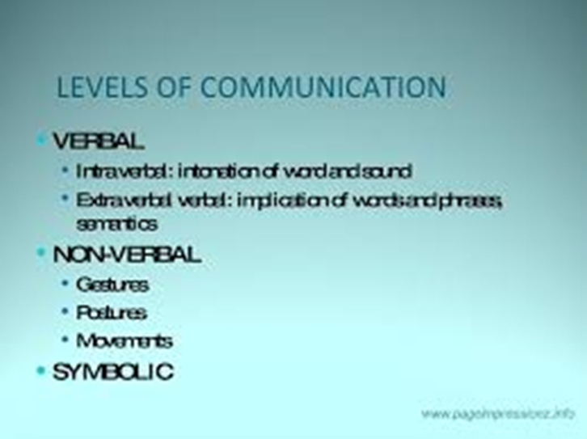
International Business Communication
There are several levels of communication:

Slide 4
International Business Communication
They can take various forms –
Verbal
Inadequate knowledge or vocabulary
Differences in interpretation
Language differences
Inappropriate use of expressions
Overabstraction or ambiguity
Polarization
Non-verbal
Inappropriate or conflicting signals
Differences in perception
Inappropriate emotions
Physical distractions

Slide 5
International Business Communication
Symbolic
Colours
Shapes Design
Smells etc.

Slide 6
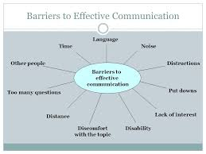
International Business Communication

Slide 7
International Business Communication
Communication is a two way process of sharing information
Linear Model of Communications
Sender’s Frame of Reference
Sender Requirements
Media
Encoded Message
Decoded Message
Receivers
Receiver Requirements
Receiver’s Frame of Reference
Distortion
Noise
Distortion
Feedback
Shramm and Shannon & Weaver (1962)

Slide 8
The INFLUENCE OF INTERMEDIEARIES
The mechanics of the marketing communications process
Receivers
Media
Opinion
Leaders
Receivers
Receivers
Opinion
Formers
Receivers
Receivers
Sender or Source
Messages
Receivers
Receivers
Opinion
Formers
Receivers
Receivers
Opinion
Leaders
Receivers

Slide 9
The INFLUENCE OF INTERMEDIEARIES
The mechanics of the marketing communications process
Least credible Most credible |  |  |  | ABSENCE of COMMUNICATION No information or feedback when an unexpected delay or service failure has occurred, or in any situation when the customer feels he is out of control of the situation.
PLANNED MESSAGES | PRODUCT MESSAGES | SERVICE MESSAGES | UNPLANNED MESSAGES
Mass Communications | Appearance | Interaction with service processes | Word of Mouth referrals
Brochures | Design | Deliveries | References
Direct Response | Usefulness | Invoicing | News stories
Sales | Product Ingredients | Claims handling | Gossip
Websites | Eco-content of product | After Sales Service | Unreported complaints
Source: After Duncan, T. and Moriarty, S. (1997)

Slide 10
International Business Communication
The need to integrate communications
The concept under which a company carefully integrates and co-ordinates its many communication channels to deliver a clear, consistent and compelling message about the organisation and its products.
“The process which involves the management and organisation of all agents in the analysis, planning, implementation and control of all marketing communication contacts, media, messages and promotional tools focused at selected target audiences.
Fill, C. (2009) Marketing Communications: Interactivity, Communities and Content. Harlow: Pearson Education Limited

Slide 11
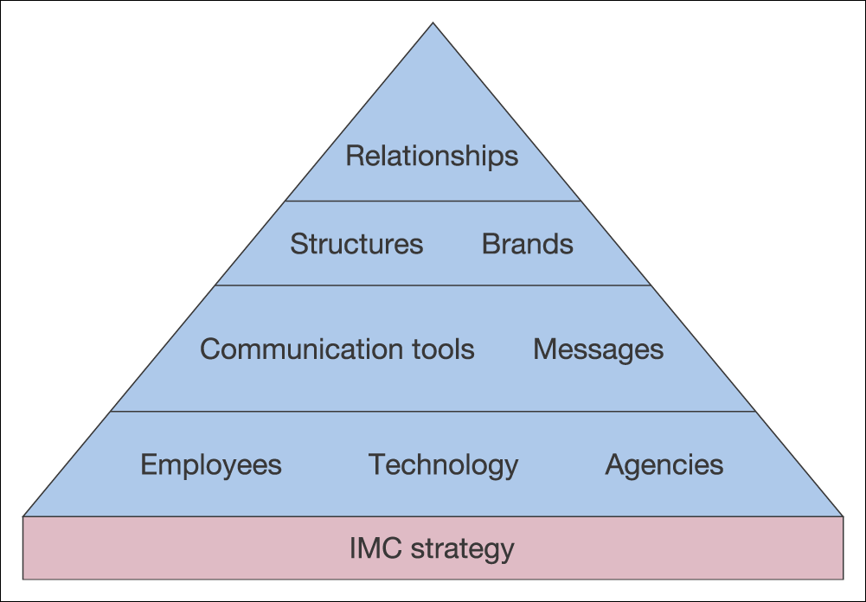
Elements for Integration
Elements for integration
Fill, C. (2009) Marketing Communications: Interactivity, Communities and Content. Harlow: Pearson Education Limited.

Slide 12
International Implications
International Business Communication
Reasons for Integrating Communications
Goal – to coordinate marketing efforts
Greater challenge due to national and cultural differences
Standardization versus Adaptation
“Think globally, but act locally”
Clow, K, E., Baack, D. (2012) Integrated Advertising, Promotions, and Marketing Communications (5th edition). Harlow: Pearson Education Limited.
Notes:
Because of the increase in global competition, firms must coordinate marketing efforts across multiple countries. Because of cultural differences and language differences, it is a greater challenge. Firms can use a standardized approach which means the same approach and message is used in every global market. This works only for global brands that are worldwide and well known. An alternative is adaptation, which means firms adapt their marketing communications to each country, region and culture. The idea is to “think globally, but act locally.”

Slide 13

Elements for integration
Marketing Mix
The elements of the marketing mix, however configured, need to be integrated.
Branding
Brands are themselves a form of integration.
Strategy
At a strategic level, IMC has its roots
in the overall business strategy of an organisation.
Fill, C. (2009) Marketing Communications: Interactivity, Communities and Content. Harlow: Pearson Education Limited.

Slide 14
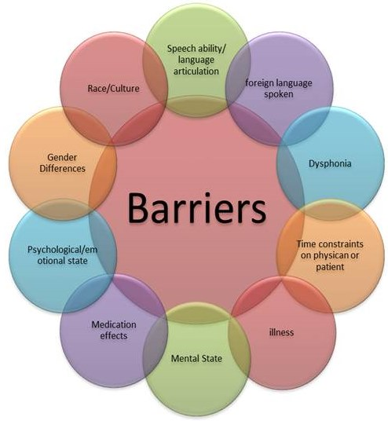

Slide 15

Barriers to IMC
Integrated Marketing Communications
Financial Structures and Frameworks
Opposition/ Reluctance to Change
Traditional brand management structures
Attitudes and structures of Suppliers and Agencies
Lack of internal communication
Complexity of planning and coordination
Fill, C. (2009) Marketing Communications: Interactivity, Communities and Content. Harlow: Pearson Education Limited.

Slide 16
Benefits of IMC
Integrated Marketing Communications
Creative integrity
Unbiased marketing recommendation
Better use of media
Cost savings
High-calibre consistent message
Easier working relations
Greater agency accountability
Operational efficiency
Fill, C. (2009) Marketing Communications: Interactivity, Communities and Content. Harlow: Pearson Education Limited.

Slide 17
Disadvantages of IMC
International Business Communications
Encourages centralization and formal bureaucratic procedures
Can require increased coordination and time management skills
Tendency to standardize might negate or dilute creative opportunities
Global brands restricted in terms of local adaptation
Has the potential to severely damage a brand’s reputation if incorrectly managed
Fill, C. (2009) Marketing Communications: Interactivity, Communities and Content. Harlow: Pearson Education Limited.

Slide 18
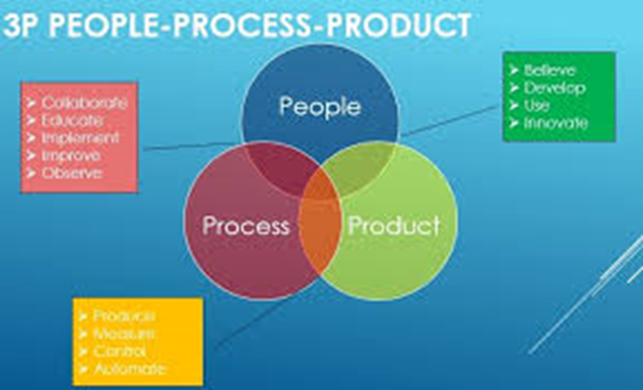
The 3 Ps Model of Communication
Scot Ober (2009)

Slide 19
Often in any business context there is a problem faced by the executive which has to be considered carefully and a process defined to solve it.
The 3Ps are Problem, Process, Product

Slide 20
Activity
People, Process, Product: How Marcus Lemonis’ Three P’s Apply to Online Community Building
Watch the short video clip and critically appraise the 3P’s and give insight how you believe it can be improved
http://www.managingcommunities.com/2015/08/27/people-process-product-how-marcus-lemonis-three-ps-apply-to-online-community/

