Slide 1

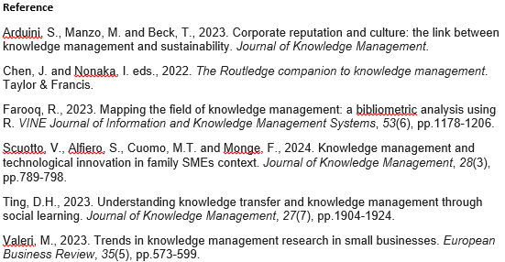
BMSW5106
Knowledge Management (KM) System in Practice at Barclays Bank
Diana Decheva
Student ID 2129230
Purpose of the Poster Presentation:
This presentation shows the improvement of Barclays Bank KM system integration in order to create a connected environment where people are made to understand and exploit knowledge, tools, and each other to ensure the generation, sharing, and application of knowledge. This drives the organizations success and innovation (Ting, 2023).
Connecting People to Knowledge
  Tool: Integrated KM Platform (SharePoint/Confluence)
  Purpose: Central hub for sharing insights, strategies, and updates.
  Usage: Accessible through desktop and mobile, secured with multi-factor authentication (Valeri, 2023).
  Interaction: Syncs with existing CRM and ERP systems to streamline information flow.
Connecting People to Information
  Tool: AI-driven Analytics Dashboard
  Purpose: Provides real-time data and predictive analytics to support decision-making.
  Usage: Customizable dashboards based on role and department, role-based access control (Scuotto et al., 2024).
  Interaction: Interfaces with market data feeds and internal transaction systems.
Connecting People to Tools
  Tool: Cloud-based Collaboration Suite (Microsoft Teams/Google Workspace)
  Purpose: Facilitates collaborative work environments, virtual meetings, and document sharing.
  Usage: Integrated chat, video, and project management features, encrypted communications (Farooq, 2023).
  Interaction: Complements email and traditional communication channels.
Promoting Knowledge-Sharing Culture
  Initiatives: Monthly knowledge sharing workshops, gamified employee engagement programs.
  Purpose: Encourages continuous learning and knowledge exchange.
  Benefits: Enhances employee involvement and innovation, builds a supportive learning community (Arduini et al., 2023).
Implementation Without Excessive Resource Expenditure:
Cloud Solutions: Reduces the need for physical infrastructure and maintenance costs.
Open Source Tools: Leverages free-to-use technologies to set up forums and wikis (Chen and Nonaka, 2022).
Employee-led Training: Utilizes in-house experts to train peers, minimizing training costs.
Commercialization of Accumulated Knowledge:
Data Monetization: Selling insights derived from aggregated customer data to market research firms (Chen and Nonaka, 2022).
Licensing KM Tools: Offering proprietary KM tools developed in-house to other businesses.
Consultancy Services: Providing KM consulting based on Barclays’ successful practices to other organizations.
Evaluation of KM Framework:
Potential Benefits:
  Improved operational efficiency and decision-making.
  Enhanced customer satisfaction through personalized services (Chen and Nonaka, 2022).
  Increased employee productivity and innovation.
Potential Drawbacks:
  Initial resistance to new tools and processes.
  Ongoing costs associated with training and system updates (Chen and Nonaka, 2022).
  Security risks associated with data sharing and new technologies

