Slide 1
Developing Professional Practice (5DVP)
Julie Thomas Room AS413
julie.thomas@uwtsd.ac.uk

Slide 2
Outline of Session:
9am -10:30am – Learning Outcomes, Assignment, CIPD HR Profession Map
10:30 – Break
11-1pm – Code of Conduct, CPD and Reflective Practice
1pm - Close

Slide 3

Edition: 2nd
Publication Date: May 2016
Stephen Taylor, Carol Woodhams
Read chapter 4 & 6
Crucial detail for the assignment
Notes:
Before you start your assignment, read these two chapters. Then conduct further research.

Slide 4
Overall Learning outcomes: 5DVP
LO1 Understand what is required to be an effective and efficient HR professional.
LO2 Be able to perform efficiently and effectively as an HR professional.
LO3 Be able to apply CPD techniques to construct, implement and review a personal development plan.

Slide 5
Learning Outcome 1
LO1: Understand what is required to be an effective and efficient HR professional
  1.1 Evaluate what it means to be a HR professional with reference to the CIPD’s HR Profession Map
1.2 Describe the elements of group dynamics and conflict resolution methods.

Slide 6
Learning Outcome 2
LO2. Be able to perform efficiently and effectively as a HR professional
2.1 Apply project management techniques
2.2 Apply problem-solving techniques.
2.3 Apply a range of methods for influencing, persuading and negotiating with others.

Slide 7
Learning Outcome 3
LO3: Be able to apply CPD techniques to construct, implement and review a personal development plan
  3.1 Undertake a self assessment of HR professional practice capabilities to identify continuing professional development needs
  3.2 Produce a plan to meet personal development objectives based on an evaluation of different options
  3.3 Reflect on performance against the plan, identify learning points for the future and revise the plan accordingly. Time lapse
  You hand in your updated development record in May

Slide 8
Some reminders
DO NOT plagiarise material from course materials , the CIPD or any other Bibliographic source
DO support you assignment with references and quotes clearly sourced/referenced from your wider reading using the Harvard referencing method
Use reputable H&/L&D sources; and avoid Wikipedia, general GOOGLE searches, Oxford English Dictionary etc.
When asked to evaluate: judge and compare different issues/areas and how they have an impact
When asked to describe: give a detailed account of a certain issue
When asked to explain – describe in detail and with clarity

Slide 9
Assessment – 4 activities
Provide written responses for each of the four tasks equating to approximately 2,600 words in total (excluding the PDP).
Activity 1
Evaluate what it means to be an HR professional, making reference to the current CIPD Profession Map
Activity 2
Briefly describe the elements of group dynamics and give at least two examples of conflict resolution methods within an HR context.
You should identify a range of the knowledge, skills and behaviours required by HR professionals and state why these are important. They may include examples from any of the professional areas and behaviours in the CIPD Profession Map
You must describe the elements of group dynamics. Illustrate this by referring to a model of group processes e.g. Tuckman, or ways of capturing group dynamics e.g. interaction analysis tools.
Also provide a few examples of conflict resolution methods e.g. you could include: using active listening to understand the nature of the conflict from the perspectives of the different parties and then using problem-solving skills to try and seek a ‘win-win’ situation; using compromise; using accommodating to provide temporary relief from the conflict.

Slide 10
Assessment – 4 activities
Activity 3
With reference to a recent or current project (large or small) which you have led (or been part of a project team):
Provide evidence of using project management and problem-solving techniques in the course of the project.
Explain how you successfully influenced, persuaded and negotiated with others in the course of the project (or other related activity).
Summarise the project you are (or have been) working on (this can be a small project) and give some examples of how used project management techniques e.g. setting objectives, defining deliverables, identifying resources, setting timelines, costing the project, using risk management, monitoring and evaluation.
Give an example of how you analysed and resolved any problems encountered with a justification of the solution used.
Give an example of how you influenced, persuaded and negotiated with others e.g. they could include: using skills of analysis, risk assessment and options appraisal.

Slide 11
Assessment – 4 activities
Activity 4
Undertake a self-assessment of one area of your practice to identify your professional development needs in that area and options to address these.
Produce a professional development plan (PDP) plan to meet your professional development needs which includes a justification of the option(s) chosen.
By May provide a reflective summary of your performance against the plan. You should also identify any future development needs and record these extra ones in your current PDP.
Relate academic concepts, theories and professional practice to the way organisations operate, in a critical and informed way, and with reference to key texts, articles and other publications and by using organisational examples for illustration. All reference sources should be acknowledged correctly and a bibliography provided where appropriate (these should be excluded from the word count).
Undertake a self-assessment of one area of their HR professional practice capabilities and identify one or more development options. (you can use CIPD tools)
Select and justify the options chosen for your self-development (emphasising your preferred learning style). These might include training courses, a secondment, a coach/mentor etc. Compare/contrast in table adv/disadvs of chosen learning options.
Produce a personal development plan (PDP) which includes objectives (use CIPD template) – at least 5 rows/entries. Make sure your 3 preferred learning options feature in some of your PDP!
Explain the main components of reflection and how reflective activities might lead to a revision of the plan.

Slide 12

What does it mean to be a professional?

Slide 13
What is a (HR) professional?
Professional
Qualified, member of a professional body, continuously updates knowledge, competent, practice skills, confidence to apply knowledge and learning, recognised qualifications; underpinned by a code of conduct or ethics
HR Professional
As above – but also…
Member of the CIPD? (including following Code of Conduct)
Continuously updates themselves – knowledge, skills and behaviours
Able to challenge, commercially aware, proactive, decisive thinker
Recognised qualifications
Professionalism has many different interpretations

Slide 14
4 concentric circle of HR professionalism
Circle | Actions/Behaviours
Self | Increasing knowledge of subject areas, issues and the business (and its business drivers) – enhances personal credibility. Understanding technical areas/other specialisms, comparisons with competitors (curious). Collaborative – finding out good practice from other organisations/professions, networking
Across the Organisation | Implementing focus groups – raising awareness (collaborative), devolving to line managers – decisive thinker. Anonymous surveys to gain viewpoints (curious/collaborative). Collaborate with other professionals to enhance HR practice (e.g. financial information, metrics)
Upwards | Courage to challenge management practices and ideas (must ensure challenge is based on insightful information – driven to deliver); skilled influencer – proactively find clear details (curious) of the impact – business/client focused. Proactive – set own objectives (curious)
Teams | Problem solving (role model – lead by example); driven to deliver (meeting targets, on-time, within budget), collaborating to gain ideas.
Notes:
Must be able to manage yourself, work in teams, manage upwards and manage across the organisation.

Slide 15
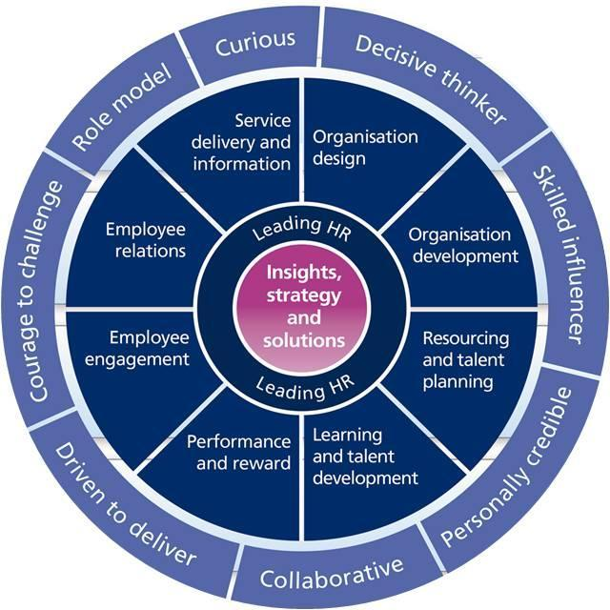
SEE handout
CIPD HR Profession Map
Click here for the Map

Slide 16
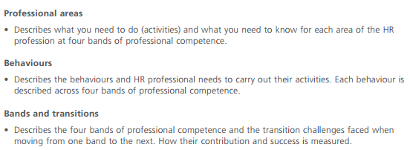
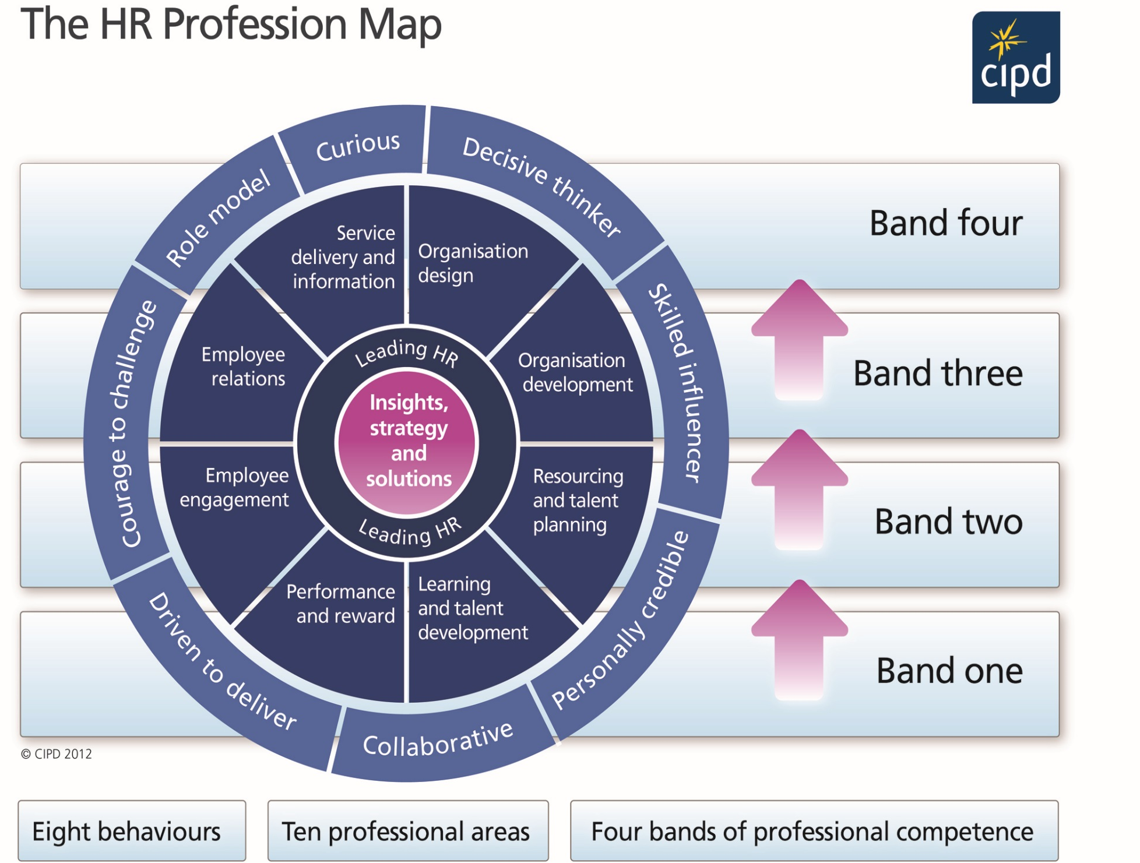
Notes:
The HR Profession Map sets out CIPD’s global standards for the profession, so if you want more detail on what HR is all about it’s a good starting point. Members can access the HRPM on the CIPD website. There are PDFs they can download that set out the professional areas and behaviours by band. There are also tools available at CIPD to help navigate the HRPM.
The ten professional areas set out the knowledge needed and the activities and skills required in that particular area of HR.
IMPORTANT: An HR professional may work across all areas, or may focus on one or any number of professional areas, depending on their role, their organisation, the current business needs, location and market. An organisation may choose to focus on one professional area to meet future business needs.

Slide 17

See full booklet on moodle
Handout extracts on core

Slide 18
CIPD HRPM
/
Outlines the underpinning skills, knowledge and behaviours needed for HR excellence
10 Professional Areas
  Eg. Leading and managing, learning & talent management
4 Bands of Competence
  Eg. Band 1,2,3 & 4
8 Behaviours
  Eg. Curious, Decisive thinker, driven to deliver

Slide 19
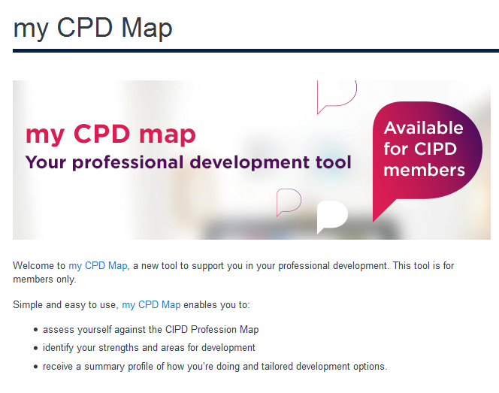

http://www.cipd.co.uk/cpd/my-cpd-map.aspx
Note: it will ask you to register for the first time before it lets you in…

Slide 20
What is the HR Profession Map?
Knowledge/behaviours stakeholders expect from HR(D) Professionals
Enable HR/L&D Professionals to focus on development needs
Provides a framework through 4 bands of competences
BAND 1 | BAND 2 | BAND 3 | BAND 4
Delivering fundamentals | Adviser, issues led | Consultant, co-operative partner | Leadership colleague, coach
Client support and processing activity, immediate/ ongoing | Advising/managing HR issues, current/near term | Addressing medium/long term HR challenges at organisational level | Developing Organisation/HR strategy, partnering the client
Activity 1 dictates band 2 here; does not affect your own self-assessment activity

Slide 21
Demonstrating the 8 behaviours
Curious
Decisive thinker
Skilled influencer
Personally credible
Collaborative
Driven to deliver
Courage to challenge
Role Model
Curious

Slide 22









So when could you use the HRPM?
Position
Yourself
against the
map
Seeking a
promotion
Building a
case for
development
Looking for a new job
Developing
specialist
expertise
Learning about the profession
Interview
preparation
Preparing for an
appraisal or review

Slide 23
Benchmarking where you sit within the HRPM
Membership user name and password required
Utilise the My CPD Map /complete some self -assessments – to receive development feedback (this will be used as evidence in your unit assessment)

Slide 24
Choose the band you are aiming for
Step One
Bands
Which band are you at?
Which band do you need to be at?
What do you need to do to get there?
Professional Areas
Which areas are you confident in?
Which areas are important to your organisation,
role or your career?
What knowledge do you need?
Behaviours
Which behaviours do you show consistently?
Which behaviours are vital to your role, or organisation?
How can you develop these behaviours?
It is likely that when you look at the description of the bands you will find that you work across 2 or possibly 3 bands, but one will usually stand out as the most relevant one for you at this time.
Step one: choose the band you want to assess/benchmark yourself against.
You can come at this from different angles: choose the band you think your current role is at, or the one you are aiming for (future promotion?) for example.

Slide 25
Choose the band you are aiming for
BAND ONE | BAND TWO | BAND THREE | BAND FOUR
Delivering fundamentals | Adviser, issues led | Consultant, co-operative partner | Leadership colleague, coach
Client support and processing activity, immediate/ ongoing | Advising and managing HR issues, current/near term | Addressing HR challenges at organisational level, medium/longer term | Developing the organisational strategy, and HR strategy, partnering the client

Slide 26
Did you know...?
The HR Profession Map gives you advice on how to move from one band or level to the next:
what you have to give up, what you have to learn, how you have to change.

Slide 27
Next choose 2 professional areas to start...
things you need to know (knowledge) & the things you need to do (activities).
Bands
Which band are you at?
Which band do you need to be at?
What do you need to do to get there?
Step Two
Professional Areas
Which areas are you confident in?
Which areas are important to your organisation,
role or your career?
What knowledge do you need?
Behaviours
Which behaviours do you show consistently?
Which behaviours are vital to your role, or organisation?
How can you develop these behaviours?
But first you need to decide which professional area to start with, and you can come at this from different angles: depending on your career stage, what is important to your organisation at this time, what’s going on in the wider world etc.

Slide 28
The core is important (also the emphasis of activity 1)
The 2 core professional areas are vital to all HR professionals. CIPD research showed that success in HR is dependant on competence in the core of the HRPM:
  Whether you are working at band 1, 2, 3 or 4..
  Whatever area of HR you work in
Notes:
The Core: Insights, strategy and solutions
How do I ensure that my role as a practitioner is contributing sustainable organisational performance?
This professional area underpins the direction of the profession as an applied business discipline with a people and organisation specialism.
HR can only deliver on its purpose of sustainable organisation performance if it works from a deep business, contextual and organisational understanding to develop actionable insight.
This understanding – and resulting insights – allows us to create prioritised and situational HR strategies that make the most difference and build a compelling case for change.
The Core: Leading HR
How do I lead myself, others and activities to ensure I am contributing to sustainable organisation performance?
Great professionals are active, insight-led leaders – owning, shaping and driving, not just observing or facilitating.
They develop across 3 main areas of leadership - personal leadership, leading others and leading issues.

Slide 29
The core is important
Insights, strategy and solutions
How do I ensure that my role as a practitioner is contributing sustainable organisational performance?
This professional area underpins the direction of the profession as an applied business discipline with a people and organisation specialism.
HR can only deliver on its purpose of sustainable organisation performance if it works from a deep business, contextual and organisational understanding to develop actionable insight.
This understanding – and resulting insights – allows us to create prioritised and situational HR strategies that make the most difference and build a compelling case for change.
Leading HR
How do I lead myself, others and activities to ensure I am contributing to sustainable organisation performance?
Great professionals are active, insight-led leaders – owning, shaping and driving, not just observing or facilitating.
They develop across 3 main areas of leadership - personal leadership, leading others and leading issues.

Slide 30
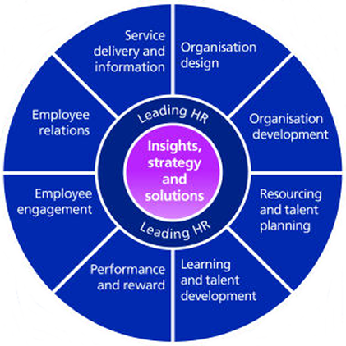
Normally start at the Core first!
Are you confident you have the core areas covered at the right band?
Other areas?
Do you need to build specialist area expertise?
Do you need to widen your experience across HR?
What areas will your organisation need you to be confident in for the future?
Notes:
S

Slide 31
Then one or two behaviours to start...
Bands
Which band are you at?
Which band do you need to be at?
What do you need to do to get there?
Professional Areas
Which areas are you confident in?
Which areas are important to your organisation, role or your career?
What knowledge do you need?
Step Three
Behaviours
Which behaviours do you show consistently?
Which behaviours are vital to your role, or organisation?
How can you develop these behaviours?

Slide 32
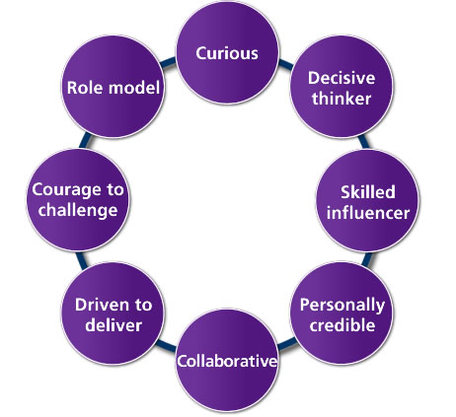
Choosing the behaviour you want to develop first
Start with Curious!
Are there other behaviours you think are areas for development?
What would make the most difference to your organisation? How does your organisation need you to go about your work?

Slide 33

Curious
Contra-indicators
(illustrate the negative manifestations of each behaviour)
Fails to see relevance of wider organisation issues, sector trends or contextual developments to organisation or role
Takes immediate information at face value and fails to ask questions when unclear
Needs to know all the answers, rather than the right method of enquiry
Rejects ideas quickly or spontaneously without reflection or adequate insights
Is focused on the present and the past and has a low interest in emergent or future issues.
As an HR professional do you:
- React negatively to feedback?
- Deliver feedback to others in an inappropriate way - do more harm than good with the things you say?
- Show little interest in developing your skills further?
- Fail to pass your skills on to others?
If you have answered yes to any of these Qs investigate it further and possibly focus on this behaviour as part of your development

Slide 34
Choosing the behaviour you want to develop first
Group exercise
Example of how you would demonstrate these behaviours in work
Short definitions supplied

Slide 35
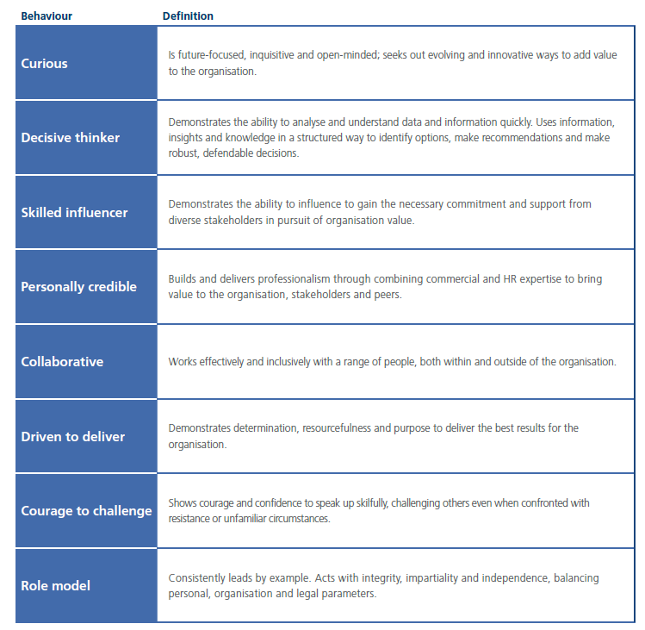

Slide 36
http://www.cipd.co.uk/pm/peoplemanagement/b/weblog/archive/2013/01/29/an-inquiry-into-being-curious-2010-09.aspx

Slide 37
CIPD series
1. Curious http://www.cipd.co.uk/pm/peoplemanagement/b/weblog/archive/2013/01/29/an-inquiry-into-being-curious-2010-09.aspx
2. Decisive Thinker http://www.cipd.co.uk/pm/peoplemanagement/b/weblog/archive/2010/10/14/make-the-right-career-choice-2010-10.aspx
3. Skilled Influencer http://www.cipd.co.uk/pm/peoplemanagement/b/weblog/archive/2010/10/28/develop-the-powers-of-persuasion-2010-10.aspx
4. Personally Credible http://www.cipd.co.uk/pm/peoplemanagement/b/weblog/archive/2013/01/29/how-to-boost-your-personal-credibility-2010-12.aspx
5. Collaborative http://www.cipd.co.uk/pm/peoplemanagement/b/weblog/archive/2013/01/29/working-together-for-success-2011-01.aspx
6. Driven to deliver http://www.cipd.co.uk/pm/peoplemanagement/b/weblog/archive/2013/01/29/delivering-success-on-business-objectives-2011-01.aspx
7. Courage to challenge http://www.cipd.co.uk/NR/rdonlyres/A7C5E08C-5FF4-4D5B-BE95-2DDBE4AEA9F8/0/CIPD_CourageousMindset.pdf
8. Role Model http://www.cipd.co.uk/pm/peoplemanagement/b/weblog/archive/2013/01/29/be-a-mirror-to-company-integrity-2010-11.aspx

Slide 38

My CPD Map is CIPD’s Continuing Professional Development (CPD) tool for HR practitioners
Use it to support your HR career, development and learning through a series of self-assessments which are relevant to your current role, your future development and your areas of interest in the world of HR

Slide 39
Through a series of self-assessments, based on the CIPD Profession Map, my CPD Map will help you identify areas where you’re particularly strong, and areas where you may have some knowledge or skill gaps.
You’ll be given some tailored guidance and development actions which are specific to your current role, or a new role that you may be interested in.
It will recommend courses, reading materials, events and other development suggestions to help you get where you want to be. It will even tell you which level of CIPD membership might be right for you.
my CPD Map is based on the standards contained in the CIPD Profession Map. So if you’re working in the world of HR – or aspire to , my CPD Map is perfect for you. It will inform your professional development, whatever your job level, and however many years of experience you may have.
So whether you’re a student who’s just starting out and aren’t quite sure where to begin, or if you’re a seasoned HR professional who’s eager to keep at the forefront of the latest industry developments – my CPD Map is a step in the right direction.

Slide 40
You’ll be asked to choose which areas you’d like to assess yourself on – and will complete a short assessment for each one.
Each assessment comprises a series of statements which you’ll rate yourself on. Your results will summarise how well you’re doing, based on your answers and give you some clear recommendations and practical development suggestions that you can undertake to support your CPD.
You can choose the assessments which are most relevant for you, or ones which interest you. Aside from a couple of mandatory areas which form the core of the CIPD Profession Map, my CPD Map invites you to shape your own future. And that means you can assess yourself against as many or as few of the Professional Areas and Behaviours, as you like.
If you’ve been in the HR world for some time, you probably have a fair idea of what all the Professional Areas are, which ones interest you most, for instance, or which Behaviours could do with a check-up.
If you feel you need a hand choosing which assessments to take, you’ll find information in the tool to guide you. If you’re new to the profession, or considering moving to a different area of HR, my CPD Map offers a handy tool to help you work out which areas of HR might interest you.

Slide 41
For every assessment you take, you’ll receive your own unique profile based on what you’ve told us in that assessment.
Your profile depending on whether you’re keen to step up from your current role, or whether you’re interested in side-stepping into a role in another area of HR.
It’ll give you an insight into what it’s like to work in different areas of HR at different levels, and give you some practical development recommendations which will support your aspirations.
It’ll recommend a reading list to help you increase your knowledge or broaden your skills in your chosen area(s) & point you in the direction of courses, programmes, qualifications and events that are just right for someone of your experience, operating at your level, with your particular development interests.
There are no rules about how many or how few assessments to take, or how frequently you need to be assessed.
As a guide, the recommendation is to revisit CPD Map at least once a year, particularly before your annual appraisal. That way you can review the progress you’ve made over the past 12 months and consider what the next step in your career might be.
my CPD Map allows you not only to see if you might be ready for that next move, it also gives you some clear and specific direction around development objectives for the coming year.

Slide 42
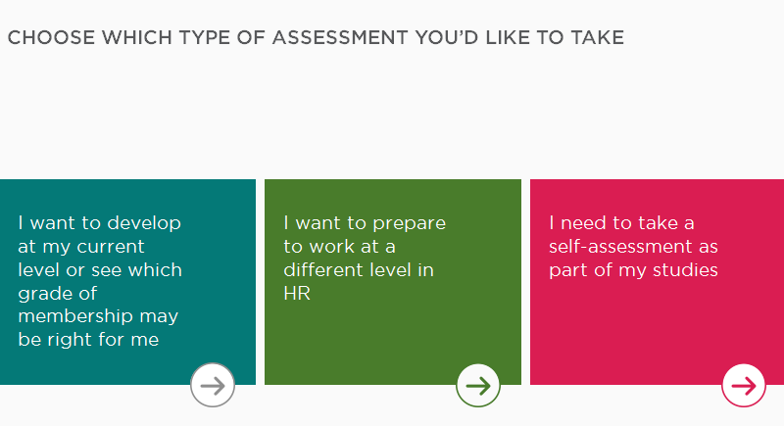
Useful to tick last box – but feel free to choose which ever option you want
See also paper based assessment on moodle for us
You must be able to provide evidence of either tools in your assessment

Slide 43
Code of Conduct & Ethics
https://www.cipd.co.uk/binaries/code-of-professional-conduct_july-2015.pdf
Designed around CIPD’s core aims i.e. to drive sustained organisation performance through HR, shaping thinking, leading practice, and building capability within the profession
Written to be applicable at all stages of an HR professionals career, any size/type of organisation, any role
4 major parts

Slide 44
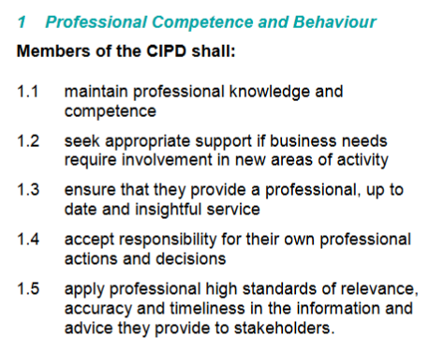
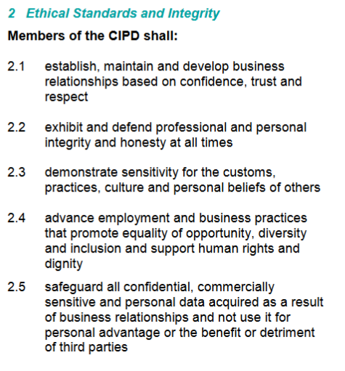
Being professional

Slide 45
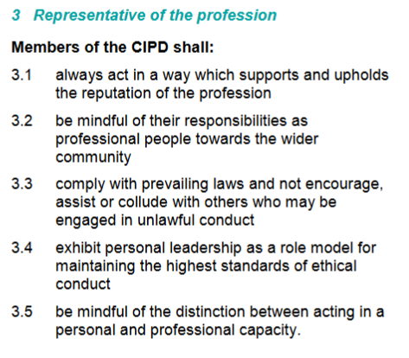
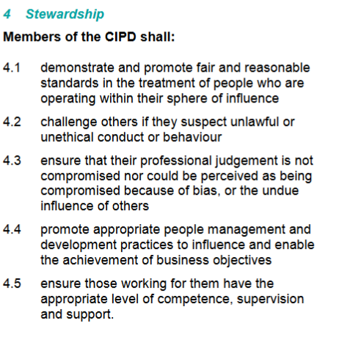
Being professional

Slide 46

Being professional
Taking a stakeholder perspective
Major groups of stakeholders are:
Customers
Shareholders/owners
Managers and their staff
Suppliers
The community
Places a requirement on HR managers to act as champions for effective and fair people management.
Not just take side of management but that genuine shareholder concerns and communication and legitimate interest are looked after

Slide 47
Activity 1
Evaluate what it means to be an HR professional, making reference to the current CIPD Profession Map (make sure answer is in a HR context)
You need to identify a range of the
1)knowledge,
2)skills
3) behaviours required by HR professionals
and state why these are important.
They may include examples from any of the professional areas and behaviours in the CIPD Profession Map

Slide 48
Learning Outcome 3: CPD & PDP planning
Self-assessment - CIPD Associate Membership criteria or HRPM
http://www.cipd.co.uk/Membership/upgrade/Associate-member-forms.htm (3.1)
Evaluate 3 development options - advantages and disadvantages preferred learning style and career aspirations (3.2/3.1)
Devise a personal development plan - for a minimum of 6 months (3.2) http://www.cipd.co.uk/cpd/guidance/
Reflect on performance – capture in reflective summary (3.3)

Slide 49
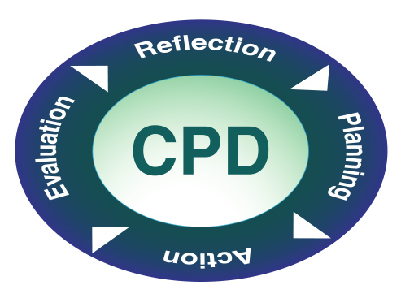
CPD

Slide 50
CPD Continuing Professional Development
An ongoing, planned, learning and development process that:
enables you/your workers to expand and fulfil their potential
contributes to your/their work-based and personal development
can be applied or assessed against competences for your/the worker’s role and organisational performance
Encourages you to take control of your own learning and development
Reflection
Action

Slide 51
CPD
Includes any activity that workers are doing on a day to day basis which increases knowledge, experience and understanding and improves performance
Ensures continuing confidence and competence, particularly as roles develop or change or people develop their careers.

Slide 52
Benefits of CPD
Employer investment on CPD will impact on the quality of the service, the individual worker and the organisation
Contribute to recruitment & retention
Enable workers to meet quality standards
Take account of a multi skilled and multi cultural workforce
Develop a learning culture
Enable cost effective & quality learning
Meet standards
Manage change

Slide 53
L&D Options
(CIPD L&TD Survey 2013)
1
On the job training
2
  In-house development programmes
3
Coaching
4
Internal knowledge sharing events
5
Conferences/workshops
6
E-learning
7
Education courses
8
Job rotation/secondments/enrichment

Slide 54
Activity
What are the advantages and disadvantages of:
Group 1 – E-learning
Group 2 – Formal short training course (workshop)
Group 3 – Being coached
Group 4 – Self directed learning – reading a book
Group 5 – Attending a conference

Slide 55
L&D Methods: Advantages/Disadvantages
Method | Advantages | Disadvantages
E-learning | Flexibility – enables individuals to do within their own time Cost savings – in terms of trainers/resources Can be blended with other types of learning Good for virtual teams – operating globally | Hard to tailor for individual requirements Lack of interactions Need the infrastructure
Coaching | Tailored to the individual Focus on specific skills No set timescales – flexible in terms of time | Hard to evaluate success Can be expensive – particularly external coaches
On the job learning | Real life experience Relatively inexpensive Tailored for the individuals needs | May learn bad habits May take a lower priority if the individual training you is busy, has other priorities, etc. Lack of structure may pose a risk

Slide 56
Learning Styles: Honey and Mumford 1988
Honey and Mumford (1988)
Pragmatist
Theorist
Reflector
Activist
Available on moodle
VAK
Visual
Auditory
Kinaesthetic
http://www.businessballs.com/vaklearningstylestest.htm

Slide 57
L&D Methods: Advantages/ Disadvantages/ Learning Style
Method | Advantages | Disadvantages | Impact on learning needs/styles
E-learning | Flexibility – enables individuals to do within their own time Cost savings – in terms of trainers/resources Can be blended with other types of learning Good for virtual teams – operating globally | Hard to tailor for individual requirements Lack of interactions Need the infrastructure | Visual learners will be attracted to videos/charts used in e-learning Can appeal to pragmatists/theorists depending on content
Coaching | Tailored to the individual Focus on specific skills No set timescales – flexible in terms of time | Hard to evaluate success Can be expensive – particularly external coaches | Auditory learners may value the two engagement Pragmatists – practical/solutions focused, instant results
On the job learning | Real life experience Relatively inexpensive Tailored for the individuals needs | May learn bad habits May take a lower priority if the individual training you is busy, has other priorities, etc. Lack of structure may pose a risk | Activist/pragmatists – practical aspects learning by doing Visual learners observing factors

Slide 58
Objective | Action | Resources/ Support Needed | Success Criteria/ Target Date
Update knowledge on 3 different pieces of employment legislation | Self directive learning – read up on employment law updates Attend seminar courses Undertake 5ELW unit on employment law | Time, money (employer), internet access to study | June 2013. Advise managers on 3 pieces of legislation
??? | ??? | ??? | ???
??? | ??? | ??? | ???
http://www.cipd.co.uk/cpd/guidance/examples/example5.htm
http://www.cipd.co.uk/cpd/guidance/examples/default.htm

Slide 59
Taking the opportunity to think about the work you are doing, as you do it, or after you have done it.
What is Reflective Practice?
‘… looking back on an experience and making sense of it to identify what to do in the future.’
(Drew and Bingham, 2001 p221)
‘…do something, think about it what you did, come to conclusions about what you did and plan to try again.’
(Kolb 1984)

Slide 60
Why should you be reflective practitioners?
To enable professional development
  The ‘knowledge’ economy
  Many industries ask professionals to undertake continuous professional development
To maintain quality
  Reflecting on what went wrong and why = improvement
  Reflecting on what went well and why = good practice
Notes:
Practitioners have considerable power derived from legislation
Practitioners make difficult professional judgments

Slide 61
Reflective practice
Reflection then includes hard systematic thinking and a soft initiative insight, leading to a plan of action based on critical evaluation of all the available evidence.
Don’t just think about what went wrong/well and why – also plan to improve skills if necessary, or to use those skills in future events

Slide 62
Reflective practice
A 'reflective practitioner' is someone who does something and is automatically reflective
thinks back on what happened and asks 'why?', 'how?’, ‘where?’,’ what?‘
The best practitioners are constantly learning, evaluating and refining their practice, even after years of experience.
The next stage is to apply what you have learned from one situation to the next

Slide 63
What can reflective practice do for me?
Enhance your self awareness
Develop creative answers to difficulties
Enhance your problem solving skills
Enhance your ability to evaluate
Enhance your ability to action plan for success
Make you an effective manager

Slide 64
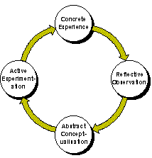
Reflective practice
What is reflection and why do I need to use it?
A key component of Kolb’s learning cycle.
A way of problem solving for everyday practice
Encourages students to think critically.
Notes:
64

Slide 65
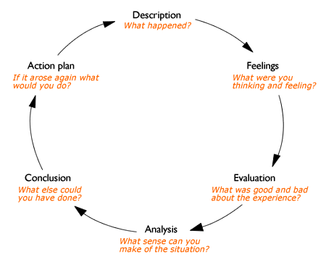
Reflective practice
Gibbs’ Reflective Cycle (1988)
Notes:
65

Slide 66
Reflective practice
Johns’ Model of Structured Reflection (2000)
Looking in
Find a space to focus on self
Pay attention to your thoughts and emotions
Write down significant thoughts and emotions
Looking out
Aesthetics: What was I trying to achieve? Why did I respond as I did?
Personal: Why did I feel the way I did within this situation?
Ethics: Did I act for the best? (ethical mapping)
Empirics: What knowledge did or could have informed me?
Reflexivity: Does this situation connect with previous experiences? How could I handle this situation better?
Notes:
66

Slide 67
Reflective practice
Rolfe’s Framework for Reflective Practice (2001)
What?
So what?
Now what?
Notes:
67

Slide 68
Activity 4
Undertake a self-assessment of one area of your practice to identify your professional development needs in that area and options to address these. (use the HRPM)
Produce a professional development plan (PDP) plan to meet your professional development needs which includes a justification of the option(s) chosen.
During your programme, provide a reflective summary of your performance against the plan. You should also identify any future development needs and record these in your PDP.
- Make good use of tables to help contain your word count, and be as bulleted/ succinct as possible

Slide 69
Activity 4
Undertake a self assessment of your HR practice capabilities (appreciate on the beginning of this journey) - if you are signed up as expected you can use the tool online - or use a downloadable copy (more basic) http://www.cipd.co.uk/binaries/how-to-asses-yourself-against-the-Profession-Map.pdf (keep snippets/snapshots of doing the tool to include as evidence you have undertaken self analysis (see previous student work in workshop)
You need to evaluate the advantages and disadvantages of at 3 development options (methods or activities) and explain how this fits with their own learning style (via H&M or other learning style identification tool) and HR career aspirations.
You should complete a PDP
https://www.cipd.co.uk/binaries/CPD-record-plan-student-example.pdf
which includes at least 5 identified self-development needs (5 separate rows) (using the development options identified above), including the achievement of this CIPD qualification. (add 2 more in the May submission alongside your development record)
The plan should include development objectives and related development activities and cover min. 6- max. 12months
Include some points on the component of reflection, its importance
and how reflective activities will lead to revision of your PDP

Slide 70
Remember
Candidates should provide written responses for each of the four tasks equating to approximately 2,600 words in total (excluding the PDP).
Candidates should relate academic concepts, theories and professional practice to the way organisations operate, in a critical and informed way, and with reference to key texts, articles and other publications and by using organisational examples for illustration.
All reference sources should be acknowledged correctly and a bibliography provided where appropriate (these should be excluded from the word count).
A portfolio of evidence of approximately 2,600 words in total (excluding the PDP) that responds to each of the four tasks.

Slide 71
Case studies
Personal
http://www.cipd.co.uk/binaries/linda-thomas-case-study.pdf
Organisational
http://www.cipd.co.uk/binaries/Co-op-case-study.pdf
Doc assessment
http://www.cipd.co.uk/binaries/how-to-asses-yourself-against-the-Profession-Map.pdf
FAQs
http://www.cipd.co.uk/cipd-hr-profession/profession-map/frequently-asked-questions.aspx
T&Cs
http://www.cipd.co.uk/cipd-hr-profession/profession-map/terms-conditions-map.aspx

Slide 72
http://community.dpgplc.co.uk/blog/making-cpd-sexy-so-what-exactly-is-cpd
http://www.dpgplc.co.uk/blog/2013/9/30/making-cpd-sexy-the-benefits-of-engaging-in-cpd.aspx
http://www.dpgplc.co.uk/blog/2013/9/28/webinar-making-cpd-sexy.aspx

