Slide 1



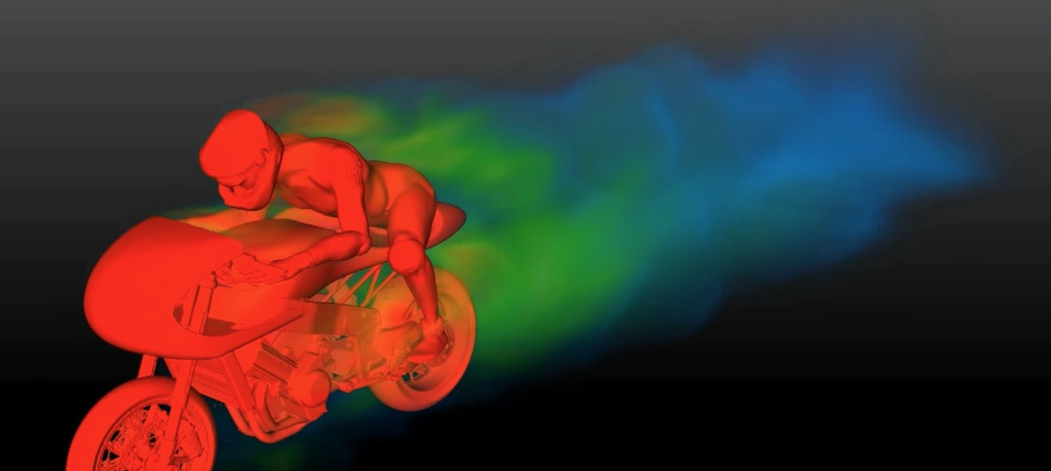
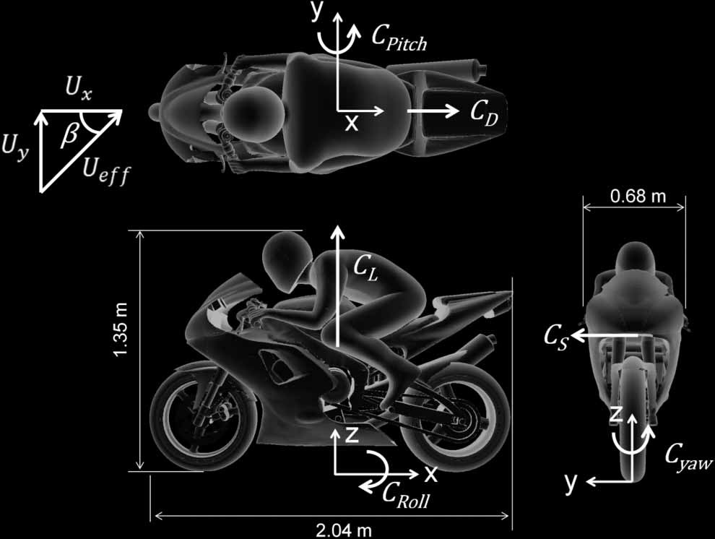
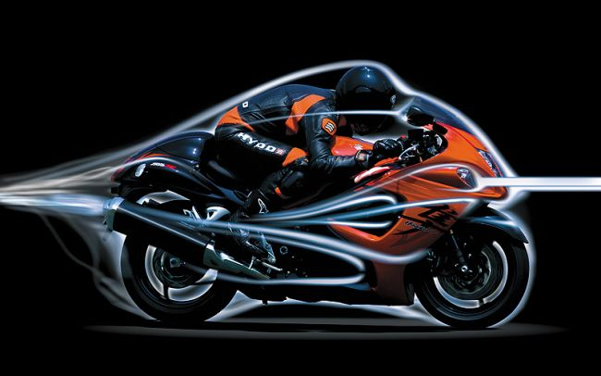
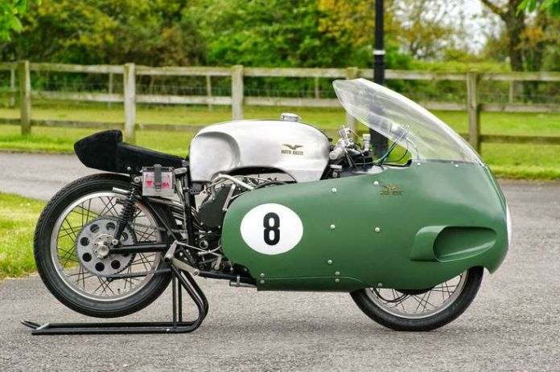
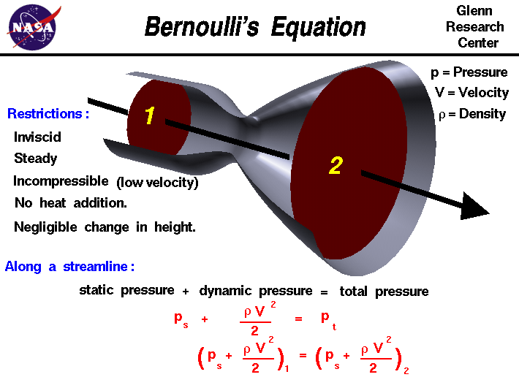
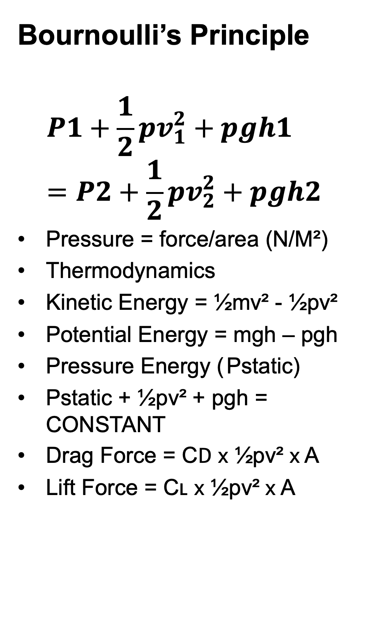
Your Pic
Motorcycle Aerodynamics
Ella Chaves
Andrew Noble
School of Engineering
BEng Motorsport Engineering
Turbulence, Drag & Lift
Turbulence causes a vacuum effect even after is it gone.
Introduction
Motorcycle Aerodynamics is often misunderstood. Unlike other vehicles, Motorcycles do not cut through the air as smooth. In the last 130 years, there has been very little development in aerodynamics for motorcycles however with technology constantly developing, what we know about motorcycles aerodynamics may about to change.
The image above shows the vacuum effect of energy being wasted; this is called aerodynamic drag. Laminar flow is air that moves smoothly that can can get slowed down by rough surfaces, the vacuum effect sucks the turbulent air into the laminar flow.
“Orthogonal views of the motorbike showing the aerodynamic forces and moments, velocity directions and yaw angle, β (the angle between the motorbike traveling direction, Ux, and the effective crosswind, Ueff).” Engineering Applications of computational fluid mechanics.
Bournoulli’s Principle
$$P1+\frac{1}{2}{pv}_{1}^{2}+pgh1=P2+\frac{1}{2}{pv}_{2}^{2}+pgh2$$
Pressure = force/area (N/M²)
Thermodynamics
Kinetic Energy = ½mv² - ½pv²
Potential Energy = mgh – pgh
Pressure Energy ( Pstatic)
Pstatic + ½pv² + pgh = CONSTANT
Drag Force = C𝖣 𝗑 ½pv² 𝗑 A
Lift Force = Cʟ 𝗑 ½pv² 𝗑 A
Drag is the level of resistance in the air mass the motorcycle is pushing through which will rise with the speed of the motorcycle. A smaller frontal area is desired to reduce drag as much as possible.
The image above shows the numerical values around a motorcycle and it shows the geometry of the motorcycle.
Aerodynamic lift reduces the grip that the tyres have on the road. Alongside reducing drag, the body needs to be able to create enough equal parts downforce at the front and lift force at the rear for safer riding.
Acknowledgements
I greatly acknowledge the assistance and help of Andrew Noble who has given me lots of feedback on previous work for me to develop my literature skills and have better outcomes in the future.
Thanks, should also go to Tim Tudor for presenting us with a very interesting and informative lecture on motorcycle aerodynamics.
BikesMedia, an in-depth of Aerodynamics.
References
Michael Uhlarik, Motorcycle Aerodynamics, Canada MotoGuide, May 4, 2016.
Gerald M. Angle II, Aerodynamic drag reduction of a racing motorcycle through vortex generation, West Virginia University, 2002.
Unknown, Motorcycle Workshop. Part 2: Aerodynamics, Yamaha Part.
Tony Foale, Aerodynamics, Moto Chassis, 1986-1997
D. Fintleman, H. Hemida, M. Sterling & F-X. Li, A numerical investigation of the flow around a motorbike when subjected to crosswinds, Engineering Applications of Computational Fluid Mechanics, 9:1, 528-542, DOI: 10.1080/19942060.2015.1071524.
1957 Moto Guzzi 500 V8, Canada MotoGuide.
The “oldest use of aerodynamics in competition motorcycles”, featuring a fully enclosed body. Covering the front wheel allowed them reduce a lot of drag and increase speed for the same horsepower, even though they could cut through the air resistance, they were extremely unstable in other conditions. This happened as a result of putting the centre of air pressure ahead of the centre of gravity which created a strong turning force.
Bernoulli’s Equation, Glenn Research Centre, NASA.
Wales Institute for Science & Art

