Slide 1
Human rights and climate change
Why climate change is a human rights abuse.

Slide 2
Climate change
Climate change is caused by dangerous anthropogenic emissions interfering with the environment.
The impacts on the environment include: drought, famine, desertification, ice caps melting, rising sea levels, flooding, extreme weather.
The serious environmental impacts caused by climate change directly and indirectly affect people and their ability to enjoy the freedoms of human rights.
Universal declaration of human rights: Article 25.
‘(1) Everyone has the right to a standard of living adequate for the health and well-being of himself and of his family, including food, clothing, housing and medical care and necessary social services, and the right to security in the event of unemployment, sickness, disability, widowhood, old age or other lack of livelihood in circumstances beyond his control.’
Notes:
Anthropogenic- pollution that is man made.

Slide 3
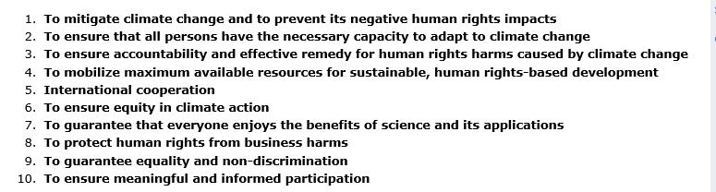
Climate change and human rights
To limit the effects of climate change on peoples human rights, the Human Rights Office of the High Commissioner (OHCHR), have put forward obligations for duty-bearers to ensure that peoples human rights are not abused by climate change.
Print screen of OHCHR website of obligations that they have recommended duty-bearers to follow.
Notes:
OHCHR- branch of UN deals with human rights
States have obligation to make sure that human rights are kept (declaration). So they have a duty to reduce impact of climate change on peoples lives so that human rights are not abused.

Slide 4
WHO?
Everyone in the world is affected by climate change, some more than others. People who depend more on the environment are on the front lines of climate change.
The Inuit community :
  “The Inuit complained that climate change jeopardizes their right to life, physical integrity and security, their right to use and enjoy the lands they have traditionally used and occupied, to use and enjoy their personal property, and the inviolability of their home—rights that are recognized by both The Universal Declaration of Human Rights and the American Convention on Human Rights.”
Notes:
Inuit community is fighting to save their land and ways of lives. Important case because they filed a complaint against America because of the harmful emissions that they are producing and how it is affecting their rights. Case is important because it shows how climate impacts peoples lives call for more action.

Slide 5
Concluding points
Climate change affects everyone globally. From a utilitarian approach it would benefit and make the most people happy to solve climate change to make sure that human rights are not abused.
All have a duty to limit/stop global warming. It is not just affecting people in far corners of the world.
If we all contribute to climate change are we ourselves the makers of our own human rights violations?
‘Climate change…is poised to become the most massive human rights violation the world has ever seen’
-Kathleen Dean Moore
Notes:
Kathleen Moore- environmental Philosopher from America who writes about need for climate action.

Slide 6
Reference List
OHCHR, (2018) http://www.ohchr.org/EN/Issues/HRAndClimateChange/Pages/HRClimateChangeIndex.aspx [Online] accessed on [15/1/18]
Ana Núñez, CIEL, http://www.ciel.org/Publications/Inuit_CaseStudy_Sep07.pdf [online] accessed on [14/1/18]
UN, http://www.un.org/en/universal-declaration-human-rights/ [Online] accessed on [14/1/18]
Letman.J. Aljazeera (2013) http://www.aljazeera.com/humanrights/2013/12/how-climate-change-destroys-human-rights-20131217174532837148.html [online] accessed on [15/1/18]

