Slide 1
AI Acknowledgement
I confirm that I have not presented any AI-generated text as my own work. I confirm I have copies of my drafts, notes, and other sources I used before and after the use of AI tools, which I may be asked to provide in evidence.

Slide 2

Introduction to narcissism
Notes:
Hello everybody, my name is Aimee and I will be talking about narcissism, what it is, what it looks like and why it is an important part of Psychology and everyday life.

Slide 3
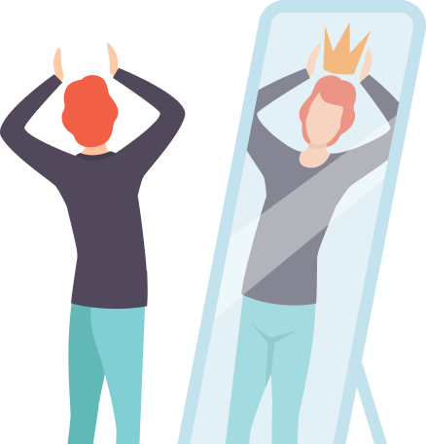
Narcissism is a personality trait characterized by an excessive focus on oneself
An inflated sense of self importance, a strong need for admiration and a lack of empathy for others.
Notes:
Firstly, narcissism is a personality trait characterized by an excessive focus on oneself. It is a personality disorder that includes “having an inflated sense of self-importance, a strong need for admiration, and a lack of empathy for others” (American Psychiatric Association, 2013). While it is normal that people may have these mild traits, it is problematic when these traits are extremely persistent and interfere with people’s everyday lives, and they struggle to maintain relationships.

Slide 4
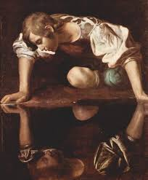
Narcissus, a young man who fell in love with his own reflection. This idea is used in psychology to describe people who are excessively focus on themselves and their own needs.
Notes:
There is a story that originates from Greek mythology about a man named Narcissus, a young man who fell in love with his own reflection. In psychology, this idea has been developed to describe people who are excessively focused on their own needs and themselves.

Slide 5
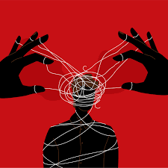
Narcissism is understood as a clinical disorder and as a personality trait.
Leadership, confidence and ambition are the positive attributes.
Notes:
Narcissism is understood as a clinical disorder and as a personality trait. As a trait, narcissism is considered part of a normal personality and has positive attributes, such as leadership, confidence, ambition and so on, however, at the extreme end of the spectrum, it may develop into NPD, Narcissistic personality disorder. “According to the Diagnostic and Statistical Manual of Mental Disorders, individuals with NPD display patterns such as grandiosity, fantasies of unlimited success, a sense of entitlement, and difficulty recognising or caring about others’ feelings” (American Psychiatric Association, 2013).

Slide 6
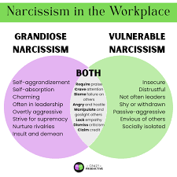
There are two different types of narcissist, the vulnerable narcissist and the grandiose narcissist, both share a few traits but both appear very different to each other.
Notes:
Psychologists often distinguish between the two types of narcissists, the grandiose narcissist and the vulnerable narcissist. Grandiose narcissism is associated with high self-esteem, dominance, and attention-seeking behaviours. These individuals may appear confident and charismatic, but can also be arrogant and exploitative. In contrast, vulnerable narcissism involves insecurity, hypersensitivity to criticism, and low self-esteem, despite still having a strong sense of entitlement (Miller et al., 2011). This highlights that narcissism is not always obvious and can present in different ways; also, this distinction helps psychologists better understand different behaviours linked to narcissism.

Slide 7
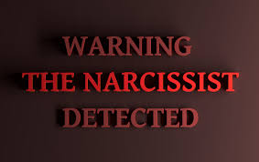
Notes:
The main characteristics or traits of narcissism are:
Inflated sense of self-importance
A strong need for validation and praise
A lack of empathy for others.
Sense of entitlement
Exploitive behaviour in relationships

Slide 8

Narcissism can be developed through neglect or being over-praised as a child, as well as other factors.
Notes:
Narcissism can be developed through multiple factors such as being a child who was neglected or over-praised, parenting styles can play a role in this aswell as genetic influences and cultural pressure on success and appearance. From a psychological perspective, early theorists like Sigmund Freud believed that narcissism was an important role in development, but if left unresolved, could become problematic. Heinz Kohut believed that narcissism can develop when a child’s emotional needs for validation are not met.

Slide 9

Narcissism has major impacts on relationships, not just romantic ones.
Notes:
Narcissism can have a major impact on relationships. At the beginning of a relationship, the narcissist may appear charming and confident, but over time, their lack of empathy and need for control can lead to manipulation, gaslighting and an unstable relationship. This is not only about their romantic relationships but friendships and even work friends.

Slide 10
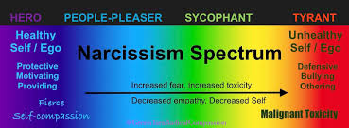
Conclusion, narcissism is a personality trait that exists on a spectrum.
Notes:
To conclude, narcissism is a personality trait that exists on a spectrum. Whilst it is considered normal to have levels of narcissism, to have extreme levels leads to interpersonal and emotional difficulties. By getting an understanding of narcissism, it allows people to more easily recognise these behaviours and handle them more appropriately in everyday situations. Thank you for listening.

Slide 11
References
https://cachsc.org/parenting-children-who-have-experienced-abuse-or-neglect/
American Psychiatric Association. (2013). Diagnostic and statistical manual of mental disorders (5th ed.). Author.
https://cachsc.org/parenting-children-who-have-experienced-abuse-or-neglect/
Miller, J. D., Hoffman, B. J., Gaughan, E. T., Gentile, B., Maples, J., & Campbell, W. K. (2011). Grandiose and vulnerable narcissism: A nomological network analysis. Journal of Personality, 79(5), 1013–1042. https://doi.org/10.1111/j.1467-6494.2010.00711.x
https://www.davismiles.com/lawyer-speak/divorcing-from-or-co-parenting-with-a-narcissist-how-to-deal-with-a-narcissist-in-a-divorce-situation/
https://www.melissagratias.com/2-faces-of-narcissism-at-work/
https://www.self.com/story/narcissism-signs
https://en.wikipedia.org/wiki/Narcissism
https://guidinglightpsychology.com.au/narcissism/
https://workscounselingcenter.com/couples-knew-about-arguing/
https://medium.com/@tarasierralee_57910/the-narcissism-spectrum-destigmatizing-narcissism-c8e7b3b87a81

