Slide 1

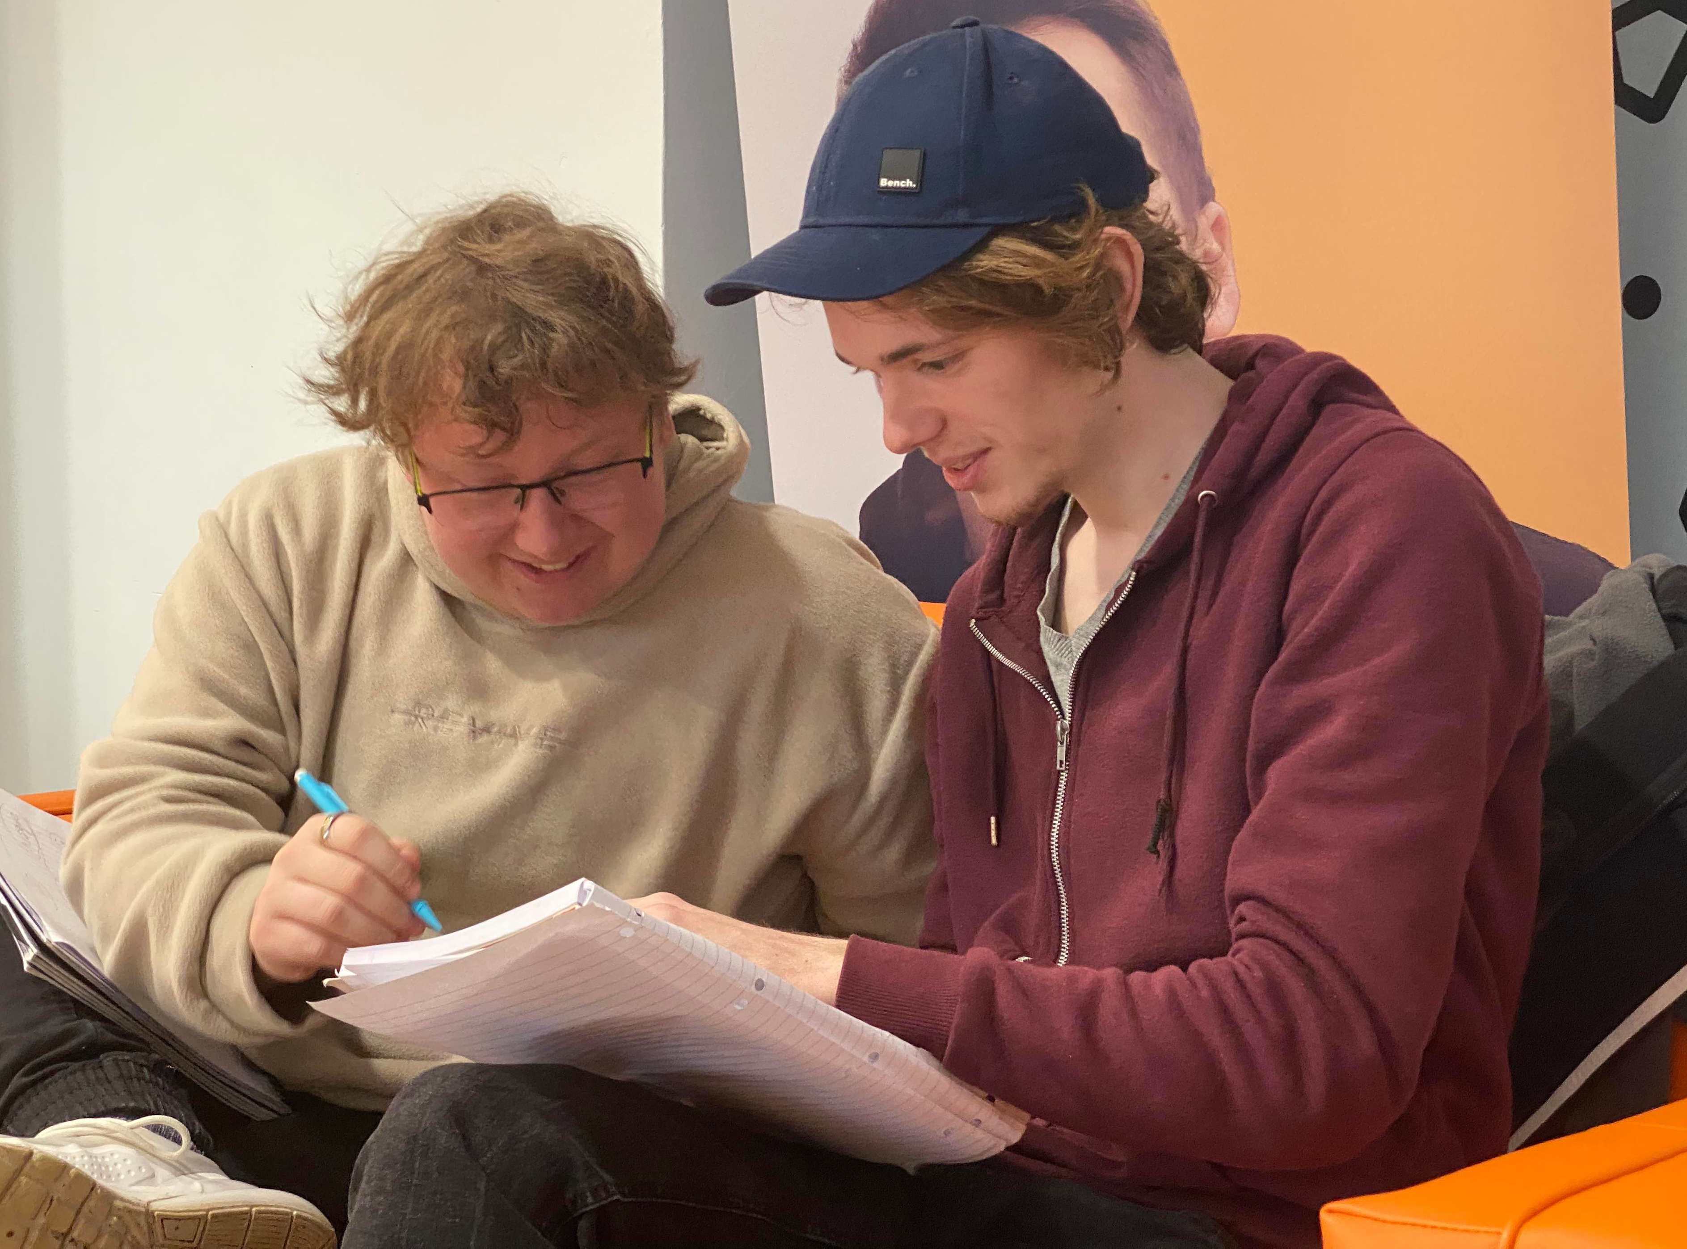
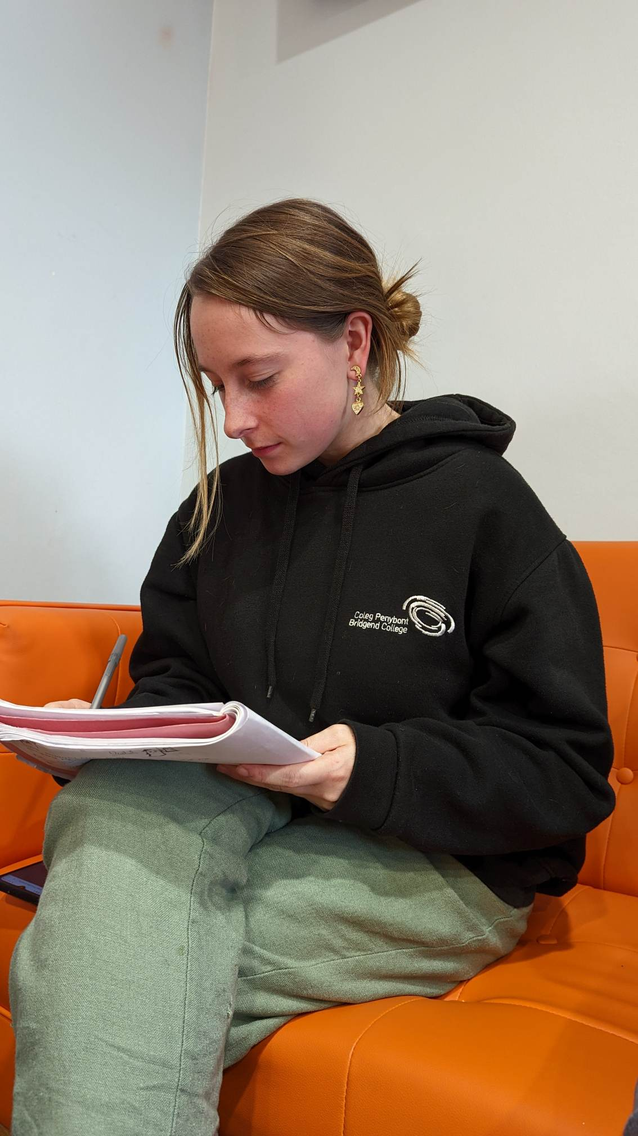
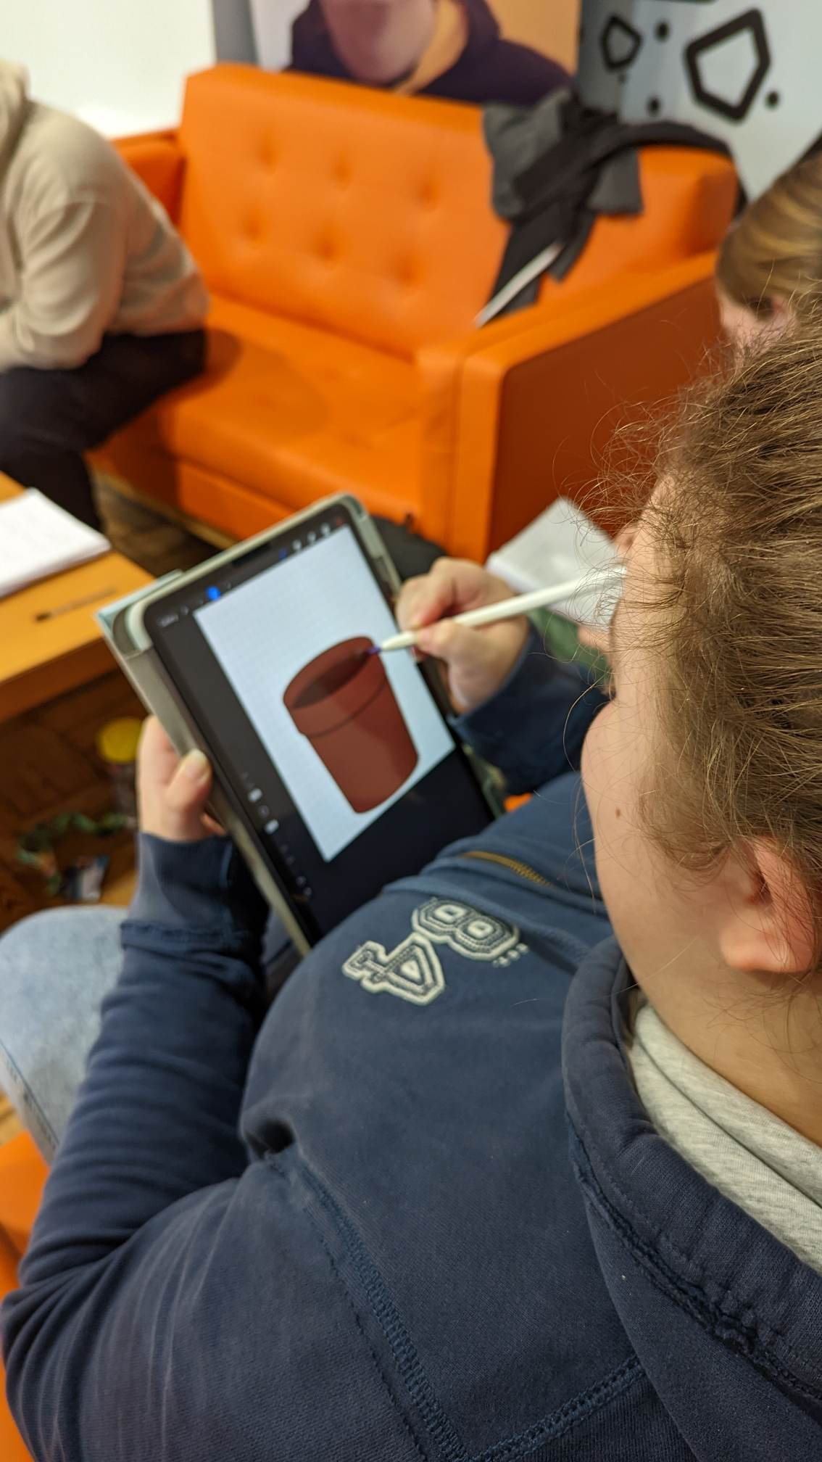
Cactus Wazowski (T3)
Introduction: As a team, we have to adapt to everyone's schedules to try and include every member in the work. Making this possible with meetings and updating the plan on messenger for people who cannot attend to know their role. Chloe was chosen as planner as she has great organisational and time management skills.
Our aims: Our aim is to work cohesively to produce an outcome of a high standard. This requires excellent communication among the team due to travel restrictions. As a group we also hope to achieve a fun and creative poster unfolding how the team formed a production company.
Layout and plan: The biggest part of our plan was deciding on our roles. It’s important that everyone knows how to use their skills in our team but also to be involved in other people’s suggestions, improving ideas to create the most effective plan.
Materials and methods: Once we were happy with our chosen roles, we mapped out our plan using Tuckman’s Stages of Team Building (2022: Acc 23/11/22) and Grotowski’s Statement of Principles (1968: pg 211-218) to resolve any dilemmas. We had an issue where a member couldn't attend. To solve this, each member took on a specific task and then we discussed as a group on how to improve it.
Conclusion: As a group, we managed to communicate and solve problems together. We also came to a decision on our chosen idea pretty well without much conflict and confusion within the group and adapted our roles really well.
Reflection: Overall, I feel very positive about this task and thought that I contributed an equal amount of ideas and opinions as everyone else. Building the team was easier by using the Tuckman’s method because we all got to know each other’s abilities and strengths. For me, I found voicing my opinion a bit of a challenge and I would find myself more on the side of ruinous empathy because I didn’t want to disagree with anyone. However, that is something I am going to work on for future team work.
References: - Grotowski, J. (1968) Towards A Poor Theatre. New York; Routledge.
- West Chester University. (2022) Tuckman’s Stages of Group Development [Online]. Available from:
https://www.wcupa.edu/coral/tuckmanStagesGroupDelvelopment.aspx#:~:text=These%20stages%20are%20commonly%20known,more%20collaborative%20or%20shared%20leadership [Accessed 23 November 2022].

