Slide 1
Norwegian Airlines
Management and Strategy Approaches
Honorata Sieczych
Student no 1708007
Contemporary Management Approaches (BMSP4002)
Tutor: Anthony Burns and Davina Evans
Due Date: 14/12/2017
Notes:
Hello, my name is Honi and I will talk today about Norwegian Airlines moreover approaches to management and strategies.

Slide 2
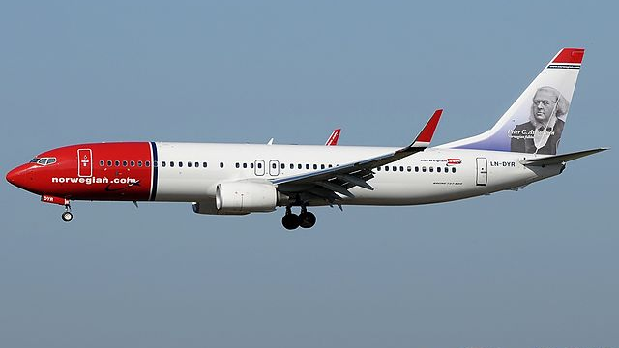
Introduction
This Photo by Unknown Author is licensed under CC BY-SA
Notes:
Norwegian Air Shuttle ASA was founded in 1993.
Norwegian Group consist parent company of Norwegian Air Shuttle ASA (Norwegian Air Shuttle ASA, 2017).It has their bases across the world and branches in so many countries (Norwegian Air Shuttle ASA, 2017).
Norwegian Air Shuttle ASA is low cost airlines based in Norway with wide range choice of destinations from so many different airports across the globe. Its offers flights to 150 destinations via 500 routes across the world. In Scandinavia this is the largest airline. In Europe its third largest airline and worldwide its sixth largest airline. Norwegian airline offers also long haul from Europe to North and South America and Asia in competitive price for happy customers. (Norwegian Air Shuttle ASA, 2017) (MarketLine, 2017).Norwegian Airline works on modern and most “greenest” aircraft such as Boeing 737-800s,Boeing 737 MAX and Boeing 787 Dreamliner’s. Average of aircraft age is 3,6 years (Norwegian Air Shuttle ASA, 2017).

Slide 3
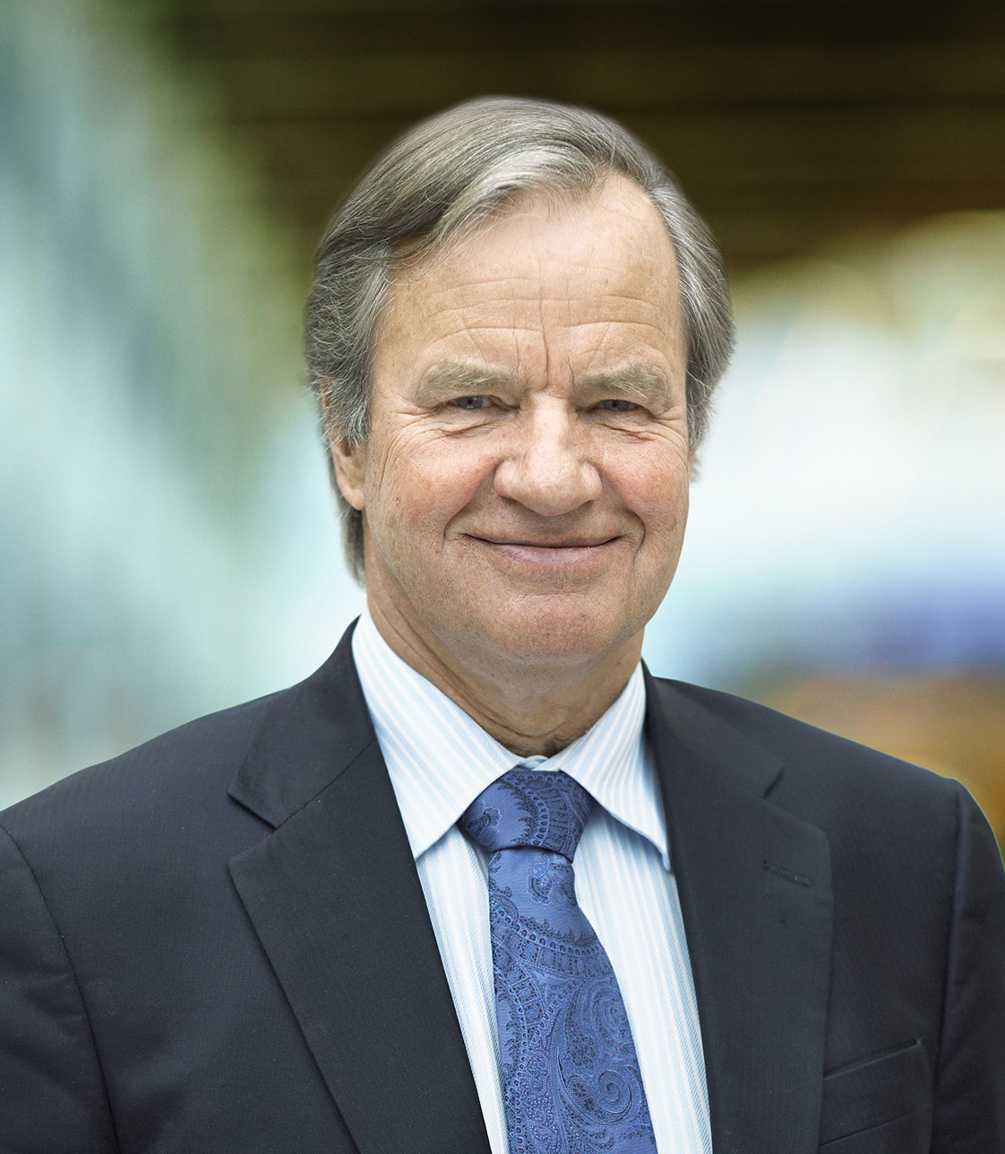
Bjorn Kjos
CEO of Norwegian Airlines
This Photo by Unknown Author is licensed under CC BY-SA
Notes:
Bjorn Kjos has been the Chief Executive Officer of Norwegian Airlines since 2002, he is one of cofounder of Norwegian airlines. He is aviator and graduated lawyer.
One of the main core of the business is affordable prices, products for their customers followed another main core high quality and safe transport (Norwegian Air Shuttle ASA, 2016) (Norwegian Air Shuttle ASA, 2017).

Slide 4
Management approaches
Classical approach + Human approach = System approach
Notes:
Management approaches
Research shows that system approach is implemented into its business along with theory y approach.
System approach is a mixture between classical approach and human approach (Mullins, 2013) The analysis shows that there is hierarchy in Norwegian Airlines management furthermore bureaucracy applied to this company throughout strict policies and procedures (Mullins, 2013) (Norwegian Air Shuttle ASA, 2017).
However human approach is also recognized in Norwegian Airline (Mullins, 2013)Its empathise on human relations inside business” Corporate Responsibility” (Norwegian Air Shuttle ASA, 2017)
It’s focus overall of work organisation, also on the relationship between structure and behaviour and the range of variables within an organisation. Going step by step to achieve a goal (Mullins, 2013). However, the system in Norwegian Airlines its generally same all over with some modification in different country followed by their policies and procedures. Obviously, law in each country is little bit different furthermore Norwegian must adapt its rules to it. The whole system applied across Norwegian Airlines but its help to achieve their goals (Norwegian Air Shuttle ASA, 2017).
System approach can be open, close or sub system. System approach in Bjorn company works with synergy is harmonised all employees to work together to achieve a goal such like work of pilots. They cooperate and make sure that flight runs smoothly and safe to the destinations (Norwegian Air Shuttle ASA, 2016) (Norwegian Air Shuttle ASA, 2017) (Mullins, 2013).

Slide 5
Input
Process
Output
Feedback
Notes:
Feedback is important in system approach. Positive feedback helps to understand that its going in the right way and the best example of those are lots of awards for Norwegian company received through years and latest one “Outstanding Contribution to Aviation” (My News Desk, 2017) (Norwegian Air Shuttle ASA, 2016)Bjorn Kjos stated “We have been profitable in last 10 years” (Calder, 2017)shows that Bjorn Kjos is going in right directions (Norwegian Air Shuttle ASA, 2017) (Norwegian Air Shuttle ASA, 2016).Norwegian also received “Airline of the Year” award by CAPA-centre for Aviation (Reed, 2017).Another award that this company received is “World best Low-Cost Long Haul Airlines and Best Low-Cost Airline in Europe by Skytrax World Airline Awards” (Zhang, 2017). However, in same article Norwegian is accused of being the most aggressive airline because of their business strategy (Zhang, 2017). Negative feedback will help you to correct and reduce in system process to re-establish and come back on track (Mullins, 2013) (Boddy, 2014).

Slide 6
Open system in organisation
Hierarchy
Neo human relations
Theory-Y
Bureaucracy
Notes:
The organisation is open system that each employee can contribute towards set goal and is open to the environment and management is analysis constant observation what happens in the organisation and outside (Norwegian Air Shuttle ASA, 2017) (Norwegian Air Shuttle ASA, 2016) (Mullins, 2013).
In any large organisations its fundamental that we have hierarchy also certain set of rules for smooth run of company.
Hierarchy of the organisation Maslow, bureaucracy Max Weber, followed by theory y Mc Gregor (Mullins, 2013).
Neo human relations focus on human personality and motivation, Maslow hierarchy of needs then Herzberg two factors of motivation and Mc Gregor Theory Y (Mullins, 2013) (Buchanan & Huczynski, 2004) Theory Y theory of leadership (Mullins, 2013)cited Mc Gregor
Work can be enjoyable place. Managers trust people. Employees enjoy this job to fulfil their ambitions. Staff participate in the company and employers trust them (Mullins, 2013).
People are less controlled using their initiative and take responsibilities. This applies with statement in Annual Report (Norwegian Air Shuttle ASA, 2016) “Employees don’t need strict directions to accomplish a goal/ task and give them freedom, use their creativity” (Norwegian Air Shuttle ASA, 2017). Leaders must find the right worker for the right job. Passionate and devoted pilots will meet criteria in it because they like to work with brand new machines and to gain experience from it. (Norwegian Air Shuttle ASA, 2017). The decisions are made by managers including workers opinions. This style fits industries and airlines using their creativity and innovations.
Theory Y theory of leadership (Mullins, 2013)cited Mc Gregor
Work can be enjoyable place. Managers trust people Employees enjoy this job to fulfil their ambitions. Staff participate in the company and employers trust them (Mullins, 2013).
People are less controlled using their initiative and take responsibilities. This applies with statement in Annual Report (Norwegian Air Shuttle ASA, 2016) “Employees don’t need strict directions to accomplish a goal/ task and give them freedom, use their creativity” (Norwegian Air Shuttle ASA, 2017). Leaders must find the right worker for the right job. Passionate and devoted pilots will meet criteria in it because they like to work with brand new machines and to gain experience from it. (Norwegian Air Shuttle ASA, 2017). The decisions are made by managers including workers opinions. This style fits industries and airlines using their creativity and innovations.

Slide 7
Flat & lean organisation
Advantages:
Only one level of hierarchy
Focus on “importance of teamwork”
Disadvantages:
More responsibility for staff for making decisions
Notes:
Flat and lean organization has only one level of hierarchy which means that Bjorn Kjos manage their subgroups, he empowers his employees and concentrate on “importance of teamwork” (Mullins, 2013). Effective team work performs better within an organisation and more profitable than their competitors (Norwegian Air Shuttle ASA, 2016) (Buchanan & Huczynski, 2004) (Mullins, 2013)
It’s also gives them creative cooperation and flat decisions (Norwegian Air Shuttle ASA, 2016) (Buchanan & Huczynski, 2004).
However, disadvantage of flat decisions that workers are more responsible for making decisions and this will work only when staff is qualified and competent (Buchanan & Huczynski, 2004).

Slide 8
Strategy Management
SWOT analysis
PESTLE analysis
Strategy definition
Notes:
Strategy is concern about company long term functions and future. Its question how to achieve successful business and goals that its sets (Mullins, 2013).Norwegian Airline stated that their strategic management maintains “flexibility and adaptability” to the present world (MarketLine, 2017).
SWOT analysis it’s a process that identifies strengths, weakness, opportunities and treats for their business (Mullins, 2013) (Molthan-Hill, 2017)
PESTLE analysis concern on industry factor that can shape business. (Mullins, 2013) (Molthan-Hill, 2017).

Slide 9
Strengths
Weakness
Opportunities
Threats
Notes:
Strength
Norwegian Airlines are strong market position and competitive prices followed by high quality services furthermore wide range of destination across the world and operates with modern aircrafts. The customers have lots of choices of destinations, routes within low price so its advantage for Norwegian Airlines. Financial position was adequate to their strategy and risk profile. In 2016 the company achieved” 81% of total revenue” (MarketLine, 2017) (Norwegian Air Shuttle ASA, 2016).
Weakness
Large debt in 2016 can lead to difficulties within business operations and it might be hard to rise above it and expand Norwegian Airline in future (MarketLine, 2017) (Norwegian Air Shuttle ASA, 2016).
Opportunities
Good reputation for Norwegian Airline and Bjorn Kjos gives new opportunities and ensure that customers are satisfied likewise worldwide airline industry (MarketLine, 2017) (Sloan, 2017) (Calder, 2017).
Threats
The biggest threats for Norwegian Airlines is terrorism. If terrorist attack will happen somewhere then automatically customers will stop travel to that destination. According to an interview of Bjorn Kjos by Chris Sloan this is the biggest fear for his company (Sloan, 2017).Another treat could be unexpected circumstances for instance earthquake, floods, tsunami, any epidemic etc that will stop tourism as well (MarketLine, 2017).

Slide 10
Political
Economic
Sociological
Technology
Legislation
Environmental
Notes:
Political
Norwegian Airlines must comply within law, regulations and policies of each country its operates moreover adapt to it (Norwegian Air Shuttle ASA, 2016).
Economic
Norwegian must ensure that economic factor won’t impact on their employees moreover employees are safe (Norwegian Air Shuttle ASA, 2016). Bjorn Kjos use outsourcing in his company to reduce a cost on taxes etc (Learmount & O'Keeffe, 2014) (Norwegian Air Shuttle ASA, 2017).
Sociological
Rapid growth of population, demands for fast and easy transport with wide range of choices and competitive price likewise increase of tourism gives Norwegian opportunity to growth and be strong rival for competition offering different choices for their customers for example free Wi-Fi on European flights and hand luggage are included in price (Norwegian Air Shuttle ASA, 2016) (Norwegian Air Shuttle ASA, 2017).
Technology
Rapid growth of innovation and technology gives benefits for Norwegian Airline. Investing in innovated technology furthermore brand new Boeing 737 is a smart move. Norwegian subsist modern and ecological aircraft fleet across the globe (Norwegian Air Shuttle ASA, 2016).
Legislation
Bjorn Kjos must comply within each countries laws and regulations. Each country that his business operates it’s have modified regulations and policies to comply with their law (Norwegian Air Shuttle ASA, 2016) (Norwegian Air Shuttle ASA, 2017).
Environmental
Operating with modern and ecological equipment it’s a bonus. Norwegian airlines planes are more sustainable for environment. New planes are built from lighter materials and its reduce noise moreover reduce weight and noise of aircraft gives decrease of emission. “Winglets reduce drag” moreover reduce fuel consumption by approximately 2% per plane. One more element that those new planes receive is “special wash” (Norwegian Air Shuttle ASA, 2016) for plane and engine which reduce fuel consumption and carbon emission by approximately 16.000 annually (Norwegian Air Shuttle ASA, 2016) (Norwegian Air Shuttle ASA, 2017).This technology and Norwegian strategy adhere to Sustainable Development Goal no13 ”Climate Action” (Molthan-Hill, 2017) (Nations, 25).

Slide 11
Outsourcing
Norwegian Airlines keep cost down
Using outsourcing for employment
Notes:
However Norwegian Airline its criticised for one of their strategy which is outsourcing of employment. Basically, it means that Bjorn Kjos company employs people in their countries rather than just in headquarter country. Norway is quite expansive country and this way Norwegian save lots of money on taxes and labour (Aero Time, 2016) (Learmount & O'Keeffe, 2014). Nevertheless, outsourcing strategy gives jobs for poorer country such us Thailand and that comply with Sustainable Development goal no8 “Decent Work and Economic Growth” (Molthan-Hill, 2017) (Nations, 25)

Slide 12
Norwegian Corporate Responsibility
Sustainable business in all aspect
Partnership with UNICEF and
Humanitarian organisations
Notes:
Norwegian Airlines aim to be a sustainable business in every aspect such as respecting people the environment and society (Norwegian Air Shuttle ASA, 2016) (Norwegian Air Shuttle ASA, 2017) (Molthan-Hill, 2017) (Nations, 25).
Norwegian’s “Corporate Responsibility” (Norwegian Air Shuttle ASA, 2017) strategy is focused on how Norwegian as an airline can devote itself to reduce pollution and emissions by flying new and fuel-efficient aircraft. Their “Codes of Ethics” (Norwegian Air Shuttle ASA, 2017) gives the directions for a good working environment and emphasises the business regulation for human rights, preventing corruption, employee rights and safety for all – both for our customers and staff. Norwegian has a promote organisational collaboration with the humanitarian organization; UNICEF (Norwegian Air Shuttle ASA, 2017) .This approach is with accordance to Sustainable Goal no 17 ”Revitalisation of global partnership…” (Molthan-Hill, 2017) (Nations, 25) .

Slide 13
Thank you for your attention
☺

Slide 14
Reference
Aero Time. (2016, June 17). Aero Time Aviation News. Retrieved from Aero Time: https://www.aerotime.aero/en/civil/12395-why-there-is-so-much-noise-about-norwegian-air-flying-in-the-us
Boddy, D. (2014). Management An Introduction. Harlow: Pearson.
Buchanan, D., & Huczynski, A. (2004). Organizational behaviour . Harlow: Pearson Education Limited.
Calder, S. (2017, October 13). Independent. Retrieved from www.independent.co.uk: http://www.independent.co.uk/travel/news-and-advice/norwegian-secret-of-success-bjorn-kjos-iag-ryanair-budget-airline-level-low-cost-a7999131.html
Learmount, D., & O'Keeffe, N. (2014, February 6). Flight Global. Retrieved from Flightglobal.com: https://www.flightglobal.com/news/articles/analysis-pilots-fight-new-norwegian-employment-mode-395645/
MarketLine. (2017, September 19). www.marketline.com. Retrieved from Norwegian Airline Shuttle ASA Company Profile: http://advantage.marketline.com.ezproxy.uwtsd.ac.uk/Product?ptype=Companies&pid=6FD175D5-8495-4BA8-A627-980B7A41E449
Molthan-Hill, P. (2017). The business student's guide to sustainable management. Sheffield: Greenleaf Publishing Limited.
Mullins, L. (2013). Management and Organisational Behaviour. Harlow: Pearson Education Limited.
My News Desk. (2017, April 8). My News Desk. Retrieved from mynewsdesk.com: http://www.mynewsdesk.com/uk/norwegian/pressreleases/norwegian-ceo-receives-outstanding-contribution-to-aviation-accolade-from-the-irish-aviation-industry-1904655

Slide 15
Reference
Nations, U. (25, 09 2015). www.un.org. Retrieved from www.un.org: http://www.un.org/sustainabledevelopment/sustainable-development-goals/
Norwegian Air Shuttle ASA. (2016, n.d. n.d.). Norwegian Air Shuttle ASA annual report 2016. Retrieved from Norwegian.com: https://www.norwegian.com/globalassets/documents/annual-report/nas_annualreport_2016.pdf
Norwegian Air Shuttle ASA. (2017, n.d. n.d.). Norwegian. Retrieved from Norwegian: https://www.norwegian.com/uk/
Reed, D. (2017, November 7). Forbes. Retrieved from Forbes.com: https://www.forbes.com/sites/danielreed/2017/11/07/norwegian-what-little-known-oslo-based-discounter-is-disrupting-big-airlines
Sloan, C. (2017, 07 31). Airwaysmag.com. Retrieved from Airways: https://airwaysmag.com/interview/high-flyer-interview-bjorn-kjos-ceo-of-norwegian-air-shuttle/
Zhang, B. (2017, June 24). Business Insider. Retrieved from Businessinsider.co.uk: http://uk.businessinsider.com/best-low-cost-airline-world-skytrax-air-asia-norwegian-jetblue-2017-6?r=US&IR=T/#2-norwegian-9

