Slide 1
Programming and Software Testing
Session 1 - Variables
Dr Tim Bashford

Slide 2
Rationale – why do we program?
Software is everywhere – and the influence of software over electronics only grows.
Initially, all computer users were programmers. Now the vast majority are not.
  “Program or be programmed”.

Slide 3
Three tiers of modern programming
High-level programming
  Abstracts from the hardware itself.
  Allows you to perform powerful operations with code that’s very similar to human readable language.
  Suffers from the abstraction penalty.
  Translates to a low-level language when compiled/interpreted.
  print("Hello")

Slide 4
Three tiers of modern programming
Low-level programming
  Not significantly abstracted from the instruction set architecture.
  Allows a great deal of control over the operation of code, but at a cost of vastly increased complexity.
  Difficult, but entirely possible for humans to read, write and understand.
  LDA A ACIA

Slide 5
Three tiers of modern programming
Machine code
  Entirely without abstraction from hardware or architecture.
  Nearly impossible for a human to work with or understand.
  The “language” of a microprocessor, i.e. no further translation required.
  014A 070001 01A6 37FF9

Slide 6
Three tiers of modern programming
High-level languages are “converted” to low-level languages to be utilised by the CPU.
The CPU relies on this limited instruction set to manipulate the other hardware, or conduct mathematical operations.
There are two main paradigms through which this occurs; compiled and interpreted.

Slide 7
Compiled programming languages
Compiled languages cannot be run until they are converted entirely into a “binary” – an executable, machine-readable file.
  The .exe format in Windows is one many people are familiar with.
Syntax errors prevent the creation of an executable, thus the program cannot be run until it is syntactically valid.
  Note that this certainly doesn’t mean that the program is error-free!

Slide 8
Compiled programming languages
In terms of code, compiled languages are often more particular about syntax than interpreted languages because they go through this rigorous complication process.
As such, can be slightly more complicated to write.
  Often strongly typed
Examples include C, C++, Java, C#.
We’ll be studying Java.

Slide 9
Interpreted programming languages
Interpreted languages are converted into machine code a line at a time, then executed.
  As such, will run a program line-by-line until it encounters an error, then stop.
Generally slightly less picky about syntax than compiled languages – often weakly typed.
Examples include Python, PHP, BASIC, JavaScript.
You will use interpreted languages as part of web development modules.

Slide 10
Compiled vs interpreted
Think of it like using a translation service from English.
Compiled languages have some (usually extremely small) overhead time to begin, but run considerably faster.
Interpreted languages do not have any initial overhead, but are considerably slower in operation than compiled languages.

Slide 11
Compiled vs interpreted
Compiled languages can never be reverted to code, i.e. an executable cannot be turned back into the source used to compile it.
  Good for preserving ownership of the application.
  Difficult to change – usually requiring replacement of the entire executable.
Interpreted languages are distributed as code.
  Anyone may see and modify this code, meaning it is difficult to maintain ownership.
  Easy to change – great for web languages where ownership isn’t a concern server-side.

Slide 12
Variables
Many people seemed to have difficulty with variables in the test, so we’ll recap them in full today.
Storing data in memory requires four pieces of information:
  Address (memory location).
  Type (the format of the information).
  Name (a descriptive reference to the variable).
  Value (the information stored in the variable).
In some languages (e.g. Python), there is no meaningful way to interact with the address, and the type is obfuscated.
Java is quite a powerful language where we can interact somewhat directly – though we almost never do.

Slide 13
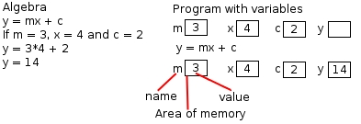
Data Storage
Data that is used by a program is stored in areas called variables
  They are similar to variables in algebra
  The represent a named area of memory
Notes:
13

Slide 14
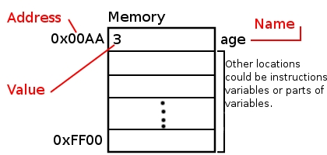
Names, Values and Addresses
Each variable has a name the name can be used to access the data stored at that place in memory
The value of the variable is the data it stores
The name is for our ease of use only, the computer uses the memory address.
Notes:
14

Slide 15
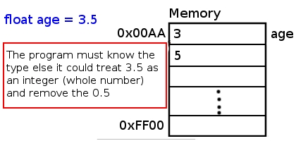
Types
Each addressed space in memory (referenced by a memory address) is of a fixed size
Some variables require more than one space the type of the variable allows the program and the programmer to handle the variables appropriately
Notes:
15

Slide 16
Variable Declaration Pattern
type variablename;
type
  Int (signed/unsigned)
  double (also: float)
  String
  boolean

Slide 17
Hide and seek champion…..
;
….. since 1958

Slide 18
Variable Assignment Pattern
variablename = value;
value:
  Whole numbers -2,-1,0,1,2…etc (int)
  Floating point numbers -2.1,-1.3,0.0,1.33,2.45, etc (double)
  Strings “Hello”, “Goodbye”, “1”, etc (string)
  Boolean true, false

Slide 19
THINGS THAT YOU KNOW
Variables must have a value
Variables have a type (int, double, boolean, String)

Slide 20
Literal Values
We should avoid using fixed values in our code
Instead we should name them
static final type LITERALVALUE = value;
Example
static final double PI = 3.14159;
public static void main(String args[ ])
{
double radius = 2;
double circumference = (2 * PI) * radius;
}

Slide 21
Enum Types
Define your own type of variable with SPECIFIC named “values”
Declaration
enum typename { name1, name2 }
Usage
  typename variablename;
Example: Days of the week
enum Day { MONDAY, TUESDAY, WEDNESDAY,THURSDAY,
FRIDAY, SATURDAY, SUNDAY }
public static void main(String args[ ])
{
Day day = Day.MONDAY;
}
Note the dot here

