Slide 1

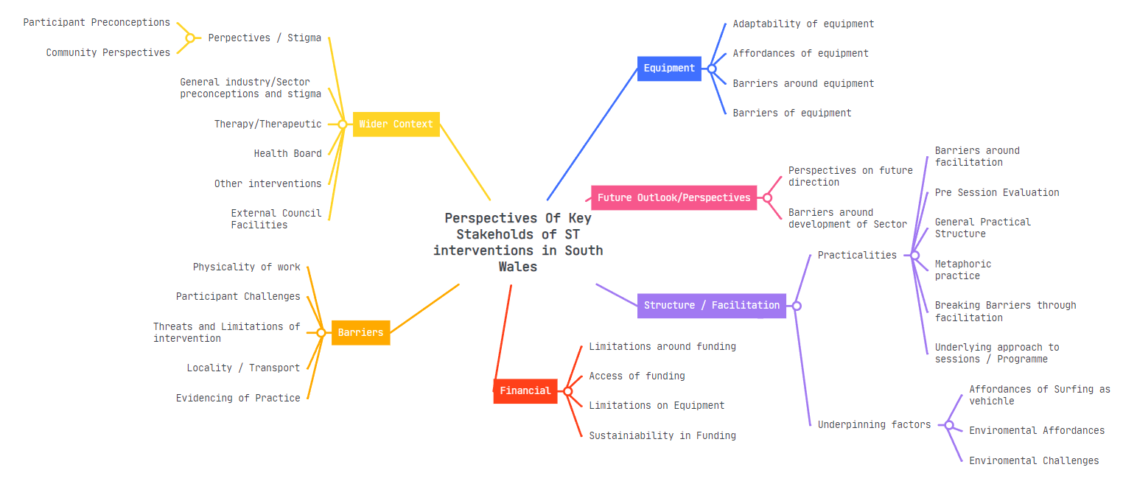
Surfing for Wellness: An Insight into the Perceptions of Key Stakeholders within Surf Therapy Interventions in South Wales.
Challenges in the Funding, Research, and Practice of Surf Therapy limit well-being and quality of life for individuals in South Wales.
Introduction
In 2022, The Office for National Statistics reported around 1 in 6 adults to be experiencing moderate to severe depressive symptoms at a time.
In comparison to a medicinal approach, nature-based interventions lead to, longer term, higher health-based quality of life.
Methods
“And that’s the most he’s ever opened up or talked, you know, was in that environment”
Participant8-CO (Community Psychiatric Nurse)
“And it was the first time they've seen a smile in about two months”
Participant2-OP (Operations and Project Manager of Surf School)
qualitative study, semi-structured interviews
10 participants from different backgrounds (Practical, clinical, organisational)
Data analysis followed Braun & Clarke's thematic analysis approach, focusing on identifying themes
Findings
The underlying structure and principles of surf therapy session in South Wales align with meeting physiological and psychological safety.
Core facilitatory principles align with those of more so ‘traditional’ clinical intervention.
An array of participatory threats, in practice are mitigated through facilitatory expertise.
Funding and research both act as a barrier for expansion and sustainable development in the future.
Implications
Facilitators should adopt a holistic approach and integrate metaphors to enhance communication and understanding.
2) Surf therapy sessions should prioritize setting individualistic, achievable goals to align with participants' needs.
3) Considerations should be made in developing and utilizing artificial wave pools to overcome environmental barriers and enhance ST accessibility.
Dafydd Millns Dafydd.Millns@Gmail.com

