Slide 1
BMOE7004
Qualitative analysis

Slide 2
Session overview
Principles of qualitative research
The element of qualitative data analysis
Approaches to qualitative analysis
Reliability and trustworthiness
Voice of the researcher

Slide 3
This to consider in qualitative analysis
There are not the same widely accepted rules in qualitative analysis as in quantitative
There is no one single or correct way to analyse present qualitative data
Can it be objectively described?
How can it be interpreted?
Fitness for purpose…what question are you addressing?
Notes:
There are not the same widely accepted rules in qualitative analysis as in quantitative this is both its challenge and its appeal
There is no one single or correct way to analyse and present qualitative data
Can it be objectively described? – there are often multiple ways of interpreting the same data
How can it be interpreted? – there is often merging of analysis, informing and merging with new data,
What it all really boils down to is ……Fitness for purpose…what question are you addressing?

Slide 4
Elements of qualitative data analysis: steps in the coding process
Transcribe the data.
Collect/code/collect: avoid waiting until all data are collected before starting the coding process, start as soon as possible.
Familiarisation: read through all field notes, documents and transcripts but suspend the temptation to interpret.
Focused reading.
Review/amend codes: are some of the codes hierarchical? In other words, is one concept a sub-category of another?
Identify key findings look for connections between categories and concepts that are emerging from the data.

Slide 5
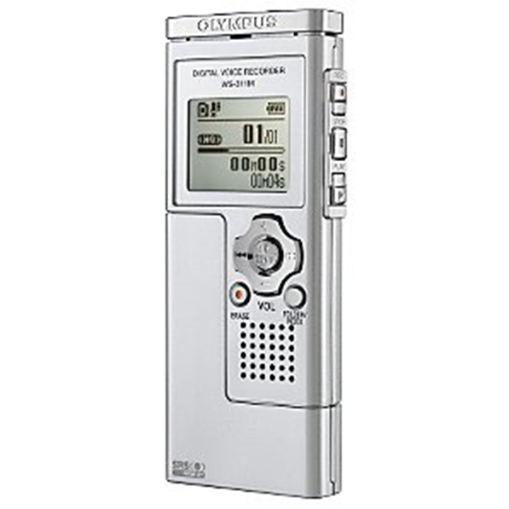
Transcribe the data
Transcribe recordings (takes 10 hours for each hour of interview!).
Doing this yourself, familiarises you with the data.
Number interviews, pages etc for referencing
Some researchers do not transcribe but go straight to first analysis
Saves time and can get bigger picture but can miss important details

Slide 6
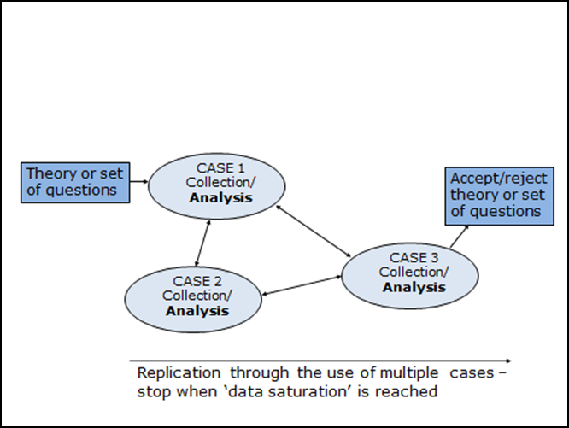
Collect/code/collect
Collect.
Code first 3 or 4 interviews (analyse the data) – helps identify themes and new cases.
Collect new cases.
Code etc.
Stop when ‘data saturation’ reached.
Notes:
This is in a bigger piece of research however for this module you will not be going to data saturation and you may not have time to be coding in between collection

Slide 7
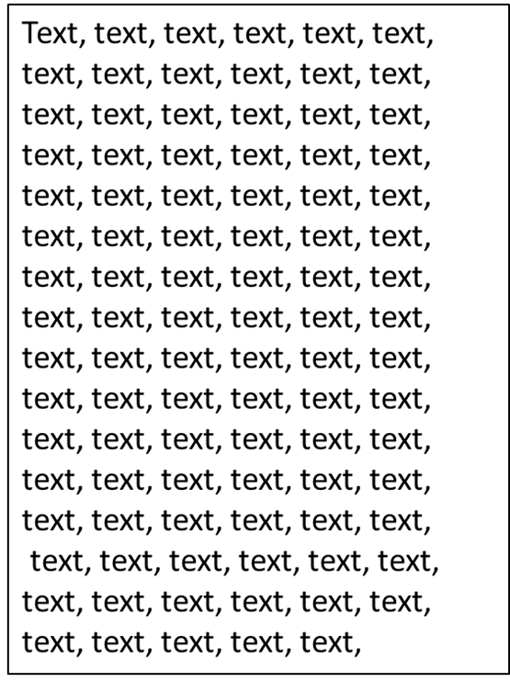
Familiarisation
Read through all transcripts.
Get a ‘feel’.
Note down any thoughts on themes (concepts/constructs) in a notebook.
BUT these will be provisional at this stage.

Slide 8
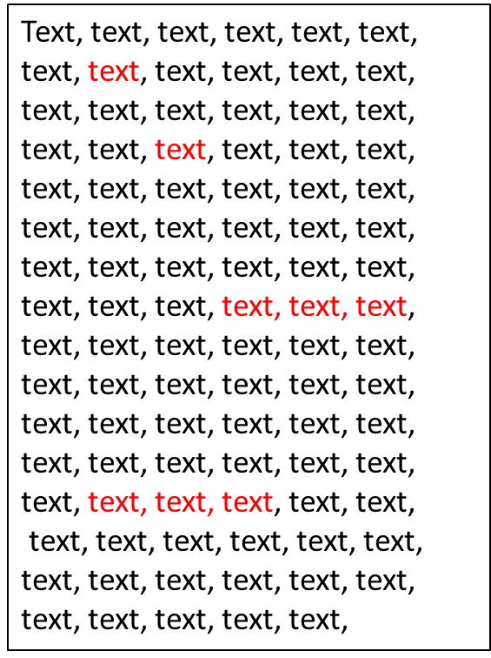
Focused reading of the data
Contradicts what is said on page 1
Underline / highlight key words or phrases – units of meaning.
Make notes in margins:
  Thoughts/reminders.
  Draft codes.
Code:
Interacting with nature
Code:
Supervision

Slide 9
Review and amend codes
2nd reading amend codes (if necessary).
Reorganise codes:
  Merge codes?
  Eliminate some codes?
  Apply code from the literature (if there is one).
  Put into hierarchies (if some concepts or sub-concept of another).
Contradicts what is said on page 1
Code:
Interacting with nature
Code:
supervision
controlling

Slide 10
Organising the units of meaning
Group or cluster the phrases / words into similar themes / codes using a highlighter
These are clusters of relevant meaning.
Categories / themes emerge from these.

Slide 11
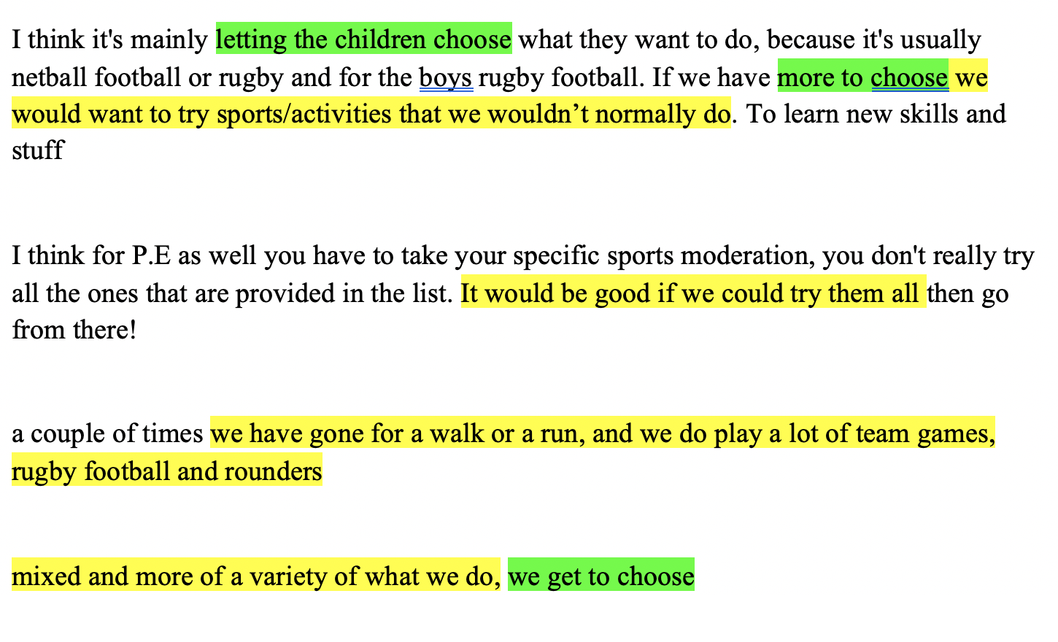
Units of meaning

Slide 12
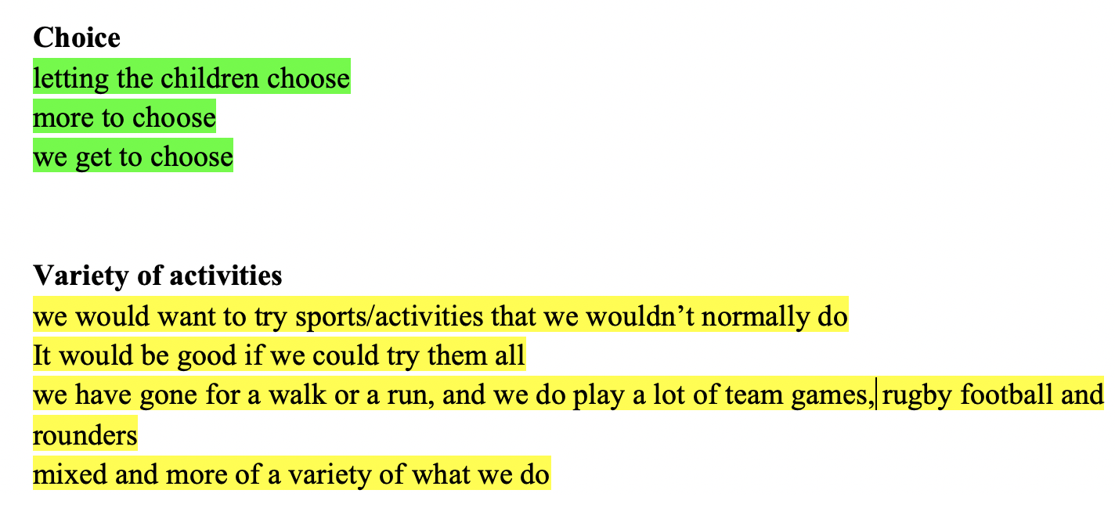
Clusters of meaning
Notes:
Once you have the clusters of meaning these may merge or split or be re coded. These develop into your themes

Slide 13
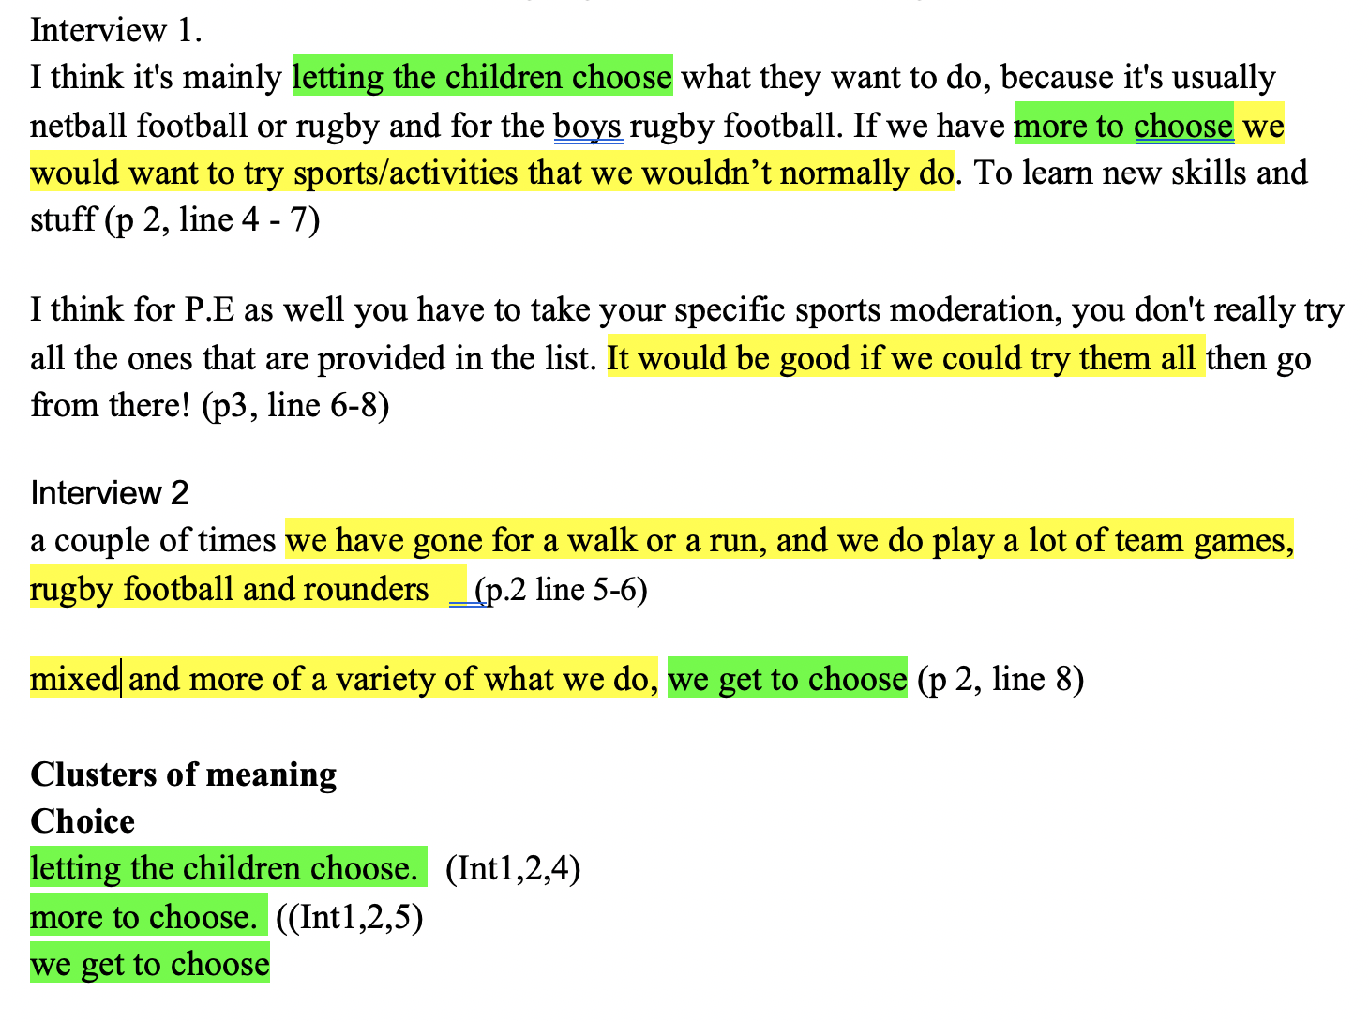
Reference all the units of meaning
You need to be able to trace the unit of meaning back to the original data source.

Slide 14
Approaches to qualitative data analysis (1)
Qualitative approach | Description
Content analysis | Involves locating classes or categories within the data. These categories are usually derived from theoretical models.
Thematic analysis | A method for identifying and analysing patterns (themes). A theme captures something important about the data in relation to the research question.
Grounded theory | A structured process comprising: • Open coding: the disaggregation of the data into units. • Axial coding: recognizing relationships between categories. • Selective coding: the integration of categories to produce a theory.

Slide 15
Approaches to qualitative data analysis (2)
Qualitative approach | Description
Narrative analysis | Captures the lived experiences of participants. Used to explain the contradictions, confusions and complexities of modern life.
Conversational analysis | Interested in the elements of social interaction such as ‘turn taking’ or ‘opening up closings’, interruptions and the distribution of speaking rights, often in relation to various aspects of an institution’s functions.
Discourse analysis | Attention is given to the structure and organization of language with an emphasis on how participants’ versions of events are constructed. Analysis becomes focused on recognizing the regularities in language in terms of patterns and repertoires.

Slide 16
Elements of qualitative data analysis: reflexivity – the voice of the researcher
Epistemological reflexivity, where the researchers reflect on their assumptions about the world and about the nature of knowledge. So they will ask themselves questions such as: how has the research question limited or distorted what was found? How could the study have been conducted differently?
Personal reflexivity, where the researcher reflects upon how their personal values, attitudes, beliefs and aims have served to shape the research. Can involve a personal reflection on how the research process impacted and changed the stance taken by the researcher.

Slide 17
Processes for achieving reflexivity
Writing a reflexive journal, including writing:
a daily schedule describing the logistics of the study;
a log of methodological decisions and changes;
a personal diary recording reflections with particular reference to one’s values and interests.

Slide 18
Strategies to enhance internal trustworthiness.
Strategy | Description
Prolonged and persistent field work | Allows interim data analysis and corroboration to ensure the match between findings and participant reality.
Low-inference descriptors | Record precise, almost literal, and detailed descriptions of people and situations.
Multiple researchers | Agreement on descriptive data collected by a research team.
Mechanically recorded data | Use of tape recorders, photographs and videotapes.
Participant researcher | Use of participant recorded perceptions in diaries or anecdotal records for corroboration.
Member checking | Check informally with participants for accuracy during data collection; frequently done in participant observation studies.
Participant review | Ask each participant to review researcher's synthesis of all interviews with the person for accuracy of representation; frequently done in interview studies.
Negative cases or discrepant data | Actively search for, record, analyse, and report negative cases of discrepant data that are an exception to patterns.
Source: McMillan and Schumacher (1997)

Slide 19
Achieving reliability in qualitative analysis
Data triangulation | Time triangulation – data gathered over a period of time. Space triangulation – data gathered over multiple sites. Person triangulation – data gathered at multiple levels (individuals, groups, departments).
Investigator triangulation | Using more than one observer in field situations.
Methodological triangulation | Combining quantitative (survey) data with qualitative interviews/observations.

Slide 20
NVIVO
This is the software for analysis of qualitative data.
We will have a workshop on this.
Make sure that you have downloaded the software from the IT service desk

