Slide 1
MBA BMMB7026
Managing Marketing Change
Digital Marketing
&
Assignment 2 Review

Slide 2
What is Digital Marketing?
The term digital marketing refers to all marketing efforts that use an electronic device or the internet.
The use of websites, apps, mobile devices, social media, search engines, and other digital means to promote and sell products and services.

Slide 3
Digital Marketing Strategy
“A plan defining the future direction and investment needed to improve the contribution of digital marketing for a business. It should set SMART objectives for digital channels and prioritise strategic initiatives to harness digital media, data and marketing technology to increase engagement of audiences using digital devices and platforms. Its scope should include opportunities from both new business and revenue models and always-on and communications integrated with offline media interactions.”
Smart Insights 2023
Notes:
definition of digital marketing strategy that is relevant to all businesses from small to large is:
"A plan defining the future direction and investment needed to improve the contribution of digital marketing for a business. It should set SMART objectives for digital channels and prioritize strategic initiatives to harness digital media, data and marketing technology to increase engagement of audiences using digital devices and platforms. Its scope should include opportunities from both new business and revenue models and always-on and campaign communications integrated with offline media and interactions.” Smart Insights

Slide 4
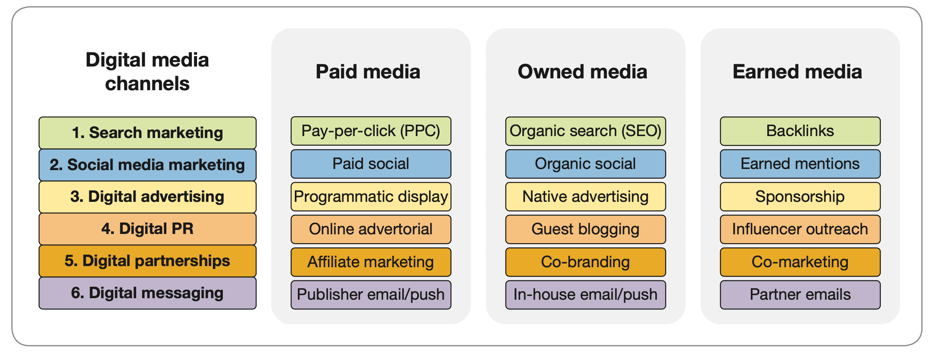
Categories of Digital Marketing

Slide 5
Digital Communication Tools
Search Engine Marketing. Increases search engine visibility for target keywords through paid Pay-Per-Click (PPC) ads and organic Search Engine Optimization (SEO), balancing paid and earned media strategies.
2. Social Media Marketing. Combines paid ads and organic content on platforms like Facebook, Instagram and LinkedIn to enhance visibility and engage customers, leveraging both owned and earned media.
3. Display Advertising. Involves online banners and video ads on social media platforms and publishers to increase brand awareness, including programmatic display and native advertising.
4. Digital PR. Aims to secure positive external mentions, using tactics like guest blogging and influencer outreach to boost awareness, drive traffic, and support SEO.
5. Digital Partnerships. Entails collaborative promotions on third-party sites, including affiliate marketing, co-branding, and co-marketing, effective in retail, travel, and finance sectors.
6. Digital Messaging. Primarily includes email marketing that remains effective, but also using mobile messaging including mobile push and SMS notifications, focusing on subscribed opt-in audiences with an emphasis on compliance with privacy regulations.

Slide 6
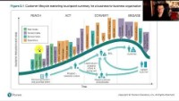

Slide 7
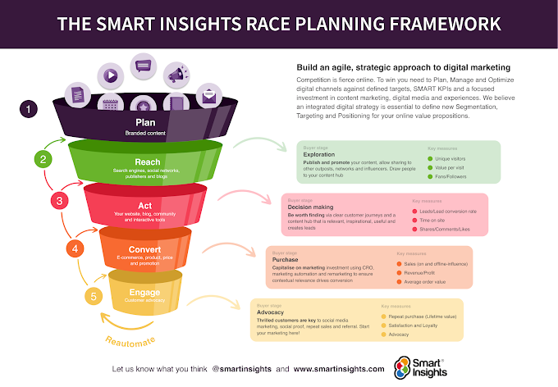

Slide 8
Plan RACE Sales Funnel
Data driven planning approach – review current digital marketing effectiveness and plan to improve.
SMART objectives, clear KPIs and digital analytics
RACE planning framework
REACH – Use key online marketing techniques to reach customers and build awareness
ACT - Build interactions on your website & social media to generate leads for the future. Having reached your audience, it's crucial you influence their next steps to move down the funnel toward a purchase decision.
CONVERT – Remind and persuade the audience to purchase - retarget, nurture and conversion rate optimisation.
ENGAGE – Keep customers engaged, optimise personalised communications using web, email and social media marketing. Use data you have on the customer to create personalised marketing campaigns.

Slide 9
Marketing Metrics
KEY MARKETING METRICS – Used throughout a digital marketing campaign for conversion rate optimisation.
KPIs – Used with all aspects of the digital marketing mix and monitored constantly.
Customer Pain Points identified and addressed.

Slide 10

Any Questions?

