Slide 1



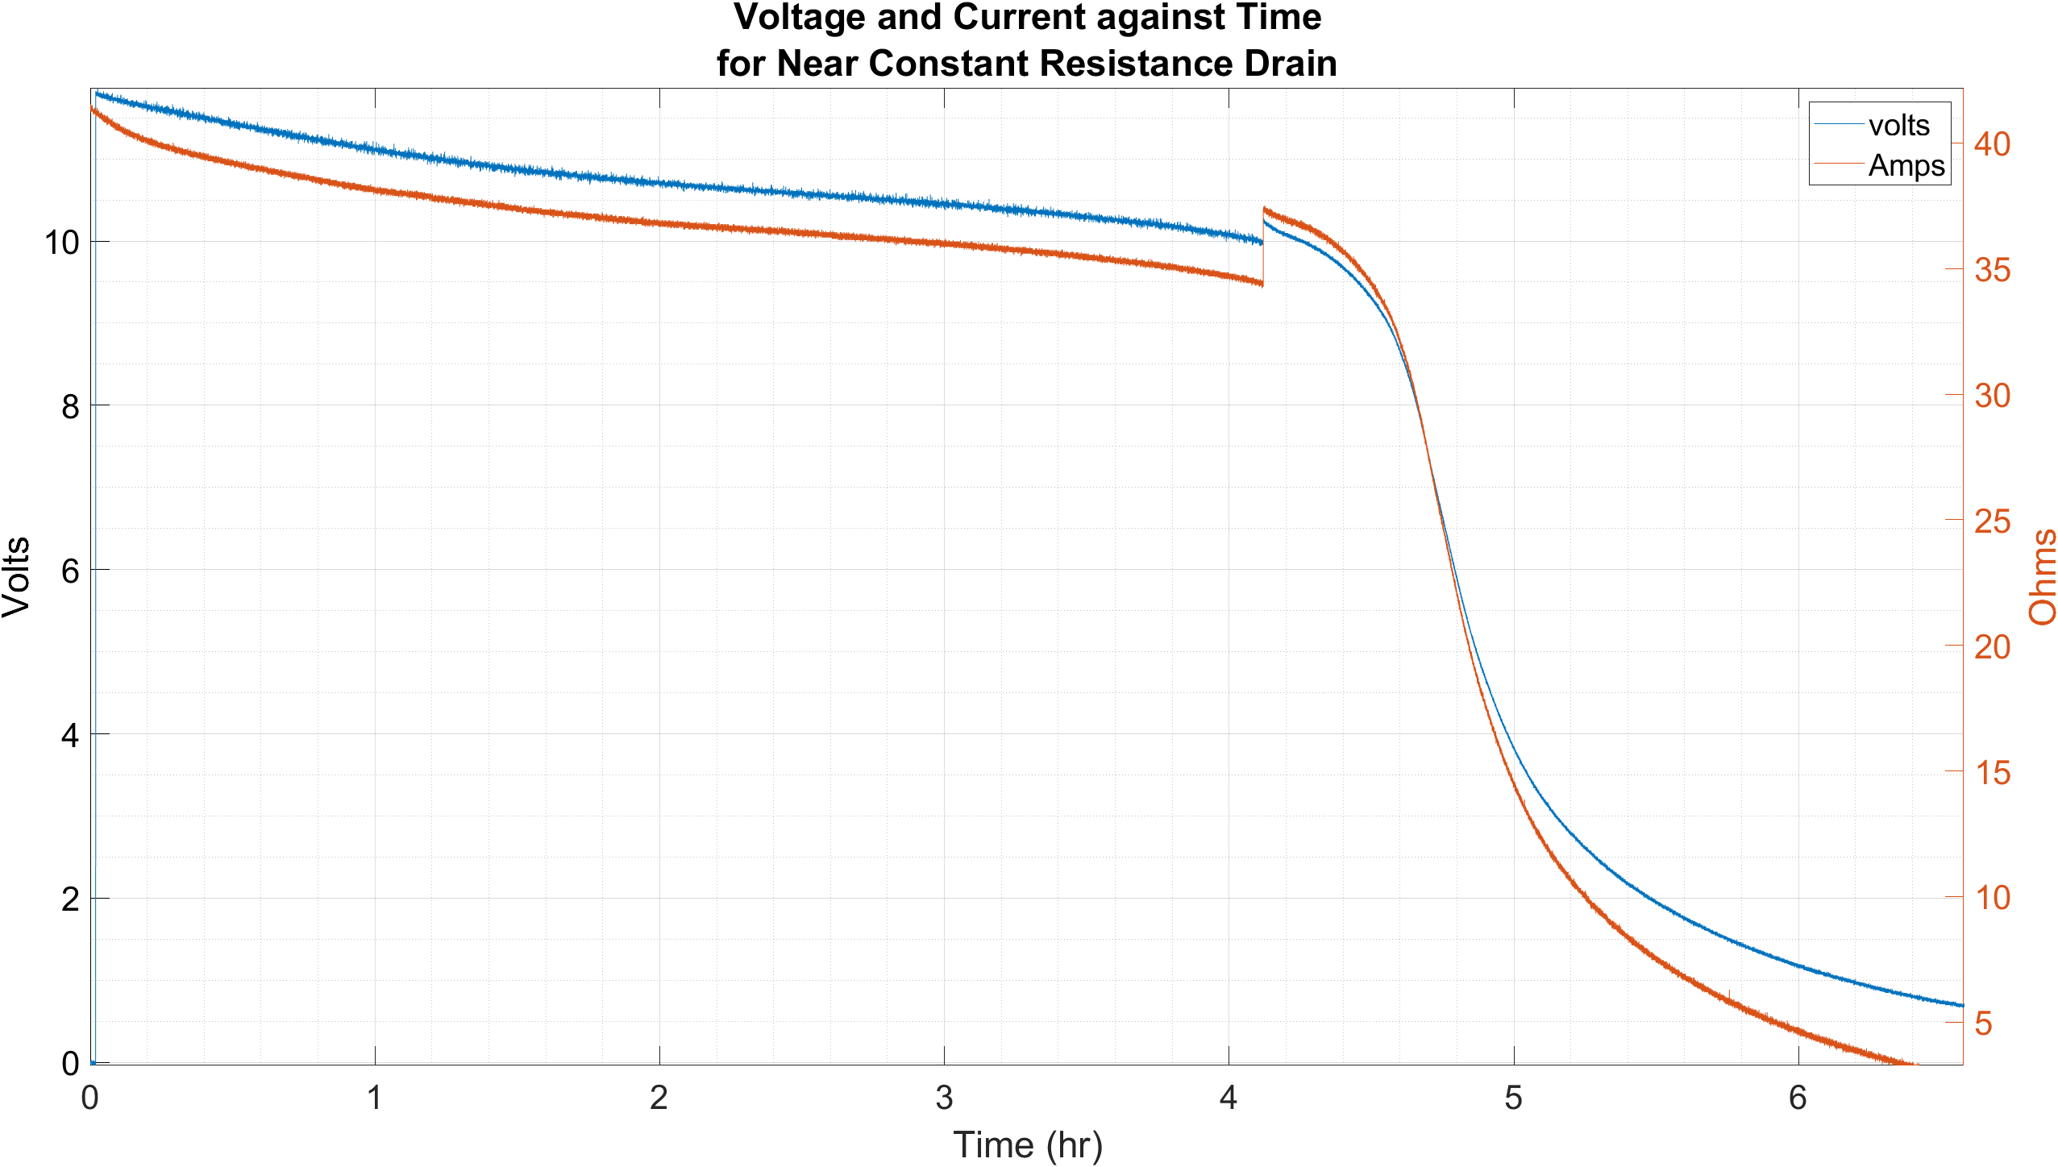
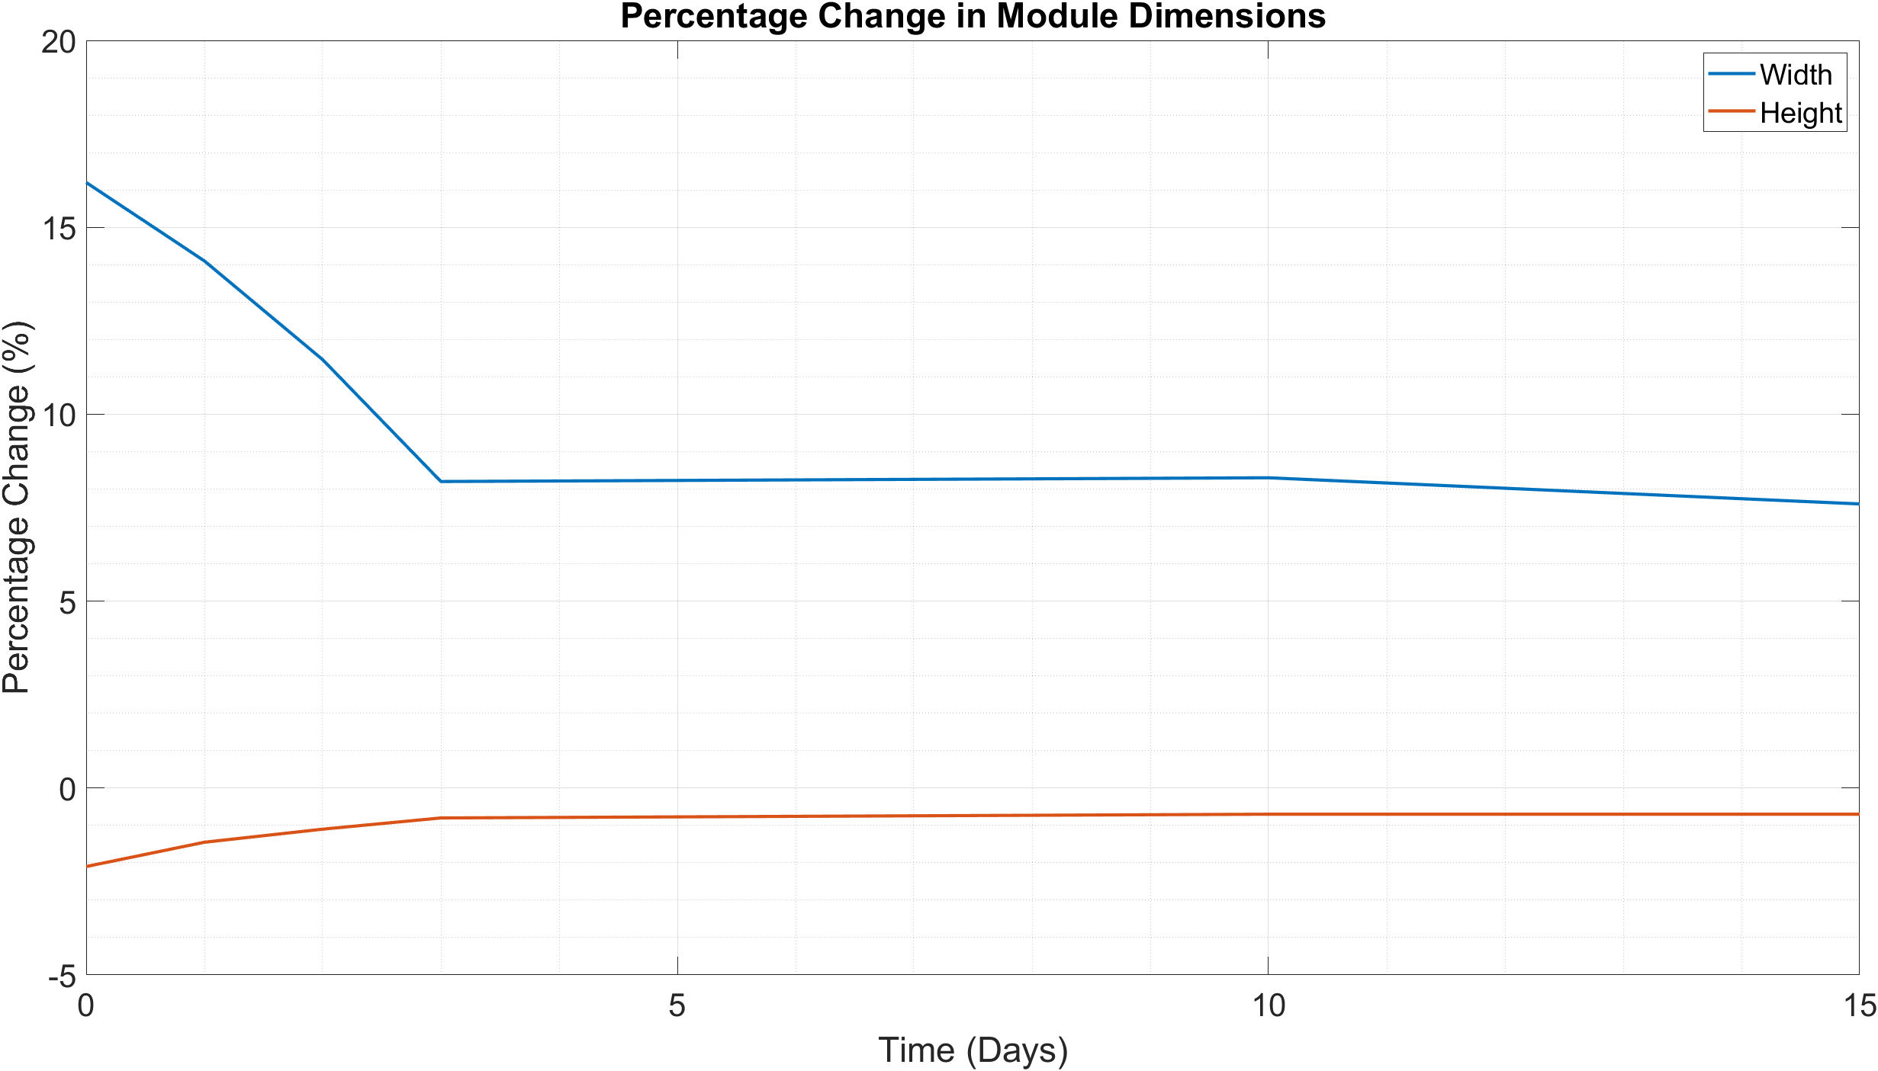
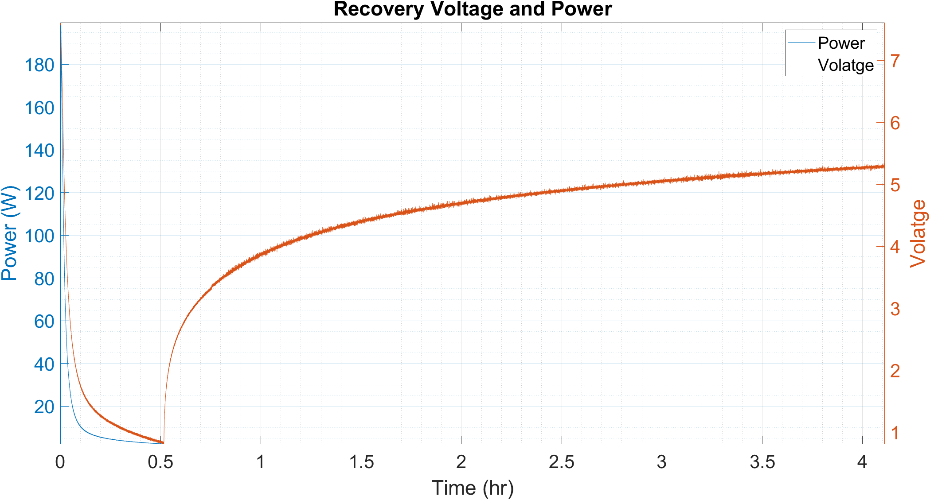
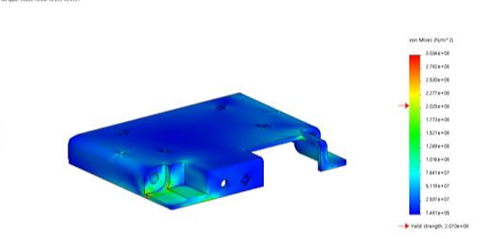
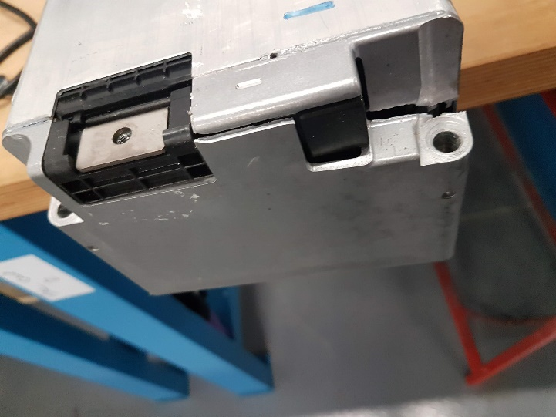
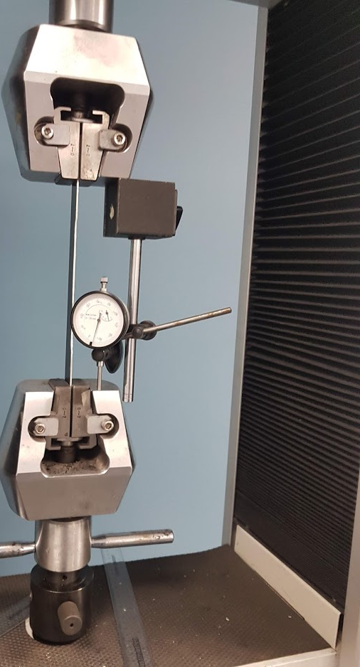
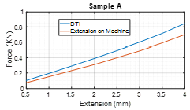



Recycling and Second Life of EV Lithium-ion Batteries
Ryan James
Supervisor: Kerry Tudor
School of Engineering
BEng (Hons) Automotive Engineering
Introduction
To fully investigate the feasibility and all the necessary considerations to reduce lithium ion batteries to their constituent parts. The focus will be on the LG module fitted to the I-pace and the Samsung module fitted to Land rovers. Where possible any physical tests will be conducted with and aim to unwrap a cell.
This project was directed by Treharne automotive engineering with a view to automate their EV Battery Recycling Business
The most challenging part of the module reduction is removing the cells from the casing that have become attached by an epoxy thermal resin. The effects on the size of the cell pack can be seen bellow when heat is applied
The above graph shows the module discharge and how there is a knee point when damage occurs as the voltage tails down
Why Reuse or Recycle
Currently the in-use lifespan of a lithium ion battery pack is 6-10 years (The Faraday Institution, 2018).
For a Battery to become no longer usable in an EV Vehicle only 20% reduction in capacity is needed
The average lifespan of an EV Battery is 8 years
The high standard EV batteries are made to mean they have potential for second use.
Methodology
Reduce the danger by reducing the state of charge
Assess the Recovery Voltage phenomenon
Assess the modules Aluminium Casing material
FEA the Casing
Test the Thermal epoxy resin
Exposing the Cells to high temperatures after complete discharge caused expansion.
The above graph shows the module recovery voltage phenomenon and how it is reduced and recover with and without load
The research showed that without testing there is no definitive way of judging a cells safety in any state of its life or charge safety Lithium ion Battery Safety.
The Project showed that the modules in question were never designed for individual cell reuse and any further work would require testing of there chemical safety.
The above images show the FEA and the physical testing match
Acknowledgements
Would like to thank George Chamberlin for support throughout the project.
References
The Faraday Institution. (2018). RECYCLING & REUSE. Didcot: The Faraday Institution.
The strain testing machine was giving Erroneous Readings, so the above check was performed to prove it.
School of Engineering

