Slide 1
Research in practice
ADAD5004
WHY ARE WE DOING THIS?

Slide 2
WHY?
You have been working with Contextual Practices for 3 semesters.
Starting with Ways of Thinking, then onto , Ways of Perceiving and recently finished Research in Context.
Now…we are on the final module Research in Practice.
This is linked very much to what do you want to do….
Research in Practice is a PROPOSAL for Independent Project which is in Year Three.
(Part One is a 5000-word dissertation which is linked to a Practice Based Project and this is all presented at the end at an internal conference) We call it the Big Idea.

Slide 3
The upside down essay
The Brief
For Research in Practice
Building on your knowledge of the traditional essay structure, you will write an ‘upside down’ essay, which rather than starting from an essay question, leads you to construct your own research question.
After an engagement with keywords used to outline an area of research, you will create your research question which will be used to initiate your 5000-word dissertation, which is part one of the Independent Project in Year Three.
In Year Three in Independent Project we call it The Big Idea as it links to a practice-based project as well as a written element.
Research in Practice is a PROPOSAL FOR YEAR THREE.

Slide 4
It is a proposal of 2500 words
Your lecture programme will cover a range of approaches to the relationship between research areas, keywords and theories specific to your subject area, and a range of practices.
In your proposal you will identify your own independent area of research.
Employ keywords to explore identify an individual research area, conclude with a focused research question, and write 2500 words.

Slide 5
Learning Outcomes
Upon the successful completion of this module, the student should be able to:
Identify and examine the contextual formation of their particular objects of study, research areas and interfaces and demonstrate intellectual curiosity through an engagement with the materials of study, archives, texts and literatures;
Engage with forms of critical analysis, argument and debate, expressed through an appropriate command of oral, written and other forms of communication.

Slide 6
The basic outline
This semester you will receive a carousel of talks given by visitors and your lecturing staff who are studio practitioners.
The purpose of these talks is to model for you how to work with 3 keywords.

Slide 7
The Basic Outline
These talks will usually begin with a biographical and cultural context, and then show and discuss practices and images in relation to three key words or themes.

Slide 8
Keywords
keywords will be used as a mode of orientation which address how practitioners look, think, consider, reshape, redesign and understand the cultural practices that surround them.

Slide 9
Keywords or themes
In a nutshell… what do you want to research?
The words or themes can be broken down deciphered and decoded.
The derivation (the action of obtaining something from a source or origin ) and construction of the word or theme can form part of how the images and practices can be approached or seen. These words will be used to position the work in a theoretical context.
These will be personal visions from which you will draw out your own frameworks for assessing the area of interest for your 5000 word dissertation at level 6 in (Part One of Independent Project).

Slide 10
What do I need to do?
- three key words,
- three key images,
in a synthesis with
- up to 3 artists and thinkers (or some variation of these)
- leading to a question that you will develop for your dissertation for next year.

Slide 11
Map Of the
Writing
Structure

Slide 12
You need
A beginning
A middle
An end

Slide 13
Beginning
write a short context for your writing
(not a formal introduction)
(100 words approx.)
Remember this is an upside-down essay

Slide 14
Middle
Explore your First Keyword
(500 to 700 words approx.)
Explore your Second Keyword
(500 to 700 words approx.)
Explore your Third Keyword
(500 to 700 words approx.)
All with references to texts and images and thinkers you hope to use in your dissertation.

Slide 15
End
Contextualise and synthesise how these have led you to a question you wish to research and write about next year
(4-600 words approx.).
With consultation with your Contextual Practices seminar lecturer you will write a fully formed research question with sub-questions that might be useful in your chapters (25-50 words approx.)
.

Slide 16
Don’t forget to shape your idea
Reference and Synthesise
Reference Harvard Referencing and quality references. I want some good books and journals and please do not list all ‘weak’ websites. Looking for good quality research.
Synthesis
The composition or combination of parts or elements so as to form a whole

Slide 17
And include and write about images

Slide 18
Writing Structure
Remember your will be marked on your ability to engage with academic research, images and keywords. You must provide in-text references and a reference list.
YOU MAY NOT RE-PRESENT FOR RE-ASSESSMENT ANY OF YOUR OWN IDEAS OR WRITING THAT HAS BEEN ASSESSED PREVIOUSLY

Slide 19
Writing Structure
In Semester One you had a choice of questions and you had the choice to pick ONE.
This Semester Two.
YOU are writing to get to the end to create your question.
This is why it is called the UPSIDE DOWN essay.

Slide 20
Last Semester DONE in Research in Context
A set research question
Introduction
field or area for discussion
Main Body 1
Main Body
Main Body 2
Main Body 3
Leading to…
Conclusion
Conclusion

Slide 21
Short context and keywords introduction
Semester 2
This essay for
Research in Practice
Keyword 1 + field or area for discussion
Keyword 2 + field or area for discussion
An upside-down essay structure
Keyword 3 + field or area for discussion
Synethesis + discussion
Thinking-through-writing leading to and justification for ….
A research question

Slide 22
100 words
Semester 2
600 words
600 words
An upside-down essay structure
600 words
600 words
25 – 50 words

Slide 23
In a nutshell
- write a short context for your writing (not a formal introduction) (100 words approx.)
- explore your first keyword (5-700 words approx.) with references to texts you hope to use in your dissertation.
- explore your second keyword (5-700 words approx.) with references to texts you hope to use in your dissertation.
- explore your third keyword (5-700 words approx.) with references to texts you hope to use in your dissertation.
- contextualise and synthesise how these have led you to a question you wish to research and write about next year (6-700 words approx.).
- with consultation with your Contextual Practices seminar lecturer you will write a fully formed research question with sub-questions that might be useful in your chapters (25-50 words approx.).

Slide 24
expectations
Whatever the topic, your enquiry must be grounded in research. Books, journal articles, image banks, films, exhibitions/catalogues etc. are the most usual source of information and ideas. What we are looking for is a personal and critical evaluation of the relevant source material. Academic communication is always supported by evidence.
Keep a research-writing diary and document everything! Use your diary to keep lecture notes and direct your tutorials. After the tutorials use the diary to reflect on key moments of learning and tasks you need to complete. Remember to note down the full Harvard references of all books and other resources you use as it doubles your workload to find them at the end of the process when the deadline is approaching.

Slide 25
http://www.tate.org.uk/art/artists/jeremy-deller-3034/jeremy-deller-turner-prize-retrospective

Slide 26
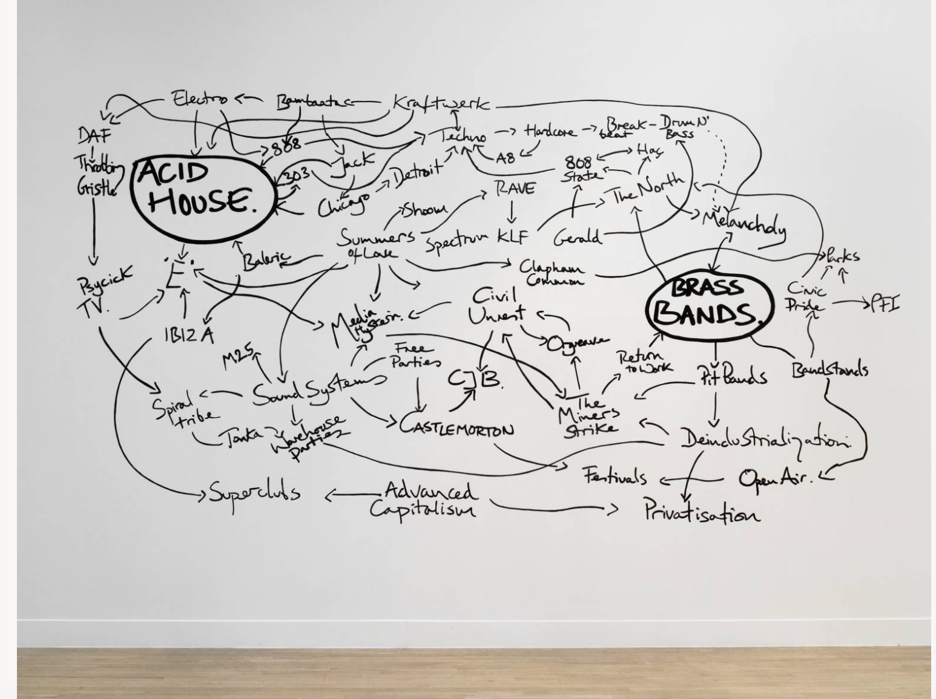
An example of Jeremy Deller’s work which is always rooted in collaboration and engagement
http://www.tate.org.uk/art/artists/jeremy-deller-3034/jeremy-deller-turner-prize-retrospective
https://www.tate.org.uk/art/artworks/deller-the-history-of-the-world-t12868

Slide 27
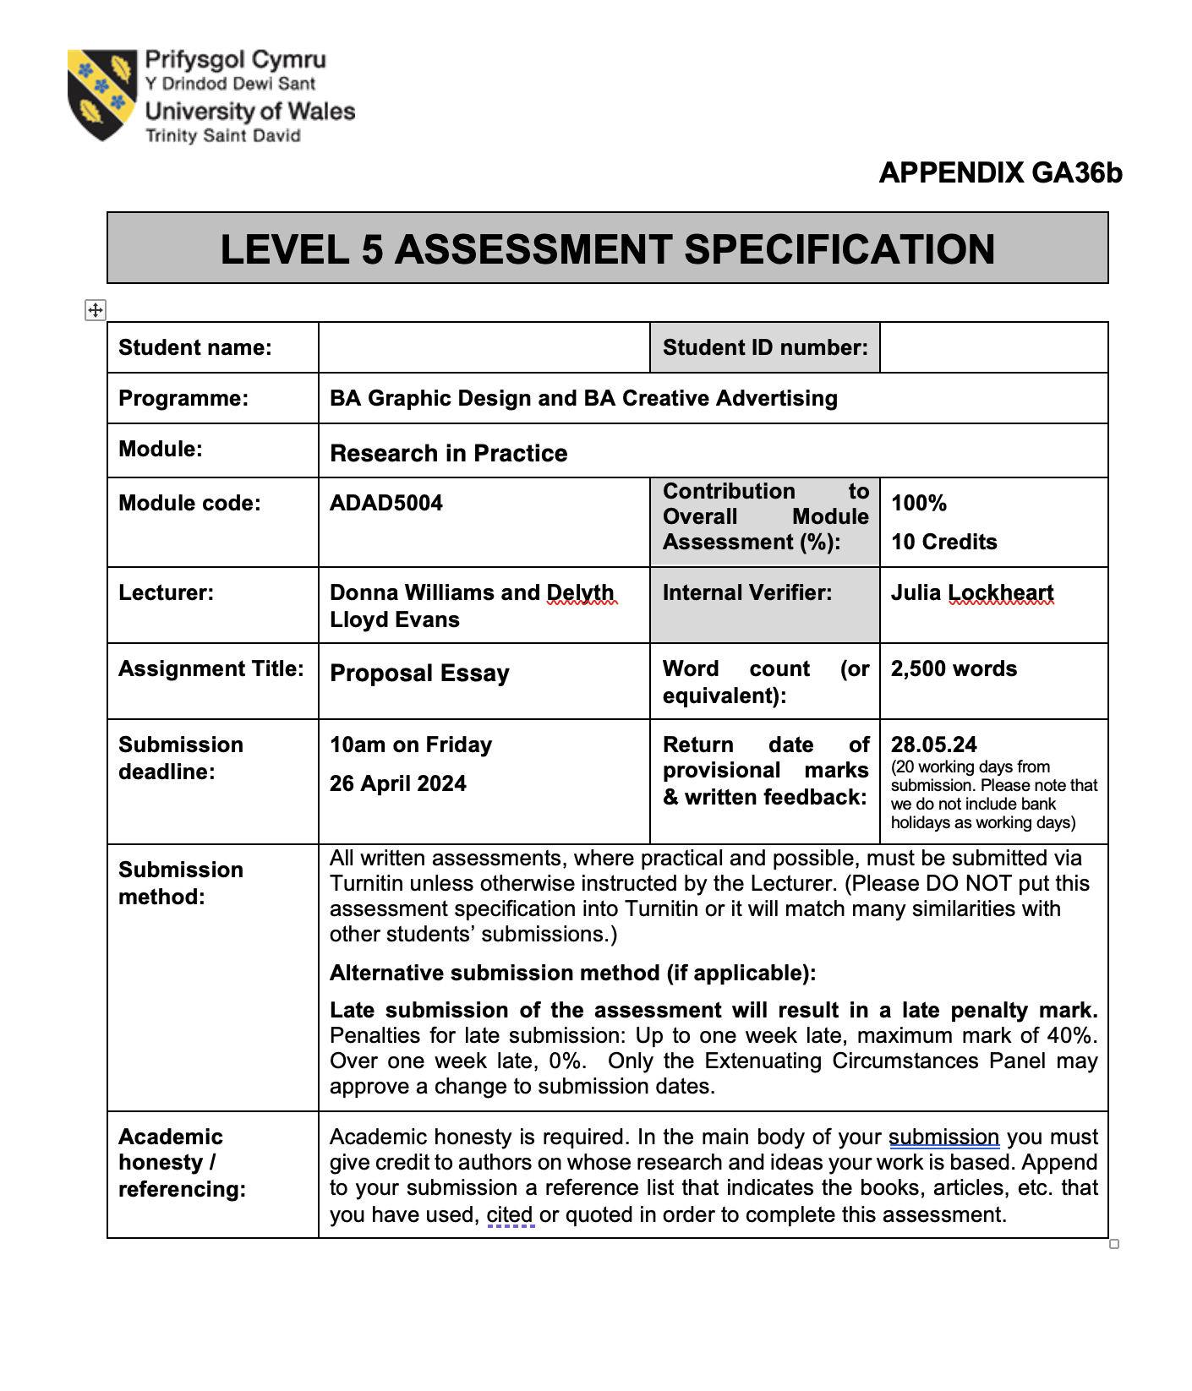
Assessment
10am on Friday
26 April 2024
Watch out as this is an early submission.
It is the first module to be submitted in semester two

Slide 28
Assessment
Word count
2500 words
(Allowance is made for 10% either side of the word count)
Semester 2 Module 2 Level 5 weighting =
1. Engagement with Literature skills 20%
2. Knowledge and Understanding Skills 30%
3. Cognitive and Intellectual Skills 30%
4. Practical Application Skills 10%
5. Transferrable Skills for Life and Professional Practice 10%

Slide 29
Assessment
Submit to moodle by
Remember that you can always submit earlier.
Please do not leave until the last moment as many students are submitting to Turnitin at that time

Slide 30
Feedback
Feedback will be found on grademark – you can assess this via your original submission portal.
All feedback will be received within 20 working days after the assignment deadline.
If you are late submitting your work, you will have 7 days to hand in your late submission and this will be capped at 40%.

Slide 31
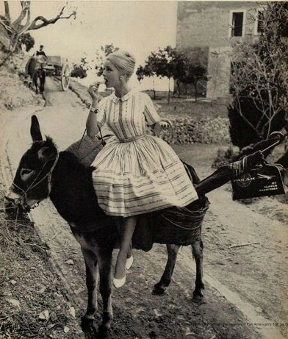
REMEMBER!
You
Your Research & 3 keywords

