Slide 1
The effect of NHS waiting times on treatment outcomes for cancer patients in England
Student Name: Mahamadfaraz Hanifbhai Belim
Student ID: 2504518
Supervisor: Dr Zeno Leung
Programme: MSc Public Health and Social Care in Practice
Module: LCHS7008 - Practice-Based Research
Date: February 2026

Slide 2

Research Title & Research Question
Research Title
The Effect of NHS Waiting Times on Treatment Outcomes for Cancer Patients in England.
Research Question
To what extent do NHS cancer waiting time targets influence treatment outcomes for cancer patients in England?
(BioVox 2016)

Slide 3
Introduction
Cancer remains a leading cause of morbidity and mortality in England, placing sustained demand on NHS oncology services(Cheo et al., 2023).
The NHS has implemented national cancer waiting time standards, the 2-week referral, 31-day decision-to-treatment, and 62-day referral-to-treatment targets to promote timely access to care (Frountzas et al., 2022).
Performance against these standards has progressively declined since 2015, with further deterioration following the COVID-19 pandemic(Pergialiotis et al., 2020).
Prolonged waiting intervals may facilitate tumor progression and stage migration, thereby potentially compromising prognosis (Pergialiotis et al., 2020; Frountzas et al., 2022).
Evidence from systematic reviews indicates that treatment delay can adversely influence survival outcomes in certain cancer populations (Cheo et al., 2023).
Beyond clinical implications, extended waiting times contribute to heightened psychological distress, uncertainty, and anxiety among cancer patients (Edge et al., 2021).

Slide 4

Literature Review
NHS waiting time targets may generate threshold effects, potentially influencing institutional behavior rather than uniformly improving care quality(Pergialiotis et al., 2020).
Prolonged surgical delays have been associated with poorer survival in resectable pancreatic cancer (Frountzas et al., 2022).
Extended waiting intervals may contribute to disease progression and reduced survival in endometrial cancer (Pergialiotis et al., 2020).
Meta-analytic evidence in hepatocellular carcinoma suggests the impact of delay on survival may vary depending on tumor biology and patient selection (Cheo et al., 2023).
Service disruption and delayed treatment pathways have been linked to increased patient anxiety, uncertainty, and psychological burden (Edge et al., 2021).
There remains limited UK-specific quantitative evidence directly linking NHS waiting times to survival, stage progression, and patient-reported outcomes(Zouzoulas et al., 2025).
(Warren-Jones 2023)

Slide 5
Prevalence
Cancer accounts for approximately 1 in 4 deaths in England, with over 3 million people currently living with cancer in the UK(Valeria & Ost, 2021).
Incidence continues to rise due to population ageing and improved detection, increasing pressure on NHS diagnostic and treatment capacity (Riera et al., 2021).
In December 2023, only 65.2% of patients began treatment within the 62-day referral-to-treatment target, substantially below the 85% standard (NHS England, 2023a).
Performance against the 31-day decision-to-treatment target was 91.7%, below the 96% standard (NHS England, 2023a).
The 2-week urgent referral standard achieved 91.5%, below the 93% target (NHS England, 2023a).
The 62-day standard has not been consistently achieved nationally since 2015, with post-COVID backlogs exacerbating prolonged diagnostic and treatment delays (NHS England, 2023b; Riera et al., 2021).

Slide 6
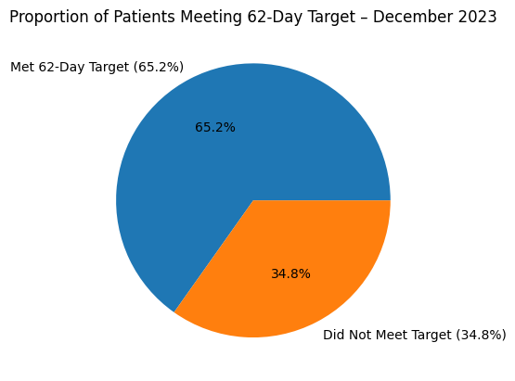
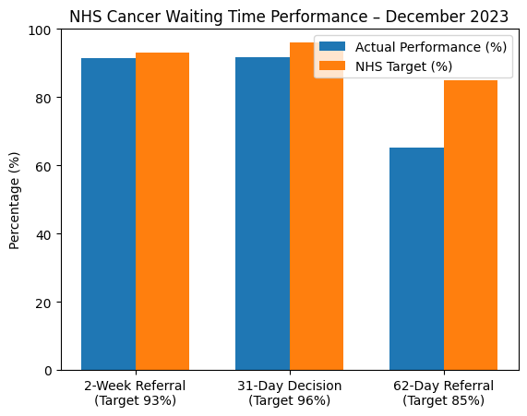
Prevalence
(Source: Author)

Slide 7
Rationale of the Study
NHS cancer waiting time standards are policy-driven performance mechanisms embedded within national accountability frameworks (Quinn et al., 2024).
Evidence indicates that threshold-based targets may influence institutional behavior, potentially prioritising compliance over continuous quality improvement (Quinn et al., 2024).
International meta-analyses demonstrate that treatment delays are associated with poorer survival in breast, lung, endometrial, and ovarian cancers (Ungvari et al., 2025; Valeria & Ost, 2021; Zouzoulas et al., 2025).
Despite global evidence, robust UK-specific causal analyses directly linking NHS waiting times to survival and stage progression remain limited(Ungvari et al., 2025).
Post-COVID backlogs have intensified waiting time breaches, with persistent underperformance against the 62-day standard (Lowes, 2026).
Evaluating the outcome impact of waiting times is essential to inform NHS cancer strategy, guide potential reform of performance targets, and strengthen patient-centered care delivery(Zouzoulas et al., 2025).

Slide 8
Aim and Objectives
Overall Aim
To examine the relationship between NHS cancer waiting times and treatment outcomes for cancer patients in England.
Objectives
To assess whether longer waiting times are associated with poorer overall survival.
To examine the relationship between waiting times and disease progression (e.g., stage migration).
To evaluate the impact of waiting time delays on patient-reported outcomes such as psychological distress and quality of life.

Slide 9

Aim and Objectives
(Learning Goals, Objectives, and Outcomes - The Peak Performance Center 2018)

Slide 10

Research Impact
Clinical Impact: Strengthen triage and prioritization strategies to minimize harmful treatment delays in high-risk cancers (Riera et al., 2021).
Clinical Impact: Support earlier treatment initiation where survival outcomes are sensitive to delay (Frountzas et al., 2022; Pergialiotis et al., 2020).
Policy Impact: Evaluate whether current NHS waiting time targets (2WW, 31-day, 62-day) improve survival outcomes or primarily influence institutional behavior (Edge et al., 2021).
Policy Impact: Inform evidence-based reform of threshold-driven performance mechanisms within NHS cancer pathways (Riera et al., 2021).
System Impact: Address structural vulnerabilities exposed by COVID-related service disruption and backlog pressures (Riera et al., 2021).
Patient Impact: Improve patient-centered care by reducing anxiety, uncertainty, and psychological burden associated with prolonged waiting times (Edge et al., 2021).

Slide 11
Research Methodology
Study Design: Retrospective population-based cohort study using secondary NHS England cancer waiting time and outcome datasets.
Scope: Adult cancer patients in England diagnosed between 2015–2023, focusing on high-incidence cancers (breast, colorectal, lung, prostate) (Frountzas et al., 2022).
Independent Variable: Time from urgent referral to treatment initiation, analyzed both continuously and categorically (≤62 days vs >62 days) (Pergialiotis et al., 2020)..
Dependent Variables (Clinical Outcomes): Overall survival, disease-free survival, stage at treatment initiation, and 30-day mortality (Pergialiotis et al., 2020)..
Dependent Variables (Patient-Centered Outcomes): Psychological distress and anxiety indicators where linked survey data are available (Edge et al., 2021).
Statistical Analysis: Kaplan–Meier survival estimation; Cox proportional hazards modelling; multivariable regression adjusted for age, stage, socioeconomic deprivation, and comorbidities (Frountzas et al., 2022; Pergialiotis et al., 2020).

Slide 12
Key Barriers
Data Limitations: Challenges in linking NHS waiting time datasets to survival and stage-specific outcomes at patient level (Lowes, 2026)).
Data Completeness: Potential gaps in recording comorbidities, tumor biology, and follow-up data, limiting causal precision (Quinn et al., 2024).
Confounding Factors: Variability in tumor aggressiveness, comorbidity burden, and socioeconomic deprivation may independently influence survival (Ungvari et al., 2025; Valeria & Ost, 2021).
Disease Heterogeneity: Evidence suggests delay sensitivity differs across cancer types, complicating generalization of findings (Zouzoulas et al., 2025).
System Complexity: Post-COVID backlogs and threshold-based performance behaviors may distort waiting time patterns (Quinn et al., 2024; Lowes, 2026).
Ethical & Governance Constraints: GDPR compliance and NHS Digital data access permissions may limit dataset linkage and analytical scope (Valeria & Ost, 2021).

Slide 13
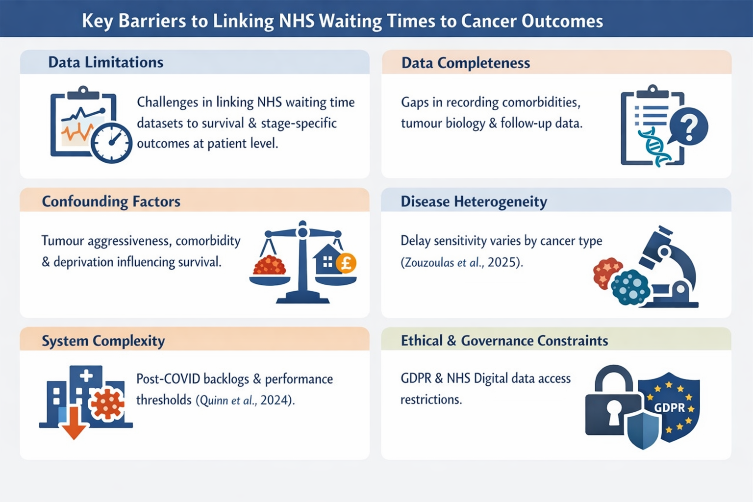
Key Barriers
Source: Author

Slide 14
Conclusion
NHS cancer waiting time standards play a central role in shaping access to timely diagnosis and treatment within England.
Prolonged waiting intervals may adversely influence overall survival and disease progression in certain cancers (Ungvari et al., 2025; Valeria & Ost, 2021; Zouzoulas et al., 2025).
Treatment delays are also associated with increased psychological distress, anxiety, and uncertainty among patients (Edge et al., 2021).
Evidence suggests that threshold-based performance targets may influence institutional behavior without consistently improving patient outcomes (Quinn et al., 2024).
Post-COVID backlogs have intensified concerns regarding prolonged diagnostic and treatment intervals (Lowes, 2026).
Strengthening outcome-focused evaluation of waiting times is essential to support patient-centered, evidence-based NHS cancer policy reform.

Slide 15
References
Cheo, FY, Lim, CHF, Chan, KS & Shelat, VG 2023, ‘The impact of waiting time and delayed treatment on the outcomes of patients with hepatocellular carcinoma: A systematic review and meta-analysis’, Annals of Hepato-Biliary-Pancreatic Surgery, vol. 28, The Korean Association of Hepato-Biliary-Pancreatic Surgery, no. 1, pp. 1–13, viewed 4 February 2026, https://pubmed.ncbi.nlm.nih.gov/38092430.
Edge, R, Meyers, J, Tiernan, G, Li, Z, Schiavuzzi, A, Chan, P, Vassallo, A, Morrow, A, Mazariego, C, Wakefield, CE, Canfell, K & Taylor, N 2021, ‘Cancer care disruption and reorganisation during the COVID-19 pandemic in Australia: A patient, carer and healthcare worker perspective’, in MWL Cheong (ed.), PLOS ONE, vol. 16, Public Library of Science (PLoS), no. 9, p. e0257420, viewed 4 February 2026, https://journals.plos.org/plosone/article?id=10.1371/journal.pone.0257420.
Frountzas, M, Liatsou, E, Schizas, D, Pergialiotis, V, Vailas, M, Kritikos, N & Toutouzas, KG 2022, ‘The impact of surgery delay on survival of resectable pancreatic cancer: A systematic review of observational studies’, Surgical Oncology, vol. 45, Elsevier BV, p. 101855, viewed 4 February 2026, https://www.sciencedirect.com/science/article/abs/pii/S096074042200150.
Lowes, S 2026, Cancer waiting times: Latest updates and analysis, Cancer Research UK - Cancer News, viewed 15 February 2026, https://news.cancerresearchuk.org/2026/01/27/cancer-waiting-times-latest-updates-and-analysis/.
Pergialiotis, V, Haidopoulos, D, Tzortzis, AS, Antonopoulos, I, Thomakos, N & Rodolakis, A 2020, ‘The impact of waiting intervals on survival outcomes of patients with endometrial cancer: A systematic review of the literature’, European Journal of Obstetrics & Gynecology and Reproductive Biology, vol. 246, Elsevier BV, pp. 1–6, viewed 5 February 2026, https://www.sciencedirect.com/science/article/abs/pii/S030121152030004X.

Slide 16
References
Quinn, L, Bird, P & Lilford, R 2024, ‘Effect of cancer waiting time standards in the English National Health Service: a threshold analysis’, BMC Health Services Research, vol. 24, Springer Science and Business Media LLC, no. 1, viewed 15 February 2026, https://pmc.ncbi.nlm.nih.gov/articles/PMC11323589/.
Riera, R, Bagattini, ÂM, Pacheco, RL, Pachito, DV, Roitberg, F & Ilbawi, A 2021, ‘Delays and Disruptions in Cancer Health Care Due to COVID-19 Pandemic: Systematic Review’, JCO Global Oncology, American Society of Clinical Oncology (ASCO), no. 7, pp. 311–323, viewed 4 February 2026, https://ascopubs.org/doi/full/10.1200/GO.20.00639.
Statistics 2023, Statistics» Cancer Waiting Times for December 2023 – 24 (Final), England.nhs.uk, viewed 4 February 2026, https://www.england.nhs.uk/statistics/statistical-work-areas/cancer-waiting-times/monthly-data-and-summaries/2023-24-monthly-cancer-waiting-times-statistics/cancer-waiting-times-for-december-2023-24-final/.
Statistics 2023, Statistics» Cancer Waiting Times for December 2023 – 24 (Final), England.nhs.uk, viewed 4 February 2026, https://www.england.nhs.uk/statistics/statistical-work-areas/cancer-waiting-times/monthly-data-and-summaries/2023-24-monthly-cancer-waiting-times-statistics/cancer-waiting-times-for-december-2023-24-final/.
Statistics 2023, Statistics» Cancer Waiting Times for December 2023 – 24 (Final), England.nhs.uk, viewed 4 February 2026, https://www.england.nhs.uk/statistics/statistical-work-areas/cancer-waiting-times/monthly-data-and-summaries/2023-24-monthly-cancer-waiting-times-statistics/cancer-waiting-times-for-december-2023-24-final/.
Statistics 2023, Statistics» Cancer Waiting Times, England.nhs.uk, viewed 4 February 2026, https://www.england.nhs.uk/statistics/statistical-work-areas/cancer-waiting-times/.

Slide 17
References
Statistics 2023, Statistics» Cancer Waiting Times, England.nhs.uk, viewed 4 February 2026, https://www.england.nhs.uk/statistics/statistical-work-areas/cancer-waiting-times/.
Statistics 2023, Statistics» Cancer Waiting Times, England.nhs.uk, viewed 4 February 2026, https://www.england.nhs.uk/statistics/statistical-work-areas/cancer-waiting-times/.
Ungvari, Z, Fekete, M, Buda, A, Lehoczki, A, Munkácsy, G, Scaffidi, P, Bonaldi, T, Fekete, JT, Bianchini, G, Varga, P, Ungvari, A & Győrffy, B 2025, ‘Quantifying the impact of treatment delays on breast cancer survival outcomes: a comprehensive meta-analysis’, GeroScience, Springer Science and Business Media LLC, viewed 4 February 2026, https://link.springer.com/article/10.1007/s11357-025-01719-1.
Valeria, P & Ost, DE 2021, ‘Impact of Delays in Lung Cancer Treatment on Survival’, CHEST Journal, vol. 160, Elsevier BV, no. 5, pp. 1934–1958, viewed 4 February 2026, https://www.sciencedirect.com/science/article/abs/pii/S0012369221036898.
Zouzoulas, D, Karalis, T, Sofianou, I, Anthoulakis, C, Tzika, K, Zafrakas, M, Timotheadou, E, Grimbizis, G & Tsolakidis, D 2025, ‘The Impact of Treatment Delay on Endometrial and Ovarian Cancer Patients: A Systematic Review’, Cancers, vol. 17, MDPI AG, no. 13, p. 2076, viewed 4 February 2026, https://www.mdpi.com/2072-6694/17/13/2076.

Slide 18


