Slide 1
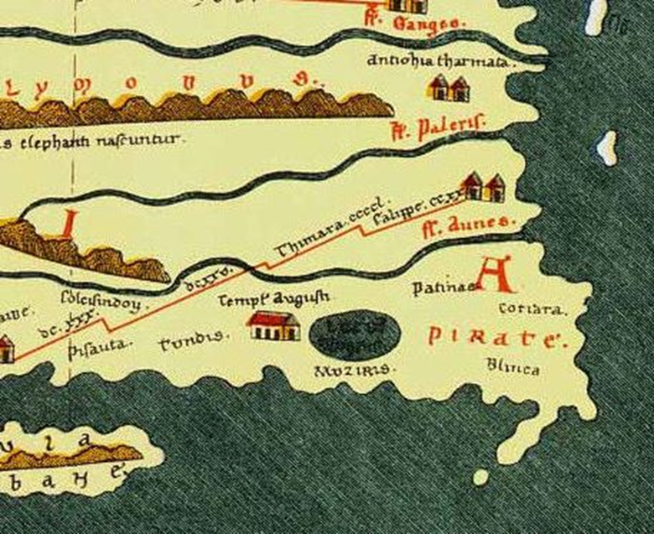
West meets East: At the Borders of the Oikoumenē and Beyond
Lecture 11 – The “Yavanas” and Merchant Diaspora
CLAH6007

Slide 2
Living in Foreign Lands
Why have merchant Diaspora?
Rhythm of the south-western and north-eastern monsoons:
  Arrive on Indian coast around end of September
  Return voyage to Egypt during December or early January
  Two to three months to conduct your business
Resident agents working on behalf of wealthy backers – consortia:
  Develop longer-term partnerships with local merchants/suppliers
  Acquire goods in advance and dispose of cargo after departure
  More immediate knowledge of market changes

Slide 3
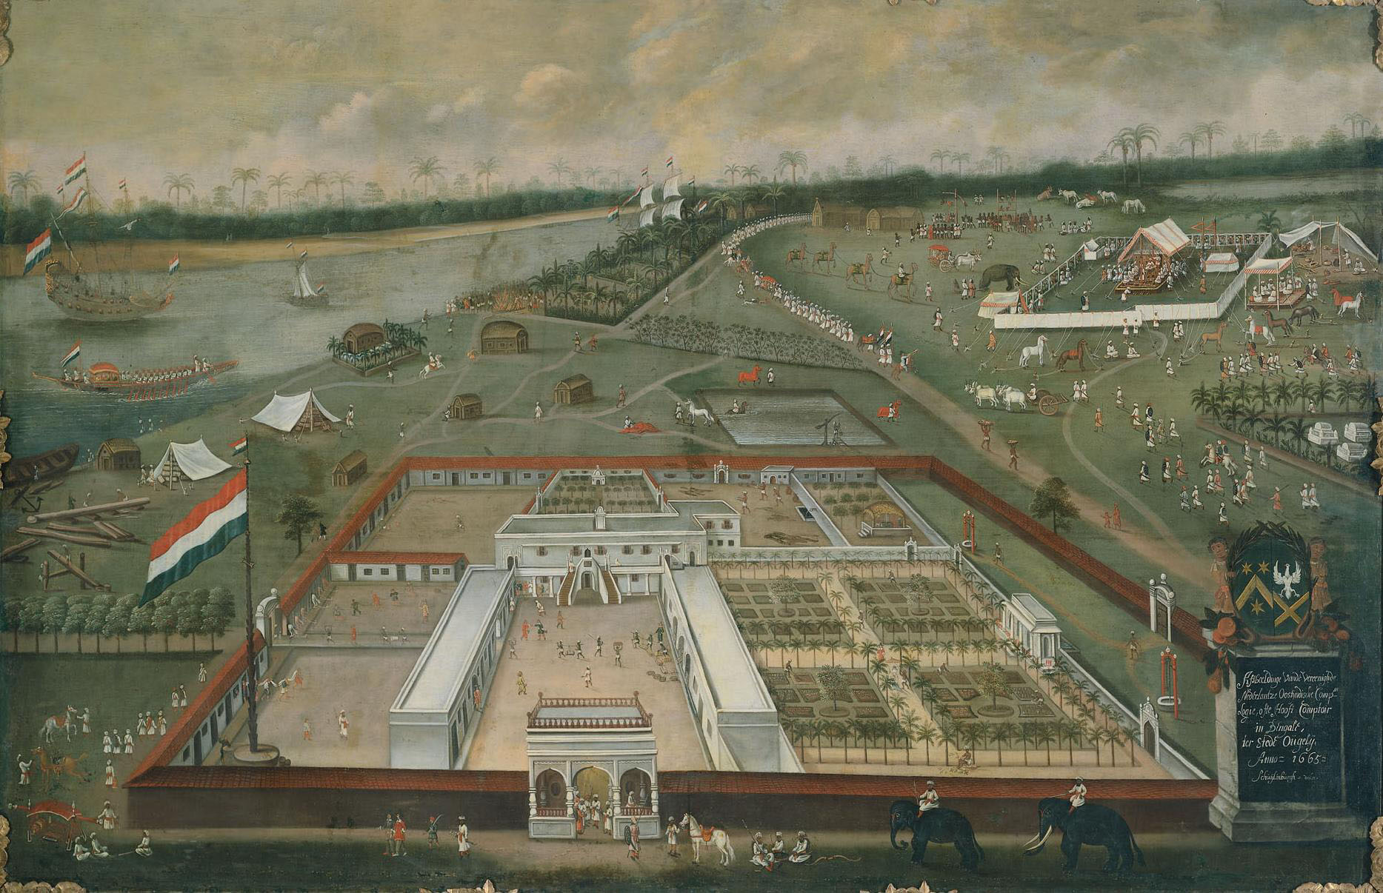
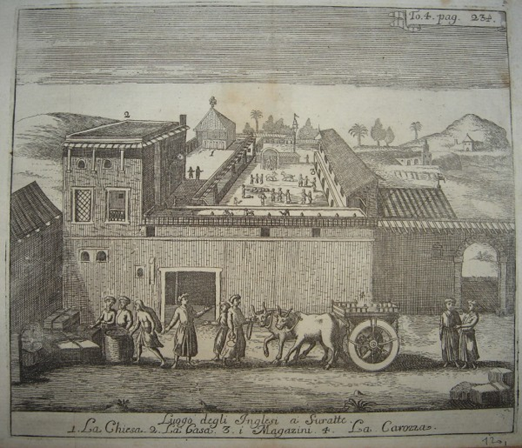
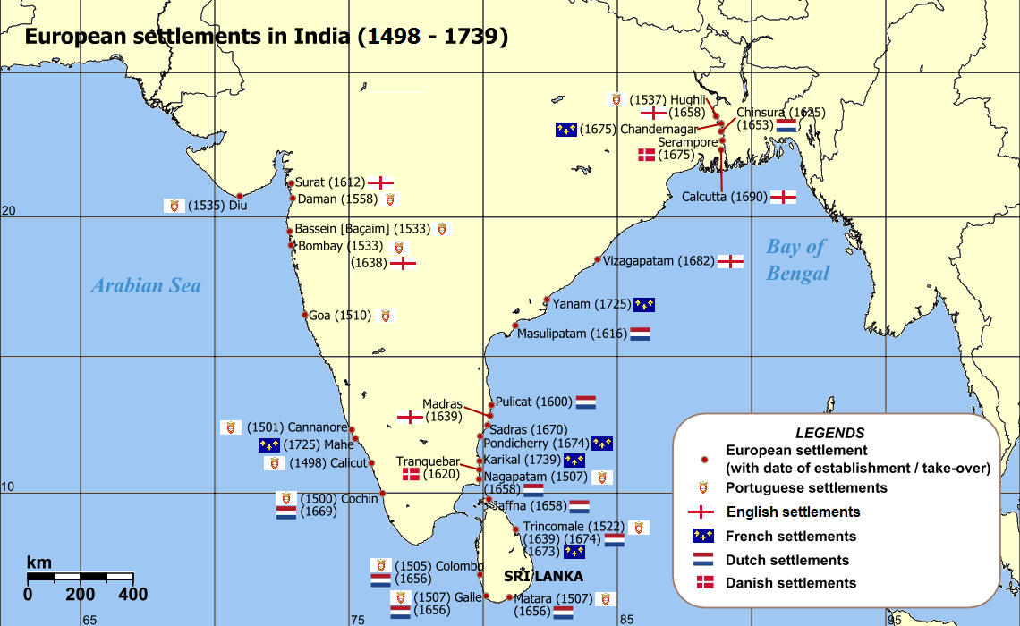
Dutch East India Company factory in Bengal region – c.1665
British East India Company factory at Surat – c.1725
“In different places at Puhar [coast of Tamilnadu] the gaze of the observer is attracted by the residence of the Yavanas, whose prosperity is without limits. At the harbour there are sailors from distant lands, but in all appearance they live as one community.” - Silappatikaram 5.9-12.

Slide 4
Other groups – seeking employment (mercenaries, artisans) – seeking knowledge (Apollonius?) – seeking adventure (Lucian Against Alexander the False Prophet).
“[Alexander convinced him] to put his servants on trial for their lives before the governor of Galatia on the charge that they had murdered his son, a student at Alexandria. But the young man is living, and has come back alive after the execution of the servants, whom you gave over to the wild beasts.” What had happened was this. The young man cruised up the Nile as far as Clysma, and as a vessel was just putting to sea, was induced to join others in a voyage to India. Then because he was overdue, those ill-starred servants concluded that the young man either had lost his life during his cruise upon the Nile or had been made away with by brigands, who were numerous at the time; and they returned with the report of his disappearance. Then followed the oracle and their condemnation, after which the young man presented himself, telling of his travels.” – Lucian Against Alexander the False Prophet 44.

Slide 5
Indians and Arabians in the Roman Empire

Slide 6
Arabians at Myos Hormos and Berenike:
  Dedications by merchants from Eudaimon Arabia (Aden) in 1st c AD.
  South Arabian graffiti, and writing on sherds.
  South Arabian utilitarian wares (e.g. calcite beehive vessel)
Indians at Myos Hormos and Berenike
  Rice (kernels and chaff) found at Berenike
  Utilitarian and domestic wares – personal baggage?
    Arikamedu style cooking ware (Myos Hormos)
    Cooking pots (Wheeler Type 24), casseroles dishes (Wheeler Type 25), flanged casseroles and lids (Wheeler Type 28-29) – southeast Indian in origin (Berenike)
    Absence of pottery from Malabar Coast and northwest Indian
Indian scripts and symbols found in Eastern Desert (e.g. svastikas)
Names of Indians – Kanan and Cātan – Brahmi script (Myos Hormos) cf. Kanan (Arikamedu); ‘Korran, the chieftain’ – Brahmi script (Berenike); Halaka, Vinhudala [=Visnudatta], and Nakada [=Nagadatta?] – ostrakon list good (oil, meat, wine) – Prakrit southwest, south central India (Myos Hormos).

Slide 7
Literary References
Indians and Arabians (among other foreign peoples) at Alexandria:
  “For I behold among you, not only Greeks and Italians and people from neighbouring Syria… nor yet Ethiopians and Arabs from more distant regions, but even Bactrians, Scythians and Persians and even a few Indians, and all these help to make up the audience in your theatre and sit beside you on each occasion…” Dio Chrysostom To the Alexandrians 32.40
Involvement in Roman politics?
  [Aurelian’s triumphal procession] “There were Blemmyes, Axomites, Arabs from Arabia Felix, Indians, Bactrians…” – SHA Aurelian 33.4
Indian servants and slaves:
  “…he [Favorinus] bequeathed to Herodes all the books he had collected at his house in Rome, and Autolecythus. This was an Indian, entirely black, a play thing of Herodes and Favorinus, for as they drank their wine together he used to amuse them by sprinkling his Indian dialect with Attic words and speaking barbarous Greek with a tongue that stammered and faltered.” - Philostratus Lives of the Sophists 1.8
  Cf. Indian eunuchs in the Alexandrian Tariff (Digest 39.4.16.6-7 (Marcianus 1.S. de delatoribus).

Slide 8
Indians in Novels and Plays
Indian chieftain comes to Alexandria to sightsee and trade:
  “Meanwhile the pirates handed over Anthia to merchants at Alexandria… sure enough someone did come to Alexandria, an Indian ruler, to see the city and do business. His name was Psammis… She was still secluded in Psammis’ household…” – Xenophon of Ephesus Ephesian Tale 3.11-12.
Fragments of a play the Charition:
  “Indians” would come on stage and babble in an unintelligible language
  Real Indian language?
  POxy. III. 413

Slide 9
Romans in India

Slide 10
Identifying Romans
Foodstuffs – exclusively Mediterranean?
  Olive oil (Arikamedu) – use in finely crafted “Yavana” vessels? - Perungadai 1.17.15.
  Garum (Arikamedu) – trade in refined fish - Puranannuru 374; Porunarattrupadai 250-60.
“[Port of Muziris]… grain in sufficient amount for those involved with shipping, because the [sc. local] merchants do not use it.” - Periplus 56.18.21-22.
Gaian, also known as Diodoros, given tax exemption in census list from Arsinoe (AD 72/73) due to absence in India.

Slide 11
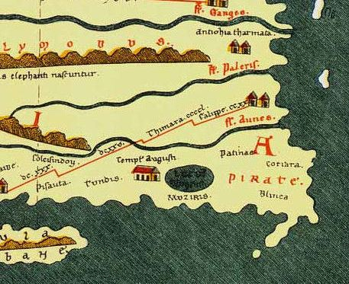
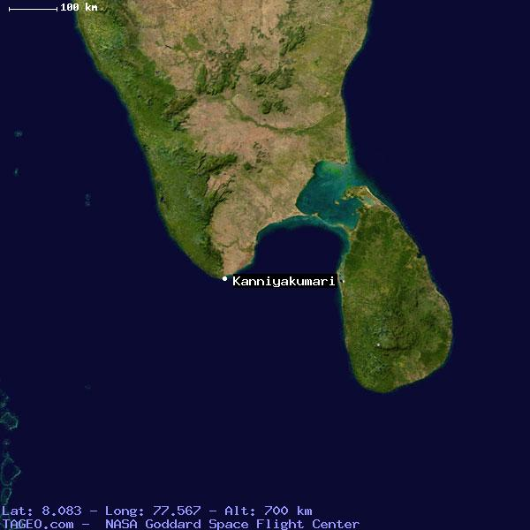
Tabula Peutingeriana
Templum Augusti or temple of Agastya at Cape Comorin?

Slide 12
Identifying the Yavanas
Existence of Roman merchant diaspora in western, south-western and south-eastern India often suggested on the basis of references to “Yavanas” in Indian literature and inscriptions
Yavana derives from the Persian for Ionians, Yauna, which was transmuted into the Prakrit term Yona, and the Sanskrit Yavana.
First-half of the first millennium AD much broader in meaning.
The challenges of identity
[THE STELE OF SŌPHYTOS] “The irresistible force of the trio of fates destroyed the house of my forefathers... But I, Sōphytos [Subhūti?] son of Naratos [Nārada?], pitiably bereft when quite small of my ancestral livelihood, after I acquired the virtue of the Archer [i.e. Apollo] and the Muses, mixed with noble prudence... travelling to many cities for commerce, I acquired ample riches without reproach...”
“This Garuḍa pillar of Vāsudeva, the god of gods, was constructed here by Heliodora [Hēliodōros], the Bhāgavata, son of Diya [Diōn], of Takhkhasilā [Taxila], the Greek [yona] ambassador who came from the Great King Aṃtalikita [Antialkidas] to King Kāsiputra Bhāgabhadra, the Saviour, prospering in (his) fourteenth regnal year.”

Slide 13
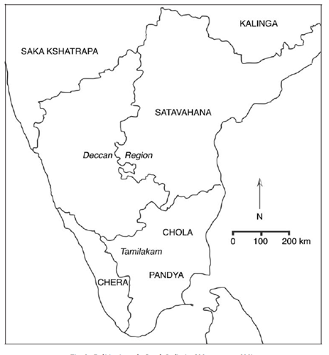
Sangam Corpus
Sangam corpus of poems – dated very broadly c.300 BC to AD 600 - works within this corpus are dated within a century or two.
“…the rich Muciṟi [Muziris] where ships, the perfect and wonderful constructions of the Yavaṉar, having come with gold, returned carrying pepper, churning the white surf of the great Cuḷḷi river which belongs to the Cēralar.” - Akanāṉūṟu 159, 7-11.
“Ships in these ports of trade [Muziris and Nelkynda, which is connected by the port of Bakarē] carry full loads because of the volume and quantity of pepper and malabathron. They offer a market for: mainly a great amount of money...” Periplus Maris Erythraei 56.

Slide 14
“They live each day with pleasure and increasing joy. The women with shining bangles pour into their beautiful decorated gold cups, the sweet cool wine brought by the superb Yavana ships.” – Purananuru 56.18-21.
In this port [Barygaza] of trade there is a market for wine, principally Italian but also Laodicean and Arabian... They [Muziris and Nelkynda] offer a market for... wine, a moderate amount, as much as goes to Barygaza...” - Periplus Maris Erythraei 49, 56.
“Philosophy seems to have produced the same effect on me as wine is said to have produced on the Indians the first time they drank it. The mere taste of such potent liquor threw them into a state of absolute frenzy, the intoxicating power of the wine being doubled in men so warm-blooded by nature.” - Lucian Nigrinus 5.

Slide 15
Craftsmen in India
“...Abbanes went to salute the king Gundaphorus, and reported to him of the carpenter whom he had brought with him... the king said unto him: What craft understandest thou? The apostle said unto him: The craft of carpentering and of building. The king saith unto him: What craftsmanship, then, knowest thou in wood, and what in stone? The apostle saith: In wood: ploughs, yokes, goads, pulleys, and boats and oars and masts; and in stone: pillars, temples, and courthouses for kings. And the king said: Canst thou build me a palace? And he answered: Yea, I can both build and furnish it; for to this end am I come, to build and to do the work of a carpenter.” – The Acts of Thomas Second Act 17.
Carpenters – Manimēgalei 19 lines 107-108.
Carpenters – Peruṅ-kadei 1.58 lines 40-44
Construction of a hero’s chamber by fierce-eyed Yavanas - Malaippattu 45-49

Slide 16
Roman Mercenaries?
“He (Kōvalaṉ) entered without being suspected by the Yavaṉar with the murderous swords, excellent as guards at the gate of the bastion of defence.” – Silappatikaram 14.66-67.
“At the present day voyages are made to India every year: and companies of archers are carried on board the vessels, as those seas are greatly infested with pirates.” Pliny NH 6.26.101.
“The inner tent has double walls of canvas held firmly by iron chains. It is guarded by powerful Yavanas whose stern looks strike terror into every beholder and whose long and loose clothes are fastened at the waist by means of belts.” - Mullaippāttu 59-62.

Slide 17
Do all references to Yavanas really indicate Romans?
  Kârla Inser no.17 – inscription set up by Andhra queen Bālasrī, dating to 1st or 2nd C AD, recording the routing of the Sakas, Yavanas and Pahlans from the Deccan forever.
  Mahavamsa 10.90 – (Pali text of fifth century AD) - speaks of a Yavana quarter in Pandukubhaya (Sri Lanka) in the early fourth century BC.
  Brahmi inscriptions (Sanskrit language) at the Hoq cave on Socotra - a Candrabhūtimukha refers to himself as a Yavana.
Six inscriptions referring to Yavanas at Karle (c.60 km from Pune, c.50 km from western coast of India) and dating to around the first century AD.
Three Yavana inscriptions discovered at Junnar (c.100 km east of Mumbai) – figure of Eros.
Buddhist cave at Nasik - Prakrit dedicatory inscriptions by Yavanas. Another inscription refers to Raumakas.

Slide 18
Overview
Explicit literary testimony revealing Indians (and Arabians) present in Roman Empire.
Material culture and written (non-literary) evidence for Indians and Arabians at Red Sea ports.
Archaeological evidence for Romans in India more ambiguous.
Western literary and cartographic testimony plausible (but not beyond dispute).
Caution required when identifying “Yavanas”.

Slide 19
Bibliography (1)
Abraham, S. A. 2003. ‘Chera, Chola, Pandya: Using Archaeological Evidence to Identify the Tamil Kingdoms of Early Historic South India’, Asian Perspectives 42 (2): 207-233.
Cutler, N. 2003. ‘Tamil Hindu Literature’, in The Blackwell Companion to Hinduism (ed., Flood, D. G.) Oxford.
Dhavalikar, M. K. 1992. ‘Eros from Junnar’, in Indian Numismatics, History, Art, and Culture: Essays in the Honour of Dr. P. L. Gupta (eds., MacDowall, D. W. and Sharma, S., and Garg, S.) Delhi: 325-327.
Mairs, R. 2014. The Hellenistic Far East: Archaeology, Language, and Identity in Greek Central Asia. Oakland, California.
McLaughlin, R. 2010. Rome and the Distance East: Trade Routes to the Ancient Lands of Arabia, India and China. London.

Slide 20
Bibliography (2)
Ray, H. P. 1987. ‘Early Historical Urbanization: The Case of Western Deccan’, World Archaeology 19 (1): 94-104.
Ray, H. P. 1988. ‘The Yavana Presence in Ancient India’, JESHO 31 (3): 311-325.
Ray, H. P. 1995. ‘The Yavana Presence in India reprint of JESHO 1988 with addendum’, in Athens, Aden, Arikamedu: Essays on the Interrelations between India, Arabia and the Eastern Mediterranean (eds., Boussac, M.-F. and Salles, J.-F.) New Delhi: 75-95.
Salomon, R. (1991) ‘Epigraphic Remains of Indian Traders in Egypt’, Journal of the American Oriental Society 111 (4): 731-736.

Slide 21
Bibliography (3)
Salamon, R. 1998. Indian Epigraphy: A Guide to the Study of Inscriptions in Sanskrit, Prakrit, and other Indo-Aryan Languages. Oxford.
Seland, E. H. 2007. ‘Ports, Ptolemy, Periplus and Poetry: Romans in Tamil South India and on the Bay of Bengal’, in The Indian Ocean in the Ancient Period: Definite Places, Translocal Exchange (ed., Seland, E. H.) Oxford: 69-82.
Tieken, H. 2003. ‘The Yavanas’ Clothes in Old Tamil Literature’, Indo-Iranian Journal 46: 261-271.
Zvelebil, K. 1956. ‘The Yavanas in Old Tamil Literature’, in Charisteria Orientalia Praecipue ad Persian Pertinetia (eds., Tauer, F. et al) Prague: 401-409.

