Slide 1

Singapore primary curriculum (6-12)
By Huw Deighton (P149462)

Slide 2
Introduction to Singapore
Republic of Singapore is the country situated in South East Asia
Capital is Singapore – country is referred to as Singapore
Population – 5.3 million (2018)
Size – 660 km2 – Less than half the size of London
Languages spoken – Mandarin, English, Malay & Tamil
Life expectancies – 79 (men), 84 (women)
(BBC News, 2018)

Slide 3
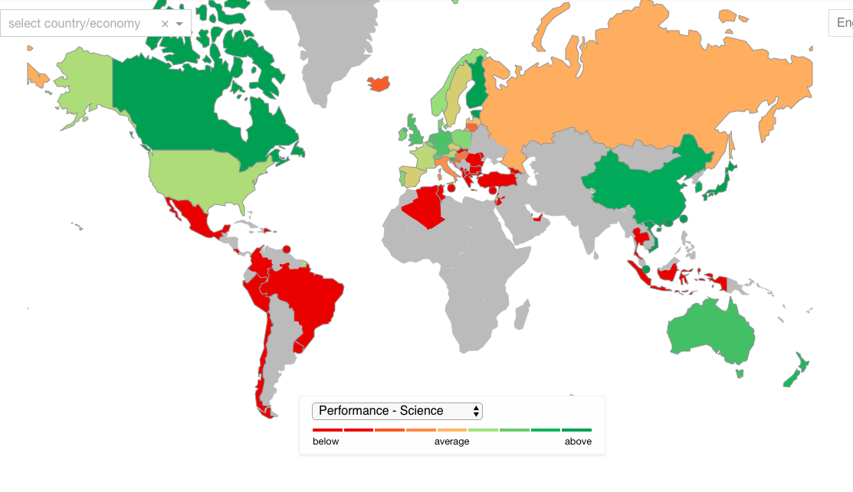
PISA Results
Singapore
(PISA, 2015)

Slide 4
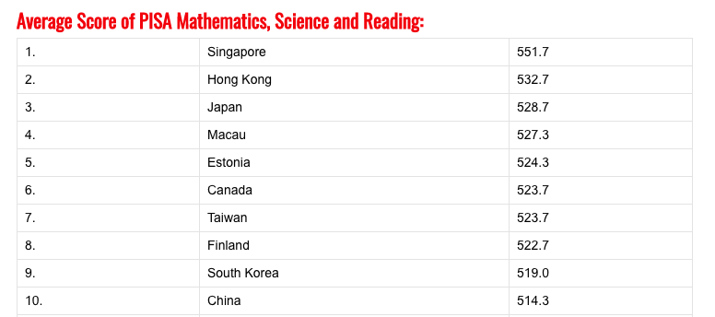
Singapore PISA results
(Fact Maps, 2015)

Slide 5
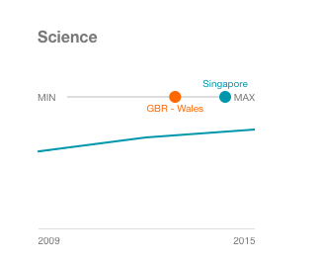
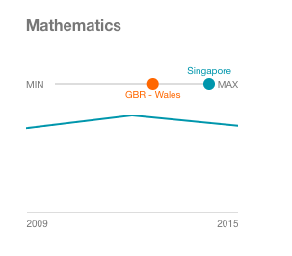
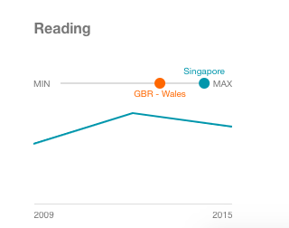
Singapore vs wales, pisa results
It appears that Singapore excels in terms of education in comparison to Wales. Although this is for 15 year old students they must have had a good primary education to prepare them for this creating a great educational foundation.
A curriculum is a continuous process
What are the differences in the curriculum that cause this change?
(PISA, 2015)

Slide 6

How is the curriculum organized
Class sizes are between 35-40 students according to Poon, Musti-Ra &Wettasinghe (2013) – Smaller in wales, Average around 30 (Learning Wales, 2015)
The primary curriculum begins at age 6 and ends at age 12
After 6 years of primary school students must pass a PSLE (Primary School Leaving Examination) state Poon, Musti-Ra &Wettasinghe (2013)
Education and curriculum are managed in Singapore by the MOE (Ministry of Education).
Core subjects – reading, science and maths are taught for between 1.5-3 hours per week according to Yew-Jin, Mijung & Hye-Gyoung (2015) – Same core subjects that appear in Wales
Subjects consist of a huge amount of learning objectives / content standards
Mathematics and science are highly regarded within the primary curriculum – allike within Wales
The ministry of education states that there is more than just content based education
The curriculum also focuses on other needs of the student such as preparing them for later life

Slide 7
Curriculum Continued….
Tan & Chew (2004) state that there is also a huge focus on civics and moral education in the Singapore primary curriculum
Focus on national and societal needs – preparing children for future life
‘Cultivating one’s loyalty and commitment to the nation.’ (Tan & Chew, 2004, p:600).
Also a focus on the needs of the community
This is a product and praxis curriculum – Focus on what student will do after education. Teachers learn from effective lessons allowing them to improve the education given to students

Slide 8
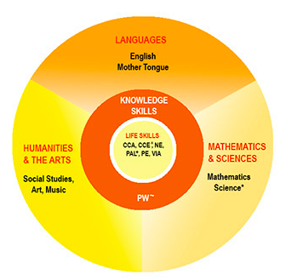
The curriculum
Life Skills
The curriculum ensures that students acquire the values and skills to see them through their lives.
Make them responsible citizens
(Non-academic values)
HIDDEN CURRICULUM
2) Knowledge Skills
These skills aim to improve children’s thinking and communication skills
Children will now be able to analyze information and express thoughts clearly
3) Content-Based subjects
Split into languages, math & Science, and humanities and arts
Ensure students have a wide range of knowledge
(Ministry of Education, Singapore)

Slide 9
Primary curriculum evaluation
Positive Aspects | Negative Aspects
Grades/ Acheivement - Singapore delivers the best primary and secondary education worldwide. According to Coughlan (2016) Singapore has the highest achieving primary schools. Very Effective Teaching – Pollard (2014) states that teachers achieve a high ‘alignment between the curriculum, instruction and assessment.’ (Pollard, 2014, p:94). This allows children to gain more from education. Students Enjoy Learning – Crehan (2016) Singapore has the highest rate of ‘student happiness.’ 88% of students report being happy at school compared to 83% in the UK. 77% report enjoying learning in mathematics compared to 56% in the UK. Respect For Teachers - Coughlan (2018) Singapore teachers gain 10th most respect worldwide | Stress – Education system seen as a pressure cooker, putting significant stress on pupils even at primary level , children being pushed towards books rather than playing outside (Nayak, 2016) Not Enough Time Outdoors – Social and cognitive benefits associated with spending time outdoors for primary aged children. (Bogut, Popvic, Mikuska, 2017). Children in Singapore cannot benefit this as they spend most time indoors.

Slide 10
A comparison to the welsh primary curriculum
1) Age of learning
Singapore primary education begins at age 6, In Wales we have the foundation phase for children between age 3-7 but is compulsory from age 4 state Learning Wales (2015)
The foundation phase focuses developing skills such as personal and social skills as well as creativity and academic development - This is not seen in the Singapore primary curriculum according to Learning Wales (2015)
Singapore primary curriculum accommodates children between ages 6-12 state Poon, Musti-Ra &Wettasinghe (2013)
whereas in Wales after the foundation phase children progress to the key stage 2-4 curriculum

Slide 11
2) Physical Education in the Curriculum
Both curriculums consist of a physical education syllabus
However the Welsh physical education curriculum focuses a lot more on children partaking in outdoor activities and the benefits of this
These benefits include improvements in self-esteem an self-confidence (Welsh Assembly Government, 2008)
Does this suggest Wales education focuses more on the well-being of the child ?
The Singapore curriculum focuses more on the fitness side of it with the curriculum consisting of sports such as swimming and physical health and fitness (Ministry of Education, Singapore, 2016)

Slide 12
3) Languages in the curriculum
In Welsh Primary Education it is now compulsory to study Welsh from the foundation phase up according to Learning Wales (2015)
The English knowing bilingual policy implemented in Singapore states Ng Chin Leong (2014)
English must be studied as a first language – the mother tongue language such as (Mandarin, Malay or Tamil) will be taught as a second language.
There is a focus on bilingual education in both Wales and Singapore

Slide 13


Any questions on the Singapore curriculum??

Slide 14
Reference List
BBC News Authors (2018) BBC News, Singapore Country Profile, https://www.bbc.co.uk/news/world-asia-15961759 (Accessed 12 November 2018).
Bogut, I., Popovic, Z. and Mikuska, A. (2017) The Role and Importance of Outdoor Teaching and Fieldwork in Biology For Primary School Teacher Education. Zivot I Skola [online]. 63 (2), p. 127. [Accessed 08 November 2018].
Coughlan, S (2016) BBC News, Singapore tops global education rankings, https://www.bbc.co.uk/news/education-38131731 (Accessed 12 November 2018).
Coughlan, S (2018) BBC News, Where do teachers get most respect? https://www.bbc.co.uk/news/business-46063947 (Accessed 12 November 2018).
Crehan, L. (2016) Clever Lands. 1st ed. London: Unbound.
Fact Maps Authors (2015) Fact Maps, PISA Worldwide Ranking – average score of math, science and reading http://factsmaps.com/pisa-worldwide-ranking-average-score-of-math-science-reading/ (Accessed 12 November 2018).
Learning Wales Authors (2015) Learning Wales, Foundation Phase Framework, http://learning.gov.wales/resources/browse-all/foundation-phase-framework/?lang=en (Accessed 12 November 2018).
Ministry of Education Singapore authors, Ministry of Education Singapore, Primary School Curriculum, https://www.moe.gov.sg/education/primary/primary-school-curriculum (Accessed 14 November 2018).
Ministry of Education Singapore authors (2016) Ministry of Education,PHYSICAL EDUCATION TEACHING & LEARNING SYLLABUS Primary, Secondary & Pre-University, https://www.moe.gov.sg/docs/default-source/document/education/syllabuses/physical-sports-education/files/physical_education_syllabus_2014.pdf (Accessed 14 November 2018).
Nayak, S, (2016) ABC News, Singapore schools: ‘The best education system in the world’ putting significant stress on young children. https://www.abc.net.au/news/2016-01-06/best-education-system-putting-stress-on-singaporean-children/6831964 (Accessed 12 November 2018).
Ng Chin Leong, P. (2014) Mother Tongue Education in Singapore: Concerns, Issues and Controversies. Current Issues in Language Planning. 15 (4), pp. 361-375.
PISA authors (2015) PISA, Singapore, http://www.compareyourcountry.org/pisa/country/sgp?lg=en (Accessed 12 November 2018).
Pollard, A. (2014) Readings For Reflective Teaching in Schools. 2nd ed. London: Bloomsbury.
Poon, K., Musti-ra, S., Wettasinghe, M.P. and , (2013) Special Education in Singapore: History, Trends, and Future Decisions. Intervention in School and Clinic [online]. 49 (1), pp. 59-64. [Accessed 16 November 2018].
Tan, T. and Chew, C. (2004) Moral and Citizenship Education as Statecraft in Singapore: A Curriculum Critique. Journal of Moral Education [online]. 33 (4), pp. 597-607. [Accessed 15 November 2018].
Welsh Assembly Government, (2008) Physical Education in the National Curriculum For Wales. 1st ed. United Kingdom: .
Yew-jin, L, Mijung, K. and Hye-gyoung, Y. (2015) The Intellectual Demands of the Intended Primary Science Curriculum in Korea and Singapore: An Analysis Based on Revised Bloom's Taxonomy. International Journal of Science Education. 37 (13), pp. 2193-2213.

