Slide 1
Estyn
Notes:
What is Estyn?
What do they do?

Slide 2
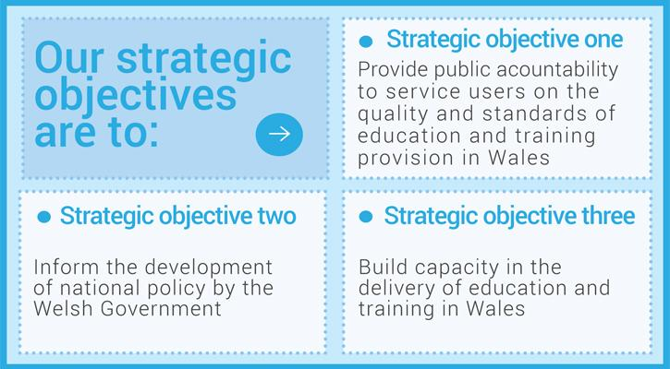
Estyn

Slide 3
What does Estyn say about W2L?
Note:
the positives
the negatives
Notes:
Distribute copies of the annual reports – one year per table if possible (two copies of each available)
Please DO NOT write on copies.
Is there a pattern?

Slide 4
Best Practice Case Study
https://www.estyn.gov.wales/best-practice/welsh-second-language-comes-first
Notes:
On Estyn website – a number of case studies available on schools noted after inspection as being best practice
Standards in Welsh second language at Plascrug C.P. School, Ceredigion, are excellent, despite less than 1% of pupils coming from homes where Welsh is the main language. The school gives high priority to preparing pupils to become part of a bilingual society promoting strongly the use of incidental Welsh. Many staff have benefited from a range of courses and classes which have helped them to improve their bilingual skills and teach more effectively through the medium of Welsh.

Slide 5
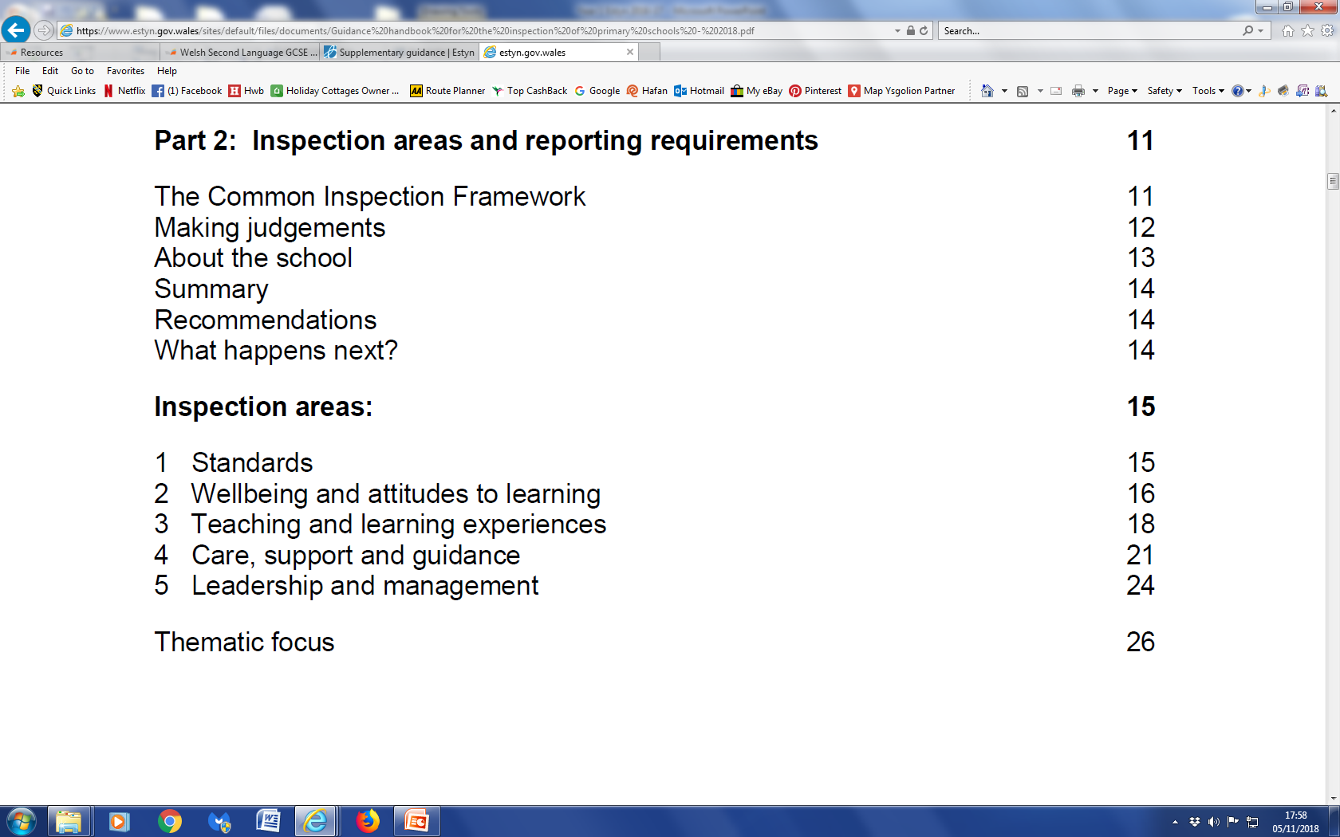
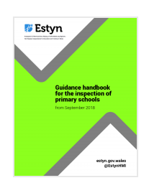
Guidance for the inspection of primary schools
https://www.estyn.gov.wales/inspection/inspection-guidance/primary-schools
Notes:
Summary
This guidance sets out the way the inspectorate will conduct inspections of primary schools from September 2017. It sets out the inspection arrangements for primary schools and offers guidance to inspectors on making inspection judgements.
Where the inspection identifies important concerns in relation to standards, quality of education and training or leadership and management, the inspectorate will arrange to conduct follow-up activity in the school to support improvement. Guidance on the different types of follow-up activity is available on Estyn’s website.
Primary schools can use this guidance to see how inspections work and to help them in carrying out their own self-evaluation.

Slide 6
Guidance for the inspection of primary schools
Inspectors should consider:
pupils’ attainment in Welsh or Welsh second language, as applicable, when compared with similar schools and previous attainment;
continuity between the end of Foundation Phase and key stage 2;
the progress pupils make in Welsh lessons;
in the English-medium sector in particular, pupils’ progress in using Welsh both passively and actively in different contexts beyond their Welsh lessons.
Inspectors should consider the surrounding area of the school when making a judgment on attainment
Notes:
Point 4 - for example in other subjects, during registration periods, assemblies and in extra-curricular activities.
In predominantly English-medium primary schools, inspectors should judge whether the school provides enough time to teach Welsh second language to all pupils. If the time allocation is well below one hour per week, it is unlikely that pupils are achieving well. Inspectors should comment on the arrangements to ensure that pupils learning Welsh reach appropriate standards.
Point 5 - For example, pupils studying Welsh second language in a school with Welsh and English streams serving an area where Welsh is spoken by a significant proportion of the local community should achieve higher standards in Welsh than in an English-medium school serving an area where pupils have few opportunities to come into contact with Welsh other than at school.

Slide 7
Guidance for the inspection of primary schools
Good standards
Most pupils make good progress in gaining skills in Welsh language.

Slide 8
Guidance for the inspection of primary schools
Unsatisfactory standards
Pupils do not make enough progress in gaining skills in the Welsh language.

Slide 9
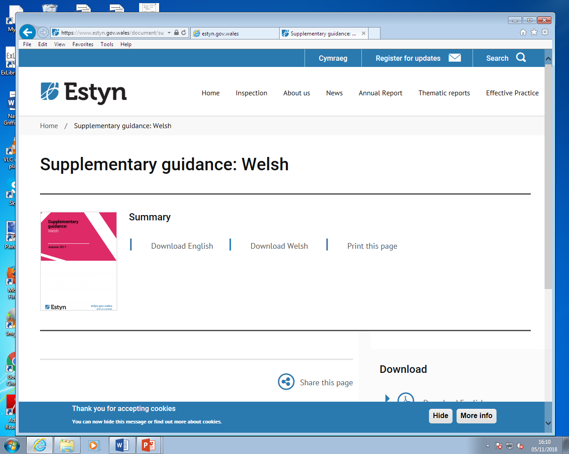
Supplementary Guidance: for Welsh lessons
Are pupils making good progress in Welsh lessons?
Is there a sequence of learning activities that reinforces pupils’ skills in speaking and listening, reading and writing Welsh and their inter-dependency?
Is there sufficient consolidation of new vocabulary and sentence patterns to ensure pupils are able to use them with increasing independence?
Is there sufficient teacher intervention to improve quality and accuracy of pupils’ oral competence in Welsh?
https://www.estyn.gov.wales/document/supplementary-guidance-welsh-0
Notes:
Supplementary Guidance specifically for Welsh - September 2017
There are more than this in the document – I have selected the most useful

Slide 10
Introduction (Pg. 2)
The number of Welsh speakers and the number of people who use the Welsh language in their daily lives are priorities for the Welsh Government. The publication of the Welsh medium Education Strategy (April 2010), in addition to A living language: a language for living - Welsh language strategy 2012 -17 (2012), reaffirms the government’s commitment to improving the quality of Welsh provision.
Based on the principles of Qualified for Life (2014), Successful Futures (2015) recognises the importance of the Welsh language in the development of Wales ‘as a bilingual nation with the strength and assurance to nurture both languages’.

Slide 11
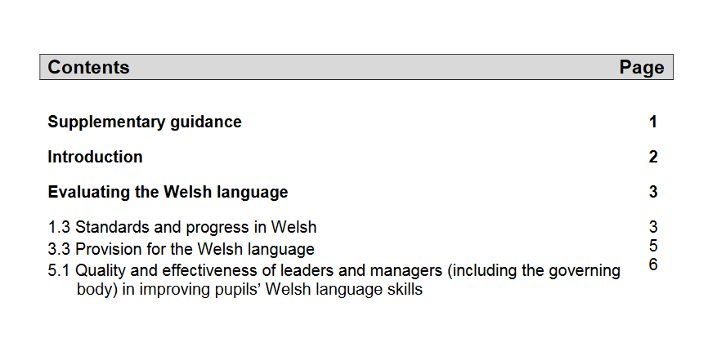

Slide 12
Maths lesson taught through the medium of Welsh
http://resources.wjec.co.uk/Pages/ResourceSingle.aspx?rIid=496
Notes:
Watch the video. Use the questions in slide 18 to determine what Estyn might say about this lesson.
Geography or maths lesson

Slide 13
Supplementary Guidance:
Welsh in the wider school community
…do pupils have a good grasp of subject terminology in Welsh in subjects across the curriculum?
…are pupils confident and competent in using Welsh in a range of situations beyond their Welsh lessons?
Do...teachers make increasing use of Welsh as a medium of communication, both in lessons and in other situations?
Does the school encourage pupils and staff to make increasing use of Welsh…as a medium of informal communication?
Notes:
As well as Welsh lessons, schools must show that Welsh is used across the curriculum and in the wider school community.

Slide 14
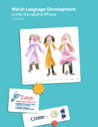
Welsh Language Development in the Foundation Phase (2013)
https://www.estyn.gov.wales/sites/default/files/documents/Welsh%20Language%20Development%20in%20the%20Foundation%20Phase%20-%20January%202013.pdf
Notes:
Report published January 2013

Slide 15
Main findings
“Welsh Language Development is good in the majority of the schools and settings visited…”
In most of these schools and settings:
Welsh is an integral part of daily routines
Nearly all children enjoy learning Welsh
Notes:
The most effective schools and settings develop children’s Welsh by improving their confidence, self-belief and attitudes to learning Welsh. Practitioners (teachers and other support staff ) plan a range of opportunities for all children to learn Welsh in class and outdoors. The most effective work draws on opportunities to introduce Welsh in the other six areas of learning of the Foundation Phase curriculum.

Slide 16
Main findings
Most children make suitable progress in speaking and listening to Welsh
Their speaking and listening skills are developing well but reading and writing are generally underdeveloped
In one-in-ten schools, children make excellent progress in acquiring Welsh language skills. In these few schools, nearly all children have a good understanding of their Welsh work across the curriculum. They use a wide range of words and sentence patterns correctly and by the end of key stage 2 can read accurately and with expression.

Slide 17
Main findings
In a minority of schools staff do not devote enough time to teaching Welsh.
In a few of schools and settings visited, staff are not devoting enough direct teaching time to deliver Welsh Language Development effectively.
Notes:
Practitioners do not practise and repeat new Welsh words regularly or offer children enough opportunities to practise their Welsh. In sessions where the quality of Welsh teaching is excellent, teachers re children’s imagination, activities are stimulating, and children respond enthusiastically, extend their vocabulary and become more confident in using Welsh.

Slide 18
Main findings
Generally, when practitioners’ own Welsh is fluent, children’s progress in learning Welsh is better.
In a few cases, practitioners cannot sustain using Welsh long enough and use a very limited amount of incidental Welsh with the children. (incidental Welsh)
Notes:
Point 1 - These practitioners use Welsh consistently across all areas of learning. Where there are no confident Welsh-speaking practitioners in a school or setting, the use of Welsh by staff is usually more limited. This means that children hear less Welsh and have less opportunity to practise it. Therefore it is important that ALL trainee teachers improve the standard of their Welsh…..
Point 2 – please discuss ‘incidental Welsh’ – including use of the term.

Slide 19
Recommendations
Schools and settings should:
ensure that enough time is devoted to the direct teaching of Welsh;
plan good opportunities for pupils to use Welsh in other areas of learning and in outdoor activities;
increase the level of skills input to develop pupil’s writing in Welsh;
monitor provision and progress in Welsh Language Development;
provide practitioners with opportunities to improve their Welsh language skills and language teaching skills.
Notes:
As a result, these recommendations were made.
Point 3 – this has been cut and pasted directly from the report. The grammatical error is theirs, not mine!!!

Slide 20
Recommendations
Local authorities should:
provide support and training in Welsh Language Development for headteachers, Foundation Phase leaders and lead practitioners;
provide better access to Welsh language support and training for practitioners…;
share good practice in Welsh Language Development.

Slide 21
Recommendations
The Welsh Government should:
review whether the Foundation Phase Outcomes Indicator should capture children’s progress in Welsh Language Development;
provide more exemplar materials of good practice in Welsh Language Development.
Notes:
NB - I have removed the recommendation regarding the non-maintained sector

Slide 22
GCSE Short Course
https://www.qualificationswales.org/english/qualifications/gcses-and-a-levels/gcses/gcse-welsh-second-language/
GCSE Welsh Second Language
GCSE Welsh Second Language was revised for first teaching in September 2017 replacing the existing GCSE and Applied GCSE full and short courses.
The revised GCSE Welsh Second Language has been created to address shortcomings in the previous courses. It will also act interim qualification before the introduction of the new Welsh Curriculum in 2022 when Welsh will be taught in English medium, Welsh Medium and bilingual schools in order to remove the distinction between Welsh first and second language.
The study of Welsh first and second language is statutory under legislation for all learners until the end of key stage 4.

