Slide 1
Poverty

Slide 2
What is poverty?
Poverty affects millions of people in the UK alone.
When your resources are well below your needs to survive.
It means not being able to:
Pay rent
Heat the home
Buy essentials for the family.
Notes:
It also means waking up each morning facing insecurity, financial instability, making impossible decisions every day.
The constant stress has an impact

Slide 3
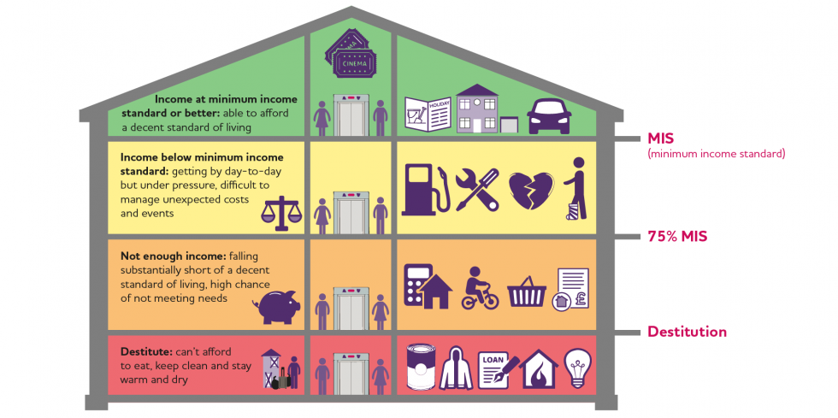
Levels of Poverty
UK Poverty 2024: The essential guide to understanding poverty in the UK | Joseph Rowntree Foundation
Notes:
Joseph Rowntree Foundation, 2022

Slide 4
JRF (2024)
More than 1 in 5 people in the UK (22%) were in poverty in 2021/22 – 14.4 million people. This included:
8.1 million (or around 2 in 10) working-age adults
4.2 million (or nearly 3 in 10) children
2.1 million (or around 1 in 6) pensioners.
Poverty rates have returned to around their pre-pandemic levels, as middle-income household incomes rose at the same time as a range of temporary coronavirus-related support was withdrawn.

Slide 5
Background to current UK poverty:
Children have consistently had the highest poverty rates, while pensioners along with working-age adults without children now have the lowest.
Before 1979, levels of poverty had been broadly flat at around 14%. In the 1980s, under the Conservative Government of Margaret Thatcher, there was an unprecedented rise in poverty even at a time of high-income growth, due to very unequal income growth over this period.
This has not been reversed, meaning current levels of poverty are around 50% higher than they were in the 1970s.
In 2021/22, 6 million people - or 4 in 10 people in poverty – were in ‘very deep’ poverty, with an income far below the standard poverty line. More than twice as many (over 12 million people) had experienced very deep poverty in at least one year between 2017–18 and 2020–21.

Slide 6
From the latest Destitution in the UK report that around 3.8 million people experienced destitution (where they could not afford to meet their most basic physical needs to stay warm, dry, clean and fed) in 2022.
This included around one million children.
These figures have more than doubled since 2017. There is further evidence of deepening poverty in the increasing number of people using food banks, with more emergency food parcels being delivered than ever before.

Slide 7
Certain groups have wholly unacceptably high rates of poverty - These include:
Larger families - 43% of children in families with 3 or more children were in poverty in 2021/22. A number of benefit policies, including the two-child limit and the benefit cap, have a disproportionate impact on larger families.
Families whose childcare responsibilities limit their ability to work – 44% of children in lone-parent families were in poverty in 2021/22.
Many minority ethnic groups – around half of people in Pakistani (51%), Bangladeshi households (53%) and around 4 in 10 people in households with an Asian background or households from Black African backgrounds (42%) were in poverty between 2019/20 and 2021/22. These households also have higher rates of child poverty, very deep poverty and persistent poverty.
Informal carers – 28% of people with caring responsibilities were in poverty in 2021/22. Informal carers face a financial penalty, because of their limited ability to work.
People living in rented accommodation – in 2021/22, more than 4 in 10 social renters (43%) and around a third of private renters (35%) were in poverty after housing costs.

Slide 8
Poverty rates vary between different groups
Families where youngest child is under 4 – 31% are below poverty line
Families where youngest child is 5 – 10 years old – 30% are below the poverty line
Families where youngest child is 11 – 15 years old – 25% are below the poverty line
Families where youngest child is 16 – 19 years old – 24% are below the poverty line

Slide 9
Causes of Poverty?
Unemployment and low-paid jobs
Minimal skills
Benefit system
Challenging and high costs
Discrimination
Chaotic lives

Slide 10
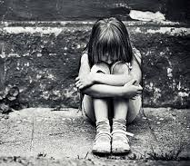
Poverty and Children and Young People
Awareness of the poverty – this may vary, but certainly young children may not be explicitly aware of the impact of poverty on their lives until they reach their older years. However, the impact may be significant.
Notes:
Despite a parent's best efforts to shield them, children are very aware of their family's poverty.
They will try to mitigate the poverty, by not asking for things that they see their friends having.
As they grow towards adolescence, they employ additional behaviours to support their family's finances, and take on additional responsibilities, again, losing out on experiences and childhood that others may experience.
Poverty shapes growth and achievement in, child health, mental health, family stress and wellbeing, partiicpation in peer and social leisure activities, cultural celebrations.
Economic advantage and disadvantage across the lifespan
Children control few of the levers that govern their families financial situation, they rely on their family for sustenance and support. They also have little control over the distribution of resources. How the resources are shared in the family
Every transition that a child makes is difficult for a child inpverty: Why might this be?

Slide 11
Impact of poverty on a child -
Health: Children in poverty may have poor physical health, low birth weight, and chronic conditions.
Mental health: Children in poverty may have mental health problems, low sense of well-being, and anxiety.
Education: Children in poverty may have academic underachievement and lower attainment.
Social: Children in poverty may experience bullying, social isolation, and feelings of exclusion.
Development: Children in poverty may have adverse developmental outcomes.

Slide 12
Impact of poverty on a child-
Employment: Children in poverty may have subsequent employment difficulties.
Housing: Children in poverty may live in insecure housing and be forced to move schools often.
Play: Children in poverty may have little time for play and recreation.
Extracurricular activities: Children in poverty may have fewer extracurricular activities, such as school trips and clubs.
Basic needs: Children in poverty may go without basic necessities, such as food, shoes, and a bed.

Slide 13

New research from Child Poverty Action Group shows child poverty’s heavy toll on children’s physical and mental health, their education and how they feel about themselves and their futures.
Over three quarters of parents (79%) worry about not having enough money to provide for their family.
65% of children report money worries themselves.
Over two thirds of parents (67%) say their children have too many money worries and challenges these days to be able to enjoy their childhood.
The vast majority of parents (85%) believe that the UK Government needs to do more.
Poverty’s threat to childhood revealed by new research | CPAG

Slide 14

Who is to blame?
Within the political frames, it is often the parents that get the blame, particularly for their shortcomings.
Government questions the role of the family -
  Children's lives are vulnerable to being marginalised and stigmatised.
Notes:
Which children live in poverty,
Are parents to blame
Is there a culture of pverty
Is poverty transmitted between generatoins
Do children learn how to be poor from their parents
Do parents have too many children that they cannot afford
Is poverty caused by parents being unwilling to work.

Slide 15
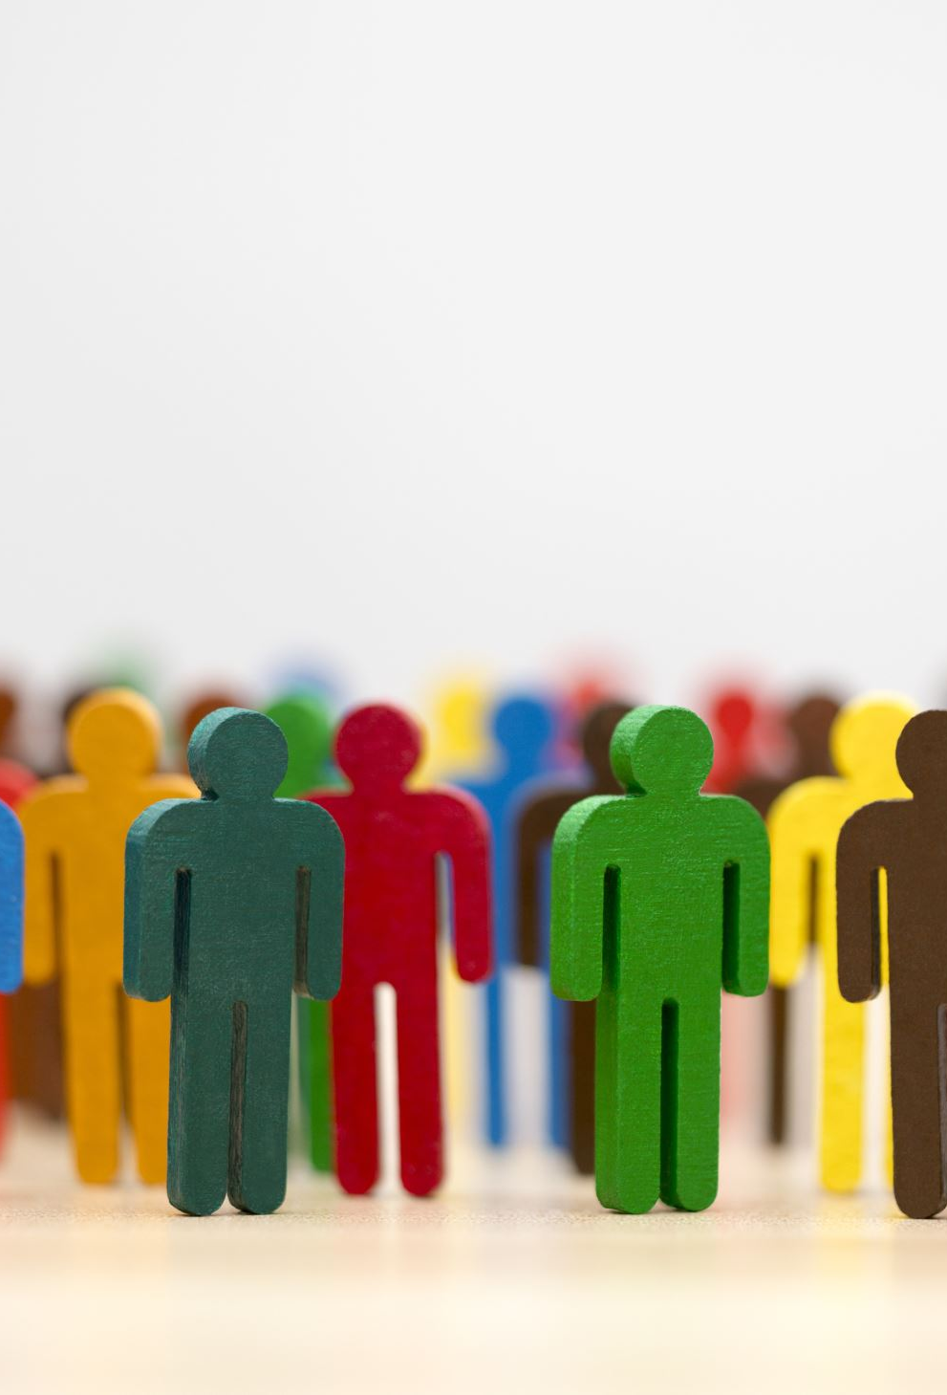
Who is to blame cont'd
Inequality – within society
Social injustice – how?
Child poverty is caused by structural and personal issues: economic, political, social and individual elements.
Notes:
Other blames?
Income inequality referns to the gaps in income (and wealth) between the highest and lowest paid in society
Income inequality perpetuates advnatage and disadvantage, leaves the poor trailing behind and negatively affects progress across all wealth nations.
Income inequality affects almost every facet of life.
People who live in unequal poverty have lower levels of health compared to more equal societies.
Structure of the labour market.
The housing market
Low pay
Irregular hours
Insecure employment.
Political factors: level of social security payments, recent social securtiy cuts, social: gender, lone parenthood, disabillity, age and race.
Individual: capacities andn choicies

Slide 16
The 2024 JRF report stated:
“For a decent standard of living, we all need security and stability in our lives – secure housing, a reliable income, and support when things get difficult. For too many of us, there is no such security. Millions of people in the UK are struggling to get by, leading insecure and precarious lives, held back from improving their living standards. It’s time to take action on poverty and put this right.”

Slide 17
Consequences?
Where are we now?
What might be the consequences of poverty?
“My niece didn’t go on hers [school trip] and she was one of only two children in the whole class of 32 that didn’t go and she cried when I picked her up from school because all her friends had been but she hadn’t been.”
Parent of primary school child
The place where she was happy and thrived was in dance classes and I now can’t pay for them and that was the thing she looked forward to every week, she made friends there; she doesn’t have friends at school as such but at dance she had friends, yeah, and we’ve had, we’ve had to stop all that.
Jessica - single parent, York
I skip meals to share with my mum...for example, I skip my meal to wait for her to come back and at least we can have the same amount of food...[We] starve together through the whole day, so at least we will have had something to eat.
Amara - aged 15, London
End Child Poverty budget briefing 2025-26 | CPAG
Notes:
health problems
housing problems
being a victim or perpetrator of crime
drug or alcohol problems
lower educational achievement
poverty itself – poverty in childhood increases the risk of unemployment and low pay in adulthood, and lower savings in later life
homelessness
teenage parenthood
relationship and family problems
biological effects – poverty early in a child’s life can have a harmful effect on their brain development
Cognitive development, social, emotional, behaviural develoopment, friendships, esteem, relationships, experience of education, educational outcomes, and access to emplooument.
Poverty has an impact on childhood as well as adulthood.

Slide 18
Impact cont`d
78% of children missed out on days out
72% of children didn't have a family holiday
65% of children couldn't take part in out of school activities
78% couldn't buy things their friends have

Slide 19
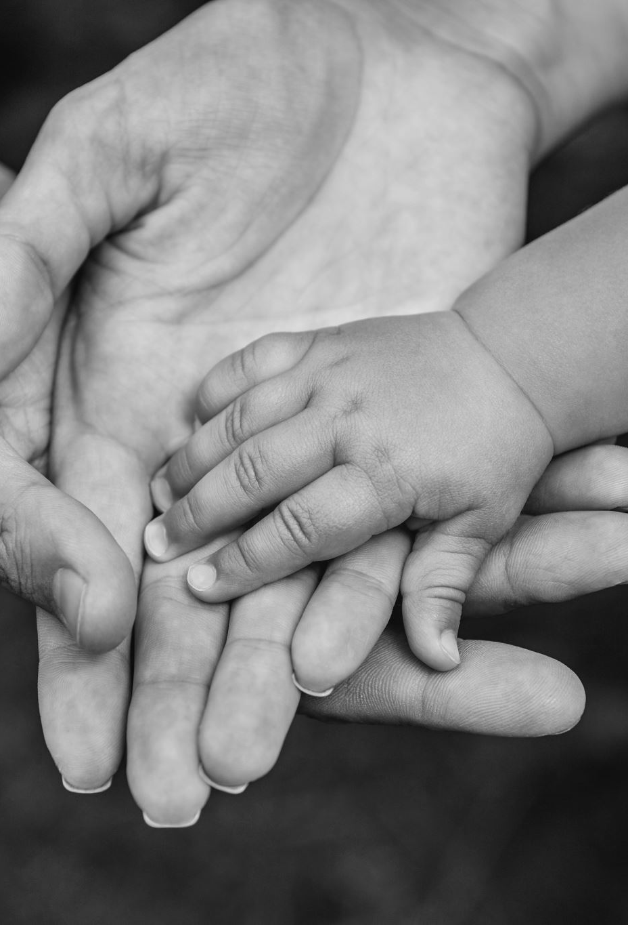
Impact cont`d
Poverty affects health even before birth.
Children born to parents living in poverty are more likely to be low birthweight and less likely to survive the first year of life.
They are also more likely to suffer from asthma and other childhood diseases.
Children who grow up in poverty may also experience poor health in later life as a result.
Children in poverty are more likely to have poor mental health and are at higher risk of psychological distress.

Slide 20
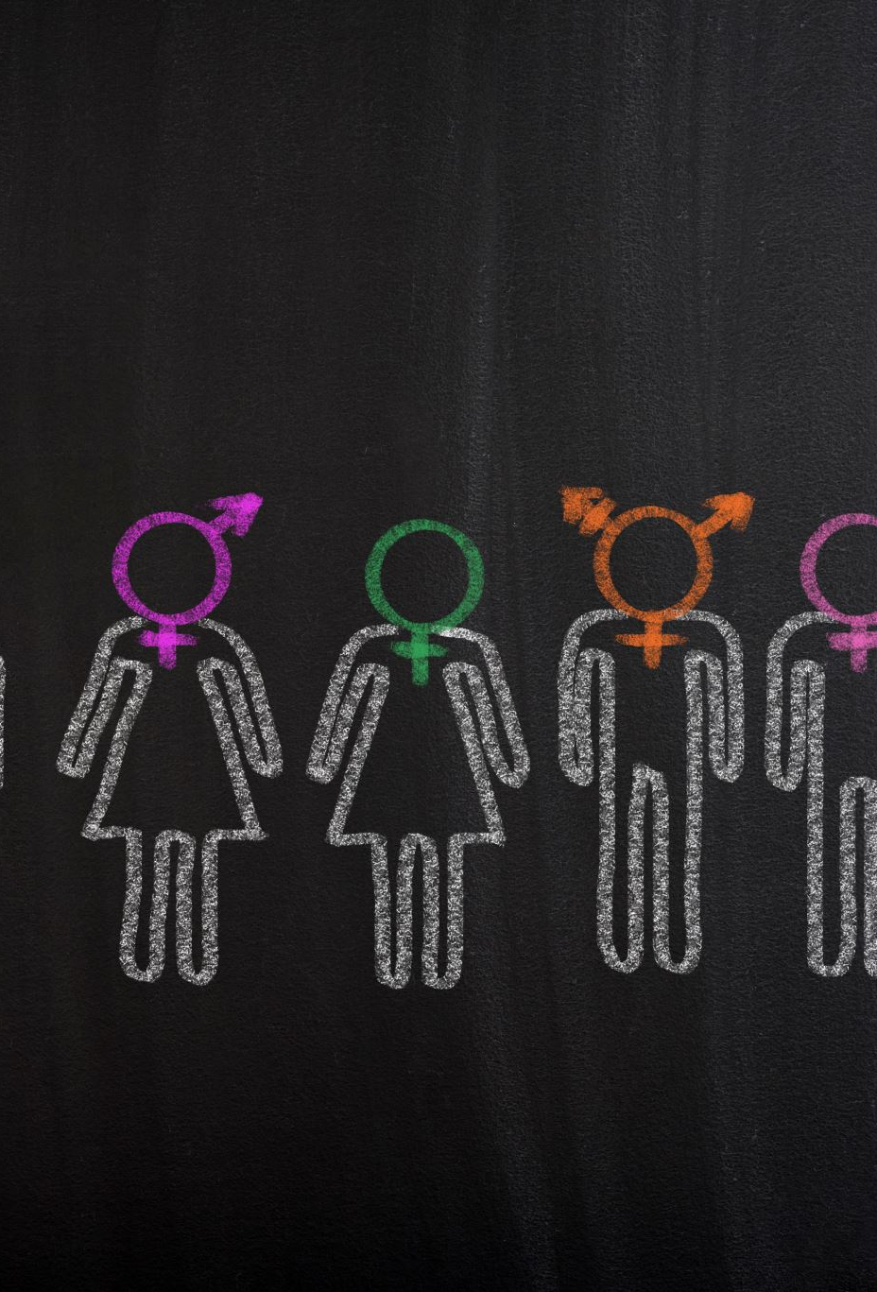
Vulnerable groups
Women
Ethnic minorities
Individuals with disabilities
Young
Unemployed
Children
Children leaving care
Teenage parents
Notes:
Children with a parent in prison, migrant children, refugee/asylum-seeking children
Children with disabilities or disabled parents
Children who are carers.

Slide 21
Poverty in the UK
Ebbs and Flows
Persistent poverty
The UK has more children who are materially deprived than any other member of the EU, with the same profile.
Between 3-5% of children do not have access to the most basic of essentials, including good nutrition and appropriate clothing for the weather.
Notes:
Poverty is dynamic and the amount of children living in poverty changes every year.
Children that live in poverty every year are known to be experiencing persistent poverty
However the majority of people do exit poverty, except that every year a new group enter it.
The trend in the UK is that child poverty is increasting and will continue to do so. The institute of Fiscal Studies suggests that children with three or more children will expereinece the sharpets rise, as a result of recent econimic changes. However lone parents in work, particularlly full time work will also be vulnerable to poverty.

Slide 22
Ebbs and flows -
Consumer credit is a part of everyday life for many people, helping to smooth the ebbs and flows of income and expenditure and manage financial resources flexibly. However, the concern is that use of consumer credit, particularly use of high-cost credit, can lead to financial difficulties and over-indebtedness.
What is the relationship between debt, credit and poverty in the UK?
How can credit and debt policies and practice interventions reduce and prevent poverty - what is the evidence on what works?
What interventions and strategies are recommended for inclusion in an anti-poverty strategy for the UK?

Slide 23


Persistent poverty -
Persistent poverty is when someone experiences relative low income for at least three out of four years in a row. Income is adjusted for household size and includes earnings, investment, pension, and state support.
UK – In 2017, the UK's persistent poverty rate was 7.8%, which was lower than the EU28 average of 11.3%.
Wales – In 2022, the persistent poverty rate in Wales was 12%.

Slide 24
Latest findings: overall poverty
Around 22% of people in Wales are living in relative income poverty after housing costs — roughly 700,000 individuals.
By age group
  Children: About 31% of children in Wales are in relative poverty.
  Working‑age adults: Around 21% are in poverty.
  Pensioners: Around 16% of pensioners are in poverty.
Deep and very deep poverty
  Nearly half a million people in Wales live in deep poverty, with 310,000 in very deep poverty (below 40% of median income).
Fuel poverty
  Approximately 340,000 households (about 1 in 4) estimated to be in fuel poverty (spending >10% of income on energy).
Wellbeing of Wales 2025 | GOV.WALES
Joseph Rowntree Foundation (2025). Poverty in Wales 2025. York: Joseph Rowntree Foundation.

Slide 25
Summary table: Wales and UK
Region / Group | Poverty (% relative after housing costs)
Wales (all people) | ~22% | ~700,000 people in poverty
Wales (children) | ~31% | higher than adults & pensioners
Wales (working age) | ~21%
Wales (pensioners) | ~16%
UK (all people) | ~21% | DWP official data (House of Commons Library)
UK (absolute) | ~18%
UK (children) | ~4.45 million children | ~record level

Slide 26

Impact of Employment
Low pay (high level of hours).
Zero hours contracts.
Child-care needs.
Rising costs of living.
Notes:
The UK ranks poorly against other developed economies in terms of low pay.
Low pay does not necessarily mean poverty, particularly if it is mitigaged with another member of the family working.
Three quarters of low-paid workers are still in low paid jobs a decade later.
Lone parents can struggle as they cannot take on high level of hours, with a low paid job because of childcare needs.

Slide 27
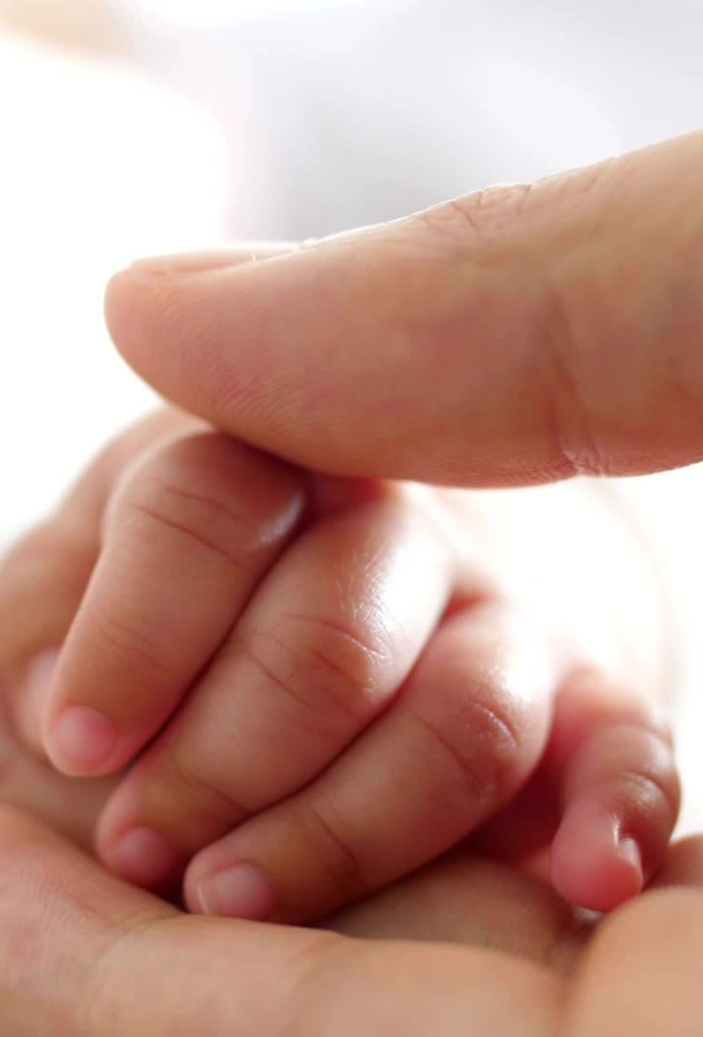
Family and their role:
What is family?
  Family: A family is a group of two or more persons related by birth, marriage, or adoption who live together; all such related persons are considered as members of one family. (HRSA, 2023)
Stigma. In what sense?
Binary definitions. How does this have an impact?
What role does government have in these definitions and expectations?
When the families take the blame –
  Both parents or just mothers?
Notes:
Low income families are particularly vulerable to categorisation as 'troubled' or troublesome families.
Families that do not conform to society's expectation of a good family.
Families are not context-free nor static. The ideae of the family has the ability to evoke more moral and evaluative judgements than almost anything else we do as humans:
Health or unhealthy, normative or troubled, functional or dysfunctional.
David Cameron, PM until 2015, said there are "the small number of families that are the source of a large proportion of the problems in society: drug addiction, alcohol abuse, crime, a culture of disrubption and irresponsibility that cascades through generations.
When the families take the blame, it devolves the government of any responsibility.,
The blame usually falls to the mother, and although the term used is parenting, it's actually usually the mother that the blame is aimed at. In fact working class othering practices that are considered to be the problem, due to poor parenting.

Slide 28
Children and Family
Children do feel the stigma of poverty.
They also experience the blame and shame.
They will deny their own needs.
They will not ask for money for trips, parties etc.
Older children will look for employment.
No access to technology.
Notes:
Children are not excluded from the stress that pverty brings, they worry about their parents, they use their own power and agency to try to ameliorate this.
Children often experiencing bullying as a result of their poverty and go to great efforst to mask it.
They feel embarrassed
Parents often hide their poverty too, particuarly from services, such as health or education
For young people not having access to social media is detrimental to young people. There is pressure for young people to have asmart phone, so that they can be like their peers, but also so they can actually access their educatoin effectively.

Slide 29
Children, education and poverty
Education can be another area of inequality, particularly for children living in poverty.
Poorer children are less likely to gain higher level qualifications.
Education is deeply entrenched in the middle-class system.
School costs.
Notes:
Assumptions such as poor parenting, genetic endownment, a poverty of aspirations is again laying the blame at the parents door.
School is argued to be 'predicated on adifferent set of values, namely individualist, competitiveness and access to priviate spaces (eg rooms to study in and computer stations to work on);.
Children in education are frequently disciplined for not having the right equipment, equipment such as a pencil case, a calculator, and even access to the internet are resources that the poorest children simply do not have access to.
The UK has the third highest levels of inequality among 24 OECD countries, with only Greece and Slovakia performing more poorly.
Cost of the uniform, the bag, the shoes. Children living in poverty are often not able to come into school at all because they do not have the right uniform, or right colour of schools.
Often children will worry for their parents or be bullied because they don't have the right clothes. Children feel shame and stigma.
Participating in school trips is beneficial to their learning, but children cannot afford to do this.

Slide 30
Poverty and vulnerabilities
Poverty exacerbates vulnerabilities
  Young carers experiences –
  ITV’s documentary Young Carers – A Hidden Crisis, provided unique insights into the lives of young carers and some of the challenges these young people face.
  Young carers are more than twice as likely as their peers to experience food poverty, at 37% compared 16% of non-carers.
  They are significantly more likely to experience psychological distress, at over half (56%), compared to 43% of non-carers. For those caring for at least two years, the figure was even higher, at 60%.
  Nearly a third of all young carers said, ‘people like me don’t have much of a chance in life’, double the rate of non-carers who said this (29% compared to 16%).
  Young carers are more likely to be Bangladeshi (16%), Black Caribbean, Pakistani and Indian (15%) than White (11%) and to live in multi-generational, larger households.
  They are more than twice as likely to live in the most deprived areas of the country (16%) than in the least deprived (7%) and are more likely to come from working class households than those with professional / managerial parents.
Notes:
There is a higher proportion of girls who are young carers than boys. Young carers are more likely to be living in poverty than their peers.
Young carers can have poorer physical and mental health and are more likely to be bullied in schools. They are often the hidden population, it is underestimated how many young people are carers. Often because young carers themselves do not identify themselves as such.
Stigma attached to this term alone. There is a very strong relationship between poverty and children being looked after by the state. Children in the most deprived 10% of neighbourhoods in the UK are over 10 time smore likely to be subject to an intervention than children who are not deprived.
The outcomes for looked after children are universally poor.
Being looked after is strongly associated with poverty and deprivation.
Looked after children and young people are reported to blame themselves fortheir family's situation.
Refugee and asylum-seeking children are among the most porrest and most vulnerable children in any society. Individuals are who asylum seekers are not allowed to work and receive only a small stipend to live on. In the UK this amounts to half the jobseeker's allowance. They are the most impoversibed group of people and among the most vulnerable. Leaving their home country, they will have experienced trauma, bereavement, exposure to violence. When they arrive in their sanctuary country they are likely to experience further turblence and uncertainty.
They may also experience racism, rejection, prejudice, indifference.

Slide 31
Poverty and vulnerabilities
  Looked-after children –
  Poverty is linked to children entering care, and children in care often have lower educational outcomes than their peers.
  One study found that between 2015 and 2020, a 1% increase in child poverty was associated with an additional 5 children entering care per 100,000 children. The study estimated that 8.1% of children entering care during this period were linked to rising child poverty.
  Policies that move children into poverty might trigger cascading inequalities through child protection systems and beyond, as poverty clusters with the very childhood adversities it produces, giving rise to further inequalities in health, life, and death.
  Refugee and asylum-seeking children – more on this next week.
  Refugee children are up to three times more likely to be poor than adults. Refugee children not only suffer from the experience of forced migration, but also from low nutrition and a disproportionately high poverty risk.

Slide 32
References
Hills, J., Brewer, M., Jenkins, S., Lister, R., Lupton, R., Machin, S., Mills, C., Modood, T., Rees, T. and Riddell, S. (2010). An anatomy of economic inequality in the UK: Report of the National Equality Panel. LSE
Hurrell, A. (2013). Starting out or getting stuck?: An analysis of who gets trapped in low paid work – and who escapes. Resolution Foundation
Marsh, A., Barker, K., Ayrton, C., Treanor, M. & Haddad, M. (2017). Poverty: The facts. London: Child Poverty Action Group
McCarthy, J.R., Gilles, V. and Hooper, C.-A. (2018). Introduction. Sociological Research Online, 23: 153–9
Treanor, Morag C. (2012). The impacts of poverty on children’s outcomes. Stirling: Scottish Child Care and Protection Network (SCCPN)
Wilkinson, R.G. and Pickett, K. (2010). The spirit level: Why equality is better for everyone. London; New York: Penguin Books

