Slide 1

Reflect – Empower – Improve
Notes:
Why them
What pilot (discounts)
Changes

Slide 2

Our Core Principles
To provide a very detailed resources to support teachers in evaluating practices.
Reflect
To support teachers and schools in knowing exactly what to do to improve: together.
Empower
To provide a means by which progress can be determined, shared and celebrated.
Improve
Notes:
Teaching Obs context

Slide 3
What’s new
Bespoke Product for Special Settings
There is a bespoke Teaching Continua product
for:
  Foundation Phase
  Junior/Key Stage 2
  Secondary
  Special Settings

Slide 4
Teaching Continua is based on key components of effective teaching as identified by Hay McBer:
High Expectations and planning
Methods and strategies
Class and pupil management
Time and resource management
Assessment strategies
Home learning

Slide 5
Each of the six main sections are broken down
into sub-sections.
Example: ‘Assessment Strategies’ and related sub-sections
Section 5: Assessment Strategies
5.1 Awareness of prior performance
5.2 Sharing and using objectives
5.3 Sharing and using success criteria
5.4 Pupils and their targets
5.5 Questioning
5.6 Pupils response systems
5.7 Teacher’s verbal feedback
5.8 Teacher’s written feedback
5.9 Self and peer assessment
5.10 Use of assessment of learning information

Slide 6
3. Class and pupil management
3.1 Understanding pupils’ contexts
3.2 Supporting learner confidence
3.3 Teacher listening skills
3.4 Effective relationships including rapport/humour
3.5 Developing pupil motivation
3.6 Behaviour management
3.7 Classroom routines
i
= New sub-sections
1. High Expectations and planning
1.1 Teacher Expectations
1.2 Teacher knowledge for subject or theme
1.3 Short term planning based on evaluation
1.4 Planning objectives
1.5 Planning success criteria
1.6 Planning for literacy
1.7 Planning for numeracy
1.8 Sequential and developmental planning
2. Methods and strategies
2.1 Connecting the learning
2.2 Appropriate balance of approaches
2.3 Whole class teaching
2.4 Group and individual work
2.5 Working together
2.6 Pupil independence
2.7 Modelling
2.8 Differentiation
2.9 Supporting learning to learn
2.10 Supporting learners with assessment of learning
2.11 Engaging the learners
2.12 ICT
2.13 Risk taking
2.14 Use of outdoors
2.15 Bilingualism
4. Time and resource management
4.1 Lesson beginnings
4.2 Lesson development and coherence
4.3 Lesson plenaries
4.4 Lesson pace
4.5 Learning environment
4.6 Scaffolds to support learning
4.7 Management of support staff
5.Assessment Strategies
5.1 Awareness of prior performance
5.2 Sharing and using objectives
5.3 Sharing and using success criteria
5.4 Pupils and their targets
5.5 Teacher questioning
5.6 Pupil response systems
5.7 Teacher’s verbal feedback
5.8 Teacher’s written feedback
5.9 Use of self and peer assessment
5.10 Use of assessment of learning
6. Home learning
6.1 Relevance and quality
6.2 Feedback and follow-up
Notes:
Highlight changes
Pedagogical principles

Slide 7
Teaching Continua process
Phase 1: Self-evaluation
Teachers: Complete their online self-evaluation
Team Leaders: Hold a ‘Confirm, Clarify, Challenge meeting.
Phase 2: Establishing clarity
SLT or Team Leaders: Select the Areas of Focus using Team Status.
Team Leaders: Hold team meeting to agree success criteria.
Phase 3: Rehearsing
Teachers: Build a portfolio of evidence for each of the sub-sections of Teaching Continua and choose to share via the News Feed
Team Leaders: Use News Feed as part of team meetings.
Phase 4: Reviewing Progress
Teachers: Indicate online if their colours have improved.
Team Leaders: Carry out a focused learning evaluation and hold a Feed-Forward meeting.
Start again at Phase 1 or 2

Slide 8
Teaching Continua process
Phase 1: Self-evaluation
Teachers: Complete their online self-evaluation
Team Leaders: Hold a ‘Confirm, Clarify, Challenge meeting.
Phase 2: Establishing clarity
SLT or Team Leaders: Select the Areas of Focus using Team Status.
Team Leaders: Hold team meeting to agree success criteria.
Phase 3: Rehearsing
Teachers: Build a portfolio of evidence for each of the sub-sections of Teaching Continua and choose to share via the News Feed
Team Leaders: Use News Feed as part of team meetings.
Phase 4: Reviewing Progress
Teachers: Indicate online if their colours have improved.
Team Leaders: Carry out a focused learning evaluation and hold a Feed-Forward meeting.
Start again at Phase 1 or 2

Slide 9
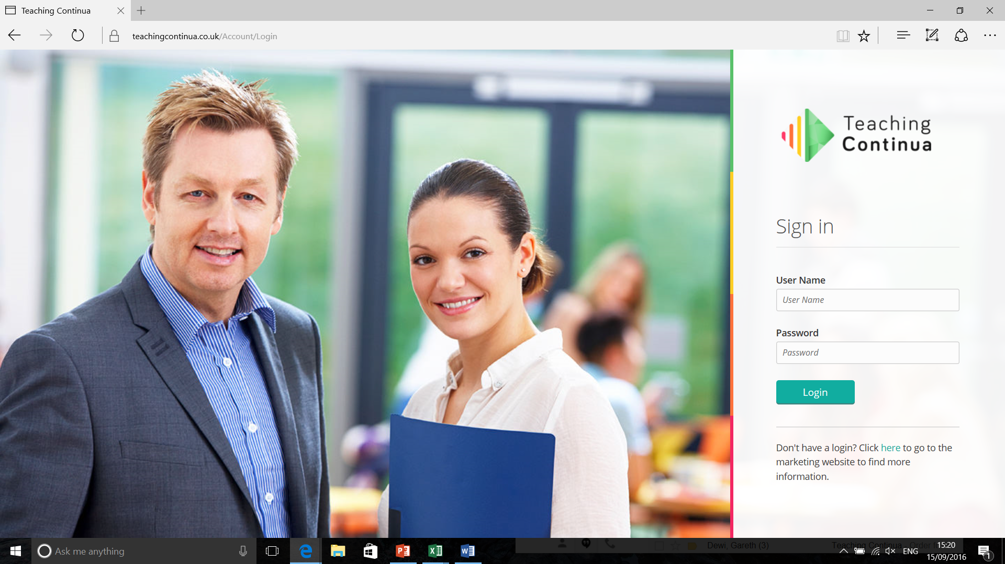
Everyone has a unique User Name and Password

Slide 10
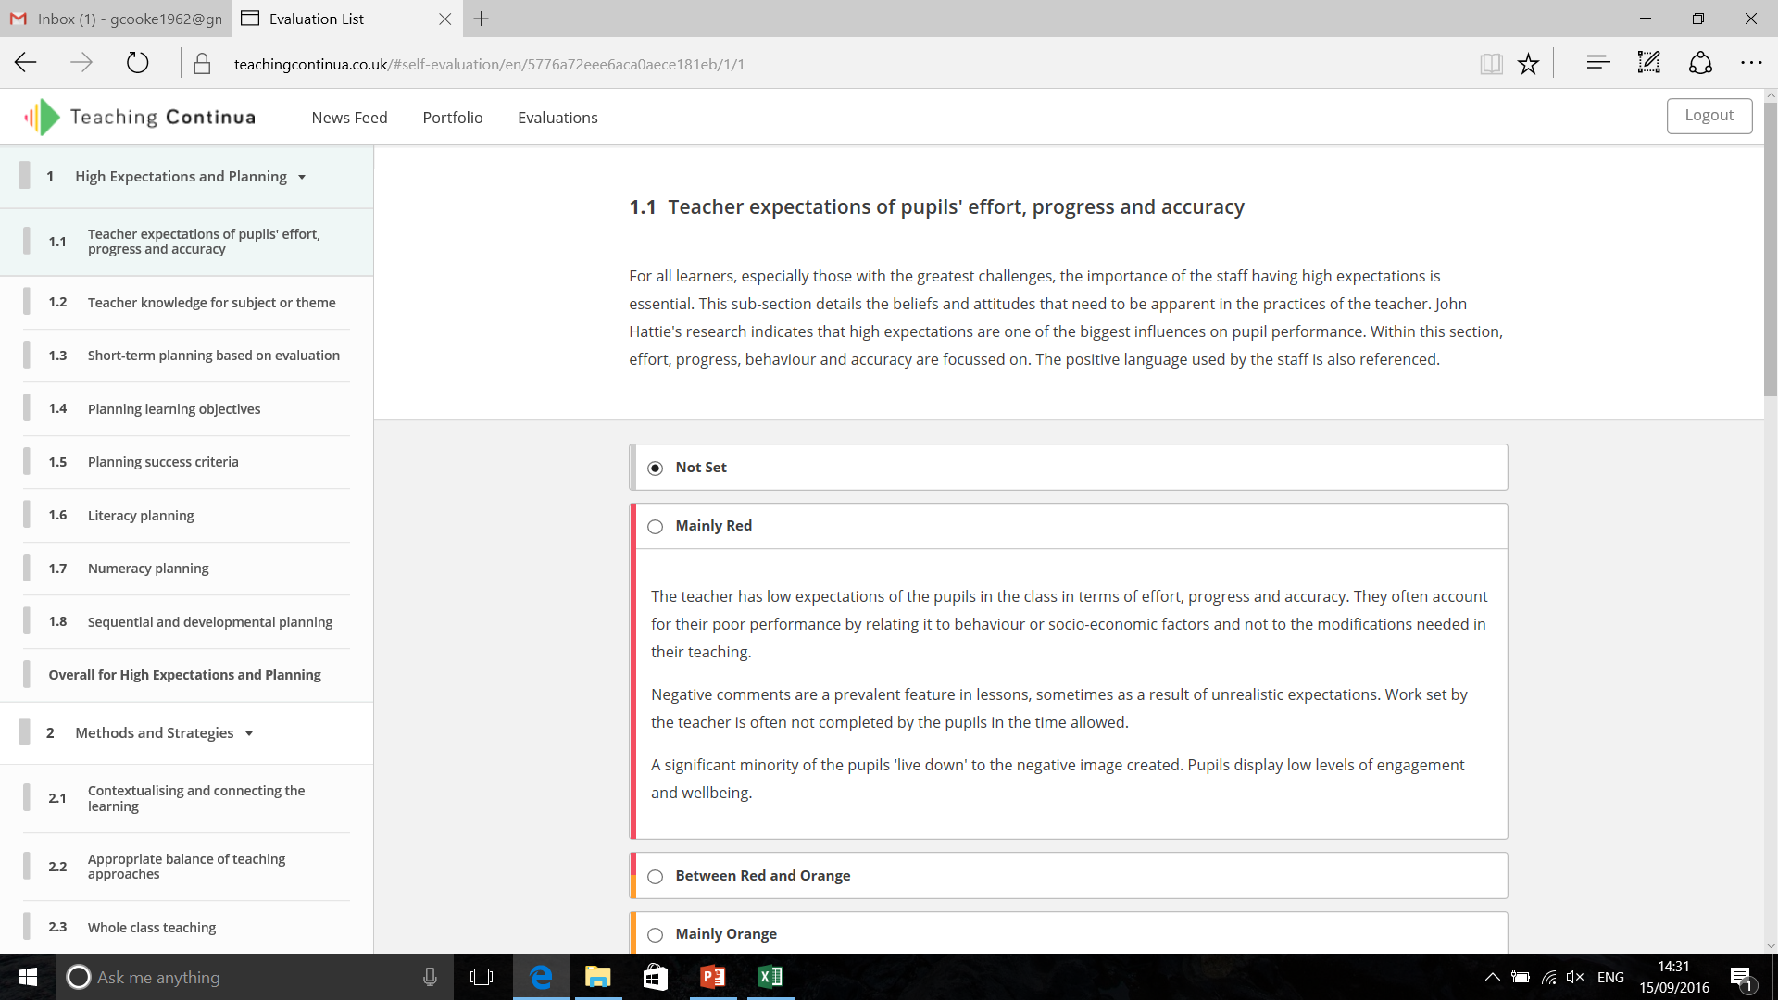
Phase 1: Self-evaluation
All teachers complete their online self-evaluation
©Teaching Continua Ltd.

Slide 11
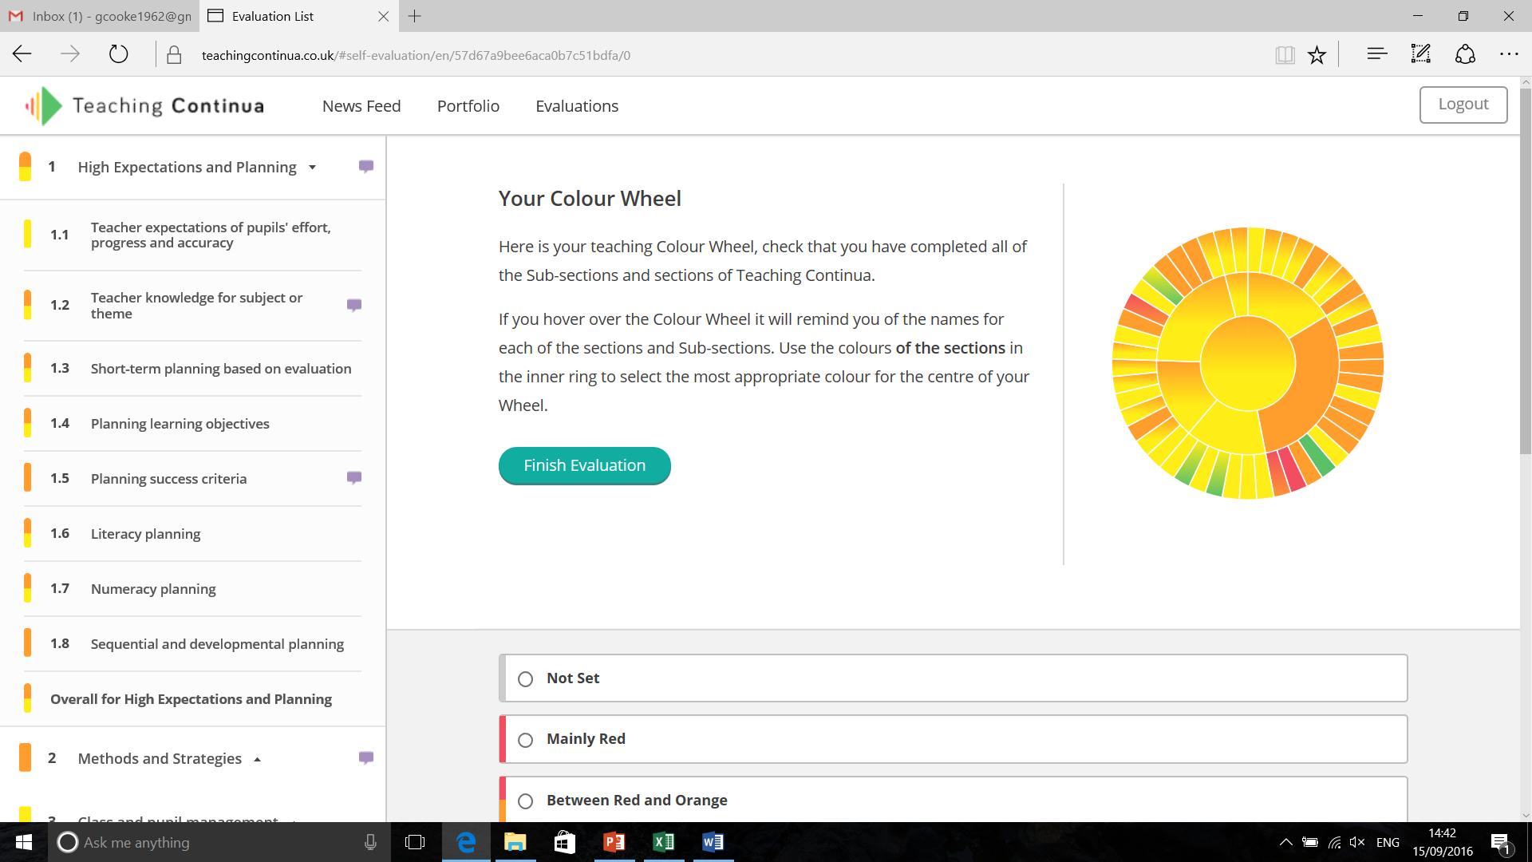
Phase 1: Self-evaluation
This completes a fully interactive Colour Wheel Profile
©Teaching Continua Ltd.

Slide 12
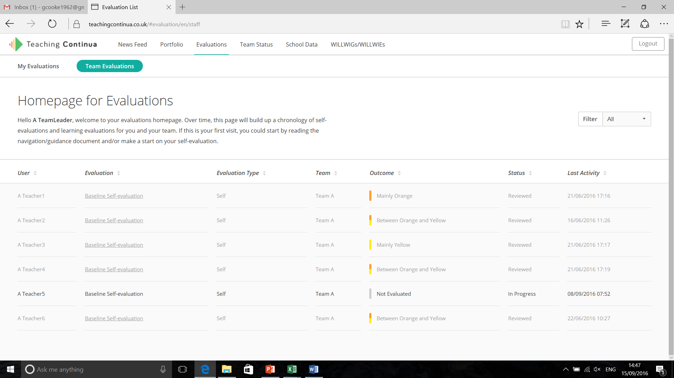
Phase 1: Self-evaluation
Team Leaders can track the progress of their teams in completing their self-evaluations.
©Teaching Continua Ltd.

Slide 13
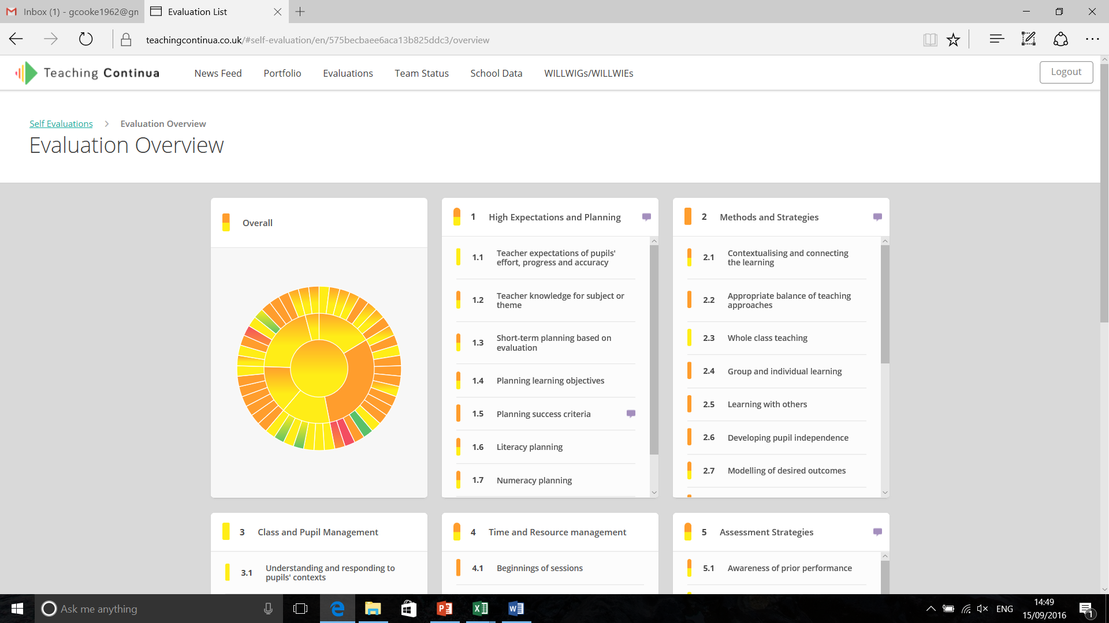
Phase 1: Self-evaluation
Team Leaders hold a meeting with each teacher before confirming the teachers self-evaluation.
©Teaching Continua Ltd.

Slide 14
Teaching Continua process
Phase 1: Self-evaluation
Teachers: Complete their online self-evaluation
Team Leaders: Hold a ‘Confirm, Clarify, Challenge meeting.
Phase 2: Establishing clarity
SLT or Team Leaders: Select the Areas of Focus using Team Status.
Team Leaders: Hold team meeting to agree success criteria.
Phase 3: Rehearsing
Teachers: Build a portfolio of evidence for each of the sub-sections of Teaching Continua and choose to share via the News Feed
Team Leaders: Use News Feed as part of team meetings.
Phase 4: Reviewing Progress
Teachers: Indicate online if their colours have improved.
Team Leaders: Carry out a focused learning evaluation and hold a Feed-Forward meeting.
Start again at Phase 1 or 2

Slide 15
Teaching Continua process
Phase 1: Self-evaluation
Teachers: Complete their online self-evaluation
Team Leaders: Hold a ‘Confirm, Clarify, Challenge meeting.
Phase 2: Establishing clarity
SLT or Team Leaders: Select the Areas of Focus using Team Status.
Team Leaders: Hold team meeting to agree success criteria.
Phase 3: Rehearsing
Teachers: Build a portfolio of evidence for each of the sub-sections of Teaching Continua and choose to share via the News Feed
Team Leaders: Use News Feed as part of team meetings.
Phase 4: Reviewing Progress
Teachers: Indicate online if their colours have improved.
Team Leaders: Carry out a focused learning evaluation and hold a Feed-Forward meeting.
Start again at Phase 1 or 2

Slide 16
Phase 2: Establishing clarity
Areas of Focus: When all the self-evaluations have been confirmed the school and/or team selects the sub-sections to focus on.
WILLWIGs and WILLWIEs: Team meetings takes place where teachers together agree the specific success criteria and monitoring evidences for each of the agreed sub-sections:
Following the meeting Team Leaders can…………….

Slide 17
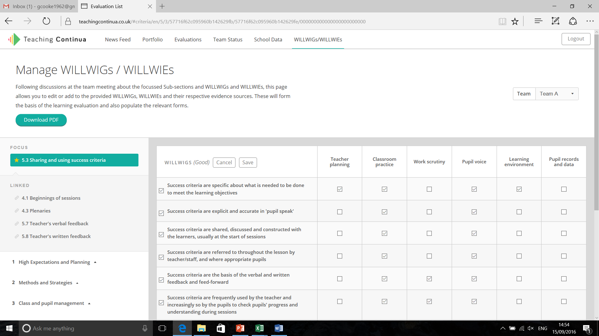
Phase 2: Establishing Clarity
Team Leaders can edit the success criteria to bespoke it for their team/school.
©Teaching Continua Ltd.

Slide 18
Teaching Continua process
Phase 1: Self-evaluation
Teachers: Complete their online self-evaluation
Team Leaders: Hold a ‘Confirm, Clarify, Challenge meeting.
Phase 2: Establishing clarity
SLT or Team Leaders: Select the Areas of Focus using Team Status.
Team Leaders: Hold team meeting to agree success criteria.
Phase 3: Rehearsing
Teachers: Build a portfolio of evidence for each of the sub-sections of Teaching Continua and choose to share via the News Feed
Team Leaders: Use News Feed as part of team meetings.
Phase 4: Reviewing Progress
Teachers: Indicate online if their colours have improved.
Team Leaders: Carry out a focused learning evaluation and hold a Feed-Forward meeting.
Start again at Phase 1 or 2

Slide 19
Teaching Continua process
Phase 1: Self-evaluation
Teachers: Complete their online self-evaluation
Team Leaders: Hold a ‘Confirm, Clarify, Challenge meeting.
Phase 2: Establishing clarity
SLT or Team Leaders: Select the Areas of Focus using Team Status.
Team Leaders: Hold team meeting to agree success criteria.
Phase 3: Rehearsing
Teachers: Build a portfolio of evidence for each of the sub-sections of Teaching Continua and choose to share via the News Feed
Team Leaders: Use News Feed as part of team meetings.
Phase 4: Reviewing Progress
Teachers: Indicate online if their colours have improved.
Team Leaders: Carry out a focused learning evaluation and hold a Feed-Forward meeting.
Start again at Phase 1 or 2

Slide 20
Phase 3: Rehearsing
Teachers have the opportunity to:
Rehearse the sub-section in focus.
‘Show and tell’ staff meetings may be used to disseminate good practices.
‘Clinics’ could be provided for staff who want additional support.
Teachers can upload evidence to their Portfolio and the News Feed.

Slide 21
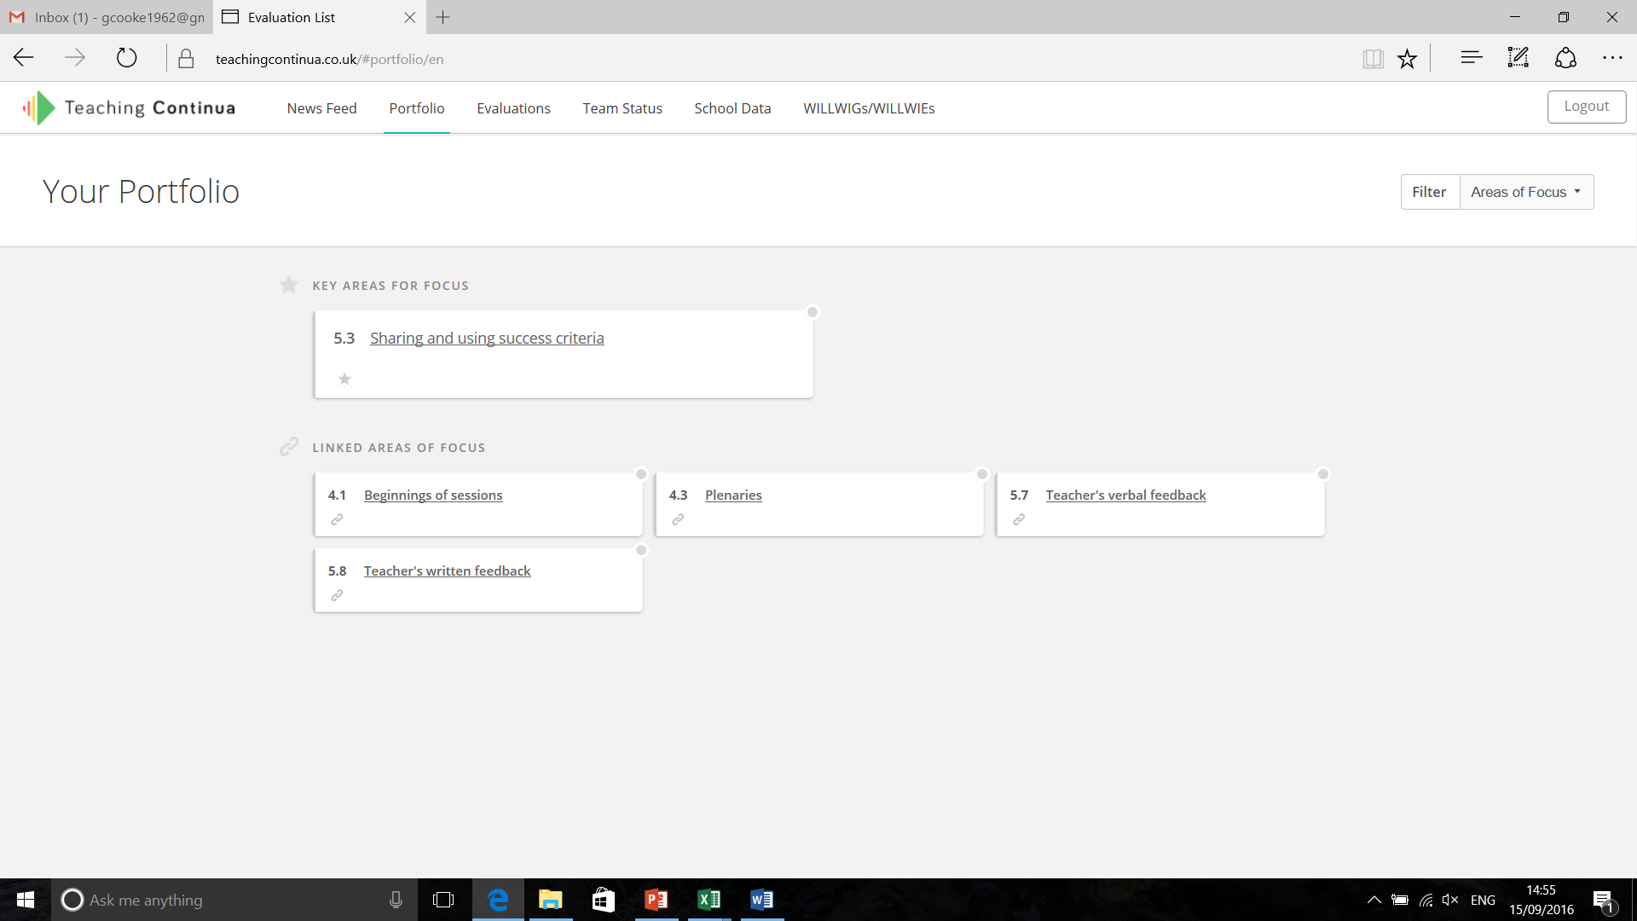
Phase 3: Rehearsing
Portfolio: All teachers can upload evidence to Key Areas of Focus and Linked Areas or………………………
©Teaching Continua Ltd.

Slide 22
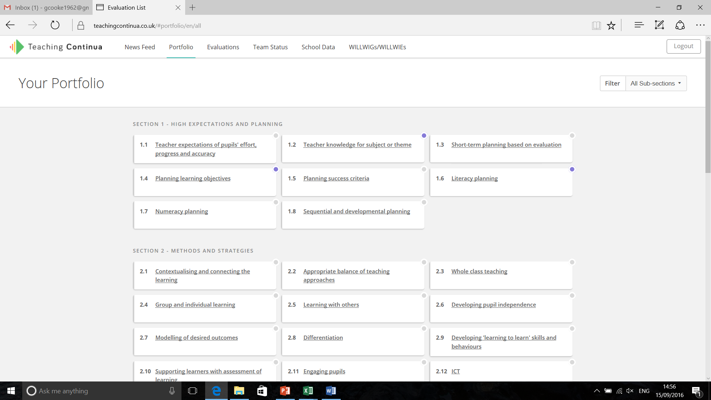
Phase 3: Rehearsing
Portfolio: Teachers can upload evidence to any sub-section of Teaching Continua.
©Teaching Continua Ltd.

Slide 23
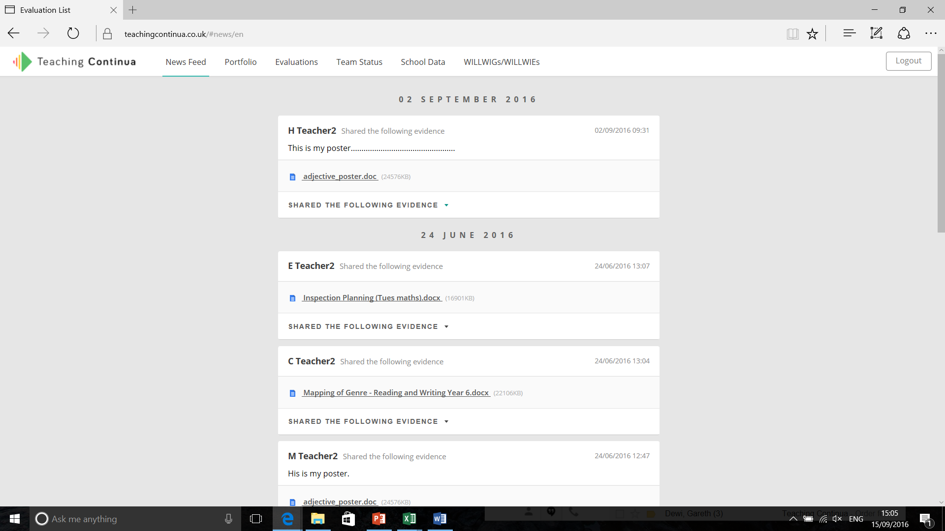
Phase 3: Rehearsing
Evidence can be shared using the school News Feed.
©Teaching Continua Ltd.

Slide 24
Teaching Continua process
Phase 1: Self-evaluation
Teachers: Complete their online self-evaluation
Team Leaders: Hold a ‘Confirm, Clarify, Challenge meeting.
Phase 2: Establishing clarity
SLT or Team Leaders: Select the Areas of Focus using Team Status.
Team Leaders: Hold team meeting to agree success criteria.
Phase 3: Rehearsing
Teachers: Build a portfolio of evidence for each of the sub-sections of Teaching Continua and choose to share via the News Feed
Team Leaders: Use News Feed as part of team meetings.
Phase 4: Reviewing Progress
Teachers: Indicate online if their colours have improved.
Team Leaders: Carry out a focused learning evaluation and hold a Feed-Forward meeting.
Start again at Phase 1 or 2

Slide 25
Teaching Continua process
Phase 1: Self-evaluation
Teachers: Complete their online self-evaluation
Team Leaders: Hold a ‘Confirm, Clarify, Challenge meeting.
Phase 2: Establishing clarity
SLT or Team Leaders: Select the Areas of Focus using Team Status.
Team Leaders: Hold team meeting to agree success criteria.
Phase 3: Rehearsing
Teachers: Build a portfolio of evidence for each of the sub-sections of Teaching Continua and choose to share via the News Feed
Team Leaders: Use News Feed as part of team meetings.
Phase 4: Reviewing Progress
Teachers: Indicate online if their colours have improved.
Team Leaders: Carry out a focused learning evaluation and hold a Feed-Forward meeting.
Start again at Phase 1 or 2

Slide 26
Phase 4: ‘Reviewing Progress’
At an agreed time after the launch:
The teacher provides their own evaluation of progress against the focused sub-sections.
Then there is a focussed learning evaluation that gathers evidence from the agreed sources.
There is a Feed Forward Meeting between the Team Leader and teacher to confirm progress against the focused sub-sections.
(Progress in Linked areas of focus is also captured)

Slide 27
Teaching Continua process
Phase 1: Self-evaluation
Phase 2: Establishing clarity
Phase 3: Rehearsing
Phase 4: Reviewing Progress:
Feed-Forward meeting
Start again

Slide 28
ASK me about Michael Fullen…
Future learning evaluations will then focuses on both areas (previous and current).
Because…
“ Change is not hard, stopping changing back is!”
Michael Fullen

Slide 29
Any Questions?

Slide 30
So what happened?
3 Special schools and 2 PRUS in RCT
2 Special schools in Bridgend
1 Special school in the Vale of Glamorgan
1 Special School in Merthyr
4 Special schools and 1 PRU in Cardiff

Slide 31
1.6 Planning for literacy
1 school
2.5 Working together
2 schools
4.6 Scaffolding for learning
1 school

Slide 32
5.3 Sharing and using success criteria
2 schools
2.8 Differentiation
2 schools
4.7 Management of support staff
1 School

Slide 33
5.7 Teacher and verbal feedback
1 school
2.13 Risk taking and the use of the outdoors
1 school
2.15 Billingualism
1 school

Slide 34
Interim Results
Due to the tight time-scales there was limited evidence of the impact of Teaching Continua on raising standards of Literacy across the region
However some key features have emerged
.

Slide 35
A significant number of schools embraced Teaching Continua and viewed its introduction positively
Strong foundations are in place in order to see more impact in the Summer term.

Slide 36
A number of schools recognised that they will see the fuller impact of Teaching Continua as a self –evaluation tool when teachers self assess in the Summer term 2017
Many saw the massive benefits of whole school data being generated for the improvement of teaching and learning from the teacher’s own self-assessment. A bottom up self-evaluation approach in comparison to the traditional to down model.

Slide 37
Many schools suggested teacher self-assessment 3 times a
year to fit into the existing school development cycle.
From the evidence provided by the schools some sections of
Teaching Continua needed refinement in order for it to be of
most benefit to the sector. e.g Home learning
Many schools involved in the project are categorised Green
or Yellow schools with recognised strong cultures of self-
evaluation.

Slide 38
A number of red and amber schools are willing to be involved in being part of the special school consortium project.
Many of these schools have challenging school agendas but saw the benefits of Teaching Continua in helping them improve the teaching and learning. In those schools the main focus for development was differentiation.
The emerging data on teaching and learning in Special schools links with the on-going moderation in Special schools, which has been well established over a number of years in South Wales

Slide 39
Autumn 2017 / Spring 18
A number of schools have continued to use Teacher Continua
Teacher Continua is being used to aid classroom observations
Teachers are using their self-assessment to aid performance management discussions.
Teacher Continua helps schools to establish a focus for peer to peer triad observations
Teacher Continua links to the new teacher standards and the New Estyn Common Inspection Framework
Using Teaching Continua to develop a AFL tool kit for Special schools and Specialist Units in the Central South Region

