Slide 1
Leoni Lewis
Enterprise & Innovation Group Project
ACDA5003

Slide 2
Table of contents
Introduction
The Team
Leoni Lewis
James Glanville
Bryn Sutton
Sol Whiteley
James Long
Team-working

Slide 3
Introduction
In this presentation I am going to introduce my team, inform you on what each team member contributes to the team and the project. I am also going to provide you with an explanation on how the team intends to work together in order to reach our end goal.

Slide 4
The team
Working on this project together are 5 team members, when we started the project we found delegating the tasks to each member easy. This is because each member has a different talent, skill or quality which allows them to excel in their chosen section of the project.

Slide 5
"Individual commitment to a group effort--that is what makes a team work, a company work, a society work, a civilization work." --Vince Lombardi

Slide 6

Leoni Lewis
Natural team leader.
Organisational skills.
Communication skills.
Social media section.
Oversees project.
Notes:
Leoni is a natural team leader as her organisational skills allow her to ensure the team stays on track with the tasks they have been given. Leoni also finds that she is able to communicate effectively with the team to make sure they are provided with all the information she has, they know exactly what they need to be doing and if they have any queries she can answer them with her best knowledge. Leoni also excels with the social media side of the project, she is able to create social media sites and promotional content to go onto these. She has a good overview of the project and helps the team with anything they need.

Slide 7

James glanville
Hands on approach.
Developing prototypes, logos and slogans.
Design, development and implementation.
Front and back end.
Communication skills.
Feedback.
Notes:
James takes a hands on approach to the project and likes to be developing the prototypes, logos and slogans. James is brilliant when it comes to designing, developing and implementing both front end and back end functionality within the website, app and promotional material. James is also good at communicating with the team in order to ensure everybody is happy with his designs, if not he will always take their comments on board.

Slide 8

Bryn Sutton
Business head.
Research skills.
Collaboration with other team members.
Notes:
Bryn excels in the business side of the project, he is able to research any legal and ethical considerations, what would be needed in order for the business to run (employees, facilities and resourses) and also is able to collaborate with other team members to ensure they are progressing.

Slide 9

Sol whiteley
Research skills.
Communication and feedback.
Report writing.
Allows other members to use this research.
Notes:
Sol has strong research skills which benefits the team by having his ability to research the market for competitors, statistics, pricing and idea feedback. Sol is also able to combine these findings and create excellent reports which the whole team can follow allowing them to use this research within their section of the project.

Slide 10

James Long
Well informed on what it takes to set up a business.
Knowledge in web design.
An eye for modern and smooth looking design techniques.
Communication skills.
Notes:
James has a great understanding of both business and computing, this allows him to inform the team on what the business would need in order to be set up, how much this would cost and where this money could come from. James has also got knowledge within web design which allows him to collaborate with other team members when designing the project webpage.

Slide 11
"Teamwork is the ability to work together toward a common vision. The ability to direct individual accomplishments toward organizational objectives. It is the fuel that allows common people to attain uncommon results." --Andrew Carnegie

Slide 12
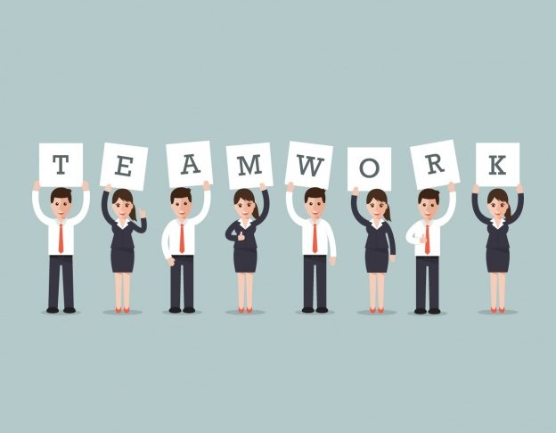
Team-working
Meeting: Once a week – Thursdays.
Group chat
Trello Account
[1],[2]
Notes:
The team is intending on meeting once a week on a Thursday morning in order to discuss the tasks they have worked on/completed, what they intend to do next and any other tasks that need to be worked on. The team has also set up a group chat which allows them to communicate about the project easily, this allows the team to keep up to date on any information other members may have without having to wait a week to see each other again. A Trello account for the project has been created, on here team members can see visually what each team member has done and what needs to be done.
https://www.pmi.org/learning/library/team-building-working-together-development-7817
http://2020projectmanagement.com/resources/communication-management/5-simple-steps-to-project-team-success

Slide 13
references
https://www.pmi.org/learning/library/team-building-working-together-development-7817 [1]
http://2020projectmanagement.com/resources/communication-management/5-simple-steps-to-project-team-success [2]

