Slide 1

Session 9
Marketing live performances

Slide 2
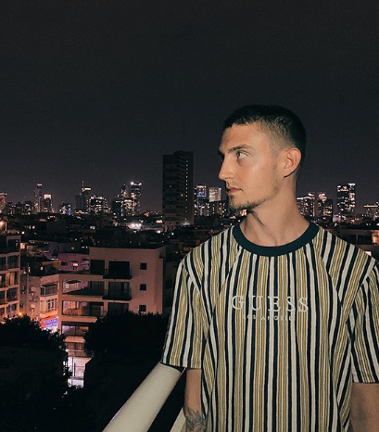
INTRODUCTION
AUSTIN TOBIAS
Senior Assistant, WME

Slide 3
LEARNING OUTCOME
Analyse and discuss the principles of marketing as applied to the live music industry, incorporating headline show and festival events.

Slide 4

TOPICS
Topics
WME Overview
Role of an Agent
Routing a Tour
Mission, Artist Participation, Key Messages
Demographics
The Marketing Plan
In Practice / Q&A

Slide 5
WME HISTORY & OVERVIEW

Slide 6
WME HISTORY AND OVERVIEW
WILLIAM MORRIS AGENCY
In 1898, William Morris went into business as William Morris, Vaudeville Agent.
The William Morris Agency held the record of being the longest-running entertainment talent agency, spanning 120 years. It represented some of the most well-known entertainers of the 20th century across mediums like television, music, and film.
In April 2009, WMA merged with the Endeavor Agency to form William Morris Endeavor. In 2014 WME acquired IMG to become WME | IMG. In 2017 WME | IMG and all assets were moved under the Endeavor Company umbrella.

Slide 7
WME HISTORY AND OVERVIEW
HISTORY
By 1965, WMA's Music Department had emerged as an industry powerhouse, representing, among others, the Rolling Stones, Sonny & Cher, the Beach Boys, and the Byrds.
In 1973, the Agency's newly established Nashville office provided another significant boost to the operations of William Morris, extending the Agency's reach into country music and beyond.
In 1989, WMA acquired the Jim Halsey Company, adding performers such as Waylon Jennings, The Oak Ridge Boys, and Tammy Wynette.
In 1992, the agency acquired Triad Artists, marking the largest acquisition of a talent agency in show business history. Some fifty Triad agents joined WMA's corps of talent and literary agents worldwide.
WMA’s London office opened in 2007.

Slide 8
WME HISTORY AND OVERVIEW
HISTORY (CONT.)
WME acquired IMG in 2014.
WME | IMG acquired Artist Voice located in Sydney, Australia in 2015.
The holding company for WME | IMG and all assets was created to be known as the Endeavor Company in 2017.
-
Endeavor was started by Ari Emanuel, Rick Rosen, Tom Strickler, and David Greenblatt who were TV agents at ICM Agency.
In early 1995, they formed a plan to start their own agency.
The agency began operations on March 30, 1995 working mainly with television clients.

Slide 9
WME HISTORY AND OVERVIEW
HISTORY (CONT.)
On April 27, 2009, WMA and the Endeavor Talent Agency announced that they were forming William Morris Endeavor, or WME.
Endeavor executives Ari Emanuel and Patrick Whitesell became the Co-CEOs of the newly formed agency.
WME | IMG and all assets were moved under the newly created holding company,
known as the Endeavor Company, in 2017
Ari Emanuel became the sole CEO with Patrick Whitesell becoming Executive Chairman.

Slide 10
WME HISTORY AND OVERVIEW
RECENT DEVELOPMENTS
WME | IMG acquired The Wall Group in 2015.
WME | IMG acquired the Professional Bull Riders, INC. (PBR) in 2015.
WME | IMG acquired The Miss Universe Organization in 2015.
WME | IMG acquired MADE Fashion Week in 2015.
WME | IMG acquired UFC in 2016
WME | IMG partnered with SNTV to launch Brand Solutions division in 2016.
WME | IMG partnered with Frieze in 2016.
WME | IMG expand into China in 2016 & partners with Perfect World and Village Roadshow to launch Perfect Village Entertainment in 2017.

Slide 11
ROLE OF AN AGENT

Slide 12
ROLE OF AN AGENT
Route Tours
Solicit Offers
Mediator between Artist and Public for Personal Appearances
Career Crossover/Development
Always act in the artist’s best interest while managing expectations

Slide 13
ROUTING A TOUR

Slide 14
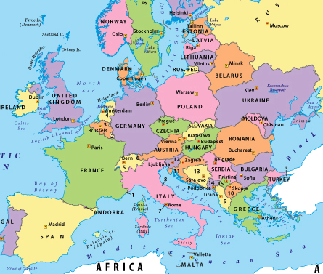
ROUTING A TOUR
RELEASE SCHEDULE (IF APPLICABLE)
TOUR PERIOD(S)
MARKETS
SCALE
PRODUCTION
VENUE SPECIFICATIONS
STEP 1
PLANNING

Slide 15
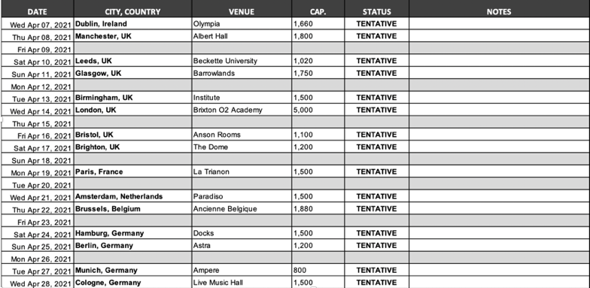
ROUTING A TOUR
DRAFT ROUTING

Slide 16
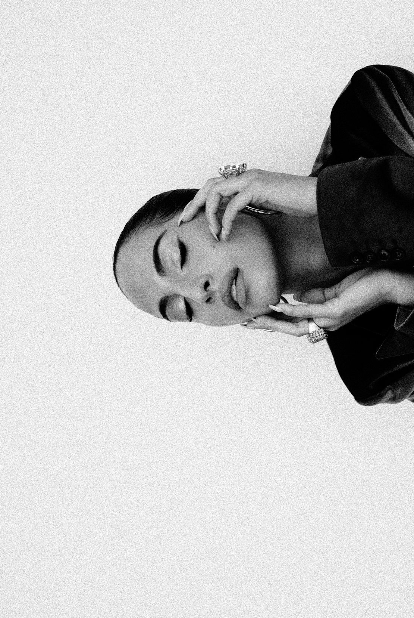
ROUTING A TOUR
TICKET PRICE ANALYSIS
TOUR HISTORY
STREAMING DATA
RADIO AIRPLAY
SOCIALS (ENGAGEMENT AND REACH)
PHYSICAL SALES
STEP 2
RESEARCH

Slide 17
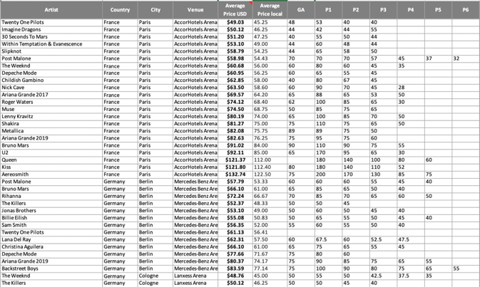
ROUTING A TOUR
TICKET PRICE ANALYSIS

Slide 18
ROUTING A TOUR
SET TICKET PRICE(S)
SOLICIT OFFERS
COLLECT AVAILS
PLACE HOLDS
CHALLENGE DATES
STEP 3
BOOKING

Slide 19
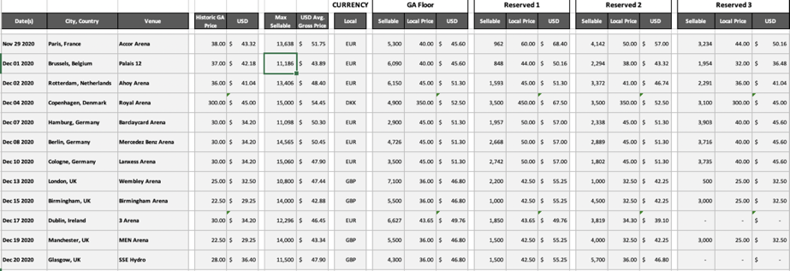
ROUTING A TOUR
TICKET SCALING

Slide 20
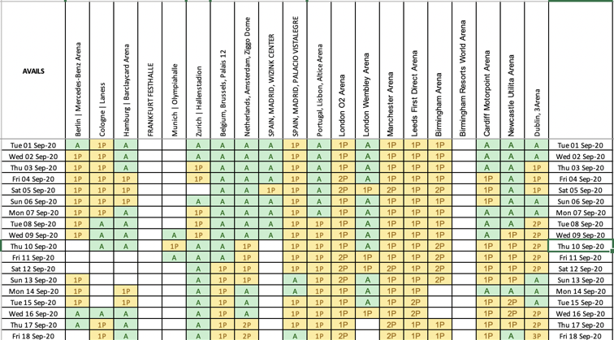
ROUTING A TOUR
AVAILS

Slide 21
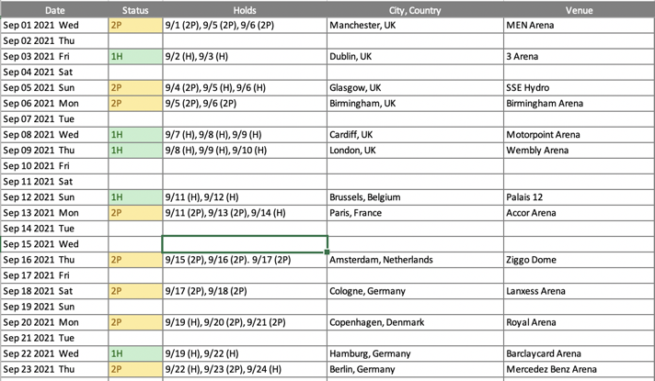
ROUTING A TOUR
HOLDS

Slide 22
ROUTING A TOUR
Use a map
Figure out the most efficient route based on the available dates at each venue
Allow sufficient time between shows for the tour to load-out, travel and load-in the following day (typically max 8 hour drive time or 500 miles)
Allow days off for the artist(s) to rest between shows. This should be pre-agreed with artist management.
ROUTING BASICS

Slide 23
ROUTING A TOUR
Tours can typically drive a MAXIMUM of 500 miles (or eight hours) in a single 24hr period. It’s advisable to keep distances between shows well under 500 miles unless planning a day off for travel.
When routing tours, always consider the schedules of any required ferry and/or train crossings (i.e. Eurotunnel or Irish Sea Ferry)
Some countries (i.e. Switzerland) charge carnet fees (vehicle permits) to transit through their territory. Consider this before routing the tour.
QUICK TIPS

Slide 24
MISSION, ARTIST PARTICIPATION, KEY MESSAGES

Slide 25
MISSION, ARTIST PARTICIPATION, KEY MESSAGES
MISSION
The festival is now a firm staple in the London festival calendar, in one of London’s favourite green spaces. Bringing several days of alternative and eclectic music and several days of free community activities and entertainment, this festival s a celebration of our East London home.
The Artist is one of the most important names in British culture and we are thrilled to welcome them to our event. We share a passion for reducing the environmental impact from live music and we are excited to work together at our event.

Slide 26
MISSION, ARTIST PARTICIPATION, KEY MESSAGES
BAND PARTICIPATION
In order to maximise our marketing campaign, reach hard-core fans and ensure a successful show, Artist participation is crucial. From social media support, collaboration on creative assets to press opportunities, we need the band to engage their audiences and maximise their platforms to promote the event and achieve maximum cut-through with our marketing efforts. To achieve this, the Artist also needs to thoroughly connect with the core event messages which underline our marketing strategy and their event at the festival:
SUSTAINABILITY UNIQUENESS OF EVENT

Slide 27
MISSION, ARTIST PARTICIPATION, KEY MESSAGES
KEY MESSAGES
SUSTAINABILITY The Artist and the event share a mutual interest and drive to reduce the environmental impact of the live music industry. As an industry-leading event for sustainability practices, there is enormous scope for the festival and the band to join forces and amplify this crucial topic for discussion and development. We propose underlining our marketing and comms strategy with this message ahead of the show.
UNIQUENESS OF EVENT This is a UK exclusive, featuring a unique line up that will not be repeated in any other event in the country or the world. The band prides itself on their phenomenal stage performances and production and the festival will be no different. We require the Artist to celebrate and communicate this unique event to their fans.

Slide 28
DEMOGRAPHICS

Slide 29
DEMOGRAPHICS
45:54
FEMALE : MALE
Fairly balanced with a slight skew to male fans
35-55
MILLENNIAL/GEN X
Largest fan group with additional audiences in the early Millennial and early Baby Boomer age groups
AUDIENCES
IN NUMBERS
3.2m
FEMALE : MALE
Sports a strong following with Facebook being their strongest channel
2.6m
SPOTIFY MONTHLY LISTENERS
1.3m Spotify followers
2.6m listeners tuning in each month

Slide 30
DEMOGRAPHICS
ALSO FANS OF:
Radiohead
Portishead
Bjork
Sigur Ros
Morcheeba
Young Fathers
Air
PJ Harvey
CITY FOCUS:
London
Bristol
Brighton
The Artists fans like credible, intelligent and alternative music that spans multiple genres
They’re liberal with strong social values with a deep concern for climate change
They’re readers and consume a mix of traditional and new age media
AUDIENCES
THE FANS

Slide 31
DEMOGRAPHICS
AUDIENCES
TARGET GROUPS
01 MILLENNIAL GEN X SUPER FANS
02 LONDON MUSO COMMUNITY
03 BRISTOL FANS AND SUPERFANS
On launch we will target three primary audience groups with a combination of carefully planned marketing tools and campaigns, in key locations to efficiently target each sector in the most relevant and appropriate way...

Slide 32
THE MARKETING PLAN

Slide 33
THE MARKETING PLAN
MARKETING
TIMELINE
Announcement 10am, Tuesday 28 January
AMEX Presale 10am, Tuesday 28 January
Artist Presale 10am, Thursday 30 January
AXS Presale 10am, Thursday 30 January
General On Sale 10am, Friday 31 January
Phase 2 Begins 10am, Tuesday 3 March

Slide 34
THE MARKETING PLAN
MARKETING PLAN
OVERVIEW
For launch and on sale, our marketing plan will focus on our three target audiences with prioritisation around our Generation X Fans.
PRINT AND PRESS On launch, our press team will drive overage in Generation X and Muso Millennial publications with an added print campaign during the on sale.
OUTDOOR On sale and Pay Day week will mark the start of our outdoor campaign to maximise awareness and reach for the show. Hitting key London hotspots with high footfall from our target audiences, plus a second campaign in Bristol.
DIGITAL A multi-channel campaign will lead launch week. For the on sale we will shift spend to the high reach and high conversion channels and formats. Facebook will lead the campaign as it’s the strongest channel for the artist’s fans.

Slide 35
THE MARKETING PLAN
MARKETING PLAN
OUTDOOR - ON SALE
LIVE FROM 31 JAN
For the on sale we will run a wide outdoor campaign around East London and Bristol with a combination of solo Artist artwork and multi-date artwork for the festival - Running from 31st Jan
LONDON - Dedicated ‘Artist’
Hackney Road, Hackney Graham Road, Commercial Street, Kentish Town Forum, Clapton Tramstore
LONDON - Full festival event artwork with ‘Artist’
Mare Street, Clapton Road, North Road, Cambridge Heath Road, Old Street, Stoke Newington, Finsbury Park, Portobello Road, Atlantic Road, London Bridge, Newington Causeway

Slide 36
THE MARKETING PLAN
MARKETING PLAN
DIGITAL AND PRINT
LIVE FROM 31 JAN
PRINT -
Full page and half page ads across key Generation and Muso Millennial Publications
Crack Metro
Q Time Out
DIGITAL -
FACEBOOK
Promoted posts from Festival
KEY FOCUS: Dark Video Ads from Artist
INSTAGRAM
Promoted Grams from Festival Promoted Insta Stories from Festival Promoted Instagram Feed from Festival
TWITTER
Promoted Tweets from Festival Promoted Twitter cards from Festival
GOOGLE
Banners and KeyWord Search

Slide 37
THE MARKETING PLAN
MARKETING PLAN
PRESS
Our press team, Outside, will target the following publications for launch interviews, previews and additional interviews across the line up in the lead up to the show.. Once media partners are confirmed, Outside will also capitalise on these relationships to maximise coverage for the event from launch to the show date. Potential media partners.
ALL MEDIA TARGETS
Evening Standard Daily Mirror Dazed & Confused Mixmag
Metro The Sun Loud & Quiet DJ Mag
Independant Time Out Resident Advisor Gigwise
The Times Press Clash Data Transmission
Daily Telegraph Association The 405 XLR8R
Bristol in Stereo BBC NME Crack

Slide 38
THE MARKETING PLAN
MARKETING PLAN
SELECT COVERAGE 28 JAN
PRINT AND ONLINE
CRACK
Time Out
Resident Advisor
Q
NME
Hackney Gazette
Radio X
The Quietus
Evening Standard Online
The Sun Online
DIY
DORK
Clash
BROADCAST
Entertainment News
Sky News Radio
LBC
Virgin Radio
Fubar Radio
Mikill Pane and Marcel
Somerville’s show

Slide 39
THE MARKETING PLAN
MARKETING PLAN
PHASE 2 - OVERVIEW
Our phase 2 campaign will capitalise on the addition of Artist ‘X’ to the show, reinforcing the Bank Holiday message and the quality and uniqueness of this stellar line up. Assets required:
PRESS SHOT - Approved press shot to circulate and use in assets VIDEO - Video footage from the Artist for digital promotion plus CREATIVE COLLABORATION - Artist to collaborate with festival on a creative asset to push the show
ARTWORK REFRESH - To achieve deeper cut through with fans SOCIAL SUPPORT - Additional social posts with new creative ADVERTISING ACCESS - Twitter and Instagram to run dark ads.
PRESS - Press opportunities will be presented to the Artist.
MEDIA PARTNERSHIP - Crack Digital Portal and physical insert
PRE-EVENT - Rough Trade pre-event instore.

Slide 40
THE MARKETING PLAN
MARKETING PLAN
CREATIVE AND CONTENT
For the next phase in the campaign, we would request the following assets to effectively boost and extend our marketing campaign from March.
ARTWORK We propose amending the artwork to increase Artist and use their official logo. This will create a better cut-through with fans and generate stronger awareness for the show.
ANIMATED ARTWORK Using the new admat, we will amend our animated versions for social campaigns.
VIDEO We invite the Artist to provide strong video assets for us to use across digital and press.

Slide 41
THE MARKETING PLAN
MARKETING PLAN
PHASE 2 - TIMELINE
TEASER
Band and festivals to push teasers out referencing Artist ‘X’.
ANNOUNCEMENT 10am, Monday 2 March
Press: Massive PR hit
Socials: Social announcement
Online: Advertising across key platforms using video/art for 2 weeks Outdoor: Projections to continue for one week
POST- ANNOUNCEMENT date tbc
Outdoor: 100 x 4 sheets to drop in key locations
Print: Hitting key publications with 1⁄2 page to full page ads

Slide 42
THE MARKETING PLAN
MARKETING PLAN
PHASE 2 - PRESS AND PRINT
PRESS Press team to engage key music publications and key radio stations with focus on the addition of Artist ‘X’ and emphasis on one of the best lineups of the year. Key editorial in our media partner, Time Out with a print ad included for maximum impact.
PRINT In line with our target audience, run print ads across key Gen X and Millennial Muso publications. This is dependent on the requested artwork changes. To run March onwards:
Evening Standard - 2nd March (full page)
Time Out - 3rd March (full page) Guardian Guide - 7th March
Observer - 8th March (25 x 4)
RADIO Radio trails and Live Reads Absolute- w/c 2nd March

Slide 43
THE MARKETING PLAN
MARKETING PLAN
PHASE 2 - DIGITAL OUTDOOR
DIGITAL Using new video assets and amended artwork, we will run a heavy digital campaign, weighted to YouTube, Facebook and Instagram and specifically targeting Artist’s & Artist ‘X’s fans. Facebook video dark ads - From Artist’s & Artist ‘X’s Instagram video dark ads
Instagram Story ads YouTube pre-roll YouTube bumpers
OUTDOOR Implement a TFL and second outdoor campaign with key focus on London. Add second Bristol campaign based on performance. Creative will be multi event artwork and solo Artist from March: Digital Outdoor - 7th March (D6 and D12)
TFL Underground - 16th March (4 sheets, 6 sheets, 12 sheets))

Slide 44
THE MARKETING PLAN
PHASE 2
QUESTIONS
● Sustainability: We need to firm up our plan to release a sustainability dossier as part of our event in conjunction with the band.
● Information: Can we announce the shows in terms of production/ set list
● Press Release: What assets are available? Messaging - quotes, sustainability
● Creative collaborative assets: Video, artwork, projection
● New material

Slide 45
THE MARKETING PLAN
PHASE 2
WISHLIST
Artwork Approval: Prompt approval to hit outdoor and print
Social Support: Phase 2 Announcement
Press Quote
Video material
Bespoke assets: Video/ artwork
Press time
Media partner collaboration: CRACK
Pre-event: Rough Trade Bristol

Slide 46
IN PRACTICE / Q&A
In Practice / Q&A
Austin Tobias
Senior Assistant, WME

