Slide 1
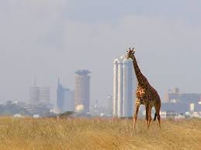
Sustainable Development in an Era of Globalisation? HPAN4008 Part 9
Worldwide Sustainability – Globalisation and/or Development?

Slide 2
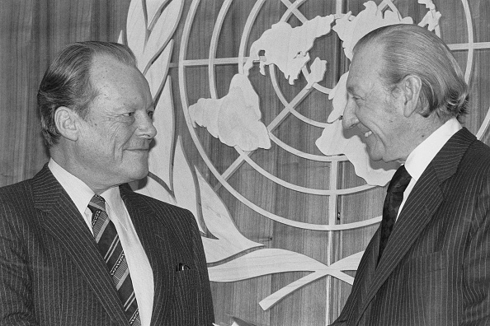
What is “Sustainability”?
From Brandt to Brundtland

Slide 3
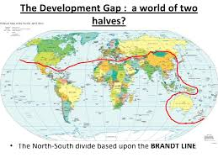
The Brandt Report 1980

Slide 4
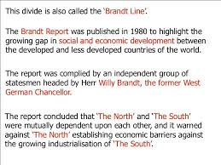
The “Brandt Line”

Slide 5
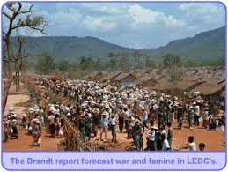
Brandt’s warning…

Slide 6
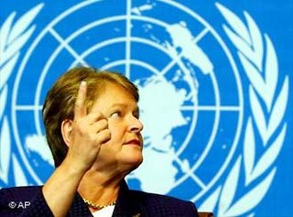
1983-1987: The Brundtland Report –
“Our Common Future”
Popularising the concept of sustainable development

Slide 7
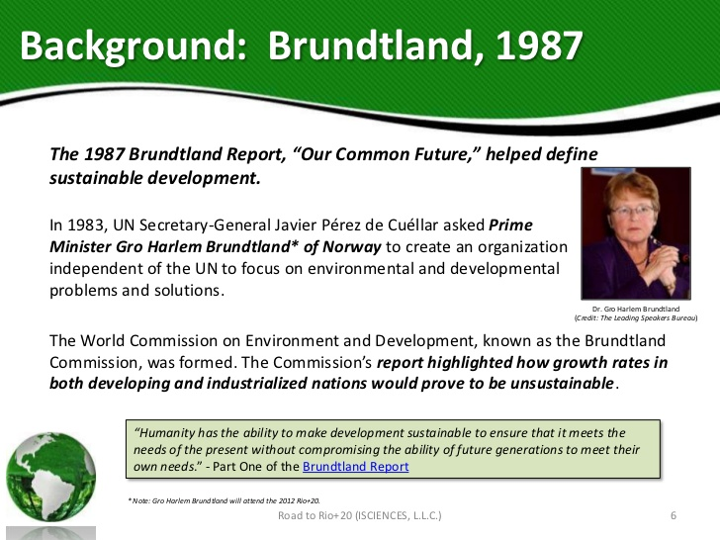

Slide 8
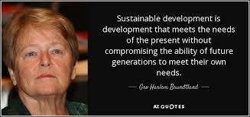
Sustainable Development defined

Slide 9
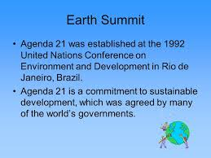

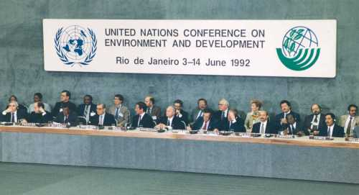
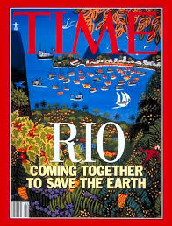
Rio 1992, the Earth Summit and Agenda 21 (and Kyoto Protocol 1997)

Slide 10
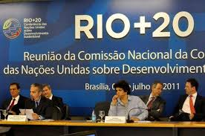
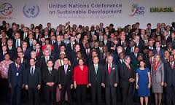


…and 20 years later, Rio+20
(and Paris Agreement, 2015)

Slide 11
So, what are the contemporary global challenges?
Population trends
Resources and output
Climate change: desertification, rising sea levels
Deforestation
Climate-driven mass migration
Peak oil
Carbon descent
Quality of life and Inequality: Gini and Robin Hood
Growth and development: or “transition”
Implications worldwide, not only in “Third World”
Active citizenship

Slide 12
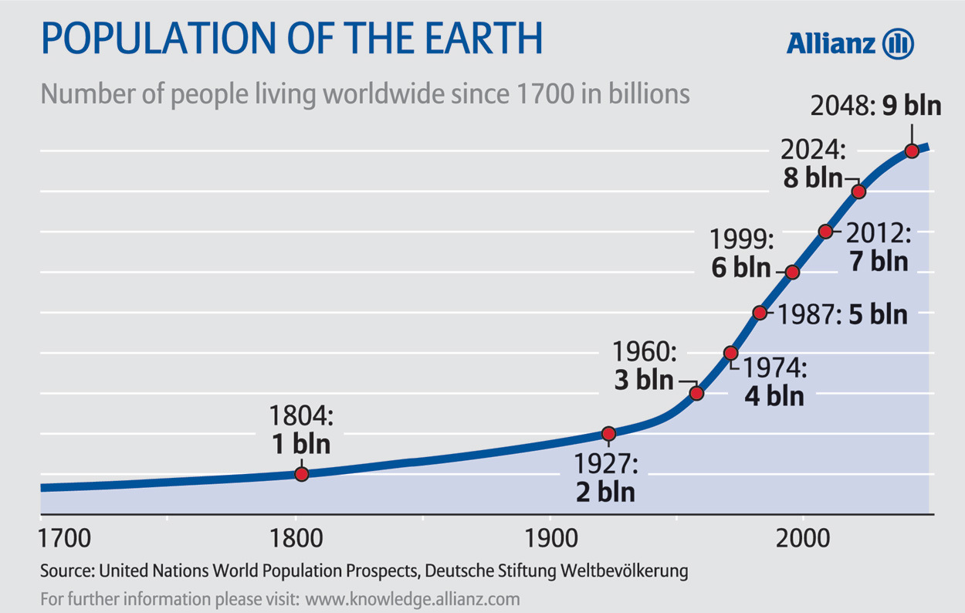
Population Growth

Slide 13
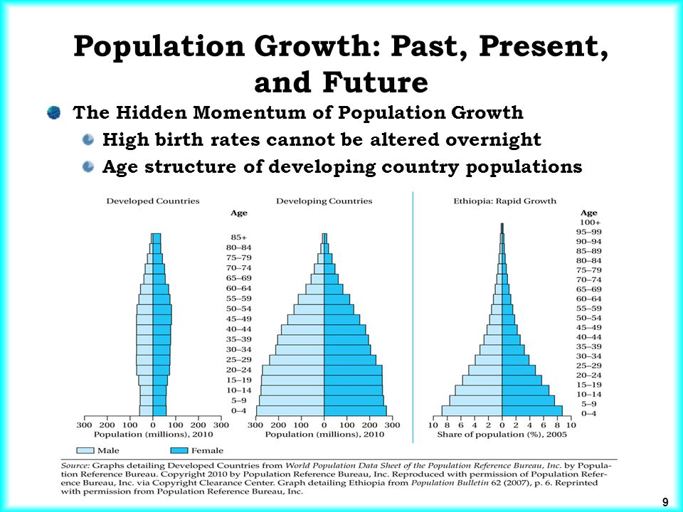
Population: Age structure variation

Slide 14
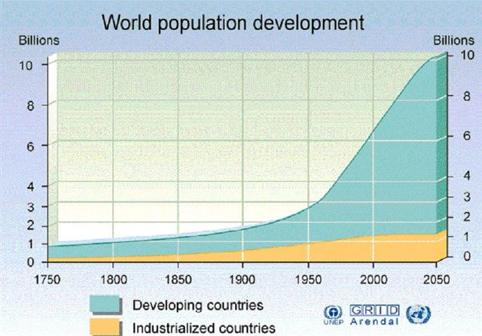
Variations in population growth trends

Slide 15
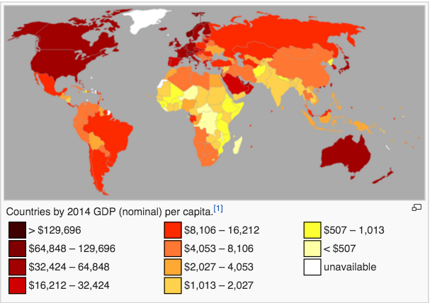
Use of Resources: Variations in World Output (GDP)

Slide 16
Gross world output (over the last 2000 years)
Source: Sachs, J.D., 2015. The Age of Sustainable Development. New York: Columbia UP

Slide 17
Gross world product per capita
Source: Sachs, J.D., 2015. The Age of Sustainable Development. New York: Columbia UP

Slide 18
Human population
(over the last 12,000 years)
Source: Sachs, J.D., 2015. The Age of Sustainable Development. New York: Columbia UP

Slide 19
Carbon dioxide emissions
Source: Sachs, J.D., 2015. The Age of Sustainable Development. New York: Columbia UP

Slide 20
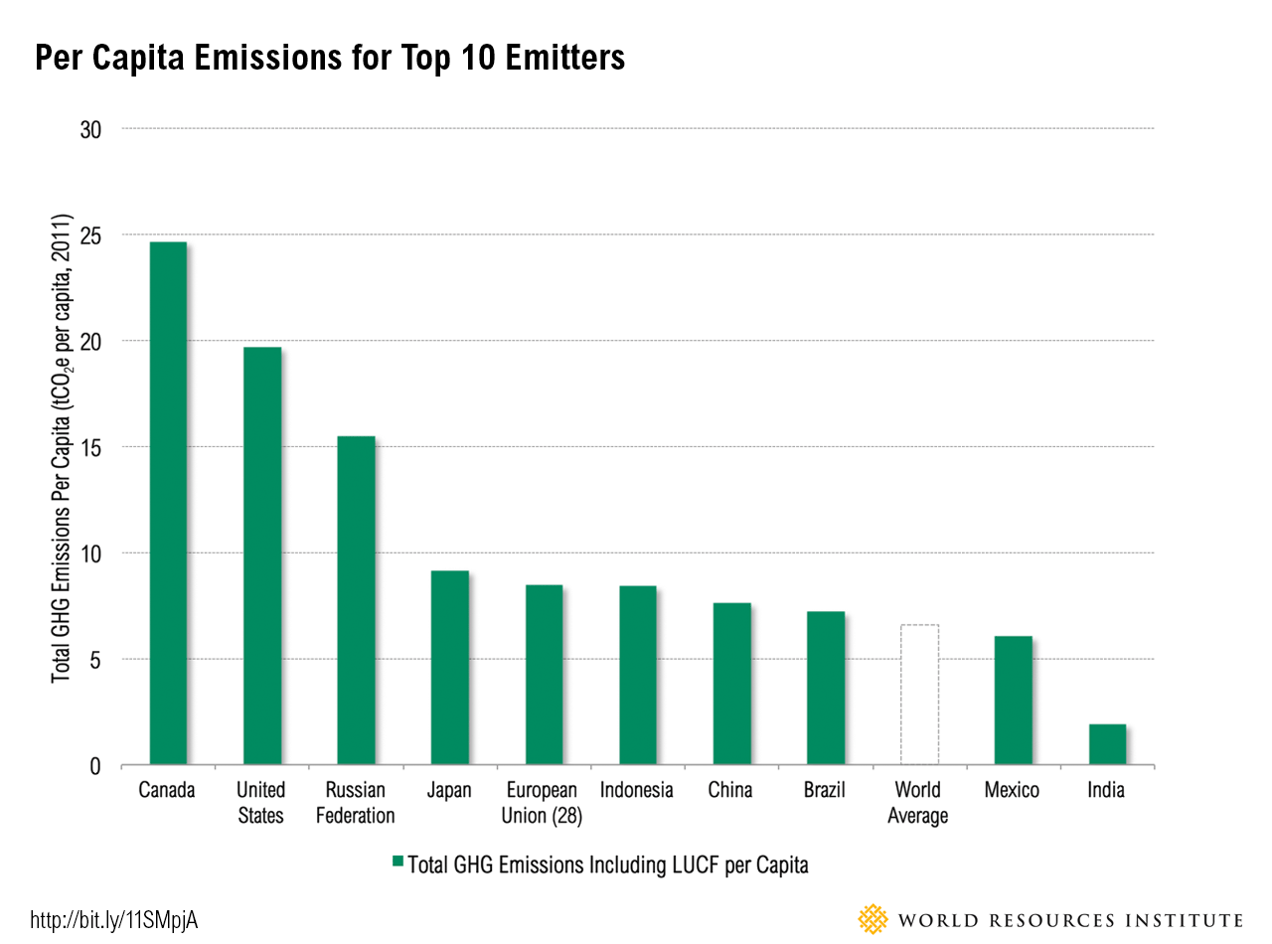
The top 10 Carbon emitters

Slide 21
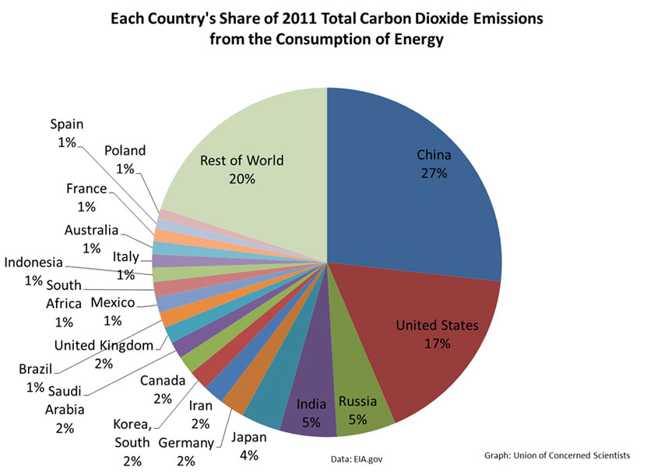
Carbon emissions by country

Slide 22
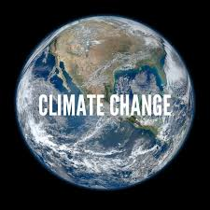
.
desertification
rising sea levels
deforestation
climate-driven mass migration

Slide 23
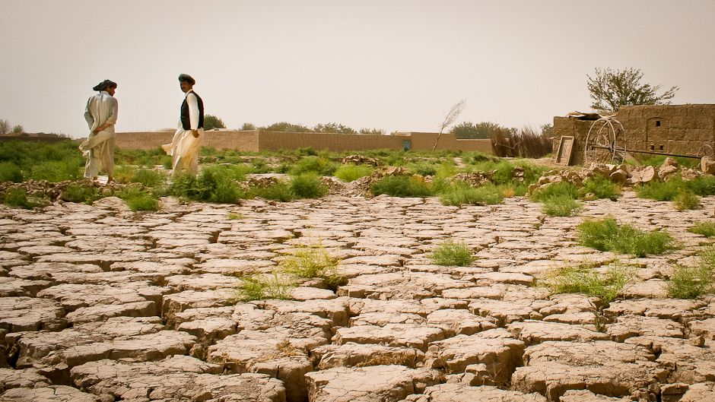
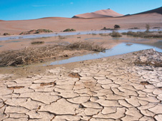
Desertification

Slide 24
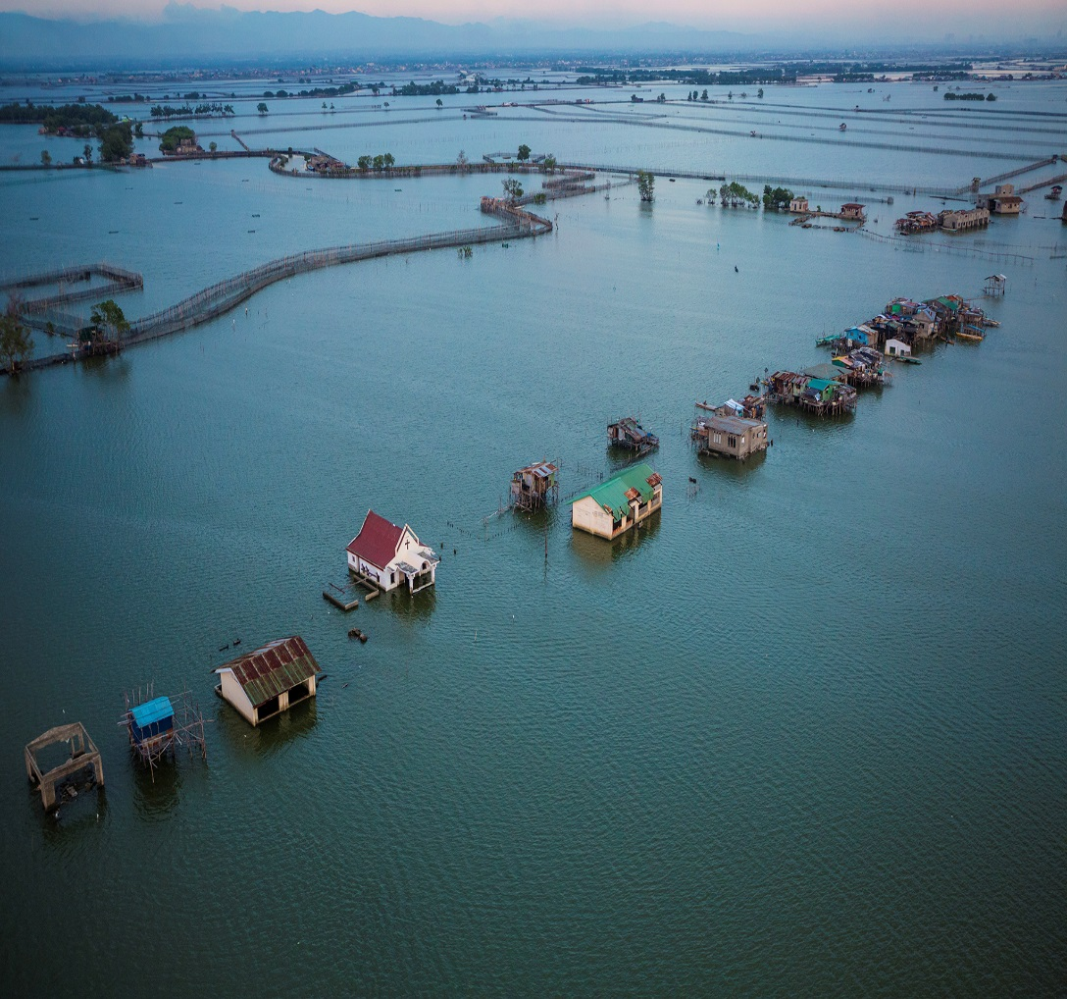
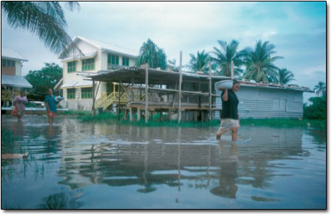
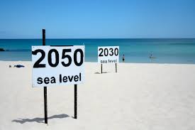
Rising sea levels

Slide 25
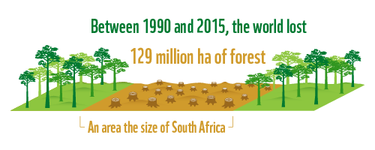
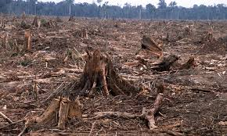
Deforestation

Slide 26
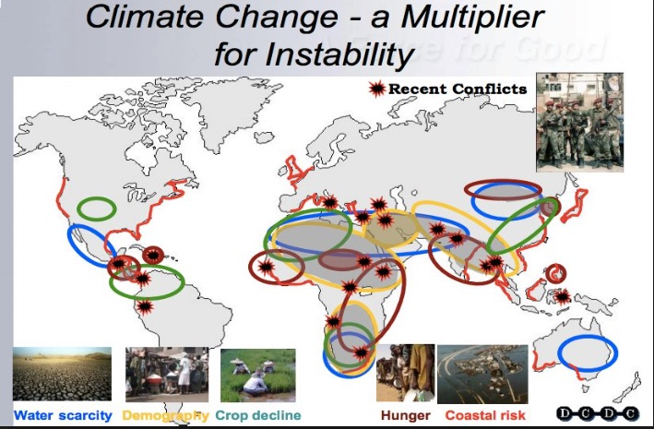
Mass Migration

Slide 27
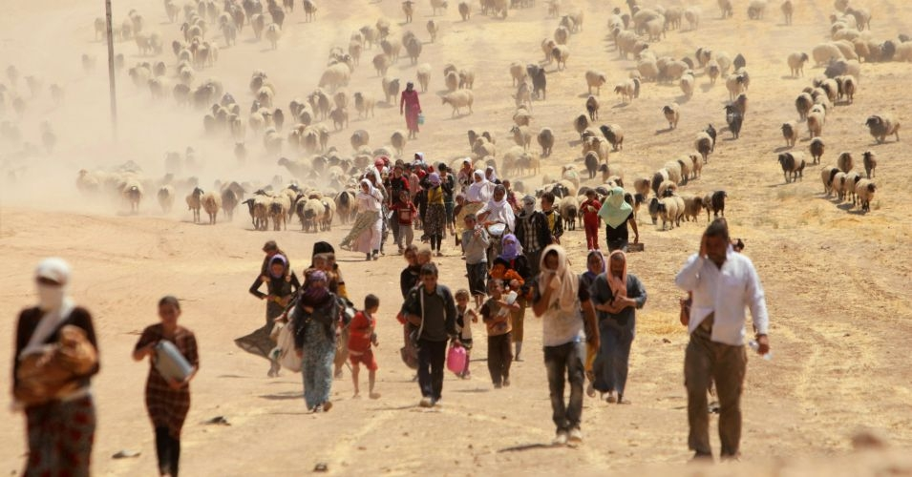
Call It What It Is: A Global Migration Shift From Climate, Not a Migrant or Refugee Crisis by Jeff Biggers in Common Dreams, Friday, August 28, 2015

Slide 28
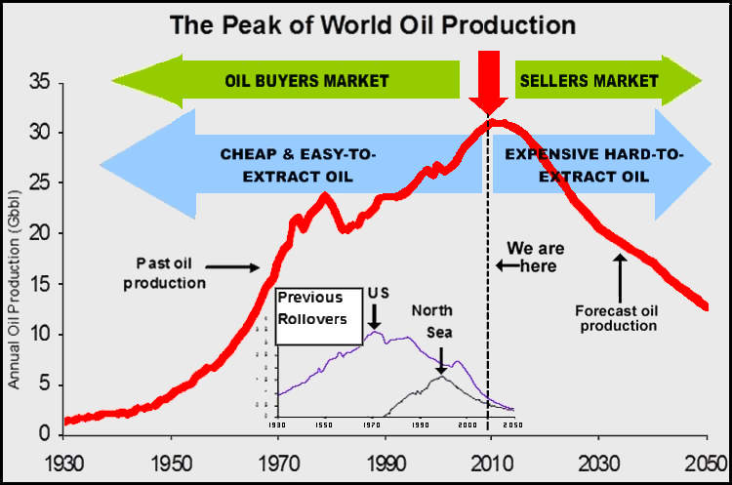
Resources:
The concept of Peak Oil

Slide 29
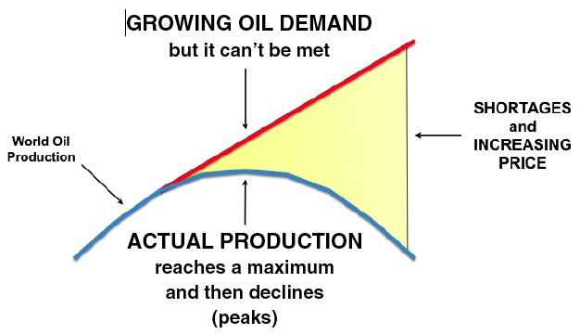
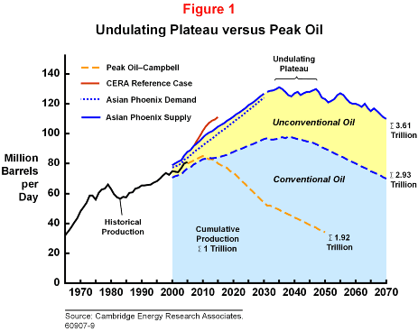
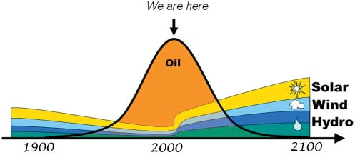
Various competing scenarios…

Slide 30
…and some more scenarios (best case, worst case etc.)

Slide 31
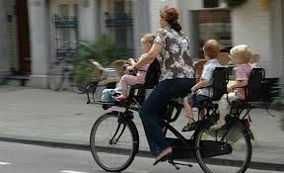
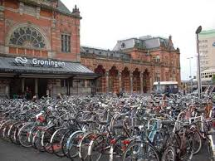
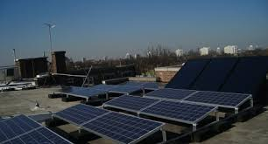
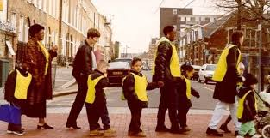
So, “Carbon Descent” and the “Economics of Transition”

Slide 32
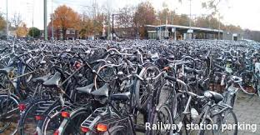
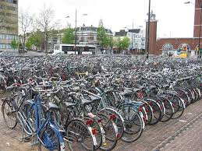

Slide 33
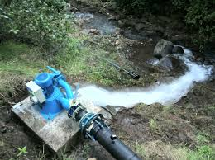

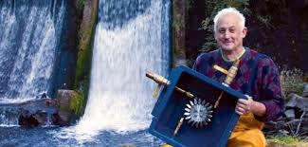
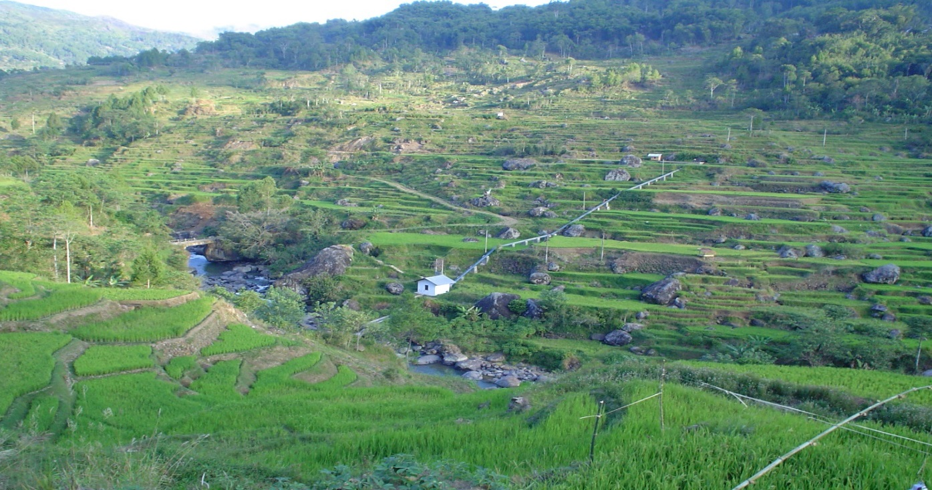
Micro-hydro electric generation

Slide 34
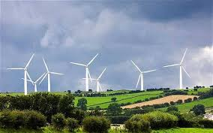
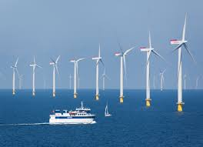
Wind energy

Slide 35
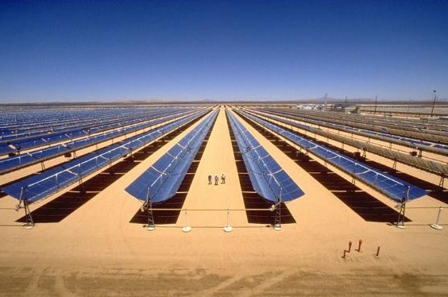
Solar energy:
A huge commercial array in South Africa

Slide 36
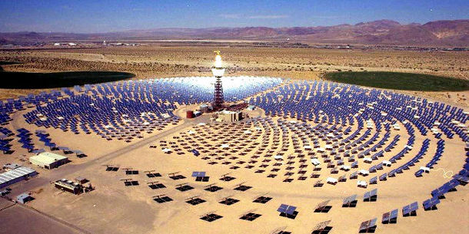
Africa: exporting energy to Europe?

Slide 37
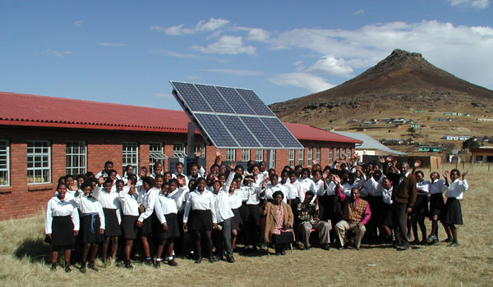
Energy for schools
.

Slide 38
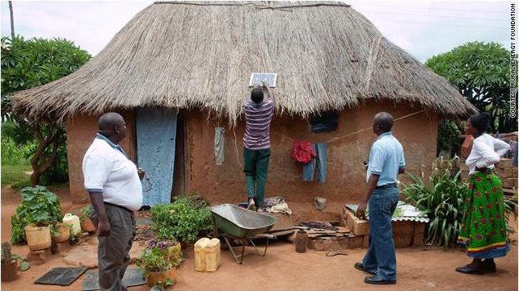
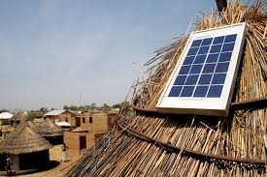
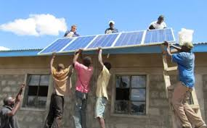

…and for homes

Slide 39


Dilemmas and debate
Quality of life and Inequality: the Gini Coefficient and the Robin Hood Index – Quality of Life
Growth and development: or “transition”
Implications worldwide, not only in “Third World”: sharing resources equitably and sustainably
Active citizenship and Global Justice

