Slide 1
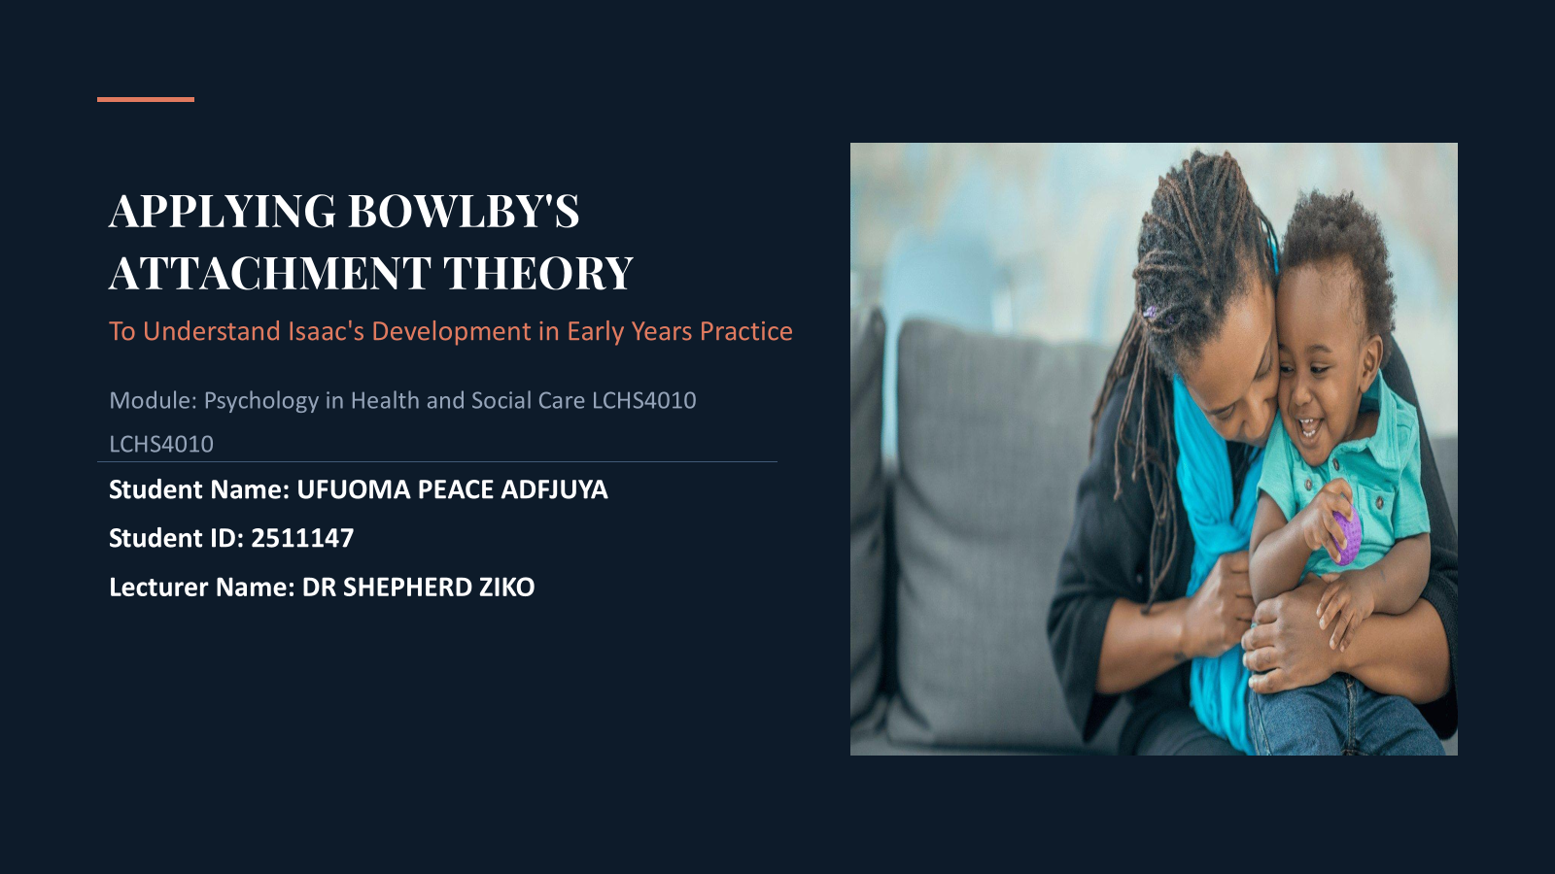

Slide 2
Acknowledge use of AI
ChatGPT (OpenAI) was used to assist with structuring the presentation and refining the wording. The final content was reviewed, edited, and approved by me.

Slide 3


Introduction to Isaac
Family Context
Developmental Concerns
Analysis Purpose
Single mother experiencing severe post-natal depression
Recent, stressful relocation to London with minimal support
Highly disrupted child-minding and childcare routines
To systematically analyze Isaac's development under the prism of John Bowlby's Attachment Theory (1958).
By matching theoretical insights to clinical reality, this analysis will formulate evidence-based practices to guide interventions in early years environments.
Highly withdrawn behavior and quietness in group environments
Acute emotional distress and crying upon separation
Evident speech and language delays
Difficulties forming Peers bonds

Slide 4


BOWLBY’S ATTACHMENT THEORY
“The young child's hunger for his mother's love and presence is as great as his hunger for food”
— JOHN BOWLBY (1951, p.11)
Bowlby (1971) hypothesized that humans are biologically predisposed to seek proximity with a primary caregiver to ensure survival. These early emotional bonds act as a core organizer for psychological development.
For a child like Isaac, disrupted early bonds do not merely cause temporary distress; they structurally impede emotional security, social confidence, and neurological organization.

Slide 5

WHY BOWLBY’S THEORY IS RELEVANT TO ISAAC (Bowlby, 1982)
01. Monotropy
02. Internal Working Model
Bowlby suggested that children havean innate need to attach to one main caregiver (typically the mother). This singular relationship is qualitatively different and vastly more critical than subsequent secondary attachments.
A cognitive framework of schemas containing expectations of self and others. Formed via primary attachment quality, it acts as a mental template for all subsequent future social and emotional relationships.
03. Secure vs. Insecure
04. Maternal Deprivation
Secure attachment arises from responsive parenting, allowing healthy exploration. Insecure attachment (avoidant, resistant, or disorganized) stems from cold, inconsistent, or emotionally unavailable caregiving.
The continuous disruption or complete absence of the primary caregiver relationship during the critical development period, leading to potentially irreversible intellectual, social, and emotional damage.

Slide 6

APPLYING BOWLBY TO ISAAC
Emotional Development
Observed
• Distress when separated from mother
• Clingy behaviour
Theory Explanation
Possible anxious attachment pattern.
Social Development
Observed
• Avoids group activities
• Withdrawn during play
Theory Explanation
Reduced confidence in exploring social environments.
Language Development
Observed
• Delayed language skills
Theory Explanation
Fewer opportunities for communication and social interaction.
(Ainsworth et al., 1978)
.
In his mind, caregivers are temporary, unpredictable, or difficult to connect with.
Consequently, he retreats from peer play, exhibiting self-protective social isolation.

Slide 7
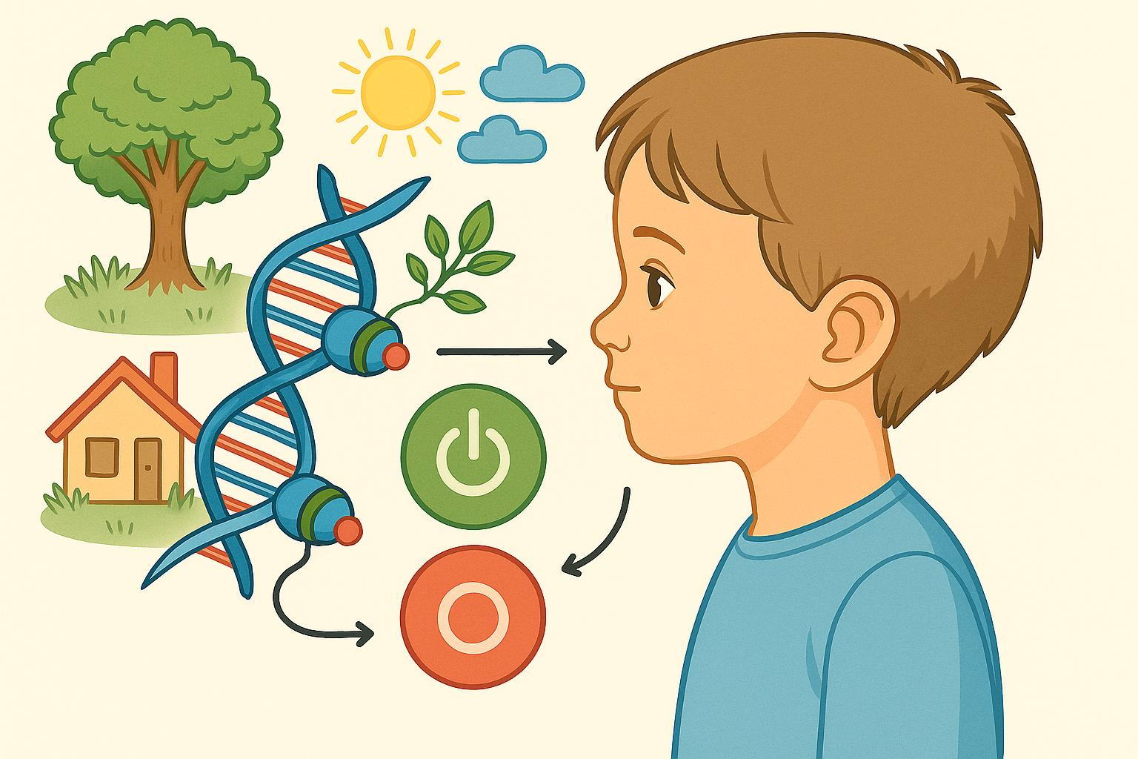


NATURE AND NURTURE INFLUENCES
Nature (Biological Base)
Nurture (Environmental Quality)
Innate Temperament:
Children have inherent biological traits (e.g., highly sensitive, slow-to-warm).
Genetic Predispositions:
Stress-reactivity pathways and nervous system baseline parameters.
Brain Development:
Amygdala and prefrontal cortex maturation shapes early fear and regulatory actions.
Caregiving Quality:
Highly responsive vs. emotionally unavailable mothering due to depression.
Home & Family Environment:
Stability metrics, relocations, structural stress, and parental emotional support.
Social Interaction Opportunities:
Access to peer-based spaces and early childhood education.
Interaction
Development results from the interaction between biological and environmental influences.
(Berk, 2023; Cassidy & Shaver, 2025).

Slide 8


SUPPORT PLAN: EMOTIONAL DEVELOPMENT
Strategies for early years practitioners:
Key Worker System
One consistent adult builds trust and security.
Predictable Routines
Reduces anxiety and uncertainty.
Transition Support
Visual schedules and preparation before separation.
Emotional Coaching
Helping Isaac identify and express feelings.
Expected Outcome
Improved emotional security and reduced separation anxiety.
(Bowlby, 1969)

Slide 9

SUPPORT PLAN: EMOTIONAL DEVELOPMENT:
Language and Social Development
Language-Rich Environment
• Daily storytelling
• Singing and rhymes
• Open-ended questions
• Shared reading
Play-Based Learning
• Small-group activities
• Role play
• Cooperative games
• Peer buddy systems
Expected Outcomes
• Improved communication
• Increased confidence
• Better peer relationships
(DfE, 2024)

Slide 10

COLLABORATIVE MULTI-AGENCY CARE
Parental Engagement
Clinical Specialists
Educational Support
Speech and Language Therapy:
Direct assessments and custom therapy routines to target developmental communication gaps.
Health Visitors:
Providing home-based holistic support, evaluating mental welfare of the family unit, and tracking long-term physical wellbeing markers.
Educational Psychologists:
Design customized cognitive progression paths, ensuring early center practices accommodate emotional vulnerability.
Social Workers:
Assess contextual hardships, offering financial, relocation, and integration support to settle the family firmly in London.
Maternal Mental Health Services:
Addressing the mother's post-natal depression is paramount for the child. Supporting the mother directly heals the primary attachment system.
Play-Based Parenting Programs:
Empowering the mother with positive child-interaction techniques, rebuilding confidence and positive home environments.
(NICE, 2021)

Slide 11

CRITICAL EVALUATION OF BOWLBY'S THEORY
Strengths
✓ Highlights importance of early relationships
✓ Supported by extensive research
✓ Influenced childcare and safeguarding practice
✓ Useful for understanding Isaac's behaviours
Limitations
✗ Focuses heavily on mother-child relationship
✗ Limited consideration of cultural differences
✗ Underestimates role of wider family and community
✗ Children can recover from early difficulties
Diverse families may have multiple attachment figures and different parenting approaches.
(Prior and Glaser, 2020)

Slide 12


CONCLUSION
Key Findings
• Bowlby's theory helps explain Isaac's behaviours.
• Early attachment experiences influence emotional, social and language development.
• Both nature and nurture affect development.
• Theory-informed interventions can improve outcomes.
• Multi-agency support is essential.

Slide 13

REFERENCES
Ainsworth, M.D.S., Blehar, M.C., Waters, E. and Wall, S. (1978) Patterns of Attachment: A Psychological Study of the Strange Situation. Hillsdale, NJ: Lawrence Erlbaum Associates.
Berk, L.E. (2023) Development through the lifespan. 9th edn. Harlow: Pearson Education.
Bowlby, J. (1969) Attachment and loss. Volume 1: Attachment. London: Hogarth Press.
Caingcoy, M. (2023) ‘Culturally Responsive Pedagogy: A systematic overview’, Diversitas Journal, 8(4), pp. 3203–3212. Available at: https://doi.org/10.48017/dj.v8i4.2780.
Cassidy, J. & Shaver, P. (2025) Handbook of Attachment: Theory, Research, and Clinical Applications. New York: Guilford Press.
Deneault, A., Duschinsky, R., IJzendoorn, van, Roisman, G.I., Ly, A., Pasco, M. and Madigan, S. (2023) ‘Does child-mother attachment predict and mediate language and cognitive outcomes? A series of meta-analyses’, Developmental Review, 70, pp. 101093–101093. Available at: https://doi.org/10.1016/j.dr.2023.101093.
Department for Education (2024) Statutory Guidance: Early years foundation stage (EYFS) statutory framework. Available at: https://www.gov.uk/government/publications/early-years-foundation-stage-framework--2 (Accessed: 26 June 2026).
Family and Childcare Trust (2016) Social Mix in London Early Years Provision 02 Acknowledgements. Available at: https://www.familyandchildcaretrust.org/sites/default/files/FCT%20Social%20mix%20in%20the%20early%20years.pdf#5#1 (Accessed: 5 July 2026).
Fink, E., Foley, S., Browne, W. and Hughes, C. (2024) ‘Parental sensitivity and family conversation: A naturalistic longitudinal study with both mothers and fathers across three time‐points in early infancy’, Infant mental health journal [Preprint]. Available at: https://doi.org/10.1002/imhj.22117.
Howe, D. (2024) Attachment across the lifecourse: A guide to theory and practice. 2nd edn. London: Palgrave Macmillan.
Keller, H. and Chaudhary, N. (2017) ‘Is the Mother Essential for Attachment?’, The Cultural Nature of Attachment [Preprint]. Available at: https://doi.org/10.7551/mitpress/9780262036900.003.0005.
McLeod, S. (2025) Attachment theory. Simply Psychology. Available at: https://www.simplypsychology.org/attachment.html (Accessed: 26 June 2026).
National Institute for Health and Care Excellence (NICE) (2023) Social and emotional wellbeing: Early years. London: NICE. Available at: https://www.nice.org.uk/guidance/ph40/documents/social-and-emotional-wellbeing-early-years-overview-paper2 (Accessed: 26 June 2026).
NICE (2021) Children's Attachment. London: National Institute for Health and Care Excellence.
Ringoot, A.P., Jansen, P.W., Kok, R., IJzendoorn, M.H., Verlinden, M., Verhulst, F.C., Bakermans‐Kranenburg, M. and Tiemeier, H. (2021) ‘Parenting, young children’s behavioral self‐regulation and the quality of their peer relationships’, Social Development, 31(3). Available at: https://doi.org/10.1111/sode.12573.
Rutter, M. (2015) 'Resilience as a dynamic concept', Development and Psychopathology, 24(2), pp. 335–344.
Seedall, R.B. and Lachmar, E.M. (2017) ‘Attachment’, The SAGE Encyclopedia of Marriage, Family, and Couples Counseling [Preprint]. Available at: https://doi.org/10.4135/9781483369532.n28.
van der Horst, F.C.P. and van der Veer, R. (2010) ‘The ontogeny of an idea: John Bowlby and contemporaries on mother–child separation.’, History of Psychology, 13(1), pp. 25–45. Available at: https://doi.org/10.1037/a0017660.
Zhao, Y. (2024) An Exploration of the Social-Emotional Development of Single Parenting: A Comparison Between Chinese and British Mothers. Available at: https://repository.essex.ac.uk/41106/1/FullPhD%20Thesis%20-%20Yu%20Zhao.pdf#41#8 (Accessed: 5 July 2026).

