Slide 1

How to create a Digital Poster in a PowerPoint
Digital Skills 2023

Slide 2
Overview
01
02
03
04
05
06
Types of posters
How to communicate to your audience
Tools for designing poster
Set up a PowerPoint
Poster design workflow
How to upload to Turnitin

Slide 3



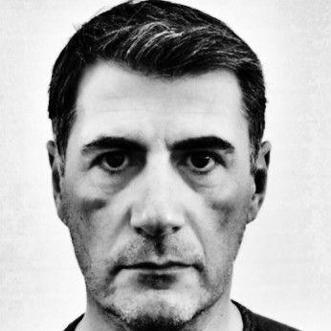



Meet the Digital Skills Team
Jessica Hill
IMH
j.hill@uwtsd.ac.uk
Stuart Gill
WISA
s.gill@uwtsd.ac.uk
Tarandeep Johal
IICL
t.johal@uwtsd.ac.uk
Roger Covello
Learning Technologist
r.covello@uwtsd.ac.uk
Gwen Couch
IEH
g.couch@uwtsd.ac.uk
E-mail: digitalskills@uwtsd.ac.uk​
​
Website: digitalskills.uwtsd.ac.uk ​
​

Slide 4
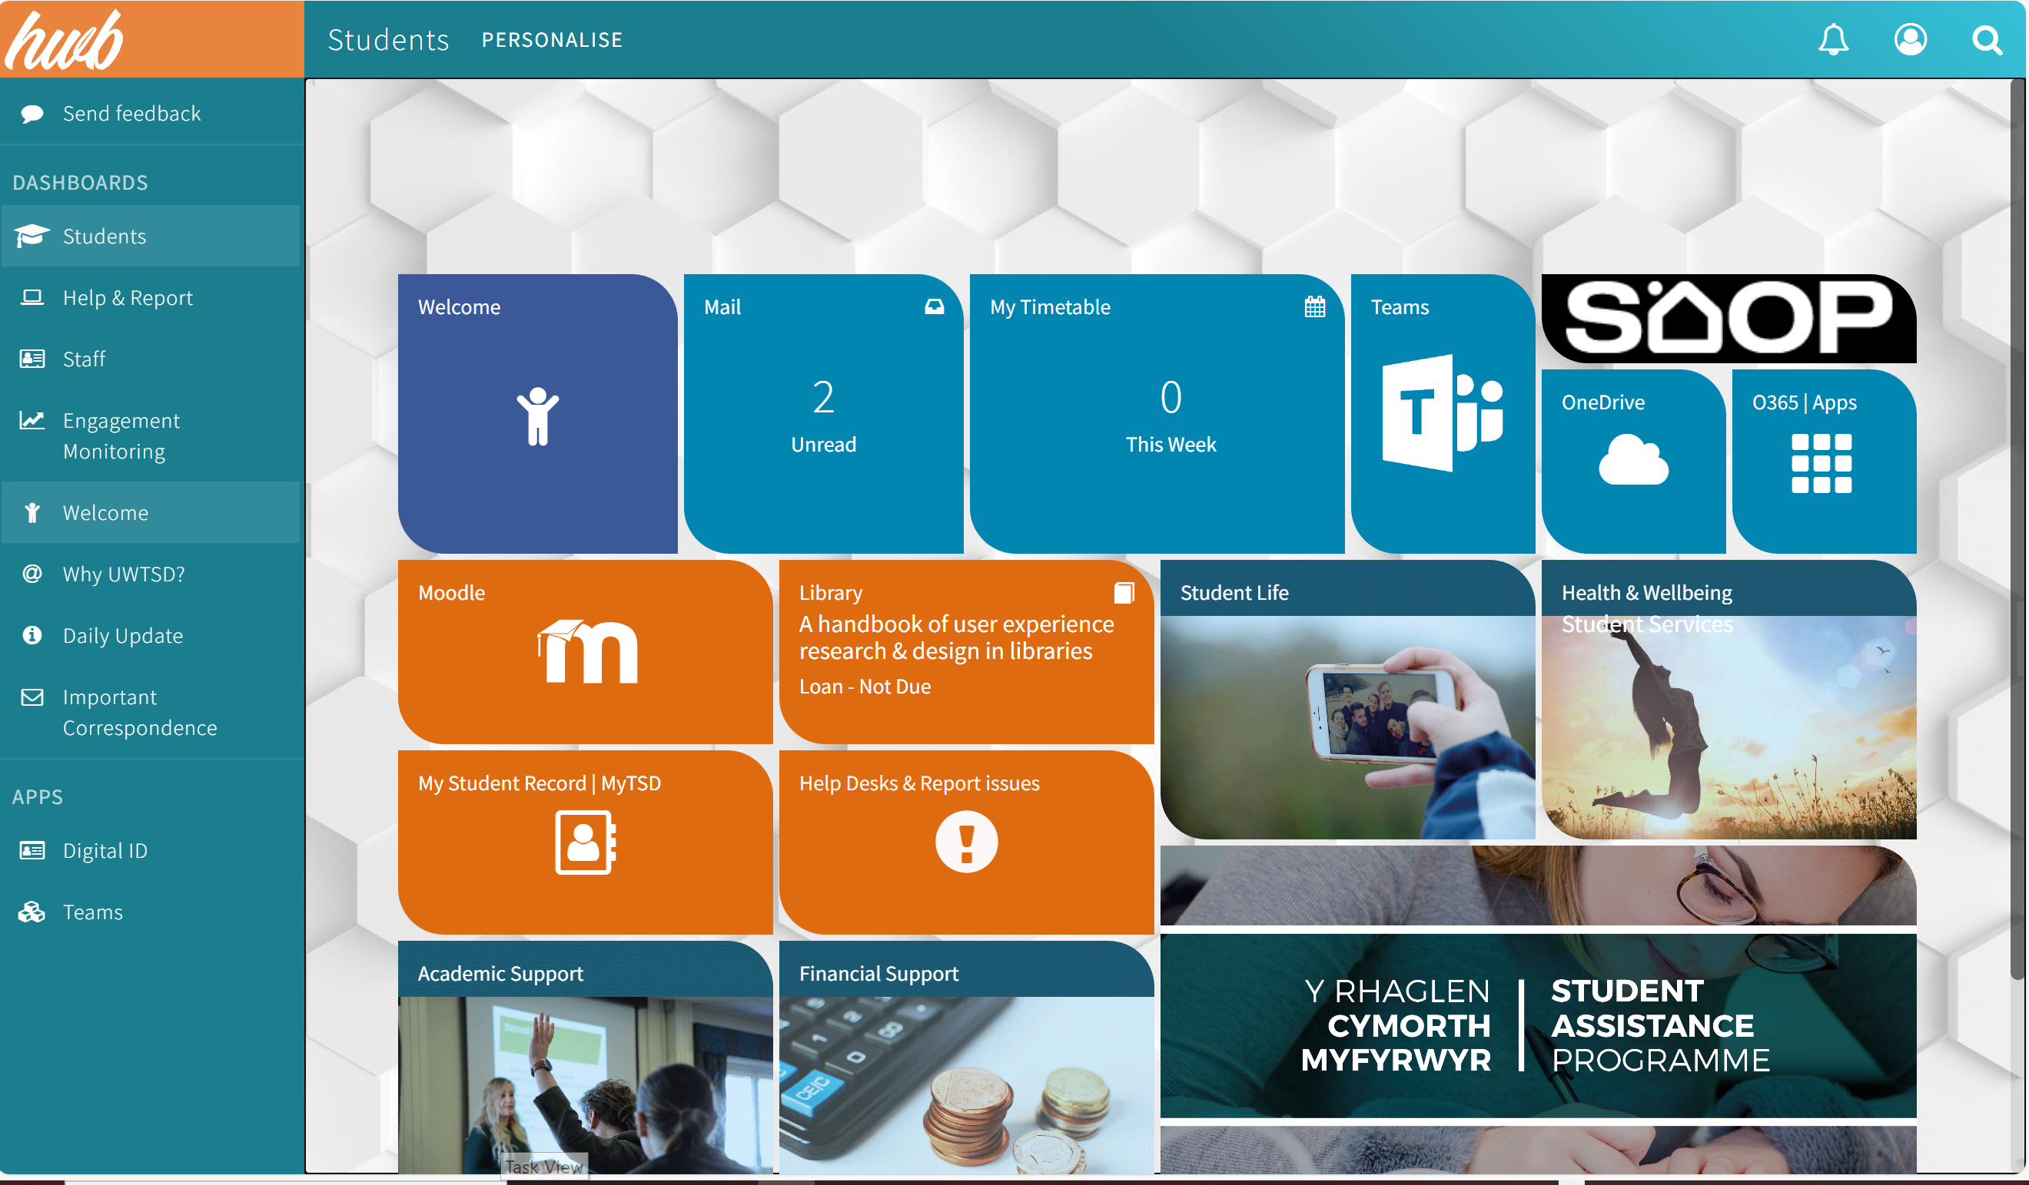
The Hwb

Slide 5
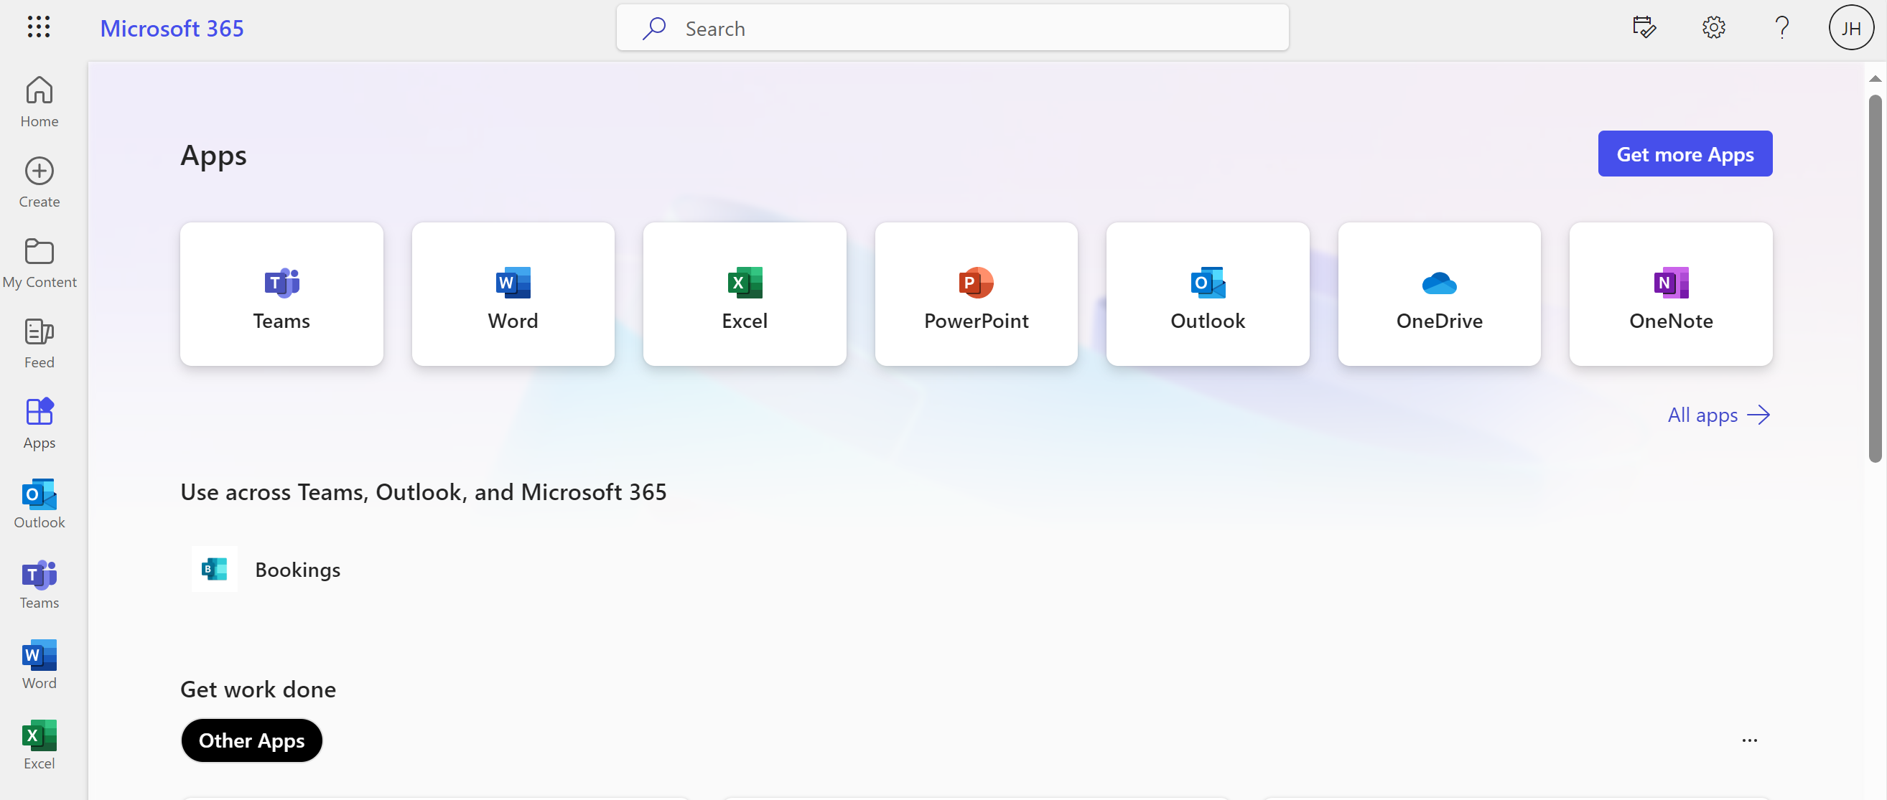
Office 365

Slide 6
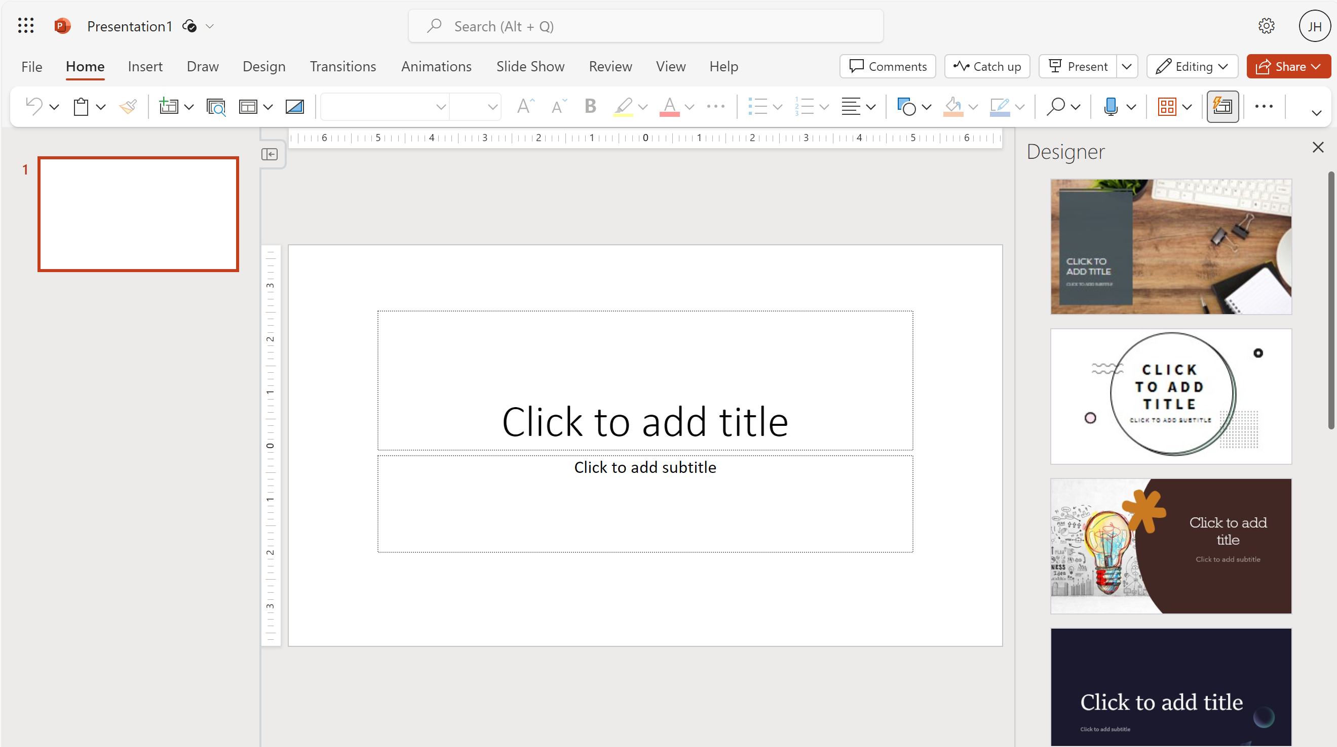
Click on ‘blank’ presentation

Slide 7
Important points to remember
You can click on editing to open in ‘desktop app’ if you have.
1
Navigate to ‘home’ or ‘insert’ to insert a new slide into the PowerPoint.
2
Choose from a various range of slides depending on your requirements.
3
Don’t forget that you have ‘Designer’ under the ‘home’ tab to make your slide/s more creative.
4

Slide 8
Purpose of a digital poster
A visual tool to communicate messages
No need for further elaboration – should be impactful and eye catching
Visually use images, charts and shapes
Relevant and meaningful to the audience
Leave a lasting impression with your poster

Slide 9
Things to consider before making a start on your poster
Size of the poster
Source of images
What is the deadline of your poster (time)

Slide 10
Effective Layout and Formatting
Overall appearance – find a good balance between of text and images, use white space to organise sections, avoid clutter.
Organisation – use headings to direct the readers eye.
Text size should be easy to read from 1 -2 metres away

Slide 11
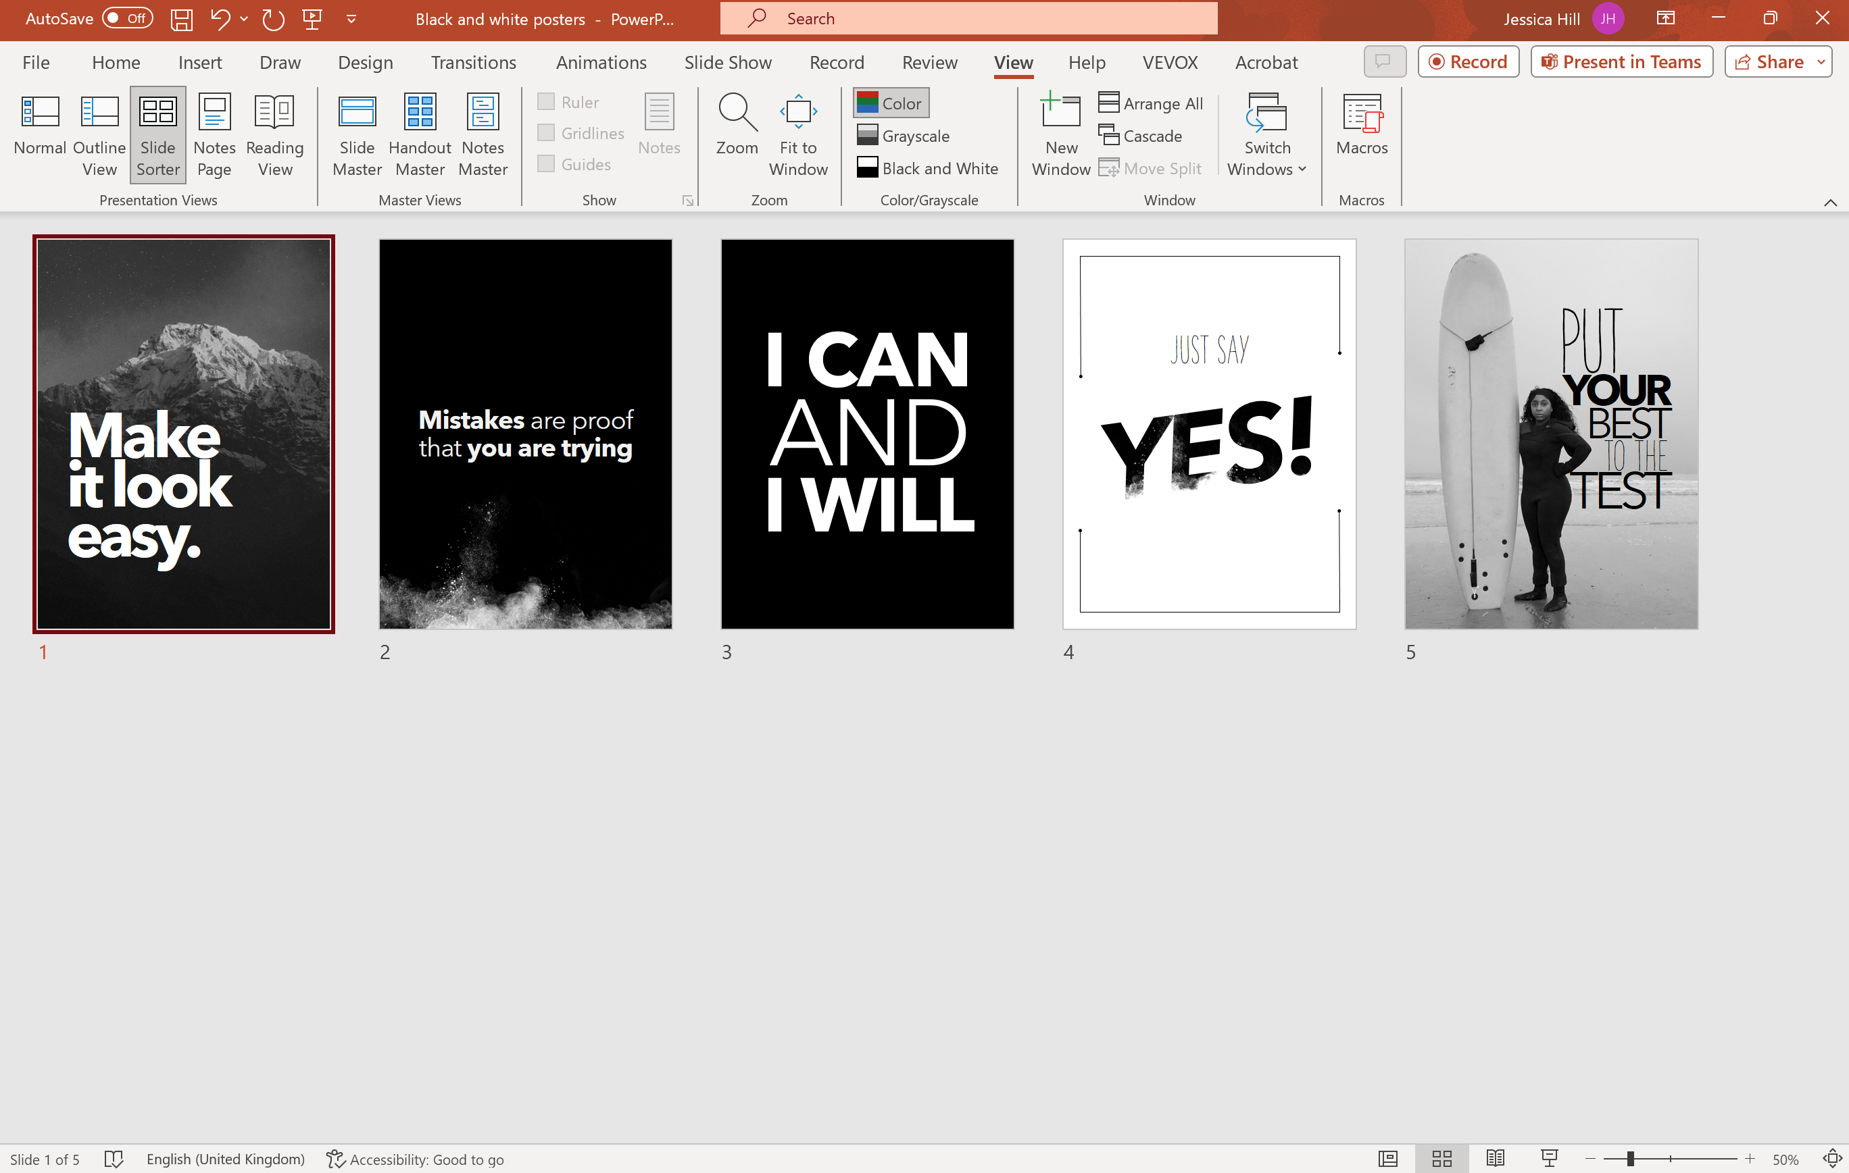
Start with a template – either choose a custom one

Slide 12
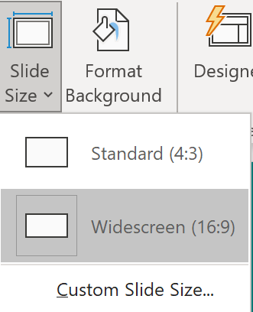
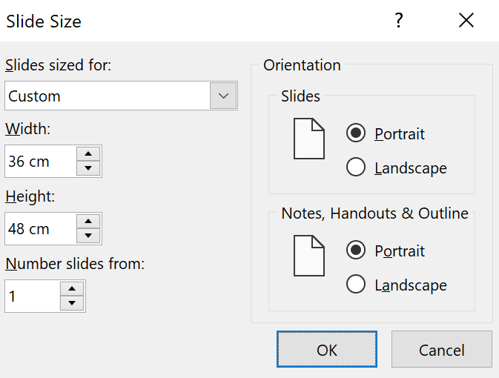
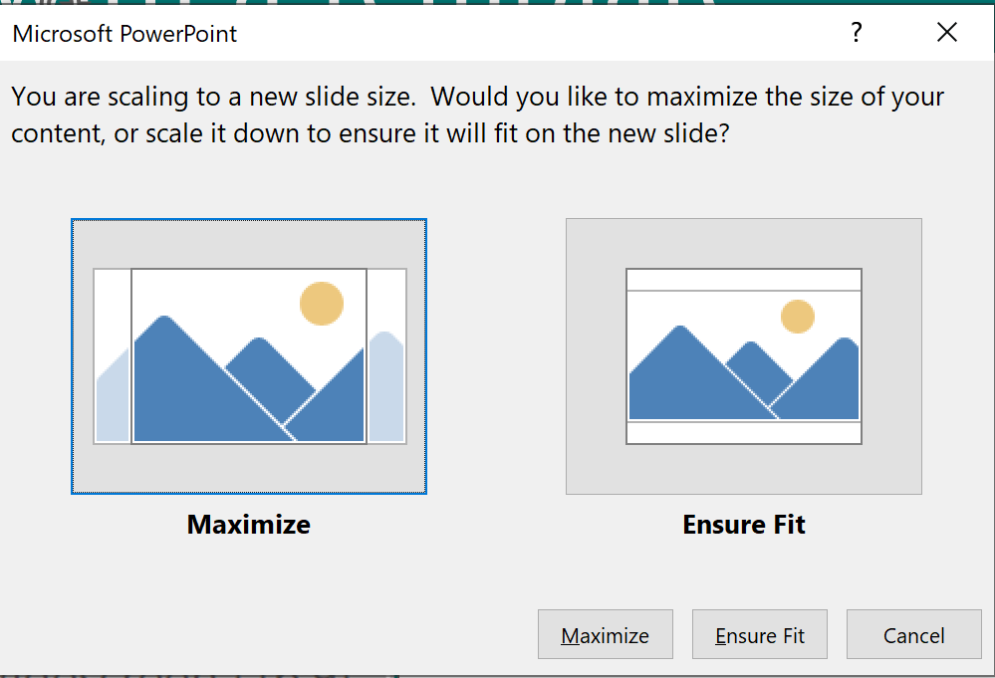
Or create your own
Go to the Design tab

Slide 13

Mental Health Matters
#itsgoodtotalk

Slide 14

What next?
Layout
Content
Images
Fonts

Slide 15
Using slide master to give uniform designs
Navigate to view
Then slide Master
Scroll to the top of the thumbnails
Click insert Picture. Then choose an image and watch it duplicate on each slide. This is great for logos.

Slide 16

Another example of a digital poster

Slide 18
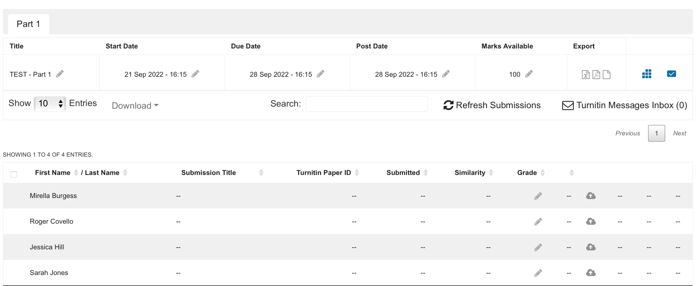
How to upload onto Turnitin

Slide 19


Slide 20

Practical task
Open Microsoft PowerPoint and create a new presentation
Navigate to Design and change the slide size to 36 cm width and 48 cm height
The theme is a “Digital Skills Pop – Up event.” Insert some text to reflect this.
Format background by right clicking on the slide and then inserting an image to showcase the event.
Add a logo using the Slide Master feature
Insert the time – 10.00 – 11.00
Insert the text “Every Thursday morning”
Use Word Art to make the text stand out
Create your own Digital poster

Slide 21
References
Powerpoint poster templates for research poster presentations 48 x 96
4 million+ Stunning Free Images to Use Anywhere - Pixabay – Pixabay
Free Stock Photos, Royalty Free Stock Images & Copyright Free Pictures · Pexels

Slide 23








Thank you for listening.
Any questions?
UWTSD DigiCentre
The One stop shop for all your Digital needs
SCAN ME
Gain all the badges to show future employers your digital skills
Digital Skills 2023
The DigiCentre UWTSD

