Slide 1

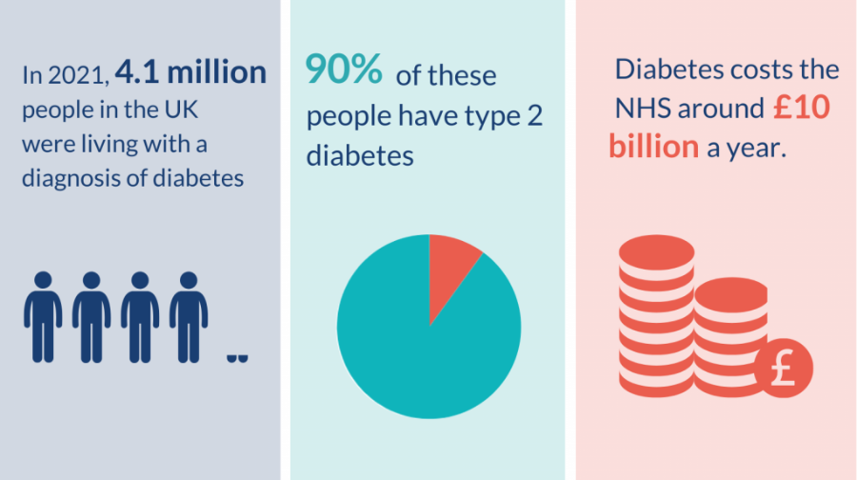
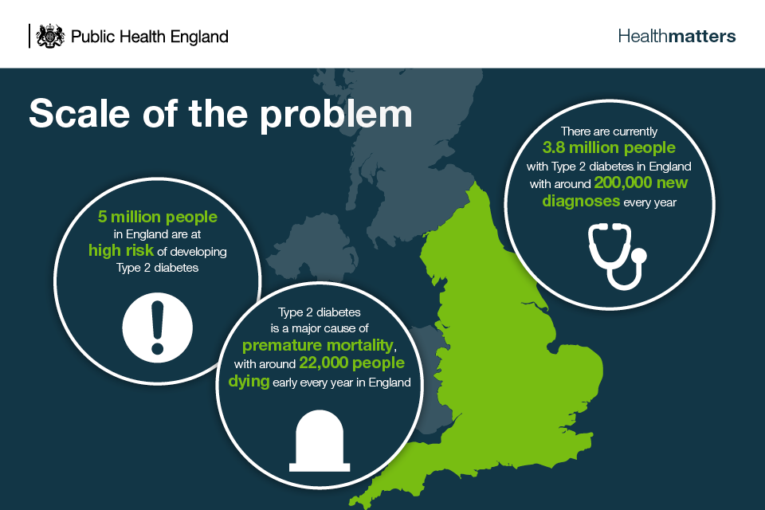
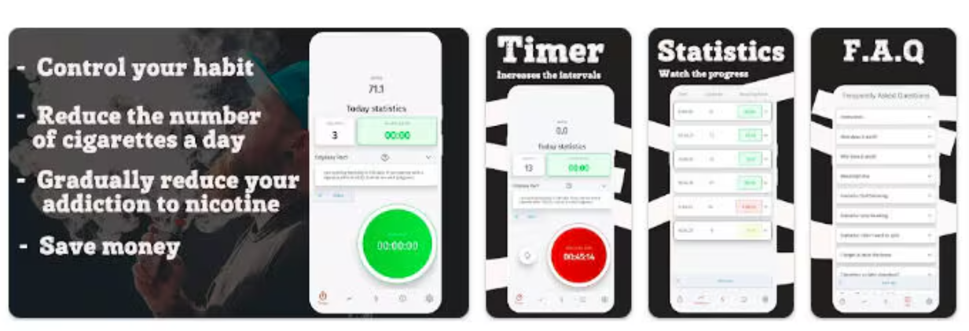
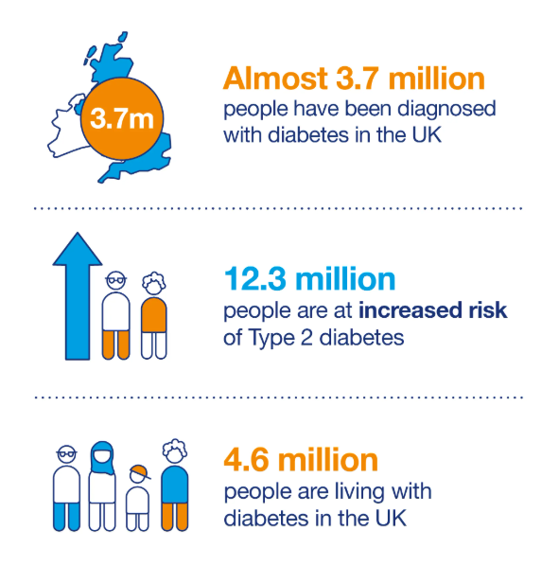
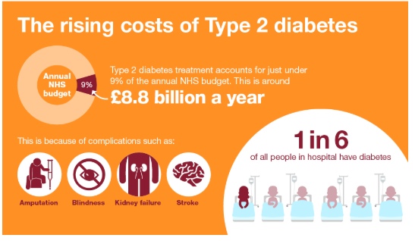
Discussing the Impact of a “SmokeFree+ AI” An Enhanced Version of NHS SmokeFree App Public Health Problem
Module code: LCHS7009
Module Tutor name:
Student Name and ID:
Background
Health promotion values and principles
Expected Outcome
Scale of Public Health Problem: Type-2 Diabetes remains a major public health issue throughout the UK that is affecting almost 3.7 million people and causing a direct economic burden in excess of £10 billion in the public healthcare system (Soares Andrade et al., 2023). Lifestyle factors like smoking or drinking combined with poor diet choices and lack of physical activity can greatly enhance the risk of Type-2 Diabetes in a person.
Previous Interventions: Oviva and NHS SmokeFree are examples of previously available digital technology interventions that have played a vital role supporting lifestyle modifications and smoking cessation among patients (Jackson et al., 2024). Examples of non-digital intervention include public health awareness campaigns like Change4Life and GP monitored diabetes prevention programmes.
Chosen Intervention:The proposed SmokeFree+ AI app is a technologically enhanced version of the existing NHS SmokeFree app. This new SmokeFree+ AI app integrates modern AI technology to provide more personalised and effective lifestyle interventions that could help users in reducing the risk of Type-2 Diabetes through healthy lifestyle adoption and smoking cessation.
Health Promotion Values and Principles
The health promotion values include a broader and positive viewpoint of health and equity while continuously striving to empower people as well as communities to have greater control over their health. The important principles in this regard include building a healthy public policy, strengthening (Harfield et al., 2018). community action, creating a supportive healthcare environment, reorienting health services through development of both personal and professional skills.
Alignment with SmokeFree+ AI app
The new SmokeFree+ AI app perfectly aligns with the health promotional values and principles by ensuring healthcare equity for the underserved populations and supporting people to lead healthy lives (Bischof et al., 2021). The app offers accessible healthadvice and guidance through digital chatbots, thereby empowering the users to take control and be responsible for their health. The SmokeFree+ AIapp strictly adheres by the principles underlined in the Ottawa Charter that describes about the need to build-up health literacy, supporting self-care and thoroughly integrating with existing NHS systems to promote sustainable behaviour and lifestyle changes among the at-risk populations(Harfield et al., 2018) n
With the adoption of HBM model, the new SmokeFree+ AI is expected to achieve the following outcomes.
A market reduction (between 20 to 25%) in smoking rates among existing user of the SmokeFree+ AI app within the first six months.
Improvement in glucose regulation and BMI by continuous tracking of a person’s overall lifestyle and providing personalised feedbacks. (Du et al., 2024).
Minimising the long-term healthcare burden of Type-2 Diabetes by helping to prevent its onset among high-risk populations.
All these outcomes and results perfectly align with the long-term plans adopted by NHS to minimise and reduce the prevalence of Type-2 Diabetes among the UK population.
Figure 3 Feature of AI driven mobile app
[Source:Smith, 2024]
Behavioural Change Theory
The SmokeFree+ AIapp has been designed by integrating the concept of (HBM).
This HBM is a psychological framework that describes how individual perceptions of health threats and the benefits resulting from affirmative action can influence the health behaviours of a person (Nouri et al., 2024).
The main components of this model are perceived susceptibility, perceived severity, perceived benefits, perceived barriers, self-efficacy and cues to action.
The SmokeFree+ AI strives to reduce the perceived susceptibility of Type-2 Diabetes by helping patients to gradually cut down on their smoking habits and eventually quit smoking altogether. (Mohammad et al., 2024)
This is achieved through digital behavioural reinforcement that encourages individuals to develop new habits through small and measurable heath goals which would enable them to maintain active lifestyle while controlling their smoking habits to minimise risk of Type-2 diabetes. (Barnett et al., 2020)
The app strives to minimise the perceived severity of medical conditions resulting from the smoking habit by building up greater awareness about the long-term medical conditions resulting from smoking cigarettes.
This is done by addressing the issue of digital inequality in the UK where almost 1.5 million people lack any digital access. Heath apps often fail to reach the underprivileged or at-risk groups who are at a greater risk of suffering from Type-2 Diabetes. SmokeFree+ AI aims to resolve this challenge by multi-modal access through smartphones and feature phones and offering multi-language accessibility in English, Spanish, Arabic and Hindi. (Rajani et al., 2019)
The app promotes the long-term benefits resulting from smoking cessation on human health and how this is useful for people suffering from Type-2 diabetes.
This is done through AI enabled chatbots that encourage people to quit their smoking habit by explaining about its long-term benefits on a person’s health and financial wellbeing.
The app strikes at the heart of perceived barrier to healthcare equity by offering completely free services for the users as it has been developed by the NHS. This makes it completely affordable for people from all sections of the society. Furthermore, it breaks down language barriers by offering multi-language accessibility to the users. (Zhang et al., 2023
Lastly, the app supports self-efficacy and cues to action to smokers to adopt healthier lifestyle choices and take control of their own health while making a conscious effort to quit their smoking habit.
Figure 4 Scale of problem
Source: (Public Health England, 2018)
Figure 1Growing Public Health Emergency in UK
Conclusions
Source: Kwint, 2022;kidneyresearchuk.org, 2018
The SmokeFree+ AI app is a modern, innovative and data driven approach towards addressing the existing healthcare inequalities within the UK and this is going to play a vital role in helping to tackle and prevent the growing prevalence of Type-2 Diabetes among the UK general population.
This would be achieved by ensuring the successful integration of AI, behavioural science and public health promotion. (Rajani et al., 2019)
The new SmokeFree+ AI would play a vital role in building upon the success of NHS SmokeFree app by offering personalised health consultation, AI based behaviour and lifestyle tracking and real-time analytics to drive sustainable health outcomes. (Jackson et al., 2024)
Figure 2. Increasing Cost of Type 2 Diabetes
Source: (Public Health England, 2018)

Slide 2
Reference list
Barnett, A., Ding, H., Hay, K.E., Yang, I.A., Bowman, R.V., Fong, K.M. and Marshall, H.M., 2020. The effectiveness of smartphone applications to aid smoking cessation: a meta-analysis. Clinical eHealth, 3, pp.69-81.https://www.sciencedirect.com/science/article/pii/S2588914120300101
Jackson, S., Kale, D., Beard, E., Perski, O., West, R. and Brown, J., 2024. Effectiveness of the offer of the smoke free smartphone app compared with no intervention for smoking cessation: pragmatic randomized controlled trial. Journal of Medical Internet Research, 26, p.e50963.https://www.jmir.org/2024/1/e50963/
kidneyresearchuk.org., 2018. The number of people diagnosed with diabetes in the UK has more than doubled in the last twenty years[online] Available at:<https://www.kidneyresearchuk.org/2018/02/28/diabetes-diagnosis-has-more-than-doubled-in-20-years/> [Date Accessed: 30 October 2025].
Kwint, J., 2022. Diabetes: putting people at the heart of services[online] Available at:<https://evidence.nihr.ac.uk/collection/diabetes-putting-people-at-the-heart-of-services/>[Date Accessed: 30 October2025].
Nouri, K., Nazari, M., Kaveh, M.H. and Hosseini, F.S., 2024. Effectiveness of a health belief model-based educational intervention on treatment adherence among type 2 diabetic patients: Insights from a randomized controlled trial in Iran. Journal of Education and Community Health, 11(2), pp.98-106.https://jech.umsha.ac.ir/PDF/jech-2585.pdf
oviva.com, 2025. Weight loss medication and expert care with Oviva[online] Available at:<https://oviva.com/uk/en/https://oviva.com/uk/en/> [Date Accessed: 30 October 2025].
Public Health England (2018). Health matters: Preventing Type 2 Diabetes. [online] GOV.UK. Available at: https://www.gov.uk/government/publications/health-matters-preventing-type-2-diabetes/health-matters-preventing-type-2-diabetes.
Rajani, N.B., Weth, D., Mastellos, N. and Filippidis, F.T., 2019. Use of gamification strategies and tactics in mobile applications for smoking cessation: a review of the UK mobile app market. BMJ open, 9(6), p.e027883.https://bmjopen.bmj.com/content/bmjopen/9/6/e027883.full.pdf
Soares Andrade, C.A., Shahin, B., Dede, O., Akpeji, A.O., Ajene, C.L., Albano Israel, F.E. and Varga, O., 2023. The burden of type 2 diabetes mellitus in states of the European Union and United Kingdom at the national and subnational levels: A systematic review. Obesity Reviews, 24(9), p.e13593.https://onlinelibrary.wiley.com/doi/pdfdirect/10.1111/obr.13593
Zhang, M., Wolters, M., O'connor, S., Wang, Y. and Doi, L., 2023. Smokers’ user experience of smoking cessation apps: a systematic review. International journal of medical informatics, 175, p.105069.https://www.sciencedirect.com/science/article/pii/S1386505623000874

