Slide 1

Sunrise Residential Care Home
LCHS4007
Modules Code: LCHS4007
Modules: Digital Skills and Research Methods
Lecturer name: Masud Siddiqui
Group names: Tanecha Crosdale (2513704)
Nicolette Franchesta Ramsay (2412969)
Jay-J Mary Theresa McKean (1813848)
Rosemary Brennnan (2504749)

Slide 2

Introduction
Hello my name is Tanecha Crosdale and I am a part of the group C from group 4 2025. the group consist of four members each need to choose 1 task out of 4 question. As a group we are going to deliver a PowerPoint presentation evaluating the use of digital technology, tools, and techniques to enhance efficiency at Sunrise residential care home and my topic is about Microsoft PowerPoint.
This is a medium size home with the capacity of 35 residents that provide long-term care for the elderly.
The home specialised in caring for adults who are living with dementia, mobility issues and other long-term health conditions.
In the home they have a team of nurses, care workers, administrators and visiting health professionals.

Slide 3
The task
In recent years sunrise been introducing new digital tools to improve the quality and work more efficiency within the home.
The home as access to Microsoft 365 suite, but only few staff still developing their confidence in using these tools.

Slide 4
Microsoft 365 and PowerPoint
Microsoft 365 is a good start in moving forward (Price M,2021)
Like other software MS PowerPoint has its Benefits and Limitations with its versatile tools for transporting information it’s been used by many audience across the world.(Kapadia (2023)
Microsoft PowerPoint is very useful for delivering presentations and is good for creating animations, and Graphics
It can be displayed on a TV screen to inform visitors about the care home and announcements.
Through its slides, MS Power Point can be useful for patients (for memories activities, Games, Historical pictures and family pictures etc.)

Slide 5
Advantages
Microsoft PowerPoint will help when training staff to make the training more engaging,
It can help if some visual or cognitive impairment,
It can simplify difficult concepts by using screenshots, audio, picture, video and some adaptable aids
By Creating training presentation once, it is easy to update and reduces space and paper
It is useful to communicate and share information by clicking few button. e.g. sharing via email
By showing families presentation, it makes it easier to sell the home
By displaying presentation on the TV screen, not forget to give important information
It entertains patients and it's something different

Slide 6

Disadvantages
Limitations of Microsoft PowerPoint
Too many slides can be overwhelming.
Can be time consuming to create
This can also come with disadvantages where it can affect persons with light sensitive nature
training

Slide 7
Conclusion
When all the staff at sunrise home is fully trained how to access Microsoft power point the home will save money because it cost efficiency on resources such as training, storage and communication
01
It enhances the home’s appeal
02
It makes the home more competitive
03

Slide 8
Reference
Kapadia, Z. (2023) article, Advantages & Disadvantages of using PowerPoint for Presentation. Available at: Advantages & Disadvantages of Using PowerPoint for Presentations (2025).
Price M. (2021), Microsoft 365 in Easy Steps.
In Easy Steps Limited. Extract pp. 9.

Slide 9



LCHS4007
Digital Skills and Research Methods
Group Names:
Nicolette Franchesta Ramsay (2412969)
Jay-J Theresa Mckean (1813848)
Tanecha Crosdale (2513704)
Rosemary Brennnan(2504749)
Lecturer Name: Masaud Sidiqui

Slide 10
Introduction
Hi there my name is Rosemary Brennan this is my assignment. I am a student studying health n social care. I have created this presentation to show the importance of Microsoft outlook in the sunrise residential care home.

Slide 11
How outlook is being used in sunrise residential care home
To enhance communication and collaboration
Secure information settings
Improve the quality and efficiency of care
It also manages emails and events
Data collecting
Residency activities
NHS England, (n.d)

Slide 12
conclusion
My conclusion is Microsoft outlook is used for a range of things to help the running of the care home smoothly ranging from documentation through to familiarity and accessibility .
Manages emails, contacts and calendars to make it easier to manage daily tasks.
It is essential for administrative efficiency and care quality
Management of staff
Compliance and reporting

Slide 13
References
https://www.england.nhs.uk/contact-us

Slide 14

SUNRISE RESIDENTIAL CARE HOME
Impact of Limited Digital Skills (Digital Literacy) on Staff in Care Delivery, Communication, and Teamworking.
Module Code: (LCHS4007_BIRM)
Module: Digital Skills and Resource Methods
Group Name: Nicolette Ramsay (2412969)
Tanecha Crosdale (2513704)
Rosemary Brennan (2504749)
Jay J Mary Theresa McKean (1813848)
Lecturer: Masud Siddiqui

Slide 15

INTRODUCTION
Digital skills is having the ability to use technology effectively for a lot of tasks, such a record keeping, online safety and communication.
This presentation will explain how the staff’s digital skills impacted on the quality of care at Sunrise Residential Care Home.
It will also explain how lack of digital literacy affects care delivery, communication and teamworking.
(Sunrise, 2025 case study material)

Slide 16
CARE DELIVERY
Staff who lack digital confidence may struggle with electronic records, leading to inaccurate or delayed information.
Poor digital skills can cause medication errors or missed health updates.
Digital tools like telehealth or e-records may not be used properly, reducing the quality and efficiency of care.
(CareLearning, n.d).

Slide 17

COMMUNICATION how limited Digital Skills Affect Communication
Limited digital skills can cause a major impact with miscommunication between staff and visiting health professional.
Staff may also miss important messages or updates sent electronically.
Residents and their families may lose contact when staff cannot help them with digital communication.
(Kaihlanen et al., 2023)
This Photo by Unknown Author is licensed under CC BY-NC

Slide 18
TEAMWORKING
How limited digital skills affects teamwork
Staff with limited digital skills may struggle to collaborate effectively, slowing down care planning.
Workers with confidence in technology may take on extra tasks, increasing stress or workload imbalance.
Lack of digital training and support can weaken overall team efficiency in managing residents’ care.
Staff with low confidence may feel withdrawn or a bit left behind, which could lead to their morals and teamworking being lowered.
(NHS Digital, 2023)

Slide 19
REFRENCE LIST
CareLearning (n.d) 1.7 Explain the importance of literacy, numeracy and digital skills in adult care and how to develop these skills in the workforce. https://carelearning.org.uk/qualifications/level-5-adult-care/Imac-6a-development/1-7-explain-the-importance-of-literacy-numeracy-and-digital-skills-in-adult-care-and-how-to-develop-these-skills-in-the-workforce/ (Accessed: 5 October 2025).
Kalihlanen, A.M., Laukka, E., Nadav, J. et al. (2023) ‘The effects of digitalisation on health and social care work: a qualitative descriptive study of the perceptions of professionals and managers’, BMC Health Services Research, 23 (714) https://bmchealthservres.biomedcentral.com/articles/10.1186/s12913-023-09730-y (Accessed: 5 October 2025)
NHS Digital (2023) Adult social care digital skills framework. https://digital.nhs.uk/services/social-care-programme/digital-skills-framework (Accessed: 5 October 2025)

Slide 20



LCHS4007
Digital Skills and Research Methods
Group Names:
Nicolette Franchesta Ramsay (2412969)
Tanecha Crosdale (2513704)
Rosemary Brennnan(2504749)
Jay-J Theresa McKean (1813848)
Lecturer Name: Masaud Sidiqui

Slide 21

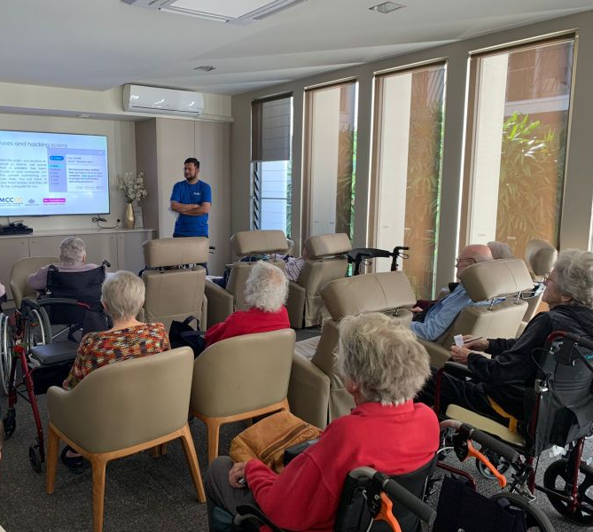
Introduction
Hello Good afternoon, hope you are well, my name is Jay-J Mckean, here I have created a checklist presentation, on how to keep digital practice safe in Sunrise residential care home, thank you for taking time to watch my presentation.

Slide 22

Sunrise residential care home Digital safety Checklist:
Email Safety (care England, 2024)
Use strong password policies
Secure WIFI networks
Use firewalls and Antivirus networks
Keep software and systems updated
Secure Logins (Chris Lewis group, 2022)
Schedule regular backs ups and data and store them
Staff training the importance of cyber safety
Ensure that networks are secure with firewalls
Safe document storage (NHS England, 2025)
Store records in a locked or access controlled area
Conduct regular reviews to identify expired records
Implement encryption and secure data storage solution to protect sensitive information
Maintaining patient confidentiality (care learning, 2025)
Store personal data securely whether in physical files or digital systems
Always have the service users consent before sharing their personal information
Ensure sensitive conversations are discussed in private settings

Slide 23
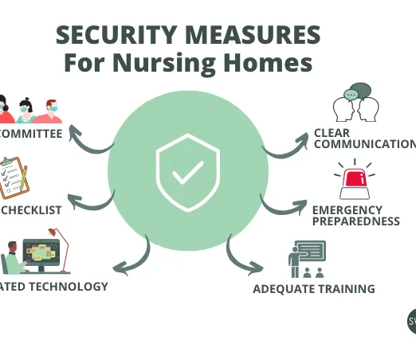


Conclusion
In conclusion, digital safety in sunrise residential care home is essential to shield privacy, dignity and wellbeing of residents, among the increase of digital technology for storing data, managing health records must assure robust cybersecurity measures are in place . Staff training, clear data protection policies, and protect systems all play a critical role in maintaining digital safety. By prioritizing digital security, care homes can build trust with service users and their loved ones while ensuring consent with legal and ethical standards.

Slide 24
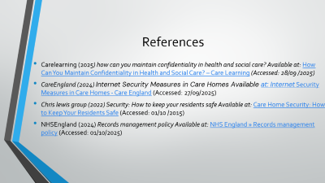
References
Carelearning (2025) how can you maintain confidentiality in health and social care? Available at: How Can You Maintain Confidentiality in Health and Social Care? – Care Learning (Accessed: 28/09 /2025)
CareEngland (2024) Internet Security Measures in Care Homes Available at: Internet Security Measures in Care Homes - Care England (Accessed: 27/09/2025)
Chris lewis group (2022) Security: How to keep your residents safe Available at: Care Home Security: How to Keep Your Residents Safe (Accessed: 01/10 /2015)
NHSEngland (2024) Records management policy Available at: NHS England » Records management policy (Accessed: 01/10/2025)

