Slide 1


Understanding and Engaging in the Customer Experience
Level 5 - Workshop 3
Cardiff WIAV
9th September 2015

Slide 2
Aim & Learning Outcomes
AIM(S)
  To instil a critical understanding of quality systems and controls for customers.
LEARNING OUTCOMES
Upon the successful completion of this module, the student should be able to demonstrate the ability to:
  evidence a critical understanding of quality process in the workplace;
  analyse the customers’ experience of an organisation;
  critically evaluate the benefits and challenges of developing and maintaining good customer relationships.
INDICATIVE CONTENT
  Quality modules and standards.
  Customer service.
  Customer centrality.
  Value and purpose of customer relationship management (CRM).
  Buyer seller relationships.
  Managing customer expectations.
  Buying decision making process: ethical considerations such as fair-trade, sustainable resources.
  Appreciation of the importance of quality control.
  Customer value.

Slide 3

Understanding and Engaging in the Customer Experience
Assessment
Critically analyse the factors that impact upon your organisation’s ability to maximise customer value
Demonstrate a critical understanding of your organisation’s quality processes and its effectiveness in meeting customer requirements
Notes:
How can an organisation maximise customer value? Value to the customer and value from the customer. What can impact on either of these? Critically analyse your organisation’s ability to do this? Best practice? Worst practice? Your practice? What could you do better?
Demonstrate a critical understanding - you show what’s good, or otherwise, in regard to your organisation’s quality processes. What are quality processes? What do they do? Meeting customer requirements……or even going beyond this to excite and generate loyalty!

Slide 4
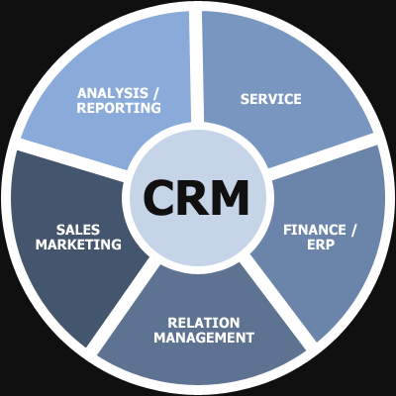
Understanding and Engaging in the Customer Experience
The story so far….
We’ve looked at CRM
  Function (Why we do it)
  Operation (Who, what, where, when and how we do it)
  Investigated Touch Points
  Customer Experience

Slide 5

Quality
Customers are looking for quality to be more than a thin veneer; they are looking for it to be the wood from which the whole organisation is cut (Patricia Wellington)
“Quality is not an act, it is a habit” (Aristotle)
Total Quality Management – TQM
4 key elements
EFQM Excellence Model

Slide 6
Definition of Quality
In small groups, pairs or individually, write down a definition of ‘Quality’.
5 mins. Then we will discuss your views.

Slide 7
Eight Dimensions of Quality
Performance
Features
Reliability
Conformance
Durability
Serviceability
Aesthetics
Perceived quality

Slide 8
Eight Key Quality Issues
Quality leads to lower costs and inspection is too late
The boardroom has ultimate responsibility for quality
Most defects are caused by the system
No process is optimised, it can always be improved
Fear degrades processes – provide job security
Managers must do more than respond to system failure
Build long term relationships with trusted suppliers
Prevention of variation and failure is the key
Source: W. E. Deming

Slide 9
Eight Routes to Poor Quality
Emphasis on short term profitability
Clamping down on cost but tolerating high waste levels
A ‘take it or leave it’ attitude towards customers
Treating employees as productive robots
Competing on price not sufficiently on quality
Buying at the lowest price
Anti - change but changing arbitrarily when forced
Macho management – the crisis manager
Source: UK Dept of Trade and Industry

Slide 10
Nine Parts to Juran’s Quality ‘Route Map’
Identify who are our customers
Determine the specific needs of those customers
Translate those needs into our language
Develop products that respond to those needs
Optimise product features to meet our needs too
Develop processes able to produce the products
Fine tune and optimise the process
Improve the process under operating conditions
Transfer the process to operations
Source: Joseph Juran
Juran, J. (1988). Quality Control Handbook 4th Edition US. McGraw-Hill

Slide 11
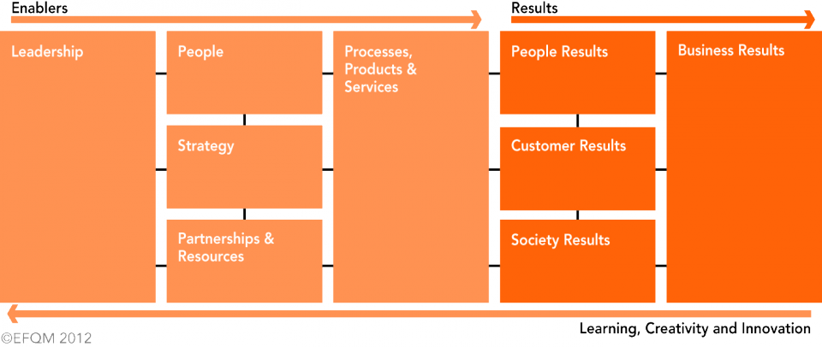
EFQM Excellence Model

Slide 12
Understanding and Engaging in the Customer Experience
Holistic
Policy focused upon Customers – not trite, but exemplified by performance
Customer Delight as a component of ‘Loyalty’
Cheapest v Unique ….avoid ‘Death Valley’!
Kano & Taguchi
Lean Principles
Piercy and the Customer Conundrum

Slide 13
Customer Satisfaction and Customer Loyalty
The goal is customer loyalty/retention because:
  retention enhances profitability dramatically
  costs of acquiring new customers are higher than costs of retaining old customers
  it maximizes customer lifetime value
  the causes of customer defection are often directly actionable
  Customer Satisfaction (what they think about us) and Customer Loyalty (share we take of their business) are different things!

Slide 14
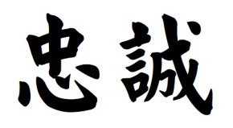
Loyalty Matrix
Hostage
(Pseudo-Loyal)
Apostle
(Supra-Loyal)
High
Loyalist (Loyal)
Customer Loyalty
Defector
(De-Loyal)
Low
Terrorist
(Anti-Loyal)
Mercenary
(A-Loyal)
Low
High
Customer Satisfaction
Source: Cartwright, R : Customer Relationships

Slide 15
The Real Customer Problem
Do we really know what service to maximize - or do we invest in creating “value” that customers do not want?
Can we deliver what we promise?
Can we track the impact of service and quality on customer satisfaction?
CS Measurement – collect the right data, interpret it effectively, and use it proactively

Slide 16
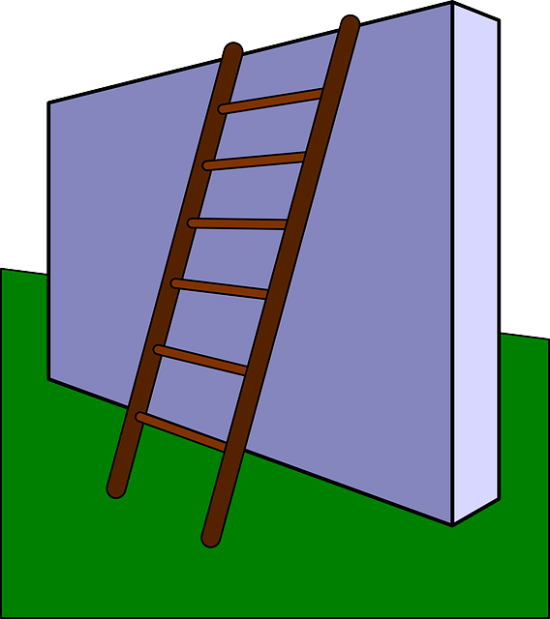
Research Suggests ...
Internal barriers to the effective use of CSM:
  internal politics (conflict and struggles for power)
  market simplification (CS does not really matter)
  customer fear (asking CS questions raises customer expectations)
  corporate culture (CS is a low management priority)
  market complacency (we already know what customers want)
  resources/capability (too difficult)
  logistics (who is the real customer?)
  cost barriers (CSM is too expensive)
  perceived market drivers (specs and price drive the market not CS)
  credibility (people do not believe the results)

Slide 17

Customer Satisfaction and the Internal Market
External Customer Satisfaction
High
Low
Synergy
“Happy customers
and “happy”
employees
Internal Euphoria
“Never mind the
customer, what
about the squash
ladder?”
High
Internal
Customer
Satisfaction
Coercion
“You WILL be
committed to
customers -
or else….”
Alienation
“Unhappy”
customers
and “unhappy”
employees
Low

Slide 18
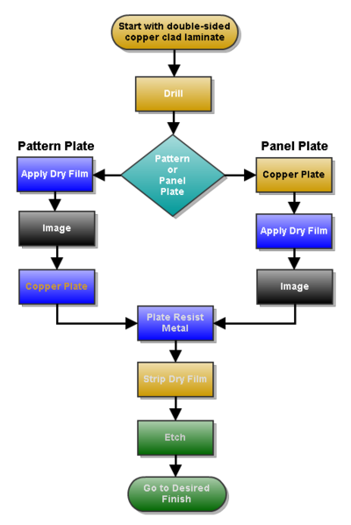
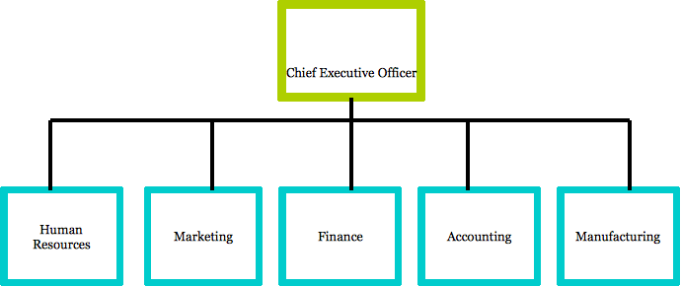
Internal Customer Satisfaction
Total Quality approach
Need a focus on Process, rather than Function
What does this mean? What are the benefits of this?

Slide 19
Lean Thinking
Womack, J.P. and Jones, D.T. (2003) Lean Thinking: Banish Waste And Create Wealth In Your Corporation, Canada: Distican
5 Principles of Lean
    Specify what creates value from the customers perspective.
    Identify all steps across the whole value stream.
    Make those actions that create value flow.
    Only make what is pulled by the customer just-in-time.
    Strive for perfection by continually removing successive layers of waste.

Slide 20
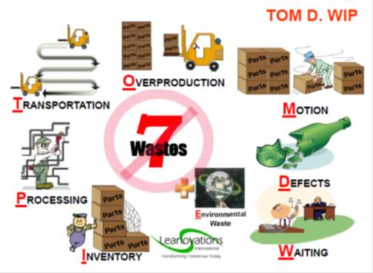
Waste - Muda

Slide 21
Process Focus
How things are done
Flowcharting
Value Stream Mapping
Process Activity Mapping
Value-Add v Non Value Add
Process Controls
Training & Education

Slide 22
Process Focus
Continuous Improvement
Internal/External Customer Focus
Process Measures
Feedback and Action
Adherence to the 5 Principles
Application of philosophy, methodologies, tools and techniques in pursuit of…..?

Slide 23
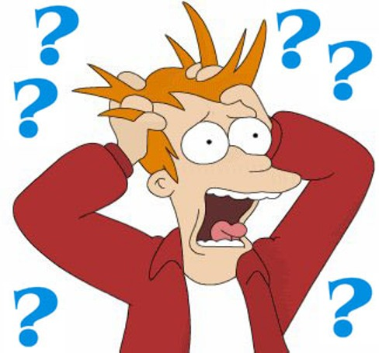
Questions

