Slide 1
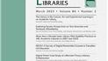
METHODOLOGICAL GUIDE
How to Conduct a
Systematic Literature Review
A Methodological Guide Based on Enang et al. (2022)
Policing and Society, 2022 • Evidence-Based Research Methodology

Slide 2
Introduction: What is a Systematic Review?
Definition
The Research Question
A systematic review is a methodical, transparent, and replicable approach to evidence synthesis that follows a predefined protocol to identify, select, appraise, and synthesize all relevant research on a specific question.
"How has vulnerability been assessed across law enforcement and public health organisations in countries belonging to the Organisation for Economic Co-operation and Development (OECD)?"
Unlike narrative reviews, systematic reviews employ rigorous methodologies to minimize bias and provide reliable evidence for policy and practice.
This question guided the entire review process, from search strategy development to data synthesis.
PRISMA Methodology
Reducing Bias
Expert Advisory Group
The Preferred Reporting Items for Systematic Reviews and Meta-Analyses (PRISMA) provides a 27-item checklist ensuring transparent and complete reporting of systematic reviews and meta-analyses.
Multiple reviewers, explicit eligibility criteria, comprehensive search strategies, and quality appraisal minimize selection bias and ensure reliable, reproducible findings.
Consulting 26 senior stakeholders, including those with lived experience, ensures research relevance, validity, and practical applicability.
Source: Enang et al. (2022) • Policing and Society, 32(4), 540-559

Slide 3
01
Define Research Question & Eligibility Criteria
Research Question Framework
Inclusion/Exclusion Criteria
A well-formulated research question is the foundation of a systematic review. It should be specific, focused, and answerable using research evidence.
Explicit eligibility criteria are essential for systematic selection and to allow replication. Criteria must be documented and consistently applied.
Inclusion Criteria
Exclusion Criteria
PICO Framework:
• Directly related to vulnerability and its assessment
• Book chapters and reviews
Population: Adults using LEPH facilities
• Adult population (16+ years) using LEPH facilities
• Research commentaries
Intervention: Vulnerability assessment
• LEPH professional groups included
• Non-peer-reviewed articles
Comparison: Varied approaches
• OECD countries only
• Grey literature
Outcomes: Effective components
• English language publications
• Articles not explicitly discussing vulnerability
• Peer-reviewed articles only
• Related concepts without vulnerability focus
• Publications between 2000-2018
• Non-English publications
Geographic Scope
Time Period
Expert Input
OECD countries only, ensuring similar political, legislative, and socio-economic structures for better comparison.
2000-2018: Lower limit ties to Adults with Incapacity (Scotland) Act 2000; upper limit marks search date.
26 senior LEPH stakeholders and people with lived experience advised on research priorities.
Source: Enang et al. (2022) • Policing and Society, 32(4), 540-559

Slide 4
02
Develop Search Strategy
Boolean Operators
Databases Searched
Search Results
Combine search terms using BOOLEAN operators to create precise, reproducible searches:
CINAHL
82
MEDLINE
Total identified
OR
Expands search within concepts
PsycINFO
Criminology Collection
61
AND
Narrows by combining concepts
Sociology Collection
Criminology/Sociology
21
Health databases
Search String Components
S1
Law Enforcement
S2
Public Health
S3
Vulnerability
S4
Assessment
S5
Collaboration
law enforcement OR police OR policing OR criminal justice
public health OR mental health OR psychol* OR psychiat*
vulnerab* OR distress OR access OR adult support
assess OR at risk OR identi* OR review
training OR collabo* OR coordinat* OR communicat*
235,824 articles
275,941 articles
217,147 articles
949,385 articles
389,080 articles
Final Combination (S6): S1 AND S2 AND S3 AND S4 AND S5 = 82 articles
Source: Enang et al. (2022) • Policing and Society, 32(4), 540-559

Slide 5
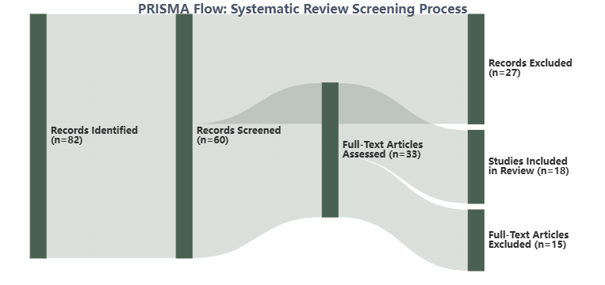
03
Systematic Screening Process
PRISMA Flow Diagram
Two-Stage Screening
Stage 1
Title & Abstract
IE screened all titles and abstracts against eligibility criteria, removing obviously irrelevant articles.
Stage 2
Full-Text Review
Remaining papers were read in full and included/excluded based on eligibility criteria.
Quality Assurance
Multiple reviewers enhance reliability and reduce bias:
Author 1 conducted initial screening
Random sample cross-checked by Authors 2, 4, and 7
Full consensus achieved on all inclusions/exclusions
82
60
33
18
Identified
Screened
Assessed
Included
Database search
After duplicates
Full-text review
After quality check
Source: Enang et al. (2022) • Policing and Society, 32(4), 540-559

Slide 6
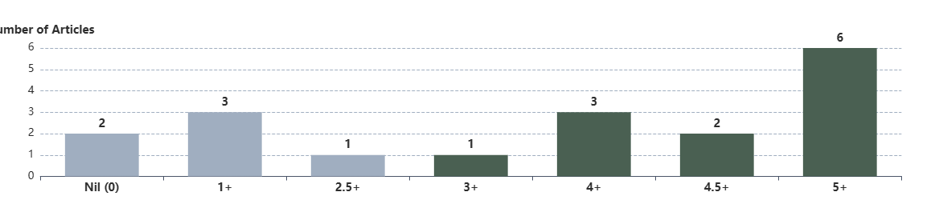
04
Quality Appraisal
Assessment Framework
Five Assessment Criteria
Quality appraisal ensures included studies meet minimum standards. Enang et al. used checklists based on CRD guidance.
1
Appropriate methods: Study design suitable for research question
Quality Assurance Process:
2
Data collection: Clear description of procedures and instruments
• Author 1 assessed all 18 full texts
3
Data analysis: Appropriate analytical techniques applied correctly
• Random sample cross-checked by Authors 2, 4, and 7
• Full consensus achieved through discussion
4
Data quality: Evidence of rigorous data validation
• No third assessor needed (no disagreements)
5
Sampling methods: Appropriate sample size and selection
Quality Appraisal Scoring Distribution
Scoring System
Key Findings
Best Practices
Nil (0): No criteria met
• Most papers scored highly
• Use established checklists (e.g., CASP, JBI)
1+: One criterion fully met
• 6 papers achieved 5+ scores
• Pilot test appraisal criteria
5+: All five criteria fully met
• Only 2 papers scored nil
• Ensure inter-rater reliability
0.5+: One criterion partly met
• 15 papers excluded after quality review
• Exclude low-quality studies
• Document all decisions
Source: Enang et al. (2022) • Policing and Society, 32(4), 540-559

Slide 7
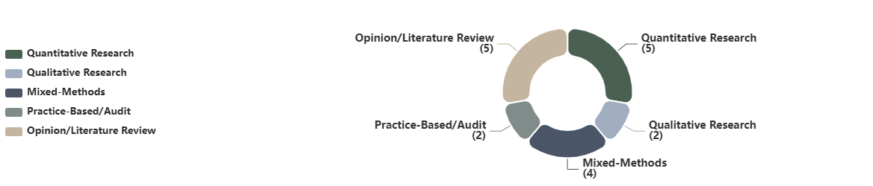
05
Data Extraction & Synthesis
Narrative Synthesis Approach
Data Extraction Process
Software Support
For heterogeneous data, a modified narrative synthesis framework (Popay et al., 2006) is recommended.
Systematic extraction of key findings by Author 1, with a random sample blind cross-checked by Author 2.
NVivo 11
Synthesis Process:
Extract key findings from each paper
Qualitative data analysis software used to support thematic analysis and identify effective components.
• Developing theory: Preliminary framework
Blind cross-check random sample
• Preliminary synthesis: Extract key findings
• Exploring relationships: Patterns across studies
Discuss findings and resolve differences
Benefits: Systematic coding, theme development, team collaboration
• Robustness testing: Validate themes
Group into overarching themes
Classification of Papers by Research Type
5
2
4
2
5
Quantitative
Qualitative
Mixed-Methods
Practice-Based
Opinion/Review
Statistical analysis
Thematic analysis
Combined approaches
Audit/project
Policy papers
Source: Enang et al. (2022) • Policing and Society, 32(4), 540-559

Slide 8
Results: What the Review Found
Key Finding
Geographic Distribution
No tools or guidelines for broad vulnerability assessment applicable across LEPH were identified.
6
6
United Kingdom
United States
However, the review identified four key themes of effective vulnerability assessment practices.
5
1
Australia
Netherlands
1
Prevention
2
Diversion/Triage
3
Interventions
4
Training
Early identification of risk profiles through inter-agency collaboration.
Redirecting individuals to appropriate services instead of criminal justice or emergency care.
Screening-based approaches and cross-agency working for vulnerable populations.
Essential for all LEPH professionals to improve competence and confidence.
• Mental health disorders in custody
• Court Liaison Services (CLS)
• Elder abuse screening tools
• CIT training effectiveness
• Elder abuse indicators
• Crisis Intervention Teams (CIT)
• Psychological vulnerability screening
• Intellectual disability awareness
• Radicalization risk factors
• Pre-arrest diversion schemes
• Mental state examinations
• Mental health crisis response
• HIV/AIDS risk behaviors
• Community outreach programs
• Joint agency investigations
• Cross-professional learning
Focus: Secondary prevention
Goal: Reduce arrests
Challenge: Information sharing
Gap: 84% minimal training
Critical Gap in Evidence
Only one study had a combined LEPH focus. The remaining 15 had a predominantly law enforcement focus, and 2 had a public health focus. This highlights the urgent need for more integrated research across LEPH boundaries.
Source: Enang et al. (2022) • Policing and Society, 32(4), 540-559

Slide 9
Discussion: Strengths, Limitations & Best Practices
Strengths of the Review
Limitations & Considerations
Methodical Rigor
Language Bias
First systematic review to synthesize effective components for vulnerability assessment across LEPH.
English language only may have excluded relevant non-English studies.
Transparent Processes
Explicit eligibility criteria, comprehensive search strategies, and detailed methodology allow replication.
Publication Type
Peer-reviewed articles only excluded grey literature and practice-based evidence.
Multiple Reviewers
Four reviewers involved in data extraction, screening, appraisal, synthesis, and reporting to reduce bias.
Definition Narrowness
Expert Advisory Group
"Vulnerability" definition may have missed related concepts (e.g., mental health).
Six senior stakeholders actively advised on research priorities, design, and interpretation.
Skewed Focus
15 law enforcement vs. 2 public health studies limits generalizability.
Recommendations for Future Reviews
Broader Definitions
Include Grey Literature
Cross-Professional Collaboration
Consider broader vulnerability definitions and expand keyword searches to capture related concepts.
Incorporate practice-based evidence, policy documents, and reports for comprehensive understanding.
Engage stakeholders from all relevant professions and include people with lived experience.
Key Insight: Systems-Level Thinking
The review emphasizes the need for a whole systems approach with collaborative leadership. Vulnerability assessment requires integrated prevention, diversion, intervention, and training. Future research must bridge academic-practice divides.
Source: Enang et al. (2022) • Policing and Society, 32(4), 540-559

Slide 10
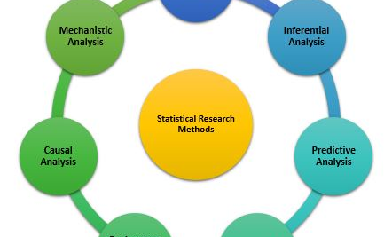
Conclusion: Key Takeaways for Researchers
1
Clear Questions
2
Comprehensive Search
3
Systematic Screening
4
Quality Appraisal
5
Appropriate Synthesis
Formulate specific, focused, and answerable research questions using frameworks like PICO.
Use multiple databases with Boolean operators, and document the search strategy.
Apply two-stage screening with multiple independent reviewers to reduce bias.
Use validated checklists to assess methodological rigor and exclude low-quality studies.
Employ narrative synthesis for heterogeneous data using established frameworks.
The Systematic Review Journey
A rigorous systematic review requires methodical rigor, transparent processes, multiple reviewers, and expert consultation. Each step builds upon the previous, creating a foundation for reliable evidence synthesis.
As demonstrated by Enang et al. (2022), systematic reviews can reveal critical gaps in research, such as the lack of integrated LEPH studies.
Future researchers should build on this by incorporating broader definitions, grey literature, and diverse stakeholder perspectives.
The journey from question to synthesis is demanding but essential for producing credible, policy- and practice-relevant evidence.
Full Citation
Enang, I., Murray, J., Dougall, N., Aston, E., Wooff, A., Heyman, I., & Grandison, G. (2022). Vulnerability assessment across the frontline of law enforcement and public health: a systematic review. Policing and Society, 32(4), 540-559. https://doi.org/10.1080/10439463.2021.1927025
This presentation is based on the methodology and findings from the systematic review by Enang and colleagues, published in Policing and Society in 2022.

