Slide 1
BMIH6007 International Meetings Management for the Hotel Industry
Student name: Nicusor Florin Mistode
Student ID: 2246469
Title: Feasibility Plan for an International Meeting / Event.
Planner Name: Nicusor Florin Mistode
Event Name: Croeso Cymru International Forum 2025: Culture, Cuisine & Connectivity
Location: Cardiff, Wales
Date: 19–20 May 2025
Theme: Celebrating the “Croeso” spirit – a warm Welsh welcome to the world
I confirm that I have not used any AI tools in the research and creation of this assignment. I confirm that I have not presented any AI generated materials as my own work. I confirm I have copies of my drafts, notes, and other resources I used, which I may be asked to provide in evidence.

Slide 2

Introduction
To launch the 2-day international MICE event to promote Wales as a premium tourism and hospitality destination (Fox et al., 2014).
Reflects Visit Wales ‘2025 ‘Year of Croeso’ theme of warmth, inclusivity and cultural celebration (Visit Wales, 2025).
Experience, sustainability and networking come together to position Wales for the world.

Slide 3

Event Content and Context
The proposed event is an international 2-day MICE (Meetings, Incentives, Conferences and Exhibitions) event aimed at promoting Wales as a destination for premium quality tourism and hospitality.
This ties in with Visit Wales’ 2025 theme: fer brics in the 'Year of Croeso', which is centred around giving off warmth, inclusiveness and celebration of the culture (Visit Wales, 2025).
Welsh chefs and culinary demos by Welsh chefs will teach inclusive hospitality and rural tourism development workshops. There will also be keynote speakers from Visit Wales and global tourism boards.
There will also be meetings in breakout sessions regarding sustainable tourism, digital storytelling and innovation, all topped off by an evening gala with live performances comprising a male voice choir and a bilingual MC (Rogers and Wynn-Moylan, 2022).
It does this by offering cultural immersion as well as the creation of long-term professional partnerships and investment in Welsh tourism.
There will also be mini familiarisation trips to various Welsh destinations post-event (Getz and Page, 2019).

Slide 4
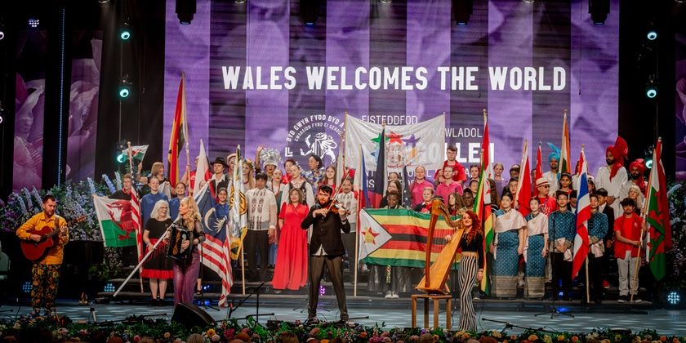
Market Factors: Target Market
International and UK-based travel agents, tour operators, travel journalists, content creators creating food and culture content, investors and corporate planners looking at potential in emerging MICE markets make up the primary targeted audience.
Welsh tourism and food producers, as well as cultural institutions and small-to-medium hospitality businesses interested in collaboration and promotion of their presence in the regional tourism and cultural sectors, are our secondary audience.
Visit Wales (2023) states that 63% of tourists are taking cultural experiences into account, and the European Travel Commission (2024) found that there is a rise in interest in alternative, regional, ‘authentic’ destinations.
According to Skift (2024) Global Travel report, it reveals that post-COVID travellers seek immersive, off-the-beaten-path experiences that Wales alone and distinctively offers.
The event falls in mid-May, thus it avoids peak summer crowds and perfectly matches up with global travel calendars, making it more accessible and attractive for the international traveler, as well as the domestic traveler.

Slide 5
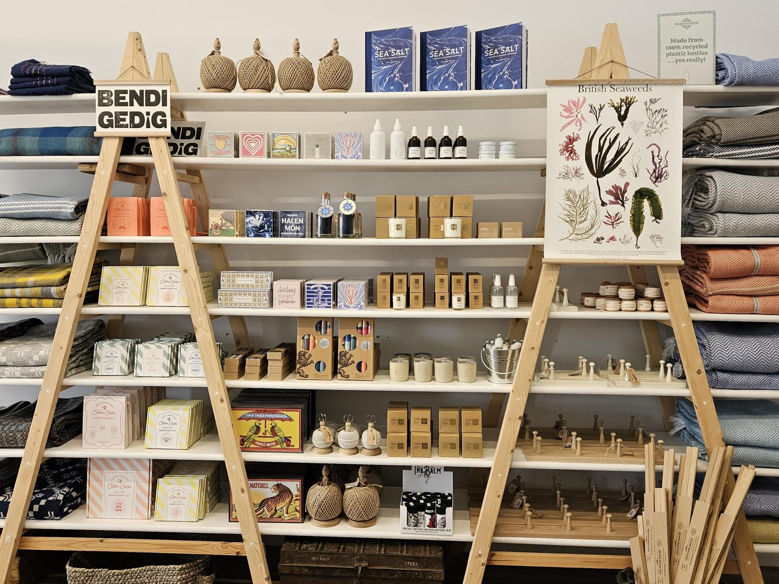
Market Factors: Demand, Supply & Competition
In the context of demand, more than 80 per cent of travellers consider sustainability important, and demand for meaningful, sustainable travel is rising. The UK’s MICE industry is set to grow at a CAGR of 7.2% from 2023 through 2028 (Bennett, 2023).
The event meets demand by creating a sustainable, immersive experience, by sourcing the event locally and with zero plastics, combining carbon-conscious practices with culturally enriching experiences, storytelling, history, and food.
In the context of supply, Welsh Lamb, Halen Môn salt and Wales’s heritage and modern venues, the Wales Millennium Centre, are some of the high-quality regional Welsh producers Wales has to offer, and its transport links via Cardiff Airport and mainline trains are also excellent (Graves, 2022).
In the context of competition, there are events such as World Travel Market London or the Edinburgh Tourism Showcase, but none offer such a place-based identity as Croeso Cymru International Forum, harnessing the power of bilingualism and local heritage, and making it part of the journey.
The forum is setting itself apart by embracing inclusivity, authenticity and regional investment, all of which dovetail alongside the Welsh Government’s tourism-led economic development strategy from which to drive sustainable growth and community involvement.

Slide 6
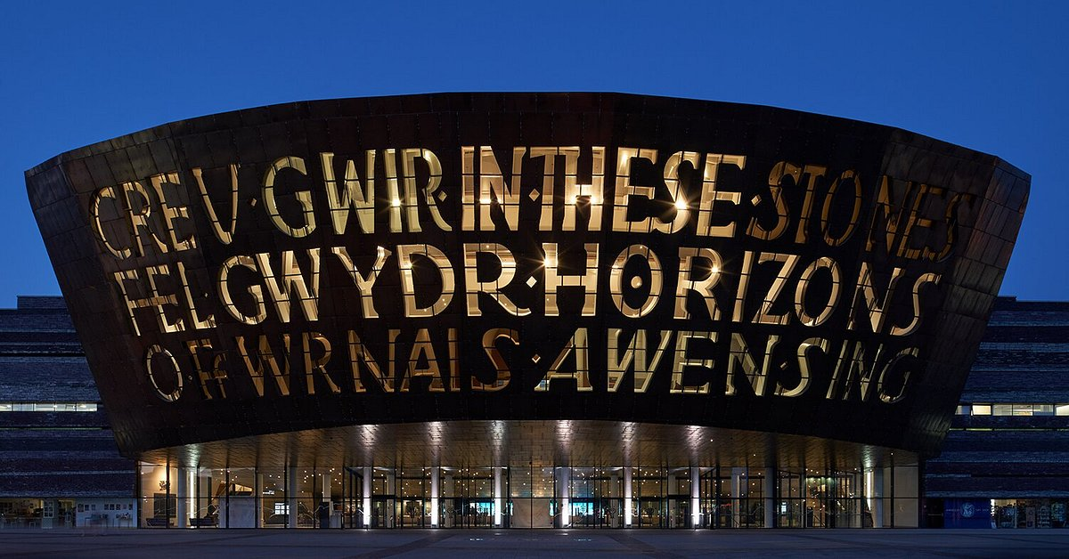
Operational Factors: Venue Suitability
Both venues are centrally located in Cardiff with excellent transport links via rail, air, and bus transport and are thus easily accessible to international delegates who will also find the city of Cardiff and the venues easy to travel to and attend (Adams et al., 2022).
State-of-the-art multifunctional spaces, such as theatre-style auditoriums and exhibition halls, which are fully suited to keynote speeches, workshops and cultural showcases in the international conference environment, are provided by Wales Millennium Centre.
Cardiff City Hall offers an elegant, heritage-rich venue which perfectly fits with the ‘Year of Croeso’ theme, offering cultural immersion which is enthused with a sense of celebration along with prestigious networking and formal receptions.
The two venues can accommodate large delegate numbers (500 – 700) and have flexible layouts, professional AV, interpretation booths, and lighting systems for bilingual sessions, and different types of event formats.
Both of these venues have ISO14001 sustainability certification, and provide inclusive access and are close to 4-star hotels, local cuisine and attractions, which brings comfort, convenience and environmental responsibility to attendees (Jones, 2022).

Slide 7
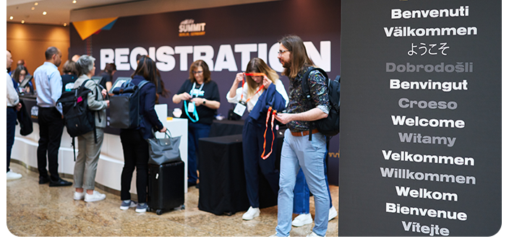
Operational Factors: Staffing and Resources
Core team members include the Event Director for planning and working with stakeholders, Marketing & Sponsorship Manager (PR, social media), Logistics Lead (transport, venue, setup) and Hospitality Coordinator (delegate care, catering, accessibility) (Meredith, 2022).
In doing so, 20–30 university event management students will volunteer in roles such as registration, wayfinding, session support and social media reporting, in ensuring an event can run smoothly.
Contracted suppliers included in this team are using a local AV team for lighting, sound and translation, caterers including Hang Fire BBQ and Penylan Pantry and our venue security and cleaning teams.
Provision of a first aid station with staff trained to deal with event situations, a quiet prayer room for inclusivity reasons, EV charging points, recycling bins and bilingual signage (English and Welsh) for accessibility (Shamim, 2022).

Slide 8
Financial Factors: Budget Breakdown
Expenditure
Category | Estimated Cost
Two days' rent of the Venue | £15,000
Welsh Menu and Tastings catering | £12,000
Cost of interpretation, technology and AV | £8,000
Expenses for volunteers and staffing | £6,000
Expenses for the digital campaign and marketing | £10,000
Cost of decor and event branding | £3,500
Contingency, Insurance, Legal | £3,000
Sustainable Materials such as signage, reusables and others | £2,000
Miscellaneous expenditure such as badges, transport and others | £2,500
Total Expenditure | £62,000
Projected Surplus | £28,000
Income
Source | Projected Amount
Government grants from Visit Wales | £25,000
Commercial sponsorships by Airlines, Hotels, Tourism suppliers and others | £15,000
Booth fees for exhibitors will be (£1,000 x 20) | £20,000
Delegate tickets (£50 each at 500) | £25,000
Advertisement and merchandise promotions | £5,000
Total Income | £90,000

Slide 9

Financial Sustainability and ROI
Logos placements, exhibition booths and speaking slots of a sponsor are visible and provide visibility to a sponsor within the sponsorship tiers, helping engage with an international tourism-focused audience (Bowdin et al., 2023).
It is anticipated that the media coverage will reach 10–15 million people worldwide, creating highly valuable PR and helping to build Wales’ international tourism profile under the Croeso 2025 campaign.
Each exhibitor is expected to guarantee a minimum of thirty targeted B2B meetings with those exhibiting, all to develop business and cultivate long-lasting trade relations with worldwide tour operators (Dolores et al., 2021).
Participating agents would lead to more destination bookings for 2026 and 2027, and drive up Wales’ tourism revenues and tourism businesses.
The success of the event will leave a legacy series under the Croeso brand, which could in turn generate recurring economic and promotional value to Wales on a biennial basis.

Slide 10

Strategic Justification
It contributes to the Wales Tourism Strategy 2020–2025, supporting inclusive tourism, regional dispersal, and delivering prosperous socio-economic outcomes to Welsh local communities and businesses over the long term (Jackson, 2025).
The event boosts international trade and strengthens local economies by providing export-ready international trade opportunities between Welsh SMES in food, culture, hospitality and the global buyers.
Wales is positioned as the authentic, bilingual destination in terms of global visibility, recognition of culture and national branding related to Visit Wales’s globalisation aims.
People might begin to discover less familiar Welsh destinations such as Pembrokeshire and the Brecon Beacons, spreading the reach more widely while taking pressure off the usual tourist meccas (Mishin and Mishin, 2021).
The event promotes sustainable tourism by working with eco-minded tour operators on the offer, championing responsible travel and backing Wales’ net-zero and environmental aspirations.

Slide 11
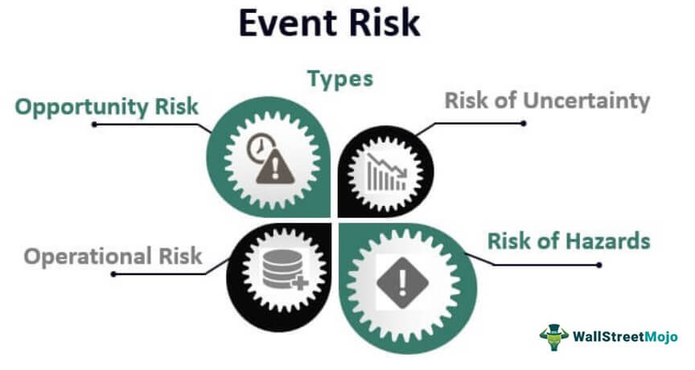
Risk Analysis and Mitigation
Poor ticket sales may occur, but early promotions, influencer marketing and other marketing will drive the interest and increase early international registrations.
Withdrawal of key sponsors could jeopardise funding, so make sure there are contracts and backup sponsors if the event no longer has them there.
Catering or tech supplier absence can disrupt the part, wreaking havoc on an event that’s driven by attendees’ experience; failure to have a reliable backup leaves both event day performance and attendees dissatisfied (Sharafat et al., 2021).
An organisation can manage differential public perception efficiently through a crisis communication plan and pre-approved content in the case of a negative attack on the press or social media.

Slide 12
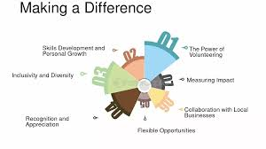
Event Legacy and Community Impact
Promotion of the Welsh language and culture worldwide; encouraging national identity and raising awareness of Wales as a unique destination all over the world.
Rural regions benefit from increases in tourism to the region and the aid of micro businesses such as chefs, artisans, and independent tour guides (Dolores et al., 2021).
Opportunities for providing practical event experience to students, which inspires them with the possibility of a career in hospitality, tourism, and events through volunteering and interning.
It allows us to build community pride through national and international media exposure, as well as garnering funding and support for future grassroots “Croeso” cultural initiatives.

Slide 13

Conclusion
The Croeso Cymru International Forum have a strategically timed, financially viable, and deliverable operational opportunity.
This section makes a meaningful contribution to the Year of Croeso (Welsh Welcome) through putting Wales before the world as welcoming, inclusive and globally connected.
With the correct partnerships, professional planning and set goals, this event can serve to impact, leave a legacy and open up Wales on an international level.

Slide 14
Reference
Adams, J., Davies, J., Davies, G.T., Davis, J., Forster, W., Gray-Williams, E., Jones, A., Jones, G., Kinsella, B., Lewis, R. and Parnaby, R., Touchstone 2022 is published by the Royal Society of Architects in Wales.
Bennett, P. (2023). Survey of travellers finds 76% want more sustainable options. World Economic Forum. Available at: https://www.weforum.org/stories/2023/04/survey-of-travelers-finds-76-want-more-sustainable-options/.
Bowdin, G.A., Allen, J., Harris, R., Jago, L., O'toole, W. and McDonnell, I., 2023. Events management. Routledge.
Dolores, L., Macchiaroli, M. and De Mare, G., 2021. Sponsorship’s financial sustainability for cultural conservation and enhancement strategies: An innovative model for sponsees and sponsors. Sustainability, 13(16), p.9070.
European Travel Commission (2024). European Tourism Reaches New Highs In 2024 As Travellers’ Plans Diversify. Available at: https://etc-corporate.org/uploads/2024/07/ETC_European-Tourism-Trends-and-Prospects-Q2-2024_final.pdf.
Fox, D. et al. (2014). Doing events research: from theory to practice. Routledge: Oxford
Getz, D. and Page, S. (2019) Event studies: theory, research and policy for planned events. 3rd Edition. Routledge: Oxford
Gov.Wales (2025). 2025: Year of Croeso in Wales. Janetredlertravelandtourism.co.uk. Available at: https://www.janetredlertravelandtourism.co.uk/news/2025-year-croeso-wales/.
Graves, C., 2022. Welsh Food Stories. University of Wales Press.
Jackson, T., 2025. The Care Economy. John Wiley & Sons.
Janjusevic, J. and Mathur, S., 2021. Financial Planning and Budgeting of Events. Event Project Management: Principles, technology and innovation, Oxford: Goodfellow Publishers.
Jones, B., 2022. International Sustainable Ecological Engineering Design for Society (SEEDS) Conference 2022: Abstracts.
Meredith, J. (2022). Project management: a managerial approach
Mishin, Y.V. and Mishin, A.Y., 2021. Increasing the level of justification of state strategic planning. In SHS Web of Conferences (Vol. 94, p. 01013). EDP Sciences.
Rogers, T. and Wynn-Moylan, P. (2022) Conferences and conventions: a global industry. 4th Edition. Routledge: Oxford
Shamim, M., 2022. The Digital Leadership on Project Management in the Emerging Digital Era. Global Mainstream Journal of Business, Economics, Development & Project Management, 1(1), pp.1-14.
Sharafat, A., Latif, K. and Seo, J., 2021. Risk analysis of TBM tunneling projects based on generic bow-tie risk analysis approach in difficult ground conditions. Tunnelling and Underground Space Technology, 111, p.103860.
Skift (2024). State of Travel 2024: Travel in 350 Charts. Skift Research. Available at: https://research.skift.com/reports/state-of-travel-2024/.
Visit Wales (2023). Visit Wales Tourism Market Demand Report – US May 2023. www.gov.wales. Available at: https://www.gov.wales/sites/default/files/statistics-and-research/2023-07/visit-wales-tourism-market-demand-report-us-may-2023.pdf.
Visit Wales (2025). Wales is celebrating a Year of Croeso, a Welsh welcome for visitors. TravelTrade. Available at: https://traveltrade.visitwales.com/useful-information/toolkit/year-of-croeso.

