Slide 1

Student Name : Tamanna Chowdhury Student ID Number:2020854
Module: Problem Solving and Decision Making
Module code: BMSW 4004
Module Coordinator: Chijioke Uba
Assignment Title: Problem Solving and Decision Making
Task 1- Presentation

Slide 2

Staff Shortage in Propercare
Propercare is a UK adult care provider
Currently facing significant staffing issues
Directly impacting on patient care and staff experience

Slide 3
Nature of the Problem
NHS hospitals, mental health and community providers reporting a shortage of FTE staff
Nurses vacancies currently 41,000 (NHS Improvement , 2018)

Slide 4
Nature of the Problem
Vacancies are rising in Adult Social Care
(Skills for Care, 2018)
Short and medium term workforce shortages has created due to Brexit
(NHS Digital, 2018)
Undergraduate Nurse Training applicants has reduced
(UCAS, 2018)
Impacting people’s care
(Care Quality Commission, 2018)

Slide 5
PESTLE Analysis of the Problem
PESTEL analysis is a useful tool to identify external factors which impacted on organization.
Political- Brexit , Government Policy
Economical- Unemployment rate, economical growth
Social- Career attitudes
Technological- Technological advancement
Legal- Employment law, Health and Safety law
Environmental- Covid -19, Weather

Slide 6
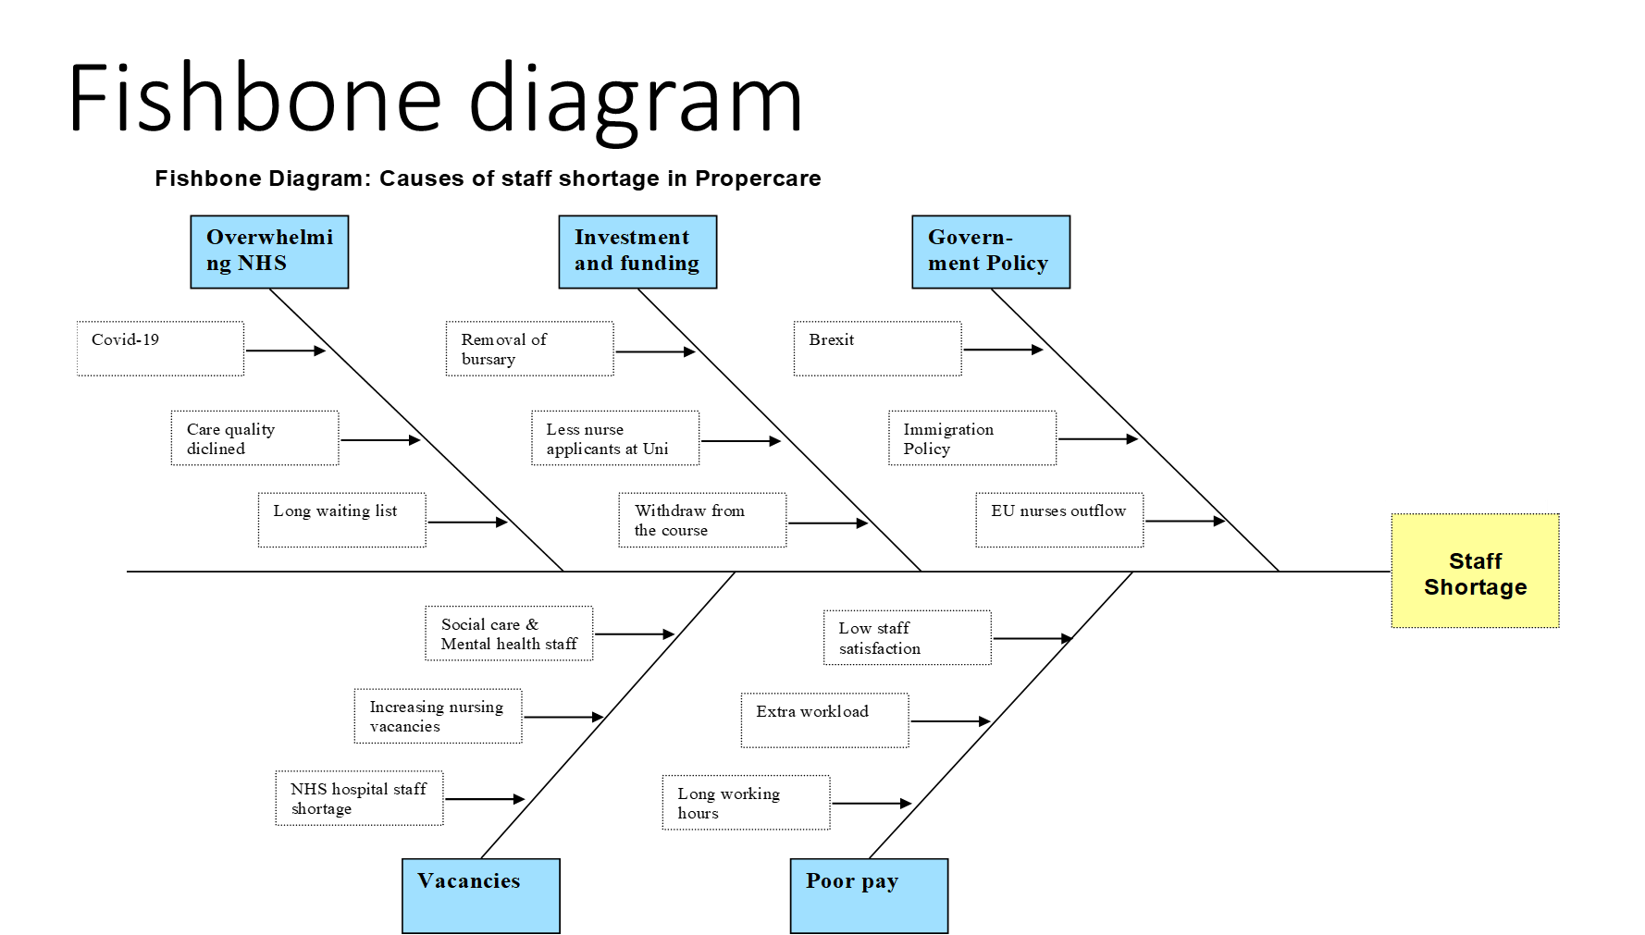

Slide 7

Identified Solution to the Problem
Increasing nursing numbers
Reform NHS in order to make a better place to work for all staff
Workforce planning in the future

Slide 8
PMI analysis for
Solution 1
‘Increasing nursing numbers’

Slide 9
PMI analysis for solution 2
‘Reform NHS in order to make a better place to work for all staff ‘

Slide 10
PMI analysis for solution 3
What’s good (+) | What’s bad (-) | What’s Interesting?
Workforce implementation plan for making the NHS a better employer (+5) Increase staff pay and opportunity (+3) | Long term policy implementation and funding (-5) | Implementation of the plan will increase effective workforce (+5)
Total= 8 | Total= -5 | Total= +5
‘Workforce Planning in the future’

Slide 11
Decision Making
According to PMI score-
Solution 2 ‘Reform NHS in order to make a better place to work for all staff ‘ is the best solution.

Slide 12
Conclusion
Problem solving follow a cycle

Slide 13
References
Adair, J. (2019) Decision Making and Problem Solving: Break Through Barriers and Banish Uncertainty at Work. Kogan Page Publishers.
Care Quality Commission (2018) State of Care. Available at: https://www.cqc.org.uk/publications/major-report/state-care (Accessed: 27 November 2022).
Health Education England (2019) HEE Board Meeting. Available at: https://www.hee.nhs.uk/about/how-we-work/board-meetings-papers/clone-hee-board-meeting-12-february-2019 (Accessed: 28 November 2022).
NHS Digital (2018) Data and Information. Available at: https://digital.nhs.uk/data-and-information/find-data-and-publications/supplementary-information/2019-supplementary-information (Accessed: 25 November 2022).
NHS England (2018) NHS Improvement. Available at: https://www.england.nhs.uk (Accessed: 28 November 2022).
NHS England (2019) The NHS Long Term Plan. Available at: https://www.longtermplan.nhs.uk/publication/nhs-long-term-plan (Accessed: 28 November 2022).
Perušić, M. et al. (2013) ‘ANALYSIS OF BUSINESS ENVIRONMENT AND BARRIERS’, Journal of Engineering & Processing Management, 5(1),pp.157-164.
Skills for Care (2018) Workforce intelligence. Available at: https://www.skillsforcare.org.uk/NMDS-SC-intelligence/Workforce-intelligence/publications/The-state-of-the-adult-social-care-sector (Accessed: 26 November 2022).
The Nuffield Trust (2019) Closing the gap. Available at: https://www.nuffieldtrust.org.uk/files/2019-03/1553101044_heaj6918-workforce-briefing-190320-web.pdf (Accessed: 27 November 2022).
The Health Foundation (2018) The health care workforce in England: make or break?. Available at: https://www.kingsfund.org.uk/publications/health-care-workforce-england (Accessed: 27 November 2022).
UCAS (2018) 2017 END OF CYCLE REPORT. Available at: https://www.ucas.com/data-and-analysis/undergraduate-statistics-and-reports/ucas-undergraduate-end-cycle-reports/2018-end-cycle-report (Accessed: 24 November 2022).
Williams and Steve, W. (2001) Making better business decisions [electronic resource] : understanding and improving critical thinking and problem-solving skills. London:SAGE Publication.

