Slide 1

Understanding the Role of Police Constable
BMPL4019
WEEK 3
Bluelightacademy@uwtsd.ac.uk

Slide 2

Last week
Understanding the role of constable:-
Powers (Arrest, seize, enter)
Legislation (ECHR, PACE)
PCSO
Alternatives to arrest

Slide 3

This week....
Decision making and discretion

Slide 4
The importance of decision making within the role of a police officer
Officers are expected to make many decisions during each shift that can have a profound impact on people’s lives.
These decisions must be made quickly and ethically, and are often scrutinised by others after the fact.
Decision-making in policing is not always easy and requires training and practice.

Slide 5
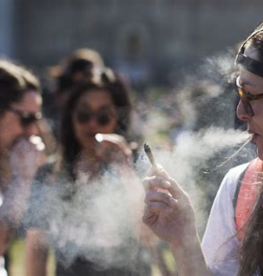
Scenario
You are on duty when you walk past a crowd of around 15 youths and there is a pungent smell of "Skunk".
What actions, if any, should you take?

Slide 6
Questions to ask yourself
Is a criminal offence taking place?
Whilst it is possible that the smell is not that of cannabis, but of something else, such as a legal herbal cigarette, this seems unlikely. Cannabis is a Class B drug, carrying up to five years in prison, an unlimited fine, or both, for anyone caught in possession.
Stop and search the person that you suspect of being in possession of cannabis?
The situation clearly requires more thought than the application of a simple decision.

Slide 7

Lets take a deeper look at this...
Can you see any practical problems with performing a S&S?
Practical problem of accurately identifying a suspect or suspects in the crowd.
You might also cause more harm than good; for example, a serious public order incident could arise as a result.
Questions to ask:-
Would a stop and search be proportionate in the circumstances? Are there reasonable grounds?
Officer are not to rely on the smell of cannabis alone when deciding to stop and search someone and instead use grounds based upon multiple objective factors’. Are there ‘multiple objective factors’ present in this situation that might justify stop and search, beyond the apparent smell of cannabis?

Slide 8

How about talking.....
One appropriate course of action to consider, is to talk with the group.
Just talk, and assess the group and the responses you receive. This might help you make a decision, whether you wish to withdraw and possibly make a ‘3 by 5 by 2’ intel report, or stop and search an individual, or some other course of action.
This is where discretion plays it's part.

Slide 9
Decision making
As a police officer you will be required to make dozens of these types of decisions during every shift.
Moreover, many of the decisions you will be expected to make as a police officer will make a difference to other people’s lives, in some cases a very profound difference.
Far-reaching decisions will need to be made on a frequent basis, in many cases very quickly and sometimes on your own.

Slide 10
The National Decision Model (NDM)
The National Decision Model (NDM) seeks to provide the decision-making basis and ethical underpinning to structure a rationale of what police officers do, or do not do, during policing activities such as attending an incident.
The model consists of a number of stages which police officers work through to aid decision-making, with the policing Code of Ethics being central.
The wording of the NDM is mainly drawn from operational police culture, but the intention is that anyone making decisions in the police service (both operational and non-operational) should use it.

Slide 11
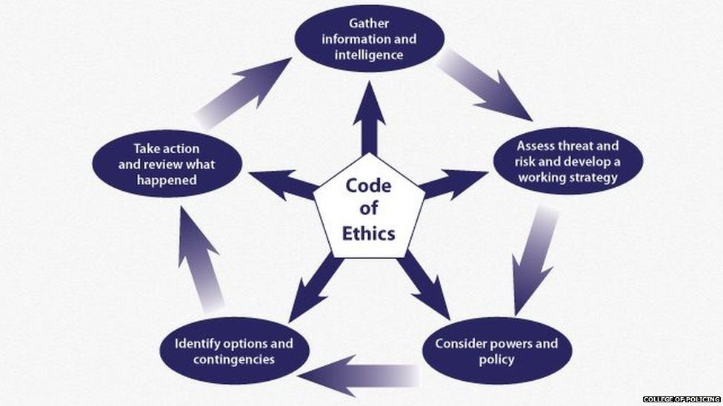
National Decision Model (NDM)

Slide 12
CIAPOAR
C-Code of Ethics is in the process of being revised but will remain at the centre of the NDM and is cross-referenced throughout.
I-Information-gather information and intelligence.
A-Assessment-assess threat and risk, and develop a working strategy.
P-Powers and policy-consider powers and policy.
O-Options-identify the options and contingencies.
A- Action-take action, and then
R- Review.

Slide 13
NDM
The NDM is ‘suitable for all decisions’ and can be applied to ‘spontaneous incidents or planned operations’.
However, there are clearly some situations, of a dynamic and potentially dangerous nature, where you simply won’t have the time to methodically work your way through all the stages of the NDM to determine what decision(s) to make.
However, even in these cases the NDM might still prove useful in terms of a structure for the subsequent writing up of notes and statements.
We will look over this in more depth next session.

Slide 14
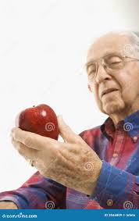
Ethical decision making and discretion in policing
Scenario- A shop owner has reported that a man has tried to steal groceries from the shop. You attend and the man is 94 years od, very confused with a bag of apples in his hand.
Has he carried out a theft?
Do you arrest him for theft?
They have committed a crime but there are mitigating circumstances: age and frailty must be taken into account, and proving ‘intention to permanently deprive’ (the basis of the Theft Act 1968) would be somewhat difficult.
Enforcing the law might not be the most appropriate response but police officers must be prepared to justify the reasons for any decision.

Slide 15
What is discretion?
"The freedom to decide what should be done in a particular situation."- (Oxford Dictionary, 2022)
Use of discretion (College of Policing, 2023)
Police discretion is necessary but must be used wisely. When using our discretion, we:
use our training, skills and knowledge about policing
are aware of the influence that biases (such as stereotypes or ‘group think’) can have on our actions and decisions
consider what we are trying to achieve and the potential effects of our decisions
ensure that we have a rationale for, and are able to explain, our use of discretion

Slide 16
Discretion
Police discretion has been a contentious issue and over time it has been curbed through legislation and various policies.
Discretion came to be seen as opportunity for officers to act in discriminatory ways according to their own prejudices and biases.
Communities lost trust in the police and the consequences were to be more directive and prescriptive in dictating how officers should deal with ever more situations.

Slide 17
Discretion
The arguments against discretion over recent years has been understandable given the arguments around institutionalized discrimination in the police, as recorded most recently concerning the MPS in Baroness Casey’s (2023) Report.
However, there are a number of reasons why discretion is an unavoidable, inevitable, and desirable aspect of policing.

Slide 18
Discretion
It is unavoidable and inevitable because policing in the British tradition is first and foremost about maintaining order and keeping the peace.
This is enshrined in the very concept of the office of constable, and Lord Scarman was at pains to remind the police of this in the aftermath of the 1981 Brixton Riots (Scarman, 1981).
Enforcing the law is a tool used by the police to achieve these ends, but only when it is appropriate to do so.

Slide 19
Discretion
Police discretion has been a contentious issue and over time it has been curbed through legislation and various policies.
Discretion came to be seen as opportunity for officers to act in discriminatory ways according to their own prejudices and biases.
Communities lost trust in the police and the consequences were to be more directive and prescriptive in dictating how officers should deal with ever more situations.

Slide 20
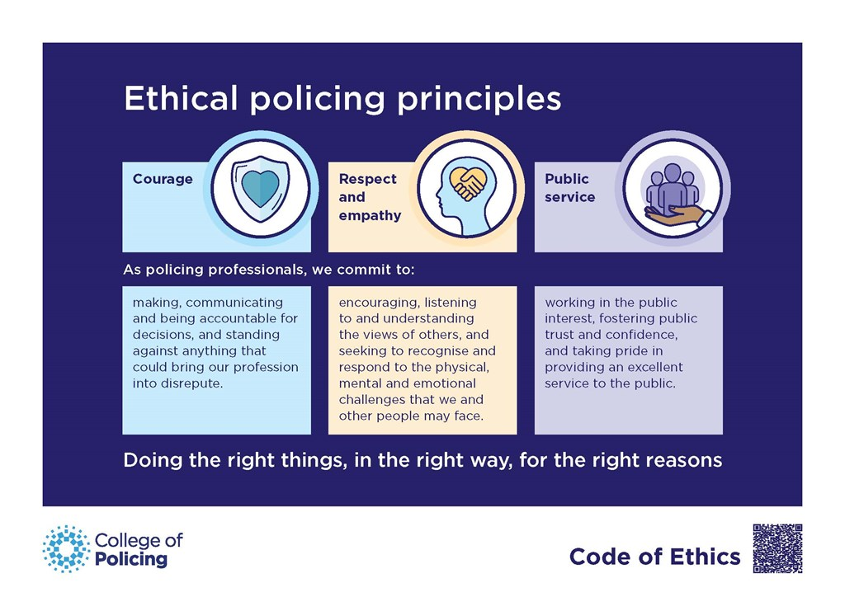
Code of Ethics and decision making
Ethical systems outline the basis for decision making by shaping what it means to be good.
Bruce-Smith et al (2023) identify three main approaches to ethical reasoning in their review underpinning the revision of the College’s Code of Ethics.
These are consequentialism, which focuses ethical reasoning on outcomes, deontological reasoning, which focuses on what we are duty bound to do through reason, and virtue ethics, which requires interpreting the specifics of a context as it relates to established values.

Slide 21
Discretion
Discretion is the art of making the most appropriate decision in each and every circumstance, a form of professional judgement that can be explained, justified, and legitimised as required.
It needs to be open and accountable and in this way it challenges all forms of discrimination, at the level of the corrupt officer, but also in institutional forms.
This understanding of discretion is recognised in the College’s revised Code of Ethics, which promotes an ethical approach to policing that is guided by the following three principles:-
prioritising public service
leading with professional courage
responding with respect and empathy

Slide 22
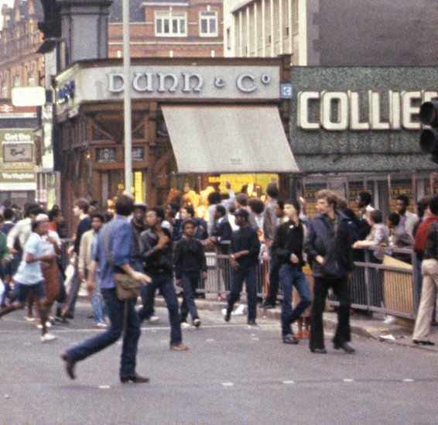
Task- 30 Mins
Research into the following cases:-
Group 1-Lynette Wallace
Group 2- GXW & KZA
Group 3- Brixton Riots
Group 4- Afzal Akmal V Commissioner of Police of the city of London

Slide 23
Is it ethical?
To help you apply ethical concepts in decision making, Davis (2014) suggested the use of ethical ‘tests’ and the tests below are adapted from his suggestions:
Harm test-Does this option do less harm than any alternative?
Rights test-Would this option violate anyone’s rights, especially a human right?
Colleague test-What might my colleagues say when I describe my problem?
Defensibility test-How would I defend my choice of this option before a local council meeting, a committee of my peers, or my parents?
Professional test-How would the Professional Standards Department view my decision?
Organisational test-How might the Chief Constable view my decision?
Virtue test-What would I become if I chose this option often?
Publicity test-Would I want my choice of this option published in the newspaper?
Is it ethical?

Slide 24

Any Questions?

Slide 25
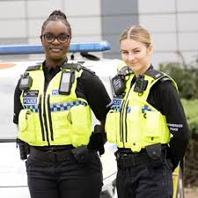
Session 2

Slide 26
NDM activity
Lets test the NDM.....

Slide 27
National Decision Model (NDM)

Slide 28
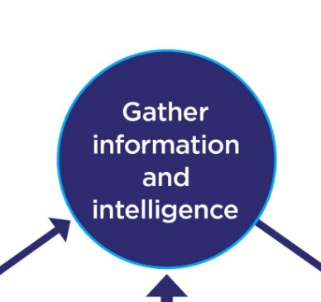
1st stage
What is happening?
What do I know so far?
What do I not know?
What further information (or intelligence) do I want/need at this moment?

Slide 29
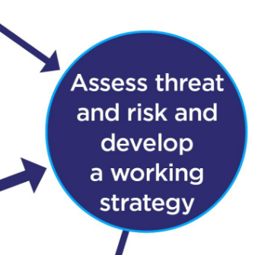
2nd Stage
Develop a working strategy to guide subsequent stages by asking yourself the following questions.
Do I need to take action immediately?
Do I need to seek more information?
What could go wrong (and what could go well)?
What is causing the situation?
How probable is the risk of harm?
How serious would it be?
Is that level of risk acceptable?
Is this a situation for the police alone to deal with?
Am I the appropriate person to deal with this?
What am I trying to achieve?
Will my action resolve the situation?

Slide 30
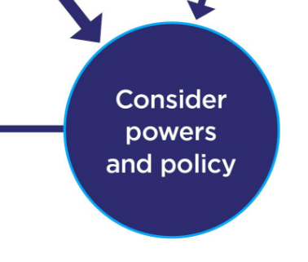
3rd Stage
What police powers might be required?
Is there any national guidance covering this type of situation?
Do any local organisational policies or guidelines apply?
What legislation might apply?
Is there any research evidence?

Slide 31
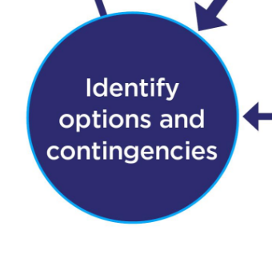
4th Stage
what options are available
immediacy of any threat
amount of time available
available resources and support
your own knowledge, experience and skills
impact of potential action on the situation and the public
what action to take if things do not happen as anticipated
If you have to account for your decision, will you be able to say it was:
proportionate, legitimate, necessary and ethical?
reasonable in the circumstances facing them at the time?

Slide 32
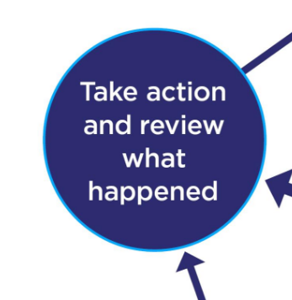
5th Stage
Action
Respond
Implement the option you have selected.
Does anyone else need to know what you have decided?
Record
If you think it is appropriate, record what you did and why.
Monitor
What happened as a result of your decision?
Was it what you wanted or expected to happen?
If the incident is continuing, go through the NDM again as necessary.
Review
If the incident is over, review your decisions, using the NDM. What lessons can you take from the event for future practice?

Slide 33
Now you decide....

Slide 34
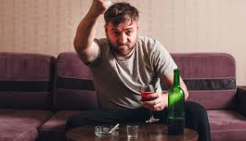
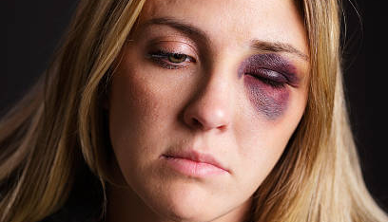
Scenario 1
Domestic Violence Call
You receive a call about a domestic disturbance. On arrival, you find a woman with visible injuries and a man who is intoxicated and aggressive.

Slide 35
1st stage
What we know:
A woman with visible injuries, a man who is intoxicated and aggressive.
What do we need to know?
The nature and severity of the injuries, any history of domestic violence, presence of weapons, and the safety of other potential occupants.

Slide 36
2nd Stage
Risks:
Immediate physical harm to the woman, potential escalation by the man, and possible involvement of others.
Threats:
Aggressive behavior from the man, intoxication increasing unpredictability.
Opportunities:
Remove the woman to safety, de-escalate the situation, gather evidence.

Slide 37
3rd Stage
Legal powers:
Arrest the man for assault/domestic violence, use reasonable force if necessary, enter the premises to prevent harm.
Policies:
Follow domestic violence protocol, prioritise victim safety, ensure all actions comply with human rights legislation.

Slide 38
4th Stage
Options:
Separate the parties, call for backup, arrest the man, provide medical attention to the woman.
Contingencies:
If the man resists arrest, use appropriate force; if the situation escalates, evacuate the premises and call for more units.

Slide 39
5th Stage
Actions taken:
Separate the parties, arrest the man, provide medical aid to the woman, gather statements and evidence, offer support services.
Review:
Ensure the woman's safety post-incident, review the use of force, debrief the team.

Slide 40
Any ethical considerations?
Prioritise the victim's safety and well-being.
Ensure fairness and respect in dealing with the suspect.
Maintain confidentiality and sensitivity.

Slide 41

Scenario 2
A suspicious package is reported in a crowded shopping centre. You are the first to arrive on the scene.

Slide 42
1st stage
Information and Intelligence
What we know:
Location of the package, crowded shopping centre.
What we need to know:
Possible contents of the package, origin, and any associated threats

Slide 43
2nd Stage
Assessment
Risks:
Potential bomb threat, mass casualties, panic among the public.
Threats:
Explosion, panic causing injuries.
Opportunities:
Evacuate the area, call the bomb squad, maintain public order.

Slide 44
3rd Stage
Powers and Policy
Legal powers:
Evacuate the area, cordon off the scene, request specialized units.
Policies:
Follow bomb threat procedures, prioritise public safety, manage crowd control.

Slide 45
4th Stage
Options and Contingencies
Options:
Evacuate the centre, use bomb disposal experts, use detection equipment.
Contingencies:
If the package detonates, manage casualties and coordinate with emergency services; if it’s a false alarm, reassure the public and conduct a thorough investigation.

Slide 46
5th Stage
Action and Review
Actions taken:
Evacuate the area, establish a perimeter, call bomb disposal, communicate with the public.
Review:
Evaluate the response effectiveness, improve evacuation procedures, review communication strategies.

Slide 47
Any ethical considerations?
Ensure minimal disruption while maximising safety.
Transparent communication to prevent unnecessary panic.
Respect individuals' rights during evacuation.

Slide 48
Any questions?

Slide 49
Next week...
Valuing diversity as a police officer
Challenges within modern day policing

